Slide 1
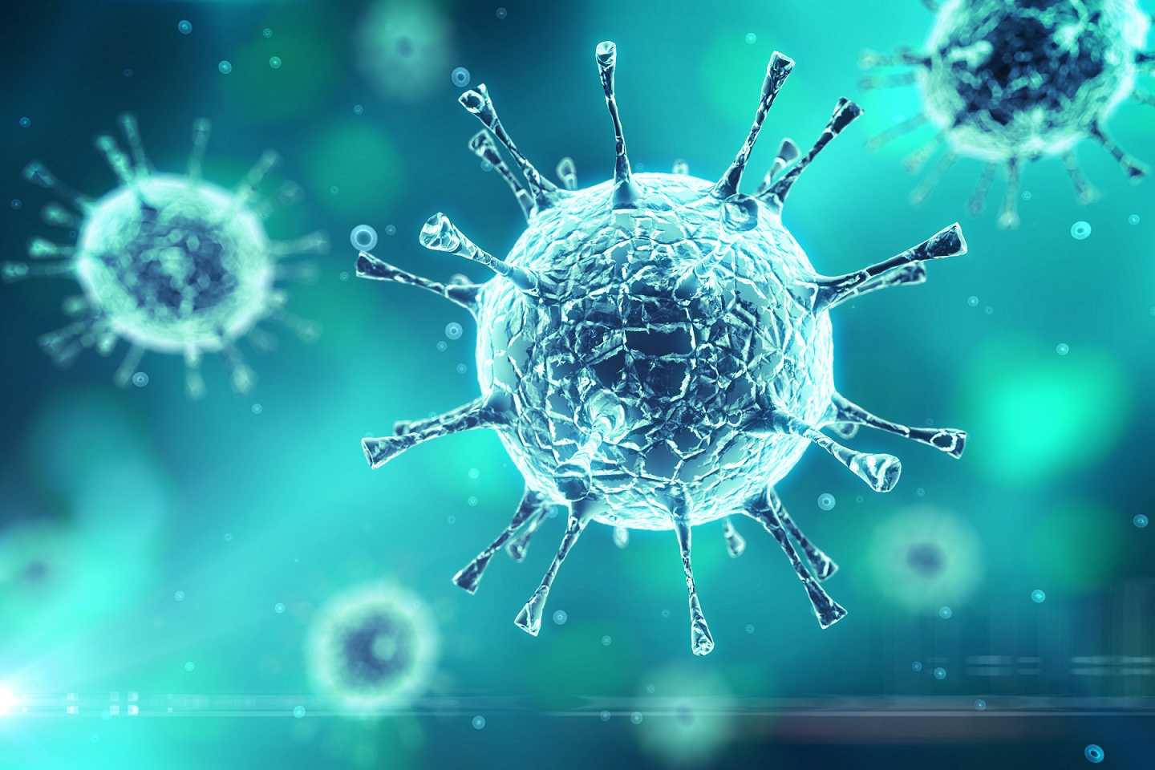
Lec TWO by Sahar Alhogail
viruses

Slide 2
General description
Viruses is not living organism, as they lack two essential properties of life- they cannot replicate independently, and cannot survive long –term independently so it is obligate intracellular organism .
They are much smaller than bacteria human viral pathogens usually 20nm in diameter where the bacteria around 1000 nm in diameter).

Slide 3
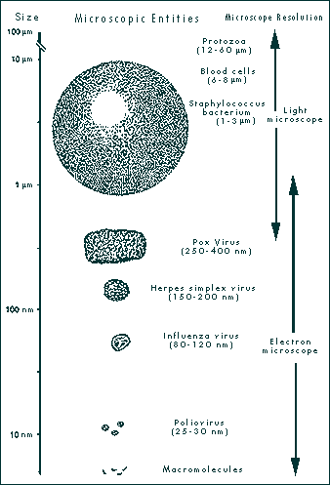
It infect animal and human viral infection
it infect bacteria bacteriophage

Slide 4
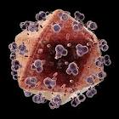

Slide 5
Viruses was seen and photographed in 1940 using electron microscope.
Negative stain procedure was developed in 1959.(electron –dense dark background)
Viruses infect humen , animal, plants, parasites.
Oncogenic virus (Lymphoma, carcinoma,and some type of lukemia).

Slide 6
It has no ribosome's or any structure requirement for harvesting of energy
Unlike cells ,they do not divide by binary fission, mitosis, or meiosis.
it lack the enzymatic capacity to replicate and it replicate within host cell.
Either DNA or RNA
Unable to replicate by on their own

Slide 7
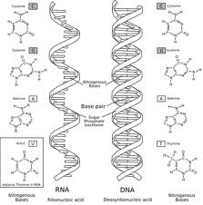
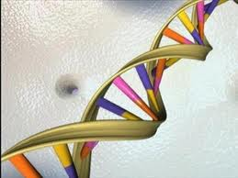
Structure and composition:
Structure
Virus particle is called virion it is consisted of
Genome
(either DNA or RNA) never both.
The most common forms of viral genomes found in nature are ds DNA or ss RNA. the RNA can be positive strand which function as messenger RNA or negative strand RNA which function as template for production of mRNA.

Slide 8
2.Capsid :repeated protein units this protein shell enclosing the genome it gives the virus shape.
for most virus families, found in either DNA or RNA virus are 2 type :
a. Helical capsid : (coiled shape)
the helical capsid is constructed of multiple copies of single poly peptide type arranged in helix shape with the nucleic acid coiled between the turn of the helix ,each poly peptide unit called protomer this structure called nucleocapsid.
B. Icosahedral symmetry:
an icosahedronis a structure with 12 vertices and 20 triangular faces.
It is more complex than helical symmetry.
Consist of several different polypeptides (protein) group called capsomer.

Slide 9
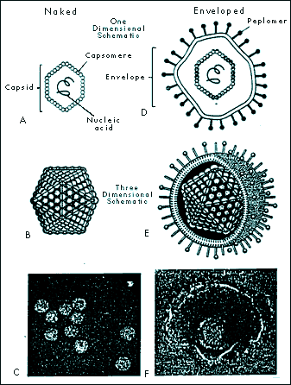
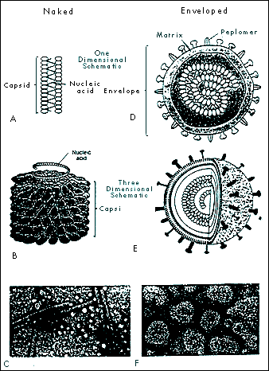
Icoshadral Structuer
Helical Structure

Slide 10
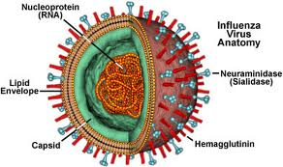
3. envelope: is membrane surrounding the nucleocapsid
It is important structural feature to define viral family is the presence or absence of lipid-containing membrane surrounding the nucleocapsid.
A virus that is not enveloped called naked virus.
The envelope is made of inner structural protein layer ,outer lipid layer and projecting spike of glycoproten.
Entry of the virus depend on prescence or absence of envelop.

Slide 11
Viruses classification
Viruses classified based on by :
Type of the genetic material DNA or RNA( SS,DS) ( linear or circular)
Shape of the capsid
Number of capsomers
Size of the capsid
Presence or absence of the enveloped
Type of the host that infect
Type of disease that produced
Target cells
Immunological or antigenic properties

Slide 12
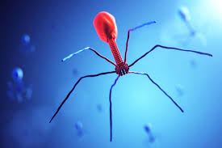
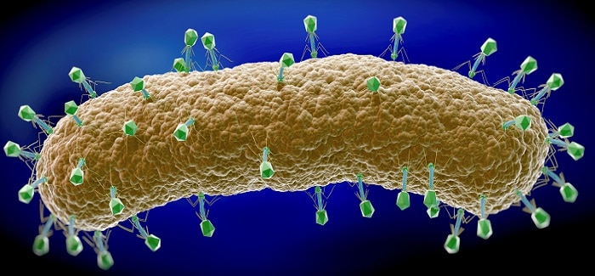
Bacteriophage

Slide 13
Viral replication
Adsorption:
Initial attachment of virus particles to a host cell involves an interaction bet. Specific molecular structure on the virion surface and molecule in the host cell membrane by cell receptor molecules. Some require more than one receptor as HIV virus .
Naked viruses: attachment between capside and cell receptors.
Enveloped viruses: attachment between glycoprotien spikes and cell receptor.

Slide 14
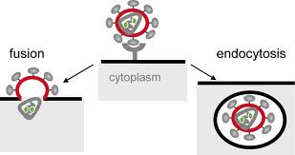
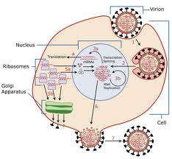
B. Penetration :
Passage of the virion from the surface of the cell across the cell membrane and into the cytoplasm by 2 mechanisms:
1. recepto-mediated endocytosis: naked viruses and enveloped virus.
2. membrane fusion : enveloped viruses

Slide 15
c. uncoating: the viral coat , exposing nucleic acid by remove the capsid by cellular enzyme in the cytoplasm.

Slide 16
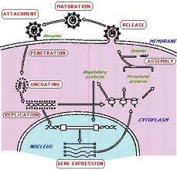
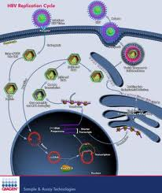
D. Replication and transulation:
In DNA virus the DNA direct the cell to replicate in the nucleus use enzyme in the host or viral encoded enzyme--→ protein synthesis
The larger the viral genome the fewer host cell enzyme are involved in replication ex :poxvirus, parvovirus .
Flu virus

Slide 17
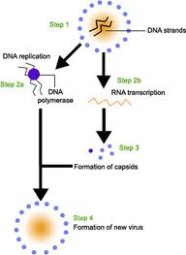

Slide 18
In RNA virus the replication occur in the cytoplasm .
Viral nucleic acid function as template for the production of m RNA ( m RNA that code the synthesis of viral proteins structural and enzymatic using cellular polysomes.
Positive single strand RNA
Attach to specific receptor CD4 + on Tcell , lymphocyte, monocyte,dentritic cells.
Fusion of the virus envelope with the cells cytoplasmic membrane .
RNA virus released into cytoplasm with enzyme called “ reverse trans-creptase “part of nucleocapsid –integrase-protease .

Slide 19
Revearse transcriptase : begin the reverse transcription of viral RNA .
ssRNA transcript into RNA-DNA double helix------→ nucles.
Integrate of DNA copy into host chromosome.
Transcription of viral gene.(many RNA copies each coding for many proteins).
Translation of viral RNA into polyprotien.
Protease cleaveage polyprotien into individual protein = capsid protein, envelop protein, reverse transcriptase
Assembly into many knew virus.

Slide 20
E. Synthesis of daughter viral nucleic acid using the parent viral nucleic acid as template.
Assembly of intact viral within the cell.
Release of the viral particles from the cell and cell membrane envelope the virus and form outer coat.

Slide 21
Interacrtion of the virus with the host
Acute infection: are usually of relatively short duration and host develop long lasting immunity
Viruses that cause infections result in productive infection .
The infected cell die with lyses (naked)or without lyses( enveloped).
Disease symptoms with localized or wide spread tissue damage .
With recovery the defense mechanism gradually eliminate the virus over a period of days or months
Example : flu – measles- mumps .

Slide 22
Persistant infection:
when the viruses are consistinually present in the body .
Chronic infection:
Is the infection that takes months or years to inflect damage on the body.
Virus can be demonstrated at any time .
Symptoms + or _ .
Example hepatitis B virus: transmitted sexually, blood transfusion, blood.
Usually pass through the acute illness ,nausea, fever and jaundice and then move to chronic stage (15-20 years)
Carrier state: virus detected in the blood –saliva -semen , this virus replicate in liver cell(hepatocytes).

Slide 23
2- SLOW INFECTION : following the initial infection there is gradually increase amount of infection agent over long period of time .no symptoms example HIV virus .
3- latent infection: the infecting virus is present in the body but is inactive .it may get activated at any time specially if there is problem with the immune system. Example : Herpesveridiea family such as herpes simplex virus –cytomegalovirus.

Slide 24
Grouping based on routes of transmission
Droplet Contact: Also known as the respiratory route, it is a typical mode of transmission among many infectious agents. If an infected person coughs or sneezes on another person the microorganisms, suspended in warm, moist droplets, may enter the body through the nose, mouth or eye surfaces. Mumps- flu-SARS-measles.
Fecal-Oral Transmission: Rotavirus – hepatitis A

Slide 25
Sexual Transmission herpes simlex 1-2-AIDS-worts HPV-1- Hepatitis C and B.
Oral Transmission:
Cytomegalovirus infections
Herpes simplex virus (especially HSV-1)
Transmission by direct contact : warts

Slide 26
Laboratory diagnosis of virus infection:
Usually in routine lab work the virus is identified by
effect of cell line culture which is the gold standard test (cytopathic effect).
Immunological techniques: which is reaction of antigen antibodies reveal evidence of virus infection
a. ELISA technique (Enzyme linked immunosorbent assay) it is sensitive, rapid, and not expensive carried out by using commercial available kits. It is to detect IgM antibody labeled with enzyme.

Slide 27
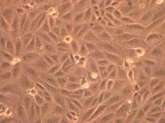
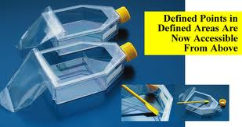

Slide 28
B. Immunofluorescence: the antibody labeled with fluorescence dye .
c. Radio –immune assay (RIA): the labeled used is radioactive material it is sensetive and automated.
d. Haemoagglutination inhibition : antiviral antibody blocks the agglutination of RBC.

Slide 29
Group of viruses :
DNA virus
Herpes viridae: it is icosahedral capsid. Envloped with lipoprotein the genome is linear ds DNA it is classified into
αHerpes virinae:
Herpes simplex virus (HSV-1,HSV-2) cause herpes disease ( lesion in the surface of mucosa or cutaneouse surfaces.
HSV1 usually affect the lips while HSV2 usually affect genital areas.

Slide 30
Varicella zoster virus (VZV) that cause chicken box in first attack and usually it recurs in a localized area that follows neurological distribution in sever cases it may affect the lunges or brain especially in immunocompromised, elderly and pregnant lades .
VZV have nucleotide homology share common feature in replication and pathogenesis with HSV.
all the three viruses settle in the nerve roots and that's how it cause a recurrent infection.

Slide 31
2.β Herpes virinae
cytomegalovirus group: it has slow replication cycle result in formation of multi-nucleated giant host cells= cytomegalo
affecting lympho reticular cells and glandular tissue causing enlargement of the lymph node and liver and spleen. In immunocompromised patient it may affect the eye causing blinds or the lungs causing sever respiratory failure that may cause death.
3. γ Herpes virinae
Epistin bar virus: it is first human virus clearly related to a malignancy.
It affect the lymph nodes causing mutation in their structure of the lymphatic cell so they may turn into malignant cell causing lymphoma.

