Slide 1
Management Functions
Administration
It is concerned about the determination of objectives and major policies of an organization.
It puts into action the policies and plans laid down by the administration
Management

Slide 2
Type of function
It is an executive function.
It is a determinative function.
Scope
It takes decisions within the framework set by the administration.
It takes major decisions of an enterprise as a whole.
Management
Administration
Management
Administration

Slide 3
Level of authority
It is a top-level activity
It is a middle level activity.
Nature of status
It is a group of managerial personnel who use their specialized knowledge to fulfill the objectives of an enterprise
It consists of owners who invest capital in and receive profits from an enterprise
Administration
Management
Management
Administration

Slide 4
Difference between Administration and Management in Nursing
Management | Administration | Basis of difference
It puts into action the policies and plans laid down by the administration. | It is concerned about the determination of objectives and major policies of an organization. | Nature of work
It is an executive function. | It is a determinative function. | Type of function
It takes decisions within the framework set by the administration. | It takes major decisions of an enterprise as a whole. | Scope
It is a middle level activity. | It is a top-level activity. | Level of authority
It is a group of managerial personnel who use their specialized knowledge to fulfill the objectives of an enterprise. | It consists of owners who invest capital in and receive profits from an enterprise. | Nature of status
It is used in business enterprises. | It is popular with government, military, educational, and religious organizations. | Nature of usage
Its decisions are influenced by the values, opinions, and beliefs of the managers. | Its decisions are influenced by public opinion, government policies, social, and religious factors. | Decision making
Motivating and controlling functions are involved in it. | Planning and organizing functions are involved in it. | Main functions
It requires technical activities. | It needs administrative rather than technical abilities. | Abilities

Slide 5
Difference between Administrator & Manager
Definition
is the person who is responsible for forming the strategic vision of the organization (top-level of hierarchy).
is the person who is responsible for translating the administration's vision into operating plans and acting in the middle and first-line levels of hierarchy
Administrator
Manager

Slide 6
Activities
Concerned with forming a strategy of the organization
Concerned with forming the operation of the unit(s).
Events
Inside the unit(s)
Inside and outside the organization and how it affect work.
Plan
long term plans
short term plans
Administrator
Manager
Manager
Administrator
Administrator
Manager

Slide 7
Difference between Administrator & Manager
Manager | Administrator | Basis of difference
Manager is the person who is responsible for translating the administration's vision into operating plans and acting in the middle and first-line levels of hierarchy | Administrator is the person who is responsible for forming the strategic vision of the organization (top-level of hierarchy). | Definition
To direct, supervise personnel working in the formulated organizational structure. | To formulate organizational structure. | Activities
Inside the unit (s) | Inside and outside the organization and how it affect work. | Events
short term plans | long term plans | Plan
To direct, supervise personnel working in the formulated organizational structure. | To formulate organizational structure. | Authority
goals and objectives governing the unit/department | mission, philosophy, goals, and policies governing the organization | Define

Slide 8
Leadership is a process of getting things done through people. Leadership is not a science. Leadership means responsibility. The leader is look to get the job done.
Leadership is guiding a person or group toward the best results. It is having sound understanding to determine and ability to articulate visions and goals.

Slide 9
What is the Difference between Leadership and Management?
Based on authority | Based on influence | 1
An informal designation | Formally designated position | 2
An assigned position | An achieved position | 3
Dependent and improved by use of effective leadership skills | Independent of management | 4
Nurse's role in the assigned managerial positions | Part of every nurse's role | 5
Focusing on people, inspiring and motivating followers, based on personal power | Focusing on service, based on position power | 6
Acting as a boss | Acting as a facilitator, and coach | 7
Aimed to maintain stability | Aimed to change for improvement | 8
Leadership
Management
Management
Leadership
Leadership
Management
Leadership
Management
Leadership
Management
Management
Leadership

Slide 10
The organizational structure of nursing service department
The organizational structure furnishes the formal framework in which the management process takes place. It provides:
effective work system
network of communications.
The organization contains both formal and informal structures.

Slide 11
Nursing department structure
Based on:
organizational goals
philosophy, & objectives
Specifies how much:
position in the department
nursing department is related to hospital departments

Slide 12
Organizational chart
It is a diagram shows the different positions and departments, and the relationships among them.
It is used to show:
The formal organizational relationships.
Areas of responsibility.
Persons to whom one is accountable.
Channels of communication.

Slide 13
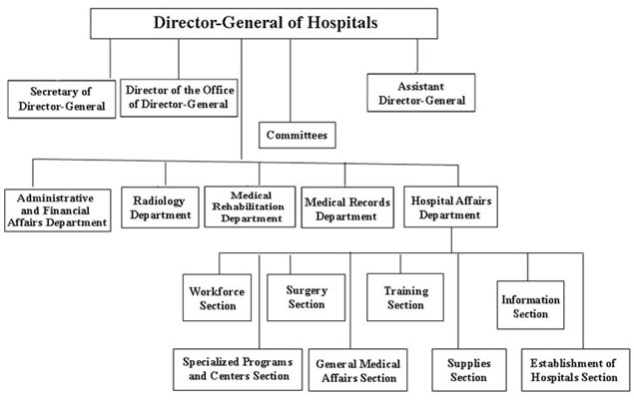
Organizational chart

Slide 14
Types of organizational charts
Vertical charts:
It shows high-level management at the top with formal lines of authority down the hierarchy.
A left-to-right (horizontal) charts:
It shows the high-level management at the left with lower positions to the right.

Slide 15
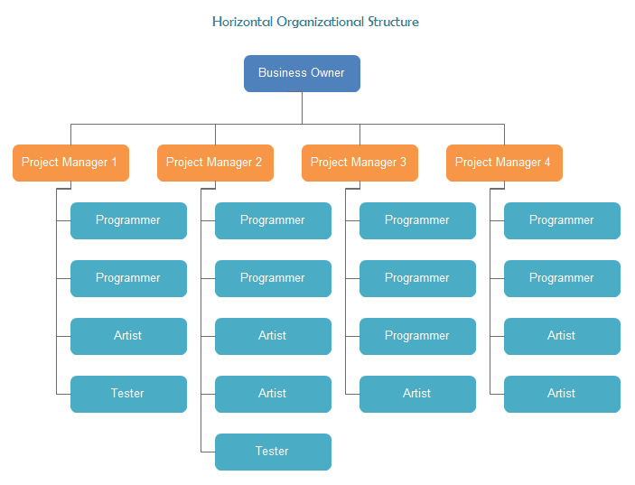

Slide 16
Functions of Management
1. Planning Function:
- function of forecasting and decision making.
The planning process :
Mission
Choice of objectives and guides for decision making
Necessary rules for their accomplishment
Mechanism to measure the accomplishment

Slide 17
The duration of planning
long-term (strategic)
short-term (operational)
:Strategic plan
The organizational plan that includes the development of overall organizational goals and objectives are known as

Slide 18
2. Organizing Function
The organizing purpose is
To establish a chain of command and a division of labor to accomplish the ends (goals).
The organizing process involves:
Identification of duties to be performed.
Grouping of duties to indicate division arrangements.
Assignment of authority.

Slide 19
3. Staffing Function
Purpose is to manage activities and adequate personnel to fulfill the organization's objectives.
The staffing process
Determining workloads or patient care needs.
Developing staffing patterns.
Developing staffing plan.
Personnel management and development.

Slide 20
4. Directing Function
Directing process is a continuous and interrelated task of leadership and supervision of personnel towards organizational objectives.
The directing process involves:
Giving directions and Delegation.
Establishing an organizational communication system.
Creating a motivating climate and motivation system.
Providing supervision, guidance, instruction, and training.

Slide 21
5. Controlling Function
Is defined as: The management process that aims at monitoring performance, comparing it with goals, and taking corrective action is known as
The controlling process
Establishment of standard related to particular course of action.
Measuring actual performance against these standards.
Reporting the results.
Correcting deviations from standard.

Slide 22
Levels of management:
Since the organization is a hierarchy, the work of management is divided into three main levels of responsibility.
Top-level managers
Middle-level
First-line level

Slide 23
Nurse Managers' Roles
Nurse Managers, at all managerial levels, are accountable
for:
Nursing practice/ patient care.
Managing resources.
Development of personnel.
Compliance with standards of care.
Strategic planning.
Collaboration among departments.

Slide 24
Skills are "the abilities developed by managers through knowledge, information & practice".
Management Skills can be divided into 3 categories
Technical
Interpersonal
Conceptual

Slide 25
1-Technical Skills
Perform a specialised task :e.g. Head nurses have technical skills in assigning, scheduling, etc.
Daily activities of most managers will involve the use of some technical skills.

Slide 26
2-Interpersonal Skills
Most top managers spend about half their time dealing with other people.
they must develop their abilities to motivate & communicate with those around them
All managers require sound interpersonal skills

Slide 27
3-Conceptual Skills
Ability to see the organization as a whole.
This is a necessary skill for strategic decision making

Slide 28
Any Questions ? ? ?

