Slide 1
Air
Lecture 2

Slide 2
Objectives
Define
Air
Air pollution
Identify the different forms of air pollution
Identify the determinants of indoor and outdoor air quality
Identify common air pollutants
Identify the effects of air pollution on human health and the environment

Slide 3
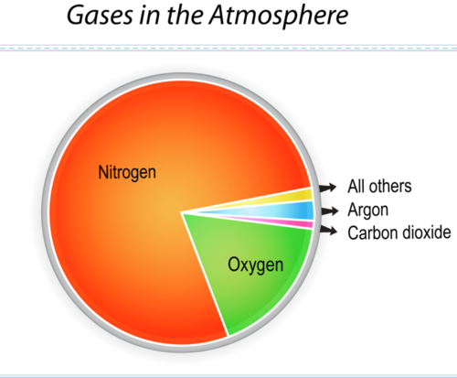
Introduction
Pure air is a mixture of several gases that are invisible and odorless.
Air supplies the oxygen essential to human life.
Middlecamp CH et al. Chemistry in Context: Applying Chemistry to Society. 7th Ed. McGrawHill. 2012

Slide 4
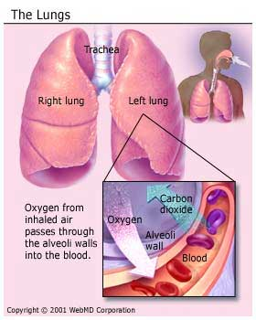
Introduction
Humans may survive for up to three (3) minutes without air.
Adults ~ 12-20 breaths/min
Children ~ 15-30 breaths/min
Infants ~ 25-50 breaths/min
Children have higher respiratory rates and may receive higher doses of pollutants relative to their body weight.
Children’s respiratory systems are still maturing and are more susceptible to the effects of polluted air.
Older people are more likely to suffer from cardiovascular disease and impairment of immune response.
Increased susceptibility to air pollutants, especially fine particulates.
Levy, B. et al. Occupational and Environmental Health. 2006. Lippincott Williams & Wilkins.

Slide 5
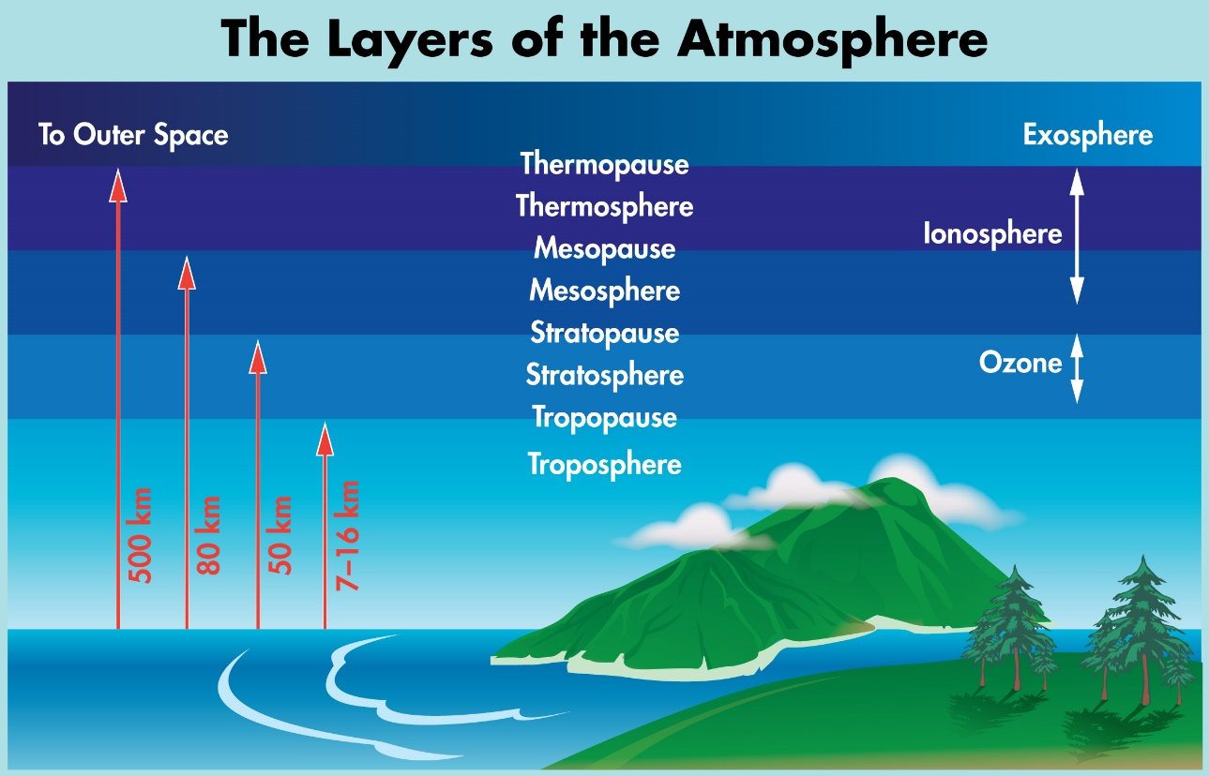
Introduction
Atmosphere
Mixture of gases that surround the earth.
Sustains life by retaining heat and blocking out harmful radiation (ultraviolet radiation) from the sun.
The troposphere is the layer closest to the earth and the thinnest.
The bottom two kilometers of the troposphere contain most of the air and weather (rain, clouds, wind) that affect us, along with most air pollutants.
BC Air Quality http://www.bcairquality.ca/101/what-is-air-quality.html

Slide 6
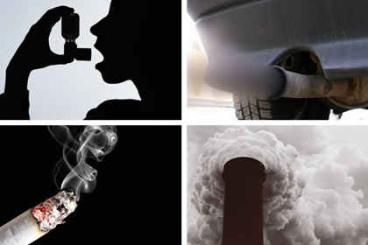
Air pollution
The presence of substances not normally found in air, and that in concentrations high enough can harm the environment, or the health of living organisms.

Slide 7
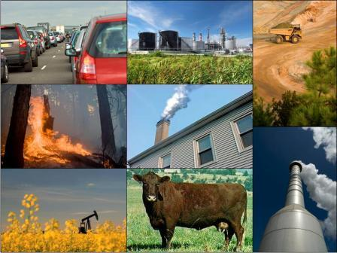
Air pollutants
Air pollutants can be gases, liquids (vapor) or very small solid particles (dust or smoke) emitted into the atmosphere.
At levels harmful to the environment, or human, animal and plant health.
Gases and vapors: form true solutions in the air and cannot be distinguished from the air.
Aerosols: dispersions of solid or liquid particles in the air.

Slide 8
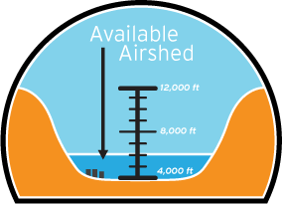
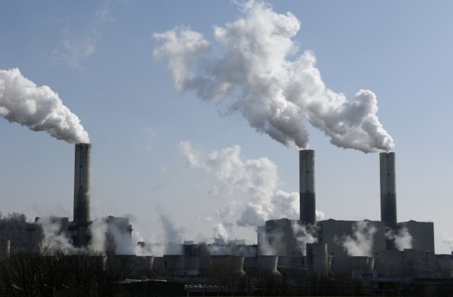
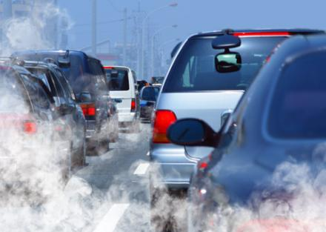
Emissions
Discharges of a pollutant from a particular source (a factory) or group of sources (vehicles) into the air.
Airshed – geographic area that shares the same air.
Notes:
‘airshed’ or geographic area that shares the same air.

Slide 9
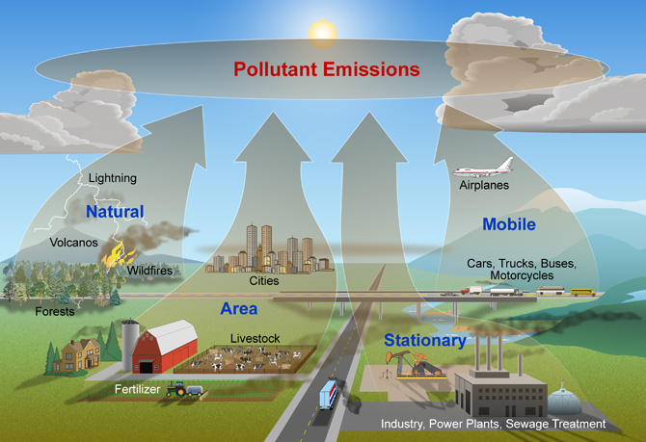
Emission Sources
1. Natural and Man-made Sources
2. Point and Non-point Sources
Point – single, large stationary sources of pollution –industrial facilities, power plants.
Non-point – multiple, smaller sources that can be stationary or mobile: motor vehicles, airplanes, residential and business areas.

Slide 10
Types of emissions
Geogenic - come from the non-living world, such as volcanic emissions, soil emissions, and natural fires.
Smoke, SO₂, CO₂.
Biogenic - come from the living world: plants, animals, microbes, soil.
VOCs and CH₄ .
Anthropogenic - come from man-made sources.
Chlorofluorocarbons (CFCs), CO₂.
Human activity can also influence geogenic and biogenic emissions.
Agriculture, deforestation, construction.
http://www.envirocomp.org/books/chapters/1aap.pdf Daly, A. and P. Zannetti. 2007. An Introduction to Air Pollution – Definitions, Classifications, and History.
Chapter 1 of AMBIENT AIR POLLUTION (P. Zannetti, D. Al-Ajmi, and S. Al-Rashied, Editors). Published by The Arab School for Science and Technology (ASST)
(http://www.arabschool.org.sy) and The EnviroComp Institute (http://www.envirocomp.org/).
Notes:
Anthropogenic - come from man-made sources.
Chlorofluorocarbons (CFCs) that can damage to the ozone layer.
CO₂ emissions and green house effect.
Biogenic - come from the living world: plants, animals, microbes. Volatile organic compound (VOC) emissions from forests and CH₄ emissions from swamps.
Geogenic - come from the non-living world, such as volcanic emissions, sea-salt emissions, and natural fires.
Human activity can also influence geogenic and biogenic emissions.
Human applications of nitrogen fertilizers and increased biogenic emissions of nitrogen compounds from the soil. Cutting down or planting trees can affect the biogenic emissions of VOC.
Geogenic emissions of dust from the earth’s surface can be altered if the surface is changed by human activity.

Slide 11
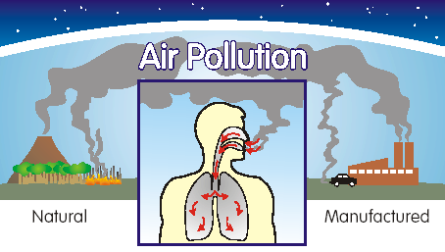
Air Quality
The state of the surrounding air.
Good air quality = clean, clear, unpolluted air.
Poor air quality occurs when substances that are not normal components of the air (pollutants) are present in amounts that can harm human health or the environment.
Pollutants can come from natural or man-made sources.
BC Air Quality http://www.bcairquality.ca/101/what-is-air-quality.html
Notes:
Clean air is essential to life
Humans, animals, plants, water and soil.
AQI - tells how clean or polluted the air in a particular area is, and what associated health effects might be a concern.
Health effects a person may experience within a few hours or days after breathing polluted air.
AQI of 100 corresponds to the national air quality standard level for the pollutant set by the EPA to protect public health.
AQI values below 100 are generally thought of as satisfactory.
When AQI values are above 100, air quality is considered to be unhealthy-at first for certain sensitive groups of people, then for everyone as AQI values get higher.

Slide 12
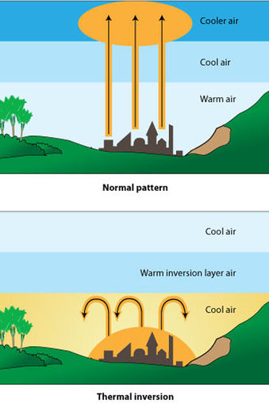
Factors Affecting Air Quality
1. The amount of pollutants
2. The type of pollutants released into the air.
Physical and chemical properties of pollutants.
3. Topography (geography of the terrain) - mountains and valleys.
4. Weather - wind, temperature, air turbulence, air pressure, rainfall and cloud cover.

Slide 13
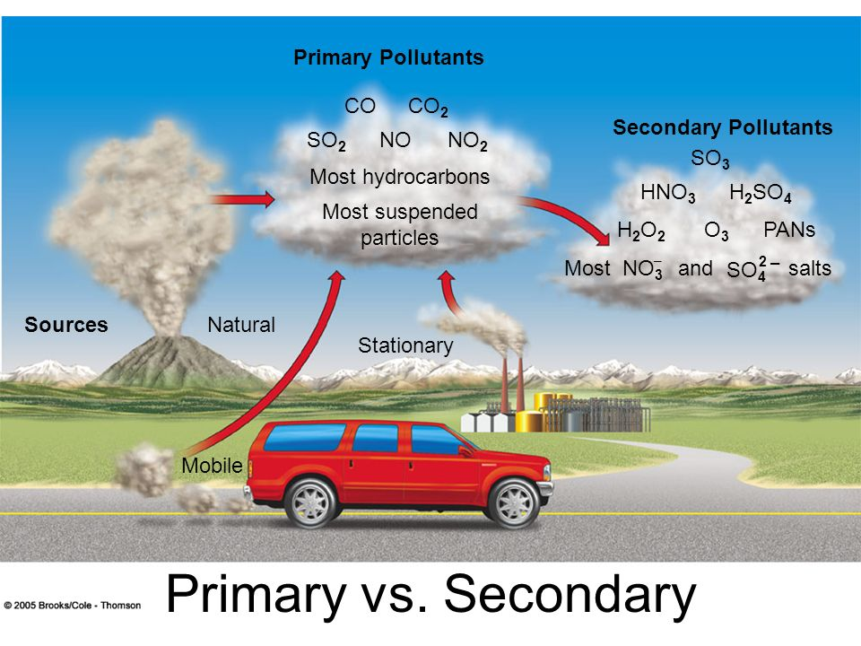
Types of air pollutants
Primary pollutants are emitted directly into the atmosphere.
Sulfur dioxide, nitrogen oxides, particles.
Secondary pollutants are the products of chemical reactions between pollutants in the air.
Secondary acidic aerosols and other particles.
Oxidant pollutants produced by photochemical reactions between hydrocarbons and nitrogen oxides.
Ground-level ozone is a secondary pollutant.

Slide 14
Standards for Air Pollution
“Criteria pollutants”
Six pollutants regulated by the US-EPA and most countries in the world:
1. Particulate matter
2. Carbon monoxide (CO)
3. Nitrogen dioxide (NO₂)
4. Ozone (O₃)
5. Sulfur dioxide (SO₂)
6. Lead
Mobile and stationary sources.
Common in the environment, posing the greatest overall threat to human health.
Other more toxic materials that may be present in the air but in smaller amounts may be mutagenic, carcinogenic or reproductive toxins.

Slide 15
Criteria Pollutants
Particulate matter (PM)
Particle size affects deposition in respiratory tract and health effects.
Airborne mixture of microscopic solid or liquid particles that form an aerosol.
Particles of various size, shape, composition and origin.
Smoke (combustion of fossil fuels, wood burning), dust, aerosols, metallic oxides, and pollen.

Slide 16
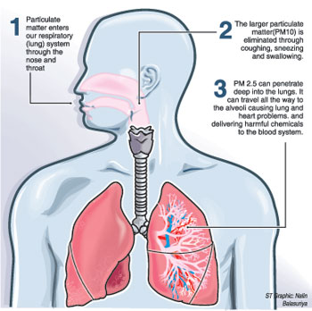
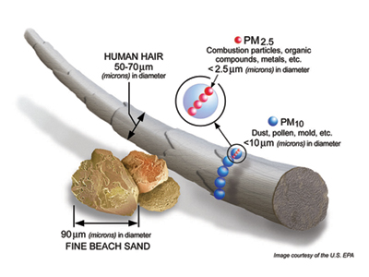
Criteria Pollutants
Particulate matter (PM)
Health impact of chronic exposure to PM:
Increases the risk of chronic respiratory diseases.
Worsens existing lung and cardiovascular disease.
Damages lung tissue.
Affects the immune system.
Increases risk for cancer.
Increases risk of early death.

Slide 17
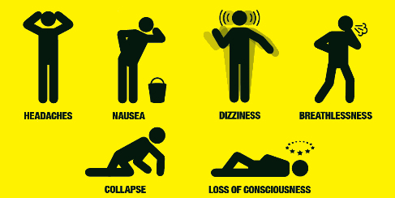
Criteria pollutants
Carbon monoxide (CO)
Odorless, colorless gas formed from incomplete combustion of fossil fuels.
Largest source is motor vehicles.
Inhalation reduces the amount of oxygen in the bloodstream.
High concentrations can lead to headaches, dizziness, unconsciousness, and death.

Slide 18
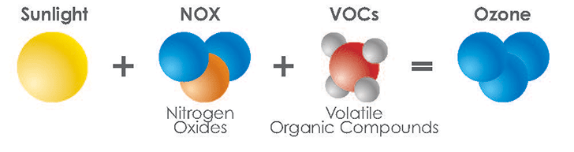
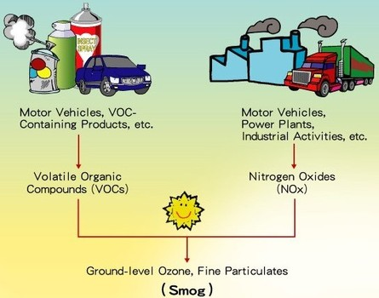
Criteria pollutants
Ground-level ozone (O₃)
Secondary pollutant that forms when nitrogen oxides and volatile organic compounds react in the presence of sunlight.
Can damage all living organisms.
Can affect both healthy people and those with respiratory diseases.
Can cause eye irritation, chest pain, coughing, nausea, and pulmonary congestion.
Permanent lung damage with chronic exposure.
Ozone (O₃). http://www.epa.gov/airtrends/aqtrnd95/o3.html

Slide 19
Criteria pollutants
Sulfur dioxide (SO₂)
Most susceptible are children, the elderly, and people with asthma, cardiovascular disease or chronic lung disease.
Can irritate lung tissues, cause respiratory illness, and aggravate existing cardiovascular disease.
Colorless, water-soluble, with a suffocating, pungent odor.
Primary source is the combustion of sulfur-containing fuels (oil and coal), metal smelting and other industries.
Sulfur Dioxide (SO₂). http://www.epa.gov/airtrends/aqtrnd95/so2.html

Slide 20
Criteria pollutants
Nitrogen dioxide (NO₂)
NO₂ reacts in the air to form corrosive nitric acid (acid aerosol), as well as toxic organic nitrates.
Large concentrations can reduce visibility and increase the risk of acute and chronic respiratory disease.
Can irritate the lungs and lower resistance to respiratory infections such as influenza.
Nitrogen oxides (NO_{x}) form from fossil fuel combustion at high temperatures – vehicles, electric utilities.
NO is the primary pollutant that converts to NO₂ in the air.
Nitrogen oxides contribute to ozone formation, and damage to living organisms.
Nitrogen Dioxide (NO₂). http://www.epa.gov/airtrends/aqtrnd95/no2.html

Slide 21
Criteria pollutants
Lead (Pb)
Fetuses and children are especially susceptible to low doses of lead.
Neurological problems such as seizures, mental retardation, and/or behavioral disorders, slowed growth.
Can affect
Blood, kidneys, liver
Nervous, immune, cardiovascular, and reproductive systems
Enzymatic and energy transfer processes.
Combustion of solid waste, fossil fuels, emissions from iron and steel production, tobacco smoke, and battery plants/recycling.
Accumulates in blood, bone, and soft tissue – not easily excreted.
Lead (Pb). http://www.epa.gov/airtrends/aqtrnd95/pb.html

Slide 22
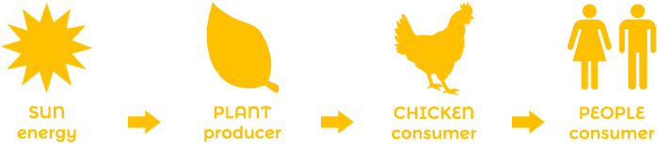
Hazardous Air Pollutants (HAPs)
Compounds more toxic than criteria pollutants.
Carcinogenic potential, birth defects, and reproductive, neurological, developmental, and respiratory problems.
~187 chemical pollutants.
Volatile Organic Compounds (VOCs).
Heavy metals – chromium, mercury, cadmium.
Regulated separately from criteria pollutants.
Sources
Natural and/or man-made.
Mobile and/or stationary.
Indoor and/or outdoor.
Exposure – inhalation, ingestion, absorption.
Accumulation in body tissues
Some are persistent.
http://www.epa.gov/haps/initial-list-hazardous-air-pollutants-modifications

Slide 23
Factors that control the risk of injury from pollutants
2. Degree of exposure and the effective dose .
The effective dose may be difficult to determine.
Atmospheric concentration of pollutants and/or concentrations of biomarkers maybe used.
3. Rate of removal
4. Individual susceptibility
1. Chemical and physical properties of the pollutant.
Solubility influences distribution in atmosphere and body tissues, and ultimately the effective dose.

Slide 24
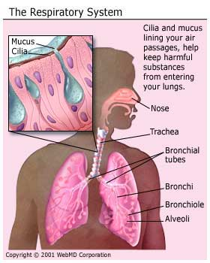
Coughing and/or sneezing prevents irritants from entering deeper into the lungs.

Slide 25
Health Effects of Air pollutants
Pollutants inside the lungs may cause irritation (chronic or recurrent) that lead to long-term illnesses.
Worsen asthma
Development or progression of chronic illnesses – lung cancer, obstructive pulmonary disease.
Affect the cardiovascular system.
Harm the developing fetus.
Small particles (< 2.5 µm) may cause more health problems.
Enter farther into the lugs.
Rom,W.N. Environmental Policy and Public Health. 2012. Jossey-Bass.

Slide 26
Health Effects of Air Pollutants
Acute (short-term) exposure
Chronic (long-term) exposure
Headache, nausea, irritation of eyes, nose, throat, cough, upper respiratory infections – bronchitis, pneumonia, worsen asthma and emphysema.
Heart disease, cancer
Damage to reproductive, immune, neurological, and respiratory systems.
Most at risk
Children, elderly, those with pre-existing heart or lung disease, and asthma.

Slide 27
Glossary of terms
Aerosols - types
Dust: solid and irregular particles, > 1µm. Ex: drilling, grinding, abrasion of solids.
Fume: high temperature combustion or sublimation vapors that condensed and became solid particles, < 0.1 µm. Can form aggregate clusters (metal oxides).
Haze: very small (< 1 µm) particles that take up water vapor at low relative humidity.
Mist: liquid droplets formed by atomization, nebulization, or spraying of liquids, range in size from 2 µm – 50 µm.

Slide 28
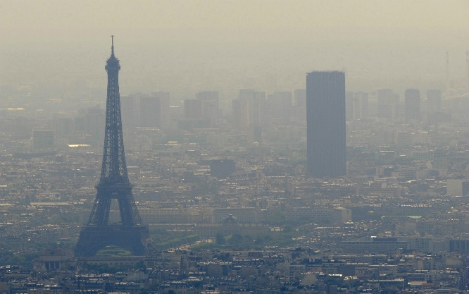
Glossary of terms
Aerosols - types
Smoke: combustion vapors of organic materials that condense into liquid droplets, < 0.5 µm,
Fog: droplets formed by condensation of water vapor on atmospheric nuclei at high relative humidity, > 1 µm.
Smog: term used to describe any atmospheric pollution mixture.
Pollution aerosol composed of smoke and fog.

Slide 29
References
Frumkin H. Environmental Health: From Global to Local. 2nd Ed. Jossey-BSS, Wiley Imprint. 2010.
Middlecamp CH et al. Chemistry in Context: Applying Chemistry to Society. 7th Edition. McGrawHill. 2012.
Air Pollution – Our Nation’s Air http://www.epa.gov/airtrends/2011/report/airpollution.pdf
An Introduction to Indoor Air Quality (IAQ). Volatile Organic Compounds (VOCs) http://www.epa.gov/iaq/voc.html
Mold. Centers for Disease Control and Prevention. http://www.cdc.gov/mold/faqs.htm

