Slide 1
The Determinants of Health

Slide 2
Do We Control our Health?

Slide 3
Definition of health
“Health is a state of complete physical, mental and social well being, and not merely the absence of disease or infirmity.” (WHO)
Health has been defined as having a wellbeing status that can overcome any social disadvantage effects (Dahlgren & Whitehead, 2007)

Slide 4
How different disciplines consider determinants of health ?
There are four schools of thoughts:
The biological view (individual genetic susceptibilities to disease)focus on the causes of disease and discrete treatments for ill individuals.
The lifestyle view emphases on individual responsibility for lifestyle choices.

Slide 5
3- The macro socio-economic approach emphasis on factors outside the health care sector; especially economic and social.
4- The population health view-emphasis on the impact on population health of wealth and distribution.
Health policy is dominated by a biological thought/school, yet there is a substantial theoretical and evidence base to support a more comprehensive perspective .

Slide 6
Canda’s Lalonde Report was the first official statement to describe a broader view of health(social determinants of health as apposed to biomedical view) that set 9 prerequisites for good health
Peace
Shelter
Education
Food
Income
A stable ecosystem
Sustainable resources
Social justice
Equity

Slide 7
Systems theory and social determinants of health
Systems theory states that a system is composed of interdependent and interrelated parts, with change in one part producing changes in others(Von Bertalanffy,1968).
Most of the health models focused on:
Causal chain
Environmental elements Health status
The “rainbow” models(Dahlgren and Whitehead,1991) is the most common conceptual model assist to understand the interrelationships of health determinants(factors):
Population health has been influenced much more by the fast changing social conditions in which people live.
Health care intervention appears in reducing disease susceptibility (immunization program).

Slide 8
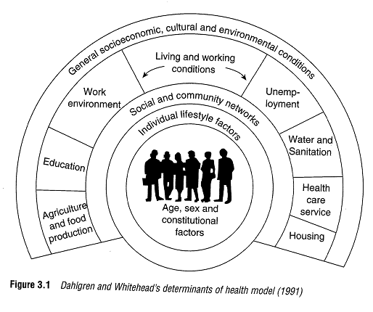

Slide 9
Systems theory and social determinants of health
Few determinants of health can be directly influenced by the individuals.
Most social determinants(education, employment, income, material environment) have a greater impact on population health status than health care services.
Many determinants of health have different impact on different groups of people.
Health inequalities concerns on unequal(unfair)distribution of health determinants.

Slide 10
The determinants of health (WHO)
The determinants of health imply the factors that may either positively or negatively influence health . WHO identified the main determinants of health at four levels:
1.The individual characteristics and behaviours: individual factors include biological and genetic factors as age, sex, and lifestyle, and psychological circumstances.
2.The physical environment: this includes living and working conditions as environmental sanitation, healthy food and water supply, work environment, unemployment, and accessibility of health services

Slide 11
The determinants of health (WHO)
3.Social and community networks factors including social exclusion, social cohesion, and social support
4.The macro level which comprises social and economic circumstances or policies such as economic growth, poverty and education.

Slide 12
Conclusion
The primary determinates of health are the economic, physical and social environments' within which individuals live.
This understanding should be used to develop a wider public health policy/ activities that promote good health

Slide 13
Workgroup
Read the relevant articles and discuses with your group what are the potential determinants of health in Arabic world?

Slide 14
Thank you

