Slide 1
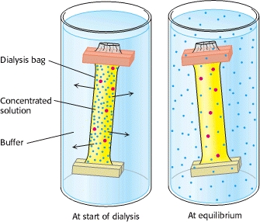
Experiment 2 Desalting by Dialysis
Dialysis
Dialysis involves placing the protein solution in a semipermeable membrane, and placing the membrane in a large container of buffer.
Small molecules (such as salt ions) pass through the dialysis membrane (moving from high concentration to low concentration), while large molecules are unable to cross the membrane.
Iman Alshehri

