Slide 1

Fundamentals of Organic Chemistry
CHEM 108
King Saud University
College of Science, Chemistry Department
CHAPTER 2. ALIPHATIC HYDROCARBON
CHEM 108

Slide 2
Hydrocarbons
Hydrocarbons are Organic Compounds, which contain only the two elements carbon and hydrogen.
Aliphatic hydrocarbons are subdivided into:
Saturated hydrocarbons
Alkanes; C_{n}H_{2n+2} (contain carbon-carbon single bond)
Cycloalkanes: C_{n}H_{2n} (contain carbon-carbon single bond in a single ring)
Alkanes and cycloalkanes are so similar that many of their properties can be considered side by side.
Unsaturated hydrocarbons
Alkenes : C_{n}H_{2n} (contain carbon-carbon double bond)
Alkynes : C_{n} H_{2n-2} (contain carbon-carbon triple bond)

Slide 3
Hydrocarbons
Hydrocarbons
Aromatic
Unsaturated Cyclic
Aliphatic
Unsaturated
Saturated
Alkenes
(Olefins)
C_{n}H_{2n}
Alkynes
(Acetylenes)
C_{n}H_{2n-2}
Alkanes
(Paraffin's)
C_{n}H_{2n+2}
Single ring
Fused ring
Conjoined benzene ring

Slide 4
Saturated Hydrocarbons
1. Alkanes
General formula is C_{n}H_{2n+2}
In alkanes, the four sp³ orbitals of carbon repel each other into a TETRAHEDRAL arrangement with bond angles of 109.5º like in CH₄.
Each sp³ orbital in carbon overlaps with the 1s orbital of a hydrogen atom to form a C-H bond.

Slide 5
Saturated Hydrocarbons
1. Alkanes
Names, Molecular formulas and Number of Isomers of the first ten Alkanes
Name | Molecular Formula | Number of isomers
Methane | CH₄ | 1
Ethane | C₂H₆ | 1
Propane | C₃H₈ | 1
Butane | C₄H₁₀ | 2
Pentane | C₅H₁₂ | 3
Hexane | C₆H₁₄ | 5
Heptane | C₇H₁₆ | 9
Octane | C₈H₁₈ | 18
Nonane | C₉H₂₀ | 35
Decane | C₁₀H₂₂ | 75

Slide 6
Saturated Hydrocarbons
1. Alkanes
Structural Isomerism
Isomers are different compounds with identical molecular formulas.
The phenomenon is called isomerism.
Structural or constitutional isomers are isomers which differ in the sequence of atoms bonded to each other.
Examples:
Butanes, C₄H₁₀.
Pentanes, C₅H₁₂.

Slide 7
Saturated Hydrocarbons
1. Alkanes
Classes of Carbons and Hydrogen
A primary (1°) carbon is one that is bonded to only one other carbon.
A secondary (2°) carbon is one that is bonded to two other carbons.
A tertiary (3°) carbon is one that is bonded to three other carbons.
Hydrogens are also referred to as 1°, 2°, or 3° according to the type of carbon they are bonded to.

Slide 8
Saturated Hydrocarbons
1. Alkanes
Alkyl Groups
An alkyl group is an alkane from which a hydrogen has been removed.
General formula C_{n}H_{2n+1}.
Alky group is represented by R.
Nomenclature of alkyl groups by
replacing the suffix – ane of the parent alkane by –yl.
i.e. Alkane – ane + yl = Alkyl
Examples:
Methane
CH₃- (Methane – ane + yl) = methyl

Slide 9
Saturated Hydrocarbons
1. Alkanes
Alkyl Groups
Ethane
CH₃CH₂- (Ethane – ane + yl) = ethyl
Propane
Propane – ane + yl = n-propyl or isopropyl

Slide 10
Saturated Hydrocarbons
1. Alkanes
Alkyl Groups
Butane

Slide 11
Saturated Hydrocarbons
1. Alkanes
Alkyl Groups
Alkane |  | Alkyl Group | Abbreviation
CH₃—H Methane | becomes | CH₃— Methyl | Me–
CH₃CH₂—H Ethane | becomes | CH₃CH₂— Ethyl | Et–
CH₃CH₂CH₂—H Propane | becomes | CH₃CH₂CH₂— Propyl | Pr–
CH₃CH₂CH₂CH₂—H Butane | becomes | CH₃CH₂CH₂CH₂— Butyl | Bu–

Slide 12
Saturated Hydrocarbons
1. Alkanes
Nomenclature
Most organic compounds are known by two or more names:
The older unsystematic names, (Common names).
The IUPAC names.
International Union of Pure & Applied Chemistry

Slide 13
Saturated Hydrocarbons
1. Alkanes
Nomenclature
The IUPAC Rules
1) Select the parent structure .
the longest continuous chain
X
not
Ethyl hexane
Propyl pentane
The longest continuous chain is not necessarily straight.

Slide 14
Saturated Hydrocarbons
1. Alkanes
Nomenclature
The IUPAC Rules
2) Number the carbons in the parent chain
starting from the end which gives the lowest number for the substituent
1
2
3
6
5
4
4
not
3
5
2
6
1
X
3-
Ethyl
hexane
4-
Ethyl
hexane

Slide 15
Saturated Hydrocarbons
1. Alkanes
Nomenclature
The IUPAC Rules
2) Number the carbons in the parent chain
2-Methylpentane

Slide 16
Saturated Hydrocarbons
1. Alkanes
Nomenclature
The IUPAC Rules
To name the compound;
1) The position of the substituent on the parent carbon chain by a number.
2) The number is followed by a hyphen (-).
3) The combined name of the substituent (ethyl).
4) The parent carbon chain (hexane)
3
-
Ethyl
hexane

Slide 17
Saturated Hydrocarbons
1. Alkanes
Nomenclature
The IUPAC Rules
3) If the same alkyl substituent occurs more than once on the parent carbon chain,
the prefixes di-, tri-, tetra-, penta-, and so on
are used to indicate two, three, four, five, and so on.
5
4
3
2
1
2,2,4-
Tri
methyl
pentane

Slide 18
Saturated Hydrocarbons
1. Alkanes
Nomenclature
The IUPAC Rules

Slide 19
Saturated Hydrocarbons
1. Alkanes
Nomenclature
The IUPAC Rules
4) If different alkyl substituents are attached on the parent carbon chain,
they are named in order of alphabetical order.
8
7
6
5
4
3
2
1
ethyl
3,3-
di
4-
methyl
5-
propyl
-
octane
methyl
-
-
3,3-
Diethyl
propyl
-
4
5

Slide 20
Saturated Hydrocarbons
1. Alkanes
Nomenclature
The IUPAC Rules
Note that each substituent is given a number corresponding to its location on the longest chain. The substituent groups are listed alphabetically.
5) When two substituent are present on the same carbon, use the number twice.

Slide 21
Saturated Hydrocarbons
1. Alkanes
Nomenclature
The IUPAC Rules
6) When two chains of equal length compete for selection as the parent chain,
choose the chain with the greater number of substituents.

Slide 22
Saturated Hydrocarbons
1. Alkanes
Nomenclature
The IUPAC Rules
7) If substituents other than alkyl groups are also presents on the parent carbon chain;
all substituents are named alphabetically.
5
4
3
2
1
2-
chloro
bromo
3-
4-
methyl
3-
bromo
-
chloro
2-
-
pentane
4-
methyl

Slide 23
Saturated Hydrocarbons
1. Alkanes
Sources of Alkanes
The two principal sources of alkanes are petroleum and natural gas.
Petroleum and natural gas constitute the chief sources of
- Alkanes up to 40 Carbons
- Aromatic
- Alicyclic (Cyclic aliphtic hydrocarbons)
- Heterocyclic

Slide 24
Saturated Hydrocarbons
1. Alkanes
Sources of Alkanes
Petroleum Refining
Some components of refined petroleum
Fraction | Boiling range (°C) | Caron content
Gas | Below 20 | C1 – C4
Petroleum ether | 20 – 60 | C5 – C6
Naphtha | 60 – 100 | C6 – C7
Gasoline | 40 – 200 | C5 – C10
Kerosine | 175 – 325 | C11 – C18
Gas oil | 300 – 500 | C15 – C40
Lubricating oil, asphalt, petroleum coke and paraffins | Above 400 | C15 – C40

Slide 25
Saturated Hydrocarbons
1. Alkanes
Physical Properties
Physical Properties of Alkanes, Alkenes and Alkynes
Those properties that can be observed without the compound undergoing a chemical reaction.
A. Physical States
C1 (C2) to C4 are gases,
C5 to C17 are liquids,
C18 and larger alkanes are wax –like solids.
B. Solubility
Alkanes, Alkenes and Alkynes are nonpolar compounds.
Their solubility “ Like dissolve like”
Alkanes, Alkenes and Alkynes are soluble in the nonpolar solvents;
carbon tetrachloride, CCl₄ and benzene,
Alkanes, Alkenes and Alkynes are insoluble in polar solvents like water.
25

Slide 26
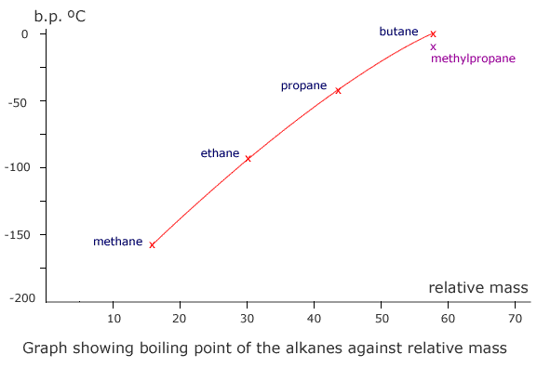
Saturated Hydrocarbons
1. Alkanes
Physical Properties
C. Boiling Points
Boiling point decreases with increasing branches
Boiling point increases with increasing molecular weight.
26

Slide 27
Saturated Hydrocarbons
1. Alkanes
Preparation of Alkanes
1) Hydrogenation of Alkenes and Alkynes
A great number of alkanes can be obtained by fractional distillation of crude petroleum and subsequent reactions as follows:
1. Catalytic hydrogenation:
Alkenes and alkynes react with hydrogen in the presence of metal catalysts such as nickel, palladium, and platinum to produce alkanes.
General Reaction

Slide 28
Saturated Hydrocarbons
1. Alkanes
Preparation of Alkanes
1) Hydrogenation of Alkenes and Alkynes
Specific Examples
28

Slide 29
Saturated Hydrocarbons
1. Alkanes
Preparation of Alkanes
2) Hydrolysis of Grignard Reagent
Grignard reagents react readily with any source of protons to give hydrocarbons.
3) By coupling of alkyl halides with dialkyl cuprate (all kinds of alkanes)

Slide 30
Saturated Hydrocarbons
1. Alkanes
Notations for bond breaking and bond making
A covalent bond can be broken in either two ways,
Homolytic cleavage.
Free radicals
Heterolytic cleavage.
Carbocation
Carboanion
30

Slide 31
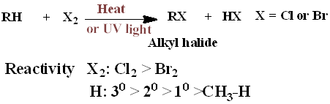
Saturated Hydrocarbons
1. Alkanes
Reactions of Alkanes
Saturated hydrocarbons undergo very few reactions, so they are called Paraffinic hydrocarbons. (Latin parum, little; affinis, affinity)
Halogenation
The halogenation of an alkane appears to be a simple free radical substitution in which a C-H bond is broken and a new C-X bond is formed
Combustion
31

Slide 32
Saturated Hydrocarbons
1. Alkanes
Reactions of Alkanes
A. Halogenation
Substitution reaction of alkanes,
i.e. replacement of hydrogen by halogen,
usually chlorine or bromine, giving alkyl chloride or alkyl bromide.
Flourine reacts explosively with alkanes
It is unsuitable reagent for the preparation of the alkyl flourides.
Iodine is too unreactive
It is not used in the halogentaion of alkanes.
Halogenation of alkanes take place at
high temperatures or under the influence of ultraviolet light

Slide 33
Saturated Hydrocarbons
1. Alkanes
Reactions of Alkanes
A. Halogenation
Chlorination of an alkane usually gives a mixture of products

Slide 34
2. ALKENES

Slide 35

The Structure of Alkenes
Alkenes are hydrocarbons that contain a carbon–carbon double bond.
Alkenes are also Olefins.
General formula is C_{n}H_{2n}
The simplest members of the Alkenes series are C₂ & C₃

Slide 36
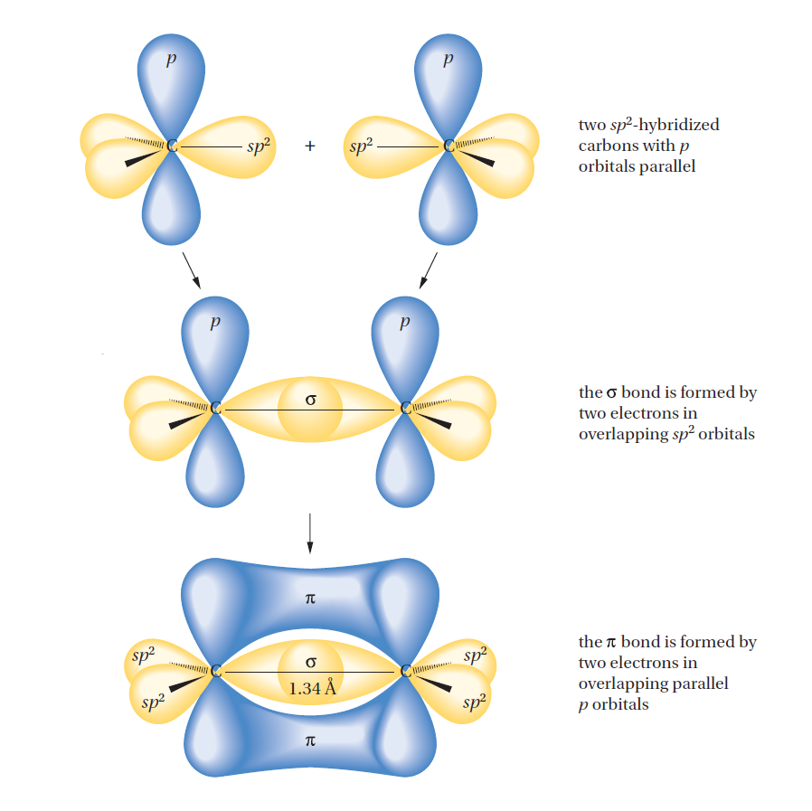
The Structure of Alkenes
Hybridization; sp²-hybridized orbitals
The angle between them is 120° and bond length C=C (1.34 Å).
A trigonal planar.

Slide 37
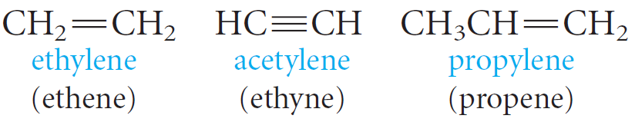
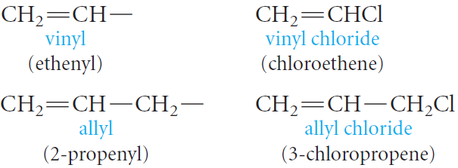
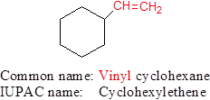
Nomenclature of Alkenes
Common Names
The simplest members of the alkene and alkyne series are frequently referred to by their older common names, ethylene, acetylene, and propylene.
Two important groups also have common names; They are the vinyl and allyl groups.
These groups are used in common names.

Slide 38
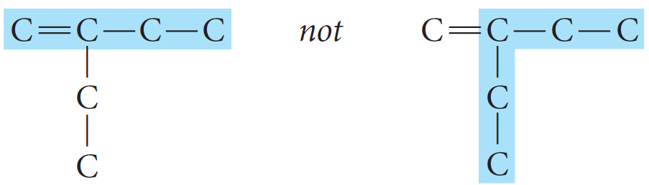
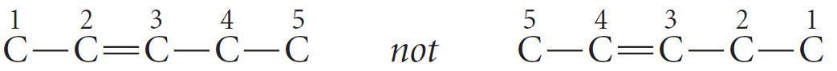
Nomenclature of Alkenes
The IUPAC Rules
The IUPAC rules for naming alkenes are similar to those for alkanes, but a few rules must be added for naming and locating the multiple bonds.
1. The ending -ene is used to designate a carbon–carbon double bond.
2. Select the longest chain that includes both carbons of the double bond.
3. Number the chain from the end nearest the double bond so that the carbon atoms in that bond have the lowest possible numbers.

Slide 39
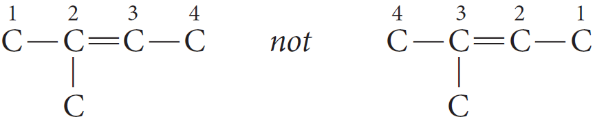
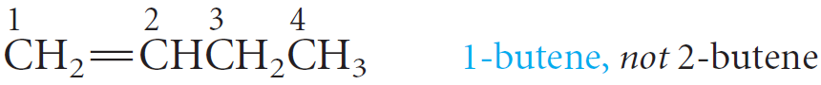
Nomenclature of Alkenes
If the multiple bond is equidistant from both ends of the chain, number the chain from the end nearest the first branch point.
4. Indicate the position of the multiple bond using the lower numbered carbon atom of that bond.

Slide 40
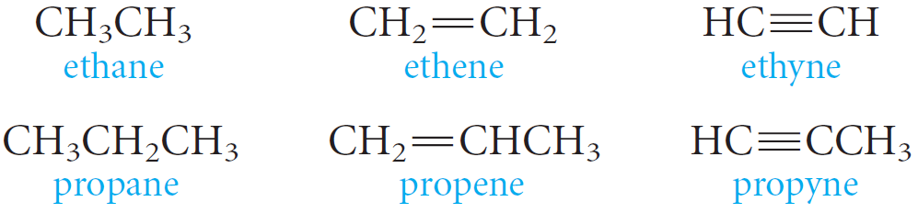
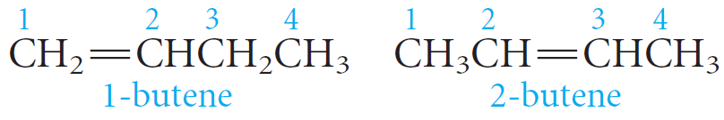
Nomenclature of Alkenes
NOTES
The root of the name (eth- or prop-) tells us the number of carbons, and the ending (-ane, -ene, or -yne) tells us whether the bonds are single, double, or triple.
No number is necessary in these cases, because in each instance, only one structure is possible.
With four carbons, a number is necessary to locate the double bond.

Slide 41
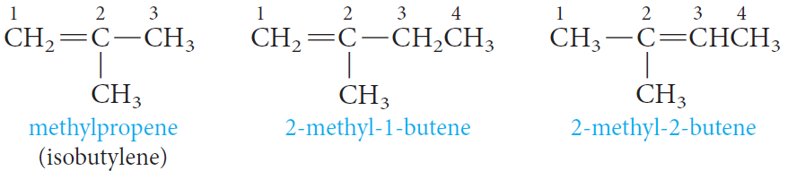
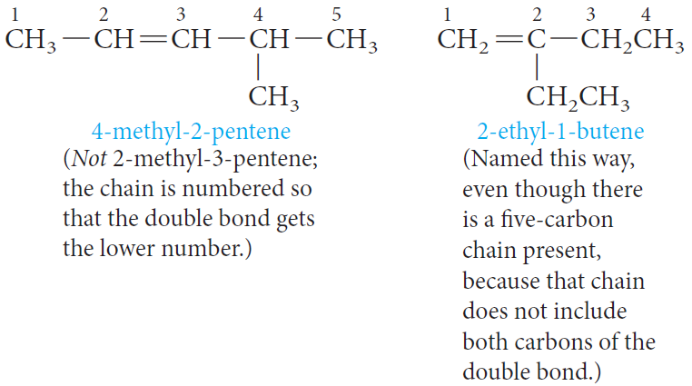
Nomenclature of Alkenes
Branches are named in the usual way.

Slide 42
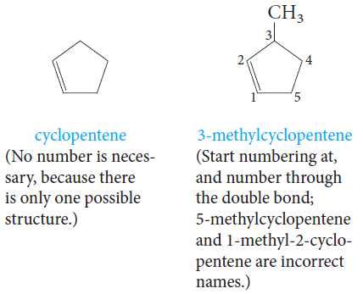
Nomenclature of Alkenes
With cyclic hydrocarbons, we start numbering the ring with the carbons of the double bond.

Slide 43



Nomenclature of Alkenes
Example: Write the structural formula of 4-Isopropyl-3,5-dimethyl-2-octene.
1) The parent carbon chain is an Octene.
The double bond is located between the 2nd and 3rd carbons.
2) Two methyl groups are attached on the parent carbon chain, one on carbon 3 and the other on carbon 5.
3) An isopropyl group is attached on carbon 4.
4) Put the missing hydrogens to get the correct structure.

Slide 44
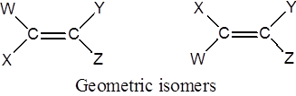
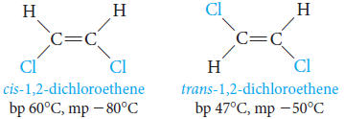
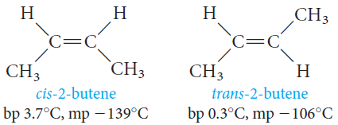

Geometric Isomerism in Alkenes
In alkenes, geometric isomerism is due to restricted rotation about the carbon - carbon double bond.
A) when W differs from X and Y from Z, Alkenes exist as geometric isomers
cis isomer; when two similar groups are on the same side of the double bond.
trans isomer; when two similar groups are on the opposite sides of the double bond.
They have different physical properties and can be separated by fractional crystallization or distillation.

Slide 46
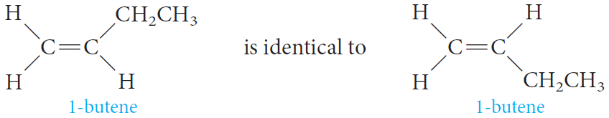
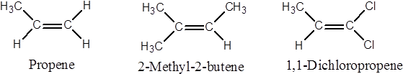
Geometric Isomerism in Alkenes
B) If (W = X or Y = Z), geometric isomerism is not possible.

Slide 47

Geometric Isomerism in Alkenes
For alkenes with four different substituent such as
Another system, the E, Z system,
Basically, the E,Z system works as follows;
Arrange the groups on each carbon of the C=C bond in order of priority
The priority depends on atomic number:
The higher the atomic number of the atom directly attached to the double-bonded carbon, the higher the priority.
Thus, in structure (I),
Cl > F, and CH₃ > H.

Slide 48
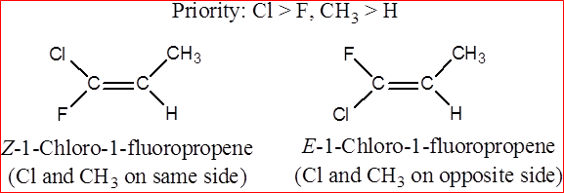
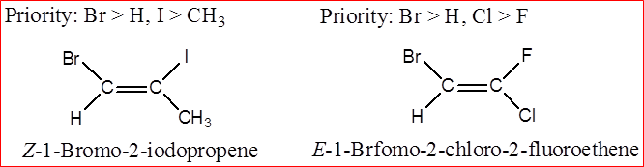
Geometric Isomerism in Alkenes
If the two groups of higher priority are on the same side of the C=C plane,
The isomer is labeled Z; (from the German zusammen, together).
If the two groups of higher priority are on opposite sides of the C=C plane,
The isomer is labeled E; (from the German entgegen, opposite).

Slide 49
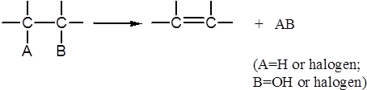
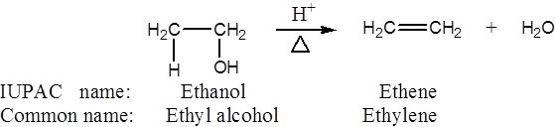
Preparation of Alkenes
Alkenes are prepared by Elimination of an atom or group of atoms from adjacent carbons to form carbon-carbon double bond.
1) Dehydration of Alcohols
When an alcohol is heated in the presence of a mineral acid catalyst, It readily loses a molecule of water to give an alkene.
The acid catalysts most commonly used are sulfuric acid, H₂SO₄, and phosphoric acid, H₃PO₄.

Slide 50
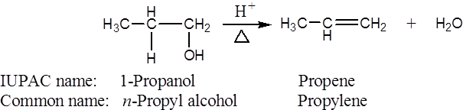
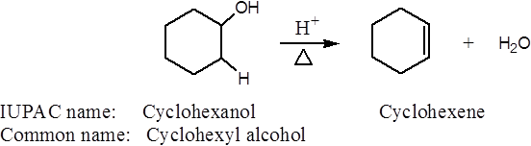
Preparation of Alkenes
1) Dehydration of Alcohols
Removal of OH group and a proton from two adjacent carbon atoms using mineral acids such as H₂SO4 or H₃PO₄

Slide 51
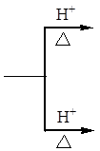



Preparation of Alkenes
1) Dehydration of Alcohols
Which Alkene Predominates?; Saytzeff’s Rule
The loss of water from adjacent carbon atoms, can give rise to more than one alkene.
Example: the dehydration of 2-butanol.
2-butene is the major (with two alkyl substituents attached to C=C)
Saytzeff’s Rule applies
In every instance in which more than one Alkene can be formed
The major product is always the alkene with the most alkyl substituents attached on the double-bonded carbons.

Slide 52


Preparation of Alkenes
1) Dehydration of Alcohols
Classes of Carbocations
according to the number of carbon atoms attached to the positively charged carbon.
Generally
1. The dehydration of alcohols requires an acid catalyst.
2. The predominant alkene formed follows Saytzeffs rule.
3. The reaction proceeds via a carbocation intermediate.
4. The stabilities of carbocations and the ease of dehydration of alcohols follows the order 3° > 2° > 1°.

Slide 53
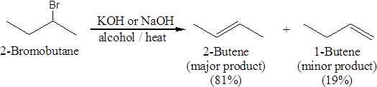
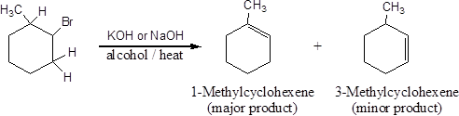

Preparation of Alkenes
2) Dehydrohalogenation of Alkyl Halides
Alkenes can also be prepared under alkaline conditions.
heating an alkyl halide with a solution of KOH or NaOH in alcohol, yields an alkene.
3) Dehalogenation of Vicinal Dibromides

Slide 54
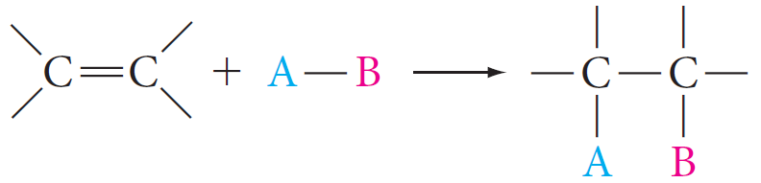
Reactions of Alkenes
The chemistry of alkenes can be divided into two general types of reactions:
(1) Electrophilic Addition Reactions
Addition of Symmetric and Unsymmetric Reagents to symmetric Alkenes.
1. Addition of Hydrogen: Catalytic Hydrogenation
2. Addition of Halogens: Halogenation
Addition of Unsymmetric Reagents to Unsymmetric Alkenes; Markovnikov’s Rule.
1. Addition of Hydrogen Halides
2. Addition of Sulfuric Acid
3. Addition of Water: Hydration
4. Addition of HOX: Halohydrin Formation

Slide 55
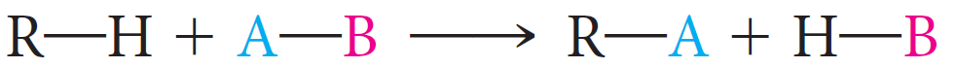
Reactions of Alkenes
(2) Substitution Reactions
(3) Oxidation Reactions
1. Ozonolysis
2. Oxidation Using KMnO₄

Slide 56

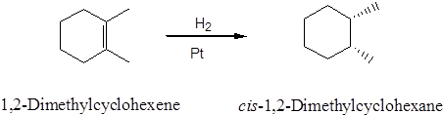
Reactions of Alkenes
Electrophilic Addition Reactions
1. Addition of Hydrogen: Hydrogenation
Addition of a mole of hydrogen to carbon-carbon double bond of Alkenes in the presence of suitable catalysts to give an Alkane.

Slide 57
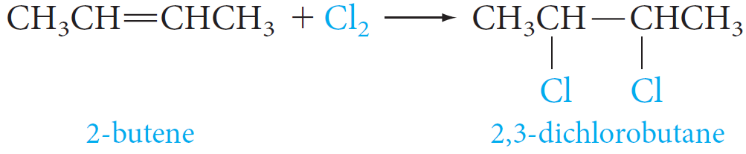
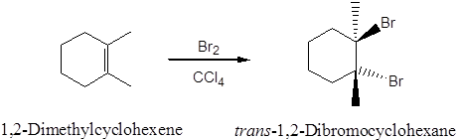
Reactions of Alkenes
Electrophilic Addition Reactions
2. Addition of Halogen: Halogenation
When an alkene is treated at room temperature with a solution of bromine or chlorine in carbon tetrachloride to give the corresponding vicinal dihalide (two halogens attached to adjacent carbons)
- Iodine is too unreactive and will not add to the double bond.
- Fluorine is too reactive and reacts explosively with an alkene.

Slide 58
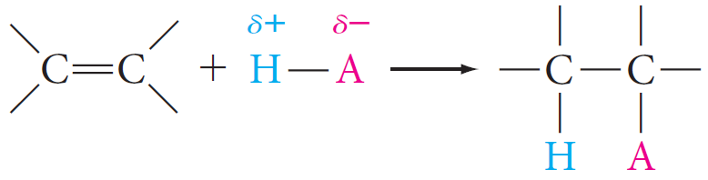
Reactions of Alkenes
Electrophilic Addition Reactions
3. Addition of Acids
A variety of acids add to the double bond of alkenes.
The hydrogen ion (or proton) adds to one carbon of the double bond, and the remainder of the acid becomes connected to the other carbon.
Acids that add in this way are the hydrogen halides (H-F, H-Cl, H-Br, H-I), and water (H-OH).
Note that
- Any electron-deficient species is called an electrophile.
- Any electron-rich species is called a nucleophile.

Slide 59
Reactions of Alkenes
Electrophilic Addition Reactions
Examples of Electrophile:
i) Positive reagents: protons (H⁺), alkyl group R⁺ , nitronium ion (NO₂⁺), etc….
ii) Neutral reagents having positively polarized centers: HCl, bromine (because it can be polarized so that one end is positive).
iii) Lewis acids: molecules or ions that can accept an electron pair ⇒ BF₃ and AlCl₃.
iv) Metal ions that contain vacant orbitals: the silver ion (Ag⁺), the mercuric ion (Hg²⁺), and the platinum ion (Pt²⁺).
Examples of Nucleophile:
Negative ions
b) Neutral molecules

Slide 60


Reactions of Alkenes
Electrophilic Addition Reactions
3. Addition of Acids
The addition of H—A to an alkene is believed to be a two-step process.
Step 1. The hydrogen ion (the electrophile) attacks the ∏-electrons of the alkene, forming a C—H bond and a carbocation.
Step 2. The negatively charged species A: - (a nucleophile) attacks the carbocation and forms a new C—A bond.
The attack by an electrophilic reagent on the ∏-electrons, falls in a general category called electrophilic addition reactions.

Slide 61

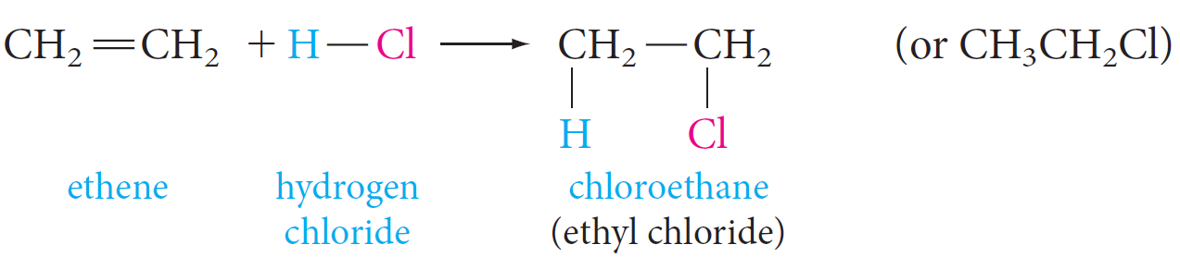

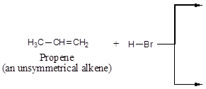

Reactions of Alkenes
Electrophilic Addition Reactions
3.1. Addition of Hydrogen Halide
Alkenes react with hydrogen chloride, HC1, hydrogen bromide, HBr and hydrogen iodide, HI, to form alkyl halides, RX.
Examples;

Slide 62
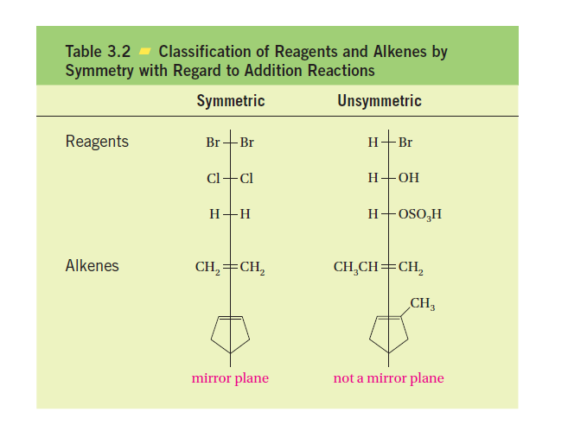
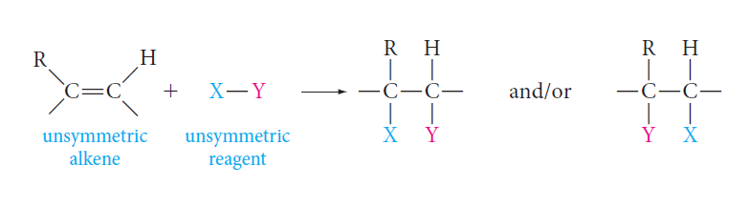
Reactions of Alkenes
Electrophilic Addition Reactions
Reagents and alkenes can be classified as either symmetric or unsymmetric with respect to addition reactions.
If a reagent and/or an alkene is symmetric, only one addition product is possible.
But if both the reagent and the alkene are unsymmetric, two products are, in principle, possible.

Slide 63
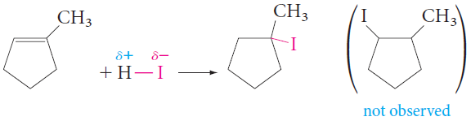
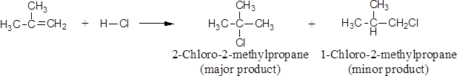
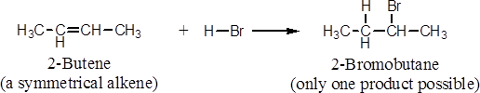
Reactions of Alkenes
Electrophilic Addition Reactions
Markovnikov’s Rule
In electrophilic addition of H—X to Unsymmetrical Alkenes the hydrogen of the hydrogen halide adds to the double-bonded carbon that bears the greater number of hydrogen atoms and the negative halide ion adds to the other double-bonded carbon.

Slide 64
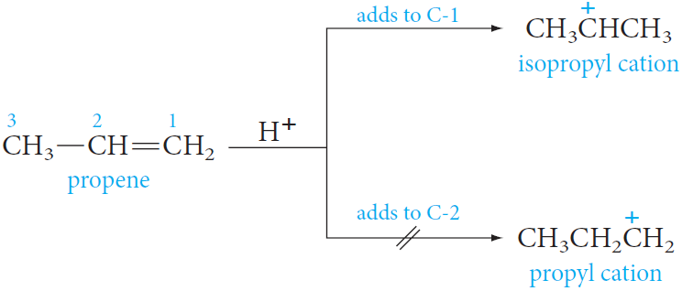
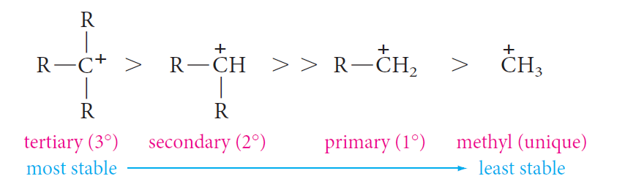
Reactions of Alkenes
Electrophilic Addition Reactions
Explanation for Markovnikov’s Rule
Example; Addition of HBr to propene
In modern terms Markovnikov’s rule can be restated:
The addition of an unsymmetrical reagent HX to an unsymmetrical alkene proceeds in such a direction as to produce the more stable carbocation.

Slide 65
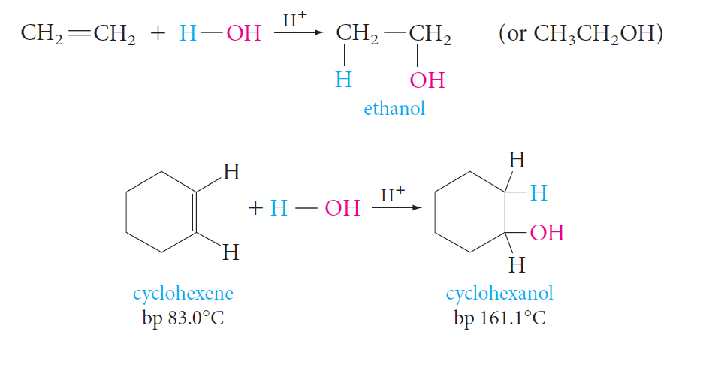
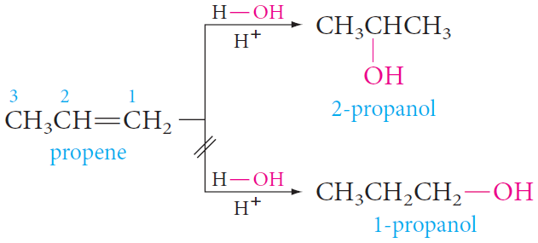
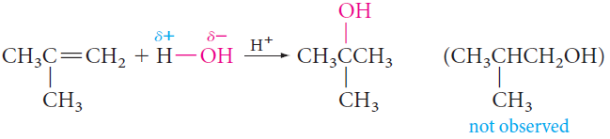
Reactions of Alkenes
Electrophilic Addition Reactions
3.2. Addition of Water: Hydration
If an acid catalyst is present, water (as H-OH) adds to alkenes and the product is alcohol.

Slide 66
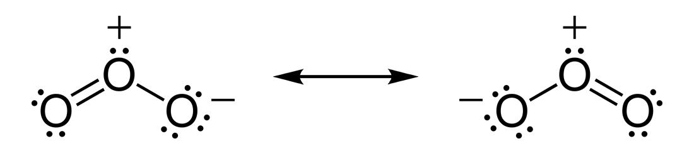
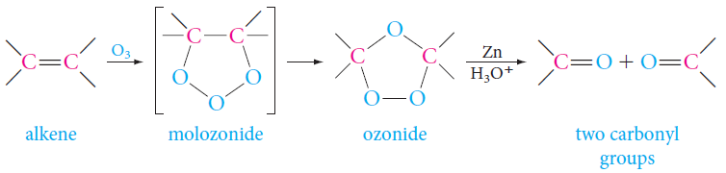
Reactions of Alkenes
Oxidation Reactions
1. Ozonolysis
The first product, a molozonide, is formed by cycloaddition of the oxygen at each end of the ozone molecule to the carbon–carbon double bond.
This product then rearranges rapidly to an ozonide (explosive if isolated).
They are usually treated directly with a reducing agent, commonly zinc and aqueous acid, to give carbonyl compounds as the isolated products.

Slide 67
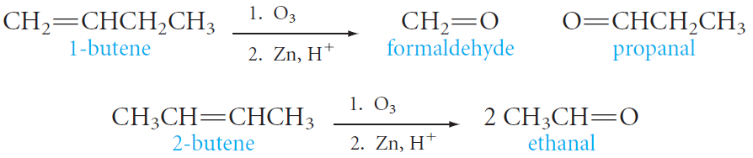
Reactions of Alkenes
Oxidation Reactions
1. Ozonolysis
Ozonolysis can be used to locate the position of a double bond.
Example;
Ozonolysis of 1-butene gives two different aldehydes, whereas 2-butene gives a single aldehyde.

Slide 68



Reactions of Alkenes
Oxidation Reactions
2. Oxidation Using KMnO₄
Alkenes react with alkaline potassium permanganate to form glycols (compounds with two adjacent hydroxyl groups).

Slide 69
3. ALKYNES

Slide 70

The Structure of Alkynes
Alkynes are hydrocarbons that contain a carbon–carbon triple bond.
Alkynes are also known as Acetylenes.
General formula is C_{n}H_{2n-2}
Hybridization; sp-hybridized orbitals
The angle between them is 180° and the bond length 1.20 A°
Linear.

Slide 71


Nomenclature of Alkynes
The simplest members of the Alkenes series are C₂ & C₃
Named are derived from the corresponding alkanes by replacing the –ane ending by –yne.
IUPAC rules as discussed for Alkenes .
Example:
3-Chloro-2,7-dimethyl-4-nonyne

Slide 72


Acidity of Alkynes
A hydrogen atom on a triply bonded carbon (Terminal Alkyne) is weakly acidic and can be removed by a very strong base ( as Sodium amide).
Internal alkynes (Non-Terminal Alkyne) have no exceptionally acidic hydrogens.
Relative Acidity of the Hydrocarbon.
Terminal alkynes, are more acidic than other hydrocarbons

Slide 73


Preparation of Alkynes
1) Dehydrohalogenation of Alkyl dihalides

Slide 74



Preparation of Alkynes
2) Reaction of Sodium Acetylide with Primary Alkyl Halides
Acetylene
Monosubstituted Acetylenes

Slide 75

Preparation of Alkenes
Electrophilic Addition Reactions
1. Addition of Hydrogen: Hydrogenation
With an ordinary nickel or platinum catalyst, alkynes are hydrogenated all the way to alkanes.
However, a special palladium catalyst (called Lindlar’s catalyst) can control hydrogen addition so that only one mole of hydrogen adds. In this case, the product is a cis alkene.

Slide 76


Preparation of Alkenes
Electrophilic Addition Reactions
2. Addition of Halogen: Halogenation
Bromine adds as follows; In the first step, the addition occurs mainly trans.
3. Addition of Hydrogen Halide
With unsymmetric triple bonds and unsymmetric reagents, Markovnikov’s Rule is followed in each step, as shown in the following example:

Slide 77


Preparation of Alkenes
Electrophilic Addition Reactions
4. Addition of Water: Hydration
Addition of water to alkynes requires not only an acid catalyst but mercuric ion as well.
Although the reaction is similar to that of alkenes, the initial product - a vinyl alcohol or enol - rearranges to a carbonyl compound (keto form).
The keto form of aldehydes and ketones are in equilibrium with the enol form.
The keto from predominates at equilibrium for most simple aldehydes and ketones.
The inter conversion is called keto-enol tautomerization.

