Slide 1
Concentration based on volume cont’ed

Slide 2
From previous lecture

Slide 3
Expression | Symbol | Definition | Unit
Based on volume
Molarity | M | = no. of moles of solute volume of solution (L) | Molar or mol/L
no. of moles | n | = Wt_{g} /MWT | moles
Normality | N | = no. of equivalents Volume of solution in (L) | normal

Slide 4
Question 1. Calculate the normality of 250 ml of HCl containing 18.25g of HCl?
N= no. of equivalents / V(L)
no. of equivalents = wt_{g} of solute / EW
EW= MW of solute / n
= 36.5 / 1
= 36.5
No. of equivalents = wt_{g}of solute / equivalents weight
= 18.25 /36.5
= 0.5
N = no. of equivalents / V(L)
= 0.5 / 0.25
=2 normal.
H | 1.00784
CL | 35.453
MWT

Slide 5
Question 2. What is the normality of the following?
0.1381 M NaOH
0.0521 M H₃PO₄
Solution:
N= n x M
A) 0.1381 M NaOH
N = 1 X 0.1381 mol/L
N = 0.1381 normal
B) 0.0521 M H₃PO₄
N = 3 X 0.0521 mol/L
= 0.156 normal

Slide 6
Concentration Based on volume

Slide 7
Avogadro’s Number
It is the number of molecules per mole of substance
OR it is the number of atoms per gram-atom of substance
OR it is the number of ions per g-ion of substance
Avogadro’s number = 6.023 × 10²³
For example: 1 mole of water contains Avogadro’s no. of 6.023 × 10²³ molecules

Slide 8
Calculate the weight in grams of 1x10²³ molecules of NaCl?
1 mole has 6.023 X 10²³(Avogadro's number)
? mole has 1 X 10²³
no of moles = 0.166 mole.
no. of moles of solute = Wt_{g} /MWT
MW of NaCl= (1 X 23) + (1X 35.5)= 58.5g/mole.
Wt = no. of moles of solute x MWT
wt_{g}= 0.166 X 58.5
= 9.71 g

Slide 9
Calculate the number of molecules in 2.25g glycine (C₂H₅NO₂)?
no. of moles of solute = Wt_{g} /MWT
MWT of glycine = (2 X12) + (5 X1) + (1X14) + (2 X16) = 75g/mole.
Wt_{g} = 2.25g
no of moles = 0.03 mole.
Since 1 mole =6.023 X 10²³(Avogadro's number)
0.03 mole ? Molecules
no. of molecules = 0.03 X 6.023 X 10²³
= 0.18 X 10²³ molecule

Slide 10
3- Weight/Volume Percent (W/V %)
It is the weight in gram of a solute per 100 ml of solution.
It is often used for routine laboratory solutions where exact concentration are not too important.
Wt in gram of solute
wt/v % =
100 ml of solution

Slide 11
20g of NaCl was dissolved in 200ml of water what is its W/V%?
20 g in 200 ml
? in 100 ml (according to w/v% definition)
= 10g NaCl in 100 ml water
the W/V% is 10%

Slide 12
How would you prepare 0.2 L of 0.3% W/V% of MgCl₂ ?
w/v% --------- 0.3 g in 100 ml
( convert from L to ml [ 0.2 x 1000= 200 ml])
0.3 g in 100 ml
? g in 200 ml
= (0.3 * 200) / 100
= 0.6 g of MgCl₂
0.6 g of MgCl₂is dissolved in a little volume of distilled water then make up the volume to 200ml with distilled water.

Slide 13
4- Milligram Percent (mg%)
It is the weight in mg of a solute per 100 ml of solution.
It is often used in clinical laboratories.
Wt in mg of solute
mg % =
100 ml of solution

Slide 14
5- Osmolarity
It is the molarity of particles in a solution.
n is the number of ions (or dissociable particles) produced per molecule.
A 1M solution of a non-dissociable solute is also 1 osmolar.
Osmolarity = n × M

Slide 15
n is the number of ions
NaCl dissociates completely in water to form Na⁺ ions and Cl⁻ions.
n = 2
n of NaCl becomes two: one of Na+ and one of Cl−.
2 solute particles/ 1 mole of NaCl
CaCl₂ has 3
(1 of Ca²⁺ and 2 mol Cl⁻)
n = 3

Slide 16
A 1M solution of a non-dissociable solute is also 1 osmolar.
osmolarity of glucose
Their osmolarity equals their molarity because n=1. The osmolarity of a 4M solution of glucose is
osmolarity = 4 x 1
= 4 Osm/L

Slide 17
Osmolarity cont’ed
It is often considered in physiological studies where tissues or cells must be bathed in a solution of the same osmolarity as the cytoplasm in order to prevent the uptake or release of water.
Isotonic solution
Hypotonic solution
Hypertonic solution

Slide 18
Isotonic solution
ISO - means alike.
TONICITY - refers to osmotic activity of body fluids; tells the extent that fluid will allow movement of water in & out cell.
Isotonic solution
The medium surrounding the cells having exactly the same water concentration as in the cell
OR that the solutions on both sides of
selectively permeable membrane have
established equilibrium.

Slide 19
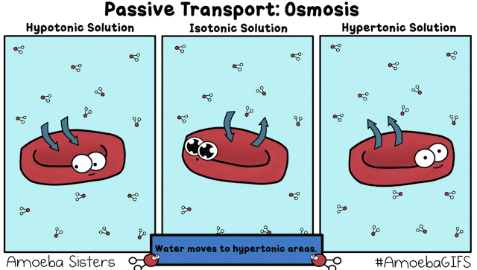

Slide 20
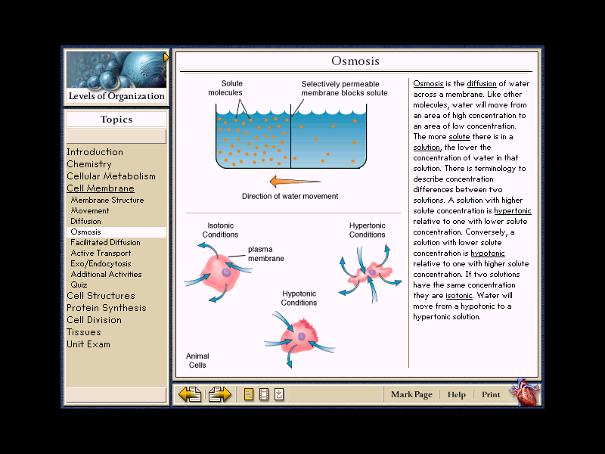

Slide 21
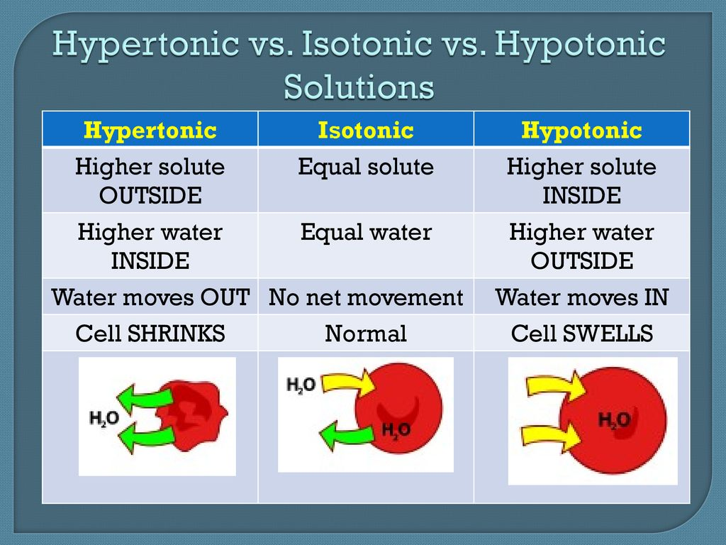
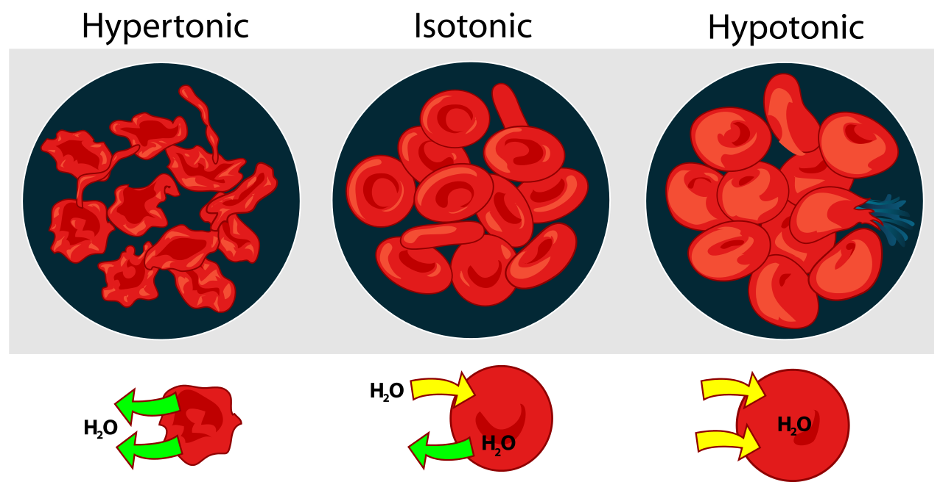

Slide 22
Example (1)
A solution of KCl that has a molarity of 0.03 M what is the osmolarity ?
Osmolarity = ?
Molarity= 0.03 M
KCl is dissociable, n = 2
Osmolarity= 2 x 0.03
= 0.06 Osmolar OR Osm/L

Slide 23
Example (2)
What is the osmolarity for 1 liter of solution that includes 3 moles of HCl and 1 mole of glucose?
(HCl dissociates, glucose does not.)
3.5 Osm/L. 2) 4 Osm/L. 3) 5 Osm/L
4) 7 Osm/L 5) 14 Osm/L.
n of HCl = 2. &. glucose does not dissociate = 1
M of HCl = no. of mole / volume (L)
M of HCl = 3/1 M of HCl = 3 molar
M of glucose = no. of mole / volume (L)
M of glucose = 1/1 M of glucose = 1 molar
Osmolarity = n × M
Osmolarity = (n × M of HCl) + (n × M of glucose)
= (2 x 3)+ (1 x 1)
= 7 Osm/L

Slide 24
Example (3)
When you want to study RBC and its osmolarity in the cytoplasm is 0.308 osmolar.
What do you think the osmolarity of RBC in vitro solution should be? And why?
0.308 osmolar.
Blood plasma is 0.308 osmolar.
Thus, red blood cells suspended in a 0.308 osmolar of NaCl solution more than this conc. the RBC will shrink and less the RBC will swell.

Slide 25
Example (4)
Classify these solution regards the RBC osmolarity
0.56 osmolar →
0.21 osmolar →
3) 0.154 M NaCl →
Hypertonic
Hypotonic
osmolarity = n x M
= 2 x 0.154
= 0.308 osmolar
so it is isotonic

Slide 26
6- Volume / volume percent
Volume /volume percent (v / v %) =
the volume in ml of a solute per 100 ml of solution.

Slide 27
Example
A 0.04M solution of NaOH was prepared by the use of 0.8 gm of NaOH and the total volume of the solution was 500 ml.
Express the concentration g/l.
W/V %.
Mg%.
Osmolarity.
Normality.
Molarity = 0.04 M
Wt = 0.8 g
Volume= 500ml

Slide 28
A 0.04M solution of NaOH was prepared by the use of 0.8 gm of NaOH and the total volume of the solution was 500 ml.
A) Express the concentration g/l.
Since 0.8gm 500 ml
? 1000 ml
The weight of NaOH = (1000 x 0.8)/500
Molarity = 0.04 M
Wt = 0.8 g
Volume= 500ml
= 1.6gm/l

Slide 29
A 0.04M solution of NaOH was prepared by the use of 0.8 gm of NaOH and the total volume of the solution was 500 ml.
B) W/V %.
W/V%= (Weight in gram solute)/(100ml of solution)
0.8 of NaOH 500 ml
? 100 ml
Molarity = 0.04 M
Wt = 0.8 g
Volume= 500ml
The weight of NaOH = (0.8 x100 )/500
= 0.16%

Slide 30
A 0.04M solution of NaOH was prepared by the use of 0.8 gm of NaOH and the total volume of the solution was 500 ml.
C) Mg%.
Wt in mg of solute
mg % =
100 ml of solution
from gm to mg =0.8 x1000
= 800 mg
Molarity = 0.04 M
Wt = 0.8 g
Volume= 500ml
800 mg 500ml
? 100 ml
mg % = (800 x100)/ 500
= 160 mg%
OR Since 0.16% (g/100) x 1000 = 160 Mg%

Slide 31
Osmolarity
Osmolarity of NaOH= n X M
NaOH it will give two ions Na⁺ , OH⁻
Osmolarity = 2 x 0.04
= 0.08 Osmolar
Normality
Normality of NaOH = n × M
= 1 × 0.04
= 0.04 N
Molarity = 0.04 M
Wt = 0.8 g
Volume= 500ml

Slide 32
You turn………..
The osmolarity of normal blood serum is 0.30 Osm/L. Show that the osmolarity of 0.90% (w/v) NaCl is the same as the normal serum?
Calculate the osmolarity of 5% of (w/v) glucose solution (the molar mass of nonelectrolyte glucose is 180 g/mole?

Slide 33
Do you have questions?

