Slide 1
Chapter 2
Chemistry: Atoms, Molecules and Ions

Slide 2
The Structure of the Atom
Dalton’s Atomic Theory (1808)
Compounds are composed of atoms of more than one element.
Elements are composed of extremely small particles called atoms.
A chemical reaction involves only the separation, combination, or rearrangement of atoms; it does not result in their creation or destruction.

Slide 3
The Structure of the Atom
Dalton’s Atomic Theory (1808)
Atom is the basic unit of an element that can enter into chemical combination.
Dalton imagined an atom that was both extremely small and indivisible.
The 1850s and extended into the twentieth century: atoms actually possess internal structure; they are made up of even smaller particles, which are called subatomic particles.
This research led to the discovery of three such particles -electrons, protons, and neutrons.

Slide 4
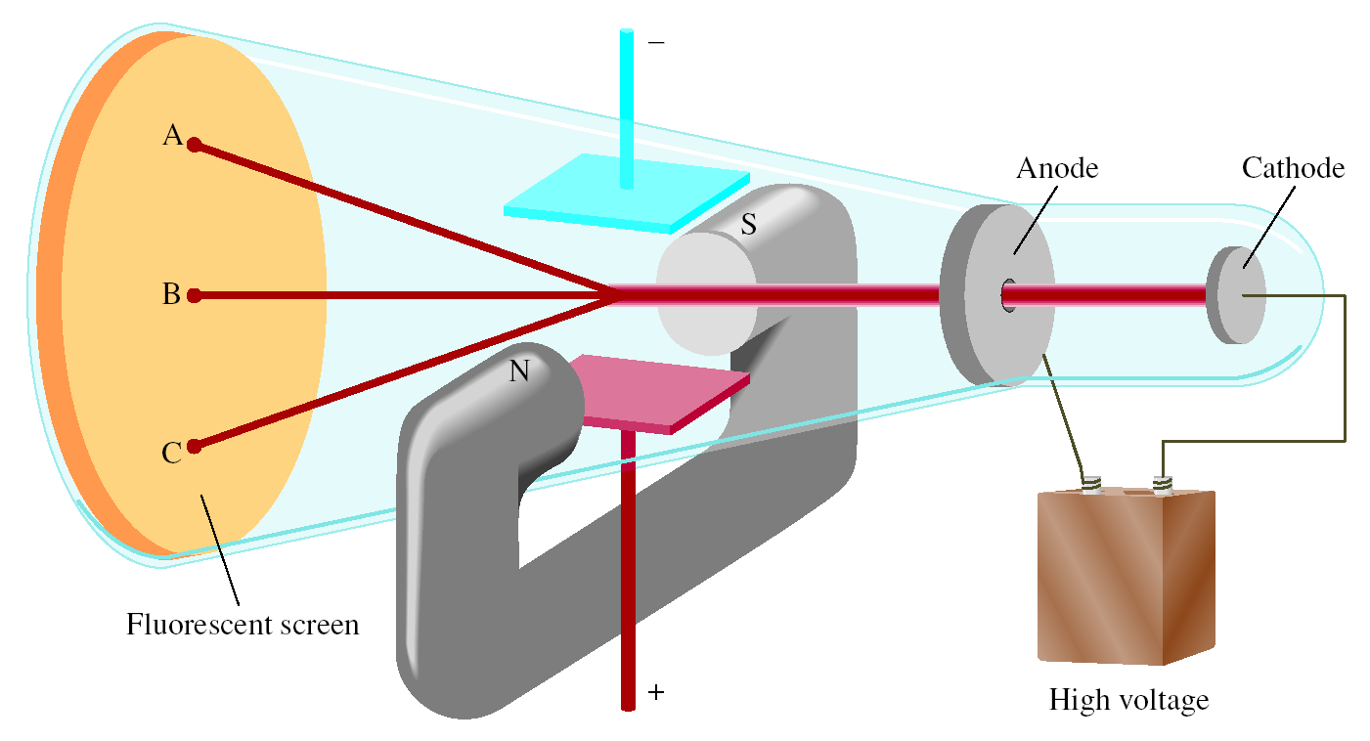
The Structure of the Atom
The Electron
Radiation - the emission and transmission of energy through space in the form of waves.
One device used to investigate this phenomenon was a cathode ray tube (It is a glass tube from which most of the air has been evacuated).

Slide 5
The Structure of the Atom
The Electron
When the two metal plates are connected to a high-voltage source;
The negatively charged plate, called the cathode, emits an invisible ray.
The cathode ray is drawn to the positively charged plate, called the anode, where it passes through a hole and continues traveling to the other end of the tube.
When the ray strikes the specially coated surface, it produces a strong fluorescence, or bright light.

Slide 6
The Structure of the Atom
The Electron
In some experiments, two electrically charged plates and a magnet were added to the outside of the cathode ray tube.
When the magnetic field is on and the electric field is off, the cathode ray strikes point A.
When only the electric field is on, the ray strikes point C.
When both the magnetic and the electric fields are off or when they are both on but balanced so that they cancel each other’s influence, the ray strikes point B.
According to electromagnetic theory, a moving charged body behaves like a magnet and can interact with electric and magnetic fields through which it passes.

Slide 7
The Structure of the Atom
The Electron
Because the cathode ray is attracted by the plate bearing positive charges and repelled by the plate bearing negative charges, it must consist of negatively charged particles.
We know these negatively charged particles as electrons.
J.J. Thomson, measured mass/charge of e⁻
(1906 Nobel Prize in Physics)
Thomson’s charge/mass of e⁻ = -1.76 x 10⁸ C/g

Slide 8
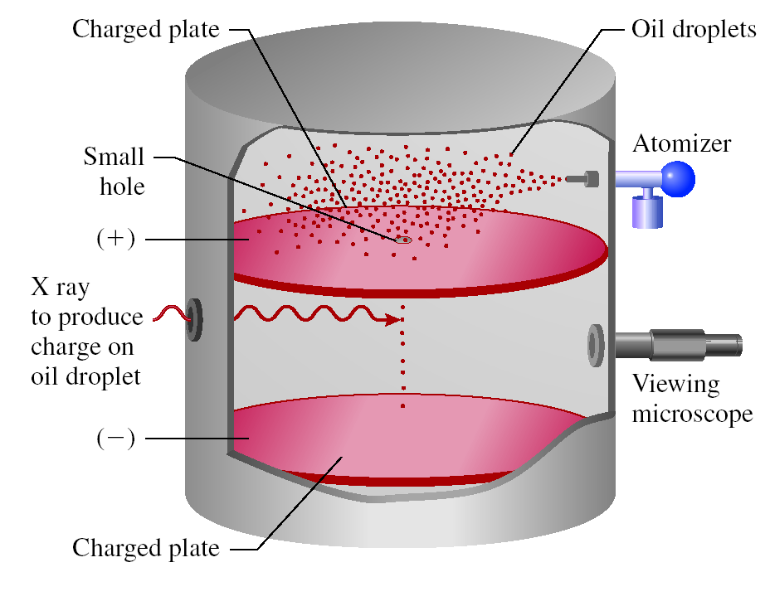
The Structure of the Atom
Millikan’s Experiment
Measured mass of e⁻
(1923 Nobel Prize in Physics)
Millikan examined the motion of single tiny drops of oil that picked up static charge from ions in the air.
He suspended the charged drops in air by applying an electric field and followed their motions through a microscope.
e⁻ charge = -1.60 x 10⁻¹⁹ C
Thomson’s charge/mass of e⁻ = -1.76 x 10⁸ C/g
e⁻ mass = 9.10 x 10⁻²⁸ g

Slide 9
The Structure of the Atom
Radioactivity
It was suggested by Marie Curie.
Radioactivity - spontaneous emission of particles and/or radiation.
Radioactive - any element that spontaneously emits radiation.
Röntgen noticed that cathode rays caused glass and metals to emit very unusual rays.
Highly energetic radiation penetrated matter, darkened covered photographic plates, and caused a variety of substances to fluoresce.
These rays could not be deflected by a magnet, they could not contain charged particles as cathode rays do.
Röntgen called them X rays because their nature was not known.

Slide 10
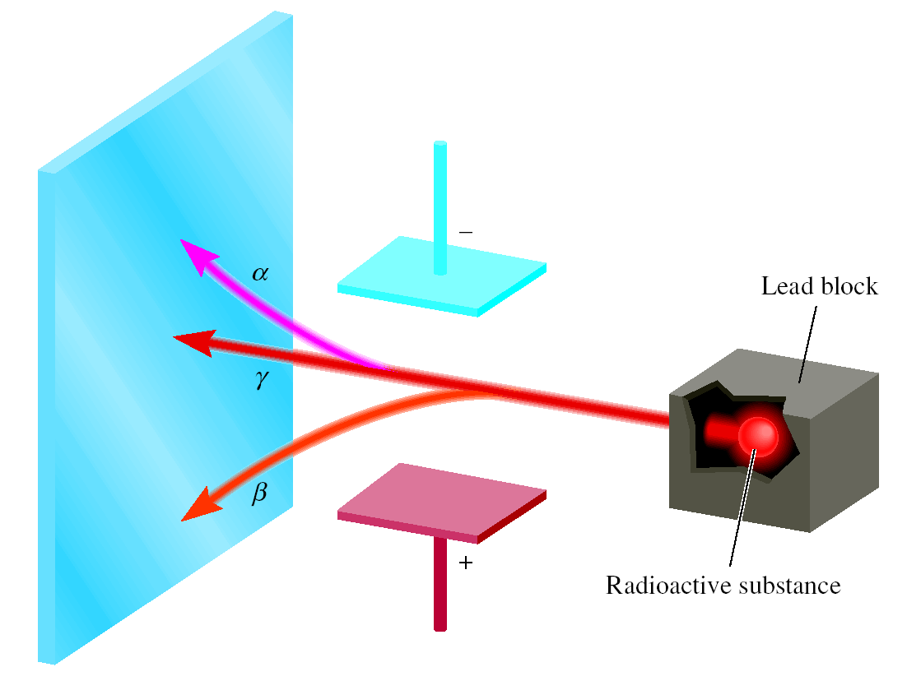
The Structure of the Atom
Radioactivity
Three types of rays are produced by the decay, or breakdown, of radioactive substances such as uranium.
Two of the three are deflected by oppositely charged metal plates.
Alpha (α) rays or α particles; positively charged particles, and are deflected by the positively charged plate.
Beta (β) rays or β particles; are electrons and are deflected by the negatively charged plate.
2. Gamma (γ) rays; high-energy rays.
Like X rays, γ rays have no charge and are not affected by an external field.

Slide 11
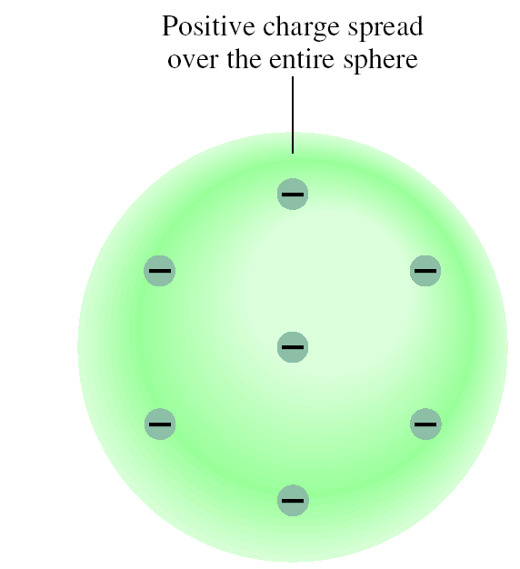
The Structure of the Atom
The Proton and the Nucleus
By the early 1900s, two features of atoms had become clear: they contain electrons, and they are electrically neutral.
To maintain electric neutrality, an atom must contain an equal number of positive and negative charges.
Thomson’s Model
a uniform, positive sphere of matter in which electrons are embedded like raisins in a cake.
This so-called “plum-pudding” model was the accepted theory for a number of years.

Slide 12
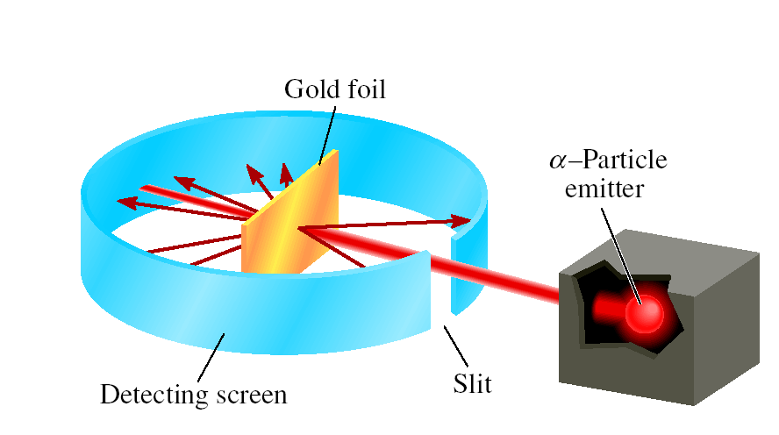
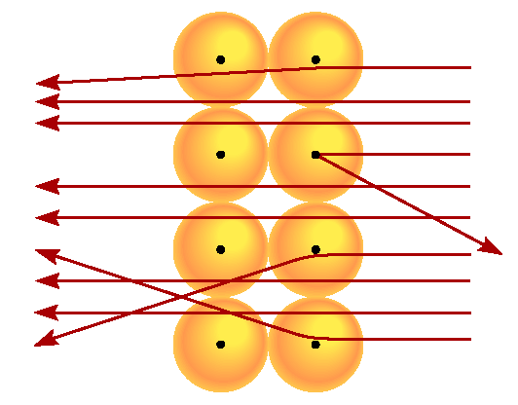
The Structure of the Atom
The Proton and the Nucleus
Rutherford’s Experiment
(1908 Nobel Prize in Chemistry)
particle velocity ~ 1.4 x 10⁷ m/s
(~5% speed of light)
atoms positive charge is concentrated in the nucleus
proton (p) has opposite (+) charge of electron (-)
mass of p is 1840 x mass of e⁻ (1.67 x 10⁻²⁴ g)

Slide 13
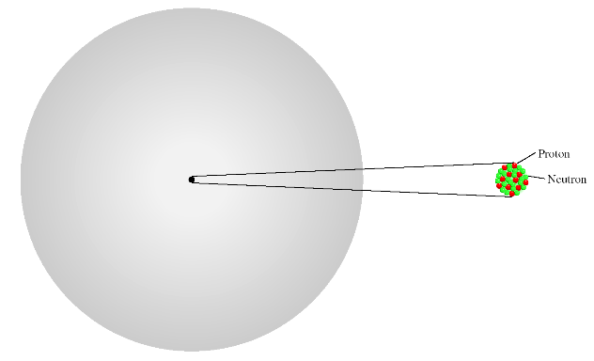
The Structure of the Atom
The Proton and the Nucleus
Rutherford’s Model of the Atom
Most of the atom must be empty space.
This explains why the majority of a particles passed through the gold foil with little or no deflection.
The atom’s positive charges, are all concentrated in the nucleus, which is a dense central core within the atom.
Whenever an α particle came close to a nucleus in the scattering experiment, a large repulsive force and therefore a large deflection.
The positively charged particles in the nucleus are called protons .
atomic radius ~ 100 pm = 1 x 10⁻¹⁰ m
nuclear radius ~ 5 x 10⁻³ pm = 5 x 10⁻¹⁵ m

Slide 14
The Structure of the Atom
The Neutron
Chadwick’s Experiment (1932)
(1935 Noble Prize in Physics)
When a thin sheet of beryllium was bombarded with a particles, a very high-energy radiation similar to γ rays was emitted by the metal.
Later experiments showed that the rays actually consisted of a third type of subatomic particles, which Chadwick named neutrons, electrically neutral particles having a mass slightly greater than that of protons.
H atoms - 1 p; He atoms - 2 p
mass He/mass H should = 2
measured mass He/mass H = 4
neutron (n) is neutral (charge = 0)
n mass ~ p mass = 1.67 x 10⁻²⁴ g

Slide 15
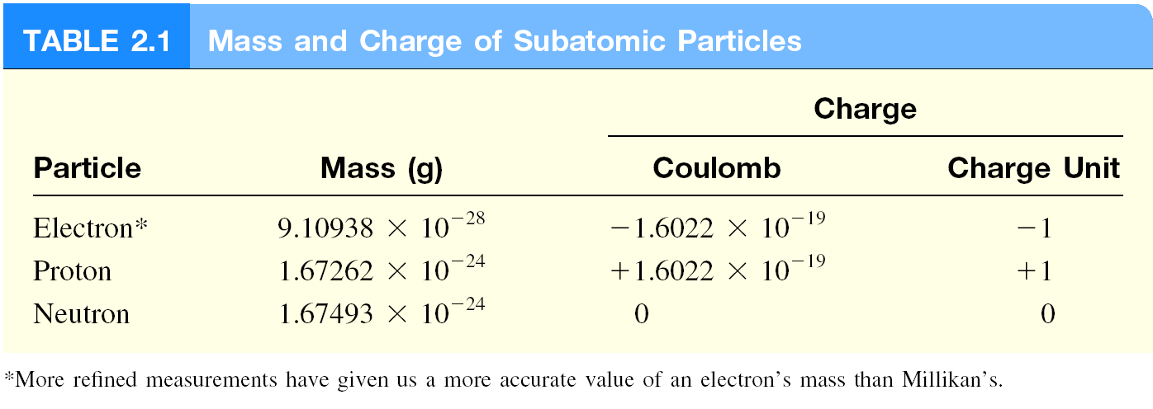
The Structure of the Atom
The Neutron
mass p ≈ mass n ≈ 1840 x mass e⁻

Slide 16
Atomic Number, Mass Number and Isotopes
Atomic number (Z) = number of protons in nucleus
Mass number (A) = number of protons + number of neutrons
= atomic number (Z) + number of neutrons
Isotopes are atoms of the same element (X) with different numbers of neutrons in their nuclei
Mass Number
A
X
Element Symbol
Atomic Number
Z
1
2
3
H
H (D)
H (T)
1
1
1
hydrogen deuterium tritium
235
U
238
U
92
92

Slide 17
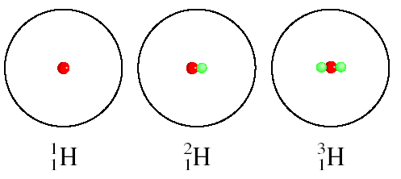
Atomic Number, Mass Number and Isotopes
The Isotopes of Hydrogen

Slide 18
Atomic Number, Mass Number and Isotopes
14
How many protons, neutrons, and electrons are in
C
?
6
6 protons, 8 (14 - 6) neutrons, 6 electrons
11
How many protons, neutrons, and electrons are in
C
?
6
6 protons, 5 (11 - 6) neutrons, 6 electrons

Slide 19
Atomic Number, Mass Number and Isotopes

Slide 20
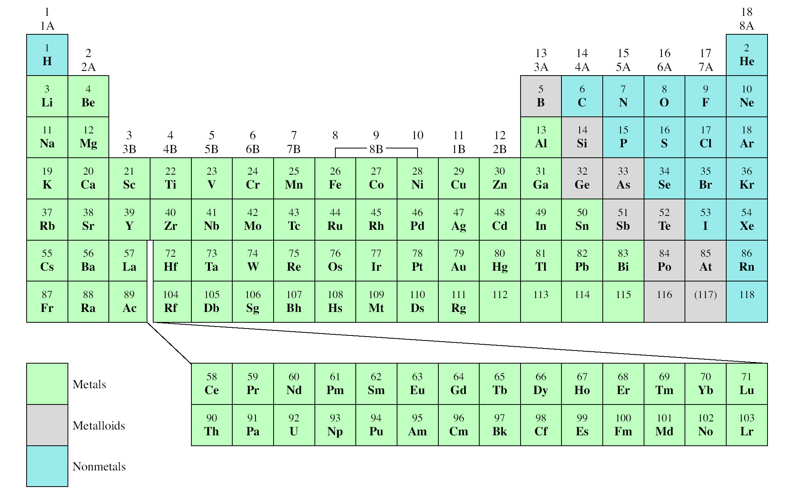
The Periodic Table
Alkali Earth Metal
Alkali Metal
Noble Gas
Group
Halogen
Period

Slide 21
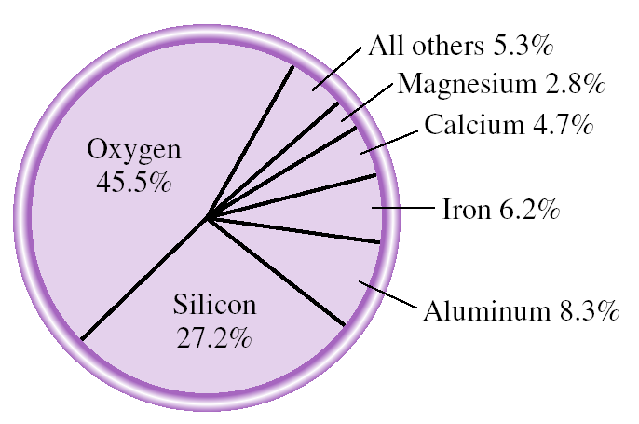
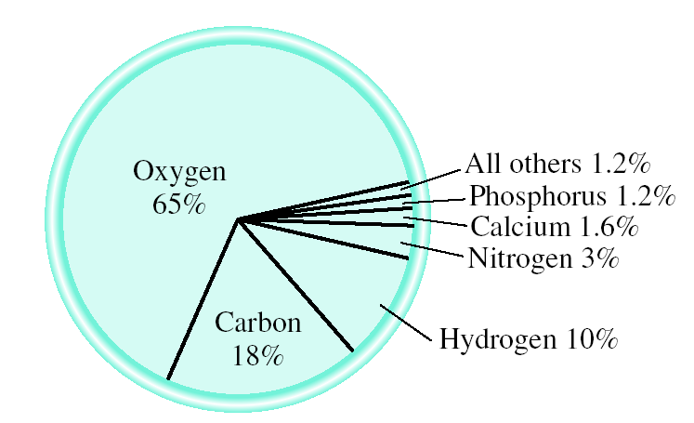
The Periodic Table
Chemistry In Action
Natural abundance of elements in Earth’s crust
Natural abundance of elements in human body

Slide 22
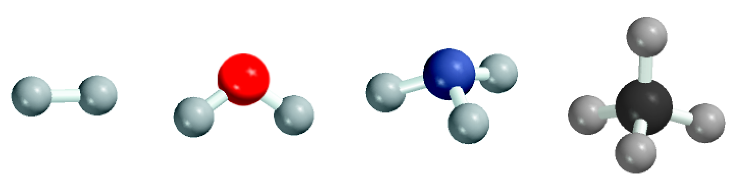
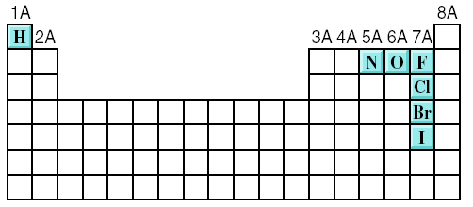
Molécules and Ions
A molecule is an aggregate of two or more atoms in a definite arrangement held together by chemical forces.
H₂
H₂O
NH₃
CH₄
A diatomic molecule contains only two atoms
H₂, N₂, O₂, Br₂, HCl, CO
diatomic elements
A polyatomic molecule contains more than two atoms
O₃, H₂O, NH₃, CH₄

Slide 23
Molécules and Ions
An ion is an atom, or group of atoms, that has a net positive or negative charge.
cation – ion with a positive charge
If a neutral atom loses one or more electrons
it becomes a cation.
Na
11 protons
11 electrons
Na⁺
11 protons
10 electrons
anion – ion with a negative charge
If a neutral atom gains one or more electrons
it becomes an anion.
Cl
17 protons
17 electrons
Cl⁻
17 protons
18 electrons

Slide 24
Molécules and Ions
A monatomic ion contains only one atom
Na⁺, Cl⁻, Ca²⁺, O²⁻, Al³⁺, N³⁻
A polyatomic ion contains more than one atom
OH⁻, CN⁻, NH₄⁺, NO₃⁻

Slide 25
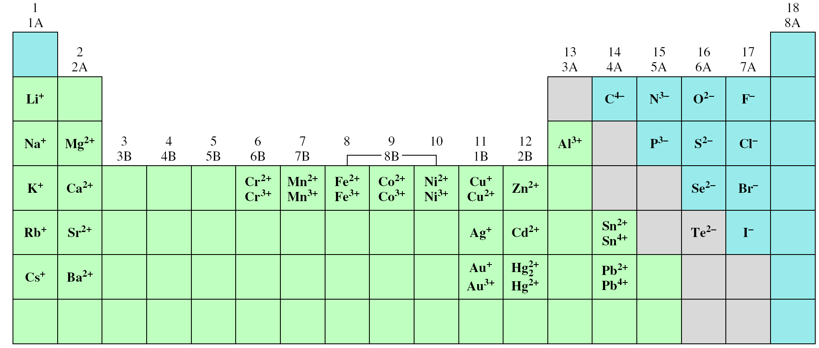
Molécules and Ions
Common Ions Shown on the Periodic Table

Slide 26
Molécules and Ions
27
3+
How many protons and electrons are in ?
Al
13
13 protons, 10 (13 – 3) electrons
78
2-
How many protons and electrons are in ?
Se
34
34 protons, 36 (34 + 2) electrons

Slide 27
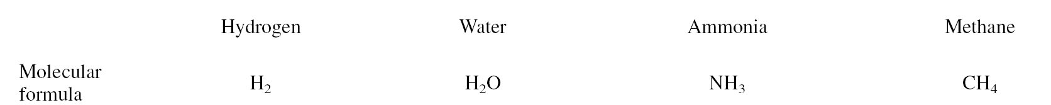
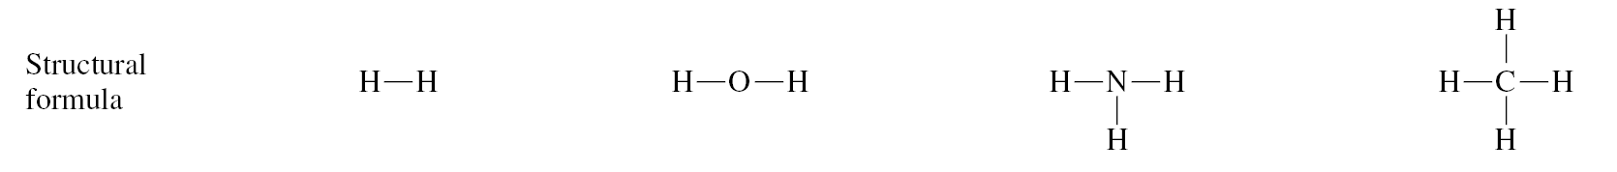
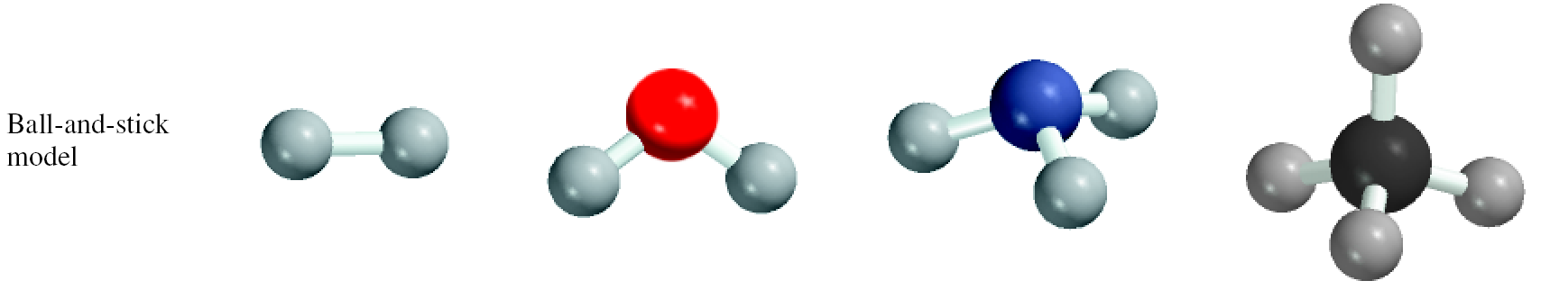
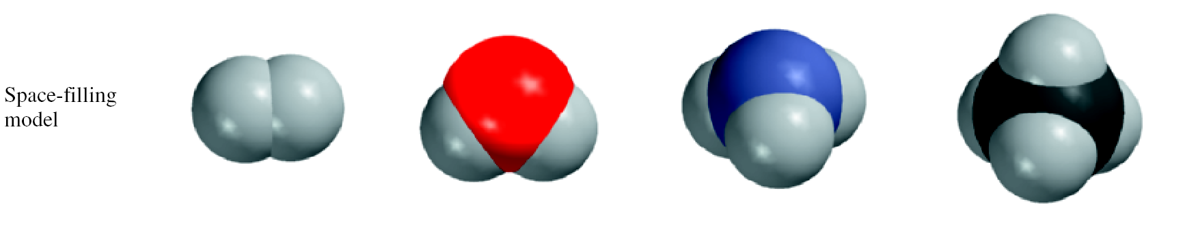
Chemical Formulas

Slide 28
Chemical Formulas
A molecular formula shows the exact number of atoms of each element in the smallest unit of a substance
An empirical formula shows the simplest whole-number ratio of the atoms in a substance
molecular
empirical
H₂O
H₂O
C₆H₁₂O₆
CH₂O
O₃
O
N₂H₄
NH₂
An allotrope is one of two or more distinct forms of an element.
Oxygen (O₂) and ozone (O₃) are allotropes of oxygen.
diamond and graphite are allotropes of carbon.

Slide 29
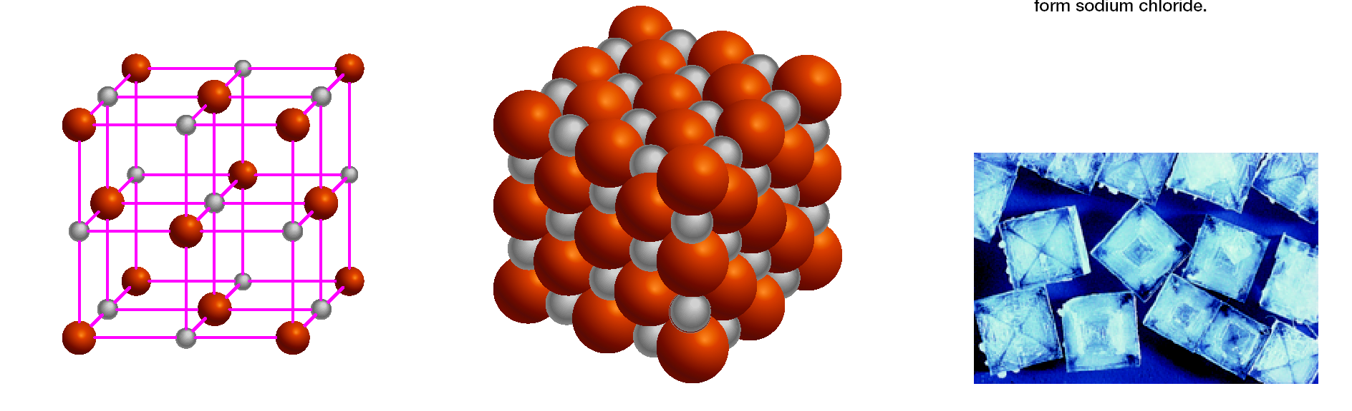
Chemical Formulas
Ionic compounds consist of a combination of cations and an anions
The formula is usually the same as the empirical formula
The sum of the charges on the cation(s) and anion(s) in each formula unit must equal zero
The ionic compound NaCl

Slide 30
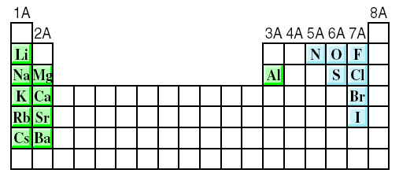
Chemical Formulas
The most reactive metals (green) and the most reactive nonmetals (blue) combine to form ionic compounds.

Slide 31
Chemical Formulas
If the charges on the cation and anion are numerically different, we apply the following rule to make the formula electrically neutral:
The subscript of the cation is numerically equal to the charge on the anion, and the subscript of the anion is numerically equal to the charge on the cation.
Aluminum Oxide. The cation is Al³⁺ and the oxygen anion is O²⁻.
The sum of the charges is 2(+3) + 3(-2) = 0. Thus, the formula for aluminum oxide is Al2O3.

Slide 32
Chemical Formulas
Formula of Ionic Compounds
2 x +3 = +6
3 x -2 = -6
Al₂O₃
Al³⁺
O²⁻
1 x +2 = +2
2 x -1 = -2
CaBr₂
Ca²⁺
Br⁻
1 x +2 = +2
1 x -2 = -2
Na₂CO₃
Na⁺
CO₃²⁻

Slide 33
Chemical Formulas

Slide 34
Naming Compounds
Ionic Compounds
  Often a metal + nonmetal
  Anion (nonmetal), add “ide” to element name
BaCl₂
barium chloride
K₂O
potassium oxide
Mg(OH)₂
magnesium hydroxide
KNO₃
potassium nitrate

Slide 35
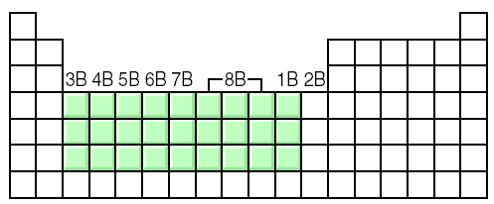
Naming Compounds
Transition metal ionic compounds
  indicate charge on metal with Roman numerals
FeCl₂
2 Cl⁻ -2 so Fe is +2
iron(II) chloride
FeCl₃
3 Cl⁻ -3 so Fe is +3
iron(III) chloride
Cr₂S₃
3 S⁻² -6 so Cr is +3 (6/2)
chromium(III) sulfide

Slide 36
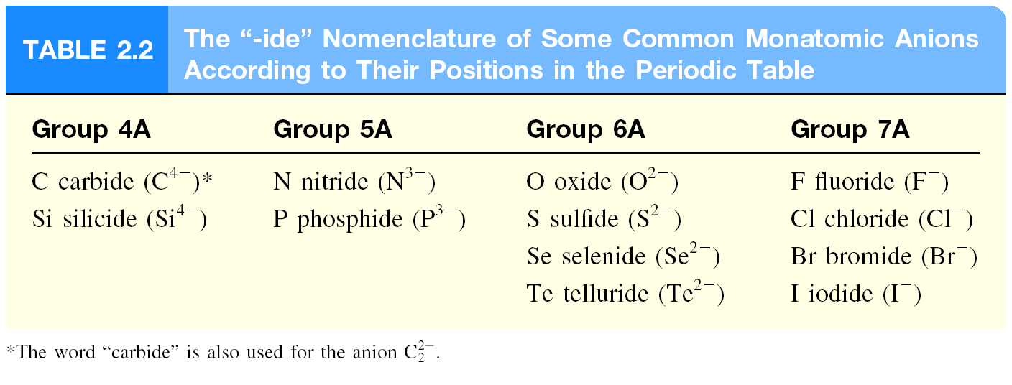
Naming Compounds

Slide 37
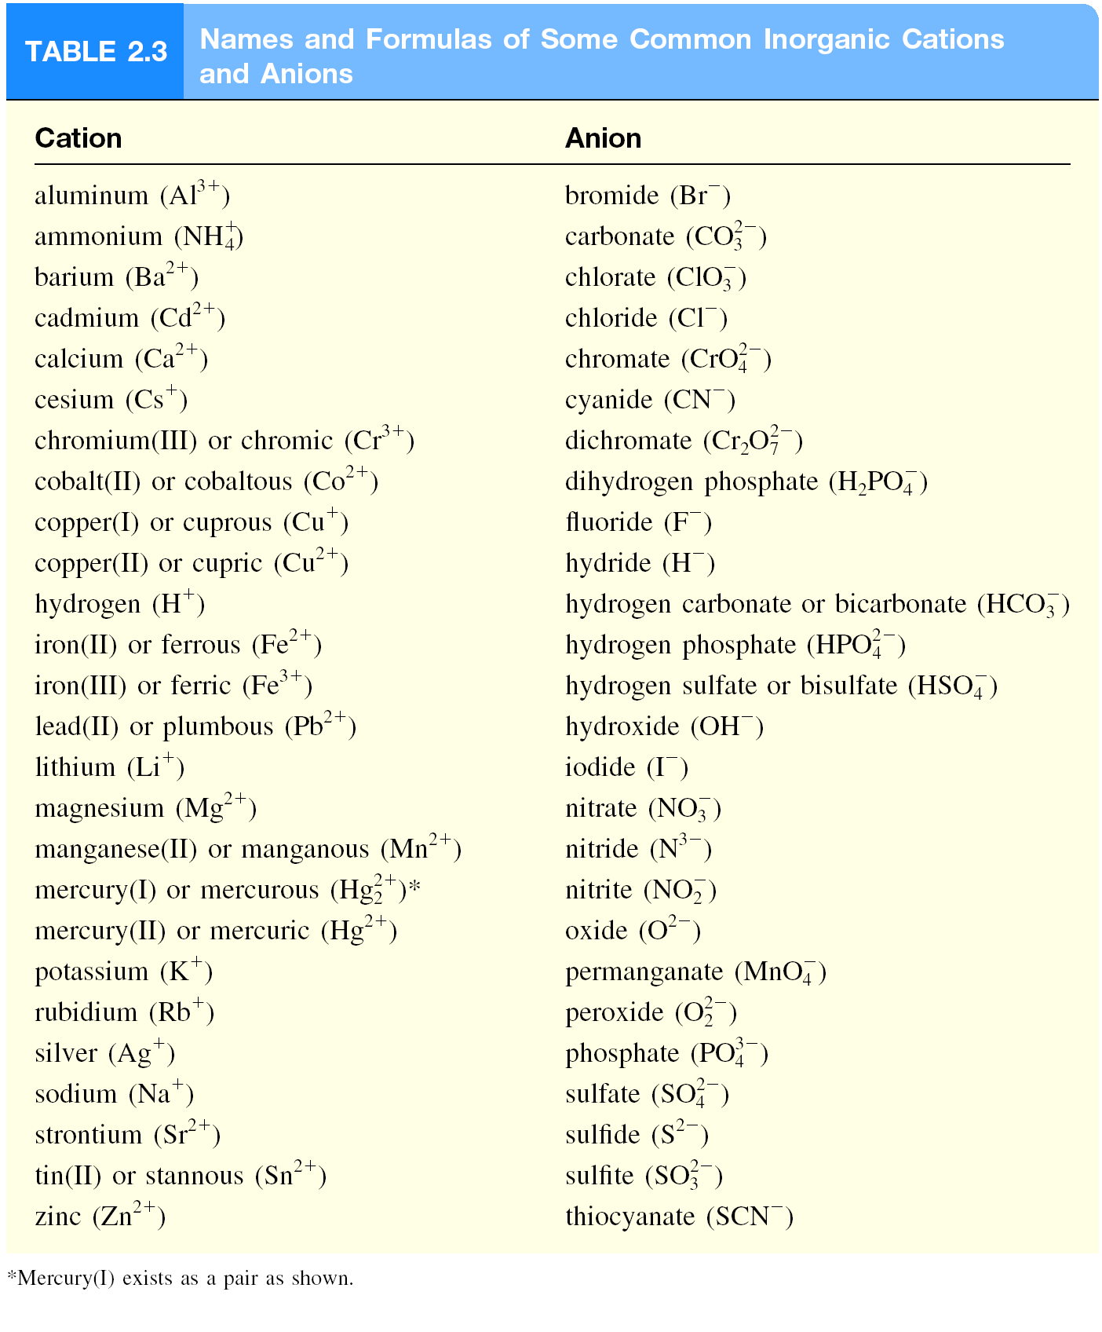
Naming Compounds

Slide 38
Naming Compounds

Slide 39
Naming Compounds

Slide 40
Naming Compounds
Molecular compounds
  They are usually composed of nonmetallic elements.
  Many molecular compounds are binary compounds.
  Naming binary molecular compounds is similar to naming binary ionic compounds.
  We place the name of the fi rst element in the formula first, and the second element is named by adding -ide to the root of the element name.
HCl hydrogen chloride
HBr hydrogen bromide
SiC silicon carbide

Slide 41
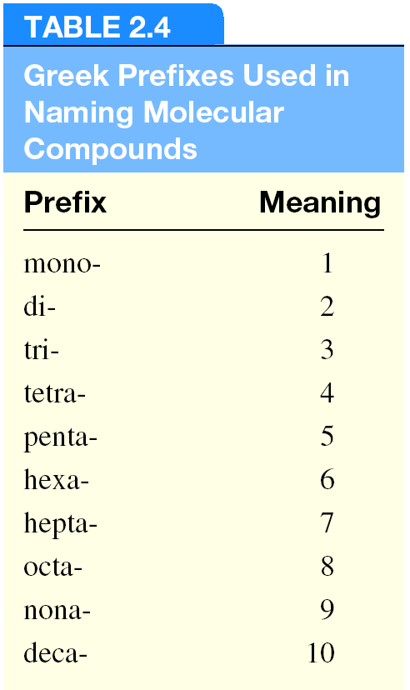
Naming Compounds
Molecular compounds
  If more than one compound can be formed from the same elements, use prefixes to indicate number of each kind of atom

Slide 42
Naming Compounds
Molecular compounds
HI
hydrogen iodide
NF₃
nitrogen trifluoride
SO₂
sulfur dioxide
N₂Cl₄
dinitrogen tetrachloride
NO₂
nitrogen dioxide
N₂O
dinitrogen monoxide

Slide 43
Naming Compounds
Molecular compounds
Notes in naming compounds with prefixes:
The prefix “mono-” may be omitted for the first element.
For example, PCl₃ is named phosphorus trichloride, not monophosphorus trichloride.
For oxides, the ending “a” in the prefix is sometimes omitted.
For example, N₂O₄ may be called dinitrogen tetroxide rather than dinitrogen tetraoxide.

Slide 44
Naming Compounds

Slide 45
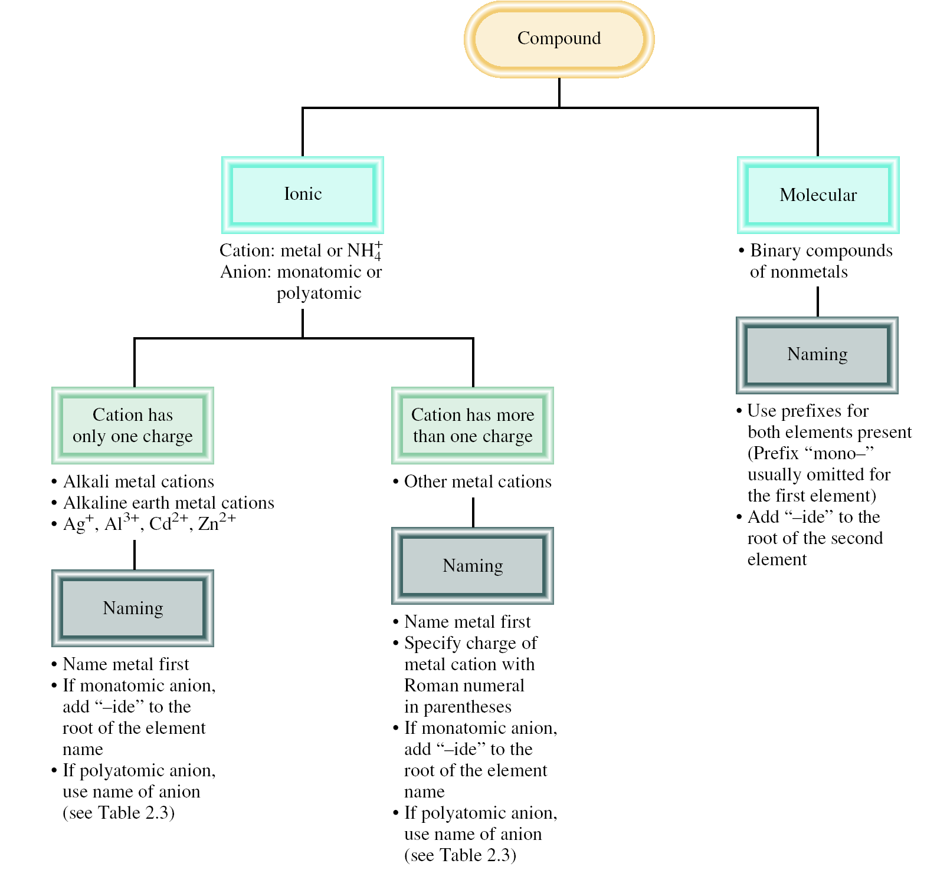
Naming Compounds

Slide 46
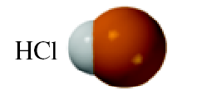
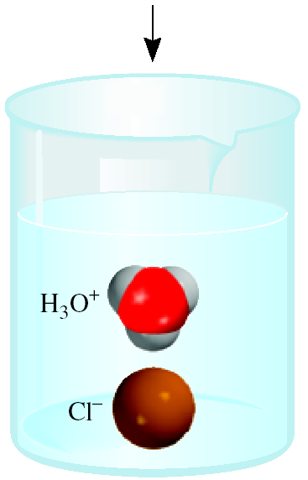
Naming Compounds
Acids and Bases
Naming Acids
An acid can be defined as a substance that yields hydrogen ions (H⁺) when dissolved in water.
For example: HCl gas and HCl in water
  Pure substance, hydrogen chloride
  Dissolved in water (H₃O⁺ and Cl⁻), hydrochloric acid
Anions whose names end in “-ide” form acids with a “hydro-” prefix and an “-ic” ending.
HCl hydrogen chloride
HCl hydrochloric acid

Slide 47
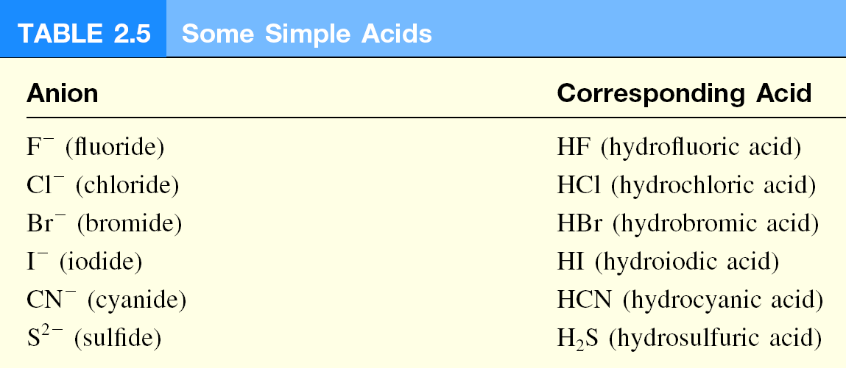
Naming Compounds
Acids and Bases
Naming Acids

Slide 48
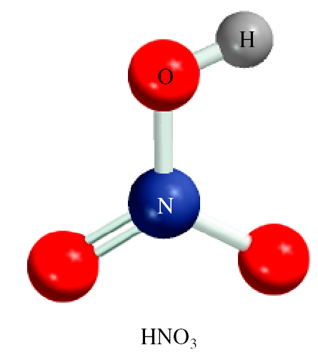
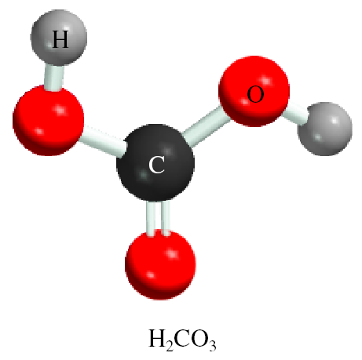
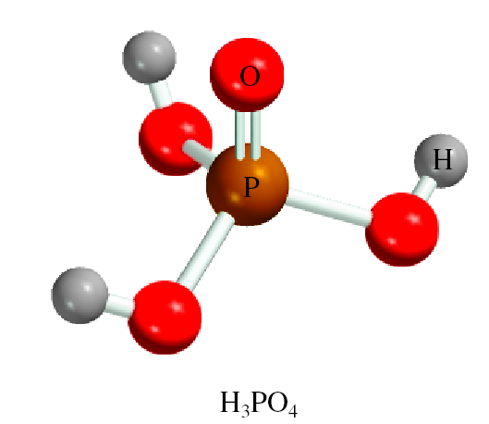
Naming Compounds
Acids and Bases
Naming Oxoacids and Oxoanions
An oxoacid is an acid that contains hydrogen, oxygen, and another element.
HNO₃
nitric acid
H₂CO₃
carbonic acid
H₃PO₄
phosphoric acid

Slide 49
Naming Compounds
Acids and Bases
Naming Oxoacids and Oxoanions
The formulas of oxoacids are usually written with the H first, followed by the central element and then O.
H₂CO₃ carbonic acid
HClO₃ chloric acid
HNO₃ nitric acid
H₃PO₄ phosphoric acid
H₂SO₄ sulfuric acid

Slide 50
Naming Compounds
Acids and Bases
Naming Oxoacids and Oxoanions
Two or more oxoacids have the same central atom but a different number of O atoms; the following rules to name these compounds.
1. Addition of one O atom to the “-ic” acid: The acid is called “per . . -ic” acid.
HClO₃ chloric acid
HClO₄ perchloric acid
2. Removal of one O atom from the “-ic” acid: The acid is called “-ous” acid.
HNO₃ nitric acid
HNO₂ nitrous acid
3. Removal of two O atoms from the “-ic” acid: The acid is called “hypo . . . -ous” acid.
HBrO₃ Bromic acid
HBrO hypobromous acid.

Slide 51
Naming Compounds
Naming Oxoacids and Oxoanions
The rules for naming oxoanions, anions of oxoacids, are as follows:
1. When all the H ions are removed from the “-ic” acid, the anion’s name ends with “-ate.”
2. When all the H ions are removed from the “-ous” acid, the anion’s name ends with “-ite.”
3. The names of anions in which one or more but not all the hydrogen ions have been removed must indicate the number of H ions present.
For example:
  H₃PO₄ phosphoric acid
  H₂PO₄⁻ dihydrogen phosphate
  HPO₄ ²⁻ hydrogen phosphate
  PO₄³⁻ phosphate

Slide 52
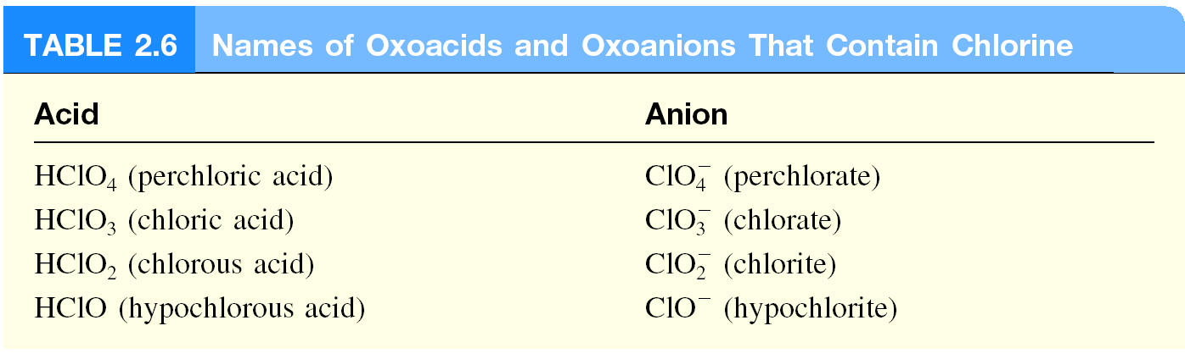
Naming Compounds
Naming Oxoacids and Oxoanions

Slide 53
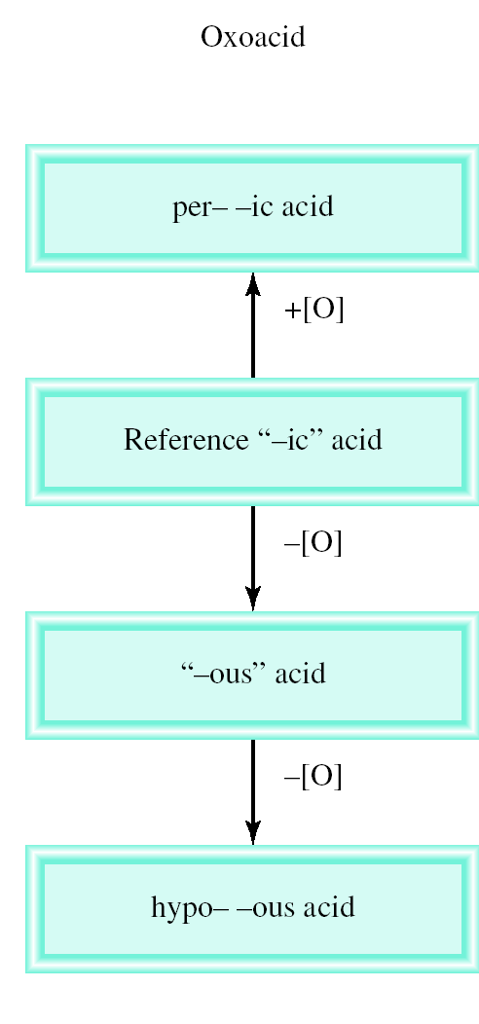
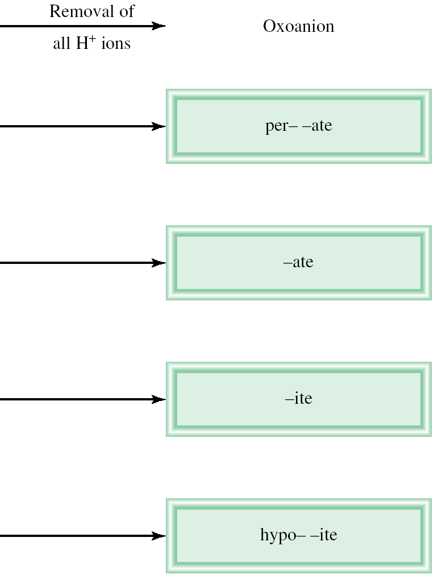
Naming Compounds
Naming Oxoacids and Oxoanions

Slide 54
Naming Compounds

Slide 55
Naming Compounds
Acids and Bases
Naming Bases
A base can be defined as a substance that yields hydroxide ions (OH⁻) when dissolved in water.
NaOH
sodium hydroxide
KOH
potassium hydroxide
Ba(OH)₂
barium hydroxide

Slide 56
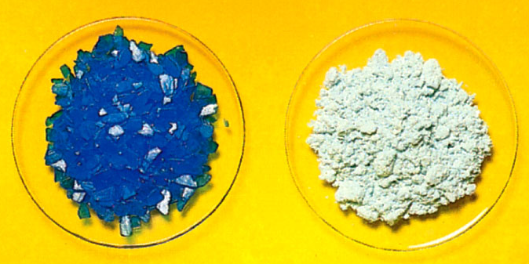
Naming Compounds
Hydrates are compounds that have a specific number of water molecules attached to them.
BaCl₂•2H₂O
barium chloride dihydrate
LiCl•H₂O
lithium chloride monohydrate
MgSO₄•7H₂O
magnesium sulfate heptahydrate
Sr(NO₃)₂ •4H₂O
strontium nitrate tetrahydrate
CuSO₄•5H₂O
CuSO₄

Slide 57
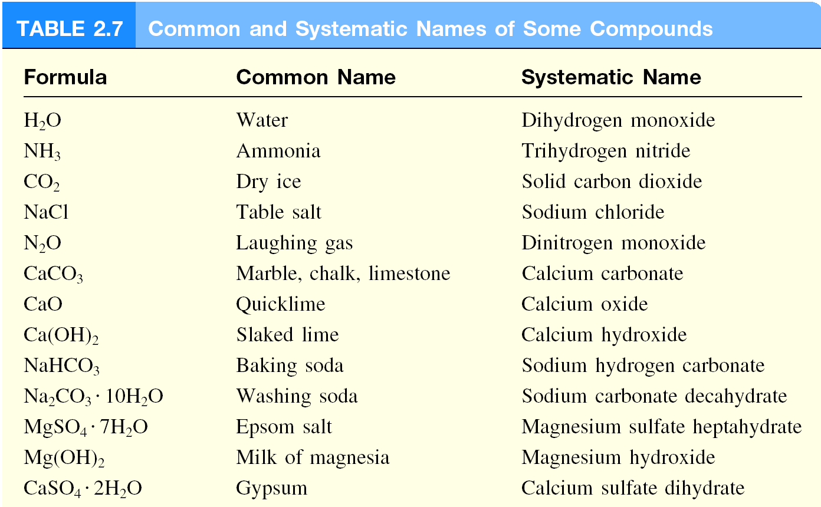
Naming Compounds
Familiar Inorganic Compounds

