Slide 1
The First Law
Internal energy
For the purposes of thermodynamics, the universe is divided into two parts, the system and its surroundings.
The system is the part of the world of interest. It may be a reaction vessel, an engine, an electrochemical cell, a biological cell, and so on.
The surroundings comprise the region outside the system and are where measurements are made.
The type of system depends on the characteristics of the boundary that divides it from the surroundings
In the Open system, the system can exchange both matter and energy with its surroundings
In the closed system, the system can exchange energy with its surroundings but not matter
In the Isolated system, the system can’t exchange neither energy nor matter with its surroundings but not
Matter
Energy
Energy
Open
Closed
Isolated

Slide 2


Work, heat, and energy
work is done to achieve motion against an opposing force
example of work is the process of raising a weight against the pull of gravity
Onether example of doing work is the expansion of a gas that pushes out a piston
energy of a system is its capacity to do work
Heat is the change in energy of a system as a result of a temperature difference between the system and its surroundings.
Diathermic Boundaries are Boundaries that permit the transfer of energy as heat.
Adiabatic Boundaries are Boundaries that do not permit the transfer of energy as heat.
An exothermic process is a process that releases energy as heat.
An endothermic process is a process in which energy is acquired as heat.
Heat
Heat
Endothermic
Exothermic
Endothermic
Exothermic
process
process
process
process

Slide 3
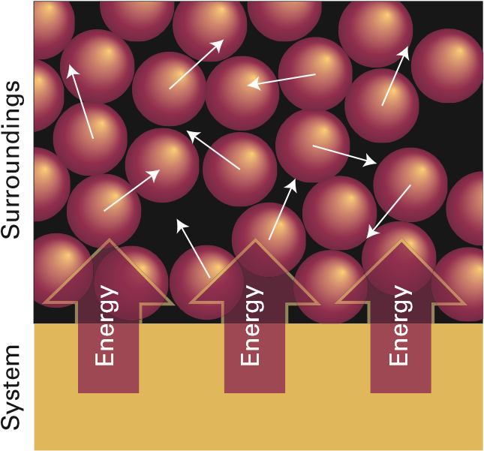
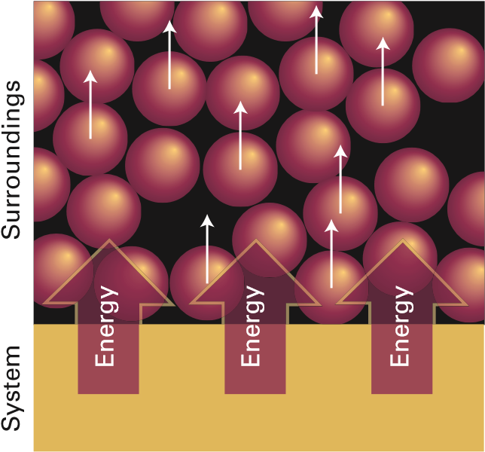
The molecular interpretation of heat and work
Thermal motion is the disorderly motion of molecules.
When energy is transferred to the surroundings as heat, the transfer stimulates random motion of the atoms in the surroundings. Transfer of energy from the surroundings to the system makes use of random motion (thermal motion) in the surroundings.
When a system does work, it stimulates orderly motion
in the surroundings. For instance, the atoms shown here may be part of a weight that is being raised. The ordered motion of the atoms in a falling weight does work on the system.

Slide 4

The definition of internal energy
In thermodynamics, the total energy of a system is called its internal energy, U.
The internal energy is the total kinetic and potential energy of the constituents (the atoms, ions, or molecules) of the system.
The change in internal energy is denoted by ΔU when a system changes from an initial state i with internal energy U _{i} to a final state f of internal energy U _{f}:
$$∆U=U_{f}−U_{i}$$
The internal energy is a state function, a property with a value that depends only on the current state of the system and is independent of how that state has been prepared
The internal energy is an extensive property of a system (a property that depends on the amount of substance present) and is measured in joules (1 J = 1 kg m² s⁻²).
The molar internal energy, U_{m}, is the internal energy divided by the amount of substance in a system, U_{m}= U/n; it is an intensive property (a property independent of the amount of substance) and is commonly reported in kilojoules per mole (kJ mol⁻¹).

Slide 5
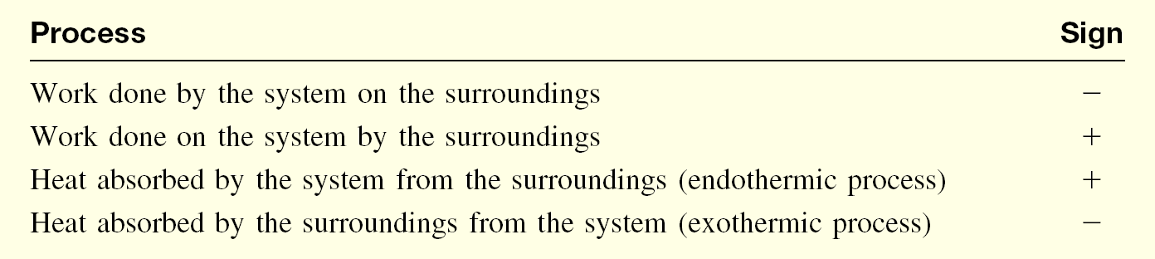

First Law of thermodynamics
States that the internal energy of an isolated system is constant
Energy can not be created nor can it be destroyed
A system can exchange energy with its surroundings in the form of heat (q) or work (w)
For an isolated system, any work done on the system or by the system will be on the expenses of heat to keep the internal energy of the system unchanged as the first law states.
$$∆U=q+w$$
First Law of thermodynamics
Sign Conventions for Work and Heat
A note on good practice Always include the sign of ΔU (and of ΔX in general), even if it is positive.

Slide 6











Expansion work
expansion work, the work arising from a change in volume.
This type of work includes the work done by a gas as it expands and drives back the atmosphere
For infinitesimal changes in the variables, the first law can be written in the form
$$dU=dq+dw$$
The work done definition is
dw = −|F|dz
When a piston of area A moves out through a distance dz, it sweeps out a volume dV = Adz. The external pressure pex is equivalent to a weight pressing on the piston, and the magnitude of the force opposing expansion is pexA.
External
pressure,
p
ex
Area,
d
z
A
d
V
=
A
d
z
dw = −p_{ex}dV Expansion work
Pressure,
p

Slide 7
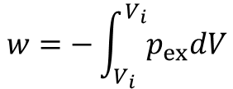
To obtain the total work done when the volume changes from an initial value V_{i} to a final value V_{f} it is necessary to integrate this expression between the initial and final volumes:
$$w=−\int_{V_{i}}^{V_{i}}{p_{ex}dV}$$
There are other types of work called either non-expansion work or additional work
Type of work | dw | Comments | Units†
Expansion | −p_{ex}dV | p_{ex} is the external pressure | Pa
 |  | dV is the change in volume | m³
Surface expansion | γ dσ | γ is the surface tension | N m⁻¹
 |  | dσ is the change in area | m²
Extension | f dl | f is the tension | N
 |  | dl is the change in length | m
Electrical | ϕ dQ | ϕ is the electric potential | V
 |  | dQ is the change in charge | C
 | Q dϕ | dϕ is the potential difference | V
 |  | Q is the charge transferred | C
* In general, the work done on a system can be expressed in the form
dw = −|F| dz,
Where |F| is the magnitude of a ‘generalized force’ and dz is a ‘generalized displacement’.
† For work in joules (J). Note that 1 N m = 1 J and 1 V C = 1 J.

Slide 8




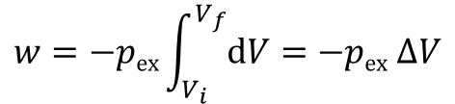
Expansion against constant pressure
p
ex
$$w=−pex\int_{V_{i}}^{V_{f}}{dV=−pex ∆V}$$
p
Pressure,
p
Area =
Δ
V
_{ex}
Expansion work
[constant external pressure]
Volume,
V
V
V
i
f
Free expansion is expansion against zero opposing force
p
ex
p
ex
$$w=0$$
Work of free expansion
The work done by a gas when it expands against a constant external pressure, p_{ex}, is equal to the shaded area in this example of an indicator diagram.

Slide 9


Example: Calculate the work done when 50 g of iron reacts with hydrochloric acid to produce FeCl₂(aq) and hydrogen in (a) a closed vessel of fixed volume, (b) an open beaker at 25 °C.
Soln:
In (a) the volume cannot change, so no expansion work is done and w = 0.
In (b) the gas drives back the atmosphere and therefore w = −p_{ex}ΔV.
The initial volume can be neglected because the final volume (after the production of gas) is so much larger and ΔV = V_{f} − V_{i} ≈ V_{f} = nRT/p_{ex}, where n is the amount of H₂ produced. Therefore,
$w=$ $−pex ∆V ≈−pex\frac{nRT}{pex}=−nRT$
Fe(s) + 2HCl(aq) → FeCl₂(aq) + H₂(g)
$$n\left(H2\right)=n\left(Fe\right)=\frac{50 g}{55.85 g{mol}^{−1} }=0.9 mol$$
$$w=−\left(0.9 mol\right) x \left(8.314 J{mol}^{−1}K^{−1}\right) x (298.15 K)$$
≈ −2200 J = 2.2 kJ

Slide 10
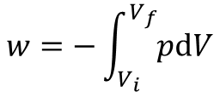
Reversible expansion
A reversible change in thermodynamics is a change that can be reversed by an infinitesimal modification of a variable
One example of reversibility is the thermal equilibrium of two systems with the same temperature
systems at equilibrium are poised to undergo reversible change.
If a gas is confined by a piston and the external pressure, p_{ex}, is set equal to the pressure, p, of the confined gas, then the gag is said to be in a mechanical equilibrium with its surroundings because an infinitesimal change in the external pressure in either direction causes changes in volume in opposite directions
When p_{ex} = p, thin
dw = −p_{ex}dV = −p dV Reversible expansion work
The total work of reversible expansion from an initial volume V_{i} to a final volume V_{f} is therefore
$$w=−\int_{V_{i}}^{V_{f}}{pdV}$$

Slide 11




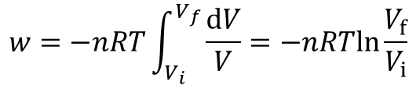
Isothermal reversible expansion of a perfect gas
the work of isothermal reversible expansion of a perfect gas from V_{i} to V_{f} at a temperature T is
$$w=−nRT\int_{V_{i}}^{V_{f}}{\frac{dV}{V}}=−nRTln\frac{V_{f}}{V_{i}}$$
Example: What is the work done when a sample of 1.00 mol Ar, regarded as a perfect gas, undergoes an isothermal reversible expansion at 20.0 °C from 10.0 dm³ to 30.0 dm³?
Soln:
$$w=−nRTln\frac{V_{f}}{V_{i}}$$
= (1 mol) x (8.314 J mol⁻¹ K⁻¹) x (293.2 K) Ln(30.0 dm³/10.0 dm³)
= 2680 J = 2.68 kJ
p
i
p
=
nRT/V
p
The work done by a perfect gas when it expands reversibly and isothermally is equal to the area under the isotherm p = nRT /V. The work done during the irreversible expansion against the same final pressure is equal to the rectangular area shown slightly darker. Note that the reversible work done is greater than the irreversible work done.
p
f
Pressure,
Volume,
V
V
V
i
f
p
p
i
f

Slide 12
Heat transactions
In general, the change in internal energy of a system is
dU = dq + dw_{exp} + dw_{add}
dw_{exp} is the expansion work
dw_{add} is the additional work other than the expansion work like, for example. the electrical work
At constant volume, there is no expansion and dw_{exp} sequals zero,and when there is no additional work and
dU = dq
Heat transferred at constant volume
This relation can also be expressed as dU = dq_{V}, where the subscript implies the constraint of constant volume.
And for a measurable change between states i and f along a path at constant volume,
ΔU = q_{V}

Slide 13
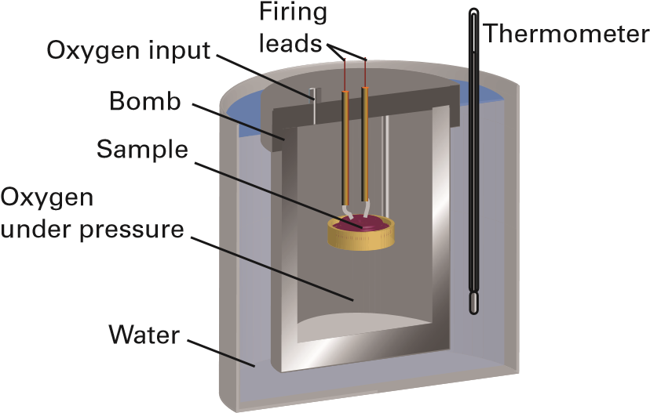
Calorimetry
Calorimetry is the study of the transfer of energy as heat during a physical or chemical process
A calorimeter is a device for measuring energy transferred as heat
The most common device for measuring q_{V} (and therefore ΔU ) is an adiabatic bomb calorimeter
A constant-volume bomb calorimeter. The ‘bomb’ is the central vessel, which is strong enough to withstand high pressures. The calorimeter is the entire assembly shown here. To ensure adiabaticity, the calorimeter is immersed in a water bath with a temperature continuously readjusted to that of the calorimeter at each stage of the combustion.

Slide 14
The change in temperature, ΔT, of the calorimeter is proportional to the energy that the reaction releases or absorbs as heat
Therefore, q_{V} and hence ΔU can be determined by measuring ΔT
q = C ΔT
Where C is a constant known as the calorimeter constant
The calorimeter constant may be measured electrically by passing a constant current, I, from a source of known potential difference, Δϕ, through a heater for a known period of time, t, for then
q = I t Δϕ
Example: To calibrate a calorimeter, a current of 10.0 A from a 12 V supply is passed for 300 s. What is the constant C of the calorimeter if the observed rise in temperature is 5.5 K?
Soln:
the energy supplied as heat is
q = I t Δϕ = (10 A) x (12 V) x (300 s) = 36000 A V s = 36 kJ
note that 1 A V s = 1 (C s⁻¹) V s = 1 C V = 1 J
q = C ΔT
C = q / ΔT= 36 kJ/5.5K = 6.5 kJ k⁻¹

Slide 15
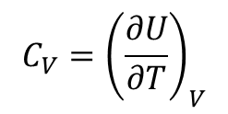
Heat capacity
The internal energy of a system increases when its temperature is raised
U
B
Internal energy,
A
Temperature,
T
The slope of the tangent to the curve at any temperature is called the heat capacity of the system at that temperature
The heat capacity at constant volume is denoted C_{V} and is defined formally as
$$C_{V}={\left(\frac{∂U}{∂T}\right)}_{V}$$
Heat capacity at constant volume
Heat capacities are extensive properties
The molar heat capacity at constant volume, C_{V,m} = C_{V} /n, is the heat capacity per mole of
substance, and is an intensive property (all molar quantities are intensive).

Slide 16
specific heat capacity (more informally, the ‘specific heat’) of a substance, which is the heat capacity of the sample divided by its mass, usually in grams: C_{V,s} = C_{V} /m.
The heat capacity is used to relate a change in internal energy to a change in temperature of a constant-volume system
dU = C_{V} dT
ΔU = C_{V} ΔT
Internal energy change on heating [constant volume]
Because a change in internal energy can be identified with the heat supplied at constant volume, the last equation can also be written as
q_{V} = C_{V} ΔT
Example: Suppose a 55 W electric heater immersed in a gas in a constant volume adiabatic container was on for 120 s, and it was found that the temperature of the gas rose by 5.0 °C.). What is the heat capacity of the sample?
Soln:
The heat supplied to the gas is
q = (55 W) × (120 s) = 6600 W s = 6600 J = 6.6 kJ since 1 J = 1 W s
q_{V} = C_{V} ΔT
C_{V} = q_{V} / ΔT = 6.6 kJ/ 5 K = 1.3 kJ K⁻¹

Slide 17












Enthalpy
The change in internal energy is not equal to the energy transferred as heat when the system is free to change its volume, such as when it is able to expand or contract under conditions of constant pressure
Under these circumstances, some of the energy supplied as heat to the system is returned to the surroundings
as expansion work
When a system is subjected to constant pressure and is free to change its volume, some of the energy supplied
as heat may escape back into the surroundings as work. In such a case, the change in internal energy is smaller than the energy supplied as heat.
Energy as work
Δ
U
<
q
Energy
as heat

Slide 18


The definition of enthalpy
The enthalpy, H, is defined as
H = U + pV Enthalpy [definition]
Because U, p, and V are all state functions, the enthalpy is a state function too
Enthalpy change and heat transfer
We can easily derive the relation between the enthalpy change and heat transfer at constant pressure
dH = dq_{p} Heat transferred at constant pressure [infinitesimal change]
ΔH = q_{p}
Heat transferred at constant pressure [measurable change]
Example: Water is heated to boiling under a pressure of 1.0 atm. When an electric current of 0.50 A from a 12 V supply is passed through a resistance in thermal contact with water for 300 s, it is found that 0.798 g of water is vaporized. What is the enthalpy of vaporization of water in kJ mol⁻¹?
Soln:
ΔH = q_{p} = I t Δϕ = (0.50 A) × (300 s) × (12 V) = 1800 A V s
= 1.8 kJ
$$n \left(H2O\right)=\frac{m (H2O)}{M(H2O)}=\frac{0.798 g}{18.o g {mol}^{−1}}=0.044 mol$$
ΔH _{vap}=$\frac{∆H}{n}=\frac{1.8 kJ}{0.044 mol}=41 kJ {mol}^{−1}$

Slide 19
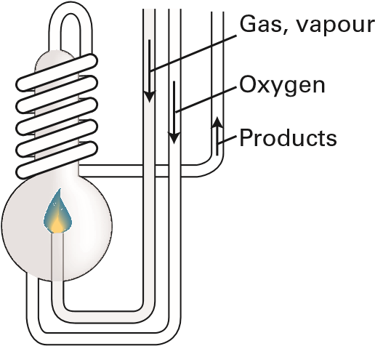
Calorimetry at constant p
An enthalpy change can be measured calorimetrically by monitoring the temperature change that accompanies a physical or chemical change at constant pressure
A calorimeter for studying processes at constant pressure is called an isobaric calorimeter
For a combustion reaction an adiabatic flame calorimeter may be used to measure ΔT when a given amount
of substance burns in a supply of oxygen
A constant-pressure flame calorimeter consists of this component immersed in a stirred water bath. Combustion occurs as a known amount of reactant is passed through to fuel the flame, and the rise of temperature is monitored

Slide 20
Relating ΔH and ΔU
The difference between the molar enthalpy and the internal energy of condensed Phases are negligible except at very high pressures, when p ΔV_{m} is not small.
In contrast to processes involving condensed phases, the values of the changes in internal energy and enthalpy might differ significantly for processes involving gases. The enthalpy of a perfect gas is related to its internal energy by using pV = nRT in the definition of H :
H = U + pV = U + nRT
ΔH = ΔU + Δn_{g}RT Relation between ΔH and ΔU [isothermal process, perfect gas]
Example: The change in molar internal energy when CaCO₃(s) as calcite converts to its polymorph aragonite, is +0.21 kJ mol⁻¹. Calculate the difference between the molar enthalpy and internal energy changes when the pressure is 1.0 bar. The mass densities of the polymorphs are 2.71 g cm⁻³ (calcite) and 2.93 g cm⁻³ (aragonite).
Soln:
ΔH_{m} = H_{m}(aragonite) − H_{m}(calcite)
= {U_{m}(a) + pV_{m}(a)} − {U_{m}(c) + pV_{m}(c)} a = aragonite & c = calcite
= ΔU_{m} + p{V_{m}(a) − V_{m}(c)}
$$∆H_{m}−∆U_{m}=pM\left(\frac{1}{ρ\left(a\right)}=\frac{1}{ρ\left(c\right)}\right)=\text{(}\text{1}\text{.}\text{0 }\text{x} {\text{10}}^{5} \text{Pa}\text{) (}\text{100}\text{.}\text{09}\text{g} {\text{mol}}^{−1}\text{)} \text{x}\left(\frac{1}{2.93 g{cm}^{−3}}=\frac{1}{2.71 g{cm}^{−3}}\right)$$
= −2.8 ×10⁵ Pa cm³mol⁻¹ = −0.28Pa m³ mol⁻¹
= −0.28 J mol⁻¹
Very small difference

Slide 21
Example: Calculate the difference between ΔH_{m} and Δum for the following reaction
2H₂(g) + O₂(g) → 2H₂O(l)
Soln:
In this reaction, 3 mol of gas-phase molecules are replaced by 2 mol of liquid-phase molecules
So Δn_{g} = 0 -3 = −3 mol
ΔH = ΔU + Δn_{g}RT
ΔH_{m} − ΔU_{m} = (−3) × RT ≈ (−3 ) x (8.314 J mol⁻¹ K⁻¹) x (298 K)
≈ −7500 J mol⁻¹ ≈ -7.5 kJ mol⁻¹
Huge difference when compared to the value in the previous example, where there are no gases involved

Slide 22
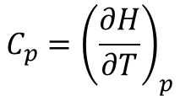
The variation of enthalpy with temperature
The enthalpy of a substance increases as its temperature is raised
The relationship between the increase in enthalpy and the increase in temperature depends on the conditions (e.g., whether the pressure or volume is constant).
Heat capacity at constant pressure
The most frequently encountered condition in chemistry is constant pressure
The slope of the tangent to a plot of enthalpy against temperature at constant pressure is called the heat capacity at constant pressure (or isobaric heat capacity), C_{p} , at a given temperature
H
B
Enthalpy,
Internal
energy,
A
U
$$C_{p}={\left(\frac{∂H}{∂T}\right)}_{p}$$
Heat capacity at constant pressure [definition]
Temperature,
T
The molar heat capacity at constant pressure, C_{p,m}, is the heat capacity per mole of substance; it is an intensive property.

Slide 23

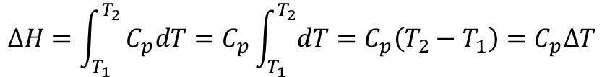

For infinitesimal changes of temperature
dH = C_{p} dT (at constant pressure)
If the heat capacity is constant over the range of temperatures of interest, then for a measurable increase in temperature
$$∆H=\int_{T_{1}}^{T_{2}}{C_{p}dT=C_{p}\int_{T_{1}}^{T_{2}}{dT=C_{p}\left(T_{2}−T_{1}\right)=C_{p}∆T}}$$
(at constant pressure)
$$q_{p}=C_{p}∆T$$
The variation of heat capacity with temperature is usually ignored if the temperature range is small, which is an excellent approximation for perfect monatomic gases.
However, when it is necessary to take the variation into account for other substances, a convenient approximate empirical expression is
$$C_{p,m}=a+bT+\frac{c}{T^{2}}$$
The empirical parameters a, b, and c are independent of temperature and are found by fitting this expression to experimental data.
 | a | b/(10⁻³ K⁻¹) | c/(10⁵ K²)
C(s, graphite) | 16.86 | 4.77 | −8.54
CO₂(g) | 44.22 | 8.79 | −8.62
H₂O(l) | 75.29 | 0 | 0
N₂(g) | 28.58 | 3.77 | −0.50

Slide 24
The relation between heat capacities
C_{p} − C_{V} = nR Relation between heat capacities [perfect gas]
in most cases, the heat capacity at constant pressure of a system is larger than its heat capacity at constant volume
The two heat capacities are typically very similar for condensed phases, and for them, the difference can normally be ignored.

