Slide 1
Introduction To
Patient Medical Records

Slide 2
https://www.youtube.com/watch?v=Kl3_HnmPP_w

Slide 3

Learning Outcomes
Explain WHAT IS MEDICAL RECORD ?
Purposes of the medical record
Standard Chart Information
Roles of Documenting the Medical Records

Slide 4
WHAT IS MEDICAL RECORD ?
It is a legal document providing a record of a patient's medical history and care.
Who can document the Medical report?
Physicians, nurse practitioners, nurses and other members of the health care team may make entries in the medical record.
What does it include?
The medical record includes a variety of types of "notes" entered over time by health care professionals, recording observations and administration of drugs and therapies, orders for the administration of drugs and therapies, test results, x-rays, reports, etc.

Slide 5
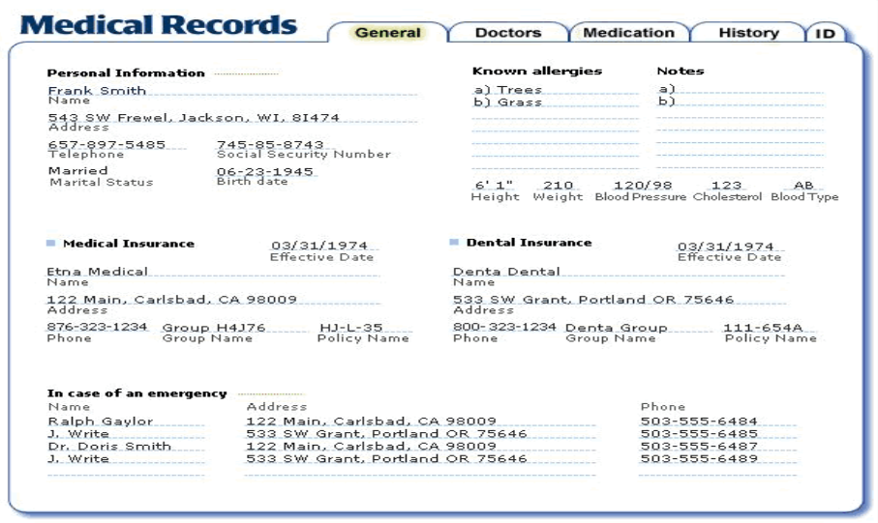

Slide 6

Purposes of the medical record
There are 2 major purposes of the medical record:
1. Clinical purposes
2. Non clinical purposes

Slide 7
1. Clinical purposes
Clinical purposes about the patient whether admitted to the hospital or treated as an outpatient or an emergency patient.
This is the PRIMARY purpose is to support the continuous patients medical care by documenting sufficient information about:
Diagnostic procedures
Diagnoses
Prognoses
treatment

Slide 8
1. Clinical purposes
It supports excellent medical care by:
Aiding in identification of the patient
It helps in generating an effective diagnostic and treatment plan
Physical exam findings
Diagnostic procedures and tests to be performed
Records the doctors' differential diagnoses ideas
Documents patients responses to treatment
Supports continuity of care
It documents communication with the patients

Slide 9
2. Non clinical purposes
Administrative : demographic and socioeconomic data such as the name of the patient (identification), sex, date of birth, place of birth, patient’s permanent address, and medical record number
Legal data: a signed consent for treatment by appointed doctors and authorization for the release of information
Financial data: the patient whether admitted to the hospital or treated as an outpatient or an emergency patient.

Slide 10
Apply Your Knowledge
What is the purpose of documentation in a patient’s medical record?
ANSWER: Documentation in the medical record provides evidence of appropriate care. If a procedure is not documented, it is considered not done.

Slide 11
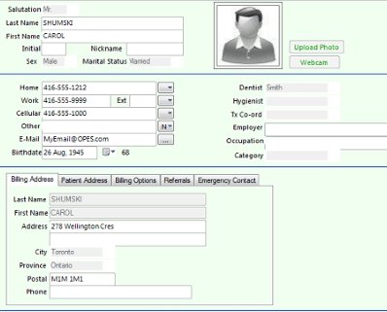
Patient Charts: Standard Chart Information
Patient Registration Form
1. Personal Identification Information
. Name
  . Record Number
  . Date
  . Patient demographic information
    * Age, DOB
    * Address
  . Insurance / financial information
  . Emergency contact
  This information varies from one hospital to another depending on the policy and requirement of each hospital.

Slide 12
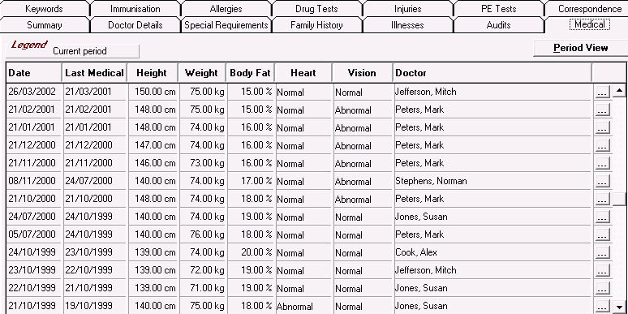
Patient Charts:
Standard Chart Information (cont.)
2. Diagnostic supporting information:
A. Past medical history
  Illnesses, surgeries, allergies, and current medications
  Family medical history
  Social history (diet, exercise, smoking, use of drugs and alcohol)
  Occupational history
  Current patient complaint recorded in patient’s own words

Slide 13
Patient Charts:
Standard Chart Information (cont.)
B. Physical examination results
C. Results of laboratory and other tests
D. Records from other physicians or hospitals
E. Doctor’s diagnosis and treatment plan
F. Operative reports, follow-up visits, and telephone calls

Slide 14
Patient Charts:
Standard Chart Information (cont.)
G. Informed consent forms
H. Hospital discharge summary forms
I. Correspondence with or about the patient
J. Information received by fax
  Request an original copy; if not available, make a photocopy of the fax
K. Dating and initialing

Slide 15
Documentation of Medical
Records - Overview
With documentation of medical records, particular emphasis must be placed on the six factors that improve the quality and usefulness of charted information:
Clarity
Accuracy
Completeness
Stability of Quantities and Measurements
Timeliness
Confidentiality

Slide 16
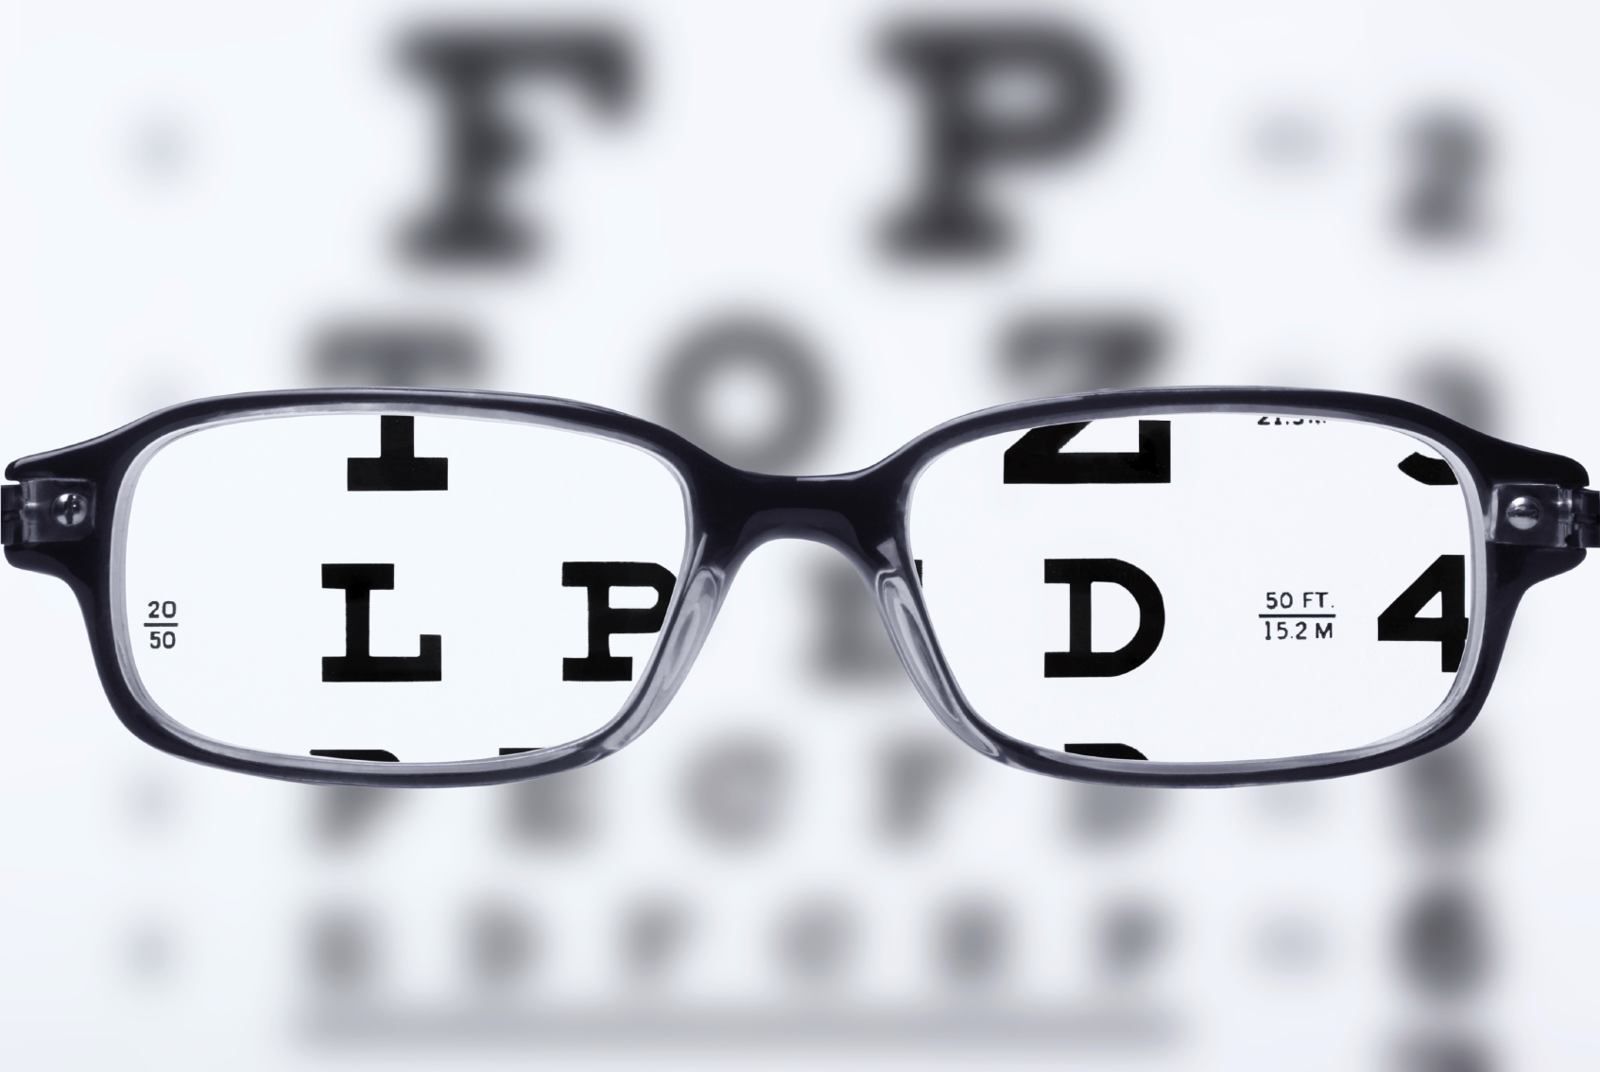
1. Clarity
All documents and forms must include identifiable data In a clear way that prevent the confusing or mixing between the different patients.

Slide 17

2. Accuracy
Each individual medical record MUST be written correctly and accurately.
All the information about the patient, his condition and about the provided health care and his response MUST be written correctly and accurately.
• Inaccuracies (either commission or omission) lead to improper medical advice being provided in error and may result in adverse healthcare outcomes or in legal proceedings.

Slide 18

3. Completeness
ALL documentation, including that from the outpatient clinics, emergency, medical laboratory and radiology departments of the hospital must be included in medical record.

Slide 19
4. Stability of Quantities and Measurements
Quantities and measurements must be specified and unified in the documentation between the health care providers.
The documentation criteria or amount of recorded data should be unified for all the patients.

Slide 20
5. Timeliness
Timeliness
  Record all findings as soon as they are available
  For late entries, record both original date and current date
  Record date and time of telephone calls and information discussed
  Retrieve file quickly in event of an emergency

Slide 21

6. Confidentiality
Medical records are confidential and protected by authority of the Privacy.
Don’t leave patient-identifiable information on your computer screen or exposed in your work area.
Don’t talk about patients or families in hallways, elevators, or in other public places.
Don’t release medical record information without the patient’s consent.

Slide 22

Apply Your Knowledge
What section of the patient record contains information about smoking, alcohol use, and occupation?
ANSWER: Information about smoking, alcohol use, and occupation is part of the patient’s past medical history.
Correct!

Slide 23

Who owns the medical record?
Medical records in hospitals or other public facilities are owned by the hospital or health authority, while the information included are owned to the patient.
The patient has the right to access the records if he need information for insurance or Medicare funding purposes.

Slide 24

Functions of a Medical Record Department
1. Admission and Discharge procedure, and completion of medical w records after an inpatient has been discharged or died.
2. Collecting:
To collect and document all the administrative, medical and technical forms about the patient , including his identification and the development and maintenance of the master patient index (MPI).
2. Organizing:
Means the process of arranging the documents inside the patient's medical record, abstracting the essential information from them, classify, code and take the necessary data to facilitate the process to bring up to it in an easy, practical way with less time and effort as possible.

Slide 25
Functions of a Medical Record Department – cont.
4. Storage:
Medical records should be stored in a safe and secure environment. The department must develop records management protocols to regulate who may gain access to records and what they may do according to their role, responsibilities, and develop a protocol to make it easy handled if needed. Also to make a proper process to store any inactive record.
5. Retrieval:
To retrieve the medical records for patient care and other authorized use.
6. Dissemination:
By providing the required information for any internal or external side.

Slide 26


