Slide 1
1 - Introduction and Overview of Manufacturing
Manufacturing Processes - 2, IE-352
Ahmed M El-Sherbeeny, PhD
Fall-2015

Slide 2
INTRODUCTION AND
OVERVIEW OF MANUFACTURING
What is Manufacturing?
Materials in Manufacturing
Manufacturing Processes
Production Systems

Slide 3
1- What is manufacturing?
“act of making something (a product) from raw materials”

Slide 4
Manufacturing is Important
Technologically
Economically
Historically

Slide 5
Manufacturing - Technologically Important
What is technology?
Technology - the application of science to provide society and its members with those things that are needed or desired
Technology provides the products that help our society and its members live better
What do these products have in common?
They are all manufactured
Manufacturing is the essential factor that makes technology possible

Slide 6
Manufacturing - Economically Important
U.S. economy:
Sector | % of GNP*
Manufacturing | 20%
Agriculture, minerals, etc. | 5%
Construction & utilities | 5%
Service sector – retail, transportation, banking, communication, education, and government * GNP= Gross Net Product | 70%
Manufacturing is one way by which nations create material wealth

Slide 7
What is Manufacturing?
The word manufacture is derived from two Latin words manus (hand) and factus (make); the combination means “made by hand”
Most modern manufacturing operations are accomplished by mechanized and automated equipment that is supervised by human workers

Slide 8
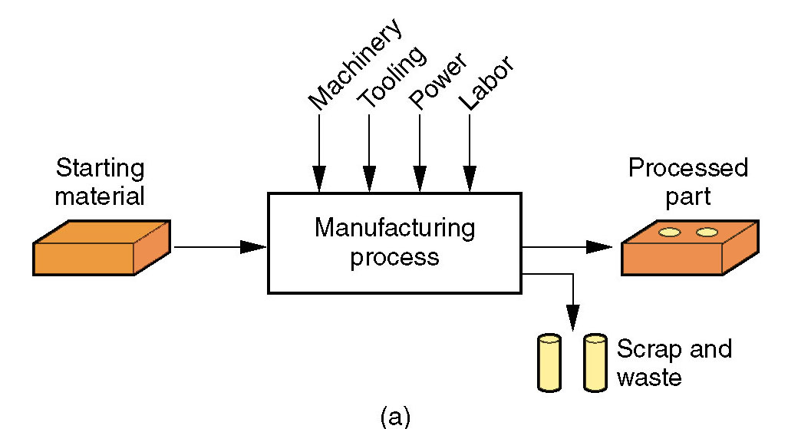
Manufacturing - Technologically
Application of physical and chemical processes to alter the geometry, properties, and/or appearance of a starting material to make parts or products
Manufacturing also includes assembly
Almost always carried out as a sequence of operations
Figure 1.1 (a)
Manufacturing
as a technical
process

Slide 9
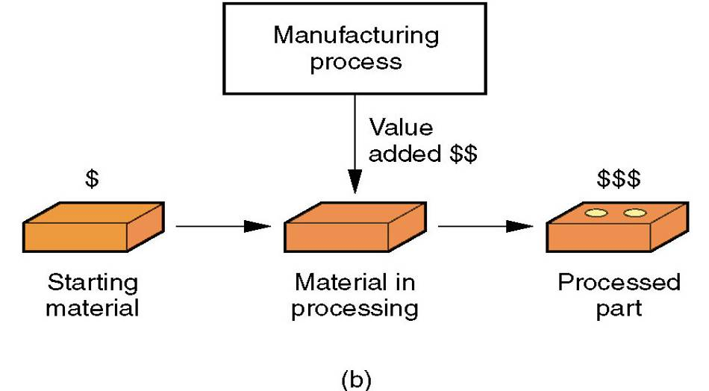
Manufacturing - Economically
Manufacturing adds value to the material by changing its shape or properties, or by combining it with other materials (this is done by means of one or more processing and/or assembly operations)
Figure 1.1 (b)
Manufacturing
as an economic
process

Slide 10
Manufacturing Industries
Industry consists of enterprises and organizations that produce or supply goods and services
Industries can be classified as:
  Primary industries -
  Secondary industries -
  Tertiary industries -
Industries can be classified as:
  Primary industries - those that cultivate and exploit natural resources, e.g., farming, mining
  Secondary industries - take the outputs of primary industries and convert them into consumer and capital goods - manufacturing is the principal activity, other examples: construction, and electric power generation
  Tertiary industries - service sector, e.g. banking

Slide 11



Manufacturing Industries - continued
Manufacturing includes several industries whose products are not covered in this book; e.g., apparel, beverages, chemicals, and food processing
For our purposes, manufacturing means production of hardware
  Nuts and bolts, forgings, cars, airplanes, digital computers, plastic parts, and ceramic products

Slide 12
Production Quantity Q
The quantity of products Q made by a factory has an important influence on the way its people, facilities, and procedures are organized
Annual production quantities can be classified into three ranges:
Production range Annual Quantity Q
Low production 1 to 100 units
Medium production 100 to 10,000 units
High production 10,000 to millions

Slide 13

Product Variety P
Product variety P refers to different product types or models produced in the plant.
Different products have different features
  They are intended for different markets
  Some have more parts than others
When the number of product types made in the factory is high, this indicates high product variety

Slide 14
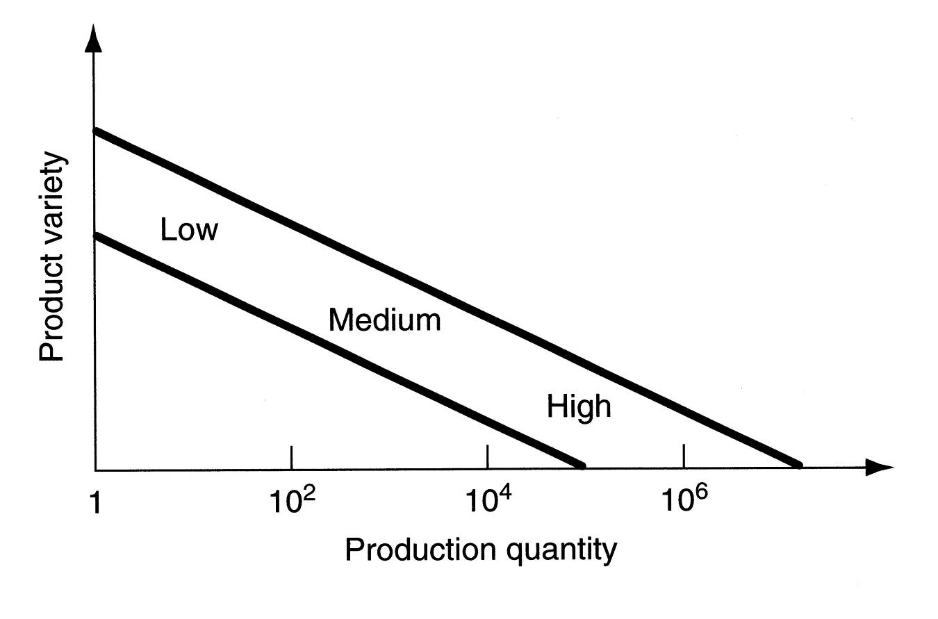
P versus Q in Factory Operations
P
Q
Figure 1.2 P-Q Relationship

Slide 15
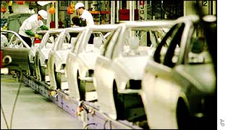

More About Product Variety
Although P is a quantitative parameter, it is much less exact than Q because details on how much the designs differ is not captured simply by the number of different designs
Soft product variety - small differences between products, e.g., between car models made on the same production line, with many common parts among models
Hard product variety - products differ substantially, e.g., between a small car and a large truck, with few common parts (if any)

Slide 16
Manufacturing Capability
A manufacturing plant consists of processes and systems (and people, of course) designed to transform a certain limited range of materials into products of increased value.
The three building blocks ‑ materials, processes, and systems ‑ are the subject of modern manufacturing.

Slide 17
Manufacturing capability includes:
  Technological processing capability
  Physical product limitations
  Production capacity

Slide 18
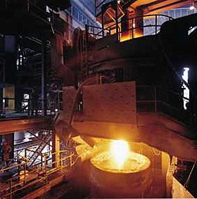
1. Technological Processing Capability
The available set of manufacturing processes in the plant (or company)
Certain manufacturing processes are suited to certain materials
(By specializing in certain processes, the plant is also specializing in certain materials)
Includes not only the physical processes, but also the expertise of the plant personnel
Examples:
  A machine shop cannot roll steel
  A steel mill cannot build cars

Slide 19
2. Physical Product Limitations
Given a plant with a certain set of processes, there are size and weight limitations on the parts or products that can be made in the plant
Product size and weight affect:
  Production equipment
  Material handling equipment

Slide 20
3. Production Capacity (or plant capacity)
Defined as the maximum quantity that a plant can produce in a given time period (e.g., month or year) under assumed operating conditions
Operating conditions refer to number of shifts per week, hours per shift, direct labor manning levels in the plant, and so on
Capacity is measured in terms of output units, such as tons of steel or number of cars produced by the plant

Slide 21
2- Materials in Manufacturing

Slide 22
Materials in Manufacturing
Most engineering materials can be classified into one of three basic categories:
  Metals
  Ceramics
  Polymers
Their chemistries and also their mechanical and physical properties are different
These differences affect the manufacturing processes that can be used to produce products from them

Slide 23
1. Metals
Usually alloys, which are composed of two or more elements, at least one of which is metallic
Two basic groups:
  Ferrous metals - based on iron, comprises about 75% of metal tonnage in the world:
    Steel = Fe‑C alloy (0.02 to 2.11% C)
    Cast iron = Fe-C alloy (2% to 4% C)
  Nonferrous metals - all other metallic elements and their alloys: aluminum, copper, magnesium, nickel, silver, tin, titanium, etc.

Slide 24
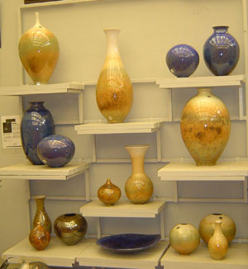

2. Ceramics
Compounds containing metallic (or semi-metallic) and nonmetallic elements.
Typical nonmetallic elements are oxygen, nitrogen, and carbon
For processing, ceramics divide into:
  Crystalline ceramics – includes:
    Traditional ceramics, such as clay (hydrous aluminum silicates)
    Modern ceramics, such as alumina (Al₂O₃)
  Glasses – mostly based on silica (SiO₂)
Notes:
Porcelain is also a type of heated clay (crystalline ceramic)

Slide 25
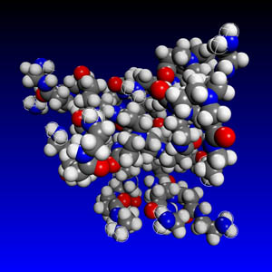
3. Polymers
Compound formed of repeating structural units called mers, whose atoms share electrons to form very large molecules

Slide 26
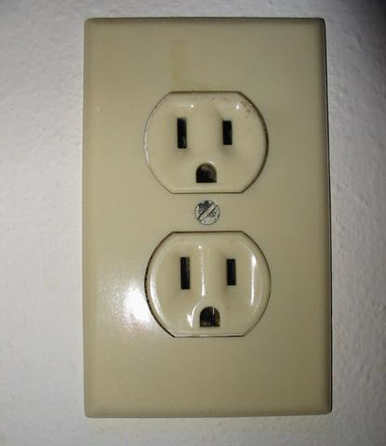
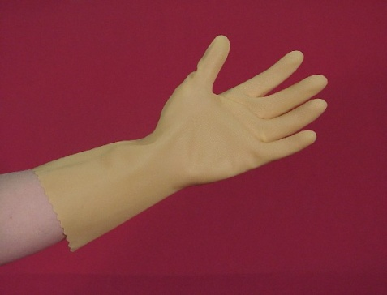
3- Polymers
Three categories:
  Thermoplastic polymers - can be subjected to multiple heating and cooling cycles without altering molecular structure
  Thermosetting polymers - molecules chemically transform (cure) into a rigid structure – cannot be reheated
  Elastomers - shows significant elastic behavior

Slide 27
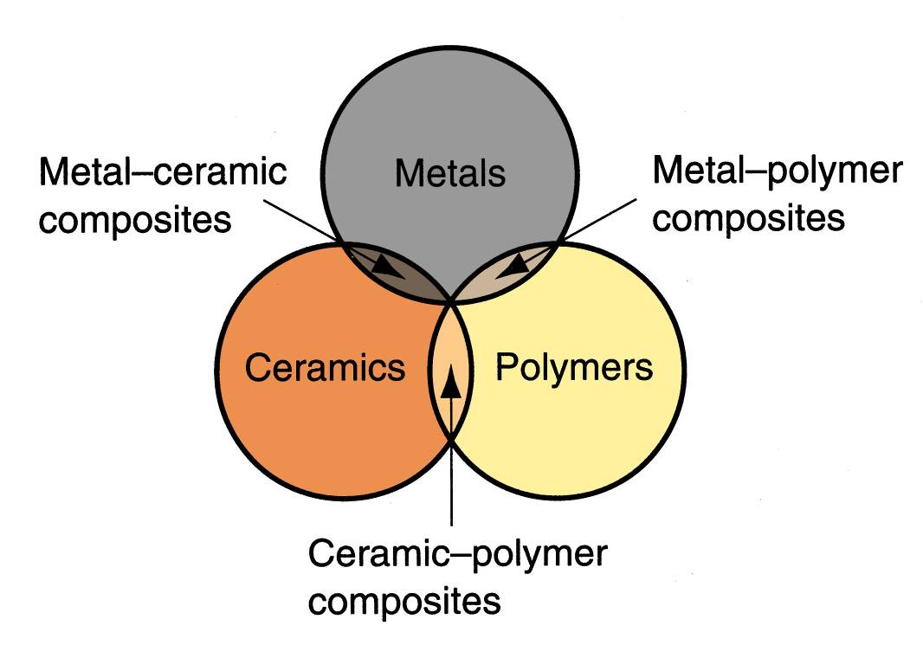
In addition- Composites
Nonhomogeneous mixtures of the other three basic types rather than a unique category
Figure 1.3 Venn diagram of three basic material types
plus composites

Slide 28
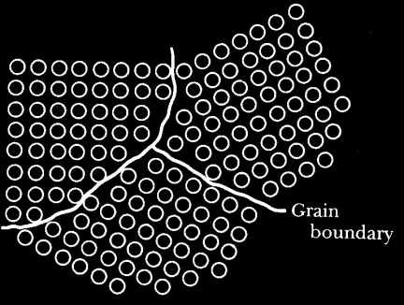
Composites
Material consisting of two or more phases that are processed separately and then bonded together to achieve properties superior to its constituents
Phase - homogeneous mass of material, such as grains of identical unit cell structure in a solid metal
Usual structure consists of particles or fibers of one phase mixed in a second phase
Properties depend on components, physical shapes of components, and the way they are combined to form the final material

Slide 29
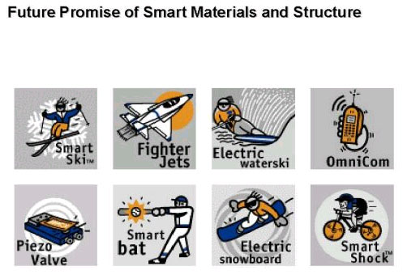
Composites

Slide 30
3- Manufacturing Processes

Slide 31
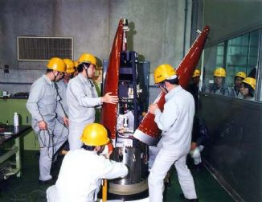
Manufacturing Processes
Two basic types:
Processing operations - transform a work material from one state of completion to a more advanced state
  Operations that change the geometry, properties, or appearance of the starting material
Assembly operations - join two or more components to create a new entity

Slide 32
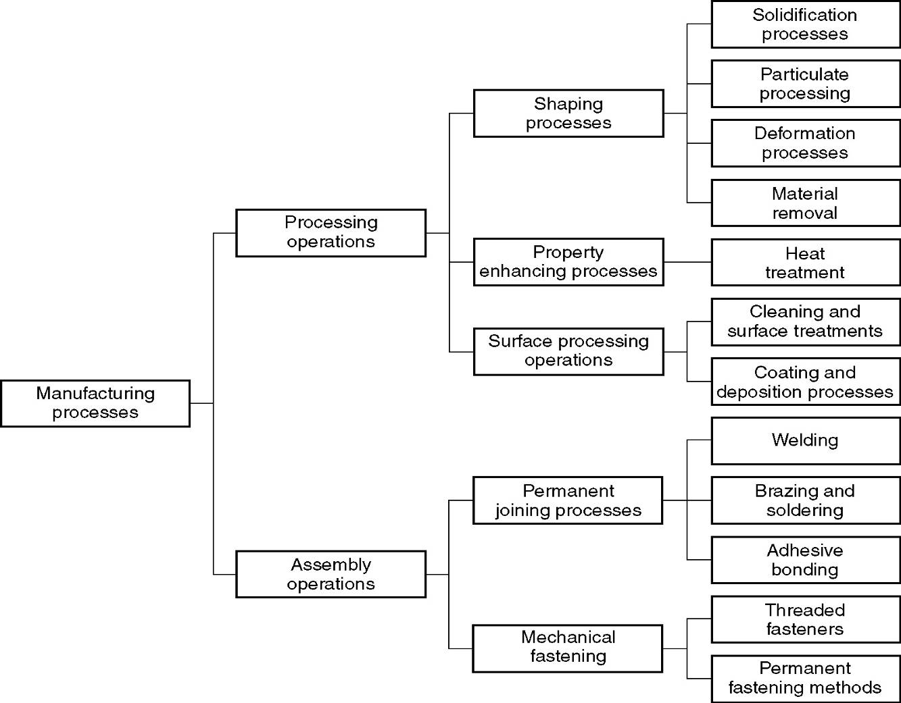
Figure 1.4 Classification of manufacturing processes
A
1
B
C
D
2

Slide 33
Processing Operations
Alters a material’s shape, physical properties, or appearance in order to add value
Three categories of processing operations:
  Shaping operations - alter the geometry of the starting work material
  Property‑enhancing operations - improve physical properties without changing shape
  Surface processing operations - to clean, treat, coat, or deposit material on exterior surface of the work
Click to see figure 1-4 again

Slide 34
Shaping Processes – Four Categories
A
Solidification processes - starting material is a heated liquid or semifluid
Particulate processing - starting material consists of powders
Deformation processes - starting material is a ductile solid (commonly metal)
Material removal processes - starting material is a ductile or brittle solid

Slide 35
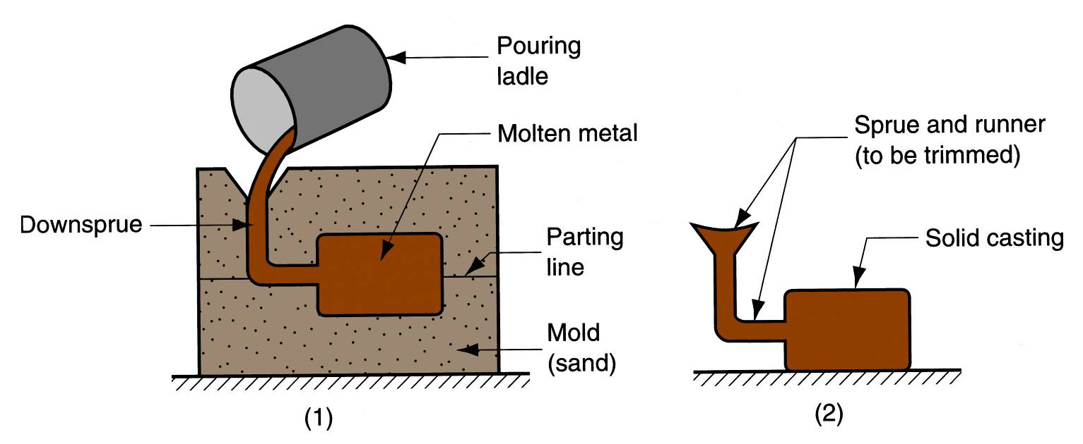
1- Solidification Processes
A
Starting material is heated sufficiently to transform it into a liquid or highly plastic state
Examples: metal casting, plastic molding

Slide 36
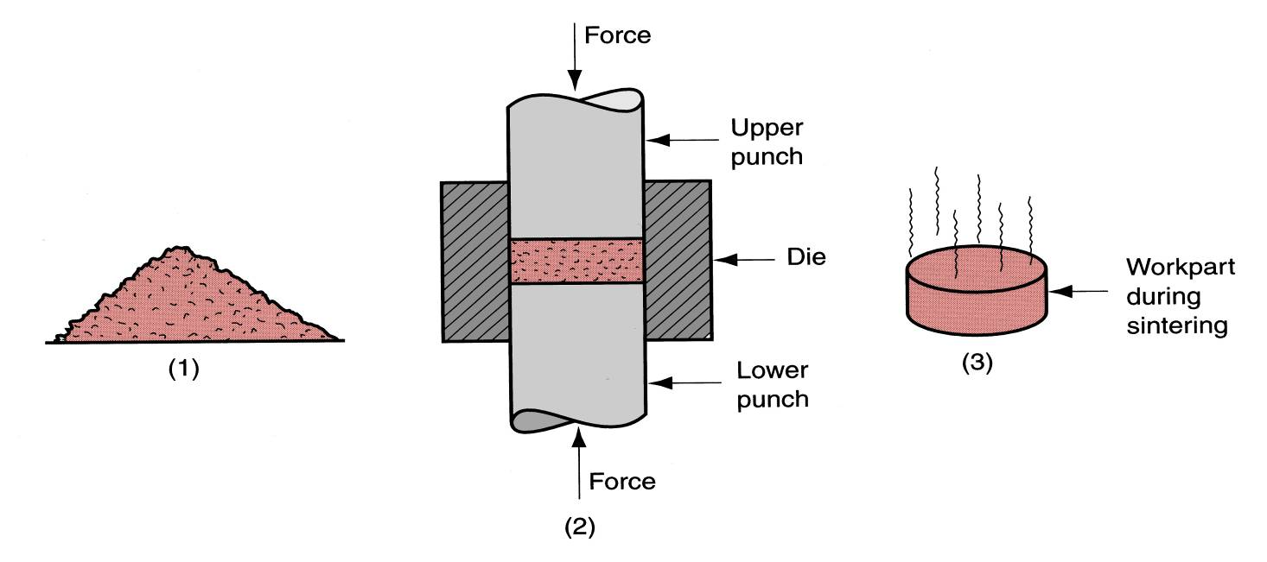
2- Particulate Processing
A
Starting materials are powders of metals or ceramics
Usually involves pressing and sintering, in which powders are first compressed and then heated to bond the individual particles
Steps: Pressing and sintering
Sintering is a method for making objects from powder, by heating the material (below its melting point) until its particles adhere to each other.

Slide 37
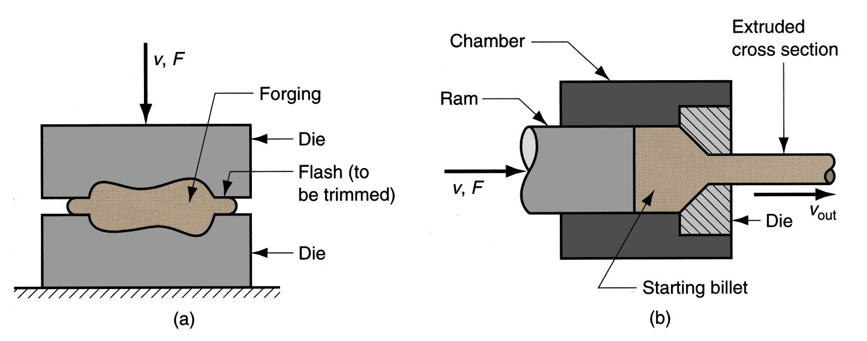
3- Deformation Processes
A
Starting workpart is shaped by application of forces that exceed the yield strength of the material
Examples: (a) forging, (b) extrusion
A press machine performs extrusion.

Slide 38
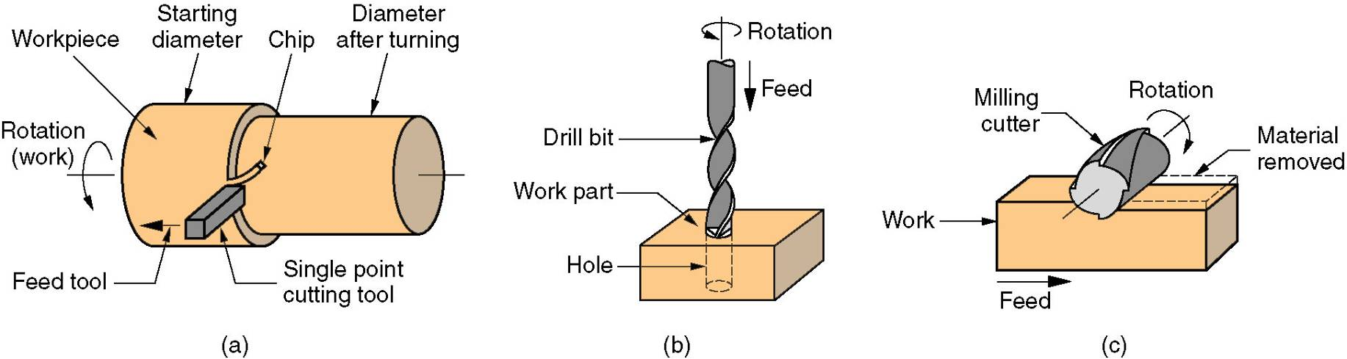
4- Material Removal Processes
A
Excess material removed from the starting piece so what remains is the desired geometry
Examples: machining such as turning, drilling, and milling; also grinding and nontraditional processes

Slide 39
Waste in Shaping Processes
A
Desirable to minimize waste in part shaping
  Material removal processes are wasteful in unit operations, simply by the way they work
  Most casting, molding, and particulate processing operations waste little material
Terminology for minimum waste processes:
  Net shape processes - when most of the starting material is used and no subsequent machining is required
  Near net shape processes - when minimum amount of machining is required
Click to see figure 1-4 again

Slide 40
Property‑Enhancing Processes
B
Performed to improve mechanical or physical properties of work material
Part shape is not altered, except unintentionally
  Example: unintentional warping of a heat treated part
Examples:
  Heat treatment of metals and glasses
  Sintering of powdered metals and ceramics
Click to see figure 1-4 again

Slide 41
Surface Processing Operations
C
Cleaning - chemical and mechanical processes to remove dirt, oil, and other contaminants from the surface
Surface treatments - mechanical working such as sand blasting, and physical processes like diffusion
Coating and thin film deposition - coating exterior surface of the workpart
Click to see figure 1-4 again

Slide 42
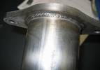
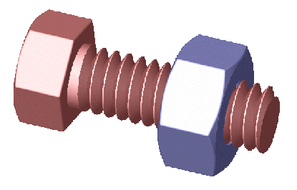
Assembly Operations
D
Two or more separate parts are joined to form a new entity
Types of assembly operations:
  Joining processes – create a permanent joint
    Welding, brazing, soldering, and adhesive bonding
  Mechanical assembly – fastening by mechanical methods
    Threaded fasteners (screws, bolts and nuts); press fitting, expansion fits

Slide 43
Production Systems

Slide 44
Production Systems
People, equipment, and procedures used for the combination of materials and processes that constitute a firm's manufacturing operations
A manufacturing firm must have systems and procedures to efficiently accomplish its type of production
Two categories of production systems:
  Production facilities
  Manufacturing support systems
Both categories include people (people make the systems work)

Slide 45
Production systems
Production systems
Production facilities
Manufacturing
support systems
Low production: Job shop
Medium production: Batch production and cellular manufacturing
High production: quantity production and flow line production
  Manufacturing engineering
  Production planning and control
  Quality control

Slide 46
1- Production Facilities
The factory, production equipment, and material handling systems
Production facilities "touch" the product
Includes the way the equipment is arranged in the factory ‑ the plant layout
Equipment usually organized into logical groupings, called manufacturing systems
  Examples:
      Automated production line
      Machine cell consisting of an industrial robot and two machine tools

Slide 47
Facilities versus Product Quantities
A company designs its manufacturing systems and organizes its factories to serve the particular mission of each plant
Certain types of production facilities are recognized as the most appropriate for a given type of manufacturing:
  Low production – 1 to 100
  Medium production – 100 to 10,000
  High production – 10,000 to >1,000,000
Different facilities are required for each of the three quantity ranges

Slide 48
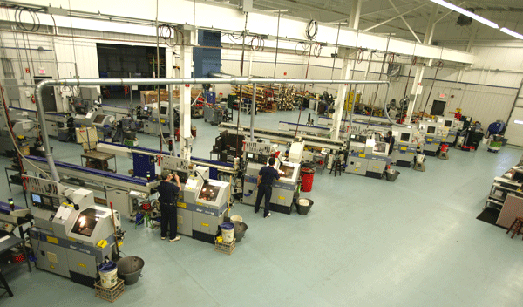
Low Production
Job shop is the term used for this type of production facility
A job shop makes low quantities of specialized and customized products
  Products are typically complex, e.g., space capsules, prototype aircraft, special machinery
Equipment in a job shop is general purpose
Labor force is highly skilled
Designed for maximum flexibility

Slide 49
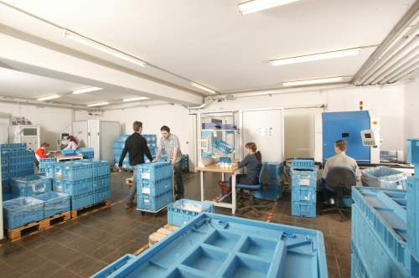
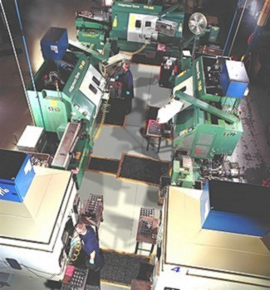
Medium Production
Two different types of facilities, depending on product variety:
Batch production
  Suited to hard product variety
  Setups required between batches
Cellular manufacturing
    Suited to soft product variety
    Worker cells organized to process parts without setups between different part styles

Slide 50
High Production
Often referred to as mass production
  High demand for product
  Manufacturing system dedicated to the production of that product
Two categories of mass production:
  Quantity production
  Flow line production

Slide 51
Quantity Production
Mass production of single parts on single machine or small numbers of machines
Typically involves standard machines equipped with special tooling
Equipment is dedicated full-time to the production of one part or product type
Typical layouts used in quantity production are process layout and cellular layout

Slide 52
Flow Line Production
Multiple machines or workstations arranged in sequence, e.g., production lines
Product is complex
  Requires multiple processing and/or assembly operations
Work units are physically moved through the sequence to complete the product
Workstations and equipment are designed specifically for the product to maximize efficiency

Slide 53
2- Manufacturing Support Systems
A company must organize itself
to design the processes and equipment,
plan and control production, and
satisfy product quality requirements
Accomplished by manufacturing support systems ‑ people and procedures by which a company manages its production operations
Typical departments:
        Manufacturing engineering
        Production planning and control
        Quality control

Slide 54
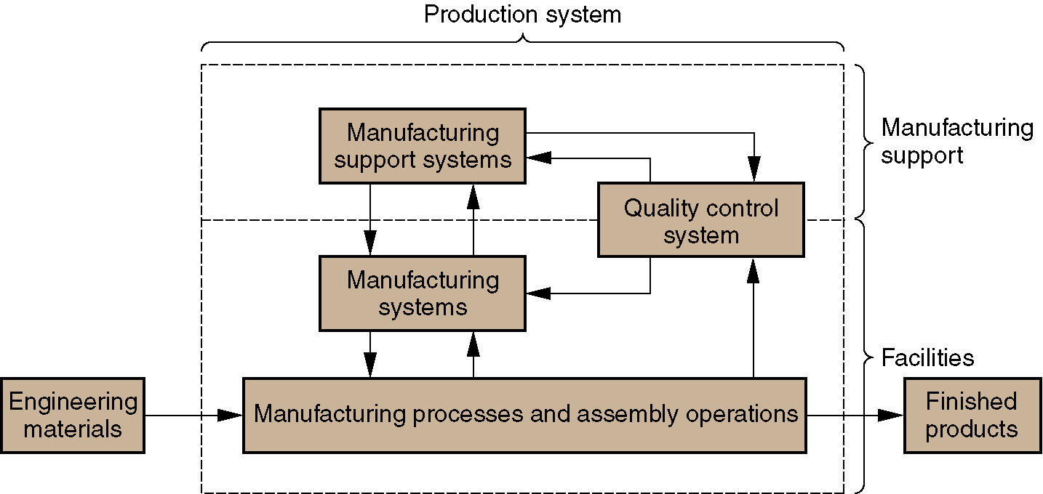
Overview of Major Topics
Figure 1.10 Overview of production system and major topics in Fundamentals of Modern Manufacturing.

Slide 55
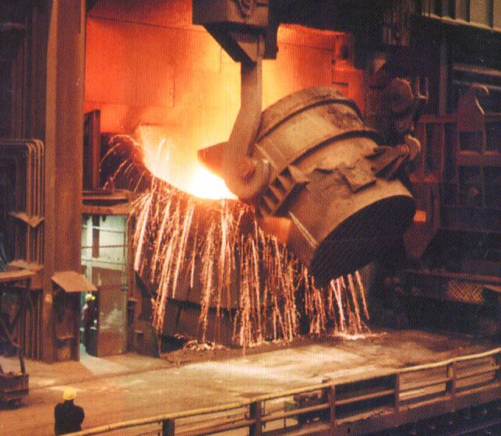
A spectacular scene in steelmaking is charging of a basic oxygen furnace, in which molten pig iron produced in a blast furnace is poured into the BOF (Basic Oxygen Furnace). Temperatures are around 1650°C (3000 ° F).

Slide 56
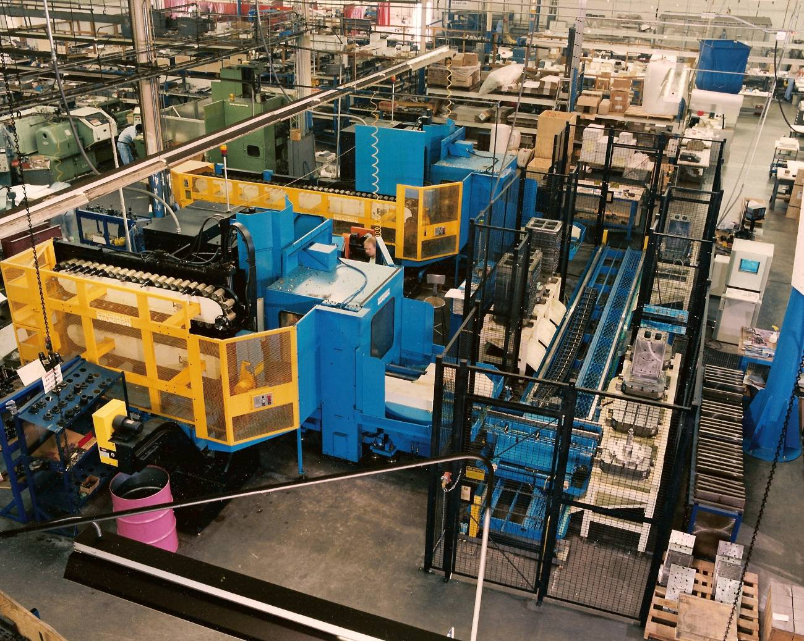
A machining cell consisting of two horizontal machining centers supplied by an in-line pallet shuttle (photo courtesy of Cincinnati Milacron).

Slide 57
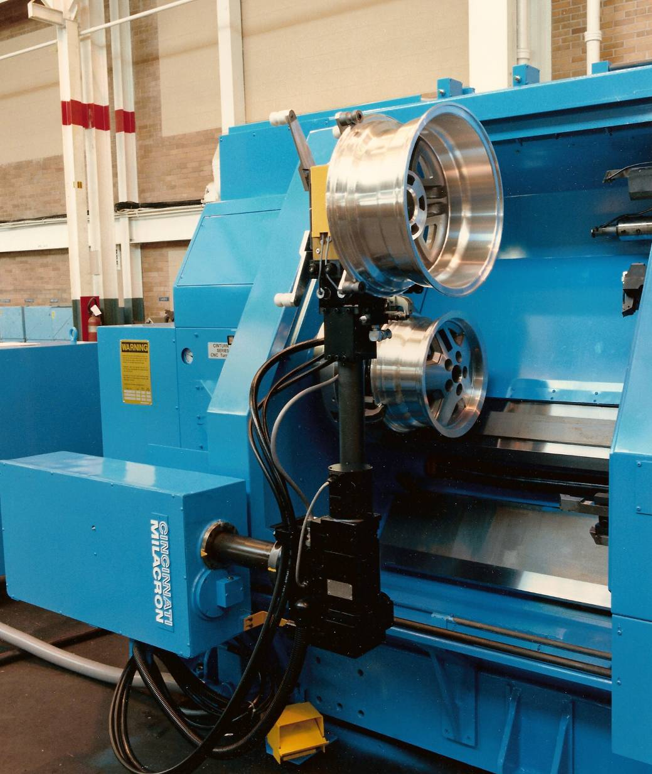
A robotic arm performs unloading and loading operation in a turning center using a dual gripper (photo courtesy of Cincinnati Milacron).

Slide 58
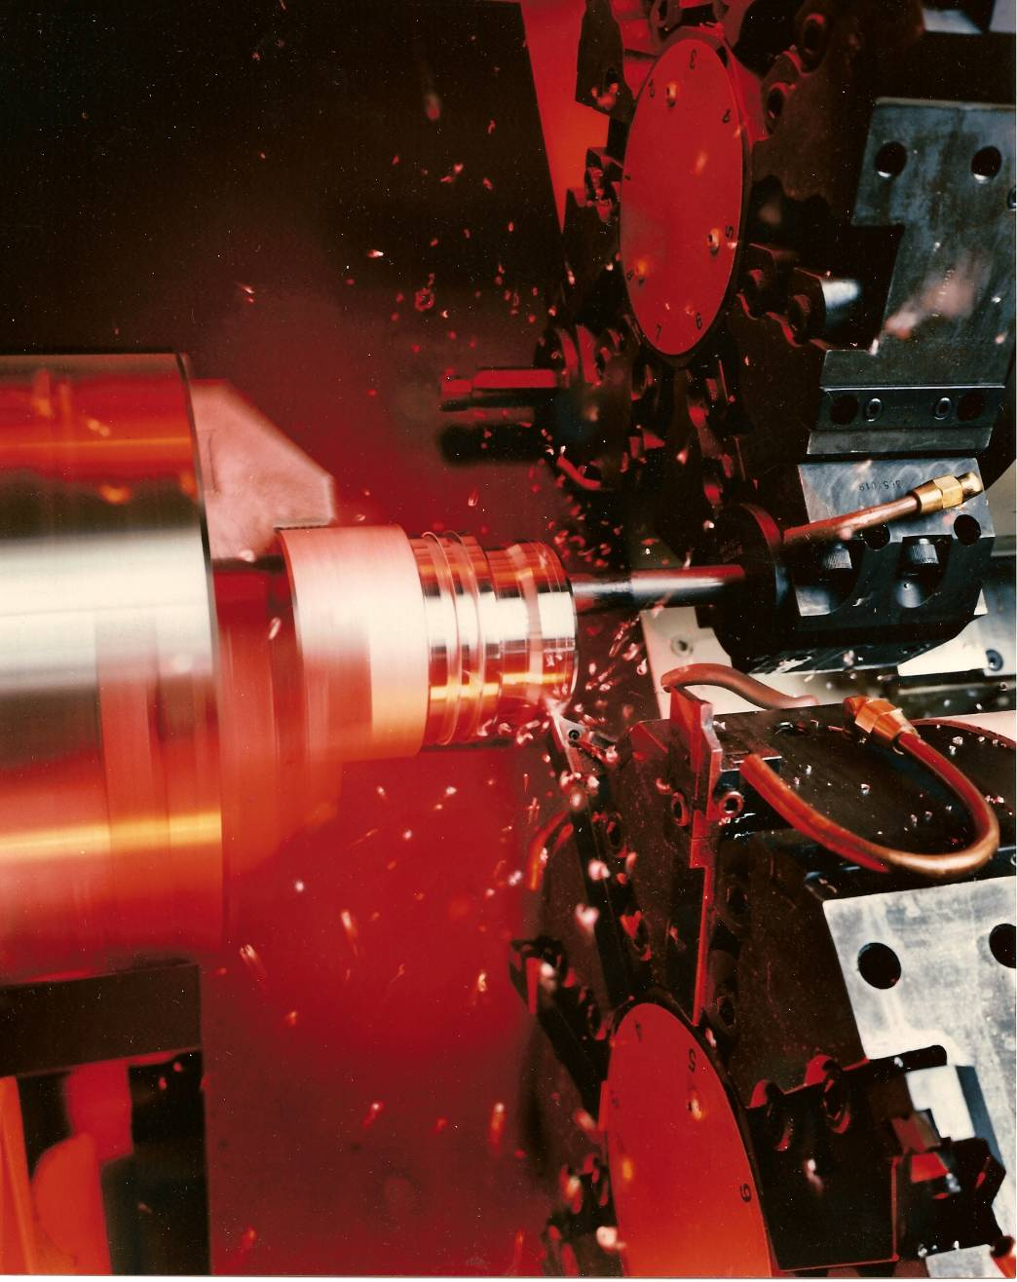
Metal chips fly in a high speed turning operation performed on a computer numerical control turning center (photo courtesy of Cincinnati Milacron).

Slide 59
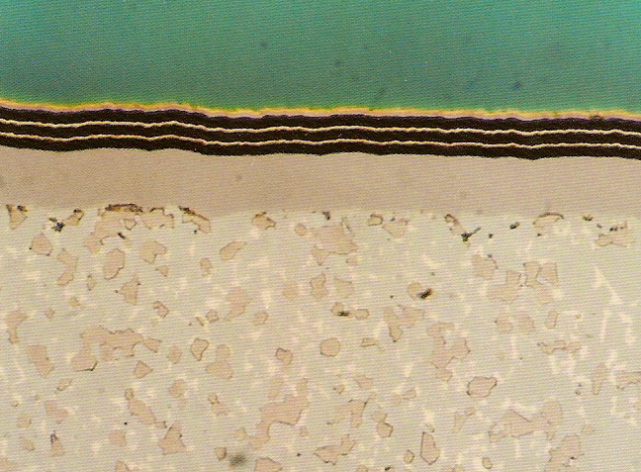
Photomicrograph of the cross section of multiple coatings of titanium nitride and aluminum oxide on a cemented carbide substrate (photo courtesy of Kennametal Inc.).

Slide 60

A batch of silicon wafers enters a furnace heated to 1000°C (1800°F) during fabrication of integrated circuits under clean room conditions (photo courtesy of Intel Corporation).

Slide 61
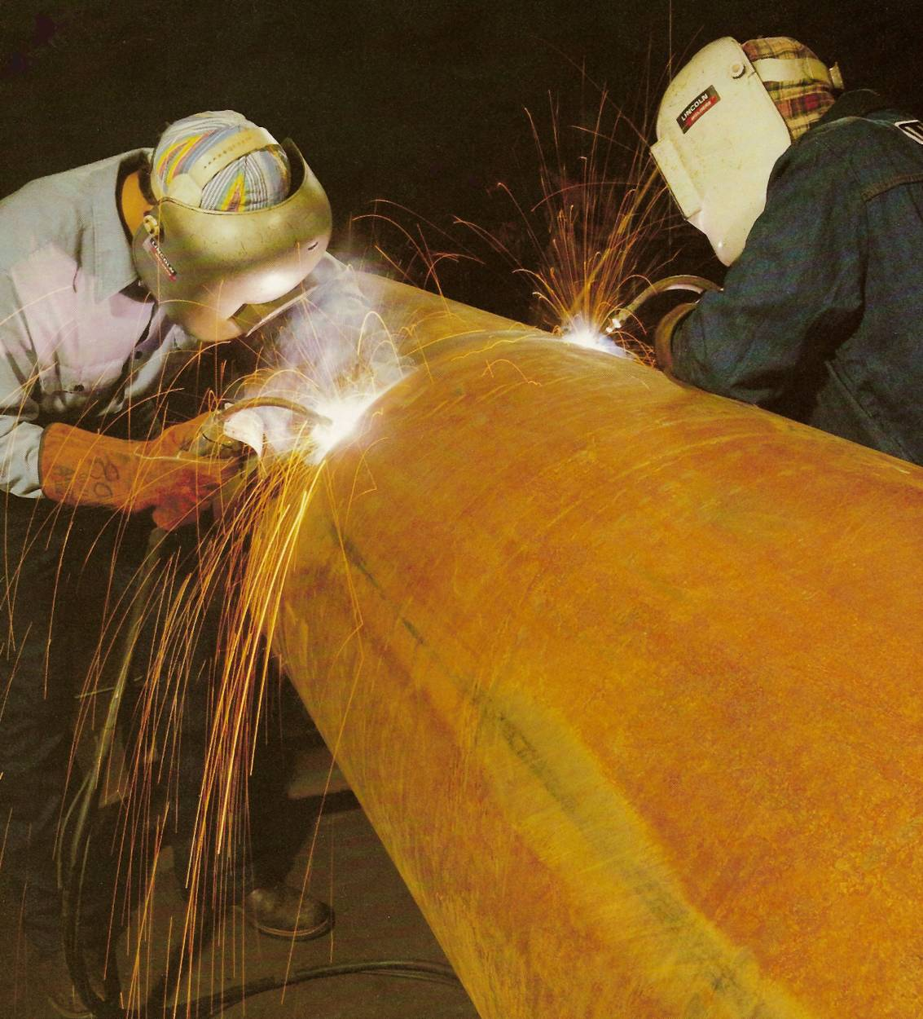
Two welders perform arc welding on a large steel pipe section (photo courtesy of Lincoln Electric Company).

Slide 62
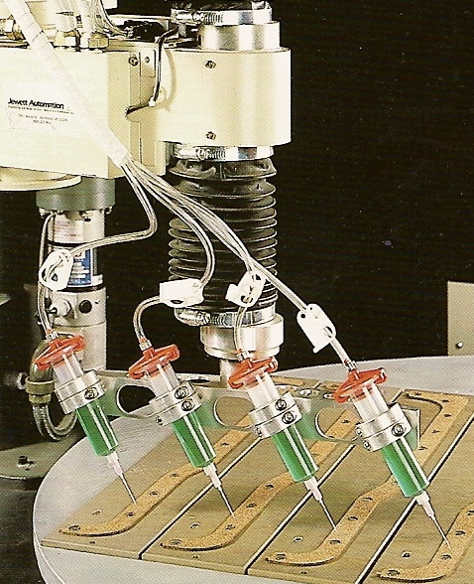
Automated dispensing of adhesive onto component parts prior to assembly (photo courtesy of EFD, Inc.).

Slide 63
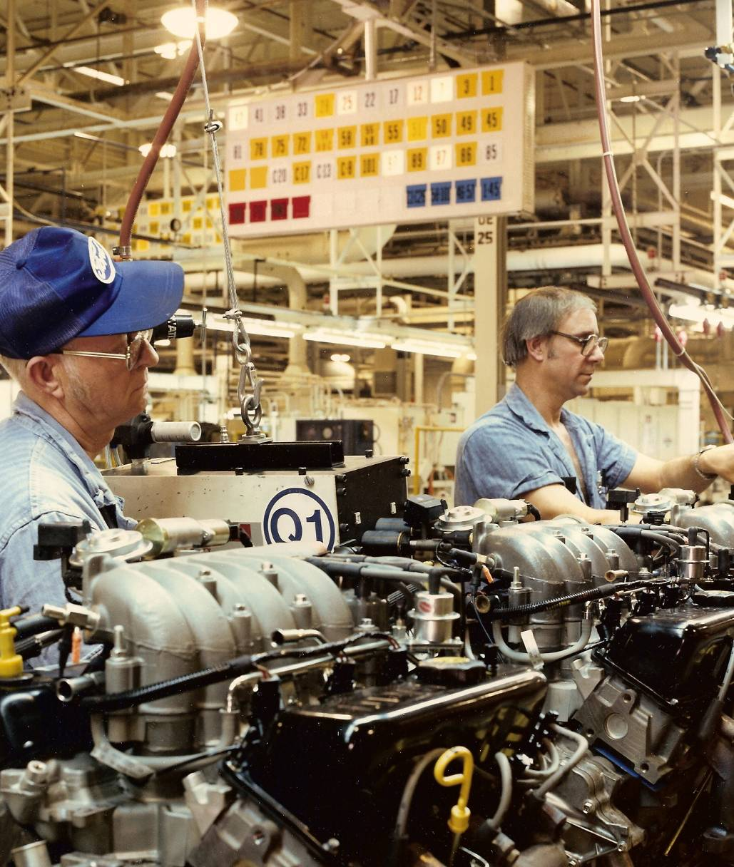
Assembly workers on an engine assembly line (photo courtesy of Ford Motor Company).

Slide 64
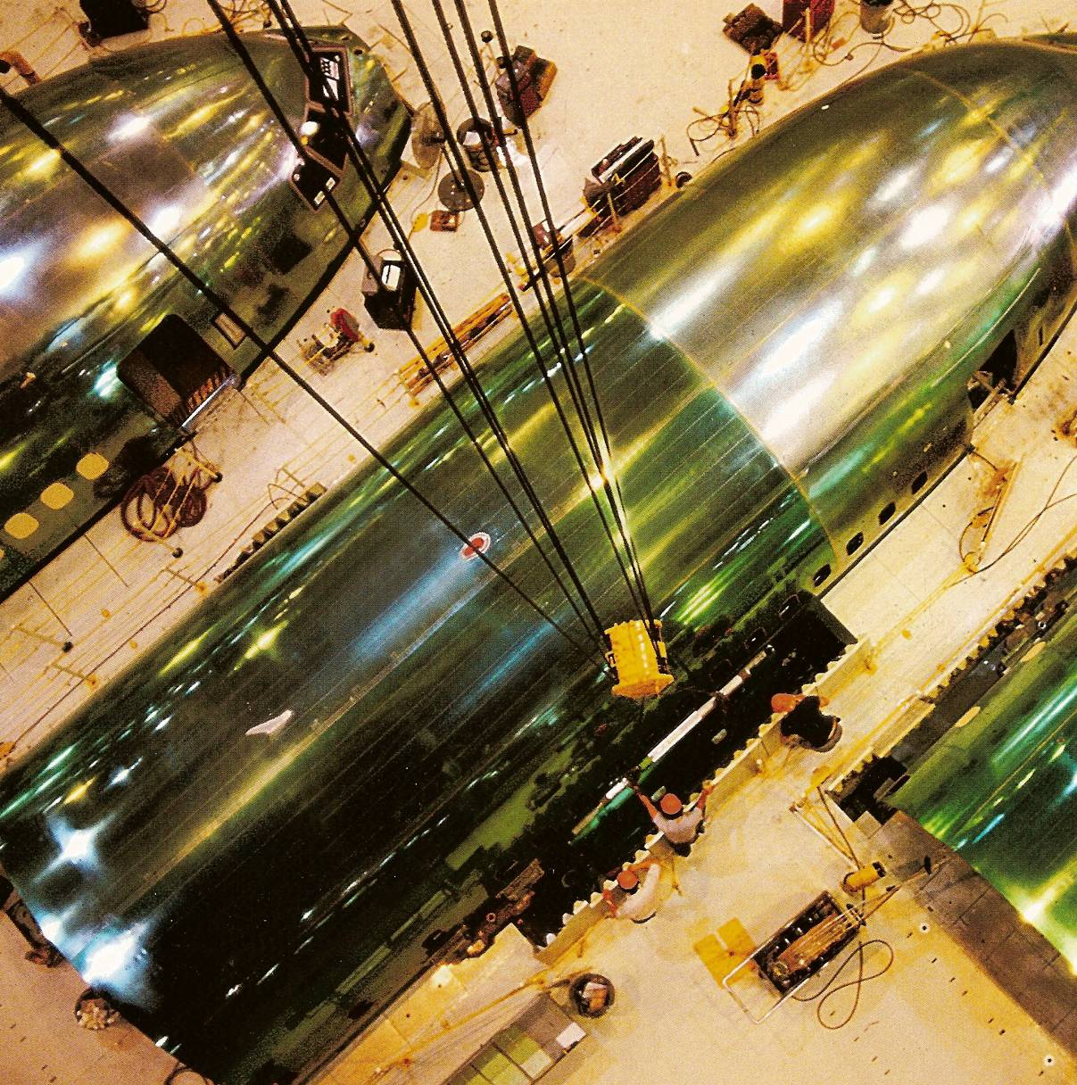
Assembly operations on the Boeing 777 (photo courtesy of Boeing Commercial Airplane Co.).

