Slide 1

CHEM 344 (REQUIRED COURSE)
ORGANIC REACTION MECHANISM
FOR CHEMISTRY’ STUDENTS, COLLEGE OF SCIENCE
Pre-requisites Course; CHEM 241
Credit Hours: 2(2+0)
Prof. Mohamed El-Newehy
Chemistry Department, College of Science, King Saud University
https://faculty.ksu.edu.sa/en/melnewehy
Prof. Zainab Almarhoon
Chemistry Department, College of Science, King Saud University
https://faculty.ksu.edu.sa/en/zalmarhoon

Slide 2
INTRODUCTION
Fundamental Principles

Slide 3
Reaction Mechanism; Basic Terminology
The general reaction is depicted as follows :
[Intermediate]
Organic molecule + Attacking Regent
Substrate Reagent
_{Reactants}
Product(s) + Byproduct(s)
_{Products}
OR
Transition state
Example:
[R⁺]
Intermediate
R-X + NaOH
Substrate Reagent
_{Reactants}
OR
R-OH + NaX
Product + Byproduct
_{Products}
HO----R----X
_{Transition state}
Substrate; A molecule whose carbon is involved in new bond formation, and the other one is called reagent.
Generally; more reactive species is labeled as the reagent. The reactive species is considered as the substrate.

Slide 4
Reaction Mechanism; Basic Terminology
Leaving Group; The part of substrate molecule that gets detached.
Nucleofuges; The leaving group with electron-pair.
Electrofuges; The leaving group without electron-pair.
Reaction Intermediate; The chemical species that are formed during the course of a chemical reaction
They are actual molecules that are short-lived and unstable
Transition states; The transition state of an organic reaction is a specific configuration along the reaction coordinate and corresponds to the highest potential energy.
The transition state is not actual molecule that can be isolated

Slide 5

Reaction Mechanism; Basic Terminology
Electrophile (E⁺); (electron-loving) are electron-deficient species and tend to attack the substrate at a site of high electron density and the reaction is called electrophilic.
Electrophiles include
Positively charged species as exemplified by proton (H⁺), cations (such as Cl⁺, NR₄⁺) and carbocations (⁺CH₃) and
Neutral species with vacant orbitals as exemplified by Lewis's acids (such as BF₃, AICI₃, ZnCl₂) and carbenes (Cl₂C:) or
Neutral molecules having functional groups like carbonyl group (>C=O) or alkyl halides (R₃C-X, where X is a halogen atom).
The electrophiles participate in the chemical reactions by accepting an electron pair to form a bond with the nucleophilic reactant.
Example; hydroxide ion combines with a proton to give water.

Slide 6

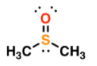


Reaction Mechanism; Basic Terminology
Nucleophile (Nu:); a reagent that brings an electron pair to the reactive site and the reaction is then called nucleophilic.
Nucleophiles include
Negatively charged ions with lone pair of electrons such as hydroxide (HO–), cyanide (NC–) ions and carbanions (R₃C:–).
Neutral electron-rich entities with lone pairs of electrons that are attracted to an electron-defficient center such as water, ammonia, alcohols, dimethylsulfide and triphenylphosphine
water ammonia dimethylsulfide triphenylphosphine
The nucleophiles participate in the chemical reactions by donating an electron pair to form a bond with the electrophilic reactant.

Slide 7
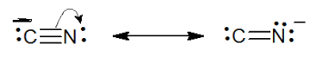
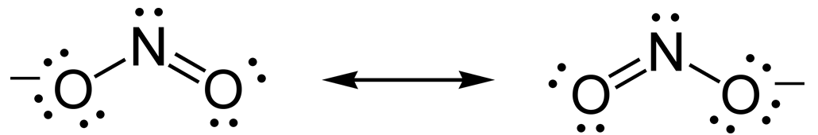
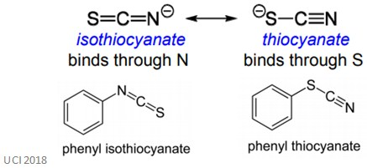
Reaction Mechanism; Basic Terminology
Ambident Nucleophiles; The nucleophiles which have more than one (generally two) suitable atoms through which they can attack the substrate .
An ambident nucleophile is an anionic nucleophile whose negative charge is delocalized by resonance over two unlike atoms or over two like but non-equivalent atoms.
Examples;
Cyanide, isothiocyanate and nitrite ions are some examples of ambident nucleophiles, since they have more than one reactive site.

Slide 8
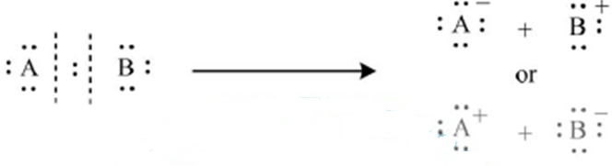
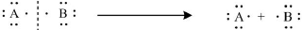
Reaction Mechanism; Basic Terminology
Depending upon the bonds-breaking, the reaction mechanism of organic compounds can be divided into;
Polar Mechanism (Bond Heterolysis);
The mechanism results from the heterolytic or unsymmetrical breaking of the covalent bond in which bonding pair goes with one of the fragments.
Radical Mechanism (Bond Homolysis);
The mechanism results from the homolytic or symmetrical breaking of the covalent bond in which bonding pair goes is distributed equally to the fragments.

Slide 9
Types of Organic Reactions
1) Substitution Reactions;
A chemical change where one functional group in an organic compound is displaced by another functional group.
A. Nucleophilic substitution
B. Electrophilic substitution
C. Free-radical substitution
2) Addition Reactions;
A chemical change where two or more molecular entities combine to give rise to a bigger molecules.
It is limited to organic compounds with multiple bonds, like carbon-carbon double or triple bonds.
The addition reaction can be treated as the opposite of an elimination reaction.
A. Nucleophilic addition
B. Electrophilic addition
C. Free-radical addition

Slide 10
Types of Organic Reactions
3) Elimination Reactions;
A chemical change where two or more substituents are detached from a molecule in either a one or two-step pathway.
A. The one-step pathway is abbreviated as E2 mechanism.
B. The two-step pathway is abbreviated as E1 mechanism.
4) Rearrangement Reactions;
A chemical change where the carbon skeleton of an organic compound rearranges itself to give rise to a structural isomer.
Generally, a group moves from one atom to another atom within the same molecule.
5) Redox Reactions;
A chemical change where the reduction or oxidation of organic compounds occurs to give rise to new product.
Oxidation is the gain of oxygen or loss of hydrogen.
Reduction is the gain of hydrogen or the loss of oxygen.

Slide 11
Thermodynamic and Kinetic Requirements of a Reaction
When we look at an organic reaction, we must consider two main concepts:
(1) The equilibrium (2) The rate of the reaction.
The conversion between reactants and products is governed by the reaction free energy ΔG;
ΔG = (free energy of the products) – (free energy of the reactants)
The reactants must be supplied with enough activation energy to enable the reaction to proceed in the forward direction.
For a reaction:
aA + bB dD + eE
K_{eq} = [products] / [reactants] = [D]^{d} [E]^{e} / [A]ª [B]^{b}
11

Slide 12
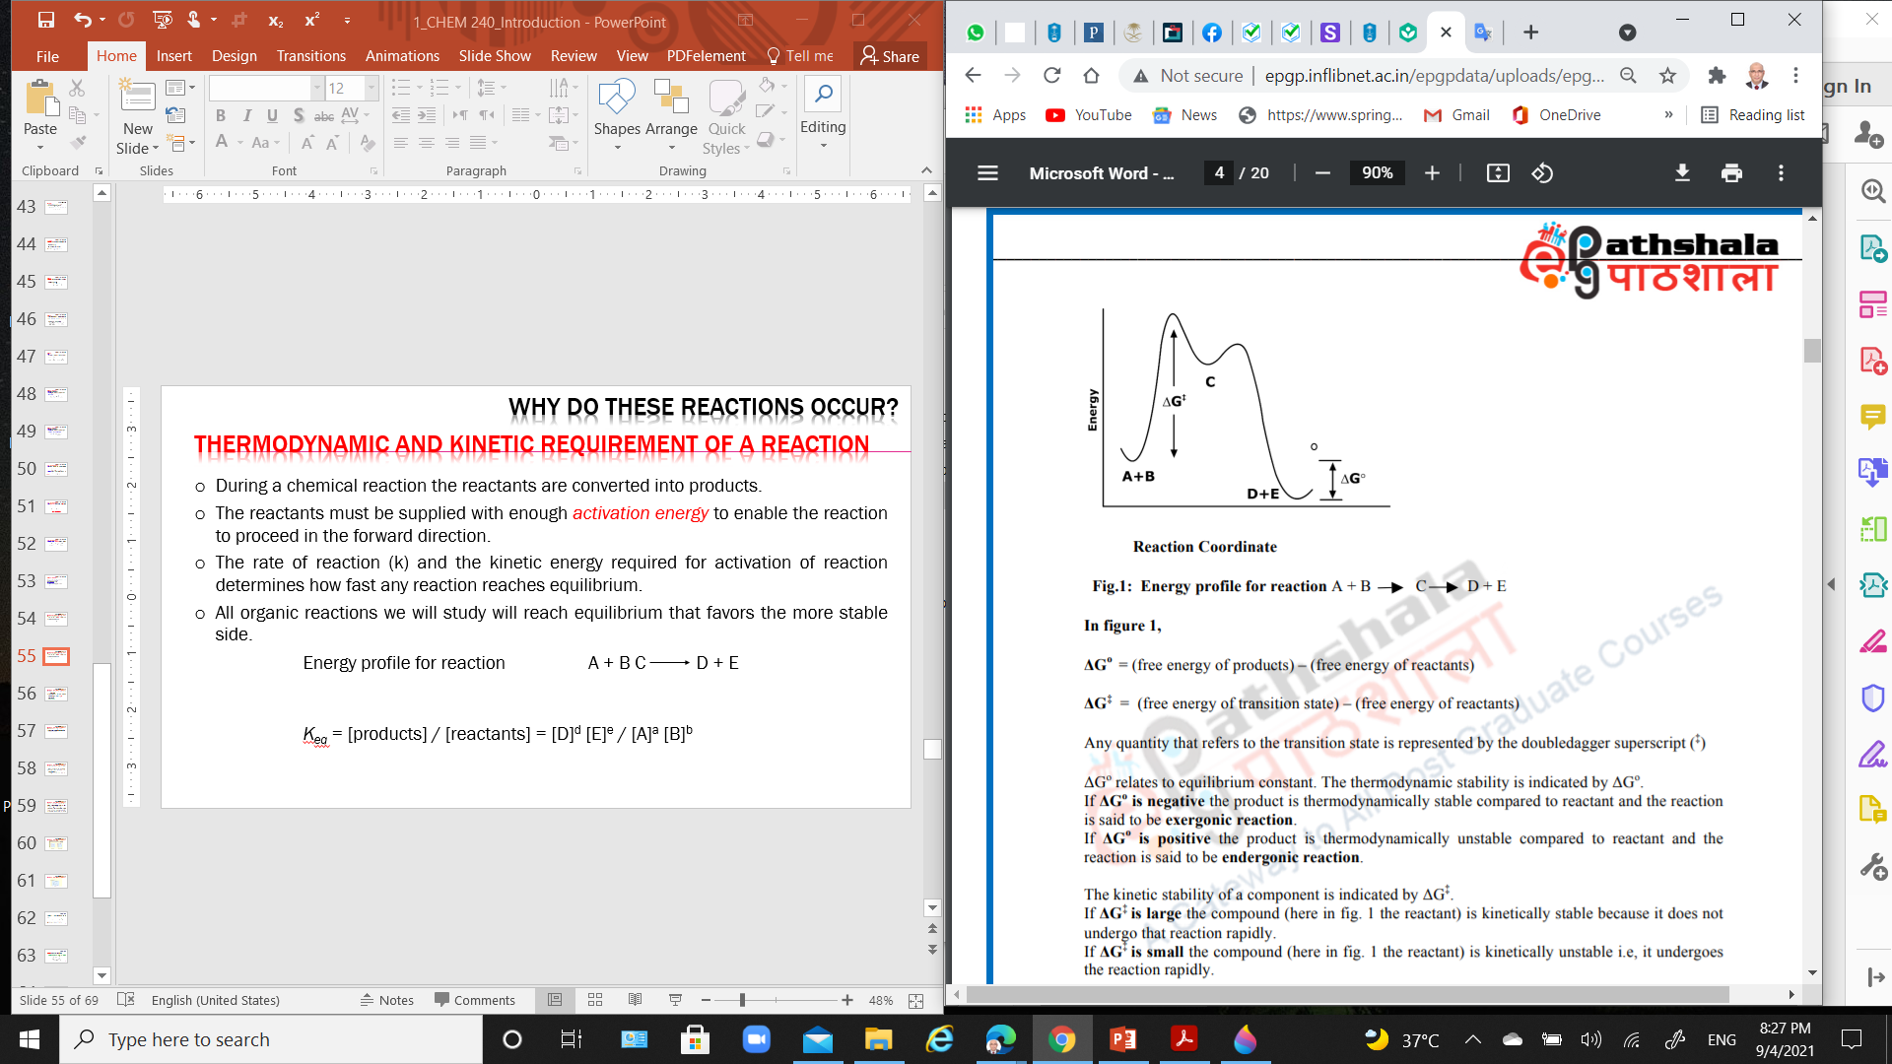
Thermodynamic and Kinetic Requirements of a Reaction
Energy profile for reaction A + B C D + E
ΔGº = (free energy of products) – (free energy of reactants)
ΔG‡ = (free energy of transition state) – (free energy of reactants)
The thermodynamic stability is indicated by ΔGº:
If ΔGº is negative the product is thermodynamically stable compared to reactant and the reaction is exergonic reaction.
If ΔGº is positive the product is thermodynamically unstable compared to reactant and the reaction is endergonic reaction.
The kinetic stability of a component is indicated by ΔG‡ :
If ΔG‡ is large, the compound (the reactant) is kinetically stable i.e., it does not undergo that reaction rapidly.
If ΔG‡ is small, the compound (the reactant) is kinetically unstable i.e., it undergoes the reaction rapidly.
12

Slide 13
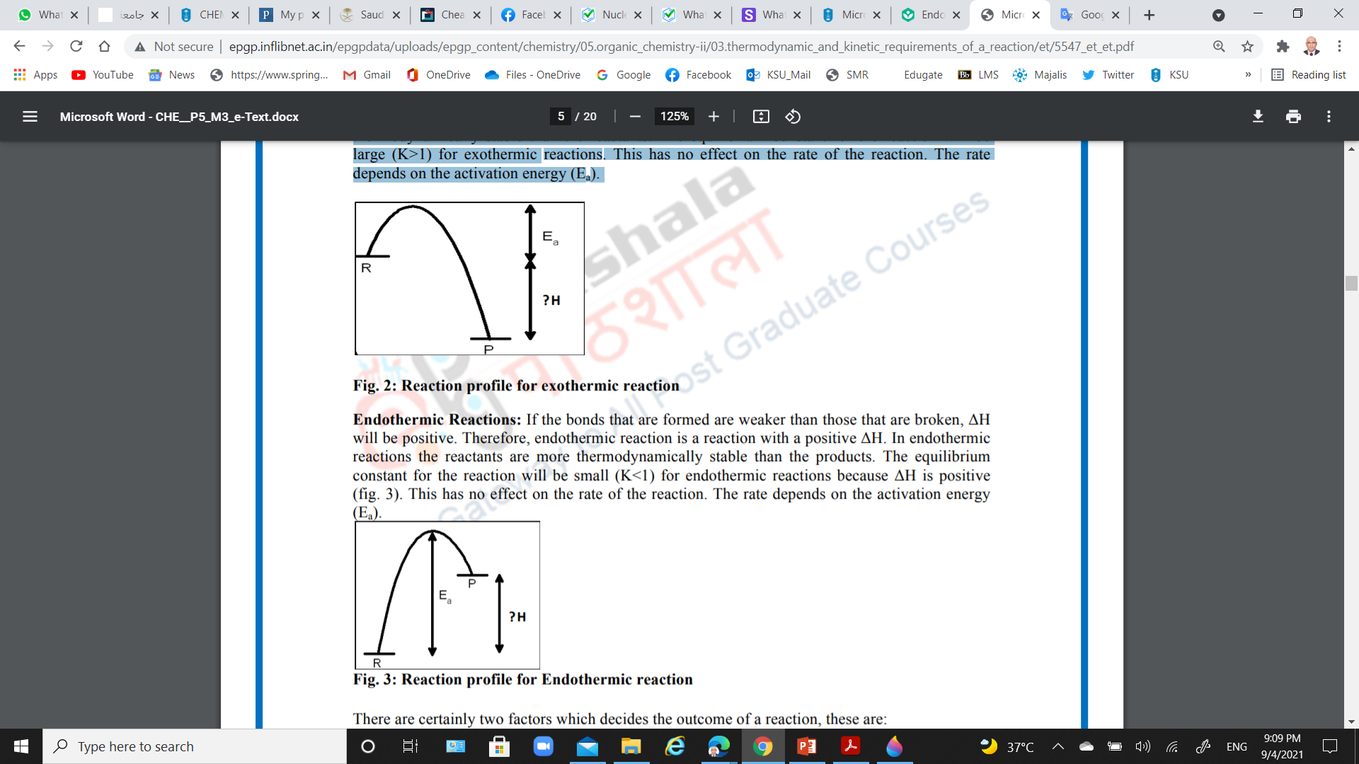
Thermodynamic and Kinetic Requirements of a Reaction
Exothermic/spontaneous Reactions
Endothermic/nonspontaneous Reactions
More energy will be released to the surrounding.
ΔH will be negative.
The products are thermodynamically stable than the reactants (-ΔG).
The equilibrium constant for the reaction will be large (K_{eq}>1).
More energy will be absorbed from the surrounding.
ΔH will be positive.
The reactants are thermodynamically stable than the products (+ΔG).
The equilibrium constant for the reaction will be small (K_{eq}<1).
13

Slide 14
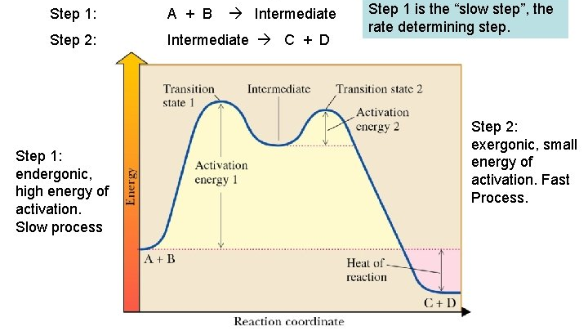
Thermodynamic and Kinetic Requirements of a Reaction
Multi-Step Reactions:

Slide 15
Electron Displacement Effects in Covalent Bonds
The electron displacement in an organic molecule may take place either in
The ground state under the influence of an atom or a substituent group
cause permanent polarization of the bond (Inductive effect and resonance effects).
Or
In the presence of an appropriate attacking reagent.
Temporary electron displacement effects (electromeric effect or polarizability effect).

Slide 16
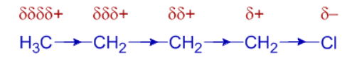
Electron Displacement Effects in Covalent Bonds: Inductive Effect
Inductive effects are electronic effects that occur through sigma σ bonds caused by electronegativity differences of atoms.
Types of inductive effect:
1) Negative inductive effect (-I):
This is the electron-withdrawing inductive effect, also known as the -I effect
NH₃⁺ > NO₂ > CN > SO₃H > CHO > CO > COOH > COCl > CONH₂ > F > Cl > Br > I > OH > OR > NH₂ > C₆H₅ > H
2) Positive inductive effect (+I):
This is electron releasing character and is indicated by the +I effect
C(CH₃)₃ > CH(CH₃)₂ > CH₂CH₃ > CH₃ > H

Slide 17
Electron Displacement Effects in Covalent Bonds: Resonance Structure
The resonance structures are hypothetical and individually do not represent any real molecule.
Example: Benzene; Its cyclic structure containing alternating C–C single and C=C double bonds
Example: Nitromethane (CH₃NO₂); It is therefore a resonance hybrid of the two canonical forms I and II.

Slide 18
Resonance or Mesomeric Effect (R Effect)
The resonance effect is defined as ‘the polarity produced in the molecule by the interaction of two π-bonds or between a π-bond and lone pair of electrons present on an adjacent atom’.
(i) Positive Resonance Effect (+R effect):
The transfer of electrons is away from an atom or substituent group attached to the conjugated system.
Examples; – X, –OH, –OR, –OCOR, –NH₂, –NHR, –NR₂, –NHCOR,
(ii) Negative Resonance Effect (- R effect):
The transfer of electrons is towards the atom or substituent group attached to the conjugated system.
Examples; – COOH, –CHO, >C=O, – CN, –NO₂

Slide 19
Electromeric Effect (E Effect)
The organic compounds having a multiple bond (a double or triple bond) show this effect in the presence of an attacking reagent only.
The complete transfer of a shared pair of π-electrons to one of the atoms joined by a multiple bond on the demand of an attacking reagent.
(i) Positive Eelctromeric Effect (+E effect):
the π−electrons of the multiple bond are transferred to that atom to which the reagent gets attached.
(ii) Negative Electromeric Effect (–E effect):
the π - electrons of the multiple bond are transferred to that atom to which the attacking reagent does not get attached.

Slide 20
Hyperconjugation
It involves delocalization of  electrons of C—H bond of an alkyl group directly attached to an atom of unsaturated system or to an atom with an unshared p orbital.
CH₃CH₂⁺ (ethyl cation); the positively charged carbon atom has an empty p orbital. One of the C-H bonds of the methyl group can align in the plane of this empty p orbital and the electrons constituting the C-H bond in plane with this p orbital can then be delocalized into the empty p orbital.

Slide 21
Hyperconjugation
This type of overlap stabilizes the carbocation because electron density from the adjacent σ bond helps in dispersing the positive charge.
In general, greater the number of alkyl groups attached to a positively charged carbon atom, the greater is the hyperconjugation interaction and stabilization of the cation.
Hyperconjugation is also possible in alkenes and alkylarenes.

Slide 22
Electron Movement in Organic Reactions: The Arrow Notation
The movement of electrons in organic reactions can be shown by curved-arrow notation.
Movement of single electron is indicated by a single barbed ‘fishhooks’ (i.e., half headed curved arrow).

Slide 23
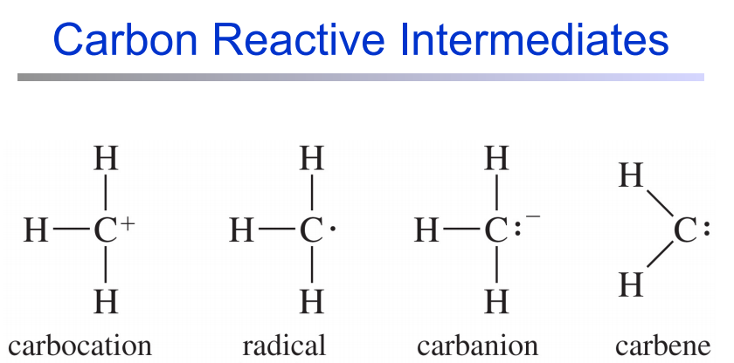
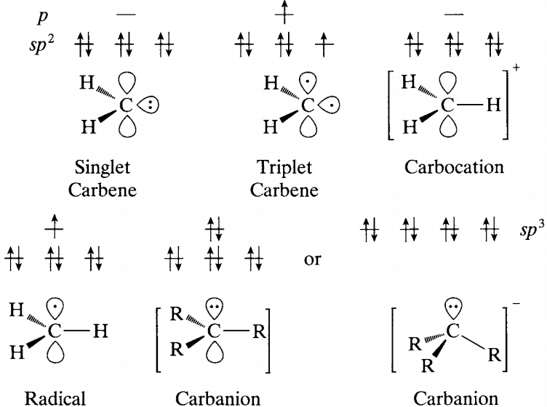
Reactive Intermediate
There are four types of organic species;
very short-lived and exist only as intermediates that are quickly converted to more stable molecules

Slide 24
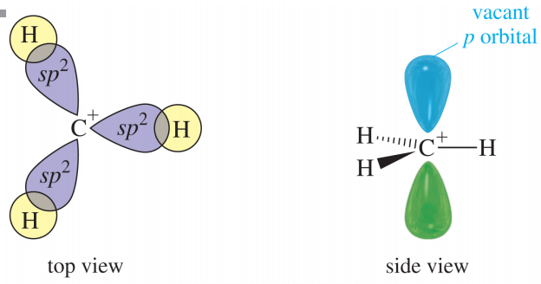
Reactive Intermediate: Carbocation
Carbocation Structure
Carbon has 6 electrons, positively charged.
Carbon is sp² hybridized with vacant p orbital

Slide 25

Reactive Intermediate: Carbocation
Methods of Forming Carbocation
Heterolytic fission of neutral species
Simple ionization; the electron pair remains with departing group, which is called leaving group and tertiary butyl group carries positive charge.
Ionization may also be induced by Lewis's acids, e.g., BF₃, AlCl₃ to yield in this case an acyl cation.
With antimony pentafluoride (SbF₅) as a Lewis acid, with either liquid SO₂ or excess SbF₅ as solvent,

Slide 26
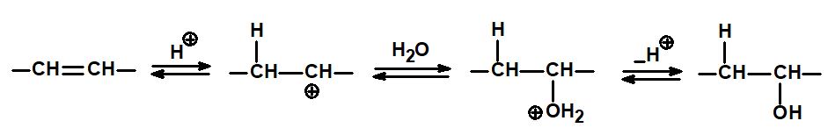
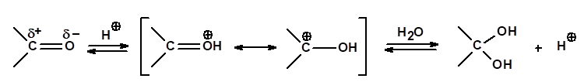
Reactive Intermediate: Carbocation
Methods of Forming Carbocation
(B) Addition of cations to neutral species
The most common cation is H⁺, adding to unsaturated linkages, i.e. protonation, in for example the acid-catalyzed hydration of alkenes:
Protonation can also occur on oxygen in a carbon-oxygen double bond,

Slide 27
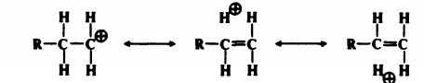
Reactive Intermediate: Carbocation
Stability and Structure of Carbocation
The simple alkyl carbocation have already been seen to follow the stability sequence,
The stability order can be explained by hyperconjugation and inductive effect
Quantum mechanical calculations for simple alkyl cations do indeed suggest that the planar (sp²) configuration is more stable than the pyramidal (sp³) by ≈ 84 kJ (20 kcal) mol^{–1}.
27

Slide 28
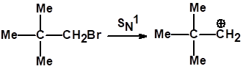
Reactive Intermediate: Carbocation
Stability and Structure of Carbocation
Carbocation Rearrangements
Without change in carbon skeleton;
1-propyl cation rearranged to the 2-propyl cation by the migration of a hydrogen atom, with its electron pair (i.e., as H–), from C₂ to the carbocationic C_{l}, a 1,2-hydride shift:
With change in carbon skeleton; Neopentyl rearrangements
28

Slide 29
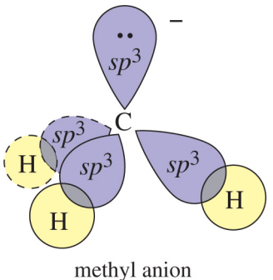
Reactive Intermediate: Carbanion
Carbanion Structure
Eight electrons on carbon: 6 bonding plus one lone pair.
Carbon has a negative charge.
Destabilized by alkyl substituents.

Slide 30
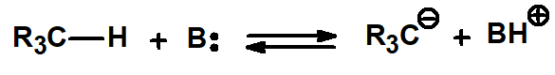
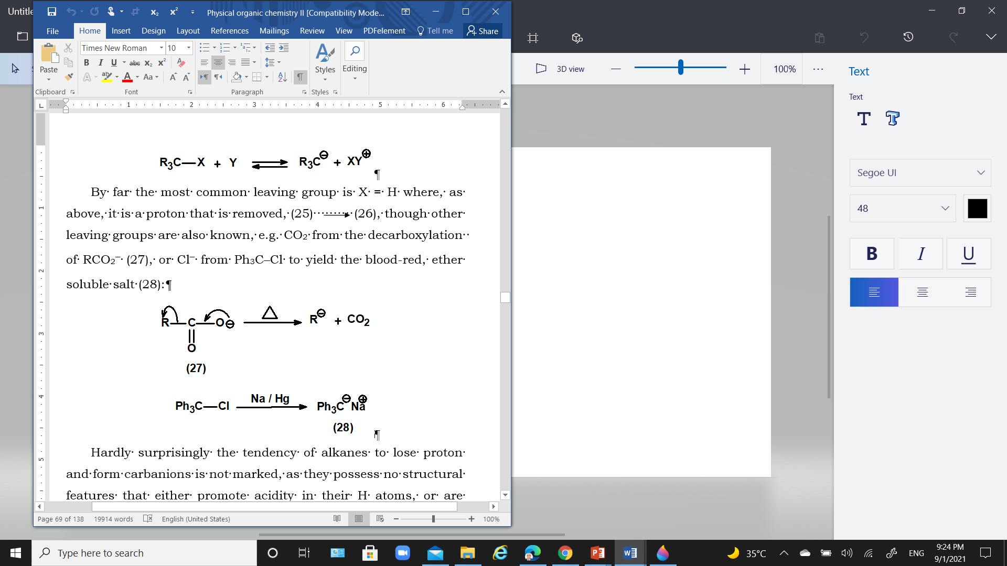
Reactive Intermediate: Carbanion
Carbanion possess an unshared pair of electrons and is therefore a base.
Carbanion can be formed by
Removal of a proton
Removal of CO₂ from decarboxylation of RCO₂⁻
Removal of Cl from Ph₃C-Cl

Slide 31
Reactive Intermediate: Carbanion
Stability of Carbanion
The main features that serve to stabilize carbanions are
increase in s character at the carbanion carbon
CH₃–CH₃ < CH₂=CH₂ < HC≡CH
electron-withdrawing inductive effects
–CF₃ and –C(CF₃)₃ by electron-withdrawal.
The destabilizing influence of the electron-donating inductive effect of alkyl groups is seen in the observed carbanion stability sequence:

Slide 32
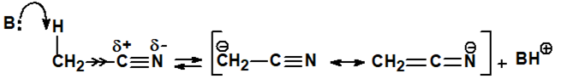
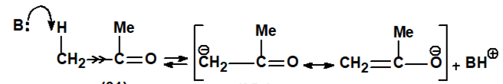
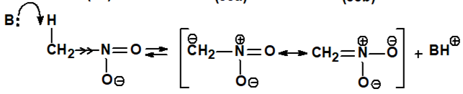
Reactive Intermediate: Carbanion
Stability of Carbanion
The main features that serve to stabilize carbanions are
Conjugation of the carbanion lone pair with a polarized multiple bond
the most common stabilizing feature, e.g. with CN, C=O, NO₂
32

Slide 33
Reactive Intermediate: Carbanion
Stability of Carbanion
The main features that serve to stabilize carbanions are
Aromatization
The cyclopentadienyl anion, being a 6π electron delocalized system.
The 6 electrons can be accommodated in three stabilized π molecular orbitals, like benzene, and the anion thus shows quasi-aromatic stabilization; it is stabilized by aromatization:
33

Slide 34
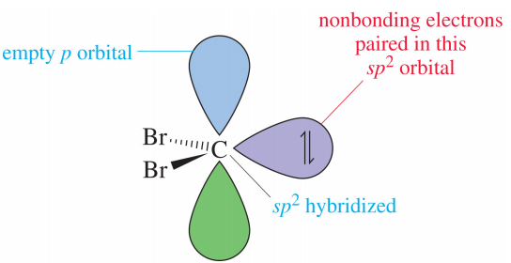

Reactive Intermediate: Carbenes
Carbenes Structure
Carbon is neutral
Vacant p orbital, so can be electrophilic
Lone pair of electrons, so can be nucleophilic
Carbenes (also called methylene) are highly reactive species.
Carbenes are molecules containing divalent carbon atoms.
Each divalent carbon has two unshared electrons, which are often shown when writing the structures of carbenes.
However, carbenes are neutral molecules, not carbanions.
34

Slide 35
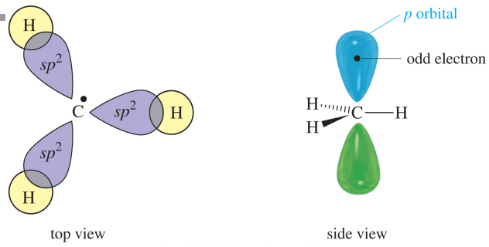
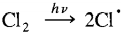
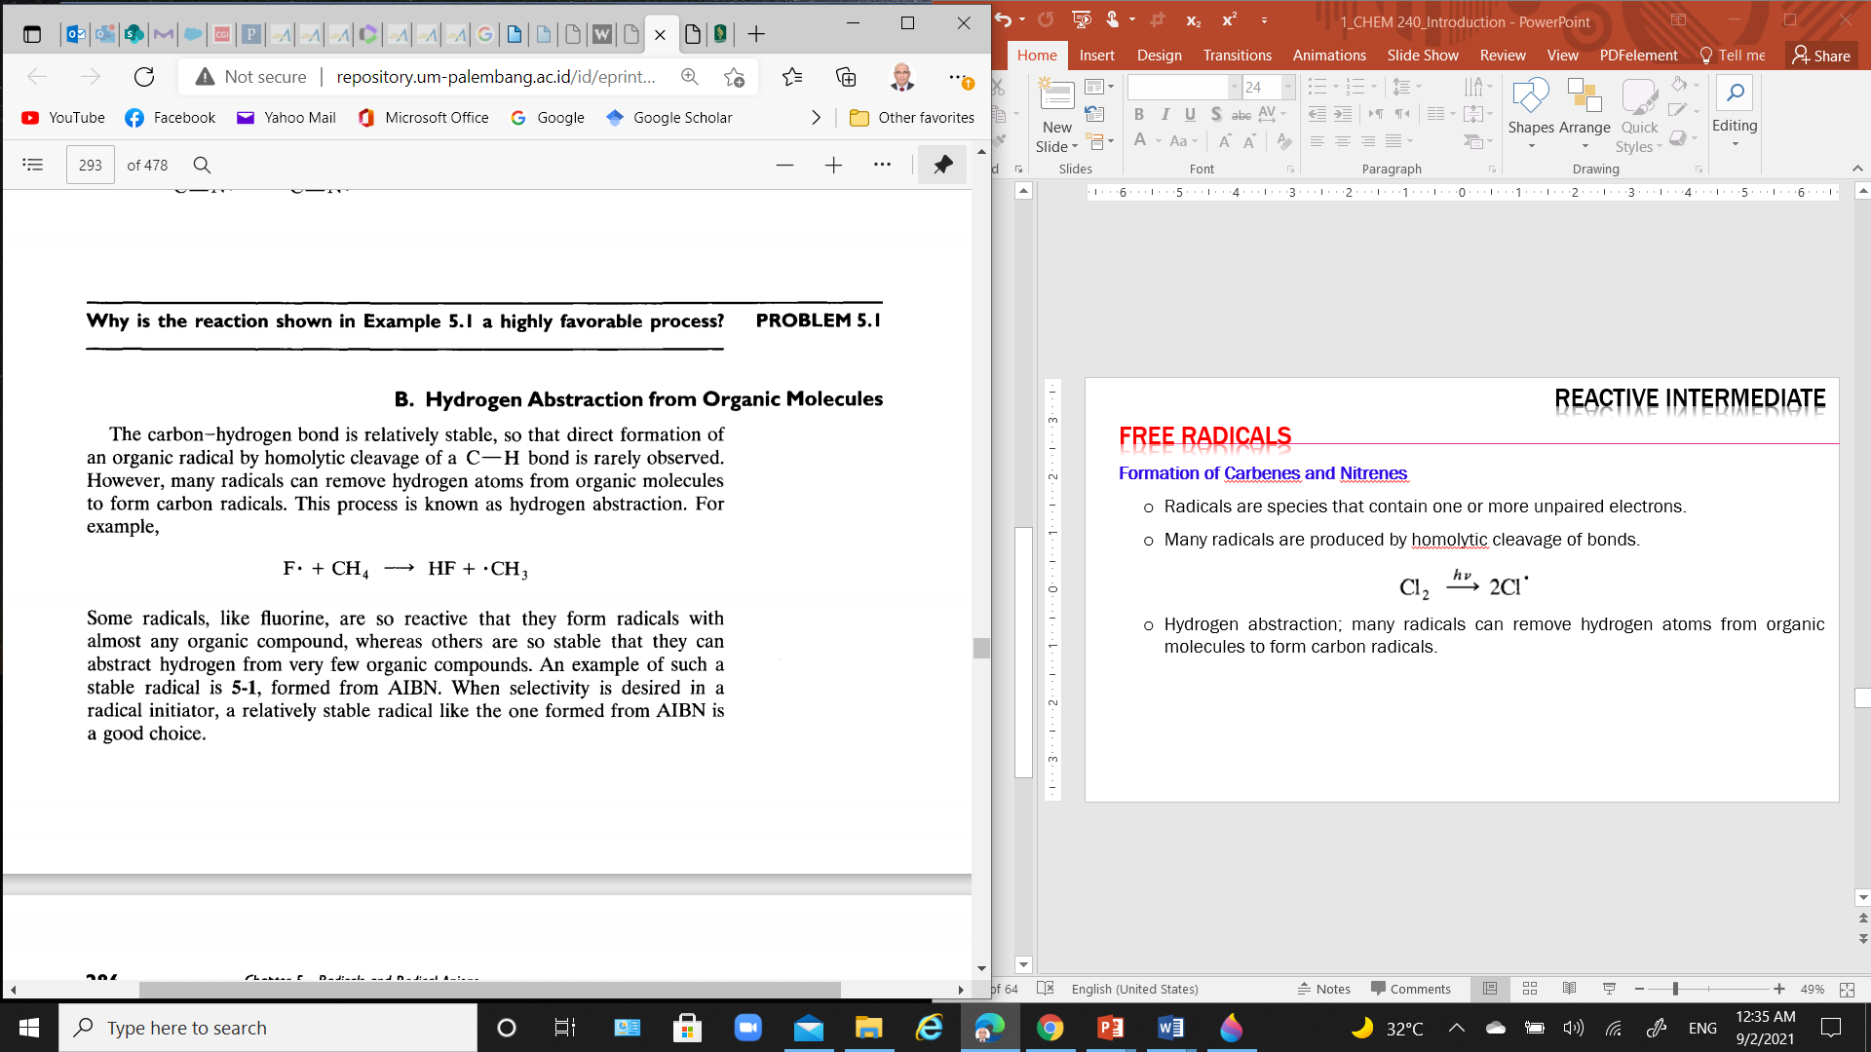
Reactive Intermediate: Free Radicals
Free radical Structure
Electron-deficient
Stabilized by alkyl substituents.
Order of stability: 3º > 2º > 1º.
Radicals are species that contain one or more unpaired electrons.
Many radicals are produced by homolytic cleavage of bonds.
Hydrogen abstraction; many radicals can remove hydrogen atoms from organic molecules to form carbon radicals.
35

Slide 36
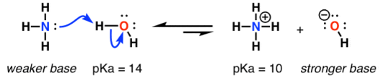
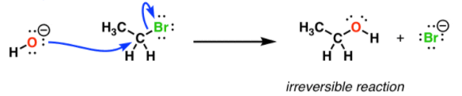
Nucleophiles and Electrophiles: Nucleophiles and Basicity?
Basicity: nucleophile attacks hydrogen (proton).
Nucleophilicity: nucleophile attacks any atom other than hydrogen (e.g., carbon).
Most species can participate in reversible acid-base reactions.
Basicity can be measured by the position of an equilibrium (e.g. stability is a thermodynamic property.
Reactions of nucleophiles with carbon are irreversible and are not in equilibrium (e.g., A bond forms, a bond breaks, and that’s the end of the reaction).
e.g., the nucleophilicity is measured by the rate of the reaction.

Slide 37

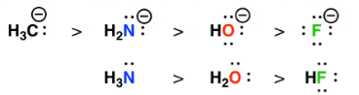
Nucleophiles and Electrophiles: Factors Affecting Nucleophilicity
Charge: the conjugate base is always a stronger nucleophile as the nucleophilicity increases with increasing electron density on an atom.
Electronegativity: nucleophilicity increases with decreasing electronegativity as the less electronegative the atom, the less “tightly held” those electrons will be.
These two factors correlate strongly with basicity.

Slide 38
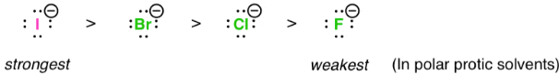
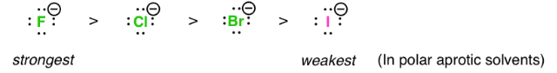
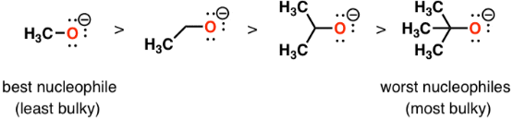
Nucleophiles and Electrophiles: Factors Affecting Nucleophilicity
Solvent: in polar protic solvents, nucleophilicity increases going down the periodic table (solvation).
Solvent: in polar aprotic solvents, nucleophilicity increases going up the periodic table (solvation).
Nucleophilicity is essentially correlated with basicity.
Steric Hindrance “Bulkiness”: in polar protic solvents, nucleophilicity increases going down the periodic table (solvation).

Slide 39
Nucleophiles and Electrophiles: Factors Affecting Nucleophilicity
Strong Bases/Strong Nucleophiles
A good base is usually a good nucleophile. So, strong bases — substances with negatively charged O, N, and C atoms — are strong nucleophiles.
Examples: RO⁻, OH⁻, RLi, RC≡C:⁻, and NH₂⁻.
Strong Bases/Poor Nucleophiles
Some strong bases are poor nucleophiles because of steric hindrance.
Examples: t-BuO⁻, t-BuLi, and LiN[CH(CH₃)₂]
Weak Bases/Good Nucleophiles
I⁻ is a weak base, but it is a good nucleophile because the large electron cloud is highly polarizable.

Slide 40
Acid–Base Reactions
Many of the reactions that occur in organic chemistry are either acid–base reactions themselves or they involve an acid–base reaction at some stage
Arrhenius regarded acid-base reactions as occurring only in water,
An Arrhenius acid is a source of H⁺ ion.
An Arrhenius base is a source of ⁻OH ion.
The Arrhenius acid-base theory provided a good start toward understanding acid-base chemistry, but it proved much too limited in its scope.
Two classes of acid–base reactions are fundamental in organic chemistry:
Brønsted–Lowry
Lewis's acid–base reactions

Slide 41
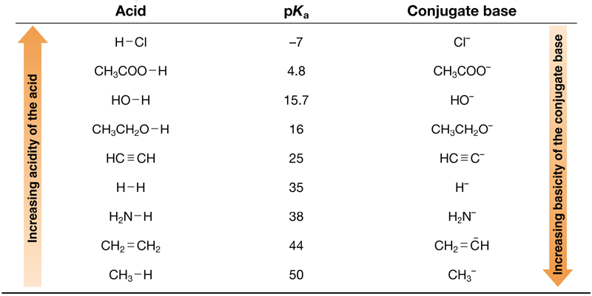
The Strength of Brønsted–Lowry Acids and Bases: Acidity and pK_{a}
Relative Strength of Selected Acids & Their Conjugate Bases

Slide 42
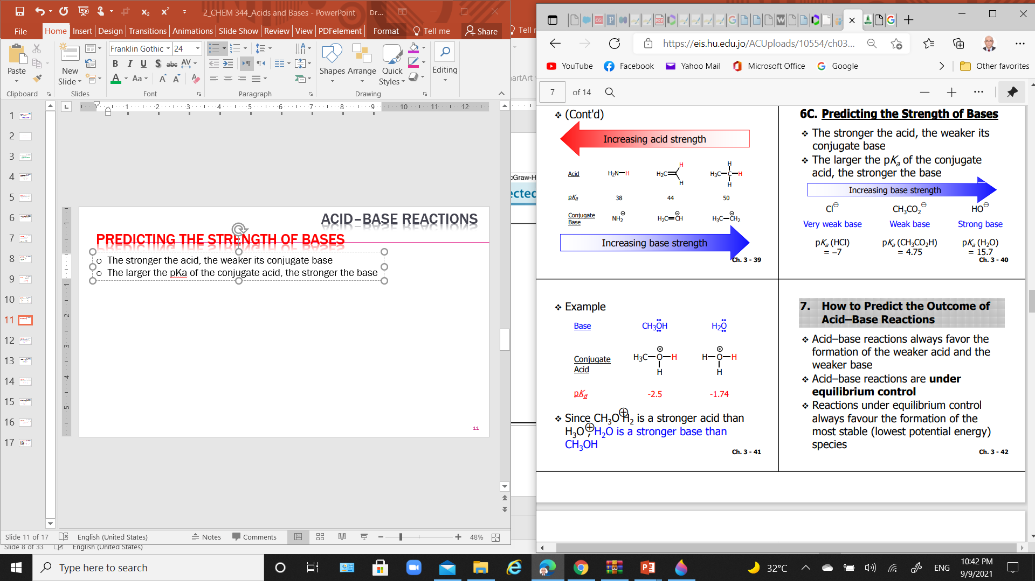
The Strength of Brønsted–Lowry Acids and Bases: Predicting the Strength of Bases
The stronger the acid, the weaker its conjugate base
The larger the pKa of the conjugate acid, the stronger the base
Since CH₃O⁺H₂ is a stronger acid than H₃O⁺, H₂O is a stronger base than CH₃OH

Slide 43
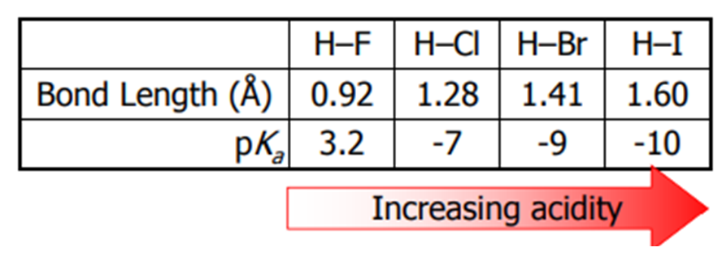
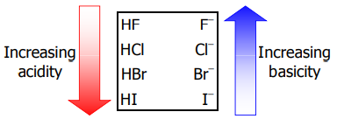
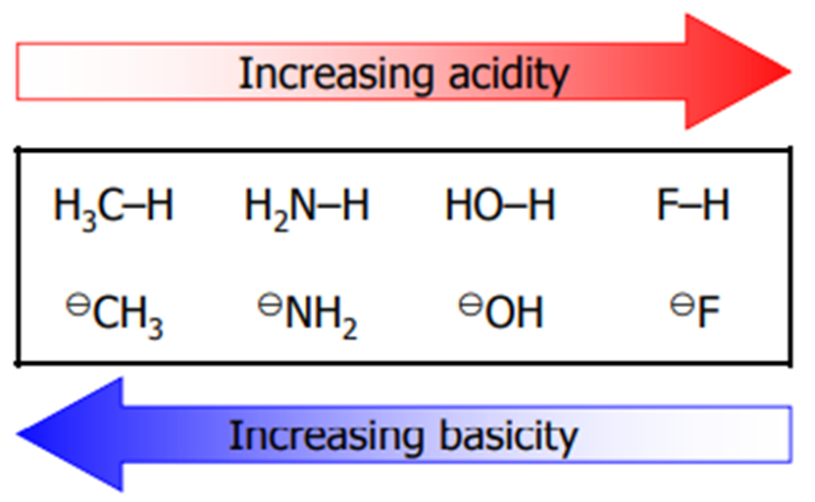
Factors Affecting Acid Strength: Relationships between Structure and Acidity
The stronger the H–X bond, the weaker the acid.
The strength of H–X bond
H–F > H–Cl > H–Br > H–I
The stronger the acid, the weaker the conjugate base.
Thus, acidity increases as we descend a vertical column in a group in the Periodic Table
The higher the electronegativity of an atom, the easier it will acquire a negative charge.
Thus, acidity increases from left to right when we compare compounds in the same row of the Periodic Table

Slide 44
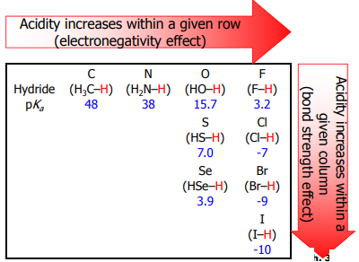
Factors Affecting Acid Strength: Relationships between Structure and Acidity

Slide 45
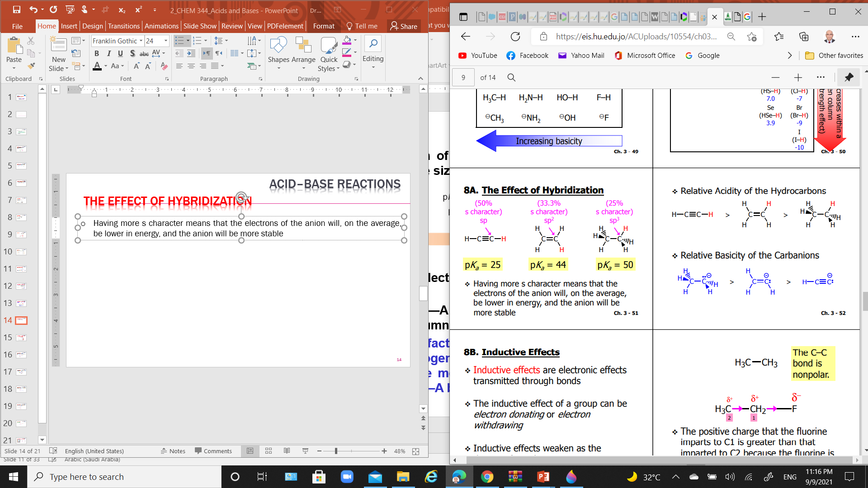
Factors Affecting Acid Strength: The Effect of Hybridization
The higher the percent of s-character of the hybrid orbital, the closer the lone pair is held to the nucleus, and the more stable the conjugate base.
Relative acidity of the hydrocarbons
Relative basicity of the carbanions

Slide 46

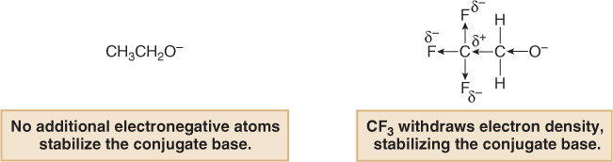
Factors Affecting Acid Strength: Inductive Effects
The inductive effect of a group can be electron donating or electron Withdrawing
When electron density is pulled away from the negative charge through σ bonds by very electronegative atoms, it is referred to an electron withdrawing inductive effect.
More electronegative atoms stabilize regions of high electron density by (-I)inductive effect.
The more electronegative the atom and the closer it is to the site of the negative charge, the greater the effect.
The acidity of H—A increases with the presence of electron withdrawing groups in A.

Slide 47
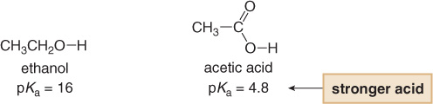
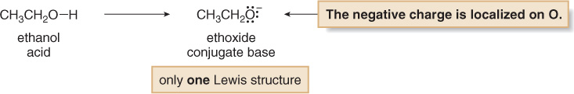
Factors Affecting Acid Strength: Resonance Effects
when we compare the acidities of ethanol and acetic acid, we note that the latter is more acidic than the former.
When the conjugate bases of the two species are compared, it is evident that the conjugate base of acetic acid enjoys resonance stabilization, whereas that of ethanol does not.

Slide 48
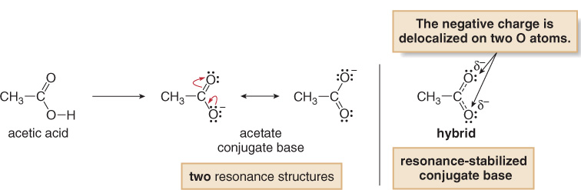
Factors Affecting Acid Strength: Resonance Effects
Resonance delocalization makes CH₃COO¯ more stable than CH₃CH₂O¯, so CH₃COOH is a stronger acid than CH₃CH₂OH.
The acidity of H—A increases when the conjugate base A:¯ is resonance stabilized.

Slide 49
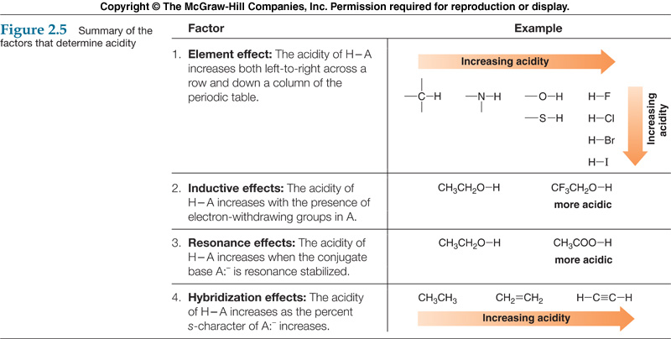
Factors Affecting Acid Strength: Summary Of The Factors That Determine Acidity

Slide 50
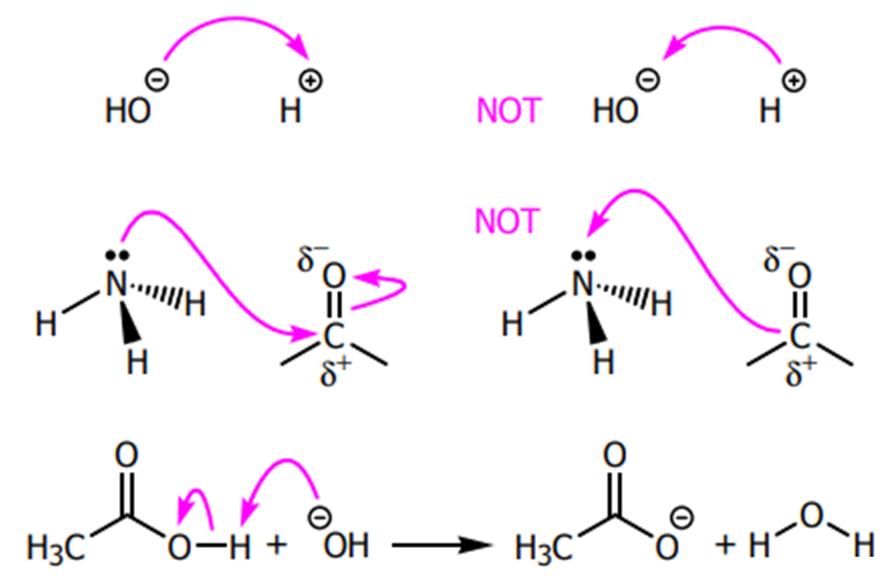
Acid–Base Reactions: How to Use Curved Arrows in Illustrating Reactions
show the direction of electron flow in a reaction mechanism
point from the source of an electron pair to the atom receiving the pair
always show the flow of electrons from a site of higher electron density to a site of lower electron density
never show the movement of atoms. Atoms are assumed to follow the flow of the electron

