Slide 1

CHEM 342 (REQUIRED COURSE)
POLYMERS AND PETROCHEMICALS
FOR CHEMISTRY’ STUDENTS, COLLEGE OF SCIENCE
Pre-requisites Course; CHEM 241
Credit Hours: 2(2+0)
Prof. Mohamed El-Newehy
Chemistry Department, College of Science, King Saud University
http://fac.ksu.edu.sa/melnewehy/home

Slide 2
Brief Historical Introduction
Raoult and van’t Hoff (1885)
The initial proof of the existence of very large organic molecules was supplied.
They carried out molecular weight determinations on rubber, starch, and cellulose nitrate (molecular weights of 10k–40k g/mol were demonstrated).
Unfortunately, chemists of that day failed to appreciate this evidence and refused to accept it.
During the period 1890–1910,
Polymeric structures were explained in terms of physical aggregates of small molecules.
For example; rubber was assumed to be composed of short sequences of isoprene units, either as chains or as cyclic structures.
No one was able to show the existence of end groups in macromolecules, and this enhanced the idea that rubber is a ring-like structure, a dimethyl cycloocatadiene.
Large numbers of such rings were assumed to be held together by associations, giving rise to colloidal materials.

Slide 3
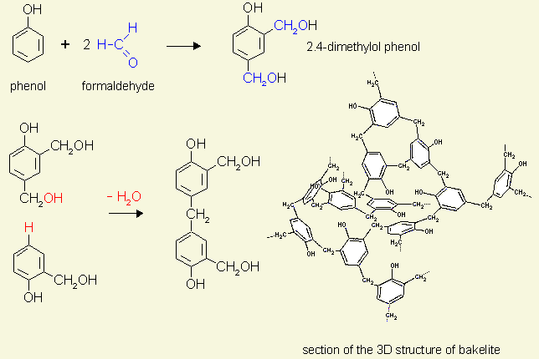
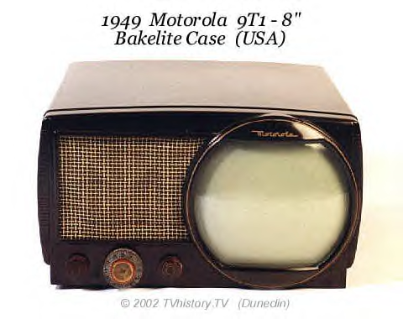
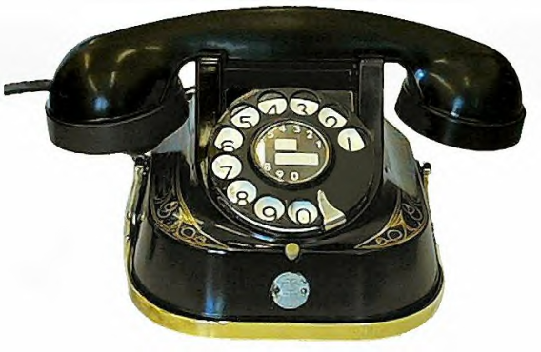
Brief Historical Introduction
Emil Fischer and his coworkers (1900)
They studied many natural polymers, such as rubber, starch, polypeptides, cellulose, and lignin.
His work probably entitles him to be called the spiritual father of polymer chemistry.
Leo Baekeland (1907)
Bakelite; the first synthetic plastic is fabricated by Leo Baekeland.
Bakelite is a heat-resistant, thermosetting, chemically stable resin (polyoxybenzylmethylenglycolanhydride, the first plastic).
It is formed by combining phenol and formaldehyde.
Radios, telephones and electrical insulators were made of Bakelite in the past due to its insulating and heat-resistant properties.

Slide 4
Brief Historical Introduction
Willstatter (1913)
Willstatter worked on the synthesis of polysaccharides and studied lignin and enzymes.
Hermann Staudinger (early 1920s)
Staudinger et al. firmly established the existence of macromolecules.
In the 1920s, he provided the basis for a systematic understanding of this class of materials. (X-ray analyses and careful use of molecular weight determinations, confirmed his findings).
He explained that the polymers are only macromolecules and assumed the existence of covalent bonds between the atoms of molecules.
He is the founder of polymer chemistry.
Nylon was invented in 1935 by Staudinger.
His work led to the knowledge of the structural formulas of the macromolecules-Nobel Prize in 1935).
Flory
The methods of studying the properties of macromolecules (polymers) (Nobel Prize in 1974).

Slide 5
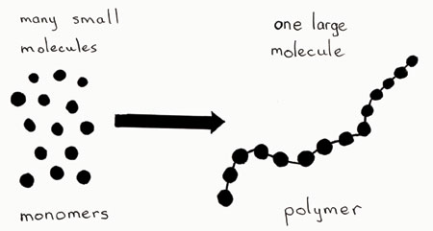
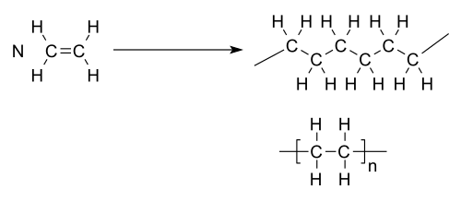
Definitions
What is Polymer?
The term polymer refers to molecules formed from several building blocks, called monomers, usually connected by covalent bonds.
Polymer
poly=many; mer=Part
Monomer
mono=single; mer=Part
Polymer is a long-chain molecule that is composed of many repeating units of identical structure.
Monomer; any chemical molecule that can form two (or more) bonds can be used as a monomer for the synthesis of macromolecules.

Slide 6
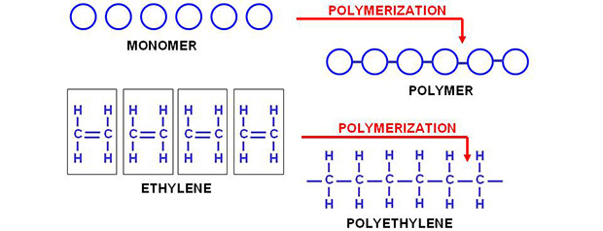
Definitions
What means by Polymerization?
Fundamental Process in which monomers (low molecular weight compounds) linked into long repeating units (chains) to form polymers (high molecular weight).
Example

Slide 7
Definitions
Molar Mass Parameters
Small molecules can usually be characterized by a particular molar mass and have the same molar mass.
For polymers; most polymerization methods result in a mixture of molecules with different chain lengths, each chain, in some cases, being made up of a very large variety of monomer units.
The molar mass of a polymer can also be defined by an average value, but for a broad distribution the average can be calculated in several different ways.

Slide 8
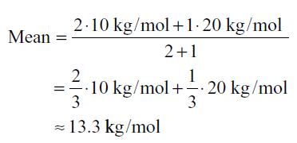
Definitions
Molar Mass Parameters
Example; Assume that a polymer sample contains three separate molecules;
two of which have a molar mass of 10,000 g/mol and the third has a molar mass of 20,000 g/mol.
Mathematically; The average molar mass (number average molar mass (M_{n})) = 13,333 g/mol.
The number average molar mass (weight average molar mass (M_{w}))
From a material scientist’s point of view, the material consists of polymers with a molar mass of 10,000 g/mol and the other half of polymers with a molar mass of 20,000 g/mol.
From this perspective it makes sense to assume a mean value of ((10+20)/2) = 15,000 g/mol.

Slide 9
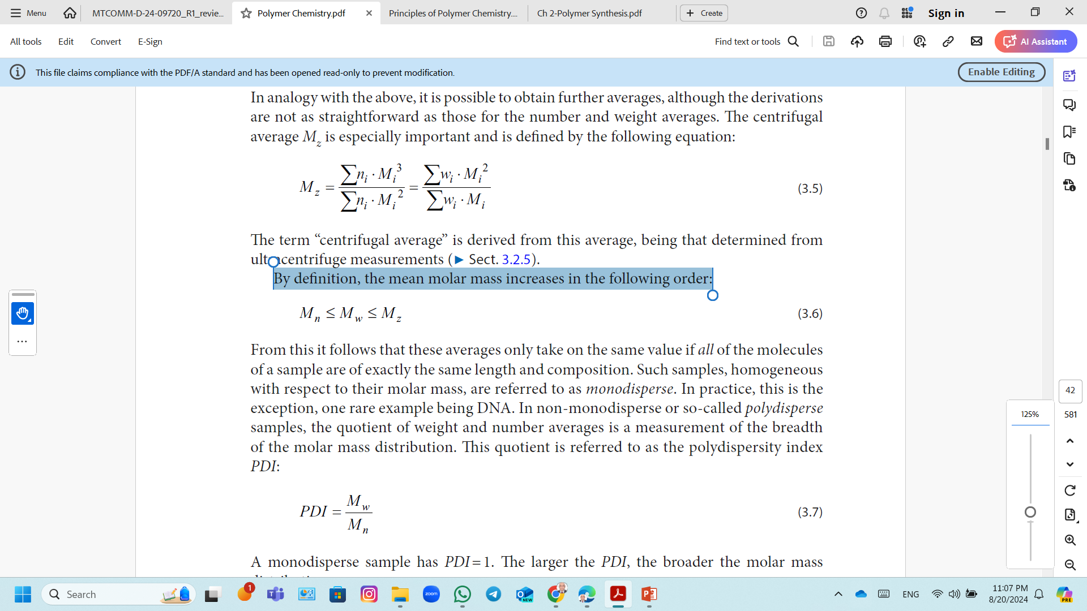
Definitions
Molar Mass Parameters
For all synthetic polydisperse polymers
Homogeneous with respect to their molar mass, are referred to as monodisperse.
In non-monodisperse or so-called polydisperse samples.
The polydispersity index (PDI): the quotient of weight and number averages is a measurement of the breadth of the molar mass distribution.
A monodisperse sample has PDI = 1.
The larger the PDI, the broader the molar mass distribution.
M_{w} and M_{n} can be determined using Gel Permeation Chromatography (GPC)/Size Exclusion Chromatography (SEC).

Slide 10
Definitions
What Degree of Polymerization or (DP)?
The degree of polymerization (n); the average number of repeating units in the polymeric chain.
Polyethene: (C₂H₄)_{n} , where n stands for DP
n = an integer “the degree of polymerization”
-A- = the repeating unit.
There is no definitive limit on the number of repeating units required to meet the definition of the polymer.
Macromolecules that are composed of relatively few repeating units (2-20 units) called oligomers (“oligo” = “few”) is used for such molecules.
“All polymers are macromolecules, but all macromolecules are not necessary polymers”

Slide 11
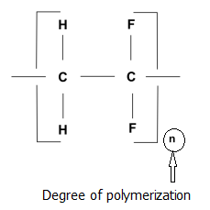
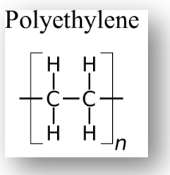
Definitions
How to Calculate Degree of Polymerization?
A polymer sample usually contains a distribution of chains with different degrees of polymerization.
The degree of polymerization can be calculated by using the following relationship if a molecular weight of a polymer molecule is known.
DP is the degree of polymerization and
M is the molecular weight of the polymer,
M₀ is the formula weight of the repeating unit.
DP = M/Mo
Example: Calculate the degree of polymerization of a sample of polyethylene [ (CH₂-CH₂)_{n}], which has a molecular weight of 150,000 g/mol.
The molecular weight of a repeating unit;
M_{o}= (12 x 2 + 1 x 4) g/ mol = 28 g/mol
DP = M/M_{o} = 150,000 / 28 = 5.35 x 10³
The molecule contains 5.35 x 10³ of repeat units.

Slide 12
Classification of Polymers
Since Polymers are numerous in number with different behaviors and can be naturally found or synthetically created, they can be classified in various ways.
The following below are some basic ways in which we classify polymers:
1) Classification Based on Structure
2) Classification Based on origin
3) Classification Based on Monomer Composition (Type of Repeating Units)
4) Classification Based on Polymer Architectures
5) Classification of Polymers Based on Thermal Response
6) Classification Based on Molecular Forces
7) Classification Based on Polymerization

Slide 13

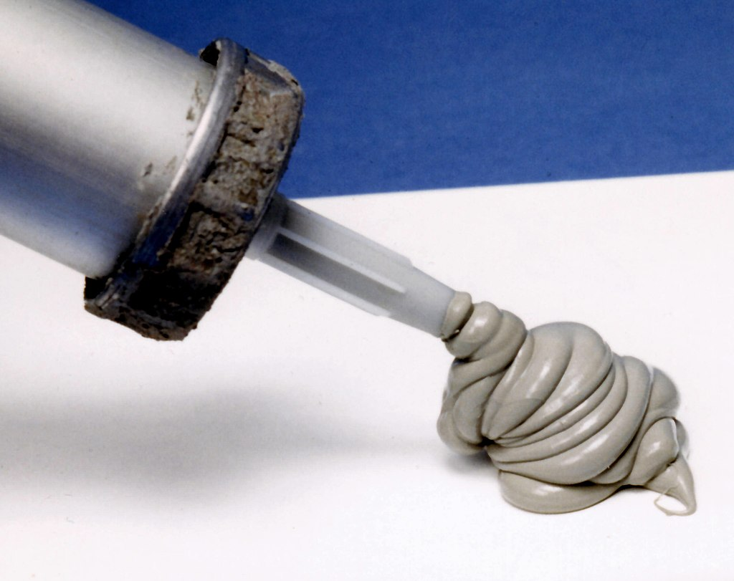

Classification of Polymers
1) Classification of Polymers Based on Structure
Depending on the chemical constituents present in their structures, polymers can also be divided into:
(i) Organic Polymers
If the carbon atoms are present in the main chain of the polymers along with the other elements, such as H, O, N etc.
Most of the polymers are included in this class.
(ii) Inorganic Polymers
If the main chain of the polymers are formed by inorganic elements, such as Si, P, S, N etc. and do not have any carbon atom in the main chain.
However, in the side chain carbon containing moiety may be present
Polysiloxanes or Silicone (Inorganic polymer)

Slide 14
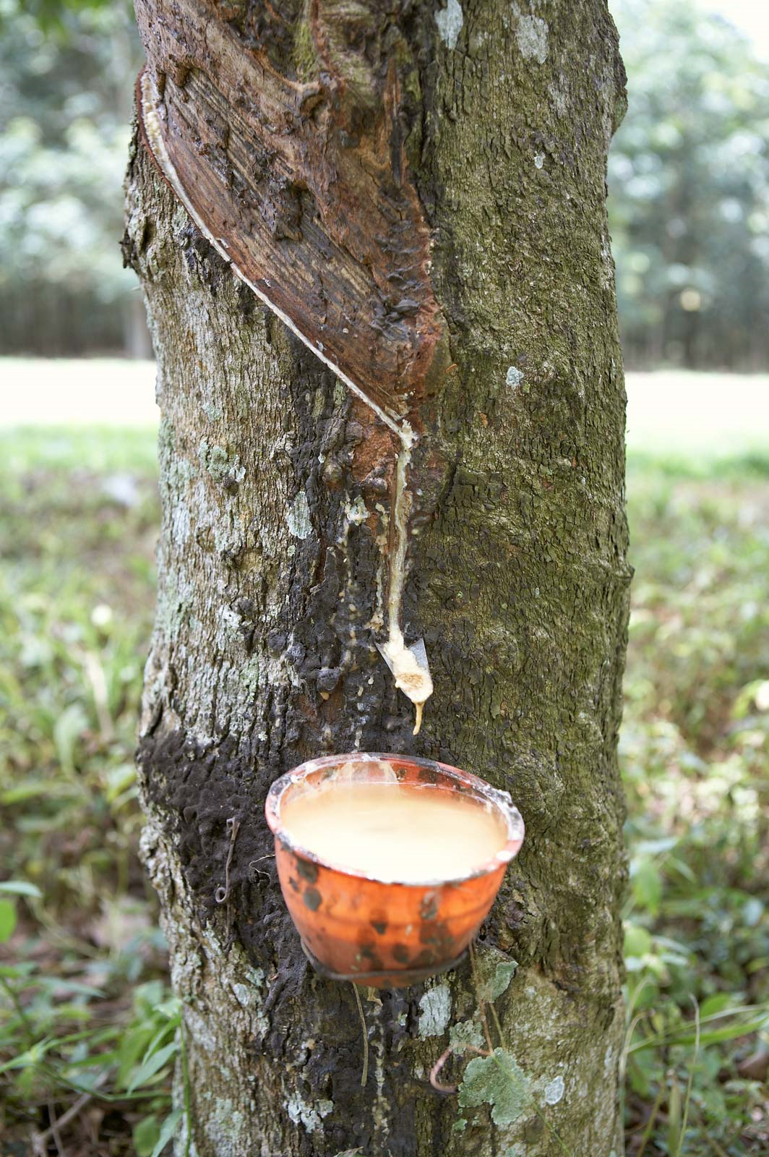
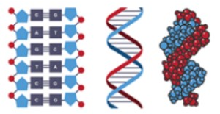
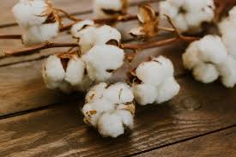
Classification of Polymers
2) Classification of Polymers Based on Origin (Source)
(i) Natural Polymers
Natural polymers are obtained from nature, e.g., plant origin, animal origin.
Biologically degradable polymers are also present, called biopolymers.
Examples; Proteins (which are found in humans and animals alike), Cellulose and Starch (which are found in plants) or Rubber (which we harvest from the latex of a tropical plant ).
Rubber
Cellulose
DNA

Slide 15
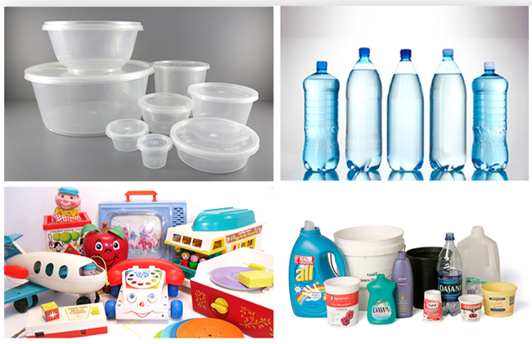
Classification of Polymers
2) Classification of Polymers Based on Origin (Source)
(ii) Synthetic Polymers
Synthetic polymers have been prepared by humans in laboratories and are currently produced industrially.
Example; Polyethylene (a mass-produced plastic which we use in packaging) or Nylon Fibers (commonly used in our clothes, fishing nets etc.)
Polyethylene & polyvinyl chloride

Slide 16
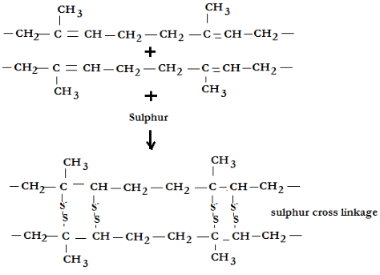
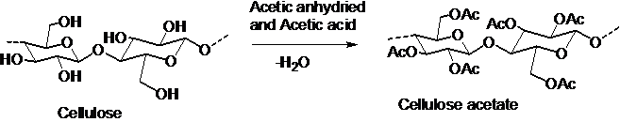
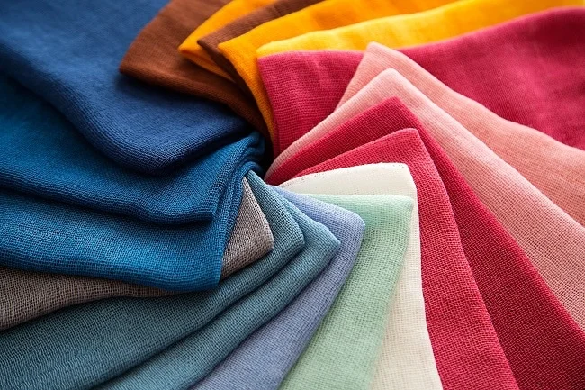
Classification of Polymers
2) Classification of Polymers Based on Origin (Source)
(iii) Semi-Synthetic Polymers
Semi-synthetic polymers are polymers obtained by making modification in natural polymers artificially in a lab.
Example; Vulcanized Rubber (Sulphur is used in cross bonding the polymer chains found in natural rubber) Cellulose acetate (rayon) etc.
Cellulose acetate fibres are used for textiles and clothing

Slide 17


Classification of Polymers
3) Classification Based on Monomer Composition (Type of Repeating Units)
Polymer
Homopolymer
Copolymer
Block
Graft
Alternating
Random

Slide 18
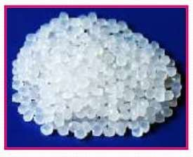
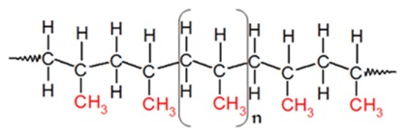
Classification of Polymers
3) Classification Based on Monomer Composition (Type of Repeating Units)
(i) Homopolymers
Homopolymers are synthesized from a single type of monomer.
Homopolymers are consists of chains with identical bonding linkages to each monomer unit.
Consist of only one type of constitutional repeating unit (A)
Polypropylene (PP)

Slide 19
Classification of Polymers
3) Classification Based on Monomer Composition (Type of Repeating Units)
(ii) Copolymers
They are polymers in which two or more different monomers are joined together.
Types of copolymers.
Random (Statistical) copolymers.
Alternating copolymers.
Block copolymers.
Graft copolymers

Slide 20
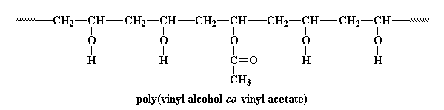
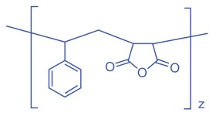

Classification of Polymers
3) Classification Based on Monomer Composition (Type of Repeating Units)
Random (Statistical) Copolymers
Two or more different repeating units are distributed randomly.
CH₂=CHOH
Alternating Copolymers
They are made of alternating sequences of different monomers.
Poly(styrene-alt-maleic anhydride)

Slide 21

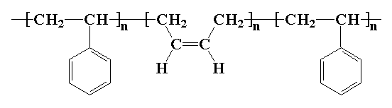
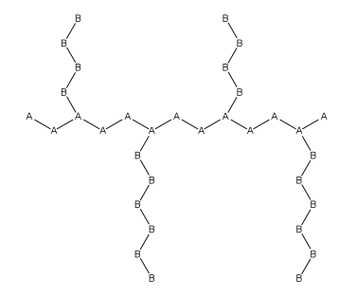
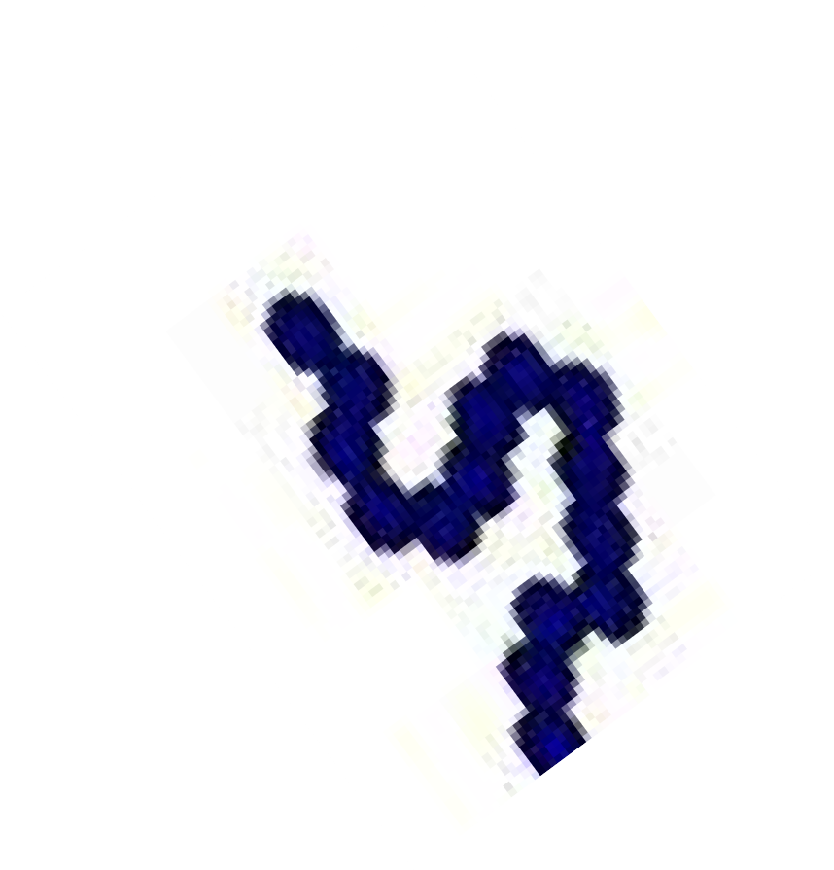
Classification of Polymers
3) Classification Based on Monomer Composition (Type of Repeating Units)
Block Copolymer
Long sequence of a monomer are followed by long sequence of another monomer
Poly(styrene-butadiene-styrene)
Graft Copolymer
One type of monomers with branches of another type.
They are more thermostable than their homopolymer counterparts.

Slide 22
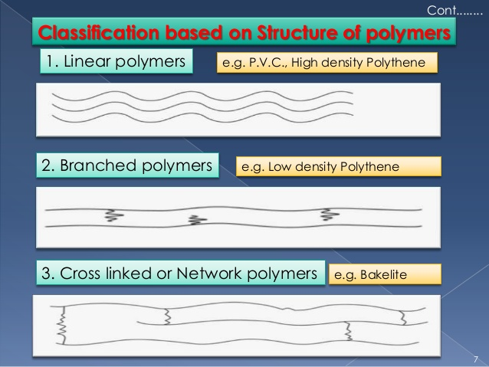
Classification of Polymers
4) Classification Based on Polymer Architectures
(i) Linear Polymers
Linear Polymers are similar in structure to a long straight chain which identical links connected to each other.
These polymers have high melting points and are of higher density.
Example: High density polyethylene (HDPE).
(ii) Branched Chain Polymers
Branched Chain Polymers are made of branching of linear chains of monomers.
They have low melting points and low densities.
Example: Low-density polyethylene (LDPE) used in plastic bags etc.

Slide 23
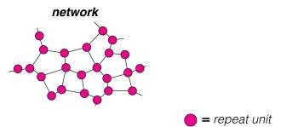
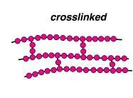
Classification of Polymers
4) Classification Based on Polymer Architectures
(iii) Cross-linked Polymers/Network Polymers
Cross-linked Polymers/Network Polymers are formed by tri-functional monomers or more with a strong covalent bond between the various linear polymer chains.
These polymers are brittle and hard.
A crosslink is a bond between two polymer chains.
These crosslinks can be either ionic bonds or covalent bonds.
These crosslinks can be formed either during the process of polymerization or after polymerization.
Crosslinks can be formed from chemical reactions using crosslinking reagents.

Slide 24
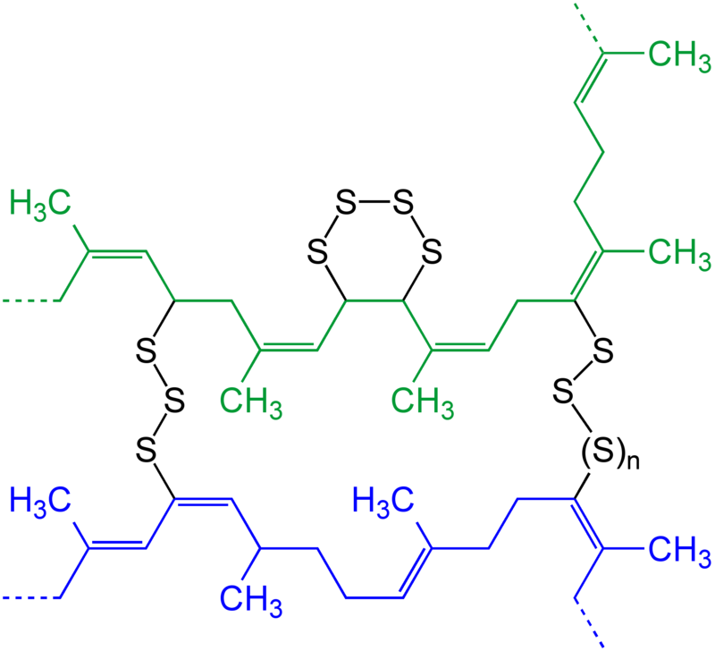
Classification of Polymers
4) Classification Based on Polymer Architectures
(iii) Cross-linked Polymers/Network Polymers
The most common example of crosslinked polymers is the vulcanized rubber .
Since natural rubber is not enough stiff and rigid, rubber is vulcanized.
It is heated with sulfur, so sulfur molecules form covalent bonds in the rubber polymer chains, connecting the chains with each other.
This makes rubber a stiff, rigid material and durable.
Video about Vulcanization of Rubber
Vulcanization of Rubber
https://www.youtube.com/watch?v=sFjGQxUTVJE

Slide 25
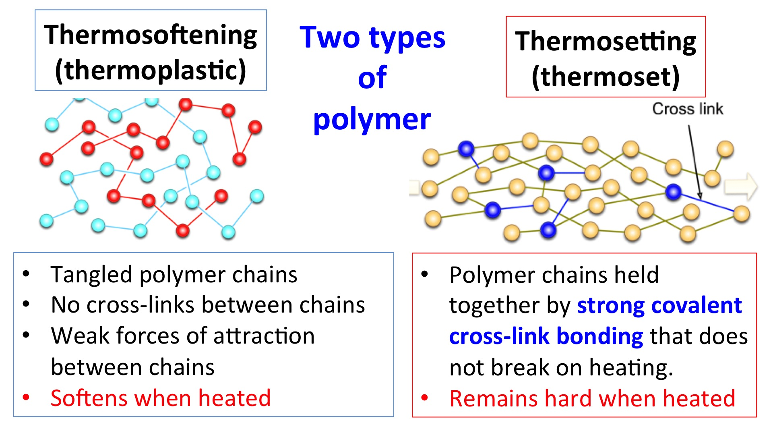
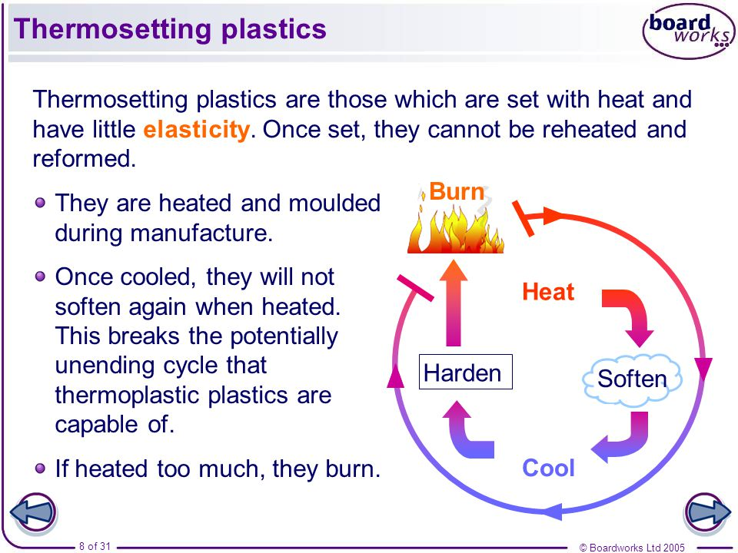
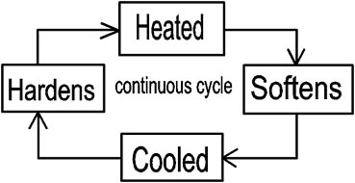
Classification of Polymers
5) Classification of Polymers Based on Thermal Response
Example
Polystyrene,
polyethylene,
polypropylene
Example
Fiberglas,
melamine

Slide 26
Classification of Polymers
6) Classification of Polymers Based on Molecular Forces
Intramolecular forces are the forces that hold atoms together within a molecule.
In polymers, strong covalent bonds join atoms to each other in individual polymer molecules.
Intermolecular forces (between the molecules) attract polymer molecules towards each other.
Thermoplastics
Thermosetting
Fibres
Elastomers
1
The Four types of
Polymers
In which classified
On:
Molecular Forces
2
3
4

Slide 27
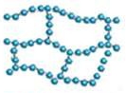
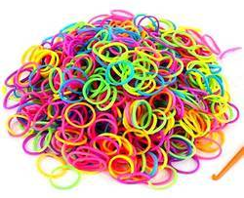
Classification of Polymers
6) Classification of Polymers Based on Molecular Forces
(i) Elastomers
Elastomers are rubber-like solid polymers, that are elastic in nature (i.e., the polymer can be easily stretched by applying a little force).
They have weak intermolecular forces between the chains that allowing polymer to be stretched.
Example; Rubber bands (or hair bands).
Applying a little stress elongates the band and by removing that stress the rubber band taking up its original form.
This happens as we introduce crosslinks between the polymer chains which help it in retracting to its original position and taking its original form.
Rubber bands
(or hair bands)

Slide 28
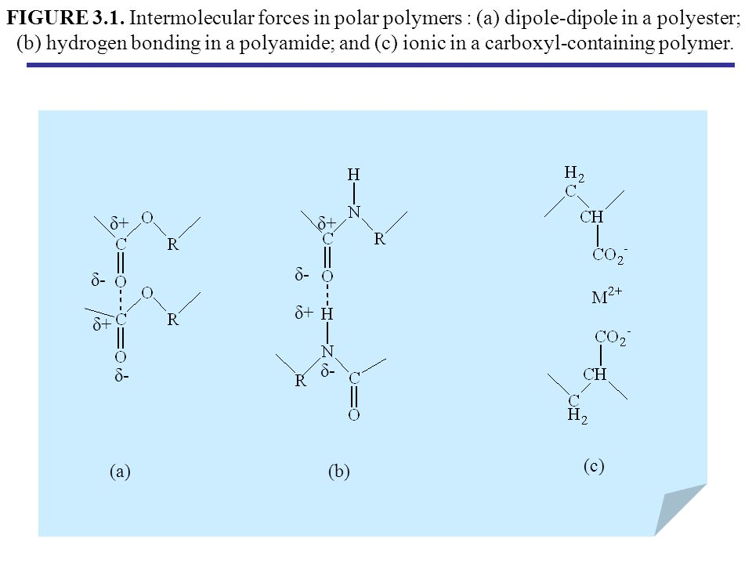
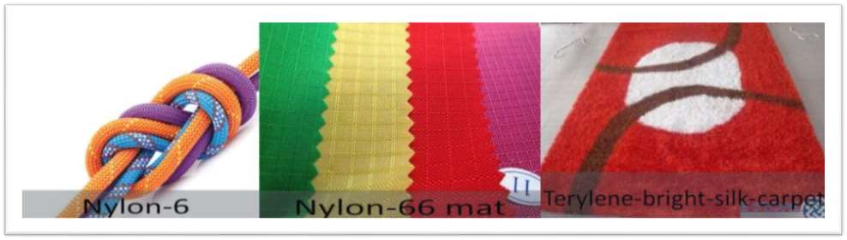
Classification of Polymers
6) Classification of Polymers Based on Molecular Forces
(ii) Fibres
They are a thread like in nature and can easily be woven.
They have strong intermolecular forces between the chains giving them less elasticity and high tensile strength.
The intermolecular forces may be hydrogen bonds or dipole-dipole interaction.
Fibres have sharp and high melting points.
Example; Nylon-66, which is used in carpets and apparels

Slide 29
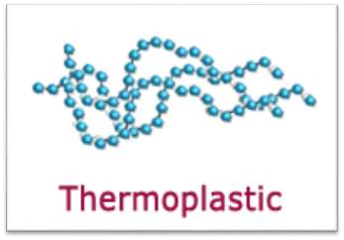
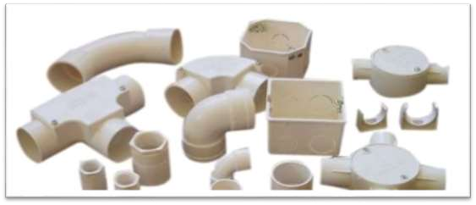
Classification of Polymers
6) Classification of Polymers Based on Molecular Forces
(iii) Thermoplastics
Thermoplastic polymers are long-chain polymers in which intermolecular forces (Van der Waal’s forces) hold the polymer chains together.
These polymers when heated are softened (thick fluid like) and hardened when they are allowed to cool down, forming a hard mass.
They do not contain any crosslinked bonds and can easily be shaped by heating and using moulds.
Example; Polystyrene and PVC (which is used in making pipes).

Slide 30



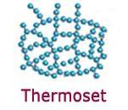
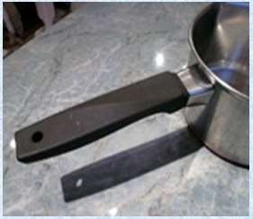
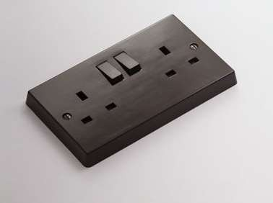
Classification of Polymers
6) Classification of Polymers Based on Molecular Forces
(iv) Thermosetting
Thermosetting plastics are polymers which are semi-fluid in nature with low molecular masses.
When heated, they start cross-linking between polymer chains, hence becoming hard and infusible.
They form a three-dimensional structure on the application of heat.
This reaction is irreversible in nature.
Example; Bakelite, which is used in making electrical insulation.
Bakelite

Slide 31
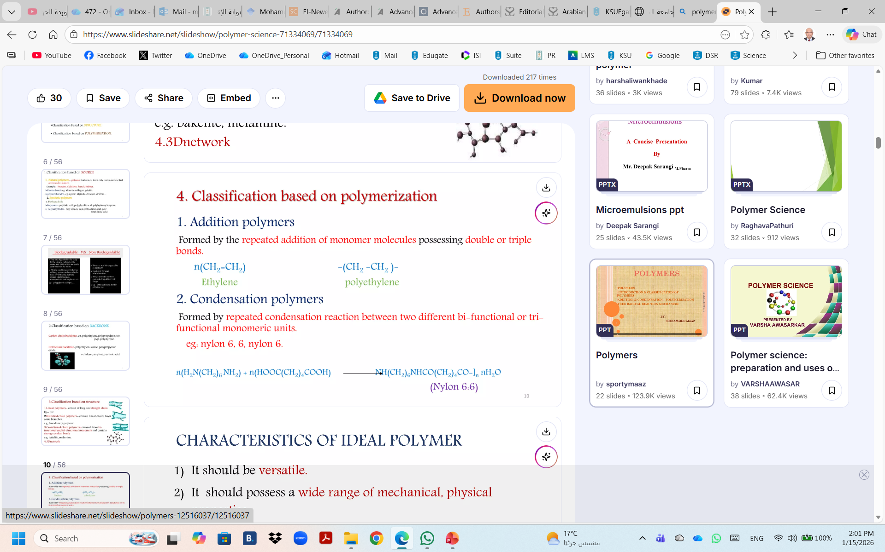
Classification of Polymers
7) Classification of Polymers Based on Polymerization
(i) Addition polymers
They are formed by the repeated addition of monomer molecules possessing double or triple bonds.
e.g. polyethylene
(ii) Condensation polymers
They are formed by the repeated condensation reaction between two different bi-functional or tri-functional monomeric units.
e.g. nylon 6, 6.

Slide 32
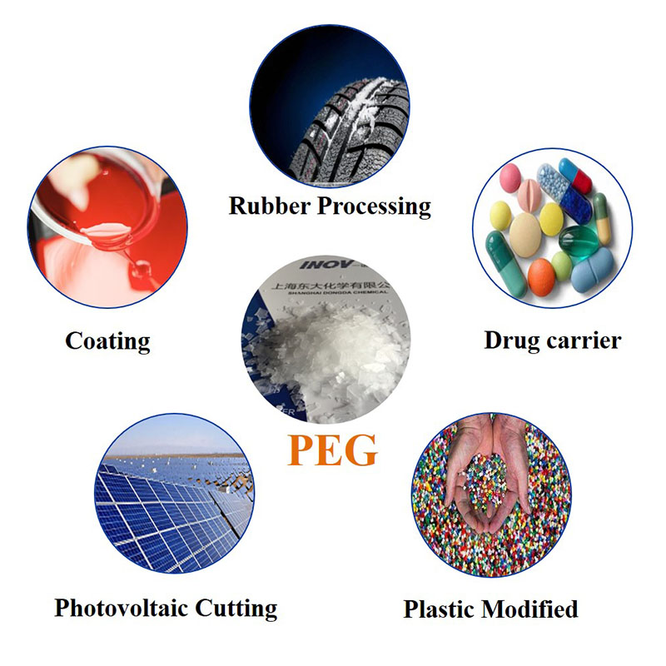
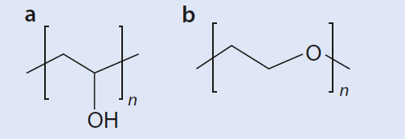
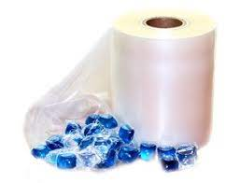
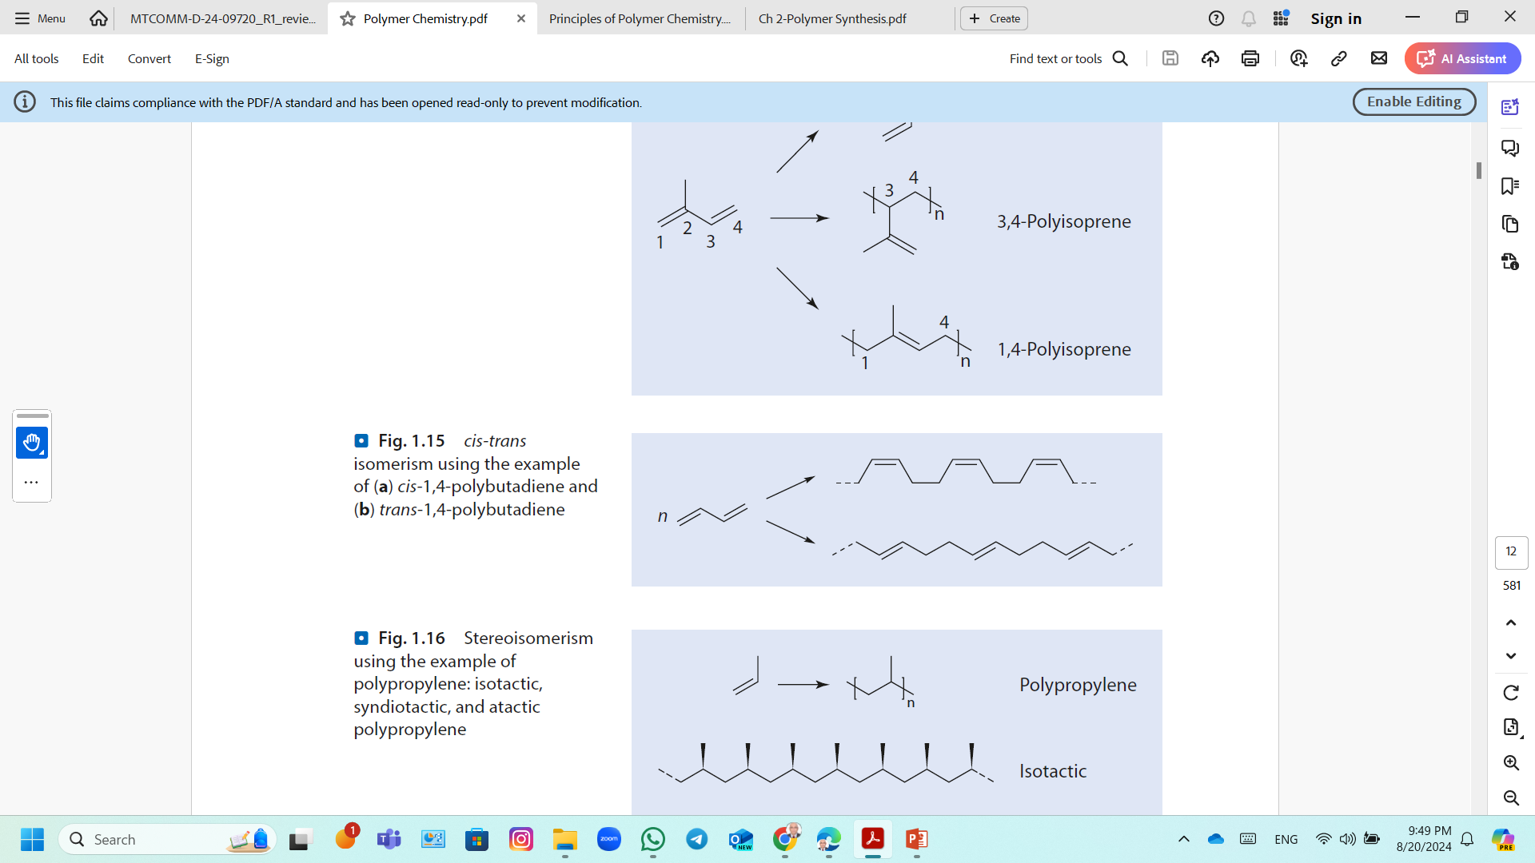
Isomerism in Polymers
Structural Isomerism
For example; poly(vinyl alcohol) and polyethylene oxide are structurally isomeric polymers.
(a) polyvinyl alcohol
(b) polyethylene glycol
Stereoisomerism
The cis-trans isomerism is particularly important for polymers with a double bond in the main chain.
Example; cis- and trans-1,4-polybutadiene
The cis Polybutadiene (butadiene rubber) is an amorphous, sticky material.
The trans isomer is a (partially) crystalline material with a high melting point.
cis-1,4-polybutadiene
butadiene
trans-1,4-polybutadiene

Slide 33
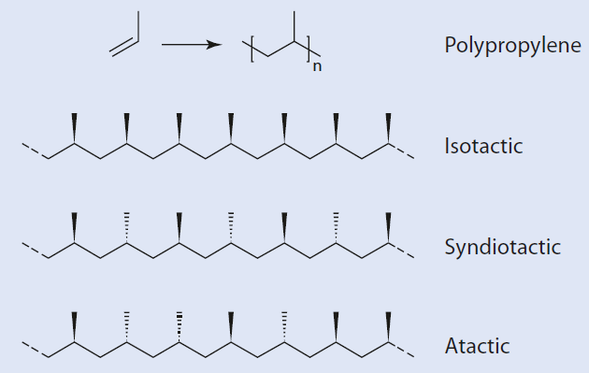
Isomerism in Polymers
Tacticity
The three types of polypropylene are diastereomers;
Isotactic polypropylene (it-PP); if all its tertiary carbon atoms are configured identically.
Syndiotactic polypropylene (st-PP); has an alternating configuration of its methyl groups along the chain,
Atactic polypropylene (at-PP); the spatial orientation of the methyl groups is irregular.
it-PP is a highly crystalline material with a melting point of 160ºC
at-PP cannot crystallize because of its irregular structure, and it is an amorphous, sticky material.

Slide 34
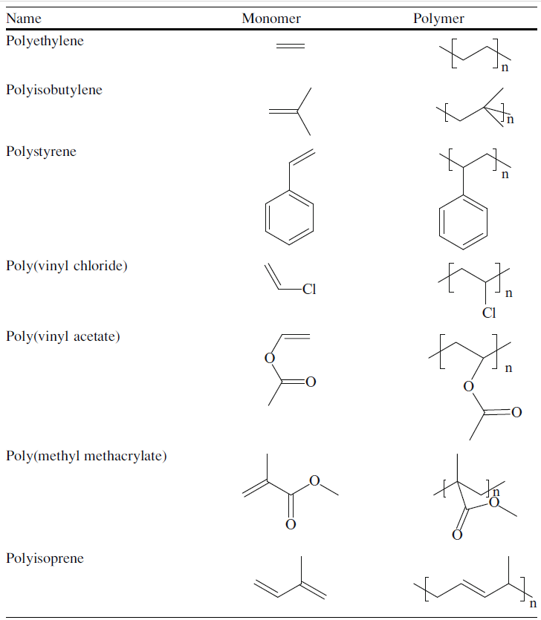
Nomenclature of Polymers
Nomenclature of Chain-Growth Polymers
The prefix, Poly, is then followed by the name of the monomer.
The monomer is named by two words or is preceded by a number, like methyl methacrylate, parentheses are used.
Examples; poly(methyl methacrylate) or poly(1-hexene).

Slide 35
Nomenclature of Polymers
Nomenclature of Chain-Growth Polymers
Random copolymers are designated by the prefix co,
Examples; poly(butadiene-co-styrene) and poly(vinyl chloride-co-vinyl acetate).
Alternating copolymers are designated by the prefix alt,
Examples; poly(ethylene-alt-carbon monoxide).
The prefix g describes graft copolymers
Example; if polystyrene is graft copolymerized with polyethylene, the product is called poly(ethylene-g-styrene).
A more complex example can be poly(butadiene-co-styrene-g-acrylonitrile-co-vinylidine chloride).
The prefix b describes block copolymers.
Example; poly(acrylonitrile-b-methyl methacrylate) or poly(methyl methacrylate-b-acrylonitrile).

Slide 36
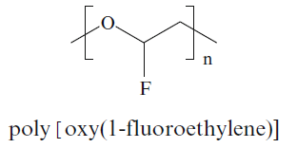
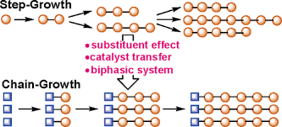

Nomenclature of Polymers
The Nomenclature Adopted By IUPAC
According to the definitive rules for nomenclature of organic chemistry
Examples; is a polymer with oxy(1-fluoroethylene) constitutional repeat unit:
The following are examples of simple constitutional repeat units:

Slide 37


Nomenclature of Polymers
Naming Polymers According To Functional Group Name
According to name of functional group in the polymer backbone.
Example; Polyester.
Polyester
A polyester from ethylene glycol and terephthalic acid is called poly(ethylene terephthalate).

Slide 38



Nomenclature of Polymers
Naming Polymers According To The Source
A product from ring opening polymerization
Example; a polymer of caprolactam might be called polycaprolactam.
Polycaprolactam
(Nylon 6)
Naming Polymers Based On Its Trade Name
Some polymers are named by their manufacturer commercial names such as; Teflon, Nylon and Bakelite.

Slide 39

Nomenclature of Polymers
Abbreviation of Polymers Name:
There is widespread agreement on the abbreviation for large number of important polymers.
These abbreviation are convenient and widely used:

Slide 40
Adjustments Influences on Properties of Polymers
The properties of polymers can be varied within a broad range. The most important adjustments are:
Type of monomers
The chemical bond between the repeating units—for example, ether vs amide bonds
Degree of polymerization
Architecture of the chain—for example, linear or cross-linked
Incorporation of chemically different monomers along the polymer chains (copolymerization)
Sequence of monomers in a copolymerization—for example, alternately or in long sequences, which consist of only one type of monomer
Specific interactions between the components of the polymer chain, e.g., hydrogen bonding or dipole–dipole interactions
In addition to many other factors, such as
Admixtures (additives)
Material processing.

Slide 41
Characteristics of Ideal Polymer
It should be versatile.
It should possess a wide range of mechanical, and physical properties.
It should be non-toxic.
It should be inexpensive.
Easy to fabricate.
It should be inert to host issue.

