Slide 1

CHEM 241
Organic Chemistry II
FOR CHEMISTRY’ STUDENTS, COLLEGE OF SCIENCE
PRE-REQUISITES COURSE; CHEM 240
CREDIT HOURS; 2 (2+0)
Organo-halogen Compounds Based on NCERT

Slide 2
Classification of Haloalkanes and Haloarenes
The replacement of hydrogen atom(s) in a hydrocarbon, aliphatic or aromatic, by halogen atom(s) (X = F, Cl, Br, or I; fluoro, chloro, bromo, and iodo compounds) results in the formation of alkyl halide (haloalkane) and aryl halide (haloarene)
On the basis of number of halogen atoms; Haloalkanes and haloarenes may be classified as follows:
mono, di, or polyhalogen (tri-,tetra-, etc.) compounds depending on whether they contain one, two or more halogen atoms in their structures.
Monohalocompounds may further be classified according to the hybridization of the carbon atom to which the halogen is bonded, as following:
⇓

Slide 3
Classification of Haloalkanes and Haloarenes
Compounds Containing sp³ C—X Bond (X= F, Cl, Br, I)
(a) Alkyl halides or haloalkanes (R—X)
The halogen atom is bonded to an alkyl group (R) & the general formula is C_{n}H_{2n+1}X.
They are classified as primary, secondary or tertiary according to the nature of carbon to which halogen is attached.
(b) Allylic halides
The halogen atom is bonded to an sp³-hybridized carbon atom next to carbon-carbon double bond (C=C).
(c) Benzylic halides
The halogen atom is bonded to an sp³-hybridized carbon atom next to an aromatic ring.

Slide 4
Classification of Haloalkanes and Haloarenes
Compounds Containing sp² C—X Bond (X= F, Cl, Br, I)
(a) Vinylic halides
These are the compounds in which the halogen atom is bonded to an sp²-hybridized carbon atom of a carbon-carbon double bond (C = C).
(b) Aryl halides
These are the compounds in which the halogen atom is bonded to the sp²-hybridized carbon atom of an aromatic ring.

Slide 5
Nomenclature of Haloalkanes and Haloarenes
Haloalkanes
Common names; alkyl halides are derived by naming the alkyl group followed by the halide. Alkyl halide
IUPAC system; alkyl halides are named as halosubstituted hydrocarbons.
Aromatic Halides
Aromatic Halides (aryl halides). When halogen atom is bonded to aromatic ring. For dihalogen derivatives, the prefixes o-, m-, p- are used in common system but in IUPAC system, the numerals 1,2; 1,3 and 1,4 are used.

Slide 6
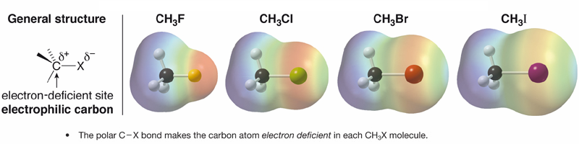
Nature of C-X Bond
Since halogen atoms are more electronegative than carbon, the carbon-halogen bond of alkyl halide is polarized; the carbon atom bears a partial positive charge whereas the halogen atom bears a partial negative charge.
Carbon-Halogen (C—X) Bond Lengths, Bond Strength and Dipole Moments
Dipole moment (Debye) | Bond Strength (kJ/mol) | Bond Length (Å) | Bond
1.847 | 452 | 1.39 | CH₃–F
1.860 | 351 | 1.78 | CH₃–Cl
1.830 | 293 | 1.93 | CH₃–Br
1.636 | 234 | 2.14 | CH₃–I

Slide 7
Importance of Organohalogen Compounds
a) Solvents: Alkyl halides are used as solvents for relatively non-polar compounds: CCl₄, CHCl₃, CCl₃CH₃, CH₂Cl₂, ….etc.
They are good solvents for fats and oils.
Polychloro compounds, such as trichloroethylene and tetrachloroethylene, are widely used as solvents for dry cleaning.
b) Reagents:
Alkyl halides are used as the starting materials for the synthesis of many compounds.
Alkyl halides are used in nucleophilic reactions, elimination reactions, formation of organometallics, and etc.
c) Refrigerants: Freons (ChloroFluoroCarbon)
d) Pesticides: DDT, Aldrin, Chlordan
DDT: [1,1,1-trichloro-2,2-bis(p-chlorophenyl)ethane]
e) Herbicides: Kills broad leaf weeds but allow narrow leaf plants to grow unharmed and in greater yield
2,4-DCPA
2,4-dichlorophenoxyacetic acid
f) Chlorine containing antibiotic, chloramphenicol: is very effective for the treatment of typhoid fever.
g) Our body produces iodine containing hormone, thyroxine: the deficiency of which causes a disease called goiter.

Slide 8
Physical Properties of Organic Halides
Solubility
All organic halides are insoluble in water.
All organic halides are soluble in common organic solvents (benzene, ether, etc.).
Density
The simple monofluoro and monochloro compounds are less dense than water,
The monobromo and monoiodo derivatives have densities greater than water.
As the number of halogen atoms increases, the density increases.
Iodide |  | Bromide |  | Chloride |  | Flouride |  | Group
Density (g mL^{–1}) | bp (°C) | Density (g mL^{–1}) | bp (°C) | Density (g mL^{–1}) | bp (°C) | Density (g mL^{–1}) | bp (°C)
2.28²⁰ | 42.5 | 1.73⁰ | 3.6 | 0.92²⁰ | –23.8 | 0.84^{–60} | –78.4 | Methyl
1.95²⁰ | 72 | 1.46²⁰ | 38.4 | 0.91¹⁵ | 13.1 | 0.72²⁰ | –37.7 | Ethyl
1.74²⁰ | 102 | 1.35²⁰ | 70.8 | 0.89²⁰ | 46.6 | 0.78^{–3} | –2.5 | Propyl
1.61²⁰ | 130 | 1.27²⁰ | 101 | 0.89²⁰ | 78.4 | 0.78²⁰ | 32 | Butyl
2.04²⁰ | 56 | 1.52¹⁴ | 16 | 0.91²⁰ | –13.9 | 0.68²⁶ | –72 | CH₂=CH–
1.84²² | 102-103 | 1.40²⁰ | 70 | 0.94²⁰ | 45 |  | –3 | CH₂=CHCH₂–
1.82²⁰ | 189 | 1.52²⁰ | 155 | 1.10²⁰ | 132 | 1.02²⁰ | 85 | C₆H₅–
1.73²⁵ | 93 ¹⁰ | 1.44²² | 201 | 1.10²⁵ | 179 | 1.02²⁵ | 140 | C₆H₅CH₂–

Slide 9
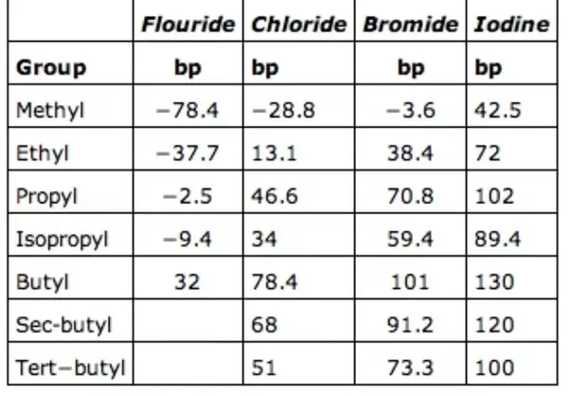
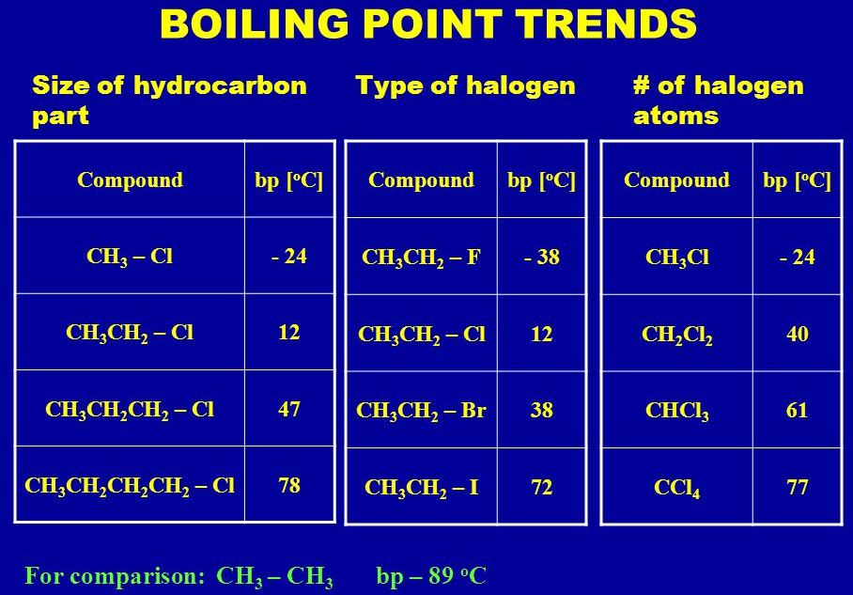
Physical Properties of Organic Halides
Boiling points
Within a series of halides, the boiling points increase with increasing molecular weights.
This is due to the increase in van der Waals forces when the size and mass of the halogen atom increases.
Within a homologous series, the boiling points also increase regularly with molecular weights.
Within a series of isomers, the straight-chain compound has the highest boiling point, and the most branched isomer the lowest boiling point.
Haloalkanes generally have a boiling point that is higher than the alkane they are derived from due to
The increased molecular weight due to the large halogen atoms
The increased intermolecular forces due to the polar bonds, and the increasing polarizabilty of the halogen.

Slide 10

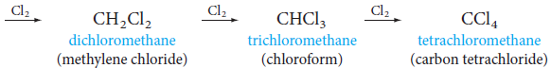

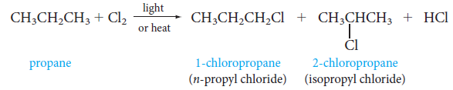

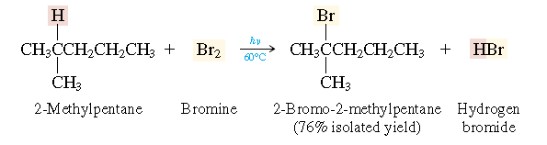
Preparation of Halogen Compounds
1- From Hydrocarbons
(a) By free radical halogenation; Alkyl halide
Free radical chlorination or bromination of alkanes gives a complex mixture of isomeric mono- and polyhaloalkanes,
Rate of halogenation:

Slide 11
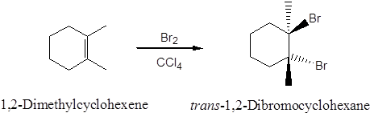
Preparation of Halogen Compounds
(b) From alkenes
(i) Addition of hydrogen halides: an alkene is converted to corresponding alkyl halide by reaction with hydrogen chloride, hydrogen bromide or hydrogen iodide.
(ii) Addition of halogens: addition of bromine in CCl₄ to an alkene resulting in the synthesis of vic-dibromides.

Slide 12
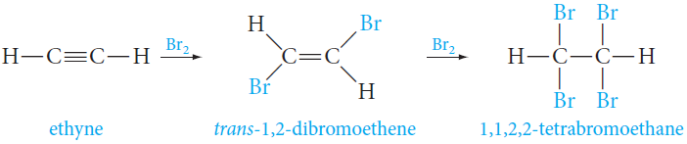
Preparation of Halogen Compounds
From Hydrocarbons
(iii) Halogenation of alkenes: Allyl halides
(c) From Alkynes
(i) Addition of HX to alkynes: Vinyl halides
(ii) Addition of Halogen: Bromine adds to alkynes and the addition occurs mainly trans.

Slide 13
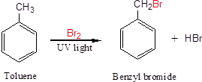
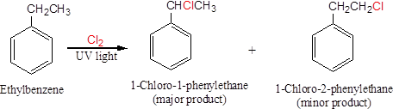
Preparation of Halogen Compounds
(d) By electrophilic substitution; Aryl halide
(i) Aryl chlorides and bromides can be easily prepared by electrophilic substitution of arenes with chlorine and bromine, respectively in the presence of Lewis acid catalysts like iron or iron(III) chloride.
(ii) Halogenation of an Alkyl Side Chain of Benzene derivatives; Benzyl halides

Slide 14
Preparation of Halogen Compounds
2- Sandmeyer’s reaction; Aryl halide
Mixing the solution of freshly prepared diazonium salt with cuprous chloride or cuprous bromide or potassium iodide results in the replacement of the diazonium group by –Cl or –Br or -I.

Slide 15



Preparation of Halogen Compounds
3- From Alcohols
The hydroxyl group of an alcohol is replaced by halogen on reaction with concentrated halogen acids, phosphorus halides or thionyl chloride.
The reactions of primary and secondary alcohols with HCl require the presence of a catalyst, ZnCl₂ .

Slide 16

with concentrated HCl at room temperature.
With tertiary alcohols, the reaction is conducted by simply shaking
The order of reactivity of alcohols is 3°>2°>1°.
The above methods are not applicable for the preparation of aryl halides
because the carbon-oxygen bond in phenols has a partial double bond character
and is difficult to break being stronger than a single bond.

Slide 17
Preparation of Halogen Compounds
Halogen Exchange
(i) Alkyl iodides are often prepared by the reaction of alkyl chlorides/bromides with NaI in dry acetone. This reaction is known as Finkelstein reaction.
(ii) The synthesis of alkyl fluorides is best accomplished by heating an alkyl chloride/bromide in the presence of a metallic fluoride such as AgF, Hg₂F₂, CoF₂ or SbF₃. The reaction is termed as Swarts reaction.
The manufacture of chlorofluoro compounds, known as Freons.

Slide 18
Reactions of Haloalkanes
The reactions of organic halides fall into three categories
(i) Nucleophiic substitution, or S_{N}, reactions.
Those in which the halogen is replaced by some other atom or group.
(ii) Elimination, or E, reactions.
Those that involve the loss of HX from the halide.
(iii) Reaction with metals (Formation of organometallic compounds).
Those that involve reaction with certain metals.

Slide 19
Reactions of Haloalkanes
Nucleophilic Substitution (S_{N}) Reactions
A nucleophile reacts with haloalkane (the substrate) having a partial positive charge on the carbon atom bonded to halogen.
The overall process describing any S_{N} reaction is
Nu:, is the nucleophile.
The nucleophile has an unshared electron pair available for bonding.
X, is the leaving group.
The leaving group is also a nucleophile.

Slide 20
Reactions of Haloalkanes
Mechanism of Nucleophilic Substitution (S_{N}) Reactions
Alkyl halides may undergo nucleophilic substitutions in two different ways:
(i) by a one-step mechanism.
(ii) by a two-step mechanism.
Which route is taken depends on
(i) The structure of the halide.
(ii) The nature of the solvent.
(iii) The strength of the nucleophile, Nu:.
In general;
Primary alkyl halides undergo nucleophilic substitutions by the one-step mechanism.
Tertiary alkyl halides undergo nucleophilic substitutions by the two-step mechanism.
Secondary halides react by either mechanism.
Let us consider the conversion of an alkyl halide to an alcohol by hydroxide.

Slide 21
Reactions of Haloalkanes
One-Step Mechanism: S_{N}² Reactions
The incoming nucleophile interacts with alkyl halide causing; the carbon-halide bond to break while forming a new carbon-OH bond.
These two processes take place in a single step and no intermediate is formed.
The nucleophile attacks the halogen-bearing carbon from the side opposite the leaving group; a so-called backside attack.
At the same time that the nucleophile attacks from the back side and the leaving group departs, the other bonds to the carbon invert (or “flip over”).
This flipping of the bonds, known as the Walden inversion.

Slide 22
Reactions of Haloalkanes
One-Step Mechanism: S_{N}² Reactions
Bimolecular Nucleophilic Substitution (S_{N}²) reaction.
The reaction rate depends on the concentrations of both reactants, the alkyl halide and the nucleophile.
For a given concentration of alkyl halide,
The rate of the reaction increases proportionally with the concentration of hydroxide ion.
i.e. This means that if we double the concentration of hydroxide ion, but maintain the same concentration of alkyl halide, the S_{N} reaction proceeds twice as fast.

Slide 23
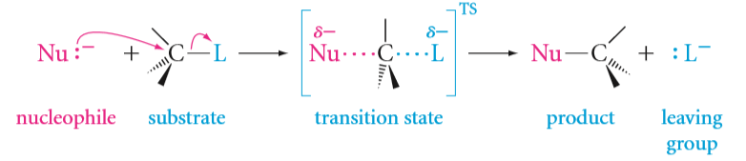
Reactions of Haloalkanes
One-Step Mechanism: S_{N}² Reactions
Summary;
1) S_{N}² reaction
S = substitution;
N = nucleophilic;
2 = bimolecular.
2) The S_{N}² reaction is a single, concerted process.
3) The rate of S_{N}² reaction depends on the concentrations of both the alkyl halide and the nucleophile.
4) The reaction is fastest for primary halides and slowest for tertiary halides.
5) All S_{N}² reactions proceed with complete inversion of configuration.

Slide 24
Reactions of Haloalkanes
Two-Step Mechanism: S_{N}¹ Reactions
The reaction between tert-butyl bromide and hydroxide ion yields tert-butyl alcohol and follows the first order kinetics,
i.e., the rate of reaction depends upon the concentration of only one reactant, which is tert- butyl bromide.
A mechanism that accounts for these facts involves two steps.
Step 1. The polarized C—Br bond undergoes slow cleavage to produce a carbocation and a bromide ion.
This is the slow, rate-determining step.

Slide 25
Reactions of Haloalkanes
Two-Step Mechanism: S_{N}¹ Reactions
Step 2. The carbocation thus formed is then attacked by nucleophile to complete the substitution reaction.
This step occurs rapidly.
The nucleophile has as much chance to bond with the positively charged carbon;
on the same side as the departed leaving group (giving retention of configuration)
on the back side (leading to inversion).
If the starting alkyl halide were optically active, the product would be a racemic mixture.

Slide 26
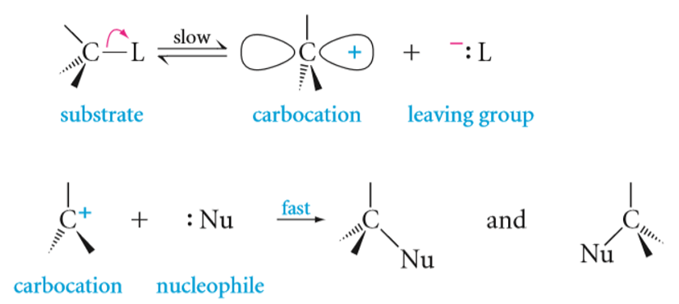

Reactions of Haloalkanes
Two-Step Mechanism: S_{N}¹ Reactions
Summary;
1) S_{N}¹ reaction
S = substitution;
N = nucleophilic;
1 = unimolecular.
2) The S_{N}¹ reaction is a two-step process.
3) The rate-determining step is the formation of a carbocation.
4) The rates of S_{N}¹ reactions follow the order of stability of carbocation.
Benzylic > allylic = 3° > 2° > 1° halide
5) S_{N}¹ reactions proceed with racemization.

Slide 27
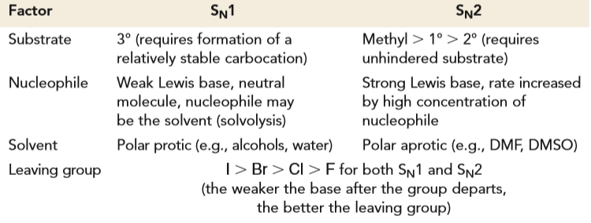
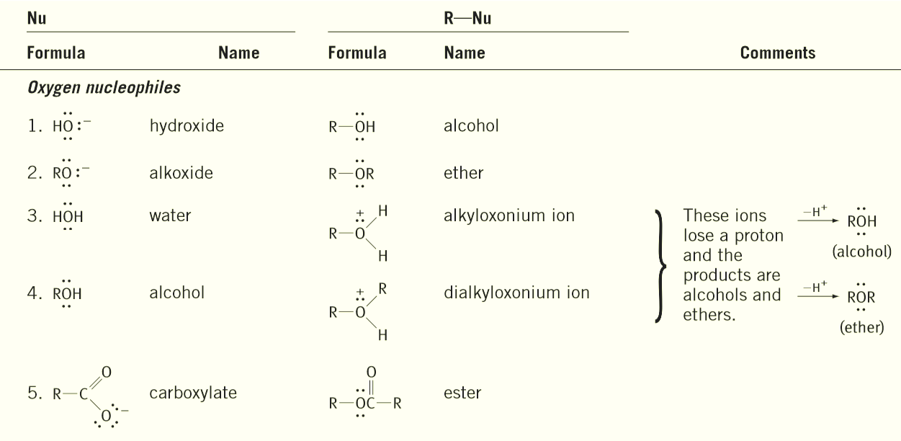
Factors Favoring S_{N}1 versus S_{N}2 Reaction:
Reactions of Common Nucleophiles with Alkyl Halides:

Slide 28
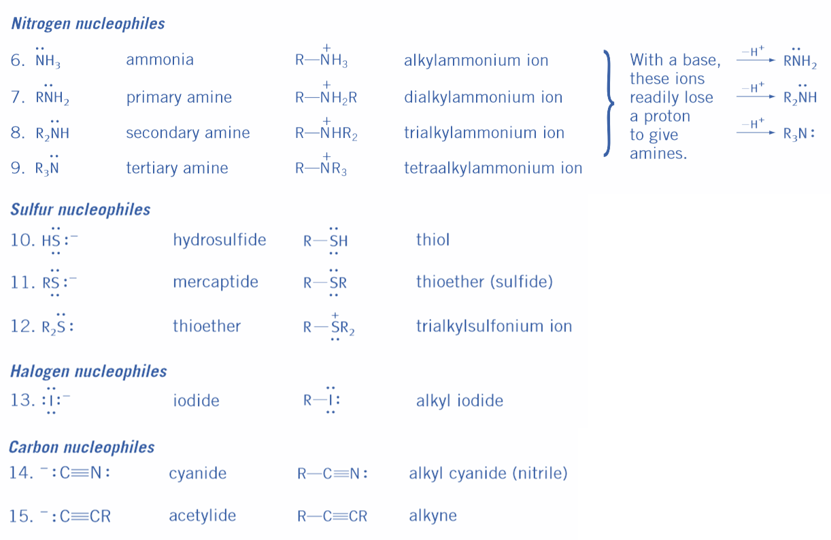
Reactions of Common Nucleophiles with Alkyl Halides:

Slide 29
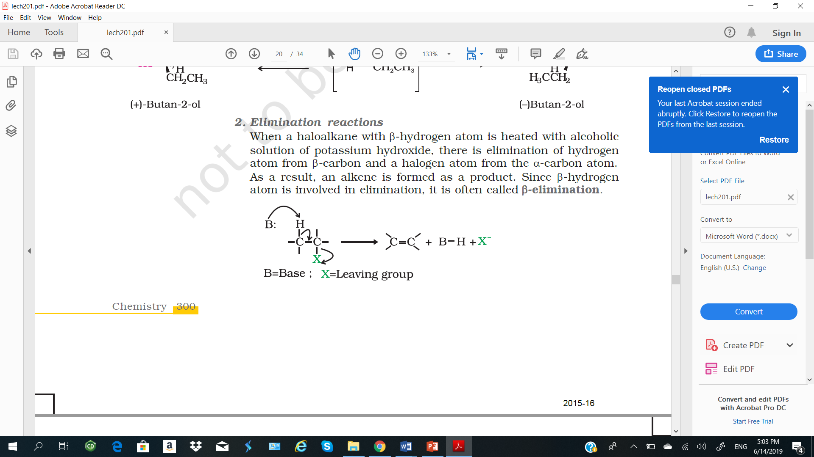
Reactions of Haloalkanes
Elimination Reactions
General consideration
Alkyl halides can lose H and X from adjacent carbons to form alkenes by an elimination process.
Mechanism of Eliminations are of two types:
The El (elimination unimolecular) reaction.
The E2 (elimination bimolecular) reaction.
Generally
The El process accompanies the S_{N}¹ reaction.
The E2 reaction accompanies the S_{N}² reaction.
El and E2 eliminations follow Saytzeff’s rule.

Slide 30
Reactions of Haloalkanes
E1 Mechanism
The El, involves the formation of a carbocation in the rate-determining step.
The order of reactivity of El reactions is
Benzyl > allyl = 3° > 2° > 1° halide
The product of an El reaction is an alkene.

Slide 31
Reactions of Haloalkanes
E2 Mechanism
In eliminations;
The attack by the nucleophile (acting as a base, B:) is on the hydrogen atom attached to the carbon next to the one bearing the halogen (the /3 hydrogen).
The E2 mechanism involves simultaneous bond breaking and bond formation and occurs most readily when the β hydrogen and the halogen atom are trans to one another.
The single-step E2 elimination.
The order of reactivity of E2 elimination is
1° RX > 2° RX > 3° RX

Slide 32
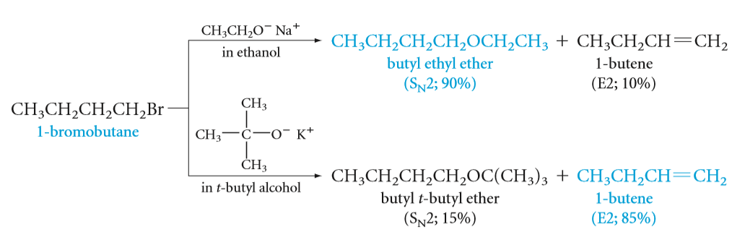
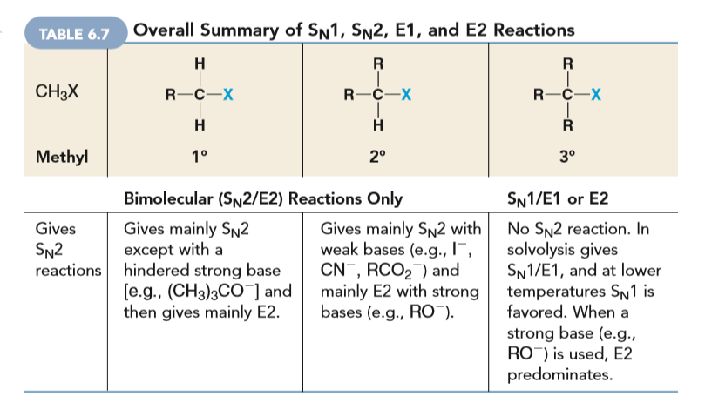
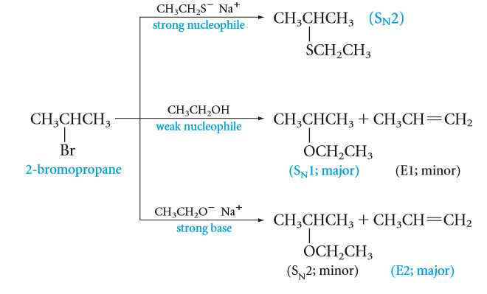
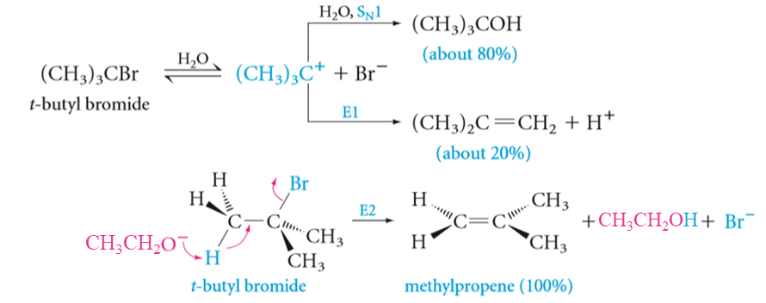
Substitution and Elimination in Competition:
Zaitsev’s Rule
Hint:

Slide 33
Reactions of Haloalkanes
Reaction with Metals
Most organic chlorides, bromides, and iodides react with certain metals to give organo-metallic compounds, molecules with carbon-metal bonds.
Grignard reagents are obtained by the reaction of alkyl or aryl halides with metallic magnesium in dry ether as the solvent.
Grignard reagents react readily with any source of protons to give hydrocarbons.
Wurtz reaction; Alkyl halides react with sodium in dry ether to give hydrocarbons containing double the number of carbon atoms present in the halide.

Slide 34
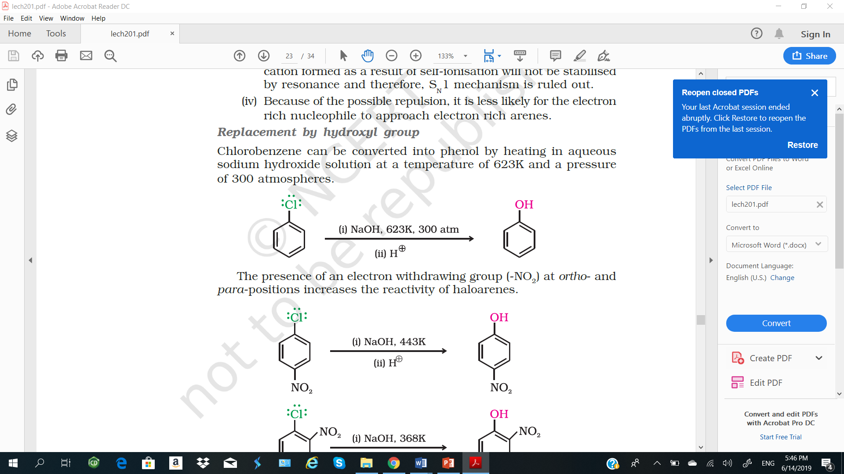
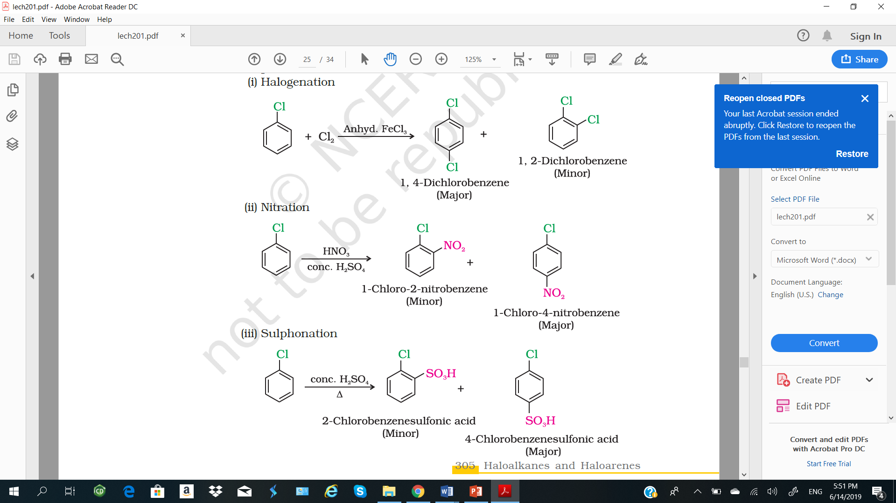
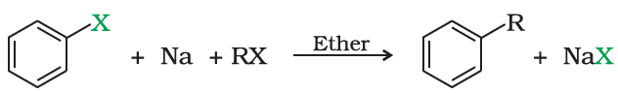
Reactions of Haloarenes
Replacement by hydroxyl group
Chlorobenzene can be converted into phenol by heating in aqueous sodium hydroxide solution at a temperature of 623K and a pressure of 300 atmospheres.
Electrophilic substitution reactions; Haloarenes undergo the usual electrophilic reactions of the benzene ring such as halogenation, nitration, sulphonation and Friedel-Crafts reactions.
Halogen atom besides being slightly deactivating is o-, p-directing; .
Wurtz reaction; a mixture of an alkyl halide and aryl halide gives an alkylarene when treated with sodium in dry ether

