Slide 1
Copyright © 2009 Pearson Education, Inc.
Publishing as Prentice Hall
Ch 1 -1
Copyright © 2011 Pearson Education

Slide 2
Strategic Management: Concepts and Cases
Arab World Edition
Fred R. David
Abbas J. Ali
Abdulrahman Y. Al-Aali
Chapter 1:
The Nature of Strategic
Management
Copyright © 2009 Pearson Education, Inc.
Publishing as Prentice Hall
Ch 1 -2
Copyright © 2011 Pearson Education

Slide 3
Strategic Management – Defined
Art & science of formulating, implementing, and evaluating, cross-functional decisions that enable an organization to achieve its objectives
In essence, the strategic plan is a company’s game plan.
Ch 1 -3
Ch 1 -3
Copyright © 2011 Pearson Education
Copyright © 2009 Pearson Education, Inc.
Publishing as Prentice Hall

Slide 4
Strategic Management
Strategic management achieves a firm’s success through integration:
Management
Marketing
Finance/Accounting
Production/Operations
Research & Development
MIS
Ch 1 -4
Ch 1 -4
Copyright © 2011 Pearson Education
Copyright © 2009 Pearson Education, Inc.
Publishing as Prentice Hall

Slide 5
Strategic Management = Strategic Planning
Who use each?
Copyright © 2009 Pearson Education, Inc.
Publishing as Prentice Hall

Slide 6
Purpose of Strategic Management
Exploit O
Avoid T
Maximize S
Minimize W
Copyright © 2009 Pearson Education, Inc.
Publishing as Prentice Hall

Slide 7
Strategic Management
Strategy Formulation
Vision & Mission
External Opportunities & Threats
Internal Strengths & Weaknesses
Long-Term Objectives
Alternative Strategies
Strategy Selection
Ch 1 -5
Ch 1 -5
Copyright © 2011 Pearson Education
Copyright © 2009 Pearson Education, Inc.
Publishing as Prentice Hall

Slide 8
Strategy Formulation
Issues in Strategy Formulation
New business opportunities
Businesses to abandon
Allocation of resources
Expansion or diversification
International markets
Mergers or joint ventures
Avoidance of hostile takeover
Ch 1 -6
Ch 1 -6
Copyright © 2011 Pearson Education
Copyright © 2009 Pearson Education, Inc.
Publishing as Prentice Hall

Slide 9
Strategy Implementation
The Action Stage of Strategic Management
Is the most difficult stage
Involves mobilization of employees & managers
Interpersonal skills are critical
There must be consensus on goal pursuits
Ch 1 -7
Ch 1 -7
Copyright © 2011 Pearson Education
Copyright © 2009 Pearson Education, Inc.
Publishing as Prentice Hall

Slide 10
Strategy Implementation
Strategy Implementation
Annual Objectives
Policies
Employee Motivation
Resource Allocation
Ch 1 -8
Ch 1 -8
Copyright © 2011 Pearson Education
Copyright © 2009 Pearson Education, Inc.
Publishing as Prentice Hall

Slide 11
Strategy Evaluation
Strategy Evaluation
Internal Review
External Review
Performance Metrics
Corrective Actions
Ch 1 -9
Ch 1 -9
Copyright © 2011 Pearson Education
Copyright © 2009 Pearson Education, Inc.
Publishing as Prentice Hall

Slide 12
Strategy Evaluation
Final Stage of Strategic Management
Subject to future modification
Today’s success is no guarantee of future success
New and different problems
Complacency leads to demise
Ch 1 -10
Ch 1 -10
Copyright © 2011 Pearson Education
Copyright © 2009 Pearson Education, Inc.
Publishing as Prentice Hall

Slide 13
Integrating Intuition & Analysis
The strategic management process attempts to organize quantitative and qualitative information under conditions of uncertainty.
Ch 1 -11
Ch 1 -11
Copyright © 2011 Pearson Education
Copyright © 2009 Pearson Education, Inc.
Publishing as Prentice Hall

Slide 14
Integrating Intuition & Analysis
Intuition is based on:
Past experiences
Judgment
Feelings
Intuition is useful for decision making in:
Conditions of great uncertainty
Conditions with little precedent
Several reasonable alternatives
Ch 1 -12
Ch 1 -12
Copyright © 2011 Pearson Education
Copyright © 2009 Pearson Education, Inc.
Publishing as Prentice Hall

Slide 15
Integrating Intuition & Analysis
Intuition & Judgment
Involve management at all levels
Influence all analyses
Ch 1 -13
Ch 1 -13
Copyright © 2011 Pearson Education
Copyright © 2009 Pearson Education, Inc.
Publishing as Prentice Hall

Slide 16
Integrating Intuition & Analysis
Analytical Thinking
Intuitive Thinking
Ch 1 -14
Ch 1 -14
Copyright © 2011 Pearson Education
Copyright © 2009 Pearson Education, Inc.
Publishing as Prentice Hall

Slide 17
Integrating Intuition & Analysis
In the Arab world, there is a cultural tendency to emphasize the role of intuition and imagination in decision making.
Ch 1 -15
Ch 1 -15
Copyright © 2011 Pearson Education
Copyright © 2009 Pearson Education, Inc.
Publishing as Prentice Hall

Slide 18
9 Key Terms:
Strategic Management is Gaining and Maintaining Competitive Advantage
Competitive Advantage:
Anything that a firm does especially well compared to rival firms
Ch 1 -16
Ch 1 -16
Copyright © 2011 Pearson Education
Copyright © 2009 Pearson Education, Inc.
Publishing as Prentice Hall

Slide 19
Achieving Sustained Competitive Advantage
Adapting to change in external trends, internal capabilities, and resources
Effectively formulating, implementing, and evaluating strategies
Ch 1 -17
Ch 1 -17
Copyright © 2011 Pearson Education
Copyright © 2009 Pearson Education, Inc.
Publishing as Prentice Hall

Slide 20
Key Terms
The Strategists – Those that affect a firm’s success or failure:
Chief Executive Officer (CEO)
Chief Strategy Officer (CSO)
President
Owner
Board Chair
Executive Director
Ch 1 -18
Ch 1 -18
Copyright © 2011 Pearson Education
Copyright © 2009 Pearson Education, Inc.
Publishing as Prentice Hall

Slide 21
Opportunities and Threats (External)
External opportunities and threats are largely beyond the control of a single organization.
Ch 1 -19
Copyright © 2011 Pearson Education
Copyright © 2009 Pearson Education, Inc.
Publishing as Prentice Hall

Slide 22
Oportunities and Threats (External) Cont’d…
Analysis of Trends:
Economic
Social
Cultural
Demographic/Environmental
Political, Legal, Governmental
Technological
Competitors
Ch 1 -20
Copyright © 2011 Pearson Education
Copyright © 2009 Pearson Education, Inc.
Publishing as Prentice Hall

Slide 23
Key Terms
Environmental Scanning (Industry Analysis):
The process of conducting research and gathering and assimilating external information
Ch 1 -21
Copyright © 2011 Pearson Education
Copyright © 2009 Pearson Education, Inc.
Publishing as Prentice Hall

Slide 24
Key Terms Opportunities & Threats
The basic tenet of strategic management:
Maximize External Opportunities
Strategy Formulation
Avoid/minimize impact of External Threats
Ch 1 -22
Copyright © 2011 Pearson Education
Copyright © 2009 Pearson Education, Inc.
Publishing as Prentice Hall

Slide 25
Strengths and Weaknesses (Internal)
Controllable activities performed especially
Well (Strengths) or poorly(Weaknesses)
Strengths and weaknesses are typically located in the functional areas of the firm, such as:
Management
Marketing
Finance/Accounting
Production/Operations
Research & Development
Computer Information Systems
Ch 1 -23
Copyright © 2011 Pearson Education
Copyright © 2009 Pearson Education, Inc.
Publishing as Prentice Hall

Slide 26
Assessing the Internal Environment
Financial Ratios
Performance Metrics
Internal Factors
Industry Averages
Survey Data
Ch 1 -24
Copyright © 2011 Pearson Education
Copyright © 2009 Pearson Education, Inc.
Publishing as Prentice Hall

Slide 27
Long Term Objectives
Long-term Objectives:
Are specific results that an organization seeks to achieve in pursuing its basic mission for more than one year
Objectives should be challenging, measurable, consistent, reasonable, and clear.
Annual Objectives:
Short-term milestones that firms must achieve to attain long-term objectives
Ch 1 -25
Copyright © 2011 Pearson Education
Copyright © 2009 Pearson Education, Inc.
Publishing as Prentice Hall

Slide 28
Long Term Objectives (Cont’d)
Long term objectives are essential for ensuring a firm’s success. They:
Provide direction
Help with evaluation
Create synergy
Focus coordination
Basis for planning, motivating, and controlling
Ch 1 -26
Copyright © 2011 Pearson Education
Copyright © 2009 Pearson Education, Inc.
Publishing as Prentice Hall

Slide 29
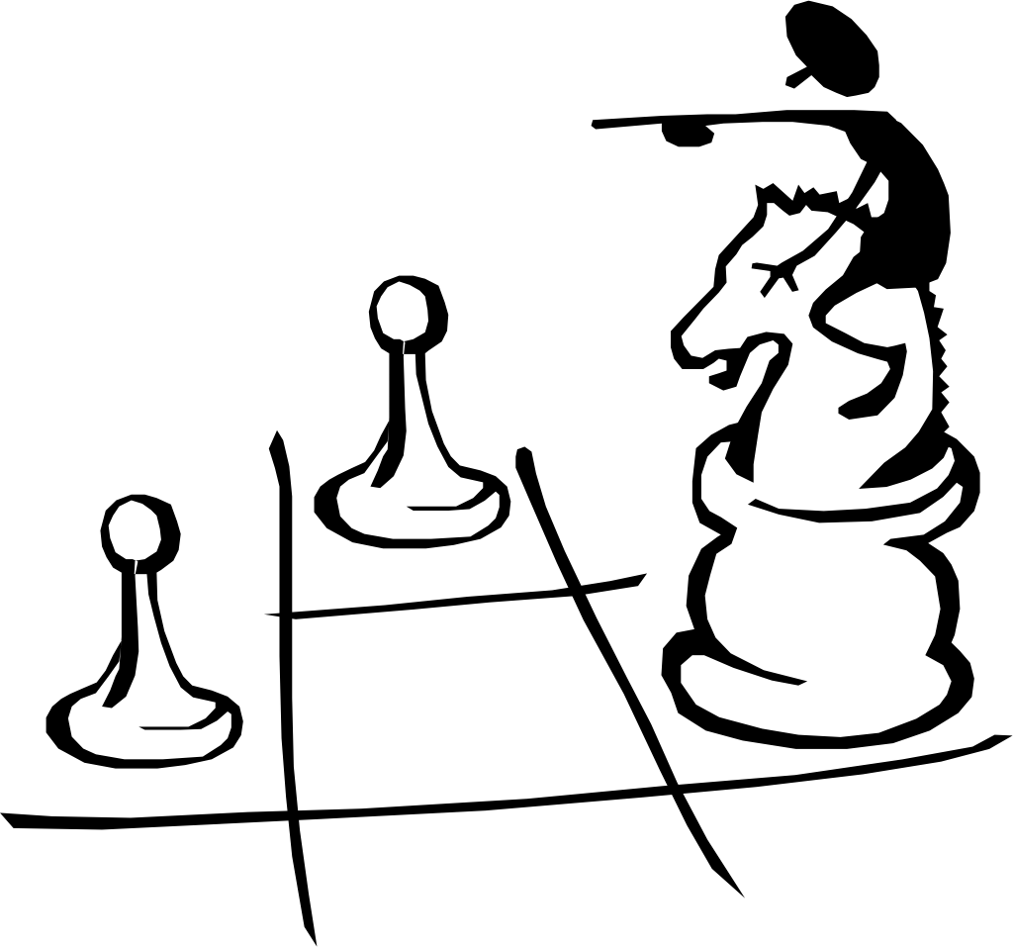
Strategies
Strategies are the means by which long-term objectives are achieved
Some examples of different strategies are:
Geographic expansion
Diversification
Acquisition
Market penetration
Retrenchment
Liquidation
Joint venture
Ch 1 -27
Copyright © 2011 Pearson Education
Copyright © 2009 Pearson Education, Inc.
Publishing as Prentice Hall

Slide 30
Key Terms
Policies:
Means by which annual objectives will be achieved
Policies include guidelines, rules, and procedures established to support efforts to achieve stated objectives.
Ex: Non Smoking working environment
Ch 1 -28
Copyright © 2011 Pearson Education
Copyright © 2009 Pearson Education, Inc.
Publishing as Prentice Hall

Slide 31
Example Strategies in Action in 2009
Mohammed Abdulmohsin Al-Kharafi & Sons Company
(MAK Group)
The MAK Group is one of the largest family-owned organizations in the Arab world. In 2008 it was listed among the top 100 companies in the Muslim world by Dinar Standard. In 2009 its annual turnover was over US$5 billion; it operates in more than 25 countries around the world and has more than 120,000 employees. The company was established as a trading company more than 100 years ago and it has since developed into a large multi-national corporation.
Faced with limited local market and enriched with a large amount of cash, the company has embarked on an ambitious diversification strategy. Since 1956 the company has participated in a number of important projects in Kuwait, the Gulf States, Africa, the Caribbean, Asia, and Eastern Europe. It has various branches and subsidiaries in area related Construction, trade, and manufacturing in various parts of the world.
Ch 1 -29
Ch 1 -29
Copyright © 2011 Pearson Education
Copyright © 2009 Pearson Education, Inc.
Publishing as Prentice Hall

Slide 32
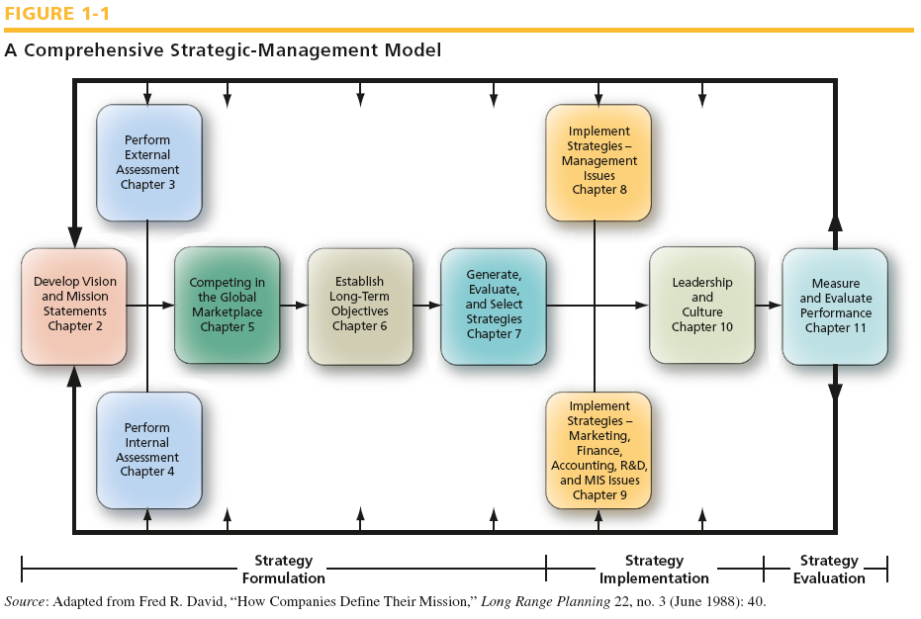
Source: Adapted from Fred R. David, “How Companies Define Their Mission,” Long Range Planning 22, no 3 (June 1988):40
Ch 1 -30
Copyright © 2011 Pearson Education
Copyright © 2009 Pearson Education, Inc.
Publishing as Prentice Hall

Slide 33
Strategic Management Model
Strategic Management Process
Dynamic & continuous
More formal in larger organizations
Good communication and feedback are needed
Ch 1 -31
Copyright © 2011 Pearson Education
Copyright © 2009 Pearson Education, Inc.
Publishing as Prentice Hall

Slide 34
Benefits of Strategic Management
Strategic Management:
Is proactive in shaping firm’s future
Initiates and influences firm’s activities
Helps to formulate better strategies that are systematic, logical, and rational
Ch 1 -32
Copyright © 2011 Pearson Education
Copyright © 2009 Pearson Education, Inc.
Publishing as Prentice Hall

Slide 35
Benefits of Strategic Management
Financial Benefits
Improvement in sales
Improvement in profitability
Productivity improvement
Ch 1 -33
Ch 1 -33
Copyright © 2011 Pearson Education
Copyright © 2009 Pearson Education, Inc.
Publishing as Prentice Hall

Slide 36
Benefits of Strategic Management
Nonfinancial Benefits
Improved understanding of competitors’ strategies
Enhanced awareness of threats
Increased employee productivity
Reduced resistance to change
Enhanced problem-prevention capabilities
Ch 1 -34
Ch 1 -34
Copyright © 2011 Pearson Education
Copyright © 2009 Pearson Education, Inc.
Publishing as Prentice Hall

Slide 37
Benefits of Strategic Management
Greenly
Identification of opportunities
Objective view of management problems
Improved coordination & control
Minimizes adverse conditions & changes
Decisions that better support objectives
Effective allocation of resources
Reduces resources and time spent correcting erroneous decisions
Ch 1 -35
Copyright © 2011 Pearson Education
Copyright © 2009 Pearson Education, Inc.
Publishing as Prentice Hall

Slide 38
Benefits of Strategic Management
Greenley (Cont’d)
Internal communication among personnel
Integration of individual behaviors
Clarify individual responsibilities
Encourages forward thinking
Cooperative approach to tackling problems and opportunities
Encourages favorable attitude toward change
Gives discipline to business management
Ch 1 -36
Copyright © 2011 Pearson Education
Copyright © 2009 Pearson Education, Inc.
Publishing as Prentice Hall

Slide 39
Why Some Firms Do No Strategic Planning
Reasons why some firms are resistant to strategic planning include:
Poor reward structures
Fire-fighting
Chief executives’ orientation
Lack of access to needed resources
Waste of time
Too expensive
Laziness
Content with success
Ch 1 -37
Copyright © 2011 Pearson Education
Copyright © 2009 Pearson Education, Inc.
Publishing as Prentice Hall

Slide 40
Why Some Firms Do No Strategic Planning (Cont’d)
Fear of failure
Overconfidence
Prior bad experience
Self-interest
Fear of the unknown
Honest difference of opinion
Suspicion
Ch 1 -38
Copyright © 2011 Pearson Education
Copyright © 2009 Pearson Education, Inc.
Publishing as Prentice Hall

Slide 41
Pitfalls in Strategic Planning
Being aware of potential pitfalls of strategic planning and being prepared to address them is essential to success.
Ch 1 -39
Copyright © 2011 Pearson Education
Copyright © 2009 Pearson Education, Inc.
Publishing as Prentice Hall

Slide 42
Pitfalls in Strategic Planning
Some pitfalls to watch out for and avoid in strategic planning (Cont’d)
Top managers not actively supporting the strategic planning process
Failing to use plans as a standard for measuring performance
Failing to create a collaborative climate supportive of change
Ch 1 -40
Copyright © 2011 Pearson Education
Copyright © 2009 Pearson Education, Inc.
Publishing as Prentice Hall

Slide 43
Pitfalls in Strategic Planning
Some pitfalls to watch out for and avoid in strategic planning (Cont’d)
Viewing planning as unnecessary or unimportant
Being so formal in planning that flexibility and creativity are stifled
Ch 1 -41
Copyright © 2011 Pearson Education
Copyright © 2009 Pearson Education, Inc.
Publishing as Prentice Hall

Slide 44
Guidelines for Effective Strategic Management
Strategic Management must:
Not become bureaucratic mechanism
Not become too formal, predictable, and rigid
Be a self-reflective learning process
Words supported by numbers, rather than numbers supported by words
Represent the medium for explaining strategic issues and organizational responses
Ch 1 -42
Copyright © 2011 Pearson Education
Copyright © 2009 Pearson Education, Inc.
Publishing as Prentice Hall

