Slide 1
More About Objects and Methods
Chapter 6

Slide 2
Objectives
Define and use constructors
Write and use static variables and methods
Write and use overloaded methods

Slide 3
Constructors
Ch 6.1

Slide 4
Constructors: Outline
Defining Constructors
Calling Methods from Constructors
Calling a Constructor from Other Constructors

Slide 5
Defining Constructors
A constructor
is a special method called automatically when an instance of an object is created with new
ClassName x = new ClassName();
has the same name as the class name.
can have parameters to specify initial values if desired
but cannot return values and it is not a void method
May have multiple definitions
Each with different numbers or types of parameters
A class contains at least one constructor.
Notes:
Before going into details, look at the next example (Pet class)

Slide 6
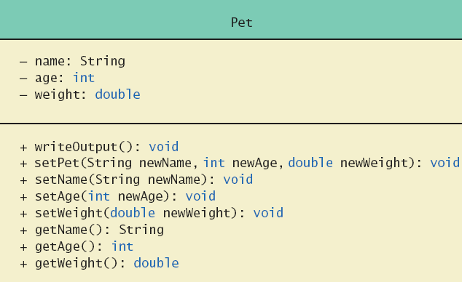
Defining Constructors
Example class to represent pets
Figure 6.1 Class Diagram for Class Pet

Slide 7
Defining Constructors
Note sample code, listing 6.1 class Pet
Note different constructors
Default
With 3 parameters
With String parameter
With double parameter
Note sample program, listing 6.2 class PetDemo

Slide 8
Defining Constructors
Sample screen output

Slide 9
Default Constructors
A constructor without parameters is a default constructor
Java will define this automatically, but ONLY if the class designer does not define any constructors
If you do define a constructor, Java will not define a default constructor automatically, but you can still add one
Usually default constructors are not included in class diagrams (UML)

Slide 10
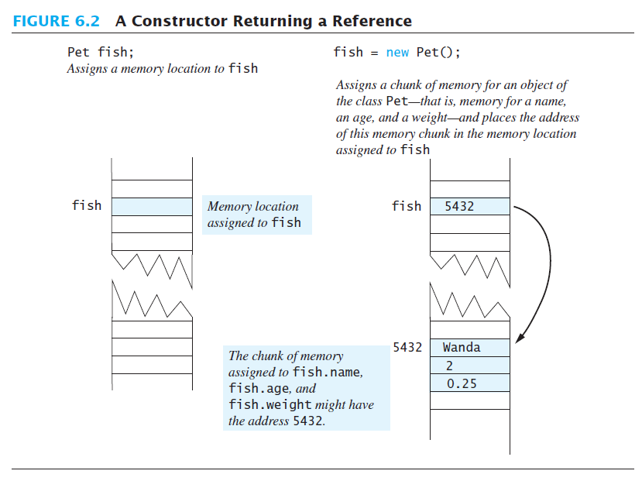
Pet fish = new Pet("Wanda", 2, 0.25);

Slide 11
Calling Methods from Other Constructors
Constructor can call other class methods
View sample code, listing 6.3 class Pet2
Note method set
Keeps from repeating code

Slide 12
Example: Constructor with No-Parameter
public class Person
{
String name;
int age;
// Constructor
public Person(){
name = “ ”;
age = 0;}
}
A. The instance variable is allocated in memory.
P1
Person
B. The object is created with initial state
name
“ ”
age
0
C. The reference of the object created in B is assigned to the variable.
P1
A
Person P1;
B
P1 = ;
Person
new Person( )
name
“ ”
age
0
C
Code
State of Memory

Slide 13
Example: Class with Multiple Constructors
Public class Person
{
String name;
int age;
// Constructor
public Person(){
name = “ ”;
age = 0;}
public Person(String n, int a )
{ name = n;
age = a; }}
A. The constructor declared with no-parameter is used to create the object
P1
Person
name
“ ”
age
0
B. The constructor declared with parameters is used to create the object
P2
Person
Person P1 , P2;
A
name
Ahmad
P1 = new Person()
P2 = new Person(“Ahmed”,27);
B
age
27
State of Memory
Code

Slide 14
Calling Constructor from Other Constructors
From listing 6.3 we have the initial constructor and method set
In the other constructors use the this reference to call initial constructor
View revised class, listing 6.4 class Pet3
Note calls to initial constructor

Slide 15
Static Variables And Methods
Ch 6.2

Slide 16
Static Variables & Methods: Outline
Static Variables
Static Methods
Dividing the Task of a main Method into Subtasks
Adding a main Method to a class (optional)
Predefined methods
Wrapper Classes (optional)

Slide 17
Static Variables
They are variables declared as static
They are shared by all objects of a class
Only one instance of the variable exists
It can be accessed by all instances of the class via the class name or the object name
Static variables are also called class variables
Contrast with instance variables
Note: Do not confuse class variables with variables of a class type
Both static (class) variables and instance variables are sometimes called fields or data members or attributes
Underline static variables in UML diagram

Slide 18
Static Variables
Values of variables declared:
static final cannot be changed, they are constants
static (without final) can be changed
A common examples of static attributes is to have a variable that keeps track of how many objects of a class have been created.

Slide 19
Constructor and Static attribute
public class Person {
String name;
int age;
public static int numofPerson=0;
// Constructor
public Person()
{ name = “ ”;
age = 0;
numofPerson++; }
public Person(String n , int a)
{ name = n;
age = a;
numofPerson++; }
} // end class Person
...
public static void main(String[] args)
{
System.out.println
(Person.numofPerson);
Person P1 = new Person();
Person P2 = new
Person(“ahmed”, 27);
System.out.println
(Person.numofPerson);
}
...

Slide 20
Constructor and Static attribute
public static void main(string[] args)
{
Person P1 = new Person();
Person P2 = new Person (“ahmed”, 27);
}
P1
Person
name
“ ”
numofPerson
age
0
0
A
1
B
P2
2
Person P1 , P2;
A
Person
P1 = new Person()
P2 = new Person(“Ahmed”,27);
name
Ahmed
B
27
age
State of Memory
Code

Slide 21
class Course {
// attributes
public String studentName; // Instance variables public String courseCode ; // Instance variables
public static int studentNumber; // Class variables
}
Course
+studentName: String
+courseCode: String
_{+studentNumber:int}
public class CourseRegistration {
public static void main(String[] args) {
Course course1, course2;
//Create and assign values to course1
course1 = new Course( ); Course.studentNumber = 1;
course1.courseCode= “CSC112”;
course1.studentName= “Majed AlKebir“;
//Create and assign values to course2
course2 = new Course( ); Course.studentNumber ++;
course2.courseCode= “CSC107”;
course2.studentName= “Fahd AlAmri”;
System.out.println(course1.studentName + " has the course “+
course1.courseCode + “ ” + course1.studentNumber);
System.out.println(course2.studentName + " has the course “+
course2.courseCode + “ ” + course2.studentNumber);
}
}

Slide 22
Class Attributes and instance Attributes
course
1
Object: Course
studentName
Majed AlKebir
course
courseCode
CSC112
2
Object: Course
studentNumber
studentName
Fahd AlAmri
2
courseCode
CSC107

Slide 23
Activity: Class Example

Slide 24
Example - Account Class
Create a Java class based on the following UML :
The class should:
Have a default constructor that initializes the attributes to default values, and another constructor that initializes the data attributes to given values.
Method deposit will add to balance
Method withdraw will reduce the balance
Provide set() and get() methods for each attribute.
In the main() method of the class TestAccount write statements that will call both constructors and test class Accounts capabilities.
Account
- number :int - balance : double
+deposit (double amount) : void +withdraw(double amount) : void

Slide 25
Class Account
public class Account
{ // definition of attributes (data)
private int number;
private double balance;
// constructor
public Account ()
{ number=0;
balance=0; }
public Account (int n , double b)
{ number=n;
balance=b; }
// definition of operations
public void deposit (double amount)
{ balance = balance + amount;
} //end of deposit
public void withdraw(double amount)
{ if (balance >= amount)
balance = balance – amount;
} //end of withdraw
public void setNumber (int n)
{ number = n;
} //end of setNumber
public void setBalance (double b) { balance=b;
} //end of setBalance
public int getNumber()
{ return number ;
} //end of getNumber
public double getBalance() {
return balance;
} //end of getBalance
} //end of class

Slide 26
Class TestAccount
public class TestAccount
{
public static void main(String[] args) {
Account Account1=new Account();
Account Account2=new Account(1,6200);
Account1. setNumber (2) ;
Account1. setBalance (4300) ;
Account2. deposit (550) ;
Account1. withdraw(200);
System.out.println(Account1. getBalance() + "-" +Account2. getBalance() );
}
}

Slide 27
Static Methods
Some methods may have no relation to any type of object
Example
Compute max of two integers
Convert character from upper- to lower case
Static methods declared in a class
Can be invoked without using an object
Instead use the class name
For example, Math library functions.

Slide 28
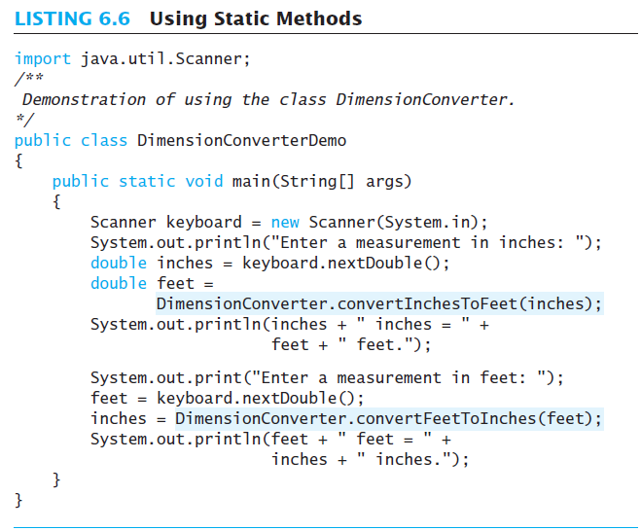
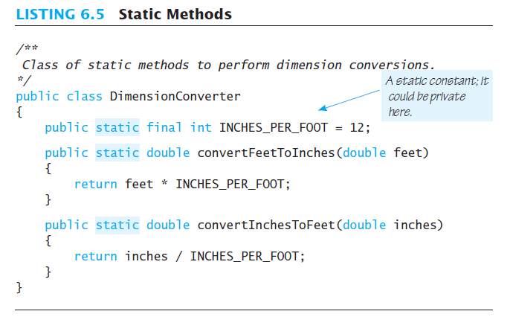
Static Methods
Sample screen output

Slide 29
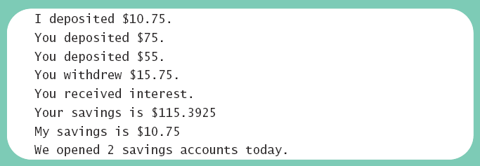
Mixing Static and Nonstatic Methods
View sample class, listing 6.7 class SavingsAccount
View demo program, listing 6.8 class SavingsAccountDemo
Sample screen output

Slide 30
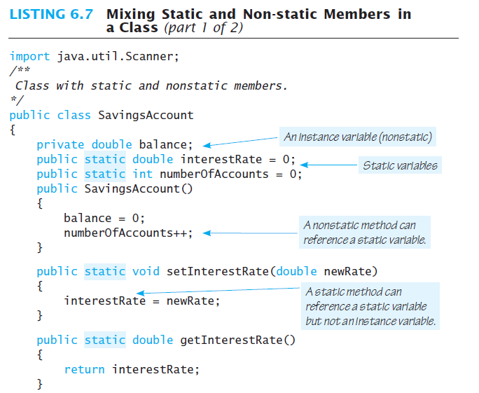
Mixing Static and Nonstatic Methods
Notes:
Remember: static variables belong to a class as a whole, they are shared with ALL instances (all objects created) of that class
Similarly static methods belong to a class and NOT to any specific object.
Therefore, a static method can not access non-static variables or non-static methods directly, UNLESS they are accessed through an appropriate object. (see next slide)

Slide 31
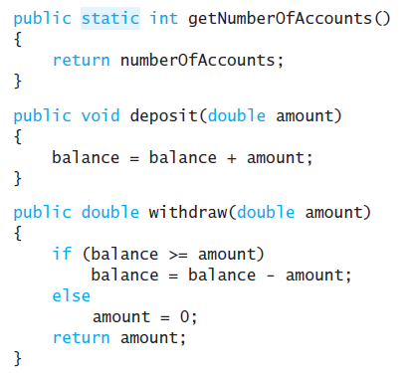
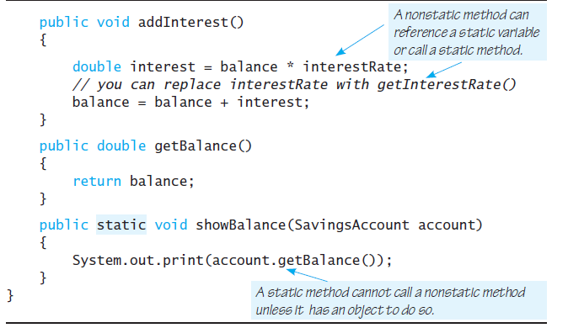
Mixing Static and Nonstatic Methods

Slide 32
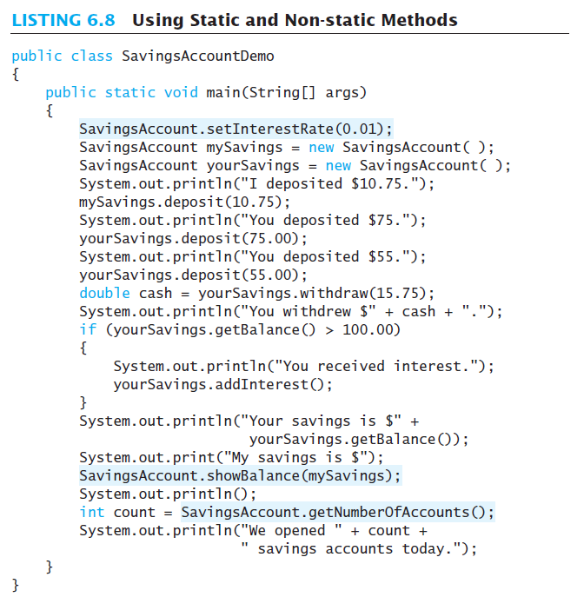
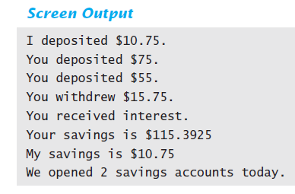
Mixing Static and Nonstatic Methods

Slide 33
Tasks of main in Subtasks
Program may have
Complicated logic
Repetitive code
Create static methods to accomplish subtasks
Consider example code, listing 6.9 a main method with repetitive code
Note alternative code, listing 6.10 uses helping methods
Notes:
Since main is a static method, other methods that we want to be able to use inside the main method have to be static too

Slide 34
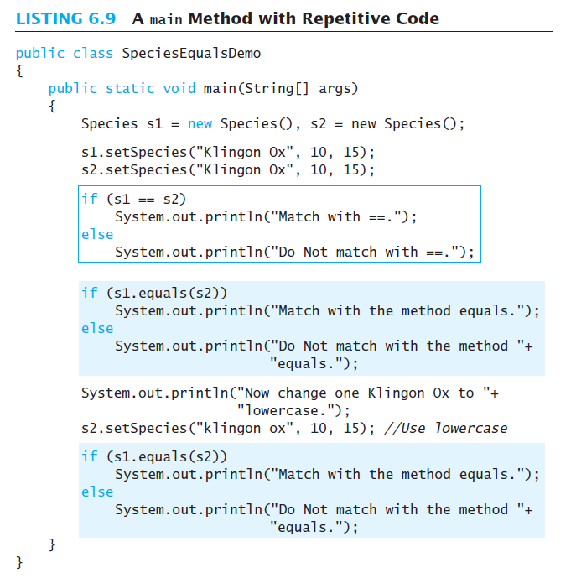
Tasks of main in Subtasks

Slide 35
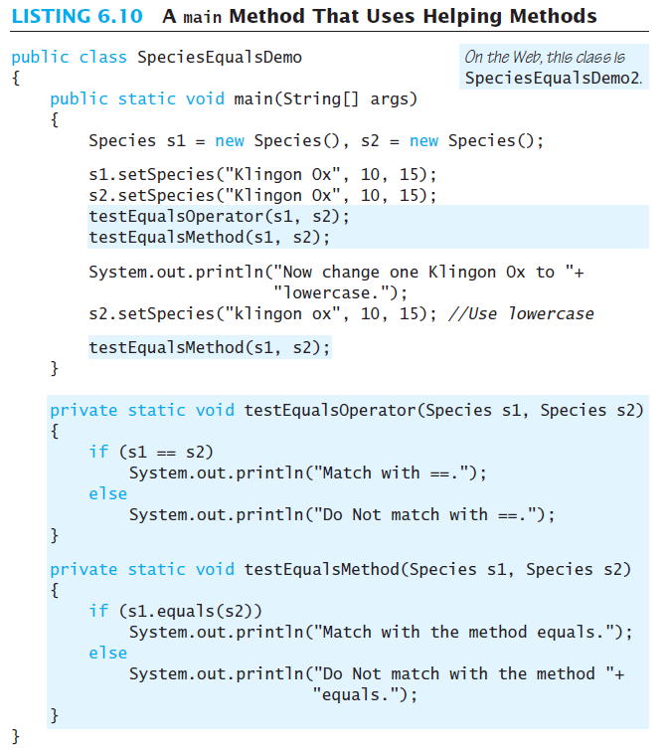
Tasks of main in Subtasks
Notes:
Notice that we made the helper methods “static” so that main is allowed to used them, because main is static.
Check the previous example:
Notice that we made setInterestRate, getInterestRate, getNumberOfAccounts, showBalance static so that main is allowed to used them. Try to compile and run the class and demo without static in front of any of them and check out the error message that you will get.

Slide 36
Identifier Scope Example
See Identifier scope outside example slides

Slide 37
Pre-defined Methods
See Pre-defined method slides.

Slide 38
Adding Method main to a Class
Method main used so far in its own class within a separate file
Often useful to include method main within class definition
To create objects in other classes
To be run as a program
Note example code, listing 6.11 a redefined class Species
When used as ordinary class, method main ignored

Slide 39
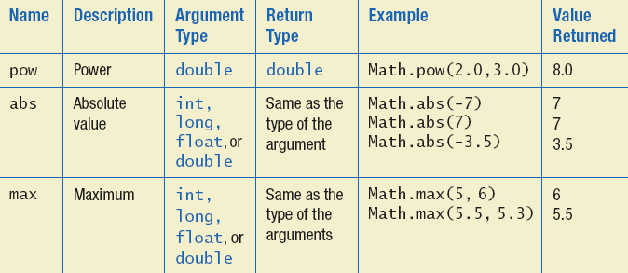
The Math Class
Provides many standard mathematical methods
Automatically provided, no import needed
Example methods, figure 6.3a

Slide 40
The Math Class
Example methods, figure 6.3b

Slide 41
Random Numbers
Math.random()returns a random double that is greater than or equal to zero and less than 1
Java also has a Random class to generate random numbers
Can scale using addition and multiplication; the following simulates rolling a six sided die
int die = (int) (6.0 * Math.random()) + 1;

Slide 42
Wrapper Classes
Recall that arguments of primitive type treated differently from those of a class type
May need to treat primitive value as an object
Java provides wrapper classes for each primitive type
Methods provided to act on values

Slide 43
Wrapper Classes
Allow programmer to have an object that corresponds to value of primitive type
Contain useful predefined constants and methods
Wrapper classes have no default constructor
Programmer must specify an initializing value when creating new object
Wrapper classes have no set methods

Slide 44
Wrapper Classes
Figure 6.4a Static methods in class Character

Slide 45
Wrapper Classes
Figure 6.4b Static methods in class Character

Slide 46
Writing Methods
Ch 6.3

Slide 47
Writing Methods: Outline
Case Study: Formatting Output
Decomposition
Addressing Compiler Concerns
Testing Methods

Slide 48
Decomposition
Recall pseudocode from listing 6.10
With this pseudocode we decompose the task into subtasks
Then solve each subtask
Combine code of subtasks
Place in a method
Notes:
Example:
Reading input and validation
Certain validation can be used for similar input
Processing part might be repetitive, consider a menu with selections, each selection performs a specific action, this action could be written in a separate method. Then the main program will simply loop on (1) displaying the menu (which can be a method), (2) reading the selection, (3) performing the action by calling appropriate method.

Slide 49
Addressing Compiler Concerns
Compiler ensures necessary tasks are done
Initialize variables
Include return statement
Rule of thumb: believe the compiler
Change the code as requested by compiler
It is most likely correct

Slide 50
Testing Methods
To test a method use a driver program
Example – code in listing 6.13
Every method in a class should be tested
Bottom-up testing
Test code at end of sequence of method calls first
Use a stub – simplified version of a method for testing purposes
Notes:
Not important to go to the example – just the idea of testing individual pieces is important

