Slide 1
Objects and References
Ch5.3

Slide 2
Objects and References: Outline
Variables of a Class Type
Defining an equals Method for a Class
Boolean-Valued Methods
Parameters of a Class Type

Slide 3
Variables of a Class Type
All variables are implemented as a memory location
Data of primitive type stored in the memory location assigned to the variable
Variable of class type contains memory address of object named by the variable

Slide 4
Variables of a Class Type
Object itself not stored in the variable
Stored elsewhere in memory
Variable contains address of where it is stored
Address called the reference to the variable
A reference type variable holds references (memory addresses)
This makes memory management of class types more efficient

Slide 5
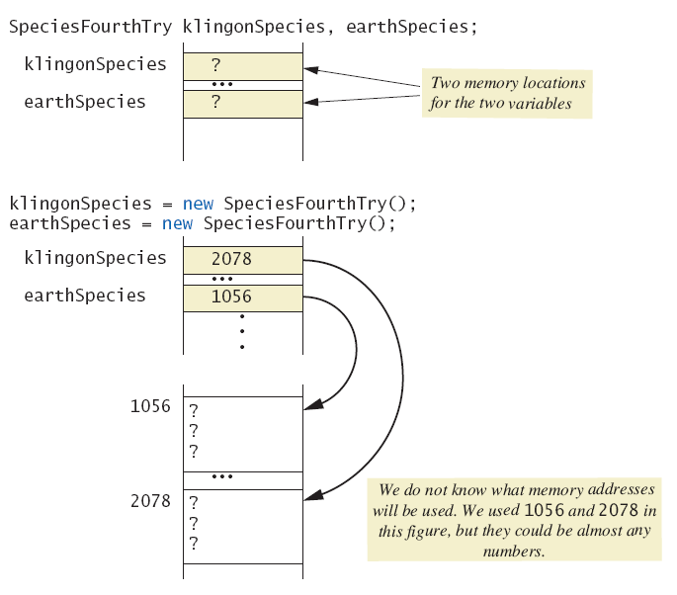
Variables of a Class Type
Figure 5.5a Behavior of class variables

Slide 6
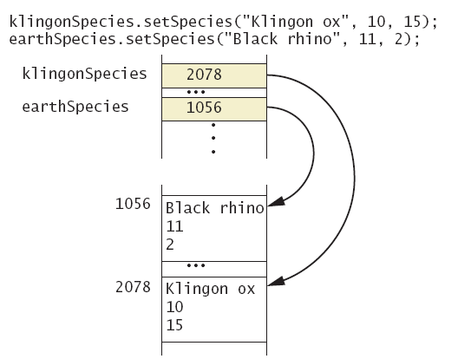
Variables of a Class Type
Figure 5.5b Behavior of class variables

Slide 7
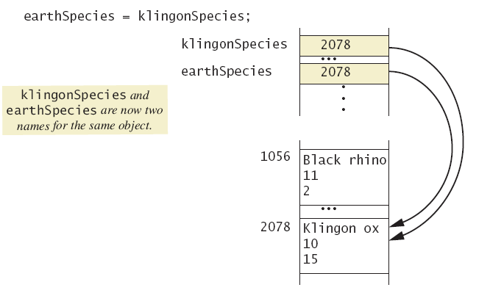
Variables of a Class Type
Figure 5.5c Behavior of class variables

Slide 8
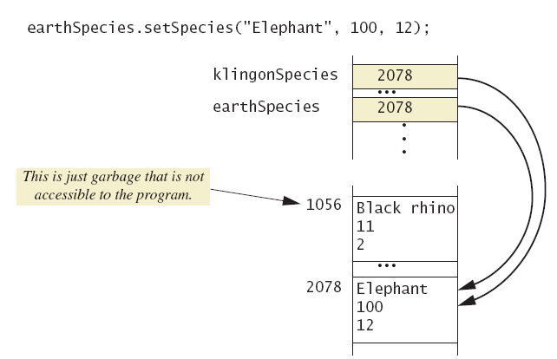
Variables of a Class Type
Figure 5.5d Behavior of class variables

Slide 9
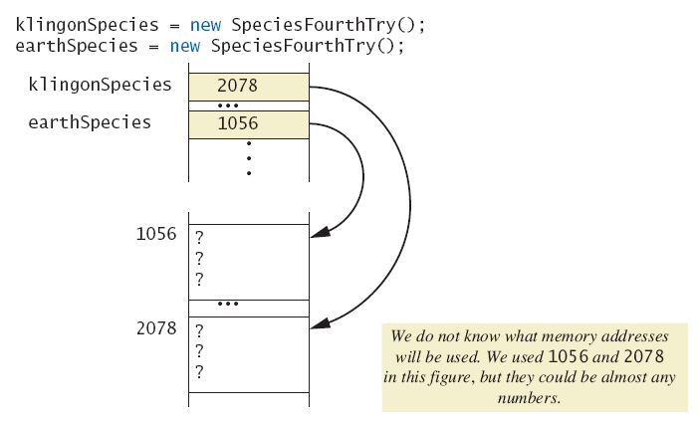
Variables of a Class Type
Figure 5.6a Dangers of using == with objects

Slide 10
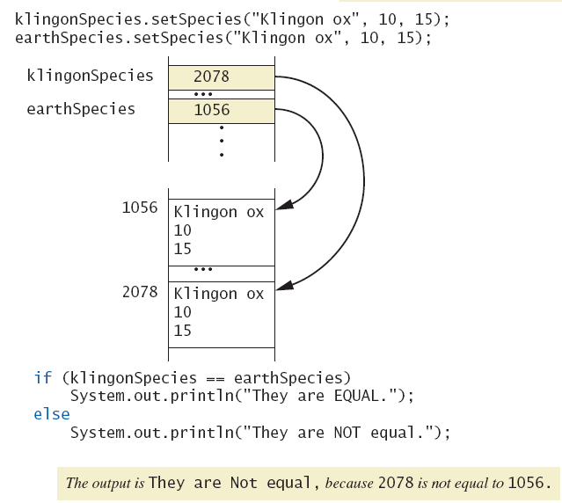
Variables of a Class Type
Figure 5.6b Dangers of using == with objects

Slide 11
Defining an equals Method
As demonstrated by previous figures
We cannot use == to compare two objects
We must write a method for a given class which will make the comparison as needed
View sample code, listing 5.17 class Species
The equals for this class method used same way as equals method for String

Slide 12
Demonstrating an equals Method
View sample program, listing 5.18 class SpeciesEqualsDemo
Note difference in the two comparison methods == versus .equals( )
Sample screen output

Slide 13
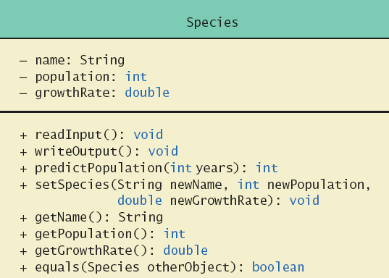
Complete Programming Example
View sample code, listing 5.19 class Species
Figure 5.7 Class Diagram for the class Species in listing 5.19

Slide 14
Boolean-Valued Methods
Methods can return a value of type boolean
Use a boolean value in the return statement
Note method from listing 5.19

Slide 15
Unit Testing
A methodology to test correctness of individual units of code
Typically methods, classes
Collection of unit tests is the test suite
The process of running tests repeatedly after changes are make sure everything still works is regression testing
View sample code, listing 5.20 class SpeciesTest

Slide 16
Parameters of a Class Type
When assignment operator used with objects of class type
Only memory address is copied
Similar to use of parameter of class type
Memory address of actual parameter passed to formal parameter
Formal parameter may access public elements of the class
Actual parameter thus can be changed by class methods

Slide 17
Programming Example
View sample code, listing 5.21 class DemoSpecies
Note different parameter types and results
View sample program, listing 5.22
Parameters of a class type versus parameters of a primitive type class ParametersDemo

Slide 18
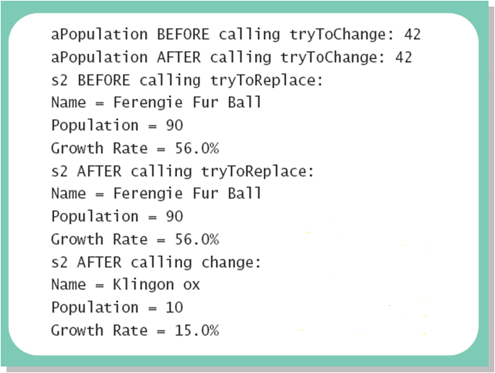
Programming Example
Sample screen output

Slide 19
Summary
Classes have
Instance variables to store data
Method definitions to perform actions
Instance variables should be private
Class needs accessor, mutator methods
Methods may be
Value returning methods
Void methods that do not return a value
Notes:
self read

Slide 20
Summary
Keyword this used within method definition represents invoking object
Local variables defined within method definition
Formal arguments must match actual parameters with respect to number, order, and data type
Formal parameters act like local variables
Notes:
self read

Slide 21
Summary
Parameter of primitive type initialized with value of actual parameter
Value of actual parameter not altered by method
Parameter of class type initialized with address of actual parameter object
Value of actual parameter may be altered by method calls
A method definition can include call to another method in same or different class
Notes:
self read

