Slide 1
Information Hiding and Encapsulation
Ch 5.2

Slide 2
Information Hiding, Encapsulation: Outline
Information Hiding
The public and private Modifiers
Methods Calling Methods
Encapsulation
UML Class Diagrams

Slide 3
Information Hiding
Client using a class method need not know details of the implementation of the method
  Only needs to know what the method does
Information hiding:
  Designing a method so it can be used without knowing details
Also referred to as abstraction
Method design should separate what from how
Careful documentation of what a method does can achieve that. For more info read: pre/post conditions
Notes:
Abstraction will be covered in more detail in CSC113
Pre and post conditions will be emphasized in your Data Structures course.

Slide 4
Pre- and Postcondition Comments
Precondition comment
  States conditions that must be true before method is invoked
Example

Slide 5
Pre- and Postcondition Comments
Postcondition comment
  Tells what will be true after method executed
Example

Slide 6
The public and private Modifiers
When an identifier is specified as public:
  Any other class can directly access that identifier by name
When an identifier is specified as private:
  Only the class itself can directly access that identifier by name
  It can not be accessed directly from the outside
Classes are generally specified as public
Instance variables are usually private
If no modifier is specified, the default is public

Slide 7
public vs private in Species...Try
public class SpeciesSecondTry
{ public String name;
public int population;
public double growthRate;
public void readInput ()
{ ....
name = keyb.nextLine ();
...
population=keyb.nextInt ();
growthRate=keyb.nextDouble();
}
public void writeOutput ()
{ ... }
public int predictPopulation
(int years)
{ ... }
}
public class SpeciesThirdTry
{ private String name;
private int population;
private double growthRate;
public void readInput ()
{ ....
name = keyb.nextLine ();
...
population=keyb.nextInt ();
growthRate=keyb.nextDouble();
}
public void writeOutput ()
{ ... }
public int predictPopulation
(int years)
{ ... }
}
Notes:
What happens if we do this change?
Note that the methods are still valid
Event the use of the private attributes ➔ because we are still inside the class that is defining them.

Slide 8
public class SpeciesSecondTryDemo
{ public static void main (String [] args)
{ SpeciesSecondTry spOfTheMonth = new SpeciesSecondTry ();
System.out.println ("Enter data ...:");
spOfTheMonth.readInput ();
spOfTheMonth.writeOutput ();
int futurePop = spOfTheMonth.predictPopulation(10);
System.out.println("In ten years we have "+ futurePop);
spOfTheMonth.name = "Klingon ox";
spOfTheMonth.population = 10;
spOfTheMonth.growthRate = 15;
System.out.println ("The new Species of the Month:");
spOfTheMonth.writeOutput ();
System.out.println ("In ten years we have " +
spOfTheMonth.predictPopulation(10));
}
}
What if we use the update class we wrote? SpeciesThirdTry
These are valid as we saw before. Because the attributes are public

Slide 9
public class SpeciesThirdTryDemo
{ public static void main (String [] args)
{ SpeciesThirdTry spOfTheMonth = new SpeciesThirdTry ();
System.out.println ("Enter data ...:");
spOfTheMonth.readInput ();
spOfTheMonth.writeOutput ();
int futurePop = spOfTheMonth.predictPopulation(10);
System.out.println("In ten years we have "+ futurePop);
spOfTheMonth.name = "Klingon ox";
spOfTheMonth.population = 10;
spOfTheMonth.growthRate = 15;
System.out.println ("The new Species of the Month:");
spOfTheMonth.writeOutput ();
System.out.println ("In ten years we have " +
spOfTheMonth.predictPopulation(10));
}
}
What about these methods?
These are now invalid because the attributes are private and we are outside the class of the object
Notes:
Being private does NOT mean we can not change the value.
There is just a restriction on how we can change it, or from where we can change it.
You can still use method readInput() to change the values again.

Slide 10
Programming Example
public class Rectangle
{
public int width;
public int height;
private int area;
public void setDimensions
(int newWidth,
int newHeight)
{ width = newWidth;
height = newHeight;
area = width * height;
}
public int getArea ()
{ return area;
}
}
Could be used like this in main:
Rectangle box = new Rectangle();
box.setDimensions(10,5);
System.out.println(box.getArea());
A statement such as
box.width = 6;
is legal since width is public
Is it a good idea? Why?
No, it causes an inconsistency. Area would still be 50.
Notes:
(Example is different from the book a little bit)

Slide 11
Programming Example
public class Rectangle
{
private int width;
private int height;
private int area;
public void setDimensions
(int newWidth,
int newHeight)
{ width = newWidth;
height = newHeight;
area = width * height;
}
public int getArea ()
{ return area;
}
}
Could be used like this in main:
Rectangle box = new Rectangle();
box.setDimensions(10,5);
System.out.println(box.getArea());
A statement such as
box.width = 6;
is illegal since width is private
Is it a good idea? Why?
Yes, keeps remaining elements of the class consistent
Can we improve it more?

Slide 12
Programming Example
public class Rectangle2
{
private int width;
private int height;
private int area;
public void setDimensions
(int newWidth,
int newHeight)
{ width = newWidth;
height = newHeight;
area = width * height;
}
public int getArea ()
{ return width * height;
}
}
Could be used like this in main:
Rectangle box = new Rectangle();
box.setDimensions(10,5);
System.out.println(box.getArea());
A statement such as
box.width = 6;
is illegal since width is private
And now we are NOT storing area but computing it when needed.

Slide 13
Accessor and Mutator Methods
When instance variables are private must provide methods to access values stored there
  Typically named getSomeValue
  Referred to as an accessor method
Must also provide methods to change the values of the private instance variable
  Typically named setSomeValue
  Referred to as a mutator method

Slide 14
Accessor and Mutator Methods
Consider an example class with accessor and mutator methods
View sample code, listing 5.11
class SpeciesFourthTry
Note the mutator method
  setSpecies
Note accessor methods
  getName, getPopulation, getGrowthRate

Slide 15
Accessor and Mutator Methods
Using a mutator method
View sample program, listing 5.12
classSpeciesFourthTryDemo
Sample
screen output

Slide 16
Programming Example
A Purchase class
View sample code, listing 5.13
class Purchase
  Note use of private instance variables
  Note also how mutator methods check for invalid values
View demo program, listing 5.14
class purchaseDemo

Slide 17
Programming Example
Sample
screen output

Slide 18
Methods Calling Methods
A method body may call any other method
If the invoked method is within the same class
  Need not use prefix of receiving object
View sample code, listing 5.15
class Oracle
View demo program, listing 5.16
class OracleDemo

Slide 19
Methods Calling Methods
Sample
screen output

Slide 20
Encapsulation
Consider example of driving a car
  We see and use break pedal, accelerator pedal, steering wheel – know what they do
  We do not see mechanical details of how they do their jobs
Encapsulation divides class definition into
  Class interface
  Class implementation

Slide 21
Encapsulation
A class interface
  Tells what the class does
  Gives headings for public methods and comments about them
A class implementation
  Contains private variables
  Includes definitions of public and private methods

Slide 22
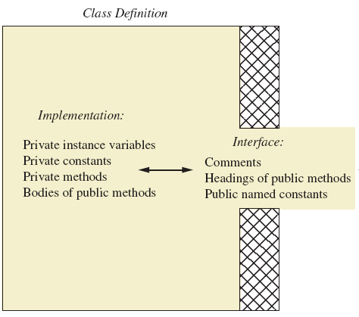
Encapsulation
Figure 5.3 A well encapsulated class definition
Programmer who uses the class

Slide 23
Encapsulation
Preface class definition with comment on how to use class
Declare all instance variables in the class as private.
Provide public accessor methods to retrieve data Provide public methods manipulating data
  Such methods could include public mutator methods.
Place a comment before each public method heading that fully specifies how to use method.
Make any helping methods private.
Write comments within class definition to describe implementation details.

Slide 24
Automatic Documentation javadoc
Generates documentation for class interface
Comments in source code must be enclosed in /** */
Utility javadoc will include
  These comments
  Headings of public methods
Output of javadoc is HTML format

Slide 25
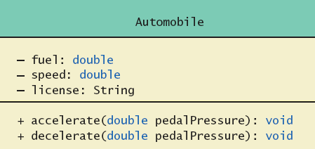
UML Class Diagrams
Recall Figure 5.2 A class outline as a UML class diagram

Slide 26
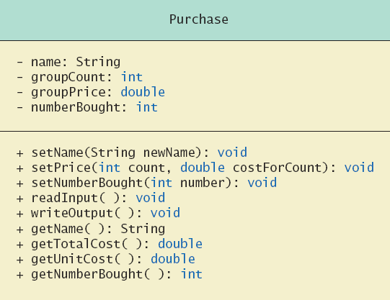
UML Class Diagrams
Note
Figure 5.4
for the
Purchase
class
Minus signs imply private access
Plus signs imply public access

Slide 27
UML Class Diagrams
Contains more than interface, less than full implementation
Usually written before class is defined
Used by the programmer defining the class
  Contrast with the interface used by programmer who uses the class

Slide 28
Summary
Designer of class should include an equals method
Graphics drawn by a JavaFX application normally done within GraphicsContext
Labels added to a JavaFX Layout

