Slide 1
Class and Method Definitions
Ch 5.1

Slide 2
Class and Method Definitions: Outline
Class Files and Separate Compilation
Instance Variables
Methods
The Keyword this
Local Variables
Blocks
Parameters of a Primitive Type

Slide 3
Class and Method Definitions
Java program consists of objects
  Objects of class types
  Objects that interact with one another
Program objects can represent
  Objects in real world
  Abstractions

Slide 4
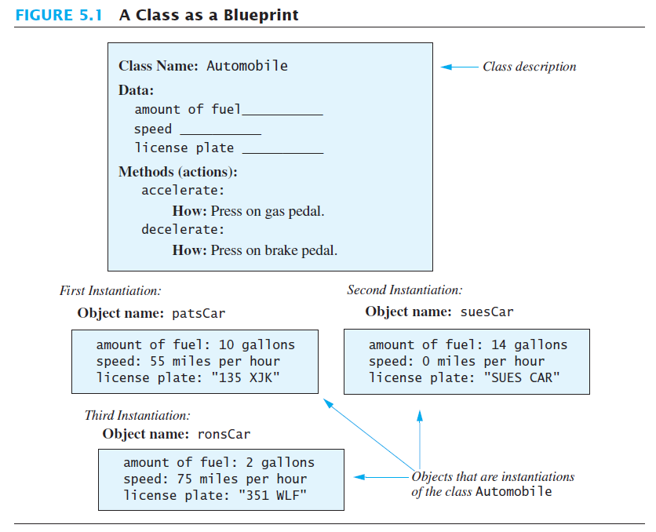
A class is a blueprint …
… for objects that we instantiate from it
Notes:
Note:
Each object has a name: patsCar, suesCar, ronsCar
In Java those would be variables.
And they would be of type Automobile

Slide 5
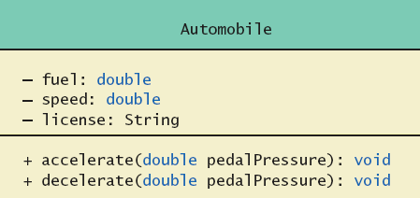
Class and Method Definitions
Figure 5.2 A class outline as a UML class diagram

Slide 6
Class Files and Separate Compilation
Each Java class definition usually in a file by itself
  File begins with name of the class
  Ends with .java
Class can be compiled separately
Helpful to keep all class files used by a program in the same directory
Notes:
You will learn this in your lab session

Slide 7
public class Dog
{ public String name;
public String breed;
public int age;
public void writeOutput()
{ System.out.println("Name: " + name);
System.out.println("Breed: " + breed);
System.out.println("Age in calendar years: " + age);
System.out.println("Age in human years: " +
getAgeInHumanYears());
System.out.println();
} // end writeOutput
public int getAgeInHumanYears()
{ int humanYears = 0;
if (age <= 2)
humanYears = age * 11;
else
humanYears = 22 + ((age-2) * 5);
return humanYears;
} // end getAgeInHumanYears
}
3 Instance variables
or Data members
or attributes
Will have different values for each Dog instance created.
Each object will have its own copy
2 behaviors
or methods
Will be the same for all Dog instances created, but act on individual instance variables.
Notes:
Use of public
No restrictions on how variables are used
Later might replace with private

Slide 8


public class DogDemo
{
public static void main(String[] args)
{
Dog balto = new Dog();
balto.name = "Balto";
balto.age = 8;
balto.breed = "Siberian Husky";
balto.writeOutput();
Dog scooby = new Dog();
scooby.name = "Scooby";
scooby.age = 42;
scooby.breed = "Great Dane";
System.out.println(scooby.name + " is a " + scooby.breed + ".");
System.out.print("He is " + scooby.age + " years old, or ");
int humanYears = scooby.getAgeInHumanYears();
System.out.println(humanYears + " in human years.");
}
}
Notes:
Note:
data members are used with the object name
Same for methods
“new” is used to create an object and allocate space in memory for it. (p.312)

Slide 9
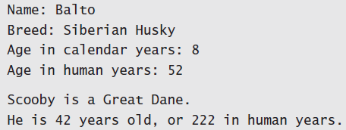
Using a Class and Its Methods
View sample program, listing 5.2
class DogDemo
Sample
screen output

Slide 10
Methods
When you use a method you "invoke" or "call" it
Two kinds of Java methods
  Return a single item
  Perform some other action – a void method
The method main is a void method
  Invoked by the system
  Not by the application program

Slide 11
Methods
Calling a method that returns a quantity
  Use anywhere a value can be used
Calling a void method
  Write the invocation followed by a semicolon
  Resulting statement performs the action defined by the method

Slide 12
Why use User-defined methods?
Using methods has several advantages:
While working on one method, you can focus on just that part of the program/class and construct it, debug it, and perfect it.
Different people can work on different methods simultaneously.
If a method is needed in more than one place in a class, or in different programs, you can write it once and use it many times.
Using methods greatly enhances the program’s readability because it reduces the complexity of the program.

Slide 13
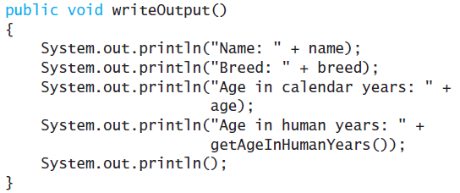
Defining void Methods
Consider method writeOutput from
class dog
Method definitions appear inside class definitions
  Can be used only with objects of that class

Slide 14
Defining void Methods
Most method definitions we will see as public
A method that does not return a value:
  Specified as a void method
Heading includes parameters
Body enclosed in braces { }
Think of a method as defining an action to be taken

Slide 15
Methods That Return a Value
Consider method getAgeInHumanYears( )
public int getAgeInHumanYears()
{ int humanYears = 0;
if (age <= 2)
humanYears = age * 11;
else
humanYears = 22 + ((age-2) * 5);
return humanYears;
} // end getAgeInHumanYears
Heading declares type of value to be returned
Last statement executed is return
return statement argument must match return type
Notes:
return statement must match return type
you can use more than one return statement (inside an if statement for example)
see p.319

Slide 16
The return statement
Make sure of the following in the value-returning methods:
  A value is returned
  The returned value has the same data type as the method
  All paths are considered to return a value
Remember that the return statement:
  is the last to execute in the method
  passes a single value to the caller method
Notes:
Covering all paths – needs an example !!!

Slide 17
Second Example – Species Class
Class designed to hold records of endangered species
View the class listing 5.3
class SpeciesFirstTry
  Three instance variables, three methods
  Will expand this class in the rest of the chapter
View demo class listing 5.4
class SpeciesFirstTryDemo

Slide 18
The Keyword this
Referring to instance variables:
  outside the class – must use:
    Name of an object of the class
    Followed by a dot
    Followed by Name of instance variable
  Inside the class,
    Use name of variable alone
    The object (unnamed) is understood to be there
    It is the receiving object

Slide 19
The Keyword this
Inside the class the unnamed object can be referred to with the name this
Example
this.name = keyboard.nextLine();
The keyword this stands for the receiving object
For simplicity Java allows you to omit it.
We will see some situations later that require the use of this

Slide 20
Local Variables
Variables declared inside a method are called local variables
  Can only be used inside the method
  For example:
    All variables declared inside method main are local to main
Local variables having the same name and declared in different methods are considered different variables

Slide 21
Local Variables
View sample file, listing 5.5A
class BankAccount
View sample file, listing 5.5B
class LocalVariablesDemoProgram
Note two different variables newAmount
  Note different values output
Sample
screen output

Slide 22
/** This class is used in the program LocalVariablesDemoProgram.
*/
public class BankAccount
{ public double amount;
public double rate;
public void showNewBalance ()
{
double newAmount = amount + (rate / 100.0) * amount;
System.out.println ("With interest added, the new amount is $"
+ newAmount);
}
}
/** A toy program to illustrate how local variables behave.
*/
public class LocalVariablesDemoProgram
{ public static void main (String [] args)
{
BankAccount myAccount = new BankAccount ();
myAccount.amount = 100.00;
myAccount.rate = 5;
double newAmount = 800.00;
myAccount.showNewBalance ();
System.out.println ("I wish my new amount were $" + newAmount);
}
}
newAmount is a local variable in method showNewBalance
Sample
screen output
it is a different variable from this one
newAmount is a local variable in method main

Slide 23
Blocks
Recall compound statements
  Enclosed in braces { }
When you declare a variable within a compound statement
  The compound statement is called a block
  The scope of the variable is from its declaration to the end of the block
A variable declared outside the block is usable both outside and inside the block
Notes:
We will expand on this later on

Slide 24
Parameters of Primitive Type
Recall method getPopulationIn10() declaration in class SpeciesFirstTry
public int getPopulationIn10 ()
{ int result = 0;
double populationAmount = population;
int count = 10;
while ((count > 0) && (populationAmount > 0))
{
populationAmount +=(growthRate/100)*populationAmount;
count -- ;
}
if (populationAmount > 0)
result = (int) populationAmount;
return result;
}
Computes the population after 10 years. What if I want a different number of years?
count controls the number of iterations, I could change the value or read it from the user.
Is that a reasonable solution? Is it sufficient? Is there a better way?

Slide 25
Parameters of Primitive Type
How will this affect the way we call the method? Previously we called it like this:
speciesOfTheMonth.getPopulationIn10()
We can give a method a parameter:
public int predictPopulation (int years)
{ int result = 0;
double populationAmount = population;
int count = years;
while ((count > 0) && (populationAmount > 0))
{
populationAmount +=(growthRate/100)*populationAmount;
count -- ;
}
if (populationAmount > 0)
result = (int) populationAmount;
return result;
}
we have to provide the parameter value
speciesOfTheMonth.predictPopulation(10)

Slide 26
Parameters of Primitive Type
Note the declaration
public int predictPopulation(int years)
The formal parameter is years
Calling the method
int futurePopulation =
speciesOfTheMonth.predictPopulation(10);
The actual parameter is the integer 10
View sample program, listing 5.7
class SpeciesSecondClassDemo
Notes:
The output will be the same as before, but if we change the actual parameter to a different number the output will be different of course.

Slide 27
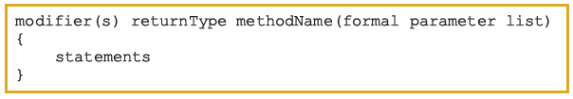
Syntax: Method
public, private, protected, static, abstract, final
The syntax of the formal parameter list is:
type of the value that the method returns (using return statement)
Notes:
A method can have more than one parameter.
Recall methods such as indexOf which can have two parameters.
The order of the actual parameters must match the oder of the formal parameter

Slide 28
Parameters of Primitive Type
Parameter names are local to the method
When a method is invoked
  Each parameter is initialized to the value in the corresponding actual parameter
  A primitive actual parameter is not (and cannot be) altered by invocation of the method
    We will learn later that this is not the case for actual parameters of non-primitive types.
Automatic type conversion is performed
byte
short
int
long
float
double

