Slide 1
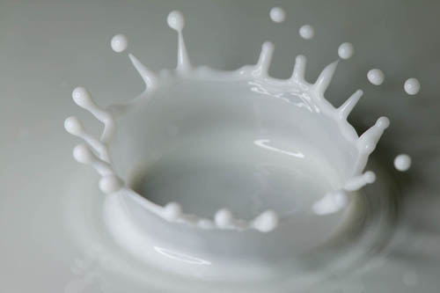
بسم الله الرحمن الرحيم
140 micro
Lab 8 : Counting of bacteria in Milk

Slide 2
طرق قياس النمو البكتيري Measurements of bacterial growth
العد الحيوي للخلايا البكتيرية بطريقة التخفيف
المتسلسل على الأطباق
Viable plate count by serial Dilution Method

Slide 3
2- Direct Count
1- Indirect Count
Serial Dilution & Colony Count
(viable count)
Spread plate
Pour plate
Microscopic cell counts
Membrane filtration
Turbidity
Microbial Growth Measurements

Slide 4
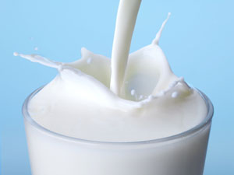
Many studies require the quantitative determination of bacterial populations. The two most widely used methods for determining bacterial numbers are:
A- The standard plate count method.
B- Spectrophotometer (turbid metric) analysis.
An indirect measurement of cell density ( live bacteria).
based on turbidity and indirectly measures all bacteria (cell biomass), dead and alive

Slide 5
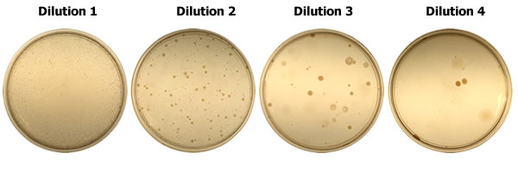
The bacteriological tests used most often are the Standard Plate Count (SPC)

Slide 6
The plate count (VIABLE COUNT)
However, if the sample is serially diluted and then plated out on an agar surface in such a manner that single isolated bacteria form visible isolated colonies, the number of colonies can be used as a measure of the number of viable (living) cells in that known dilution.
We are determining the number of Colony-Forming Units (CFUs) in that known dilution.

Slide 7
Colony counting
bacteria may be clumped together. Therefore, when doing the plate count technique, we generally say we are determining the number of Colony-Forming Units (CFUs) in that known dilution.
the bacterial sample is diluted by factors of 10 and plated on agar.
After incubation, the number of colonies on a dilution plate showing between 30 and 300 colonies is determined.
Notes:
Colonies forming units
Not the same as bacteria.
2 bacteria might have been very close and formed one colony

Slide 8
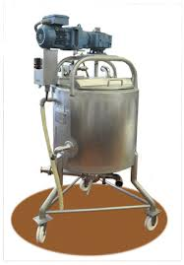
Bacterial contamination of raw milk can generally occur from three main sources:
within the udder.
outside the udder.
From the surface of
equipment used for milk
handling and storage.

Slide 9
(( The experiment ))

Slide 10
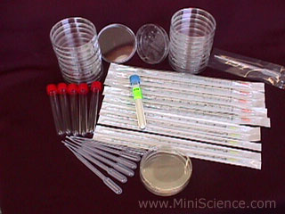
Materials
Test tubes
Pipettes (1 ml, graduated).
Petri plates
Nutrient milk agar
Bent glass rod.
Alcohol 70%.

Slide 11
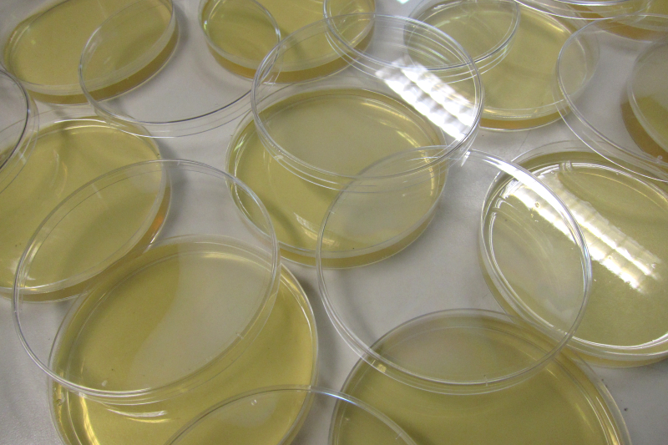
First, Preparation of milk agar media
Prepare 200ml nutrient agar media
Add 1ml of sterilized milk in the prepared sterilized media
Mix it thoroughly
Pour the media in petri plates and let them solidify

Slide 12
Preparation of dilutions :
Take six test tubes and add 9 ml of ditilled sterilized water (DDW) in each tube and label them as 1,2,3,4,5,6
Transfer 1ml of the sample (unsterilized milk) to tube no.1 contained 9ml DDW and Reflame and cap the sample.
Mix the tube throughlty. And this makes the first dilution.
Transfer1 ml from the 1st dilution to test tube no.2. And this makes the second dilution.
Repeat the same pattern with other tubes as shown in the diagram.

Slide 13
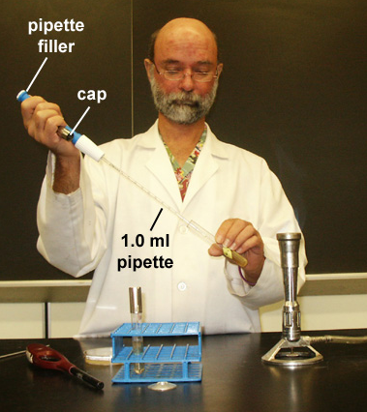
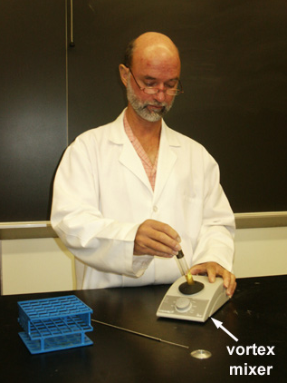
Using a Pipette to Remove Bacteria from a Tube
Using a Vortex Mixer to Mix Bacteria Throughout a Tube

Slide 14
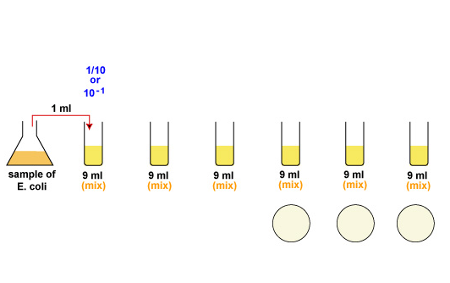
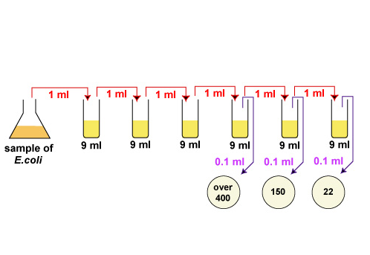
For a more accurate count it is advisable to plate each dilution in duplicate or triplicate and then find an average count.

Slide 15
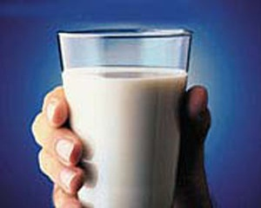
water

Slide 16
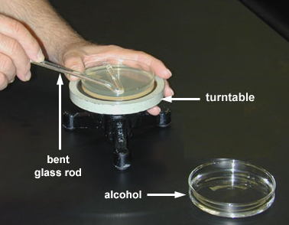
Inoculation of Diluted Sample
From the last three dilutions, transfer 1ml to prepared milk agar plate
Using a turntable and sterile bent glass rod, immediately spread the solution over the surface of the plates.
Replace the lid and re-sterilize the glass rod with alcohol and flaming.
Repeat for each plate.
Incubate the plates converted for 24 hrs at 37°C.
Count the colonies of bacteria after incubation.
Using a Bent Glass Rod and a Turntable to Spread a Bacterial Sample

Slide 17
water

Slide 18
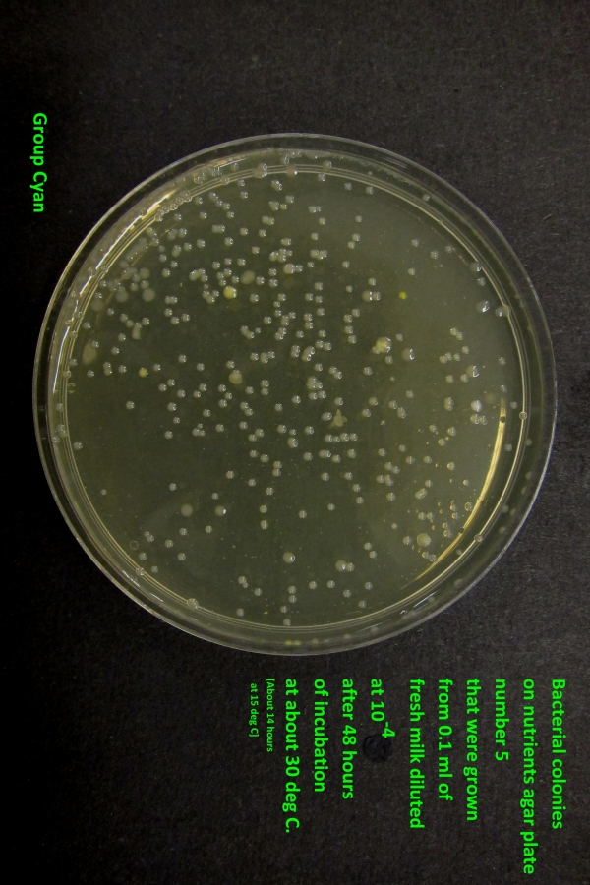
After incubation

Slide 19
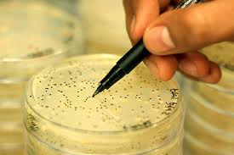
Colony counting
Count the colonies on each plate.
Select all of the Petri plates containing between 30 and 300 colonies.

Slide 20
Colony counting
At the end of the incubation period, Count by looking at the bottom of the plate (while keeping the Petri plate closed).
Agar is translucent you should not have to open the plate
Select all of the Petri plates containing between 30 and 300 colonies. Count the colonies on each plate.

Slide 21
Counting of bacteria in Milk ( CFU )
Calculation :
Count of cell =
Number of colonies in plate ÷ (dilution of sample x volume plated in ml )
= Number of bacteria /ml.
for example; if 32 colonies in plate of 1/10,000 dilution and volume plated 0,5 then the count is :
32 ÷ (1/10,000 x0.5) = 640,000 cell /ml

Slide 22
CFU
Calculate the number of bacteria (CFU) per milliliter or gram of sample by dividing the number of colonies by the dilution factor multiplied by the amount of specimen added to agar plate.
A simple calculation is given below:

Slide 23
Example: CFU calculation
You count 46 colonies on your plate
You put 1 ml of bacterial culture into 99 ml of saline and plated 0.1 ml
Dilution 1/100
CFU= 46
1/100 * 0.1
= 46 * 100 * 10 =46 000

Slide 24
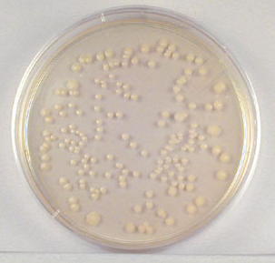
Colony counting
A plate having 30-300 colonies is chosen because this range is considered statistically significant.
This plate has between 30 and 300 colonies and is a suitable plate for counting.

Slide 25
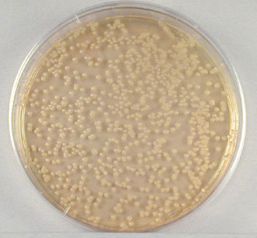
Colony counting
If there are less than 30 colonies on the plate, small errors in dilution technique or the presence of a few contaminants will have a drastic effect on the final count. ‘too few to count (TFTC)’.
Likewise, if there are more than 300 colonies on the plate, there will be poor isolation and colonies will have grown together. ‘too numerous to count (TNTC)’.
This plate has over 300 colonies and cannot be used for counting.
This plate less than 30 colonies and is unsuitable plate for counting.
Notes:
http://www.ehow.com/how_7806269_calculate-cfu-dilution.html

Slide 26
Good luck
أ.شروق الشهراني
أ.أمل الغامدي

