Slide 1
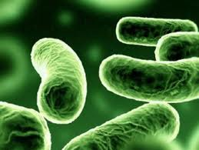
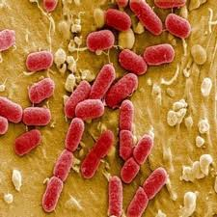
علم الأحياء الدقيقة
Microbiology
Introduction to Bacteriology

Slide 2
Occurrence & distribution of bacteria
They live everywhere. They occur in water (fresh and salty), in soil and air.
Some types live as SAPROPHYTES, others are PARASITES on plants, animals and humans causing diseases, and some are SYMBIOTIC organisms. Some of them can survive in ice and others can live in hot water. They can form spores which are very resistant to drought, chemical, rays and temperature variations.

Slide 3
Bacterial Cells Morphology
Eubacteria have three main shape categories:
1- Rod-shaped are known as bacilli. These are short rods.
According to their arrangement, they are divided to:
- Mono-bacilli: Some of them have pin-head thickenings and they give an impression of branched structure and they causes diseases in human.
- Diplo-bacilli: They occur in pairs, also causing diseases in humans.
- Strepto-bacilli: That occur in chains of different lengths, arranged in end-to-end chains.
- Coryne-form bacillus: A bacterium with irregularly rod-shaped cells arranged at angles (V- and/or L-shaped).

Slide 4
Bacterial Cells Morphology
2-Spherical are called cocci : They are divided in six groups depending on the cell arrangement and cell division:
- Mono-cocci: They are single celled and lives as saprophytes.
- Diplo-cocci: The cell divides in one plane and the pairs remain attached or cells arranged in pairs.
- Strepto-cocci: Division of cell in one plane and causes diseases in humans.
- Tetra-cocci (Tetrad): The cell divides in two planes resulting in four cells and causes diseases in humans. Looks almost like a square under the microscope.
- Sarcinae: The cell divides in three planes resulting in 8 cells. Look like small cubes and may be difficult to distinguish from tetrads.
Staphylo-cocci: Division in several planes resulting in cluster of cells like cluster of grape.

Slide 5
Bacterial Cells Morphology
3- Spiral are called spirilla. They can be divided into:
- Vibrion: The cell resemble a comma or curved in appearance.
- Spirillia: Coiled forms exhibiting twists with one or more turns. They have constant shapes and they move by flagella
- Spirochaets: They are intermediate between bacteria and protozoa, they don’t have cell wall and flagella. Their movement is like a worm with helical or corkscrew-shaped.

Slide 6
Bacterial Cells Morphology
Actinomycetes (Filamentous/Mold-like bacteria): Their body consists of mycelium just like fungi. Streptomyces group belongs to these molds like bacteria. Streptomycin, an antibiotic is produced by Streptomyces.

Slide 7
Bacterial Cells Morphology

Slide 8
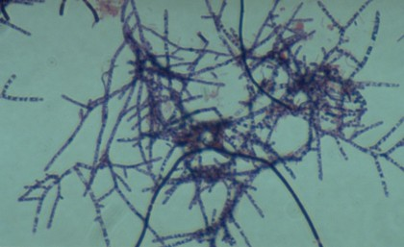
Bacterial Cells Morphology

Slide 9
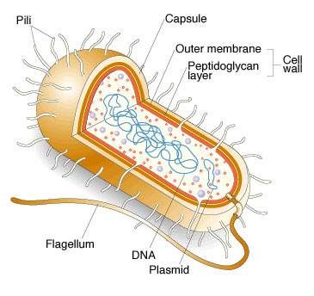
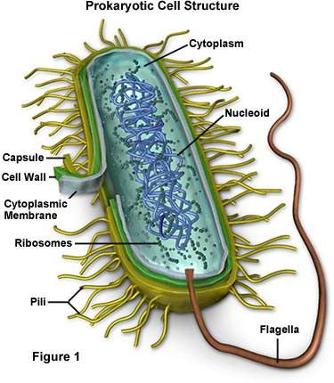
Bacterial Structures

Slide 10
The bacterial structures may be divided into three categories:
- Essential structures, present in all bacteria.
- Structures present in some species (primary taxonomic characters).
- Structures present in some strains of some species.

Slide 11
The bacterial structures may be divided into three categories:
Essential structures, present in all bacteria
- Protoplast (cytoplasm and nuclear body).
- Cytoplasmic membrane.
- Cell wall.
Structures present in some species:
- Flagella
- Spores
- Inclusion granules.

Slide 12
Structures present in some strains of some species:
- Fimbriae.
- Pili.
- Glicocalix (capsule, microcapsule, etc.).

Slide 13
Motility in bacteria
Bacteria are either non-motile or motile. Motile forms are either creeping or swimming.
Creeping bacteria (e.g. Myobacterium) move or creep slowly on a supporting surface as a result of wave-like contractions (contract and relax) of their bodies.
Swimming bacteria move freely in a liquid medium due to the presence of flagella.

Slide 14
Motility in bacteria
Flagellated forms differ with respect to number and pattern of attachment of flagella. The following forms can be to:
Monotrichous One flagellum attached to one pole of the cell.
Lophotrichous A tuft of flagella at one pole of the cell.
Amphitrichous A single or a tuft of flagella at the two poles of the cell.
Peritrichous Many flagella distributed over the whole surface of the cell.

Slide 15
Monotrichous
Lophotrichuos
Amphitrichous
Peritrichous

Slide 16
QUESTIONS??

