Slide 1
Mbio 140 Lecture-2

Slide 2
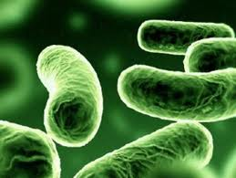
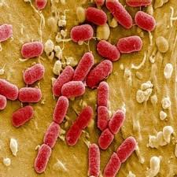
علم الأحياء الدقيقة
Microbiology
Introduction to Bacteriology

Slide 3
Methods of studying microorganisms
Microscopes, Centrifugation, Filtration.
Solid and liquid media-simple and complex.
Live cell cultures, animal models.
Samples collection:
Inoculation.
Incubation.
Isolation.
Inspection.
Identification.

Slide 4
أنواع المجاهر
Microscopes Types
الضوئي
Light
متحد البؤر
Confocal
الساطع
Bright field
الالكتروني
Electron
الصوتي الماسح
Scanning acoustic
المظلم
Dark field
متباين الطور
Phase contrast
النفاذ
Transmission
10000-100000x
المسبار الممسوح
Scanned-probe
متباين التداخل التفريقي
Differential interference contrast
الماسح
Scanning
1000-10000x
المسح النفقي
Scanning tunneling
الوميضي
Fluoresence

Slide 5
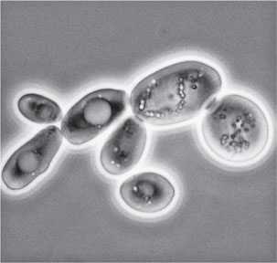
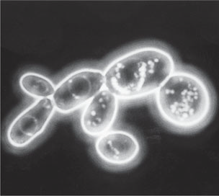
Methods of studying microorganisms
Phase-Contrast Microscopy
Dark-Field Microscopy

Slide 6
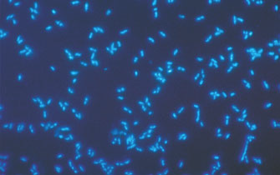
Methods of studying microorganisms
Fluorescence Microscopy

Slide 7
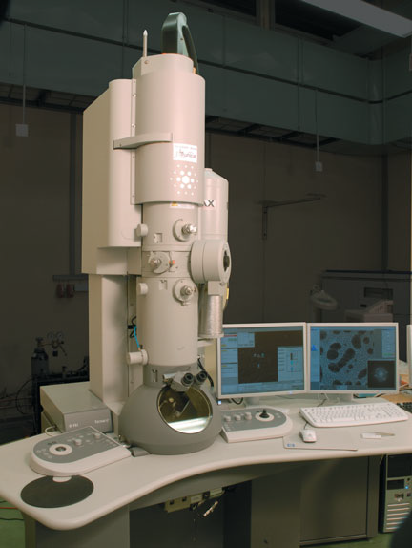
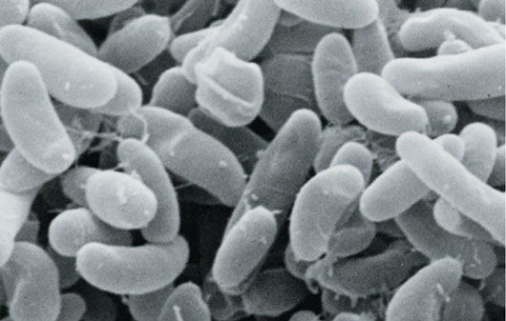
Methods of studying microorganisms
The Electron Microscope:
1- Transmission Electron Microscopy (TEM)
2- Scanning Electron Microscopy (SEM)

Slide 8
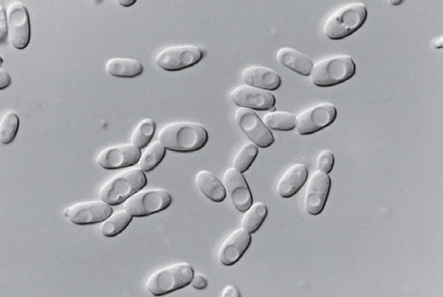
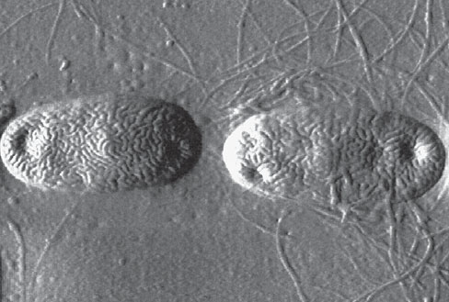
Imaging Cells in Three Dimensions (3D)
Differential Interference
Contrast Microscopy
Atomic force Microscopy

Slide 9
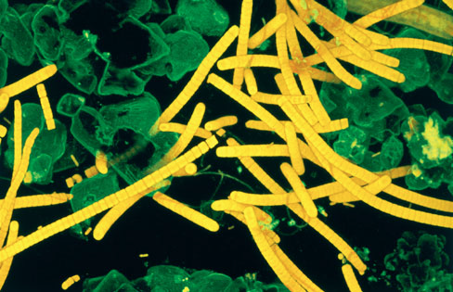
Confocal Scanning Laser Microscopy

Slide 10
Microbial Cells Staining
الصبغ المركب
Complex Stain
الصبغ البسيط
Simple Stain
التفريقي
Differential Stain
صبغ التراكيب الخاصة
Special Stain
صبغة جرام
Gram Stain
Capsule Stain
Endospore Stain (Schaeffer-Fulton endospore Stain).
Flagella Stain
Crystal violet
Methylene Blue
Malachite green
Safranin
الصبغ المقاوم للأحماض
Acid-Fast Stain

Slide 11
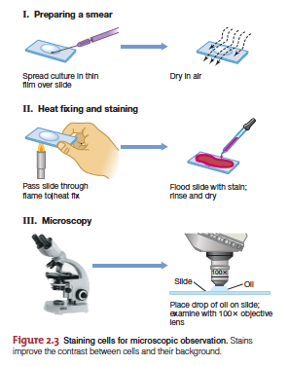
Methods of studying microorganisms

Slide 12
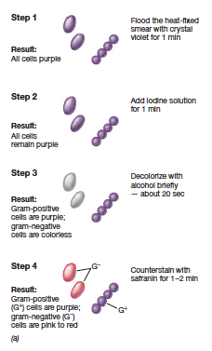
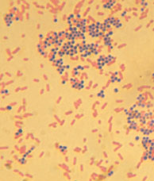

Slide 13
Classification of living organisms
The modern classification of five Kingdoms system of living organisms, according to Whittaker (1969), classify the living organisms to five kingdoms:
Living Organisms
Monera
Protista
Fungi
Plantae
Animalia

Slide 14
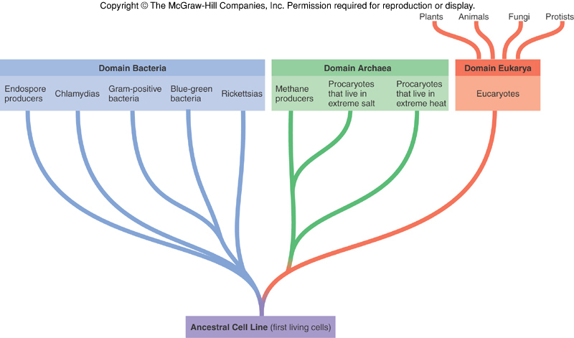
Classification of living organisms
Carl Woese et al. in 1977

Slide 15
Microorganisms
Prokaryotic cells
Eukaryotic cells
Fungi (Molds and Yeast)
Algae
Protozoa
(Parasitic worms) Helminths
Cyanobacteria
Bacteria
Archaea

Slide 16
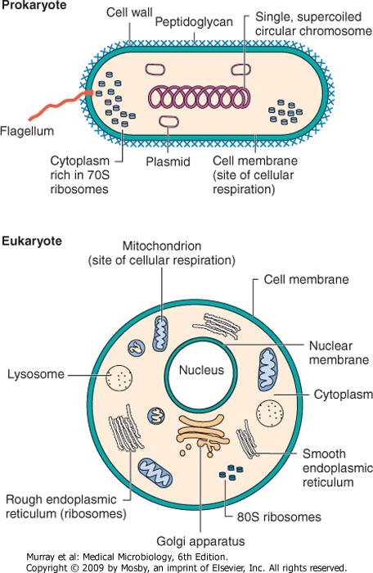

Slide 17
Major Differences between Prokaryotic and Eukaryotic microorganisms
Prokaryotes | Eukaryotes
1- Lack membrane bound nucleiod region | 1- Membrane bound nucleus containing DNA
2- DNA-one circular molecule one chromosome | 2- DNA-linear molecules arranged to form several chromosomes
3- Haploid-One copy of a gene | 2- Diploid-Two copies of a gene
4- Plasma membrane does not contain sterols | 4- Plasma membrane contains sterols
5- Reproduction—simple binary fission | 5- Reproduction—meiosis and mitosis

Slide 18
Major Differences between Prokaryotic and Eukaryotic microorganisms
Prokaryotes | Eukaryotes
6- lack membrane bound organelles | 6- Presence of membrane bound organelles such as chloroplasts and mitochondria
7- Cell walls almost contain complex polysaccharide Peptidoglycan | 7- Cell wall is chemically simple when present

Slide 19
Size of Microorganisms
Microorganisms vary in size ranging from 10 nm (nanometers) to 100 µm (micrometers):
- Viruses in nm = 10⁻⁹ m (meter)
- Bacteria in µm = 10⁻⁶ m
- Helminths in mm = 10⁻³ m

Slide 20
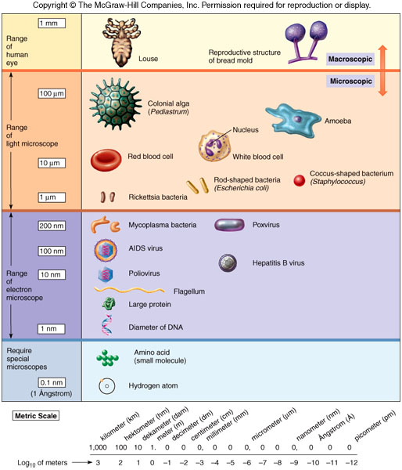
Size of Microorganisms

Slide 21
Nomenclature
Binomial (scientific) nomenclature
Genus –Escherichia, always capitalized
- Species - coli, lowercase
Both italicized or underlined: Escherichia coli or Escherichia coli.

Slide 22
Identification
Morphological characteristics.
Physiological/Metabolic characteristics.
Ecological characteristics.
Genetic characteristics.
Molecular characteristics.

Slide 23
QUESTIONS??

