Slide 1
Molecular biology - Calculations
By Dr. Mansour Gatasheh

Slide 2
Molecular Biology Calculations
In this section we will discuss
DNA-RNA-Protein relations
Mainly quantification of nucleic acids
Spectrophotometric
Gel based

Slide 3
In biochemistry one can not avoid dealing with nucleic acids
With the current trend of genomics it is essential to handle nucleic acids
Became an integral part of biochemistry
Any experiment dealing with nucleic acids requires to quantify the amount
For optimal conditions of the experiment
This ensures reproducibility of the experiment

Slide 4
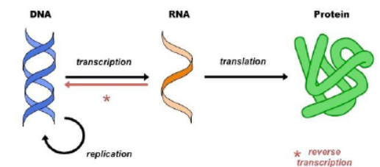
Central dogma – concept
DNA → RNA → Proteins
Replication
Transcription
Translation
Reverse transcription

Slide 5
Central dogma - concept
DNA → RNA → Proteins
Codon – 3 bases (DNA/ RNA) – 1 amino acid
Average mol.wt of DNA base – 327(330)
dAMP – 331
dTMP – 322
dGMP – 347
dCMP - 307
Average mol. wt of RNA base – 339
Average mol. wt of amino acid – 110

Slide 6
Given MW only for rough estimate
Can be used for quick calculation to get some idea
Never to consider that distribution of these bases is equal in a stretch of DNA Example problem ……
A protein is made of 100 amino acids. Estimate its MW
Average MW of amino acid = 110
So 100 a. a. x 110 = 11000 or 11 KD

Slide 7
Example problem ……
One protein is 60 kD. How many codons needed to code this protein. What is the length of DNA
60 KD = 60 000 gm/mol
We know 1 a.a. = 110
60 KD protein has 60 000/110 = 545 a.a.
545 codons needed
1 codon = 3 bp
545 x 3 = 1635 bp or 1.6 KB

Slide 8
Example problem ……
There is a piece of DNA of length 1000 bp. What is the length of protein it will code
What is the mol. Wt of protein in KD
1000 / 3 = 333 a.a
We know 1 a.a. = 110
333 x 110 = 36630
= 36.6 KD

Slide 9
Quantification of nucleic acids
Spectrophotometric methods
Some chemicals have natural colors
Some chemicals can be made to have colors by changing them
These can be estimated by colorimetry (measured in visible wavelengths)

Slide 10
Quantification of nucleic acids and proteins
Spectrophotmetric methods
Some chemicals do not have colors
And show absorbance in UV region
Presence of conjugated double bond in nucleotides results in DNA and RNA absorb light in UV region with absorption maxima at 260 nm
Presence of aromatic amino acid (tyr, trp,phe) in proteins having absorption maxima at 280 nm.

Slide 11
Quantification of nucleic acids and proteins
Spectrophotometric methods

Slide 12
Quantification of nucleic acids
Spectrophotometric methods
There are variations in exact absorption peak for individual bases of DNA
The peak we saw in last slide is a cumulative peak
Absorbance varies and dependent on
Contributing nucleotides (poly A/T/G/C)
DNA / RNA differences
Hydrogen bonding dsDNA vs ssDNA…

Slide 13
Quantification of nucleic acids and proteins
Spectrophotmetric methods
Despite of some limitations.. A260 / A280 method is very popular in Biochemistry because:
Easy to perform Very sensitive
With the advancements of instrumentation
only 1ul should be enough to accurately estimate

Slide 14
Quantification of nucleic acids and proteins
Spectrophotometric methods
For protein estimations A280/A260 ratio
The greater the A280.. The less the protein is contaminated with DNA
A correction factor is calculated
(A280) correction factor = mg/ml protein

Slide 15
Quantification of nucleic acids and proteins
Spectrophotometric methods
Converse approach for DNA A260/A280 ratio
The greater the A260.. The less the DNA is contaminated with protein
Pure DNA = A260/A280 = 1.8
Pure RNA = A260/A280 = 2
Impurities (phenol) can be checked A230
Low A260/A230 = phenol contamination
Low A260/A280 = protein contamination
A260/A280 > 1.8 = RNA contamination

Slide 16
Quantification of nucleic acids and proteins
Example problem
Calculate the molar absorbency of a single stranded 10 nucleotide DNA sequence
From our previous slides we know
40 ug/ml ssDNA has A260=1
10 mer = 330 x 10 =3300 ug/ml gives ? A260
=3300/40 = 82.5
Convert to mg/ml = 82.5x103 or 8.25x104
So 1Molar gives 8.25x104

Slide 17
Quantification of nucleic acids and proteins
Beer-Lambert law

Slide 18
Melting temperature (Tm) of DNA
Often employed in PCR
Increasing temp. denatures DNA
dsDNA → ssDNA
Temperature at which half of the DNA is denatured is called melting temperature
GC content of DNA mainly determines
High GC content = high Tm

Slide 19
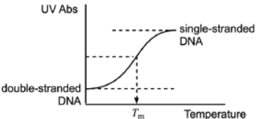
Melting temperature (Tm) of DNA
Often employed in PCR
Increasing temp. denatures DNA
dsDNA → ssDNA
Temperature at which half of the DNA is denatured is called melting temperature
GC content of DNA mainly determines
High GC content = high Tm

Slide 20
Melting temperature (Tm) of DNA
During PCR it is important to know Tm
Tm too low – non specific binding of primer
Tm too high – no priming
Rough calculations
Tm = 4x # of G/C + 2x # of A/T
Many other precise methods are available

Slide 21
Melting temperature (Tm) of DNA
Practice…

Slide 22
Melting temperature (Tm) of DNA
Practice…

