Slide 1
1211 CYS IT Systems Components 4#Lecture Network Mapping تعيين الشبكة – Part 2
King Saud University – Applied Studies and Community Service –1211 CYS

Slide 2
Topics:
Network Mapping تعيين الشبكة
Network mapping techniques (تقنيات رسم الشبكة)
How Does Network Mapping Work? (كيف يعمل تعيين الشبكة؟)
Network Mapping Solutions Using SNMP (حلول تعيين الشبكة باستخدام بروتوكول إدارة الشبكة البسيط (SNMP))
Enterprise network mapping (تعيين الشبكة للشركات)
Network mapping software (برمجيات تعيين الشبكة)
Network mapping cybersecurity (تعيين الشبكة في مجال أمن المعلومات)
King Saud University – Applied Studies and Community Service –1211 CYS

Slide 3
Objectives
Discuss the network mapping techniques. ناقش تقنيات تعيين الشبكة.
Describe how does network mapping work. (صف كيف تعمل عملية تعيين الشبكة.
)
Discuss the basic network mapping cybersecurity issues.
(ناقش مشاكل أمان تعيين الشبكة الأساسية.
)
King Saud University – Applied Studies and Community Service –1211 CYS

Slide 4
Network Mapping
The process of visualizing (visual representation of devices in the network) the connections between systems and different computers in a network, to understand how a physical and virtual network connects, through a range of tools, including flowcharts, network diagrams, topology discovery, and device inventories.
عملية تصور الاتصالات بين الأنظمة وأجهزة الكمبيوتر المختلفة في الشبكة، لفهم كيفية اتصال الشبكة الفعلية والافتراضية، من خلال مجموعة من الأدوات، بما في ذلك الرسوم التخطيطية للتدفق، والرسوم البيانية للشبكة، واكتشاف الطوبولوجيا، وجرد الأجهزة.
Network maps are one of the most fundamental tools in a network admin's toolkit. The network's physical architecture and associated data provide a lot of information that would be impossible to access through other means. These maps are used to locate network bottlenecks.
خرائط الشبكة هي أحد أدوات إدارة الشبكة الأساسية في مجموعة أدوات المسؤولين عن الشبكة. توفر هندستها الفيزيائية للشبكة والبيانات المرتبطة بها الكثير من المعلومات التي من الصعب الوصول إليها عبر وسائل أخرى. تُستخدم هذه الخرائط لتحديد نقاط التكدس في الشبكة.
King Saud University – Applied Studies and Community Service –1211 CYS

Slide 5
Network mapping techniques
SNMP-based approaches, active probing, and route analytics are the three basic approaches for creating an automated network map.
المقاربات القائمة على بروتوكول إدارة الشبكة البسيط (SNMP)، التحقق النشط، وتحليل المسارات هي الطرق الثلاث الأساسية لإنشاء خريطة الشبكة الآلية.
SNMP-based maps: SNMP (Simple Network Management Protocol) is a widely used industry standard protocol that is created to help locate faulty devices. The SNMP-based approach gets data from router and switch MIBs (Management and Information Base ) in order to construct the network map.
خرائط قائمة على بروتوكول إدارة الشبكة البسيط (SNMP): يعد بروتوكول إدارة الشبكة البسيط (SNMP) من أبرز البروتوكولات الصناعية القياسية المستخدمة على نطاق واسع والتي تم إنشاؤها لمساعدة في تحديد الأجهزة المعطلة. تعتمد المقاربة القائمة على SNMP على الحصول على البيانات من MIBs (قاعدة إدارة ومعلومات الأجهزة) للموجهات والمفاتيح الذكية لبناء خريطة الشبكة.
Active probing: The active probing technique uses a sequence of traceroute-like probe packets, or special data packets or frames, to generate network maps. These packets or frames report IP router and switch forwarding paths to the destination address.
Route analytics: The route analytics approach uses routing protocol data for creating a network map through passively listening to Layer 3 protocol exchanges between routers. This information is not only useful for network mapping, but also for network discovery, real-time network monitoring, and routing diagnostics.
King Saud University – Applied Studies and Community Service –1211 CYS

Slide 6
Network mapping techniques
Network mapping systems use an active probing method to gather network data by sending probe packets that hop from node to node, which return information to the mapping system with the IP address and other technical details. In large networks like the Internet and its smaller constituents, this probe may be limited to gathering publicly available, non-confidential and general node information.
تستخدم أنظمة تعيين الشبكة طريقة الاستجواب النشط لجمع البيانات الشبكية عن طريق إرسال حزم استجواب تتنقل من عقدة إلى عقدة، حيث ترجع بمعلومات إلى نظام التعيين مع عنوان IP وتفاصيل تقنية أخرى. في الشبكات الكبيرة مثل الإنترنت ومكوناتها الأصغر، يمكن أن يكون هذا الاستجواب مقتصرًا على جمع معلومات العقد العامة وغير السرية المتاحة للجمهور.
Network mapping allows network administrators (NA) to visualize and break down complex networks into smaller portions, allowing the NA to analyze and view the network, check for connection errors and pull up details that facilitate an issue’s root cause analysis. By using a mapping system’s active monitoring module, administrators can track network changes in real time. This is useful for network providers and Internet service providers (ISP), as well as anyone that operates a large, complex network.
تسمح عملية تعيين الشبكة لمسؤولي الشبكات بتصور الشبكات المعقدة وتقسيمها إلى أجزاء أصغر، مما يتيح لهم تحليل الشبكة وعرضها، والتحقق من أخطاء الاتصال واسترجاع التفاصيل التي تسهل عملية تحليل سبب العطل. عن طريق استخدام وحدة المراقبة النشطة في نظام التعيين، يمكن للمسؤولين تتبع تغييرات الشبكة في الوقت الحقيقي. هذا مفيد لمزودي الخدمات الشبكية ومقدمي خدمات الإنترنت، بالإضافة إلى أي شخص يدير شبكة كبيرة ومعقدة.
King Saud University – Applied Studies and Community Service –1211 CYS

Slide 7
Network mapping techniques
Network mapping systems use an active probing method to gather network data by sending probe packets that hop from node to node, which return information to the mapping system with the IP address and other technical details. In large networks like the Internet and its smaller constituents, this probe may be limited to gathering publicly available, non-confidential and general node information.
تستخدم أنظمة تعيين الشبكة طريقة الاستجواب النشط لجمع البيانات الشبكية عن طريق إرسال حزم استجواب تتنقل من عقدة إلى عقدة، حيث ترجع بمعلومات إلى نظام التعيين مع عنوان IP وتفاصيل تقنية أخرى. في الشبكات الكبيرة مثل الإنترنت ومكوناتها الأصغر، قد يتم تقييد هذا الاستجواب لجمع معلومات العقد العامة وغير السرية المتاحة للجمهور.
Network mapping allows network administrators (NA) to visualize and break down complex networks into smaller portions, allowing the NA to analyze and view the network, check for connection errors and pull up details that facilitate an issue’s root cause analysis. By using a mapping system’s active monitoring module, administrators can track network changes in real time. This is useful for network providers and Internet service providers (ISP), as well as anyone that operates a large, complex network.
تسمح عملية تعيين الشبكة لمسؤولي الشبكات بتصور الشبكات المعقدة وتقسيمها إلى أجزاء أصغر، مما يتيح لهم تحليل الشبكة وعرضها، والتحقق من أخطاء الاتصال واسترجاع التفاصيل التي تسهل عملية تحليل سبب العطل. بواسطة استخدام وحدة المراقبة النشطة في نظام التعيين، يمكن للمسؤولين تتبع تغييرات الشبكة في الوقت الحقيقي. هذا مفيد لمزودي خدمات الشبكة ومزودي خدمات الإنترنت، بالإضافة إلى أي شخص يدير شبكة كبيرة ومعقدة.
King Saud University – Applied Studies and Community Service –1211 CYS

Slide 8
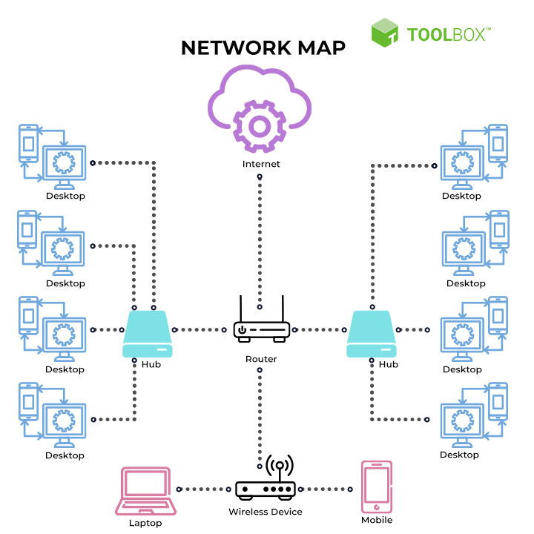
Network mapping techniques
King Saud University – Applied Studies and Community Service –1211 CYS

Slide 9
Network mapping techniques
With network mapping tools, enterprises can easily manage such vast networks and resolve downtime issues. This is because network mapping enables granular visibility into company networks and generates actionable insights to help IT teams detect problems in real-time. Network mapping allows automatic visualization of the connections between different endpoints, servers, networking equipment, and how they function together.
مع أدوات تعيين الشبكة، يمكن للشركات إدارة شبكاتها الواسعة بسهولة وحل مشكلات التوقف. وذلك لأن تعيين الشبكة يمكنه توفير رؤية دقيقة في شبكات الشركة وتوليد تحليلات قابلة للتنفيذ لمساعدة فرق تكنولوجيا المعلومات على اكتشاف المشاكل في الوقت الفعلي. تعيين الشبكة يتيح تصورًا آليًا للاتصالات بين نقاط النهاية المختلفة والخوادم ومعدات الشبكات، وكيفية عملها معًا.
King Saud University – Applied Studies and Community Service –1211 CYS

Slide 10
How Does Network Mapping Work?
Network mapping solutions gather and interpret data using easy-to-read visualizations that accurately reflect the status of the enterprise network and all linked devices. Alerts are generated to notify IT personnel of network problems such as excess traffic or abnormal behavior. Simply checking the map allows IT teams to spot devices exhibiting problems and gain additional context-driven data to help figure out the cause of the issue quickly. The metrics gauged by network mapping tools include latency, bandwidth, and throughput.
تقوم حلول تعيين الشبكة بجمع وتفسير البيانات باستخدام تصورات بصرية سهلة القراءة تعكس بدقة حالة شبكة الشركة وجميع الأجهزة المرتبطة بها. يتم إنشاء تنبيهات لإخطار موظفي تكنولوجيا المعلومات بمشاكل الشبكة مثل زيادة حركة المرور أو السلوك غير الطبيعي. ببساطة، يمكن لفرق تكنولوجيا المعلومات التحقق من الخريطة للكشف عن الأجهزة التي تعاني من مشاكل والحصول على بيانات إضافية تساعدهم في تحديد سبب المشكلة بسرعة. تشمل المقاييس التي تقيسها أدوات تعيين الشبكة التأخير، وعرض النطاق الترددي، والنفاذية.
King Saud University – Applied Studies and Community Service –1211 CYS

Slide 11
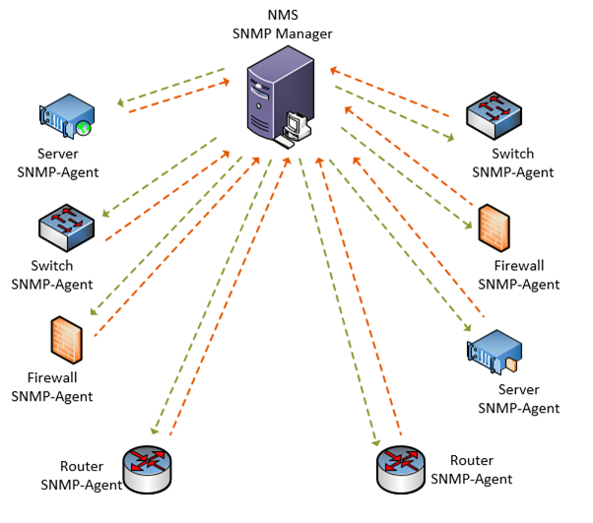
Network Mapping Solutions Use SNMP To Discover and Map Network Objects Automatically
King Saud University – Applied Studies and Community Service –1211 CYS

Slide 12
Network Mapping Solutions Use SNMP To Discover and Map Network Objects Automatically
Network mapping solutions generally use simple network management protocol (SNMP) to discover and map network objects automatically. SNMP works by exposing technical data as variables on the managed systems. These variables are organized in a management information base (MIB) that describes the configuration and status of the system. Managing applications can remotely query and sometimes even manipulate these variables.
حلول تعيين الشبكة عمومًا تستخدم بروتوكول إدارة الشبكة البسيط (SNMP) لاكتشاف وتعيين كائنات الشبكة تلقائيًا. يعمل بروتوكول SNMP عن طريق عرض البيانات التقنية كمتغيرات على الأنظمة التي يتم إدارتها. تُنظم هذه المتغيرات في قاعدة معلومات الإدارة (MIB) التي تصف تكوين وحالة النظام. يمكن لتطبيقات الإدارة الاستعلام عن هذه المتغيرات عن بعد وأحيانًا حتى تلاعب بها.
Network mapping solutions leverage SNMP to determine the type of device and collect associated information from all entities on a network. This data is then automatically used to create an object in the map diagram.
تستفيد حلول تعيين الشبكة من بروتوكول إدارة الشبكة البسيط (SNMP) لتحديد نوع الجهاز وجمع المعلومات المرتبطة من جميع الكيانات على الشبكة. يتم استخدام هذه البيانات تلقائيًا لإنشاء كائن في رسم الخريطة.
King Saud University – Applied Studies and Community Service –1211 CYS

Slide 13
Network Mapping Solutions Use SNMP To Discover and Map Network Objects Automatically
At the most superficial level, network mapping works because every network is a massive cache of data simply waiting to be tapped. Network mapping tools use MIB via SNMP to collect details that are part of open standards and information specific to the device and vendor. This gives IT teams access to advanced device information such as the number of active ports, the device’s power draw, and even the temperature value.
على أكثر مستوى سطحي، تعمل عملية تعيين الشبكة لأن كل شبكة هي مخزن ضخم من البيانات في انتظار الاستفادة منها. تستخدم أدوات تعيين الشبكة MIB عبر بروتوكول SNMP لجمع التفاصيل التي تتبع المعايير المفتوحة والمعلومات الخاصة بالجهاز والمورد. وهذا يمنح فرق تكنولوجيا المعلومات الوصول إلى معلومات الجهاز المتقدمة مثل عدد المنافذ النشطة، واستهلاك الطاقة للجهاز، وحتى قيمة الحرارة.
Network mapping solutions allow enterprises to easily track what’s on the network, automatically gather information about all the devices, and monitor how the entities are linked together.
تسمح حلول تعيين الشبكة للشركات بتتبع ما هو موجود على الشبكة بسهولة، وجمع معلومات تلقائياً حول جميع الأجهزة، ومراقبة كيفية ربط الكيانات معًا.
King Saud University – Applied Studies and Community Service –1211 CYS

Slide 14
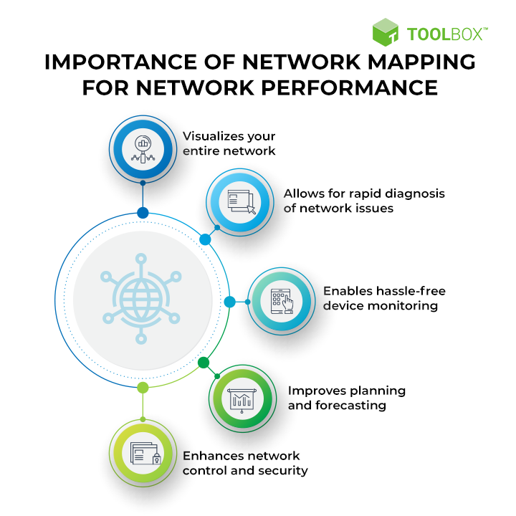
Top five reasons to consider a network mapping solution for your organization
King Saud University – Applied Studies and Community Service –1211 CYS

Slide 15
Enterprise network mapping
Many organizations create network maps of their network system. These maps can be made manually using simple tools such as Microsoft Visio, or the mapping process can be simplified by using tools that integrate auto network discovery with Network mapping, one such example being the Fabric platform. Many of the vendors from the Notable network mappers list enable you to customize the maps and include your own labels, add un-discoverable items and background images. Sophisticated mapping is used to help visualize the network and understand relationships between end devices and the transport layers that provide service. Mostly, network scanners detect the network with all its components and deliver a list which is used for creating charts and maps using network mapping software.^{[1]} Items such as bottlenecks and root cause analysis can be easier to spot using these tools.
King Saud University – Applied Studies and Community Service –1211 CYS

Slide 16
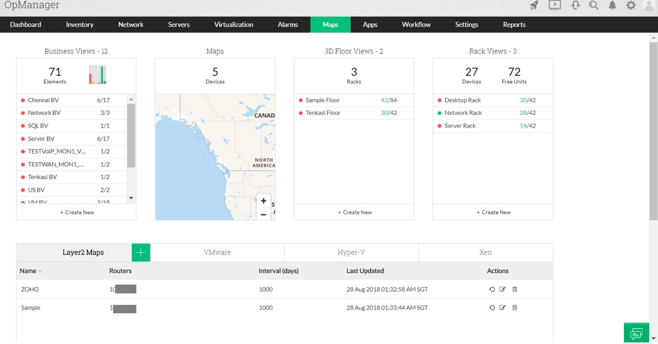
The holistic network mapping software
OpManager's network topology mapping tool has become a must have tool for network admins managing an organization's IT infrastructure. Today, there are large corporate networks which can span across millions of network devices and spread across a wide geographical region. Network mapping tools offer the capacity to monitor and regulate these networks with an understanding of the structure and operation of these networks. With OpManager, you can also map virtual devices like VMware, Hyper-V, Xen, and Nutanix.
Network mapping software offer information such as the list of devices located on the network, the components they directly communicate with, the different methods of communication that are used, and more.
King Saud University – Applied Studies and Community Service –1211 CYS

Slide 17
The holistic network mapping software
King Saud University – Applied Studies and Community Service –1211 CYS

Slide 18
Network mapping - Cybersecurity
Following a successful attack, attackers will try to map out the hosts in a network in order to discover the ones that contain valuable information. There are a number of tools that can be used here to identify the hosts connected in a network. One of the most commonly used is nmap and this section shall explain the mapping capabilities that this tool has. The tool, like many others, will list all the hosts that it detects on the network through a host discovery process. This is initiated using a command to scan an entire network subnet as shown in the following:
#nmap 10.168.3.1/24
A scan can also be done for a certain range of IP addresses as follows:
#nmap 10.250.3.1-200
The following is a command that can be used to scan ...
King Saud University – Applied Studies and Community Service –1211 CYS

Slide 19
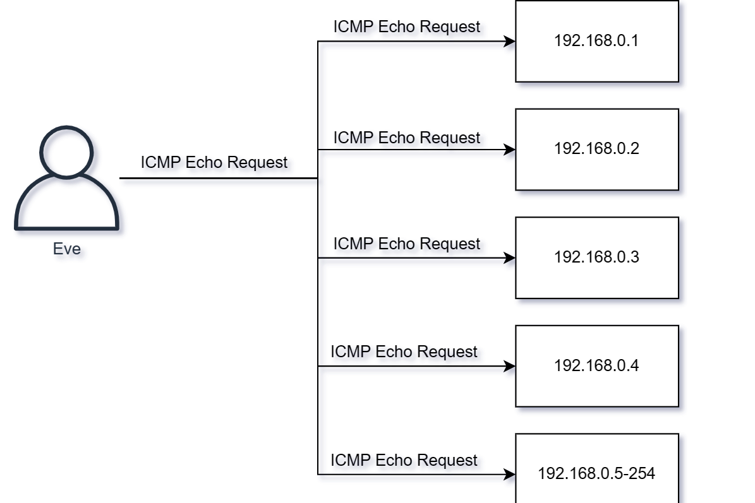
Network mapping - Cybersecurity
One way to identify hosts which are active on the network is to send a ping, i.e. ICMP Echo Request, to all IP Addresses in the network. This is often referred to as a Ping Sweep.
King Saud University – Applied Studies and Community Service –1211 CYS

Slide 20
Network mapping - Cybersecurity
A better approach involves sending a different kinds of packets to a system to try ask for any kind of answer to determine if system is alive or not. For example Nmap will send the following packets to the system to try cause a response:
ICMP Echo Request
TCP SYN packet to port 443
TCP ACK packet to port 80
ICMP Timestamp request
King Saud University – Applied Studies and Community Service –1211 CYS

Slide 21
Network mapping - Cybersecurity
Based on the TCP specifications, that is the rules of communications, a system should always engage in a three-way handshake before starting to communicate. Nmap seems to be intentionally breaking the rules with the packets above. Can you spot which packet is not behaving as systems would expect?
Sending a TCP ACK packet to port 80 is not conforming to the rules of the TCP standard. Nmap does this specifically to try cause the target system to make a reply. In order to send packets which are not following the rules, Nmap must run with the highest level of privileges, e.g. root or local administrator. Most port scanners will be more accurate because of this.
Disabling the Network Mapping can be done with Nmap with the -Pn flag. Nmap will now consider all IP/systems to be up and go directly to port scanning.
King Saud University – Applied Studies and Community Service –1211 CYS

Slide 22
Network mapping – Cybersecurity
Port Scanning
Port Scanning is done to try determine which services we can connect to. Each listening service provides attack surface which could potentially be abused by attackers. As such it is important to learn which ports are open.
Attackers are interested in knowing which applications are listening on the network. These applications represent opportunities for attackers. There might be vulnerabilities enabling them to attack successfully the organization.
Port Scanning works by sending packets to an application and looking for any replies. This is exceptionally easy for TCP, as if a TCP service is available it will always reply with a SYN/ACK packet. For UDP however it is more difficult. In order to detect if the service is available or not, in most cases the attacker must send specific input which forces the application to reply. Most applications hosted in UDP will not reply unless the Clients sends exactly the input required to engage in communications.
King Saud University – Applied Studies and Community Service –1211 CYS

Slide 23
Network mapping – Cybersecurity
TCP Port Scanning:
TCP is an easy protocol to scan because the TCP standard dictates that systems should reply with a SYN/ACK when receiving a SYN. We can send a SYN packet to all 65536 ports and record all SYN/ACK's coming back and conclude the ports which are opened based on the reply of a SYN/ACK. When no reply is received, we can assume the port is closed or filtered by for example a Firewall.
King Saud University – Applied Studies and Community Service –1211 CYS

Slide 24
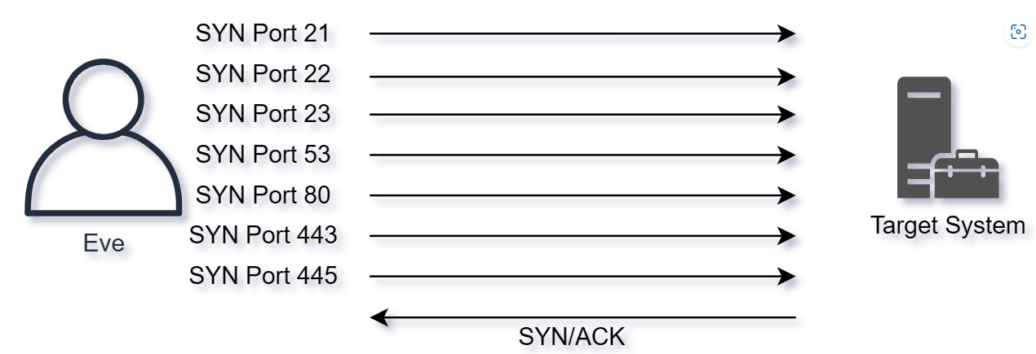
Network mapping – Cybersecurity
With the SYN/ACK on port 445 we have identified the port is open
King Saud University – Applied Studies and Community Service –1211 CYS

Slide 25
Network mapping – Cybersecurity
UDP Port Scanning:
With UDP it is harder to determine if a port is up or not. For UDP ports the scanner can not rely on a SYN/ACK. In fact, the scanner must almost always rely on making the service listening cause some sort of reply.
With so many ports potentially open and different services only replying to the correct kind of data, it becomes time consuming and hard to scan all ports in a reasonable time.
Consider the following conversation where Eve tries to figure out if a UPD port is open
King Saud University – Applied Studies and Community Service –1211 CYS

Slide 26
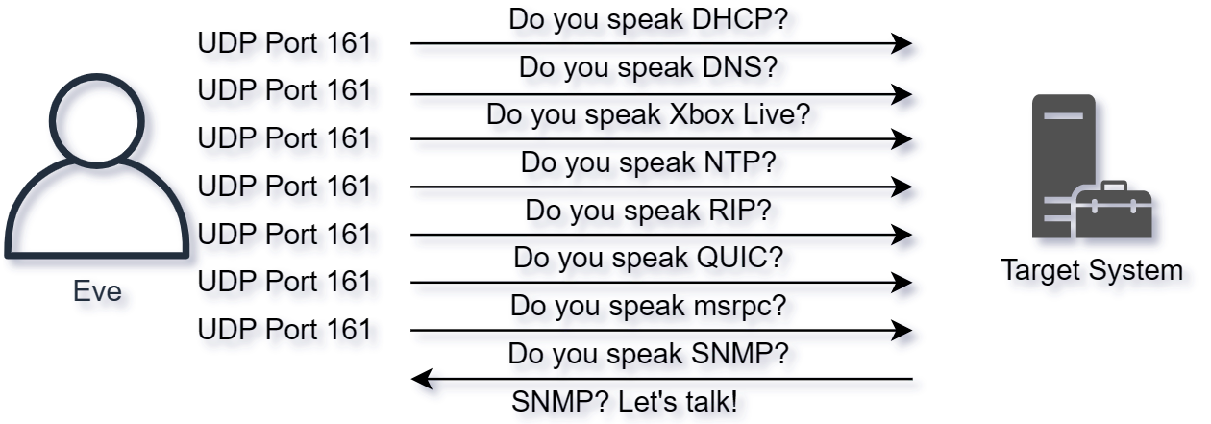
Network mapping – Cybersecurity
Eve need to talk the correct protocol, and make sure the packets reach their destination, e.g. no packet loss. Otherwise Eve might not discover the port is open.
Because of this UDP scanning can be very time consuming if we want to scan all ports.
King Saud University – Applied Studies and Community Service –1211 CYS

Slide 27
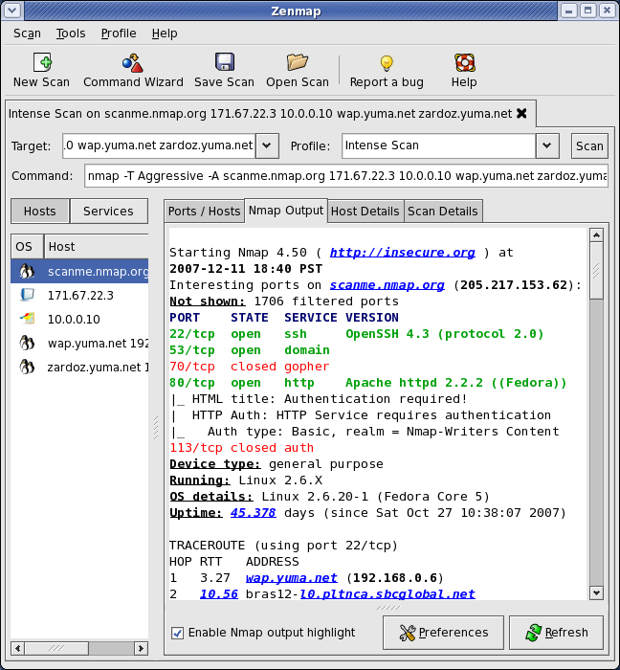
Network mapping – Cybersecurity
Zenmap:
Nmap has a built-in GUI("Graphical User Interface") a long side with other tools too. The GUI can be useful to visualize networks and browse open ports across different hosts. The GUI looks like this:
King Saud University – Applied Studies and Community Service –1211 CYS

Slide 28
Discuss the Network mapping techniques and cybersecurity.
King Saud University – Applied Studies and Community Service –1211 CYS

Slide 29
End of Lecture
King Saud University – Applied Studies and Community Service –1211 CYS

