Slide 1
1211 CYS IT Systems Components 2#Lecture Storage Devices – Part 1
King Saud University – Applied Studies and Community Service –1211 CYS

Slide 2
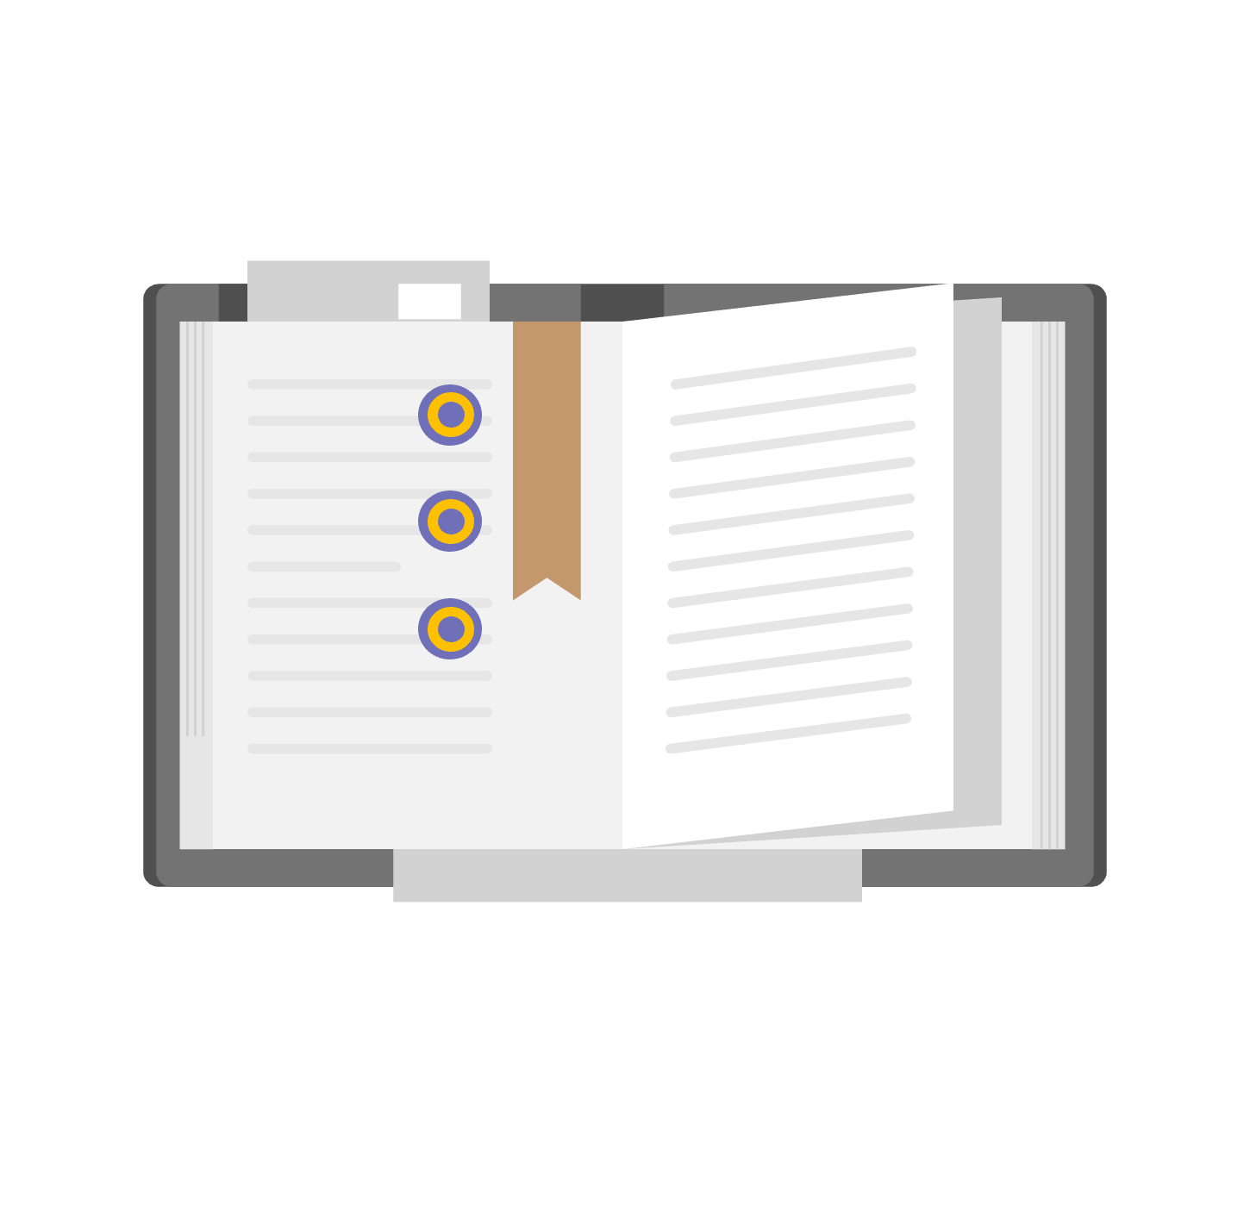
Topics:
Data Security vs Data Protection
Threats to Data Security
Storage Vulnerabilities
Data Security Best Practices
King Saud University – Applied Studies and Community Service –1211 CYS

Slide 3
Objectives
Distinguish between Data Security vs Data Protection.
Describe the Threats of Data Security and Vulnerabilities.
Describe Data Security Best Practices.
King Saud University – Applied Studies and Community Service –1211 CYS

Slide 4
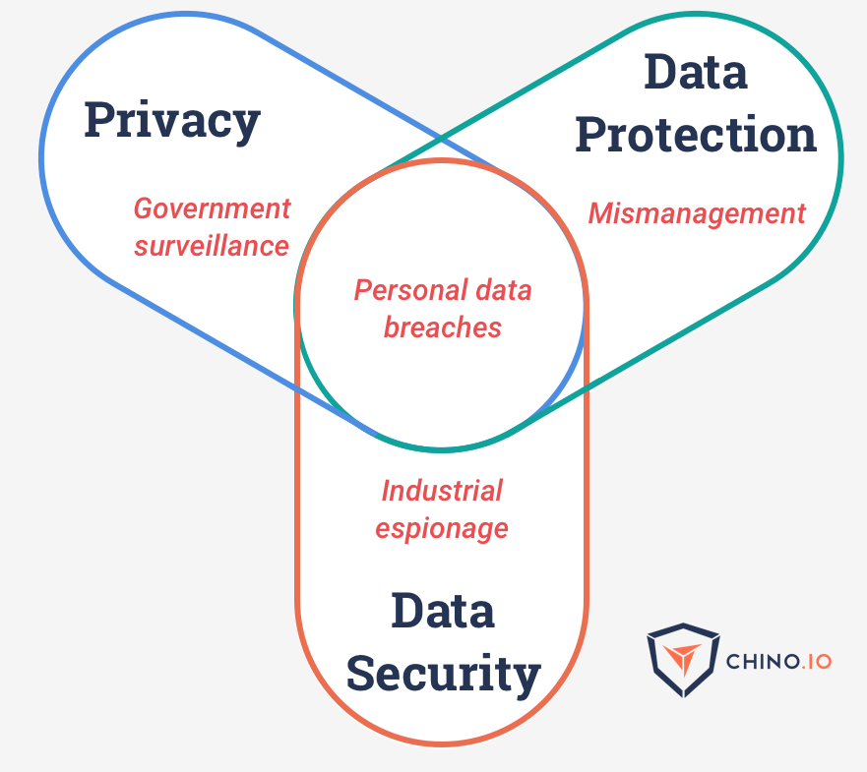
Data Security vs Data Protection
Storage security and data security are closely related to data protection. Data security primarily involves keeping private information out of the hands of anyone not authorized to see it. It also includes protecting data from other types of attacks, such as ransomware that prevents access to information or attacks that alter data, making it unreliable.
Data protection is more about making sure data remains available after
less nefarious incidents, like system or component failures or even
natural disasters.
But the two overlap in their shared need to ensure the reliability
and availability of information, as well as in the need to recover
from any incidents that might threaten an organization’s data.
King Saud University – Applied Studies and Community Service –1211 CYS

Slide 5
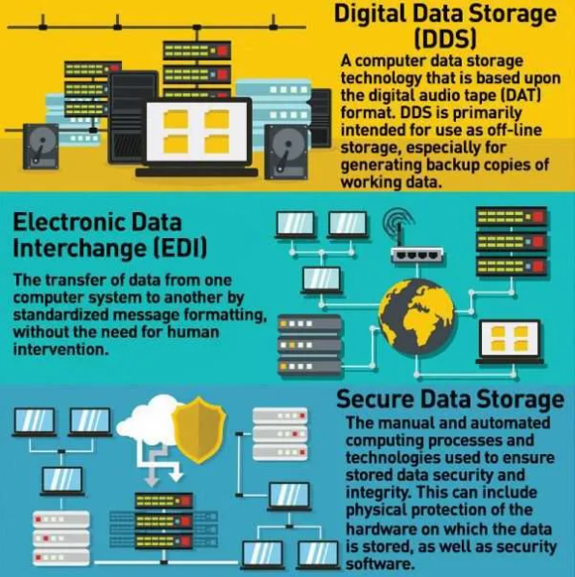
Data Security vs Data Protection
King Saud University – Applied Studies and Community Service –1211 CYS

Slide 6
Threats to Data Security
Before looking at how to implement data storage security, it is important to understand the types of threats organizations face. Threat agents can be divided into two categories: external and internal.
External threat agents include:
Nation states
Terrorists
Hackers, cybercriminals, organized crime groups
Competitors carrying out “industrial espionage”
Internal threat agents include:
Malicious insiders
Poorly trained or careless staff
Disgruntled employees
Other threats include:
Fire, flooding and other natural disasters
Power outages
King Saud University – Applied Studies and Community Service –1211 CYS

Slide 7
Storage Vulnerabilities
Another huge driver of interest in data storage security is the vulnerabilities inherent in storage systems. They include the following:
Lack of encryption —The means organizations need to install separate software or an encryption appliance in order to make sure that their data is encrypted.
Cloud storage —The cloud adds complexity to storage environments and often requires storage personnel to learn new tools and implement new procedures in order to ensure that data is adequately secured.
Incomplete data destruction — When data is deleted from a hard drive or other storage media, it may leave behind traces that could allow unauthorized individuals to recover that information.
Lack of physical security — Some organizations don’t pay enough attention to the physical security of their storage devices.
King Saud University – Applied Studies and Community Service –1211 CYS

Slide 8
Data Storage Security Principles
At the highest level, data storage security seeks to ensure “CIA” – confidentiality, integrity, and availability.
Confidentiality: Keeping data confidential by ensuring that it cannot be accessed either over a network or locally by unauthorized people is a key storage security principle for preventing data breaches.
Integrity: Data integrity in the context of data storage security means ensuring that the data cannot be tampered with or changed.
Availability: In the context of data storage security, availability means minimizing the risk that storage resources are destroyed or made inaccessible either deliberately – say during a DDoS attack – or accidentally, due to a natural disaster, power failure, or mechanical breakdown.
King Saud University – Applied Studies and Community Service –1211 CYS

Slide 9
Data Security Best Practices
Data storage security policies: Enterprises should have written policies specifying the appropriate levels of security for the different types of data that it has.
Access control: Administrators should also be sure to change any default passwords on their storage devices and to enforce the use of strong passwords by users.
Encryption: Data should be encrypted both while in transit and at rest in the storage systems. Storage administrators also need to have a secure key management systems for tracking their encryption keys.
Data loss prevention: Many experts say that encryption alone is not enough to provide full data security. They recommend that organizations also deploy data loss prevention (DLP) solutions that can help find and stop any attacks in progress.
Strong network security: firewalls, anti-malware protection, security gateways, intrusion detection systems and possibly advanced analytics and machine learning based security solutions.
Strong endpoint security: appropriate security measures in place on the PCs, smartphones and other devices that will be accessing the stored data.
Redundancy: Redundant storage, including, not only helps to improve availability and performance, in some cases, it can also help organizations mitigate security incidents
Backup and recovery: make sure that their backup systems and processes are adequate, disaster recovery purposes, In addition, they need to make sure that backup systems have the same level of data security in place as primary systems.
King Saud University – Applied Studies and Community Service –1211 CYS

Slide 10
Data Center Storage and Cloud Storage
Data center storage primarily refers to the devices, equipment and software technologies that enable data and application storage within a data center facility.
Data center storage primarily refers to the devices, equipment and software technologies that enable data and application storage within a data center facility.
This includes:
- Hard disk drives, tape drives and other forms of internal and external storage
- Storage and backup management software utilities
- External storage facilities/solutions such as cloud or remote storage
Storage networking technologies such as storage area networks (SAN), network attached storage (NAS).
Cloud storage is also known as utility storage – a term subject to differentiation based on actual implementation and service delivery.
Cloud storage works through data center virtualization, providing end users and applications with a virtual storage architecture that is scalable according to application requirements.
King Saud University – Applied Studies and Community Service –1211 CYS

Slide 11
Data Center Storage and Cloud Storage
Data center storage primarily refers to the devices, equipment and software technologies that enable data and application storage within a data center facility.
The main difference between the cloud vs. data center is that a data center refers to on-premise hardware while the cloud refers to off-premise computing.
King Saud University – Applied Studies and Community Service –1211 CYS

Slide 12
Discuss the Threats to Data Security and Data Security Best Practices
King Saud University – Applied Studies and Community Service –1211 CYS

Slide 13
End of Second Lecture
King Saud University – Applied Studies and Community Service –1211 CYS

