Slide 1
A Closer Look at Instruction Set Architectures: Expanding Opcodes

Slide 2
Lecture Overview
Instruction formats
Expanding Opcodes
Instruction types
Addressing

Slide 3
Expanding Opcodes
Instruction formats
We have seen how instruction length is affected by the number of operands supported by the ISA.
In any instruction set, not all instructions require the same number of operands.
Operations that require no operands, such as HALT, necessarily waste some space when fixed-length instructions are used.
One way to recover some of this space is to use expanding opcodes.

Slide 4
Expanding Opcodes
Instruction formats
The idea of expanding opcodes is to make some opcodes short, but have a means to provide longer ones when needed.
When the opcode is short, a lot of bits are left to hold operands
So, we could have two or three operands per instruction
If an instruction has no operands (such as Halt), all the bits can be used for the opcode
Many unique instructions are hence available
In between, there are longer opcodes with fewer operands as well as shorter opcodes with more operands.

Slide 5
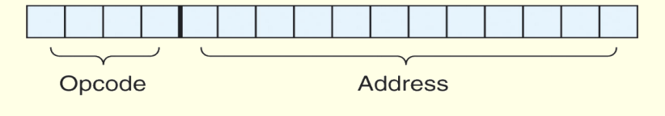
Expanding Opcodes
Instruction formats
Example 1: Consider a machine with 16-bit instructions and 16 registers.
The instruction format can have several structures:
Opcode + Memory address (such as MARIE):
If we have 4KB byte addressable memory we need 12 bits to specify an address location
The remaining 4 bits are used for the opcode: 16 instruction are hence available
Opcode + Registers Addresses
we need 4 bits to select one of the 16 available registers
Suppose we have 4 bits opcode, we could encode 16 different instructions with three operands each (3 x 4 bits = 12 bits).

Slide 6
Expanding Opcodes
Instruction formats
Example 2: Consider a machine with 16-bit instructions and 16 registers. And we wish to encode the following instructions:
15 instructions with 3 addresses
14 instructions with 2 addresses
31 instructions with 1 address
16 instructions with 0 addresses
Can we encode this instruction set in 16 bits?
Answer: Yes if we use expanding opcodes

Slide 7
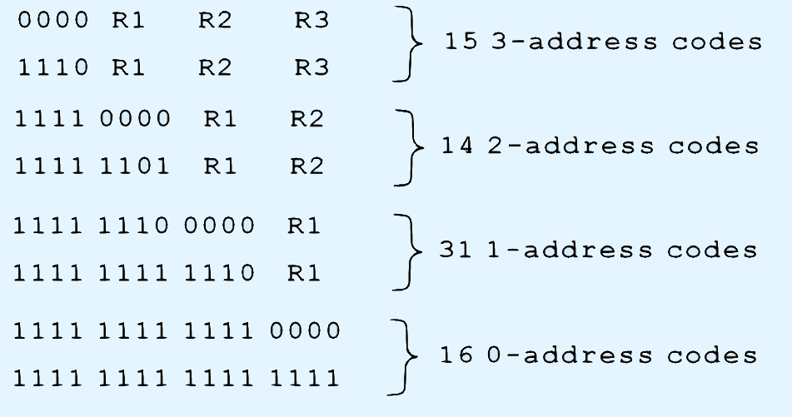
Expanding Opcodes
Instruction formats
One possible encoding is as follows:
Is there something missing from this instruction set?

Slide 8
Expanding Opcodes
Instruction formats
How do we know if the instruction set we want is possible when using expanding opcodes?
We must determine if we have enough bits to create the desired number of bits patterns

Slide 9
Expanding Opcodes
Instruction formats
Going back to Example 2 (Slide 6):
The first 15 instructions account for:
15x2⁴x2⁴x2⁴ = 15 x 2¹² = 61440 bit patterns
The next 14 instructions account for:
14 x 2⁴ x 2⁴ = 15 x 2⁸ = 3584 bit patterns
The next 31 instructions account for:
31 x 2⁴ = 496 bit patterns
The last 16 instructions account for 16 bit patterns
In total we need 61440 + 3584 + 496 + 16 = 65536 different bit patterns
Having a total of 16 bits we can create 2¹⁶ = 65536 bit patterns
We have an exact match with no wasted patterns.
So our instruction set is possible.

Slide 10
Expanding Opcodes
Instruction formats
Example 3: Is it possible to design an expanding opcode to allow the following to be encoded with a 12-bit instruction? Assume a register operand requires 3 bits.
4 instructions with 3 registers
255 instructions with 1 register
16 instructions with 0 register

Slide 11
Expanding Opcodes
Instruction formats
Solution:
The first 4 instructions account for:
4x2³x2³x2³ = 4 x 2⁹ = 2048 bit patterns
The next 255 instructions account for:
255 x 2³= 2040 bit patterns
The last 16 instructions account for 16 bit patterns
In total we need 2048 + 2040 + 16 = 4104 bit patterns
With 12 bit instruction we can only have 2¹² = 4096 bit patterns
Required bit patterns (4104) is more than what we have (4096), so this instruction set is not possible with only 12 bits.

Slide 12
Lecture Overview
Instruction formats
Expanding Opcodes
Instruction types
Addressing

Slide 13
Instruction types
Instruction types
Instructions fall into several broad categories:
Data movement instructions
The most frequently used instructions
Data is moved from memory into registers, from registers to registers, and from registers to memory
Examples: Load, Store, Move, Push, Pop, etc.
Arithmetic instructions
Include those instructions that use integers and floating point numbers.
As with the data movement instructions, there are sometimes different instructions for providing various combinations of register and memory accesses in different addressing modes.
Examples: Add, Subtract, Multiply, Increment, Decrement, etc.

Slide 14
Instruction types
Instruction types
Instructions fall into several broad categories:
Boolean Instructions
Perform Boolean expressions.
Commonly used to control I/O devices.
Examples: Not, Or, Xor, Test, compare, etc.
Bit manipulation instructions
Used for setting and resetting individual bits (or sometimes groups of bits) within a given data word.
Examples: Shift left, shift right, rotate left, rotate right

Slide 15
Instruction types
Instruction types
Instructions fall into several broad categories:
I/O instructions
Used to communicate with input/output devices
Examples: Input, Output.
Control transfer Instructions
Include branches, skips and procedure calls.
Examples: For MARIE we have Jump, skipcond and JnS.
Special purpose Instructions
Include those used for string processing, high-level language support, protection, flag control, and cache management.

Slide 16
Instruction types
Instruction types
When designing an instruction set for a given architecture, we must respect the following:
Create a complete instruction set.
Be carful not to add redundant instructions
We should respect instructions orthogonality
Each instruction should perform a unique function without duplicating any other instruction

Slide 17
Lecture Overview
Instruction formats
Expanding Opcodes
Addressing
Introduction
Addressing Modes

Slide 18
Addressing - Introduction
Addressing
Addressing modes specify where an operand is located.
They can specify a constant, a register, or a memory location.
The actual location of an operand is its effective address.
Certain addressing modes allow us to determine the address of an operand dynamically.

Slide 19
Addressing Modes
Addressing
Immediate addressing
The data is part of the instruction.
Example: Load 008
The numeric value 8 is loaded into the AC
Direct addressing
The address of the data is given in the instruction.
Example: Load 008
The data value found at memory address 008 is loaded into the AC
Register addressing
The data is located in a register.
Example: Load R1.
The contents of R1 register is used as the operand.

Slide 20
Addressing Modes
Addressing
Indirect addressing
Gives the address of the address of the data in the instruction.
Example Load 008
The data value found at memory address 008 is actually the effective address of the desired operand.
Suppose we find the value 2A0 stored in location 008.
2A0 is the “real” address of he value we want.
The value found at location 2A0 is then loaded into the AC

Slide 21
Addressing Modes
Addressing
Register indirect addressing
Uses a register to store the effective address of the data.
Works exactly the same way as indirect addressing mode, except it uses a register instead of a memory address to point to the data.
Example: Load R1
The effective address of the desired operand is found in R1.

Slide 22
Addressing Modes
Addressing
Indexed addressing
uses a register (implicitly or explicitly) as an offset, which is added to the address in the operand to determine the effective address of the data.
Example: Load X, where the index register holds the value 1.
The effective address of the operand in actually X + 1

Slide 23
Addressing Modes
Addressing
Based addressing
Similar to indexed addressing except that a base register is used instead of an index register.
An index register holds an offset relative to the address given in the instruction, but a base register holds a base address where the address field represents a displacement from this base.
Example: Load 3, where the base register holds the address value X.
The effective address of the operand is actually X +3
Stack addressing
The operand is assumed to be on top of the stack.

Slide 24
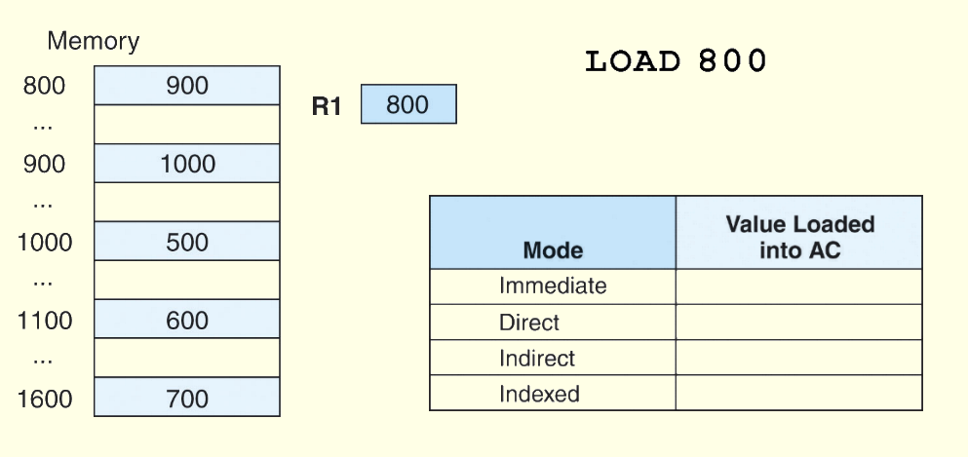
Addressing Modes
Addressing
Example: For the instruction shown, what value is loaded into the accumulator for each addressing mode?
800

Slide 25
Addressing Modes
Addressing
Example: For the instruction shown, what value is loaded into the accumulator for each addressing mode?
800
900

Slide 26
Addressing Modes
Addressing
Example: For the instruction shown, what value is loaded into the accumulator for each addressing mode?
800
900
1000

Slide 27
Addressing Modes
Addressing
Example: For the instruction shown, what value is loaded into the accumulator for each addressing mode?
800 + 800 = 1600
800
900
1000
700

