Slide 1

1111 CYS
Cyber Security Foundations
3#Lecture
Cyber Security concepts and principles– Part 1
King Saud University – Applied Studies and Community Service –1111 CYS

Slide 2

Topics:
CIA Triads
Cyber Security Basic Terminologies
Categories of Attackers
Security Attacks
Security Threats
King Saud University – Applied Studies and Community Service –1111 CYS

Slide 3
Objectives
Explain the concept of CIA
Differentiate between the basic terminology of Cyber Security
Differentiate between categories of attackers.
Identify the security attacks and threats
King Saud University – Applied Studies and Community Service –1111 CYS

Slide 4
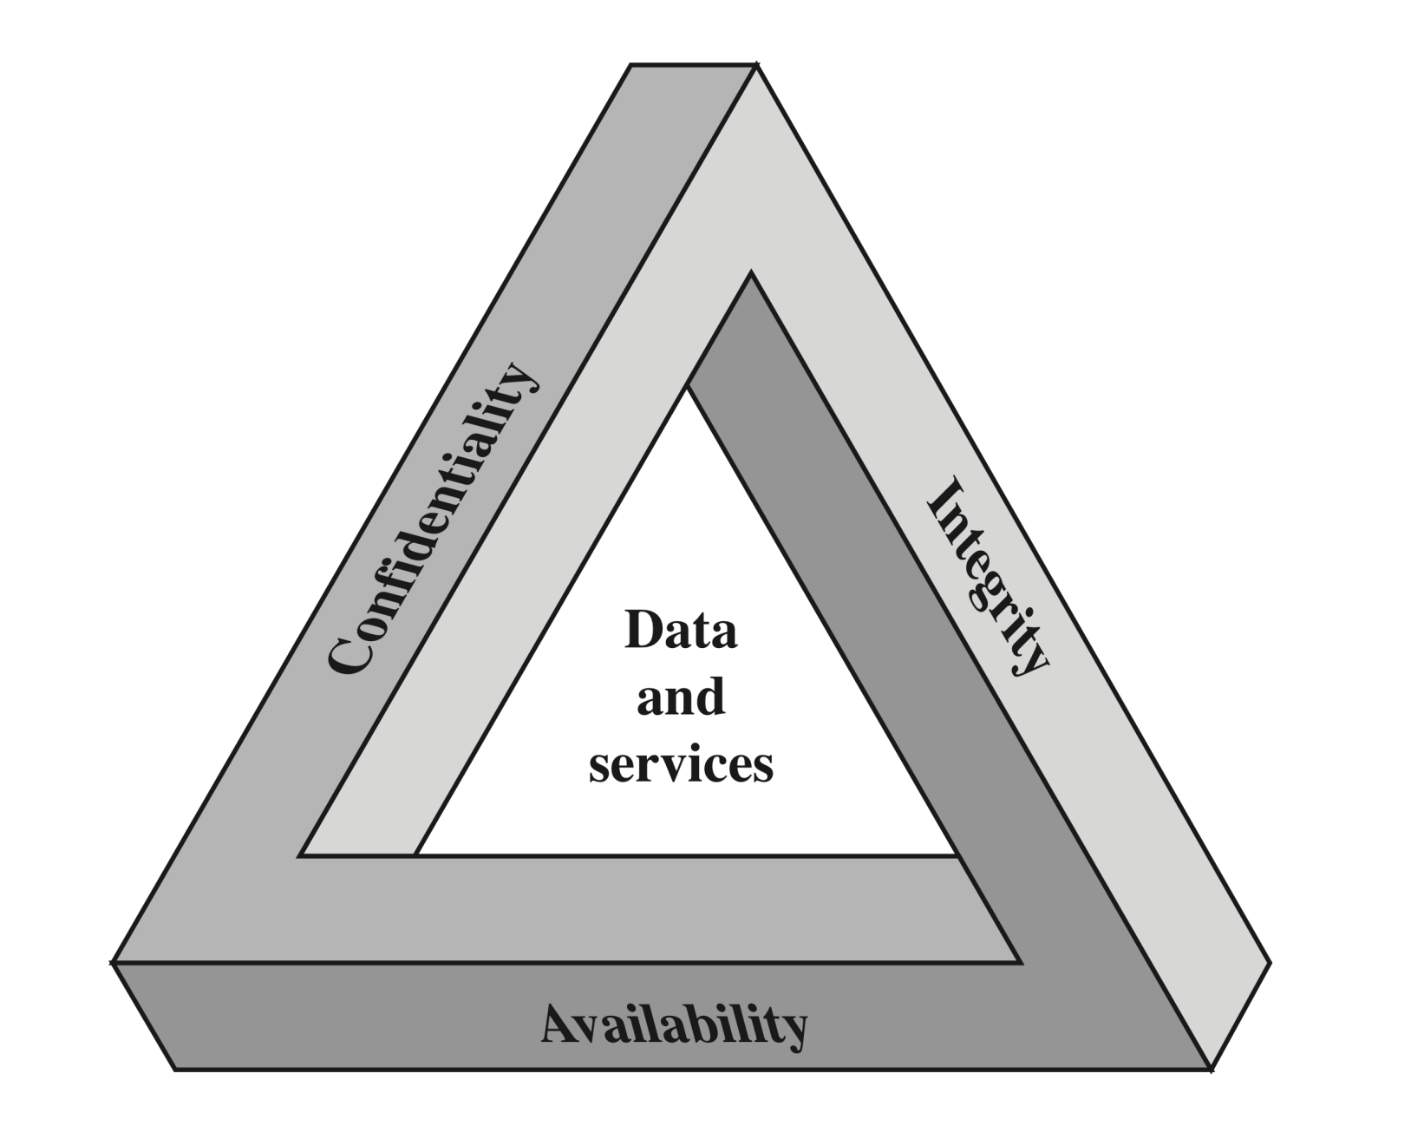
CIA Triads
King Saud University – Applied Studies and Community Service –1111 CYS

Slide 5
CIA Triads
Confidentiality: is the need to ensure that information is disclosed only to those who are authorized to view it. This term covers two related concepts:
Data confidentiality: Assures that private or confidential information is not made available or disclosed to unauthorized individuals.
Privacy: Assures that individuals control or influence what information related to them may be collected and stored and by whom and to whom that information may be disclosed.
King Saud University – Applied Studies and Community Service –1111 CYS

Slide 6
CIA Triads
Example 1 - Bank
Confidentiality: an employee should not disclose a customer’s account information to another customer.
Integrity: an employee should not improperly modify a customer’s account balance.
Availability: system should be usable when customers purchase with credit cards.
Example 2 - Healthcare
Confidentiality: doctors should not disclose patients’ medical records without consent.
Integrity: patients’ medical records should not be illegally modified or deleted.
Availability: patients’ medical records should be accessible in case of emergencies.
King Saud University – Applied Studies and Community Service –1111 CYS

Slide 7
Basic Terminologies
Plaintext (cleartext): a message or data in its original format.
Encryption: the process of hiding the plaintext.
Cipher: A cryptographic algorithm for encryption and decryption.
Ciphertext: an encrypted message.
Decryption: the process of turning the ciphertext back into plaintext.
Cryptography: the science of keeping messages secure.
Cryptanalysis: the science of breaking ciphertext.
An adversary: A person that is interested in attacking your network
King Saud University – Applied Studies and Community Service –1111 CYS

Slide 8
Basic Terminologies
A threat is any potential occurrence, malicious or otherwise, that could harm an asset. In other words, a threat is any bad thing that can happen to your assets.
A vulnerability is a weakness that makes a threat possible. This may be because of poor design, configuration mistakes, or inappropriate and insecure coding techniques.
An attack is an action that exploits a vulnerability or enacts a threat. Examples of attacks include sending malicious input to an application or flooding a network in an attempt to deny service.
King Saud University – Applied Studies and Community Service –1111 CYS

Slide 9
Basic Terminologies
Virus: a hidden, self-replicating section of computer software, usually malicious logic, that propagates by infecting
Malware: a generic term for a number of different types of malicious code.
Worm: a computer program that can run independently, can propagate a complete working version of itself onto other hosts on a network, and may consume computer resources destructively.
Spyware: is software with malicious behavior that aims to gather information about a person or organization and send it to another entity in a way that harms the user.
King Saud University – Applied Studies and Community Service –1111 CYS

Slide 10

Differentiate between treats, vulnerability, and attack terms?
King Saud University – Applied Studies and Community Service –1111 CYS

Slide 11
End of Lecture 3 Part 1
King Saud University – Applied Studies and Community Service –1111 CYS

