Slide 1

1111 CYS Cyber Security Foundations 1#Lecture Introduction to Computer Security – Part 1
King Saud University – Applied Studies and Community Service –1111 CYS

Slide 2

Topics:
Facets of the security problem of computer systems.
Meaning of security.
Vulnerabilities of computer security.
Importance of computer security.
Goals of system security.
Security domains.
King Saud University – Applied Studies and Community Service –1111 CYS

Slide 3
Objectives
Trace the history of security industry.
Identify the main goals of computer security
Appreciate the need for security in today’s hostile world
Identify the main Security Domains
King Saud University – Applied Studies and Community Service –1111 CYS

Slide 4
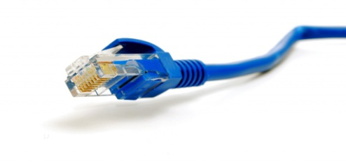



Facets of the Security Problem
Elements of the Computer System
Stand alone computer with: HW, SW, OS and data.
Networked facilities to the Internet.
Data
Message transaction
SW
OS
HW
Stand alone computer
Internet
King Saud University – Applied Studies and Community Service –1111 CYS

Slide 5
Facets of the Security Problem
Early days
Few decades ago, computer security was mainly concerned with the physical devices that made up the computer.
Now, the high-value item is not the machine, but the information that it stores and processes.
This changed the focus of computer systems security.
Data
SW
Data may be disclosed, abused, modified or damaged.
OS
HW
Stand alone computer
King Saud University – Applied Studies and Community Service –1111 CYS

Slide 6
Facets of the Security Problem
Electronic business
In the past, no business is conducted across the Internet.
Today, people perform online transactions every day.
Companies rely on Internet to conduct business.
This also encourages others to take advantage of the environment to conduct fraud or theft.
Encryption is a very important part of network security.
More recently, skillful intruders are attacking computers with criminal or military goals in mind.
They may outwit even sophisticated security systems.
King Saud University – Applied Studies and Community Service –1111 CYS

Slide 7


The Holistic Scene of Security Problem
Data may be disclosed, abused, modified or damaged.
Intrusion may be performed
Data
Message transaction
SW
OS
HW
Stand alone computer
message may be intercepted, modified or fabricated.
Internet
Hardware may be destructed
Malware may infect the system.
King Saud University – Applied Studies and Community Service –1111 CYS

Slide 8

Discuss the main elements of the Computer System?
King Saud University – Applied Studies and Community Service –1111 CYS

Slide 9
End of First Lecture
King Saud University – Applied Studies and Community Service –1111 CYS

