Slide 1
Minimization of Circuits

Slide 2
Introduction
consider the circuit that has output 1 if and only if x = y = z = 1 or x = z = 1 and y = 0. The sum-of-products expansion of this circuit is
The two products in this expansion differ in exactly one variable, namely, y. They can be combined as
Hence, x z is a Boolean expression with fewer operators that represents the circuit.

Slide 3
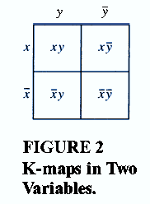
Karnaugh Maps (K-map)
K-map in two variables

Slide 4
EXAMPLE 1
Find the K-maps for:

Slide 5
EXAMPLE 2
Simplify the sum-of-products expansions given in Example 1 .
Solution:

Slide 6
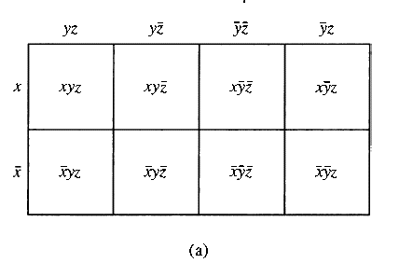
K-map in three variables

Slide 7
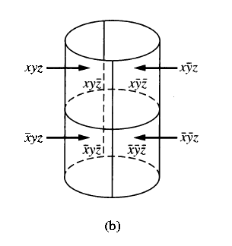
K-map in three variables
This K-map can be thought of as lying on a cylinder, as shown in Figure 5(b). On the cylinder, two cells have a common border if and only if they are adjacent.

Slide 8
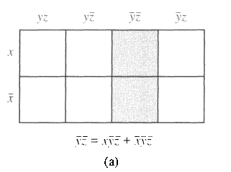
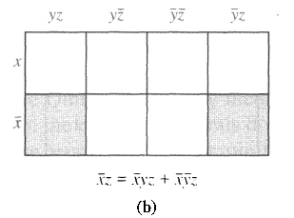
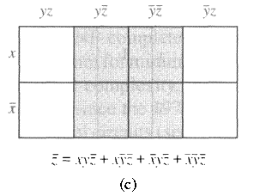
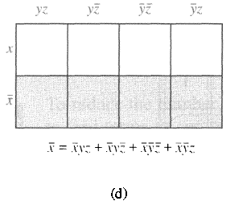
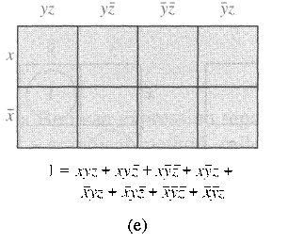
Simplify a sum-of-products in 3 variables
1 x 2 block
2 x 1 block
2 x 2 block
4 x 1 block
4 x 2 block

Slide 9
EXAMPLE 3
Use K-maps to minimize these sum-of-products expansions.

Slide 10
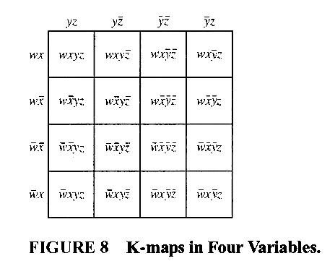
K-map in 4 variables

Slide 11
EXAMPLE 4
Use K-maps to simplify these sum-of-products expansions:

Slide 12
Solution:

Slide 15
Homework
Page 779
1 (b)
2 (c)
3 (a,b,c)
5 (a,b)
7 (a,b).

