Slide 1
Infectious and Communicable Diseases
Osama A Samarkandi, PhD, RN
EMS 313; Public Health for EMS Professionals

Slide 2
Introduction
Communicable disease: an infectious disease that can be passed from one person to another
Notes:
2

Slide 3
Responsibilities of Public Health Agencies
National agencies and laws
OSHA
Spreads rules and regulations to protect employees
CDC
Collects data and research for health care providers and the public
Notes:
3

Slide 4
Responsibilities of Public Health Agencies
National agencies and laws (cont’d)
Ryan White CARE Act
Requires medical facilities to notify emergency personnel of transmitted diseases involving patients they transported
Notes:
4

Slide 5
Responsibilities of Public Health Agencies
State and local public health departments
Responsible for protecting the public from disease
Monitor reportable diseases.
Endemic
Epidemic
Pandemic
Notes:
5

Slide 6
Responsibilities of Paramedics
Obligation to protect patients from health care-associated infections
Comply with work restriction guidelines.
Keep the ambulance and equipment disinfected.
Critical equipment
Semi-critical equipment
Noncritical equipment
Notes:
6

Slide 7
Responsibilities of Paramedics
General cleaning routines:
Strip used linens and appropriately discard.
Appropriately discard all medical waste.
Wash contaminated areas.
Disinfect all non-disposable equipment used.
Clean the stretcher with a germicidal-virucidal solution.
Notes:
7

Slide 8
Responsibilities of Paramedics
General cleaning routines (cont’d):
If any spillage, clean with a germicidal-virucidal solution.
Create a schedule for routine cleaning.
Have a written policy and procedure for cleaning.
Notes:
8

Slide 9
Communicable Disease Transmission
Diseases that can be transmitted from one person to another under certain conditions
Depend on:
Dose
Virulence
Mode of entry
Health status of the host
Notes:
9

Slide 10
Communicable Disease Transmission
Spread by several mechanisms:
Contact transmission
Direct
Indirect
Droplet transmission
Airborne transmission
Vector
Notes:
10

Slide 11
Personal Protective Equipment and Practices
Hand hygiene is the primary protective measure.
Use antimicrobial, alcohol-based foams or gels.
Cover open cuts or sores with a dressing.
Notes:
11

Slide 12
Personal Protective Equipment and Practices
Should include:
Gloves
Eyewear
Gowns
Surgical Masks
N95/P100 respirators
Waterless handwashing foam or gel
Needle-safe or needleless devices
Biohazard bags
Resuscitative equipment
Notes:
12

Slide 13
Personal Protective Equipment and Practices
Particulate respirator
Filters particles that come in through the mask
If on an EMS vehicle, a full respiratory protection program must be in place.
Notes:
13

Slide 14
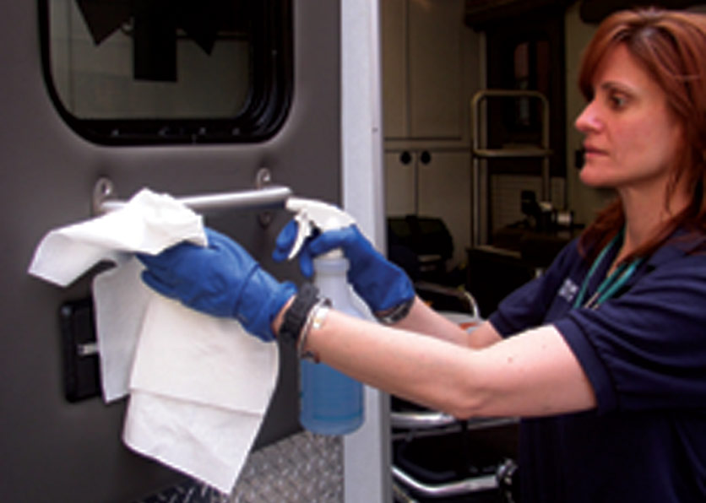
Personal Protective Equipment and Practices
Gloves
Utility-style gloves are required for cleaning activities.
Hands should be washed after removal.
Notes:
14

Slide 15
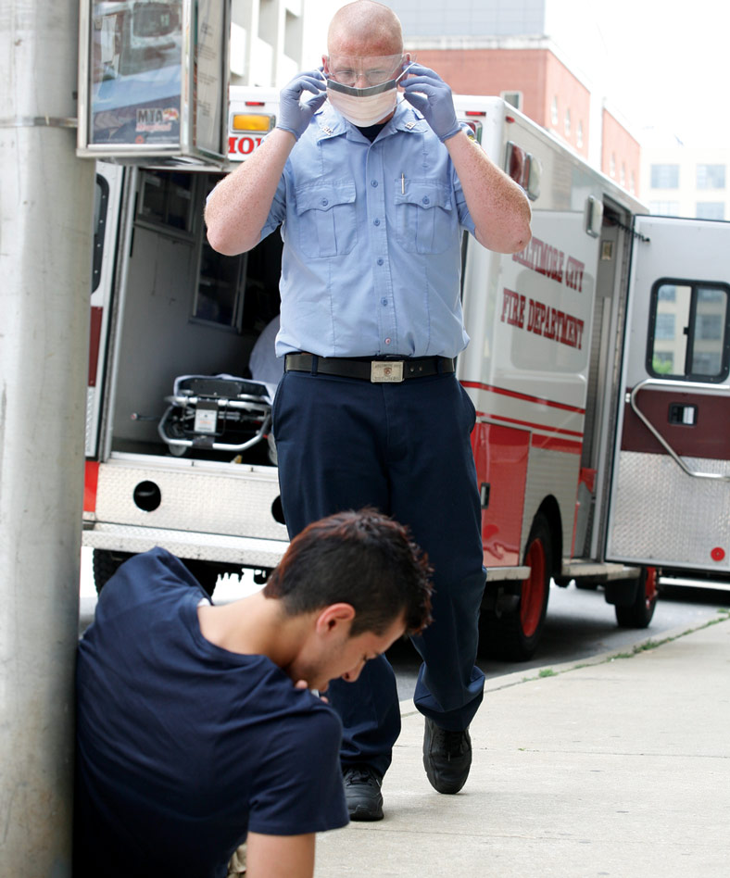
Personal Protective Equipment and Practices
Protective eyewear
Blocks splatter into eye
Cover garments
Recommended for large-splash situations
Notes:
15

Slide 16
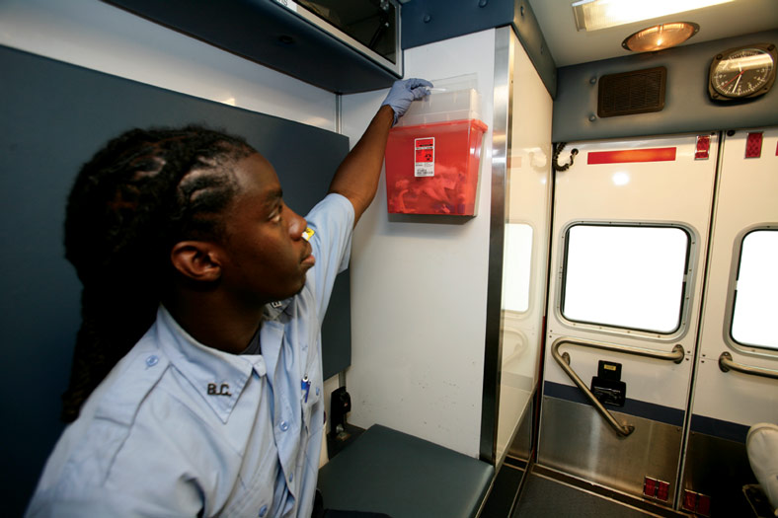
Personal Protective Equipment and Practices
Needle-stick Safety and Prevention Act
Requires all sharps be needle-safe or needleless systems
Notes:
16

Slide 17
Post-exposure Medical, Follow-Up
DICO ensures proper treatment is received.
Exposure to blood-borne pathogens:
Contaminated needle-stick injury
Blood or OPIM into eye, nose, or mouth
Blood or OPIM in contact with an open area
Cuts with an object covered with blood or OPIM
Human bites involving blood
Notes:
17

Slide 18
Post-exposure Medical , Follow-Up
For airborne- and/or droplet-transmissible disease, the DICO will review:
Organism involved
Amount of time spent with the patient
Provider’s distance from the patient
Procedure or task performed
Ventilation present
Notes:
18

Slide 19
Post-exposure Medical, Follow-Up
Source individual should be tested for:
HIV
HBC
HCV
Syphilis (if HIV or HCV is positive)
Test results must be released to the DICO and exposed employee.
Notes:
19

Slide 20
Designated Infection Control Officer (DICO)
Ensures that proper post-exposure medical treatment and counseling are provided
Tracks and monitors compliance
Liaison between employee and medical facility
Ensures confidentiality
Ensures that documentation adheres to guidelines
Notes:
20

Slide 21
Designated Infection Control Officer (DICO)
Communication network for exposure involves:
The exposed paramedic
The DICO
The treating physician
The public health department acts as a backup for exposure notification.
Notes:
21

Slide 22
Standard Precautions
Infection control practices that reduce the opportunity for an exposure to occur
Apply to all body substances except sweat
Notes:
22

Slide 23
CDC-Recommended Immunizations and Vaccinations
Vaccines
Suspensions of bacteria or viruses that have been rendered nonpathogenic
CDC published an immunization schedule for health care providers.
Notes:
23

Slide 24
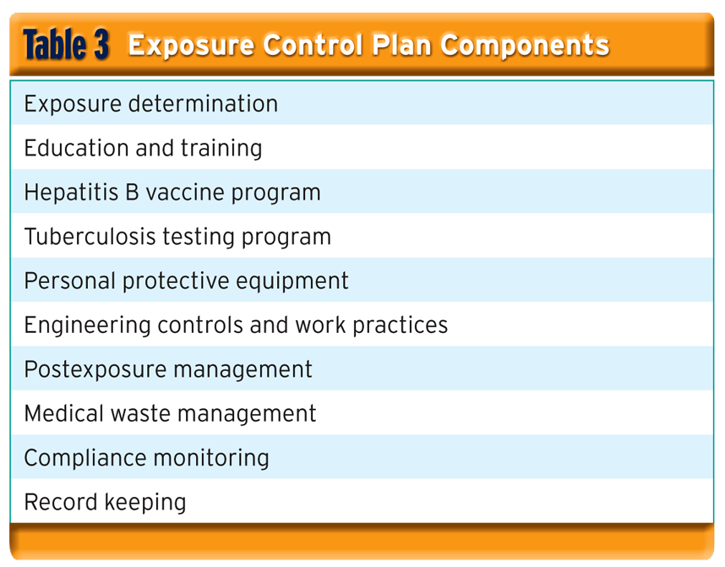
Department Responsibilities
EMS departments are required to have an exposure control plan.
How the department plans to reduce the risk of exposure to infectious agents
Notes:
24

Slide 25
Department Responsibilities
Contaminated: an object that has microorganisms on or in it
Infected: microorganisms produce an illness
Carriers: persons who have a disease but are not ill
Notes:
25

Slide 26
Patient Assessment
Size up the scene.
Take precautions.
Assess ABCs and mental status.
Prioritize treatment.
Obtain history.
OPQRST (Onset of the even, Provocation or Palliation, Quality of the pain, Region and Radiation, Severity, and Time “history”)
SAMPLE and baseline vital signs
Medications
Events leading to problem
Recent travel
Notes:
26

Slide 27
Chain of Infection
The study of infectious diseases considers:
Age distributions
Genetic factors
Income levels
Ethnic groups
Workplaces
Schools
Geographic boundaries
Expansion, decline, or movement of the disease
Notes:
27

Slide 28
Exposure and the Risk of Infection
Factors include:
Type of organism
Dose of organism
Virulence of organism
Mode of entry
Host resistance
Incubation period
Communicable period
Reservoir
Host defense mechanisms
Notes:
28

Slide 29
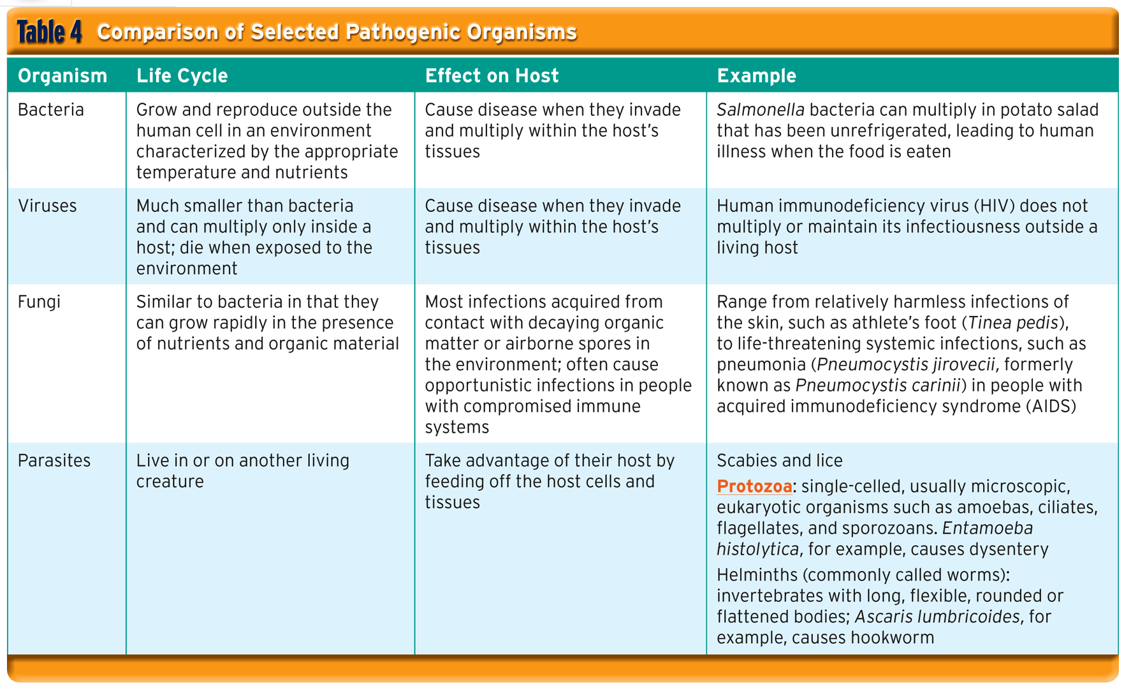
Exposure and the Risk of Infection
Notes:
29

Slide 30
General Management Principles
Focus on life-threatening conditions.
Be empathetic.
Place in a position of comfort.
Treat for dehydration.
Notes:
30

Slide 31
General Management Principles
Use standard precautions.
Dispose of sharps properly.
Follow your agency’s exposure control plan.
Properly discard any disposable supplies.
Notes:
31

Slide 32
Airborne

Slide 33
Meningitis
Inflammation of the meninges
Bacterial: communicable
Viral: non-communicable
Meningococcal meningitis is most often involved in epidemic outbreaks.
Notes:
33

Slide 34
Meningitis
Pathophysiology
Transmission occurs following:
Direct contact with infected nasopharyngeal secretions
Prolonged contact time of 8 or more hours
Incubation period is between 2 and 10 days.
Communicable period is variable.
Notes:
34

Slide 35
Meningitis
Assessment
Signs and symptoms may include:
Fever
Headache
Stiff neck
Kernig sign
Brudzinski sign
Notes:
35

Slide 36
Meningitis
Management
Place a mask on the patient.
Use standard precautions.
Treat symptoms.
Post-exposure treatment includes ciprofloxacin or rifampin.
Notes:
36

Slide 37
Tuberculosis
Pathophysiology
Not highly communicable
Three types: typical, atypical, extrapulmonary
Persons at risk:
Malnourished
Incarcerated persons
Notes:
37

Slide 38
Tuberculosis
Pathophysiology (cont’d)
Multidrug-resistant TB (MDR-TB)
Bacterium is resistant to two or more of the first-line drugs.
Extensively drug-resistant TB (XDR-TB)
Bacterium is resistant to two of the first-line oral medications and two of the first-line injectable medications.
Notes:
38

Slide 39
Tuberculosis
Pathophysiology (cont’d)
Transmission by airborne particles
Incubation period is 4–12 weeks
Communicable when a lesion develops in the lungs
Early infection can be detected by a skin test
Notes:
39

Slide 40
Tuberculosis
Assessment
Signs and symptoms include a persistent cough plus:
Night sweats
Fatigue
Hemoptysis
Hoarseness
Notes:
40

Slide 41
Tuberculosis
Management
Place a surgical mask on the patient.
Administer oxygen or ventilatory support if needed.
Report the incident to your DICO.
Clean the vehicle following transport.
Notes:
41

Slide 42
Pneumonia
Pathophysiology
Inflammation of the lungs
More than 50 types identified
Most types not communicable
Notes:
42

Slide 43
Pneumonia
Assessment
Most susceptible:
Older adults
Heavy smokers
Alcoholics
Chronically ill
Immunosuppressed
Pediatrics
Signs and symptoms:
High fever
Chest pain
Productive cough
Respiratory distress
Notes:
43

Slide 44
Pneumonia
Management
Antibiotics treat common bacterial forms.
Mask on patient or paramedic to reduce exposure
Notes:
44

Slide 45
Respiratory Syncytial Virus
Pathophysiology
Transmission occurs by:
Direct contact with large droplets
Indirect contact with contaminated hands or items
Incubation period: 2–8 days
Notes:
45

Slide 46
Respiratory Syncytial Virus
Assessment
Signs and symptoms may include:
Sneezing
Runny nose
Cough
Disease progression may lead to:
Pneumonia
Bronchiolitis
Tracheobronchitis
Notes:
46

Slide 47
Respiratory Syncytial Virus
Management
Relies on proper use of PPE
Post-transport cleaning of the vehicle is important.
Post-exposure treatment is supportive.
Notes:
47

Slide 48
Other Respiratory Conditions
Bronchitis
Inflamed inner walls of the bronchioles
May be caused by:
Virus that causes the cold and gastric reflux disease
Pollutants
Smoking or second-hand smoke
Notes:
48

Slide 49
Other Respiratory Conditions
Laryngitis
Inflammation of the voice box due to overuse, irritation, or infection
Cause is usually viral but can be bacterial
Notes:
49

Slide 50
Other Respiratory Conditions
Epiglottitis
Epiglottis and supraglottic tissues swell.
Occludes the glottic opening
Caused by the Hib bacteria
Contagious by the droplet route
Notes:
50

Slide 51
Other Respiratory Conditions
Common cold
Infection of the upper respiratory system
Usually last about a week
Spread by droplets, coughing, hand-to-hand contact, and shared utensils
Notes:
51

Slide 52
Seasonal Influenza
Pathophysiology
Droplet-transmitted
Incubation period: 1–4 days
Communicable from day before symptoms until 5 days after onset
Notes:
52

Slide 53
Seasonal Influenza
Assessment
Signs and symptoms may include:
Fever
Headache
Muscle pain
Respiratory symptoms
Duration of illness: 3–4 days
Notes:
53

Slide 54
Seasonal Influenza
Management
Place a mask on the patient.
Key preventive measure: annual “flu shot”
If not vaccinated and have exposure, antiviral drugs may be offered within 48 hours.
Notes:
54

Slide 55
Severe Acute Respiratory Syndrome (SARS)
Pathophysiology
Transmission by close personal contact
Incubation period: 10 days from exposure
Communicable period: undefined
Notes:
55

Slide 56
Severe Acute Respiratory Syndrome (SARS)
Assessment
Signs and symptoms include:
Fever > 100.4°F
Headache
Overall feeling of discomfort
Body aches
Dry cough after 7 days
Notes:
56

Slide 57
Severe Acute Respiratory Syndrome (SARS)
Management
Use adequate PPE.
Notify DICO.
Complete an exposure form.
Possible 10-day quarantine
Notes:
57

Slide 58
Avian (Bird) Flu
Pathophysiology
Virus carried in the intestinal tract of wild birds
Very contagious in domestic birds
Transmission risk for humans is low.
Notes:
58

Slide 59
Avian (Bird) Flu
Assessment
Signs and symptoms include:
Fever
Sore throat
Cough
Muscle aches
Eye infection
Notes:
59

Slide 60
Avian (Bird) Flu
Management
Place a surgical mask on the patient.
Follow CDC guidelines regarding protection.
Antiviral drug may be offered following exposure.
Get an annual flu shot.
Notes:
60

Slide 61
Sexual Transmitted Disease
(STD)

Slide 62
Gonorrhea
Pathophysiology
Infection caused by Neisseria Gonorrhoeae
Transmission occurs sexually
Incubation period: usually 2–7 days
Remains communicable for months if not treated
Notes:
62

Slide 63
Gonorrhea
Assessment
Male signs and symptoms:
Pus-containing discharge from urethra
Pain on urination
Female signs and symptoms:
Inflammation of the urethra or cervix
Pelvic inflammatory disease
Notes:
63

Slide 64
Gonorrhea
Management
Prevention includes glove use if touching drainage from the genital area.
Notes:
64

Slide 65
Syphilis
Pathophysiology
Caused by Treponema pallidum
Transmitted by direct contact with fluids
Incubation period: 10 days to 3 months
Communicable period variable
Noncontagious within 48 hours of treatment
Notes:
65

Slide 66
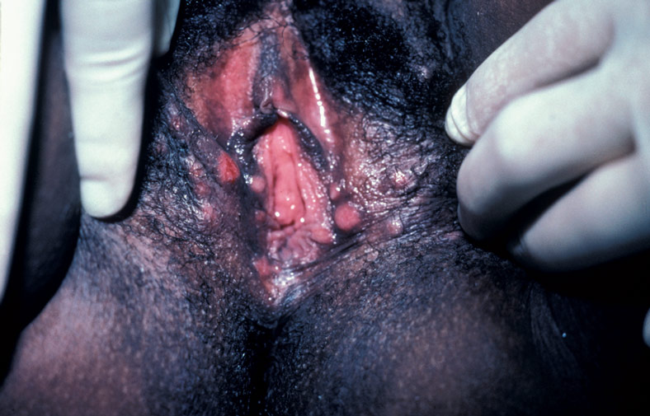
Syphilis
Assessment
Primary infection
Chancre
Secondary infection
Skin rash
Patchy hair loss
Swollen lymph glands
Tertiary stage can include complications.
Notes:
66

Slide 67
Syphilis
Management
Prevention measures include use of gloves and good hand washing techniques.
Notes:
67

Slide 68
Genital Herpes
Pathophysiology
Chronic, recurrent illness produced by the herpes simplex virus
Classified into:
Type: transmitted via oral secretions
Type 2: spread through sexual contact
Notes:
68

Slide 69
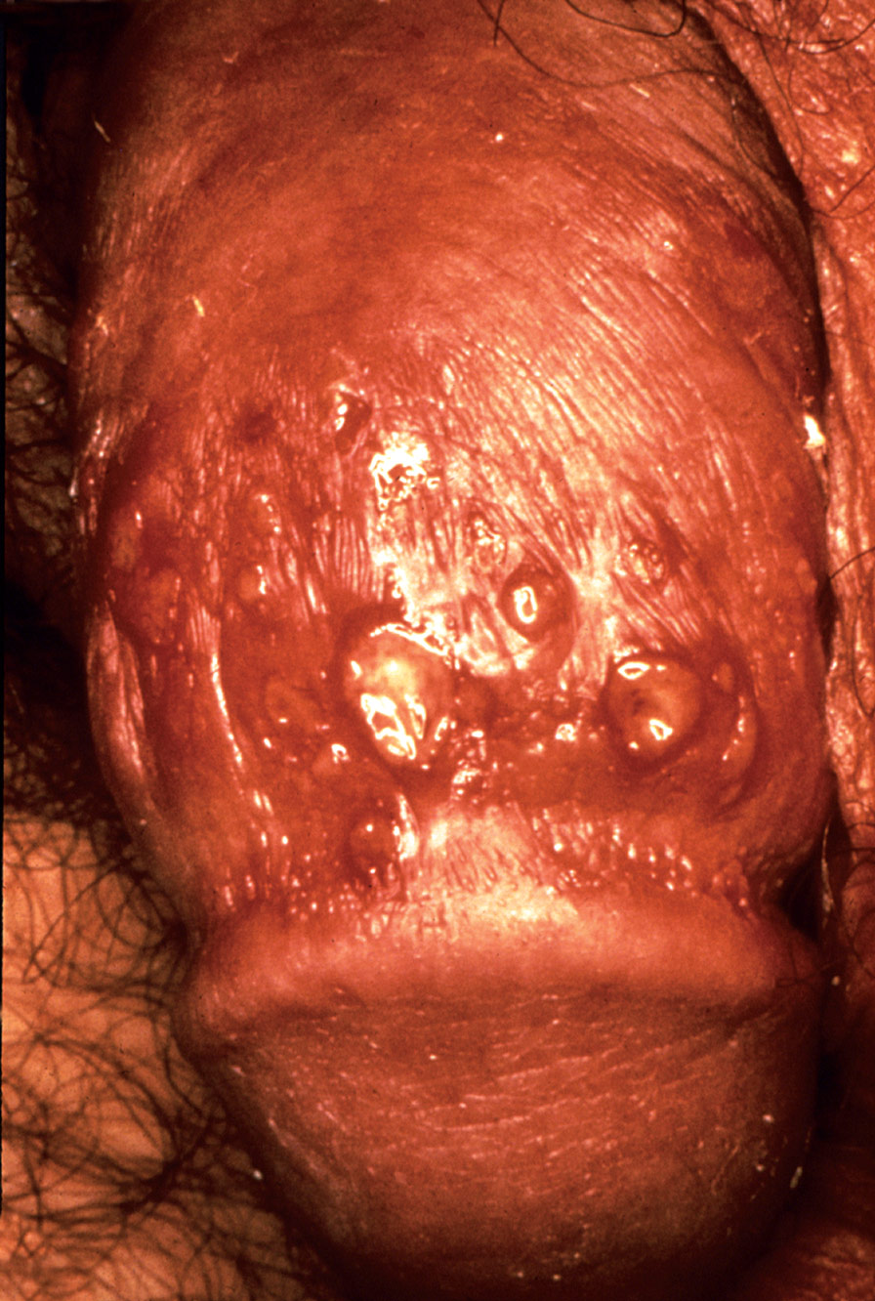
Genital Herpes
Assessment
Characterized by vesicular lesions
Transmission through sexual contact
Incubation: 2–12 days
Infectious: 4–7 days
Notes:
69

Slide 70
Genital Herpes
Management
No cure
Can be treated with acyclovir, valacyclovir, or famciclovir to reduce outbreaks
Preventive measures include the use of gloves and good hand washing techniques.
Notes:
70

Slide 71
Chlamydia
Pathophysiology
Transmission through sexual contact
Incubation period: 7–14 days or longer
Communicable period: unknown
Notes:
71

Slide 72
Chlamydia
Assessment
Signs and symptoms:
Inflammation of the urethra, epididymis, cervix, and fallopian tubes
Gray or white urethral discharge
Notes:
72

Slide 73
Chlamydia
Management
Treated with antibiotics
Preventive measures include gloves and good hand washing techniques.
Notes:
73

Slide 74
Types of Viral Hepatitis
Inflammation of the liver produced by a virus
Five distinct forms
A, B, C, D, and E
Vary in means of transmission
Same signs and symptoms
Notes:
74

Slide 75
Hepatitis B Virus Infection
Pathophysiology
Needles are implicated in transmission.
Incubation period: 45 to 200 days
Communicable from weeks before symptoms appear and may persist for years
Notes:
75

Slide 76
Hepatitis A Virus Infection
Pathophysiology
Transmission is by the fecal-oral route.
Infection is often described as “benign.”
Incubation period: 2 to 4 weeks
Communicable period: from end of incubation period to a few days after jaundice
Notes:
76

Slide 77
Hepatitis A Virus Infection
Assessment
Phase 1:
Fatigue
Loss of appetite
Fever
Nausea
Abdominal pain
Smokers lose interest in smoking.
Phase 2:
Jaundice
Dark-colored urine
Whitish stools
Resolves after several weeks
Notes:
77

Slide 78
Hepatitis A Virus Infection
Management
Use good hand washing techniques and gloves.
A vaccine is recommended for FEMA response team members who work outside the United States.
Notes:
78

Slide 79
Hepatitis D Virus Infection
Pathophysiology
Only occurs with HBV
Transmitted through percutaneous or mucosal contact with infected blood
Management
Administration of a hepatitis B vaccination
Notes:
79

Slide 80
Hepatitis E Virus Infection
Pathophysiology
Transmission occurs via fecal-oral route.
Incubation period: 15–64 fays
Communicable period: same as HAV infection
Notes:
80

Slide 81
Hepatitis D Virus Infection
Assessment
Signs and symptoms same as other forms of hepatitis
Management
Use gloves when in contact with stool.
Good hand washing
Clean contaminated equipment.
Notes:
81

Slide 82
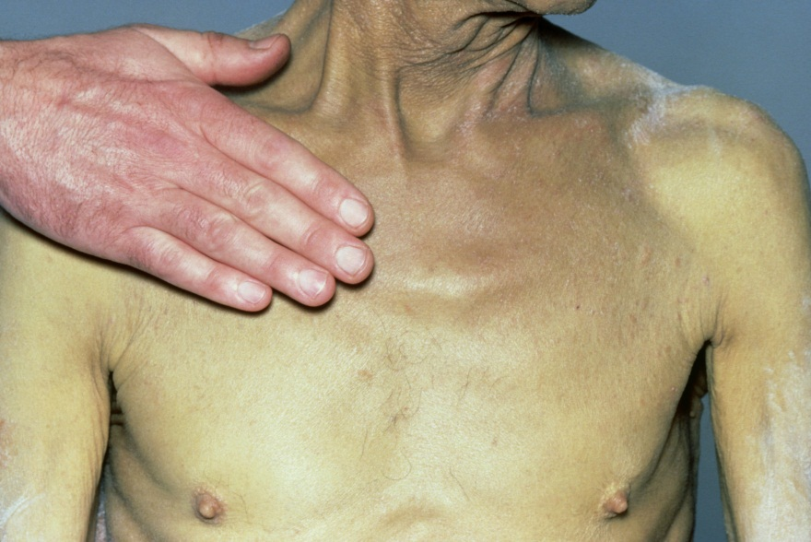
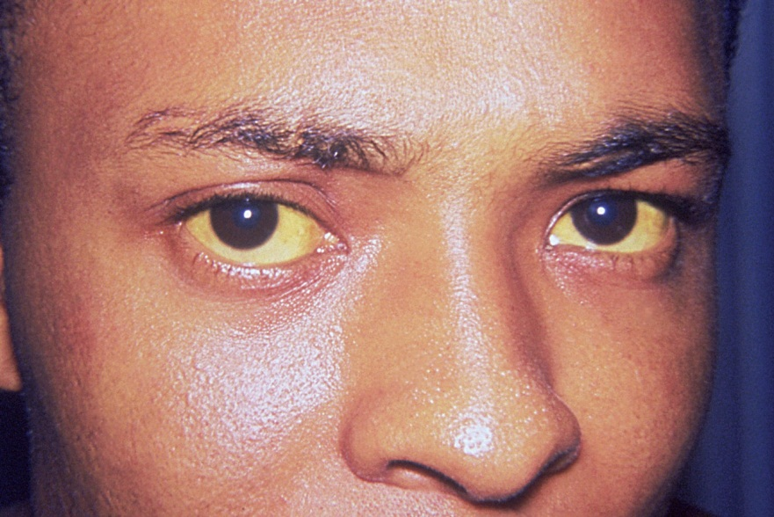
Hepatitis B Virus Infection
Assessment
Signs and symptoms may include:
Loss of appetite
Abdominal discomfort
Jaundice
Scleral icterus
Notes:
82

Slide 83
Hepatitis B Virus Infection
Management
Use gloves and good hand washing.
Paramedics should be immunized.
Practice standard precautions.
If you are exposed, notify your DICO.
Notes:
83

Slide 84
Hepatitis C Virus Infection
Pathophysiology
Transmitted by:
Blood-to-blood contact
Sexual contact
Blood transfusion
Organ donation
Unsafe medical practices
Mother to infant
Incubation: 2–24 weeks
Notes:
84

Slide 85
Hepatitis C Virus Infection
Assessment
Signs and symptoms the same as HBV infection
Phase 2 signs and symptoms do not develop.
Notes:
85

Slide 86
Hepatitis C Virus Infection
Management
Use gloves.
If exposed, testing begins with the source patient.
24 weeks of treatment with a drug “cocktail”
Results in a 75% cure rate
Notes:
86

Slide 87
Hepatitis D Virus Infection
Must be infected with Hepatitis B
Pathophysiology
Transmission by percutaneous exposure
Incubation period: 30 to 180 days
Infectious during all phases of illness
Notes:
87

Slide 88
Hepatitis D Virus Infection
Assessment
Signs and symptoms same as HBV infection
Management
Use gloves and needle-safe or needleless devices.
Perform routine cleaning.
Testing begins with source patient.
Notes:
88

Slide 89
Human Immunodeficiency Virus (HIV) Infection
Pathophysiology
Transmitted through blood and body fluids
Pathogen attacks the immune system
Takes about 7 days
May occur 4 to 6 weeks after exposure
Communicable period: unknown
Notes:
89

Slide 90
Human Immunodeficiency Virus (HIV) Infection
Assessment
Signs and symptoms may include:
Acute febrile illness
Malaise
Swollen lymph glands
Seroconversion occurs usually within 3 months.
Notes:
90

Slide 91
Human Immunodeficiency Virus (HIV) Infection
Management
Use gloves when in contact with blood or OPIM.
Use needle-safe or needleless devices.
Good hand washing technique
Routine cleaning of the vehicle
Risk for health care providers is related to sharps.
Notes:
91

Slide 92
Acquired Immunodeficiency Syndrome (AIDS)
Pathophysiology
Incubation period: between documented infection and development of end-stage disease
Communicable period is presumed to last as long as patient is seropositive
Notes:
92

Slide 93
Acquired Immunodeficiency Syndrome (AIDS)
Assessment
AIDS-defining or AIDS-related conditions
PCP pneumonia
Cytomegalovirus
Kaposi sarcoma
Atypical TB
Cryptococcal meningitis
Notes:
93

Slide 94
Acquired Immunodeficiency Syndrome (AIDS)
Management
Follow standard precautions.
If exposed, testing proceeds according to state.
May be given antiretroviral drugs
Criteria are published by the CDC.
Not given automatically
Notes:
94

Slide 95
Contact Disease

Slide 96
Scabies
Pathophysiology
Caused by Sarcoptes scabiei
Transmission via skin-to-skin contact
Incubation period: 4–6 weeks
Communicable until mites and eggs are destroyed
Notes:
96

Slide 97
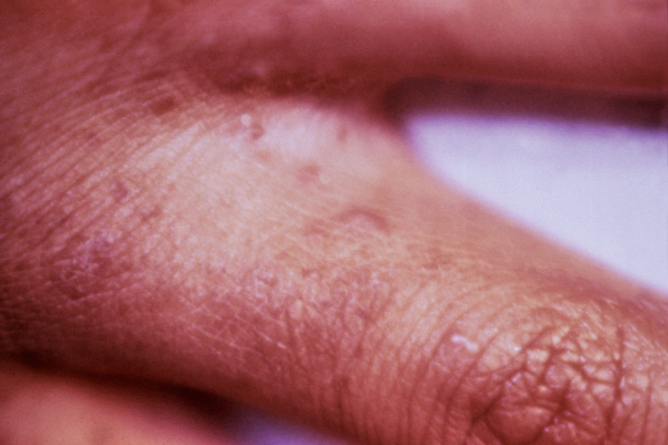
Scabies
Assessment
Signs and symptoms include:
Rash
Intense itching
Sores from scratching
Notes:
97

Slide 98
Scabies
Management
Prevent by wearing gloves and good hand washing.
Routine cleaning for vehicle and linens
Lindane is a topical treatment.
Notes:
98

Slide 99
Lice
Pathophysiology
Insects that crawl through hair, feed on blood
Three types:
Head louse
Body louse
Pubic louse
Acquired through direct contact
Notes:
99

Slide 100
Lice
Pathophysiology (cont’d)
Pubic lice
Transmission through intimate or sexual contact
Incubation period: 8–10 days after eggs hatched
Communicable until all lice and eggs are destroyed
Notes:
100

Slide 101
Lice
Assessment
Signs and symptoms include:
Itching and irritation
Sores
Nits
Notes:
101

Slide 102
Lice
Management
Wear gloves and practice good hand washing.
Routine cleaning of the vehicle is sufficient.
Permethrin cream may be prescribed.
Notes:
102

Slide 103
Rabies
Pathophysiology
Transmission is primarily related to the direct bite of an infected animal.
Another route is contamination of mucous membranes
Incubation period: 2–8 weeks
Notes:
103

Slide 104
Rabies
Assessment
Signs and symptoms:
Fever, chills
Sore throat
Malaise
Headache
Weakness
Paresthesia
Neurologic phase follows and includes:
Hyperactivity
Seizures
Bizarre behavior
Hydrophobia
Notes:
104

Slide 105
Rabies
Management
Follow standard precautions.
If you are bitten or scratched by a suspect animal, you may be offered human rabies vaccine.
Not recommend on a routine basis
Notes:
105

Slide 106
Tetanus
Pathophysiology
Transmission occurs when spores enter the body by:
Contaminated puncture wound
Contaminated street drugs
Not transmitted from person to person
Incubation period: 14 days
Notes:
106

Slide 107
Tetanus
Assessment
Signs and symptoms begin at the site of the wound.
Followed by painful muscle contractions or rigidity
Key sign is abdominal rigidity.
Notes:
107

Slide 108
Tetanus
Management
Use gloves when treating wounds and drainage.
Patient may require airway and ventilation support.
Tetanus immune globulin is recommended.
Paramedics should receive booster every 10 years.
Notes:
108

Slide 109
Infection with Antibiotic-Resistant Organisms

Slide 110
Infection with Antibiotic-Resistant Organisms
The overuse and misuse of antibiotics have led some pathogens to develop resistance to them.
Patients infected may be protected by the Americans With Disabilities Act.
Notes:
110

Slide 111
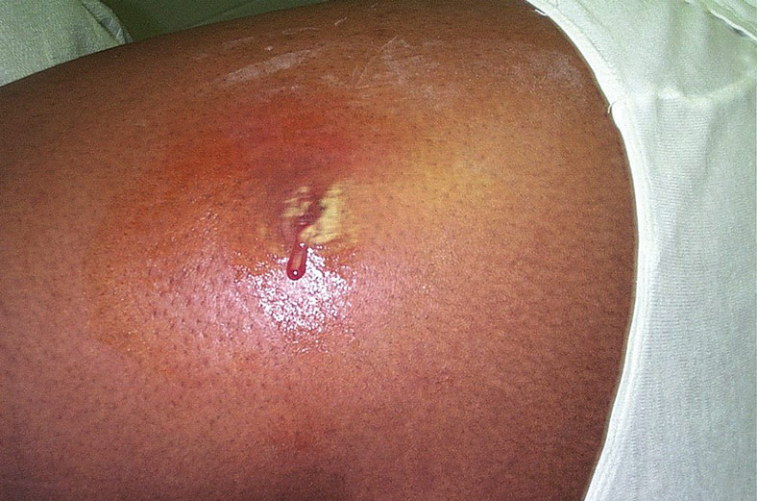
Methicillin-Resistant Staphylococcus Aureus
Pathophysiology
Transmitted via unwashed hands
Increased risk:
Antibiotic therapy
Prolonged hospital stay
Stay in an intensive care or burn unit
Exposure to infected patient
Notes:
111

Slide 112
Methicillin-Resistant Staphylococcus Aureus
Assessment
Incubation period: 5–45 days
Communicable period varies.
Secondary infections can occur after blood infection.
Notes:
112

Slide 113
Methicillin-Resistant Staphylococcus Aureus
Management
Patients undergo incision and drainage for soft-tissue infections.
No antibiotic necessary
Use standard precautions.
No post exposure treatment recommended.
Notes:
113

Slide 114
Vancomycin-Resistant Staphylococcus aureus
Pathophysiology
Persons at risk include those with:
Severe underlying health conditions
Previous MRSA infections
Indwelling catheters
Recent hospitalizations
Recent exposure to vancomycin
Notes:
114

Slide 115
Vancomycin-Resistant Staphylococcus aureus
Assessment
Signs and symptoms may include:
Localized skin abscesses
Cellulitis
Meningitis
Body weakness and pain
Notes:
115

Slide 116
Vancomycin-Resistant Staphylococcus aureus
Management
Treatable with antibiotics
Use standard precautions and routine cleaning.
Make sure all open cuts are covered.
No post exposure treatment is recommended.
Notes:
116

Slide 117
Vancomycin-Resistant Enterococci
Pathophysiology
Primarily a nosocomial infection
Susceptible if already ill or immuno-compromised
Found in urinary traction and bloodstream infections
Infection can be treated with linezolid.
Notes:
117

Slide 118
Vancomycin-Resistant Enterococci
Assessment
Can cause UTIs
Catheters can serve as a port of entry.
Surgical wounds may become infected.
Notes:
118

Slide 119
Vancomycin-Resistant Enterococci
Management
Use standard precautions.
Post-transport cleaning of all areas that came in contact with the patient
Notify DICO if you come in direct contact with an open wound or body fluids from an infected patient.
Notes:
119

Slide 120
Common Communicable Diseases of Childhood

Slide 121
Common Communicable Diseases of Childhood
There are increased numbers of cases of preventable communicable diseases across the United States.
Goal is to vaccinate all children
Notes:
121

Slide 122
Bronchiolitis
Infection of lungs and airways
Pathophysiology
Usually viral
Transmission occurs by inhaling droplets of infected mucus or respiratory secretions.
Notes:
122

Slide 123
Bronchiolitis
Assessment
Initial symptoms
Runny nose
Slight fever
After 2–3 days
Wheezing
Coughing
Tachypnea
Tachycardia
Notes:
123

Slide 124
Bronchiolitis
Management
Supportive measures include:
Oxygen
IV fluids
Assisted ventilations
Intubation
Notes:
124

Slide 125
Croup
Inflammation of the larynx and below airway
Pathophysiology
Similar to virus that causes the common cold
Spread by respiratory secretions or droplets
Notes:
125

Slide 126
Croup
Assessment
May last 3 to 7 days and include:
Loud, harsh, barking cough
Fever
Noisy inhalations
Hoarse voice
Mild to moderate dyspnea
Notes:
126

Slide 127
Croup
Management
Same as for most respiratory emergencies
No definitive treatment for the virus
Supportive care
Respiratory support
Hydration
Notes:
127

Slide 128
Measles
Pathophysiology
Highly communicable, transmitted by:
Airborne aerosolized droplets
Direct contact with nasal or pharyngeal secretions
Incubation period: 10 days
Communicable period: from first symptoms to about 2 days after rash appears
Notes:
128

Slide 129
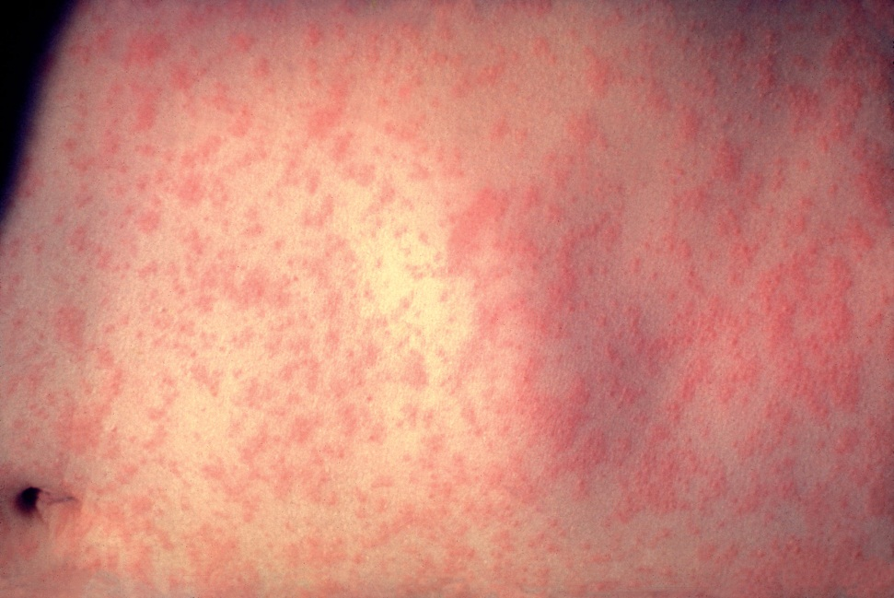
Measles
Assessment
Early signs and symptoms:
Fever
Conjunctivitis
Coryza
Followed by:
Cough
Blotchy rash
Koplik spots
Notes:
129

Slide 130
Measles
Management
Supportive care
The only certain protection is immunity.
Anyone who has had measles or who received live vaccine after 1968 should be immune.
Wash contact areas and launder any soiled linens.
Notes:
130

Slide 131
Rubella
Pathophysiology
Transmitted by direct contact with nasopharyngeal secretions of an infected person
Incubation period: 14–23 days
Communicable period: a week before the rash appears until 4 days after
Notes:
131

Slide 132
Rubella
Assessment
Signs and symptoms may include:
Low-grade fever
Headache
Runny nose
Swollen lymph glands
Diffuse maculopapular rash
Notes:
132

Slide 133
Rubella
Management
Supportive care
Only protection is immunity.
Place a surgical mask on the patient.
Practice standard precautions and routine cleaning.
Notes:
133

Slide 134
Mumps
Pathophysiology
Transmission occurs by droplet spread or direct contact with infected saliva.
Incubation period: 12–26 days
Communicable period: lasts 9 days after salivary glands swell
Notes:
134

Slide 135
Mumps
Assessment
Signs and symptoms in children may include:
Fever
Swelling and tenderness of a salivary gland
Males past puberty may have inflammation of the testicles.
Notes:
135

Slide 136
Mumps
Management
Place a surgical mask on the patient.
Wear gloves, and carry out routine cleaning.
Supportive care is needed.
Notes:
136

Slide 137
Chickenpox
Pathophysiology
Produces itchy, fluid-filled vesicles
Transmitted by direct contact or droplet spread of respiratory secretions
Incubation period: 10 to 21 days
Communicable period: 1 to 2 days before rash until about 5 days after
Notes:
137

Slide 138
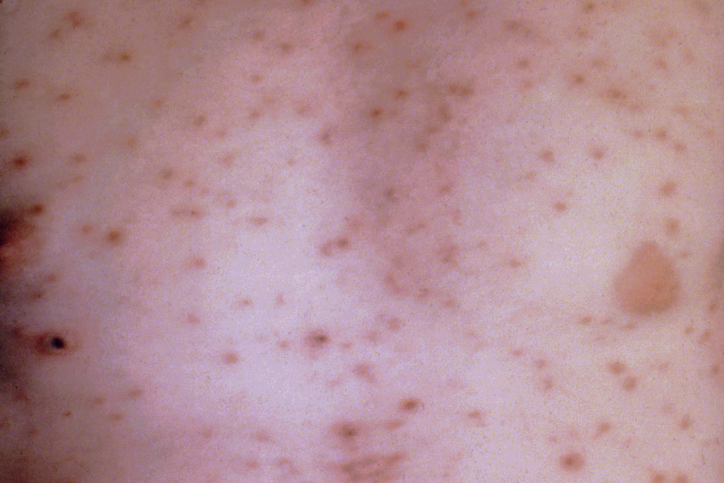
Chickenpox
Assessment
Highly contagious
Signs and symptoms include:
Listlessness
Slight fever
Photosensitivity
Vesicular rash
Notes:
138

Slide 139
Chickenpox
Management
Place a surgical mask on the patient.
Supportive care
Wear gloves when in contact with discharge/drainage.
Postexposure treatment includes vaccination.
Notes:
139

Slide 140
Pertussis
Assessment
Cough becomes paroxysmal in about 1 to 2 weeks
May last 1 to 2 months
A high-pitched “whoop” sound occurs on inspiration.
Notes:
140

Slide 141
Pertussis
Pathophysiology
Transmitted via direct contact with discharge from mucous membranes and/or airborne droplets
Incubation period: 7–14 days
Highly communicable in the early stages
Complications include apnea and pneumonia.
Notes:
141

Slide 142
Pertussis
Management
Place a mask on the patient.
Supportive care and antibiotic treatment
Good handwashing and routine cleaning
All paramedics should be assessed for immunity.
Notes:
142

Slide 143
Summary
OSHA, CDC, and state and county public health departments bear responsibility for:
Protection of public health
Prevention of epidemics
Management of outbreaks
Clean and disinfect the ambulance and your equipment to prevent spread of infection.
A patient suspected of having an infectious disease is assessed like any other medical patient.
Notes:
143

Slide 144
Summary
Infection involves a chain of events through which a communicable disease spreads.
Communicable diseases can be transmitted from person to person under certain conditions.
The risk of infection depends on the type and dose of the organism, its virulence, its mode of entry, and the host’s resistance.
The human body offers several defenses to protect against infection.
Notes:
144

Slide 145
Summary
Protection against and reduction of the occurrence of communicable diseases involve:
Designated infection control officer (DICO)
Public health department
Standard precautions
Immunizations
Vaccinations, PPE
Post-exposure follow-up
Exposure control plan
Notes:
145

Slide 146
Summary
Sexually transmitted diseases (STDs) are usually acquired by sexual contact and are caused by a wide range of organisms.
Enteric diseases are infectious diseases that affecting the gastrointestinal tract.
Bloodborne diseases include viral hepatitis, HIV, and AIDS.
A vector is a living organism that carries a disease-causing human pathogen.
Notes:
146

Slide 147
Summary
Overuse and misuse of antibiotics has made some pathogens resistant to the antibiotic drugs commonly prescribed to eradicate them.
Serious communicable childhood diseases that had become uncommon are making a resurgence because some parents refuse to have their children vaccinated.
New and emerging diseases of concern include severe acute respiratory syndrome (SARS) and the avian flu.
Notes:
147

Slide 148
Questions
?

