Slide 1
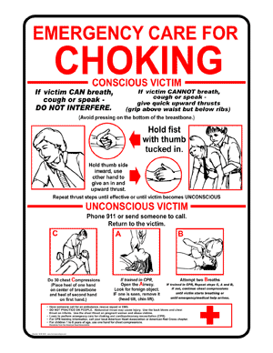
Foreign body obstruction

Slide 2
Objectives
Enumerate commonest causes for FB obstruction.
Remember prophylactic measures against FB airway obstruction.
Identify signs of airway obstruction.
Practice management of airway obstruction in:
A – Adult (conscious or unconscious)
B – Child (conscious or unconscious)
C- Infant (conscious or unconscious)

Slide 3
Cont.
Remember:
Cut food into small pieces.
Chew slowly.
Avoid running, laughing during chewing or swallowing.
Keep away small foreign bodies such as coins, bids, nuts...
Causes:
Meat is a common cause of obstruction.
Other foods and foreign bodies.
Dentures.
Elderly with dysphagia.

Slide 4
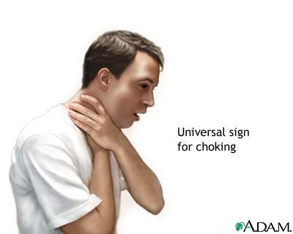
Signs of airway obstruction
Obstruction may be partial (patient chocking but able to cough) or complete.
Inability to speak.
Inability to cough.
Difficulty to breath.
High-pitched sounds or no sound during inhalation.
Cyanosis.
Victim clutches his neck.

Slide 5
I – Adult FB airway obstruction
A – Conscious chocking victim:
1- Ask “are you chocking?”.
2- Recognize signs of chocking.
3- Stand behind, apply Heimlich’s maneuver.
For obese or pregnant, use chest thrust.
4- Repeat till FB expulsion or victim becomes unable to talk, becomes cyanosed or unconscious.

Slide 6
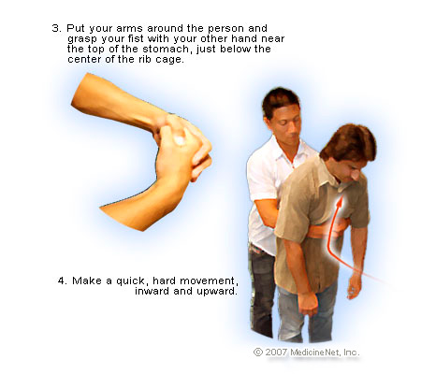
Heimlich’s maneuver

Slide 7
Cont.
5- call 997.
6- Every time you open airways, look for object and remove by finger sweep.
7- Begin CPR until you succeed or EMS arrive.

Slide 8
B- The victim is unconscious:
Establish unconsciousness.
Call 997.
Every time you open airways, look for object and remove by finger sweep.
If no breathing give 2 rescue breaths.
Begin CPR until you succeed or EMS arrive.
After 5 cycles, reassess & progress as mentioned in CPR.

Slide 9
II – Child FB airway obstruction
A- Child is Conscious:
1- Ask child “are you chocking?”.
2- Recognize signs of chocking.
3- Stand behind, apply Heimlich’s maneuver.
4- Repeat till FB expulsion or victim becomes unable to talk, becomes cyanosed or unconscious.

Slide 10
Cont.
5- call 997.
6- Every time you open airways, look for object and remove.
Never use blind finger sweep..
7- If obstruction is not relieved in 2 minutes, call 997.
8- Begin CPR until you succeed or EMS arrive.

Slide 11
B- Child is unconscious:
Establish unconsciousness.
Call 997.
Every time you open airways, look for object and remove by finger sweep.
If no breathing give 2 rescue breaths.
Begin CPR until you succeed or EMS arrive.
After 5 cycles, reassess & progress as mentioned in CPR.

Slide 12
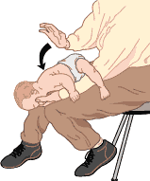
III – Infant FB airway obstruction
A- infant is conscious:
1- Confirm airway obstruction (absent or weak cry).
2- Give 5 back blows, turn carefully supporting head and give 5 chest thrusts.
3- Repeat until succeeding or infant becomes unconscious.

Slide 13
Cont.
4- Call 997.
5- Open airways and look into mouth, remove object, never use blind finger sweep.
6- Try to ventilate.
7- If unsuccessful, begin CPR.
8 – If obstruction is not relieved after 2 minutes, call 997.

Slide 14
B- Infant is unconscious
Establish unconsciousness.
Call 997.
Every time you open airways, look for object and remove by finger sweep.
If no breathing give 2 rescue breaths.
Begin CPR until you succeed or EMS arrive.
After 5 cycles, reassess & progress as mentioned in CPR.

Slide 15
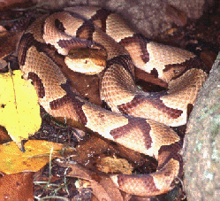
Snakes

Slide 16
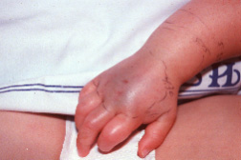
Viper Bites
Pain, swelling
Progressive edema
Bruising
Blood-filled vesicles

Slide 17
Viper Bites
Weakness, sweating, nausea, vomiting
Tachycardia, hypotension, shock
Prolonged clotting
Bleeding gums
Hematemesis, melena, hematuria
Numbness, tingling, neurological symptoms

Slide 18
Snake bite Management
Calm victim
Oxygen
Proximal constricting band ( + )
Clean, bandage wound
Immobilize bitten area, keep dependent
Watch constricting bands, bandages, splints carefully for edema
Transport

Slide 19
Snakebite Management
Do NOT
Apply ice
Cut and suck
Actively attempt to locate snake
Bring live venomous snake to hospital

Slide 20
Thank you

