Slide 1
Section

Slide 2
Chapter 10 Energy and work
Section 10.1 The Basic Energy Model
Section 10.2 Work
Section 10.3 Kinetic Energy
Section 10.4 Potential Energy
Section 10.6 Using the Law of Conservation of Energy
Section 10.7 Energy in Collisions
Section 10.8 Power

Slide 3
Section 10.1 The Basic Energy Model

Slide 4
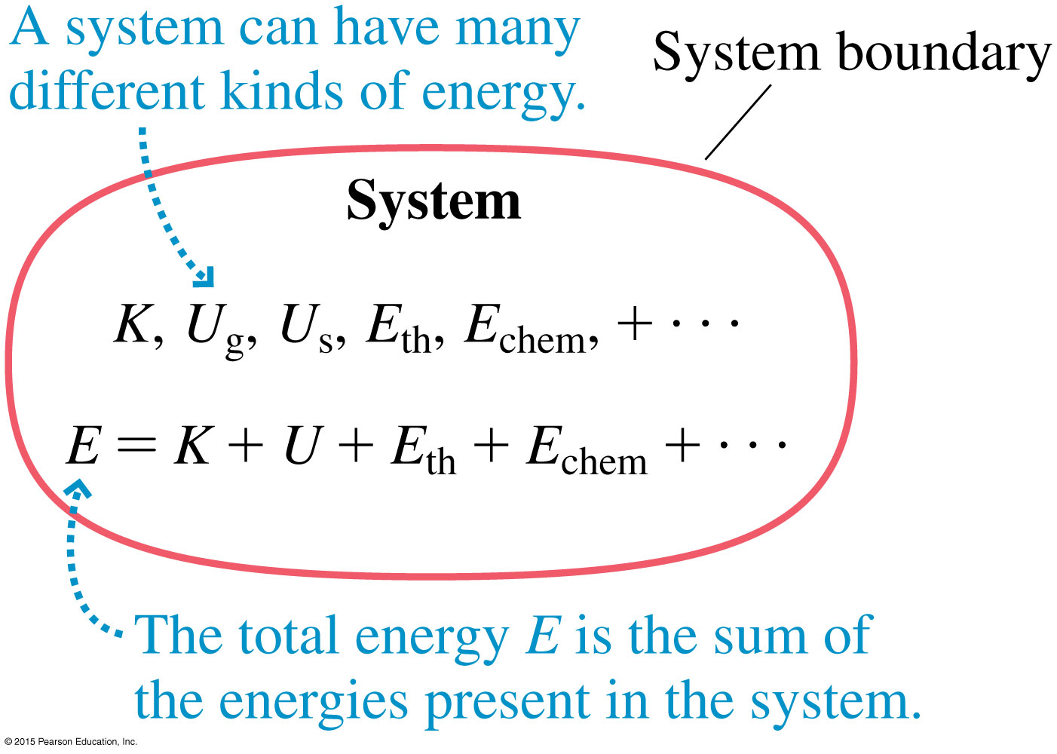
The Basic Energy Model
Every system in nature has a quantity we call its total energy E.

Slide 5
Forms of Energy
Some important forms of energy are
Kinetic energy K: energy of motion.
Gravitational potential energy U_{g}: stored energy associated with an object’s height above the ground.
Elastic or spring potential energy U_{s}: energy stored when a spring or other elastic object is stretched or compressed.
Thermal energy E_{th}: the sum of the kinetic and potential energies of all the molecules in an object.
Chemical energy E_{chem}: energy stored in the bonds between molecules or atoms.
Nuclear energy E_{nuclear}: energy stored in the mass of the nucleus of an atom.

Slide 6
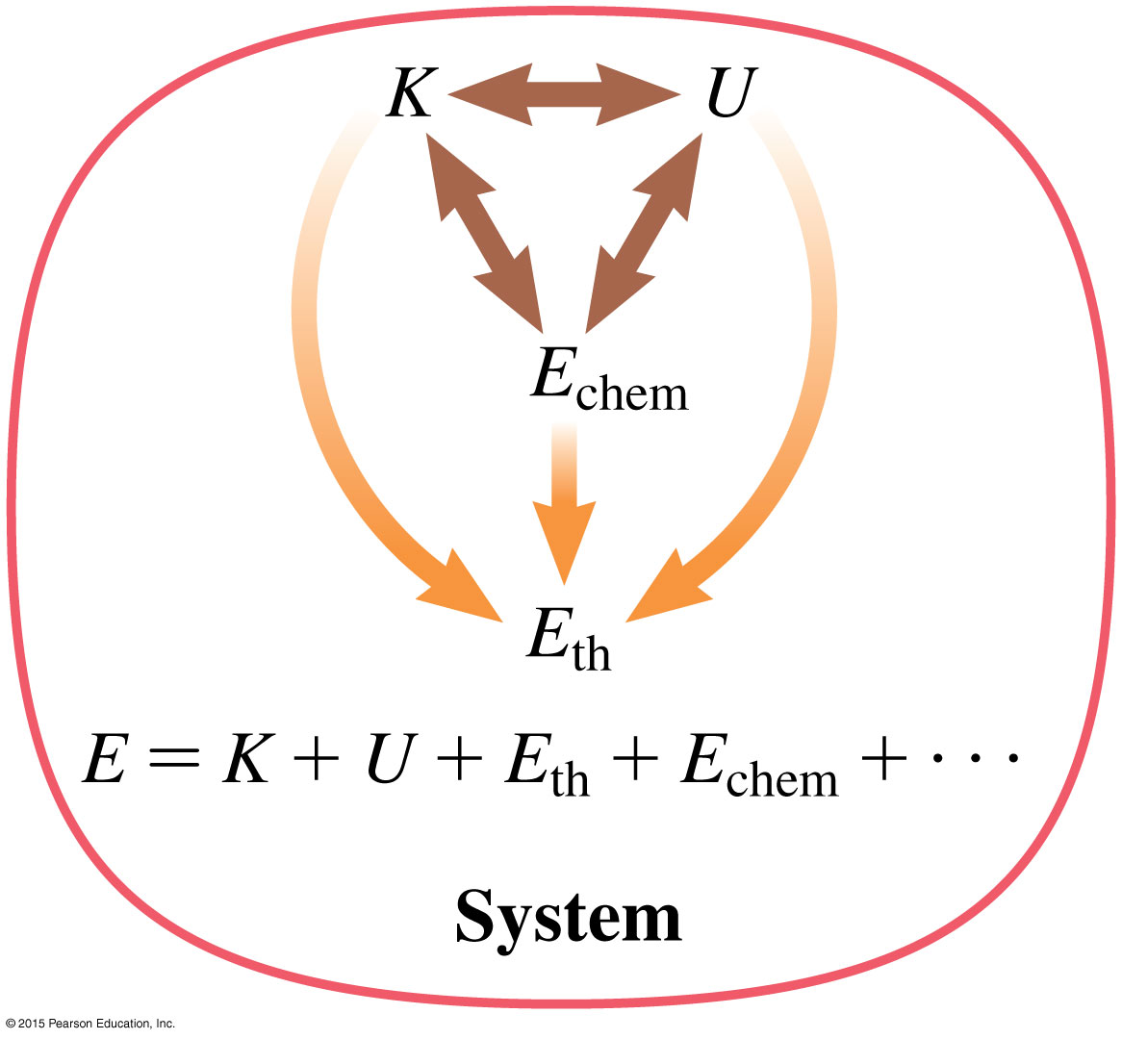
Energy Transformations
Energy of one kind can be transformed into energy of another kind within a system.

Slide 7
Energy Transfers and Work
Energy can be transferred between a system and its environment, or between objects. It also can be transformed from one form to another.
Work is the process of transferring or transforming energy
Heat is another process by which Heat energy is transferred or transformed

Slide 8
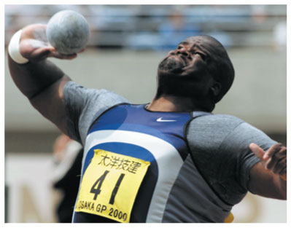
Energy Transfers and Work
The system: The shot
The environment: The athlete
As the athlete pushes on the shot to
get it moving, he is doing work on the system; that is, he is transferring energy from himself to the shot. The energy transferred to the system appears as kinetic energy.
The transfer: $W ⇨K$

Slide 9
Energy Transfers and Work
The system: The slingshot
The environment: The boy
As the boy pulls back on the elastic bands,
he does work on the system, increasing its
elastic potential energy.
The transfer: $W ⇨Us$

Slide 10
The Work-Energy Equation
Work represents energy that is:
1- transferred into or out of a system.
2- transformed from one form to another within the system
The total energy of a system changes by the amount of work done on it.
Work can increase or decrease the energy of a system.
If no energy is transferred into or out of a system, that is an isolated system, ∆E = 0.

Slide 11
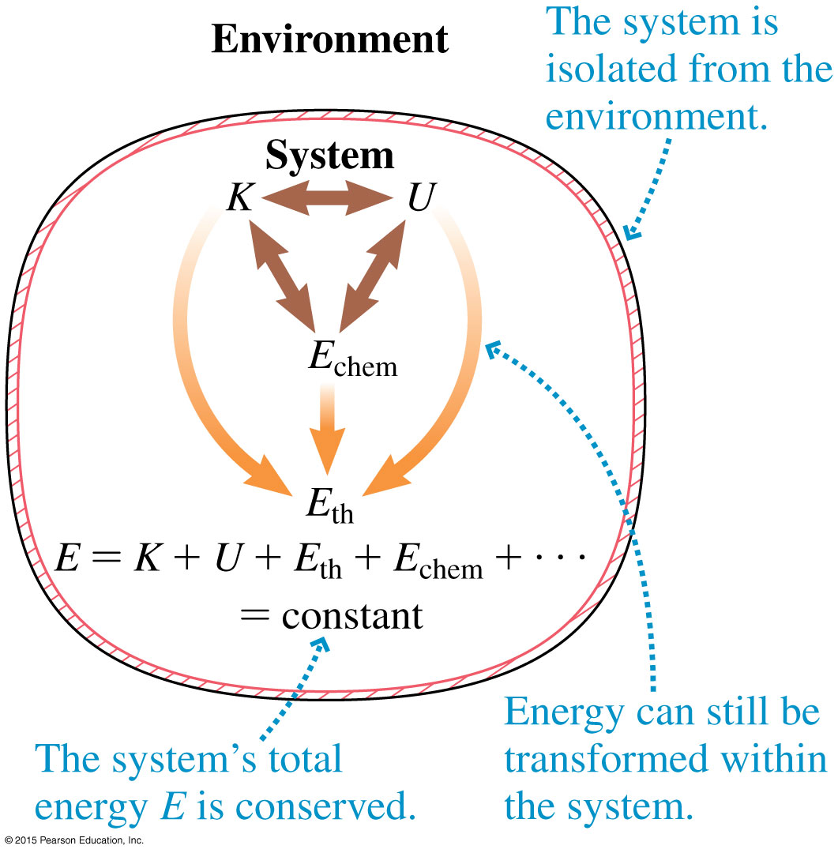
The Law of Conservation of Energy In an Isolated system
The total energy E of an isolated
System remains constant,
and ∆E = 0.

Slide 12
Section 10.2 Work

Slide 13
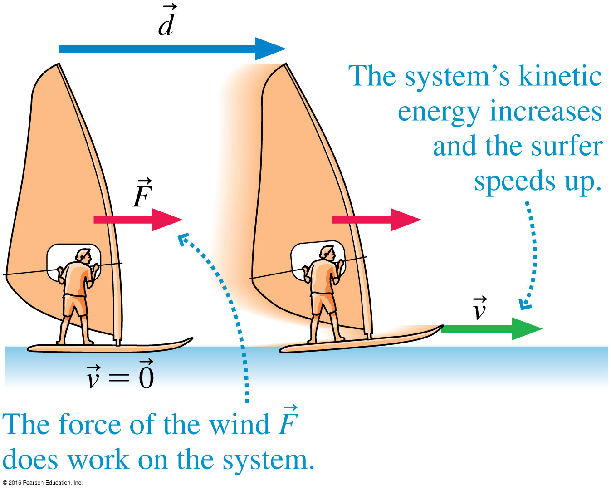
Work
Work is done on a system by forces, these are external forces.

Slide 14
Calculating Work
Although both the force and the displacement are vectors, work is a scalar.
The unit of work (and energy) is the Joule:

Slide 15
Example 10.1 Work done in pushing a crate
Sarah pushes a heavy crate as shown in the figure. How much work does Sarah do on the crate?
prepare Sarah pushes with a constant force (F) in the direction of the crate’s motion through displacement (d), so we can use the equation to find the work done.
SOLUTION The work done by Sarah is
W = Fd = (70 N)(3.0 m) = 210 J

Slide 16
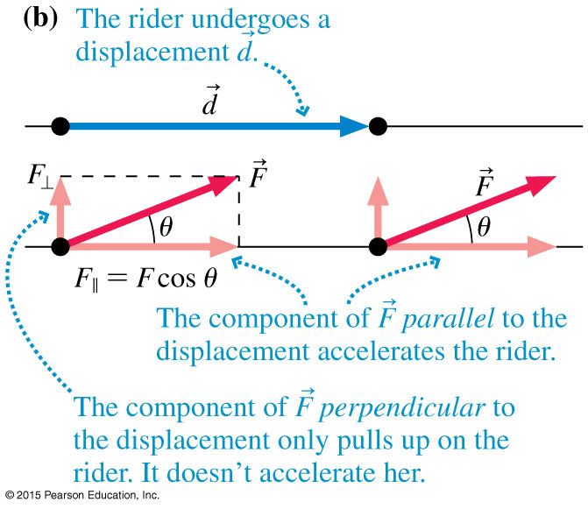
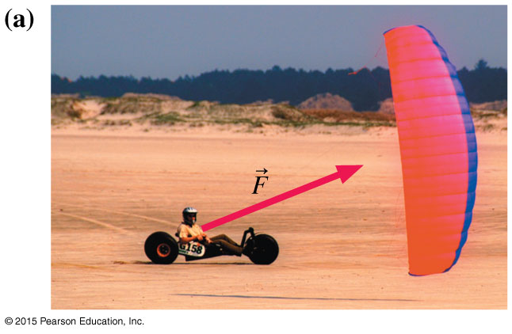
Force at an Angle to the Displacement
Only the component of a force in the direction of displacement does work.
If the force is at an angle θ to the displacement, the component of the force, F, that does work is Fcosθ.

Slide 17
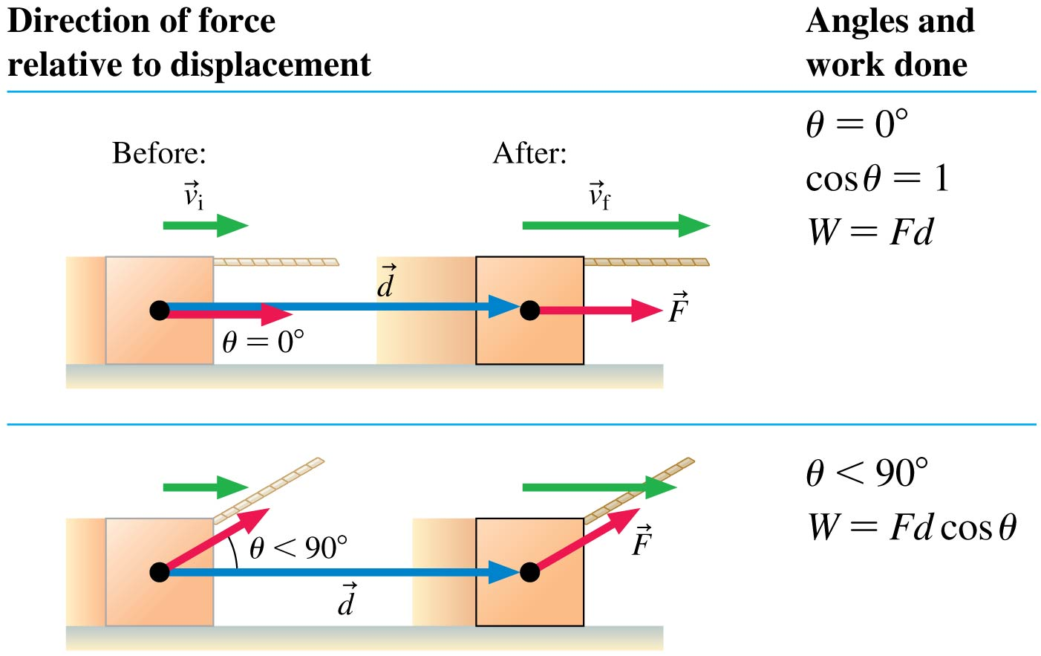
Force at an Angle to the Displacement

Slide 18
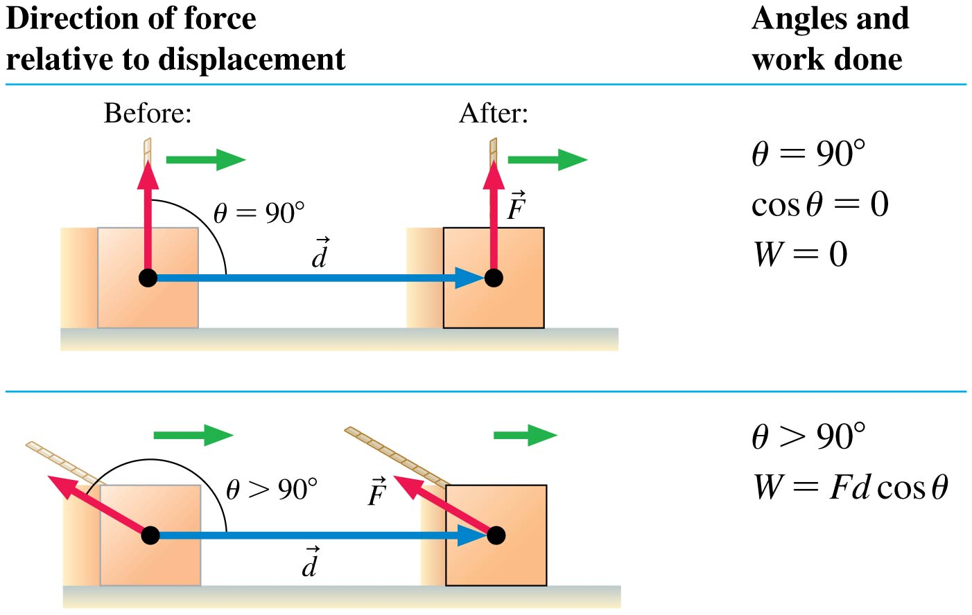
Force at an Angle to the Displacement

Slide 19
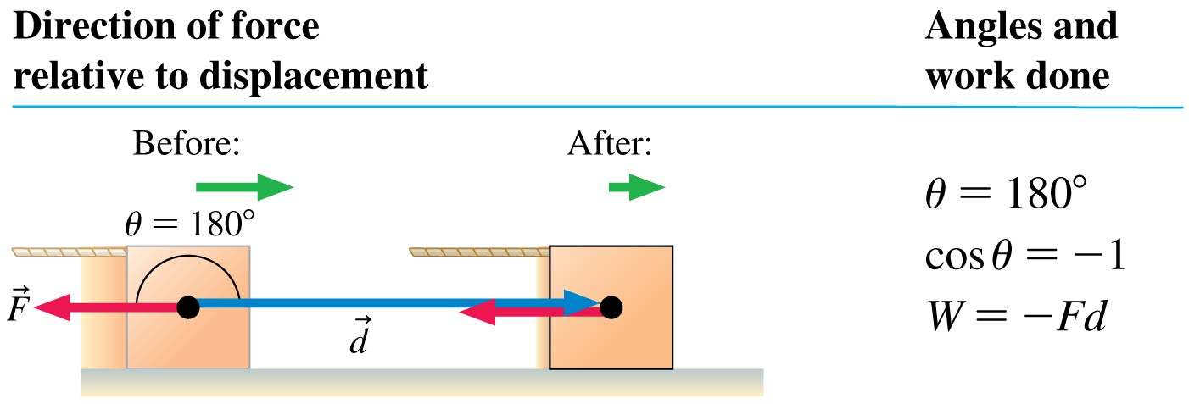
Force at an Angle to the Displacement
The sign of W is determined by the angle θ between the force and the displacement.

Slide 20
QuickCheck 10.4
A crane lowers a girder into place at constant speed. Consider the work W_{g} done by gravity and the work W_{T} done by the tension in the cable. Which is true?
W_{g} > 0 and W_{T} > 0
W_{g} > 0 and W_{T} < 0
W_{g} < 0 and W_{T} > 0
W_{g} < 0 and W_{T} < 0
W_{g} = 0 and W_{T} = 0
Notes:
20
20
Answer: B

Slide 21
QuickCheck 10.4
A crane lowers a girder into place at constant speed. Consider the work W_{g} done by gravity and the work W_{T} done by the tension in the cable. Which is true?
W_{g} > 0 and W_{T} > 0
W_{g} > 0 and W_{T} < 0
W_{g} < 0 and W_{T} > 0
W_{g} < 0 and W_{T} < 0
W_{g} = 0 and W_{T} = 0
Notes:
21
21
Answer: B

Slide 22
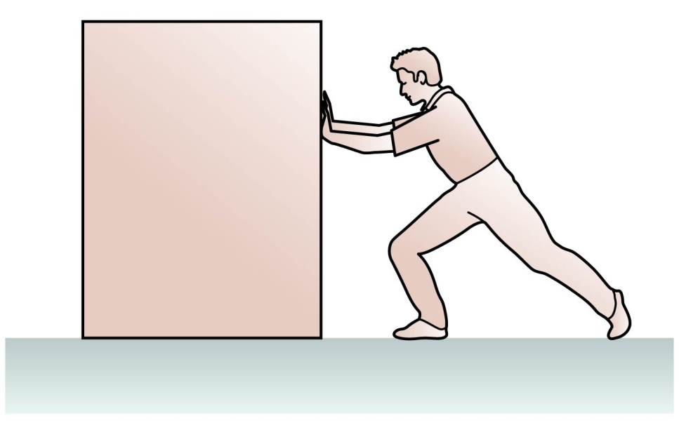
QuickCheck 10.5
Saud pushes the box to the left at constant speed. The work done by Saud on the box is:
positive
negative
Zero
Notes:
22
22
Answer: A

Slide 23
QuickCheck 10.5
Saud pushes the box to the left at constant speed. The work done by Saud on the box is:
positive
negative
Zero
Notes:
23
23
Answer: A

Slide 24
QuickCheck 10.6
A constant force pushes a particle through a displacement
In which case or cases does the force do negative work?
Notes:
24
24
Answer: D

Slide 25
QuickCheck 10.6
A constant force pushes a particle through a displacement
In which case or cases does the force do negative work?
Answer: A and B.
Notes:
25
25
Answer: D

Slide 26
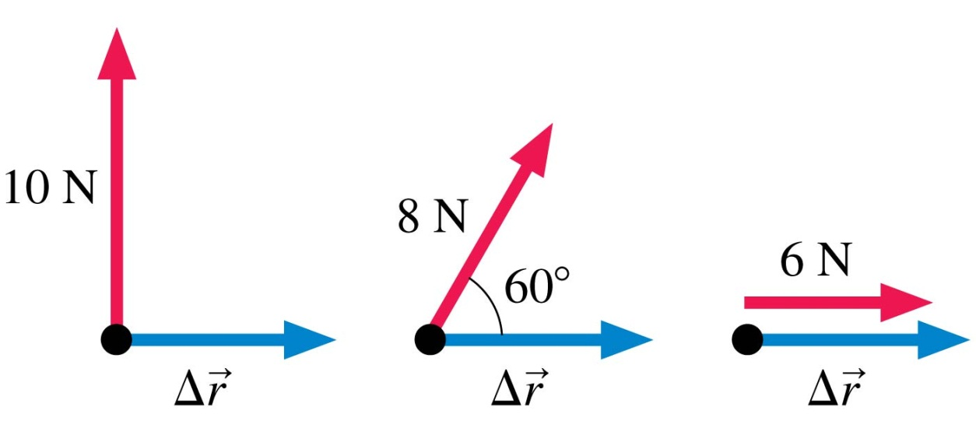
QuickCheck 10.7
Which force below does the most work? All three displacements are the same.
The 10 N force.
The 8 N force
The 6 N force.
They all do the same work.
sin60° = 0.87
cos60° = 0.50
Notes:
26
26
Answer: C

Slide 27
QuickCheck 10.7
Which force below does the most work? All three displacements are the same.
The 10 N force.
The 8 N force
The 6 N force.
They all do the same work.
sin60° = 0.87
cos60° = 0.50
Notes:
27
27
Answer: C

Slide 28
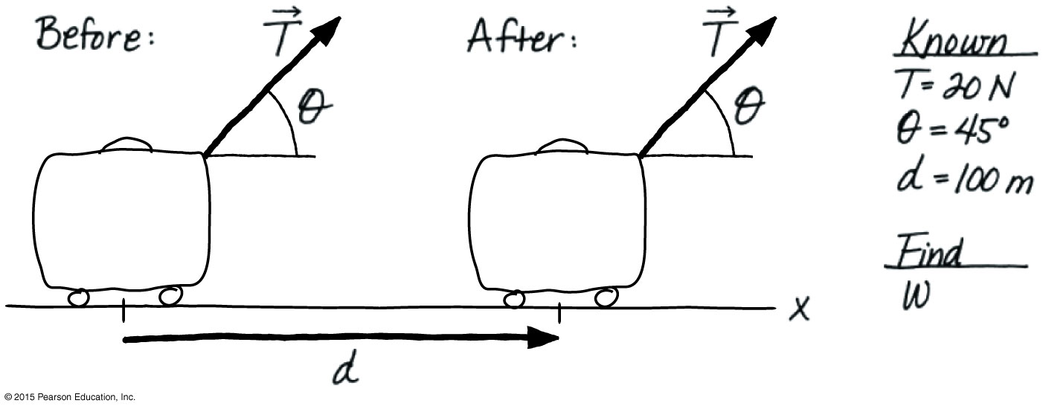
Example 10.2 Work done in pulling a suitcase
A strap inclined upward at a 45° angle pulls a suitcase through the airport. The tension in the strap is 20 N. How much work does the tension do if the suitcase is pulled 100 m at a constant speed?

Slide 29
Example 10.2 (cont.)
prepare Since the suitcase moves at a constant speed, there must be a rolling friction force (not shown) acting to the left.
solve We can use Equation: $W=Fdcosθ$ with force F = T, to find the work done by the tension:
W = Td cos θ = (20 N)(100 m)cos 45° = 1400 J
The tension is needed to do work on the suitcase even though the suitcase is traveling at a constant speed to overcome friction. So the work is positive and goes entirely into increasing the thermal energy of the suitcase and the floor.

Slide 30
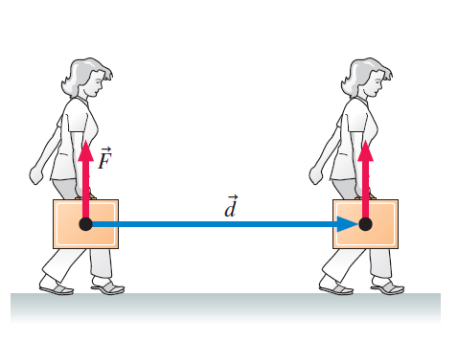
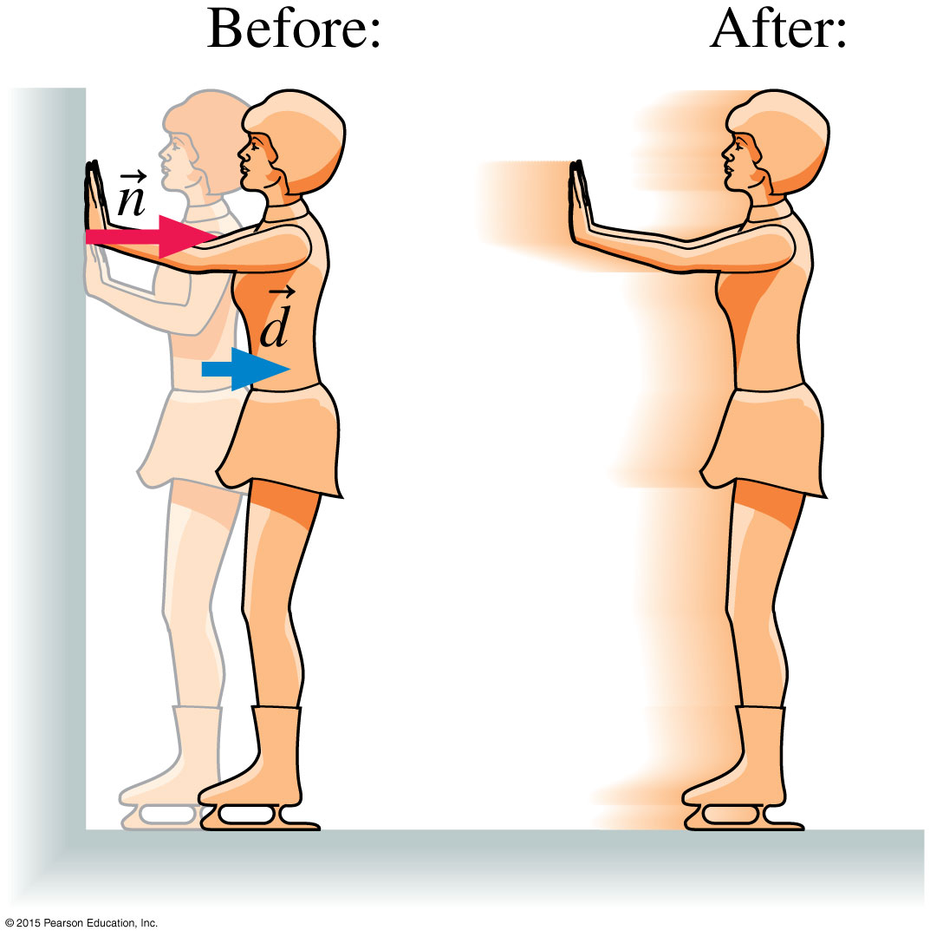
Forces That Do No Work
A force does no work on an object if
The object undergoes no displacement.
The force is perpendicular to the displacement.
The suitcase is kept at the same height
by force (F) which is 90º to the displacement (d)
The wall does no work on the girl, because
the point of her body on which the force n
acts (her hands) undergoes no displacement.

Slide 31
Section 10.3 Kinetic Energy

Slide 32
Kinetic Energy
Kinetic energy is energy of motion.

Slide 33
Example 10.5 Speed of a bobsled after pushing
A two-man bobsled has a mass of 390 kg. Starting from rest, the two racers push the sled for the first 50 m with a net force of 270 N. Neglecting friction, what is the sled’s speed at the end of the 50 m?
prepare friction is negligible, therefore no change in the sled’s thermal energy.
The sled’s height is constant, hence its gravitational potential energy is unchanged as well.
The work done by the pushers increases the sled’s kinetic energy.

Slide 34
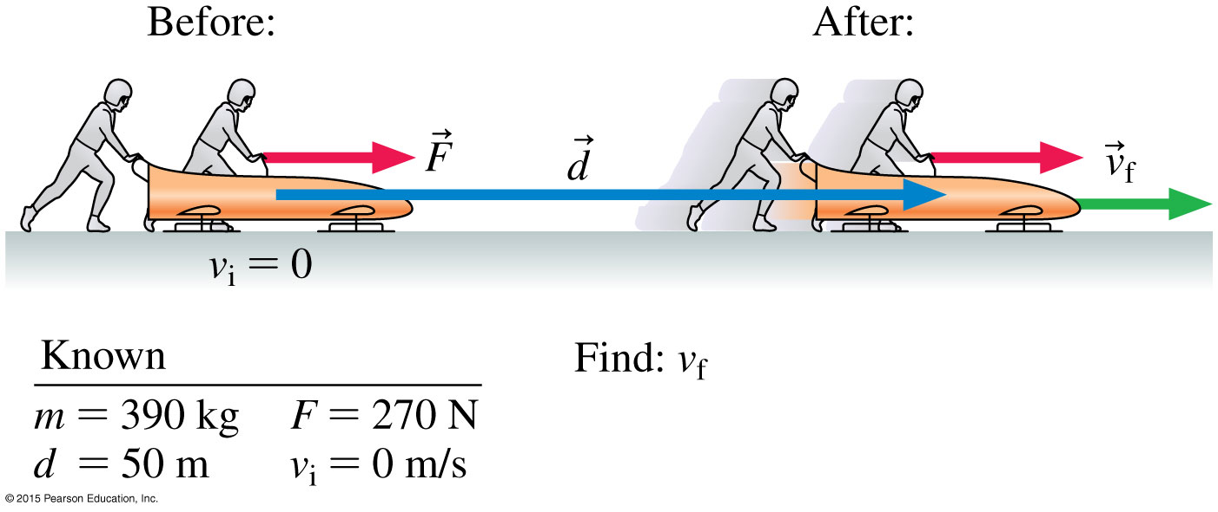
Example 10.5 (cont.)
Thus the work-energy equation is simply ΔK = W.
Using the equation the sled’s final kinetic energy, and hence its speed is found.
The work done by the pushers increases the sled’s kinetic energy.

Slide 35
Example 10.5 (cont.)
solve From the work-energy equation, the change in the sled’s kinetic energy is ΔK = K_{f} − K_{i} = W. The sled’s final kinetic energy is thus
K_{f} = K_{i} + W
Using our expressions for kinetic energy and work, we get
Because v_{i} = 0, the work-energy equation reduces to .
We can solve for the final speed to get

Slide 36
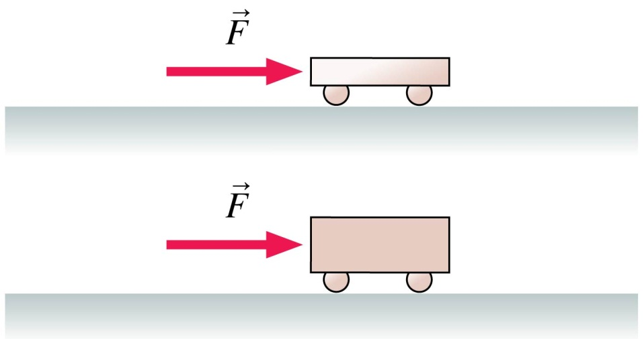
QuickCheck 10.10
A light plastic cart and a heavy steel cart are both pushed with the same force for a distance of 1.0 m, starting from rest. After the force is removed, the kinetic energy of the light plastic cart is ________ that of the heavy steel cart.
greater than
equal to
less than
It depends on force size.
Notes:
36
36
Answer: B

Slide 37
QuickCheck 10.10
A light plastic cart and a heavy steel cart are both pushed with the same force for a distance of 1.0 m, starting from rest. After the force is removed, the kinetic energy of the light plastic cart is ________ that of the heavy steel cart.
greater than
equal to
less than
It depends on force size.
Notes:
37
37
Answer: B

Slide 38
QuickCheck 10.11
Each of the boxes shown is pulled for 10 m across a level, frictionless floor by the force given. Which box experiences the greatest change in its kinetic energy?
Notes:
38
38
Answer: D

Slide 39
QuickCheck 10.11
Each of the boxes shown is pulled for 10 m across a level, frictionless floor by the force given. Which box experiences the greatest change in its kinetic energy?
Notes:
39
39
Answer: D

Slide 40
QuickCheck 10.12
Each of the 1.0 kg boxes starts at rest and is then is pulled for 2.0 m across a level, frictionless floor by a rope with the noted force at the noted angle. Which box has the highest final speed?
°
°
°
°
°
Notes:
40
Answer: B

Slide 41
QuickCheck 10.12
Each of the 1.0 kg boxes starts at rest and is then is pulled for 2.0 m across a level, frictionless floor by a rope with the noted force at the noted angle. Which box has the highest final speed?
°
°
°
°
°
Notes:
41
Answer: B

Slide 42
Section 10.4 Potential Energy

Slide 43
Potential Energy
Potential energy is stored energy that can be readily converted to other forms of energy, such as kinetic or thermal energy.
Forces that can store useful energy are conservative forces:
Gravity
Elastic forces
Forces such as friction that cannot store useful energy are non-conservative forces.

Slide 44
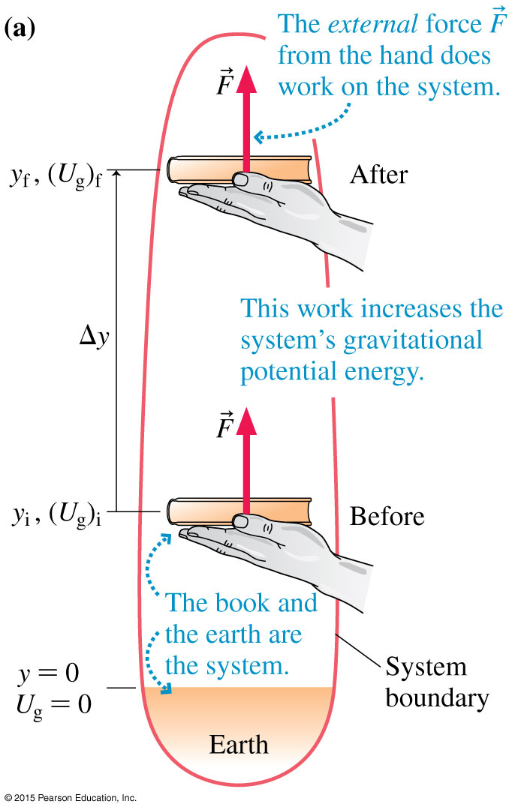
Gravitational Potential Energy
The change in gravitational potential energy is proportional to the change in its height.

Slide 45
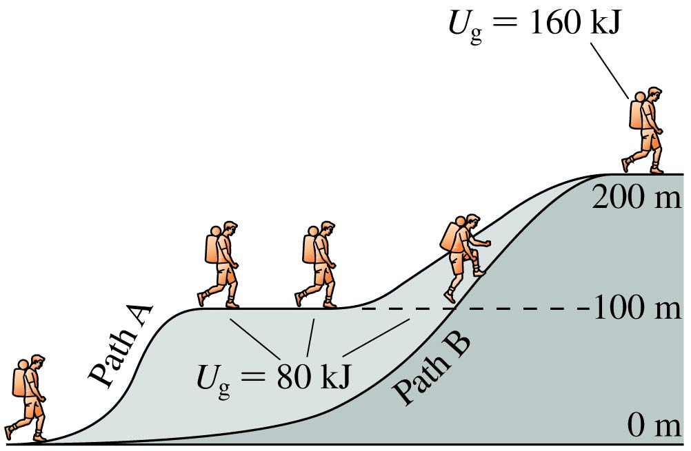
Gravitational Potential Energy
We can choose the reference level where gravitational potential energy U_{g} = 0 since only changes in U_{g} matter.
Because gravity is a conservative force, gravitational potential energy depends only on the height of an object and not on the path the object took to get to that height.

Slide 46
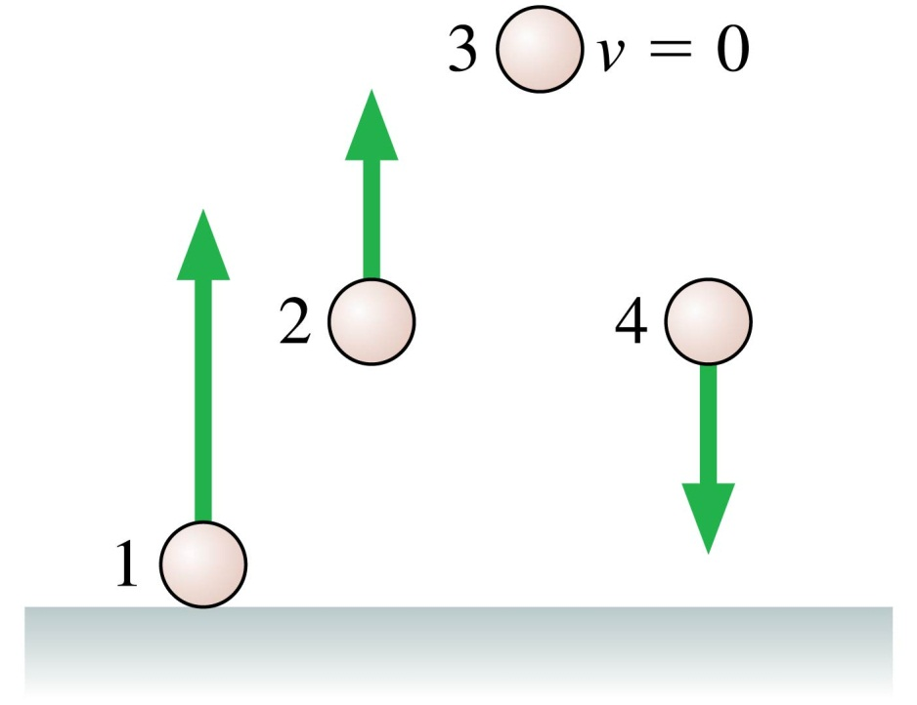
QuickCheck 10.13
Rank in order, from largest to smallest, the gravitational potential energies of the balls.
1 > 2 = 4 > 3
1 > 2 > 3 > 4
3 > 2 > 4 > 1
3 > 2 = 4 > 1
Notes:
46
Answer: D

Slide 47
QuickCheck 10.13
Rank in order, from largest to smallest, the gravitational potential energies of the balls.
1 > 2 = 4 > 3
1 > 2 > 3 > 4
3 > 2 > 4 > 1
3 > 2 = 4 > 1
Notes:
47
Answer: D

Slide 48
QuickCheck 10.14
Starting from rest, a marble first rolls down a steeper hill, then down a less steep hill of the same height. For which is it going faster at the bottom?
Faster at the bottom of the steeper hill.
Faster at the bottom of the less steep hill.
Same speed at the bottom of both hills.
Can’t say without knowing the mass of the marble.
Notes:
48
Answer: C

Slide 49
QuickCheck 10.14
Starting from rest, a marble first rolls down a steeper hill, then down a less steep hill of the same height. For which is it going faster at the bottom?
Faster at the bottom of the steeper hill.
Faster at the bottom of the less steep hill.
Same speed at the bottom of both hills.
Can’t say without knowing the mass of the marble.
Notes:
49
Answer: C

Slide 50
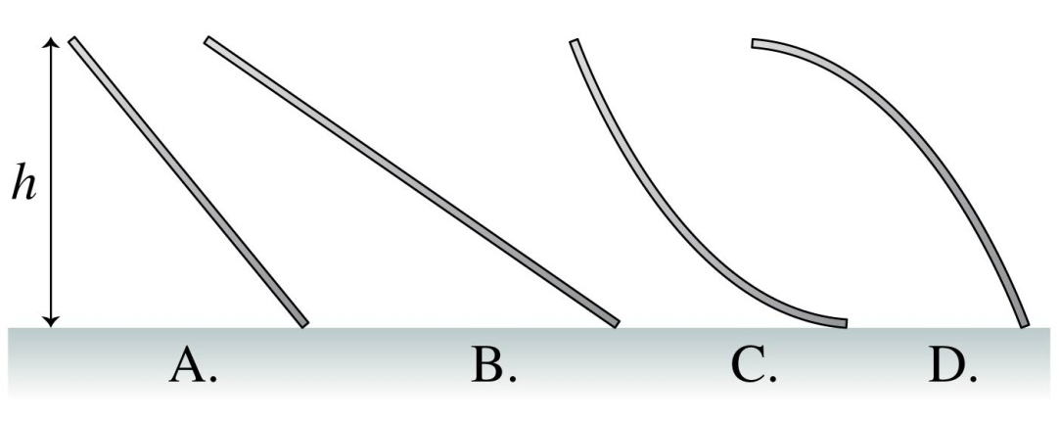
QuickCheck 10.15
A small child slides down the four frictionless slides A–D. Rank in order, from largest to smallest, her speeds at the bottom.
v_{D} > v_{A} > v_{B} > v_{C}
v_{D} > v_{A} = v_{B} > v_{C}
v_{C} > v_{A} > v_{B} > v_{D}
v_{A} = v_{B} = v_{C} = v_{D}
Notes:
50
Answer: D

Slide 51
QuickCheck 10.15
A small child slides down the four frictionless slides A–D. Rank in order, from largest to smallest, her speeds at the bottom.
v_{D} > v_{A} > v_{B} > v_{C}
v_{D} > v_{A} = v_{B} > v_{C}
v_{C} > v_{A} > v_{B} > v_{D}
v_{A} = v_{B} = v_{C} = v_{D}
Notes:
51
Answer: D

Slide 52
Section 10.6 Using the Law of Conservation of Energy

Slide 53
Using the Law of Conservation of Energy
We can use the law of conservation of energy to develop a before-and-after perspective for energy conservation:
∆E = ∆K + ∆U_{g} = W
K_{f} + (U_{g})_{f} = K_{i} + (U_{g})_{i} + W
In an isolated system, W = 0:
K_{f} + (U_{g})_{f} = K_{i} + (U_{g})_{i}

Slide 54
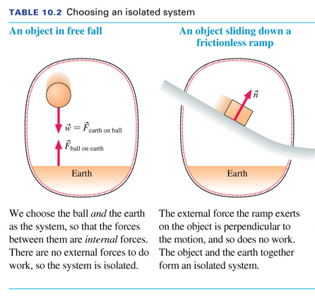
Choosing an Isolated System

Slide 55
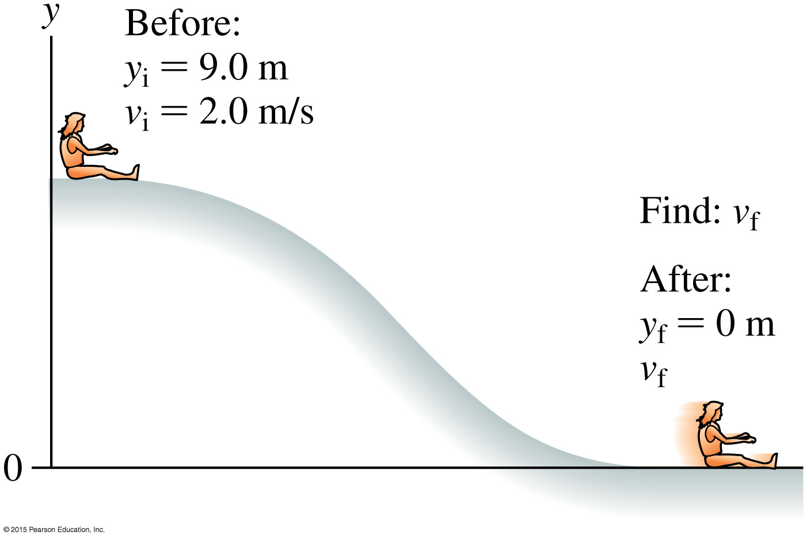
Example 10.11 Speed at the bottom of a water slide
While at the county fair, Sarah tries the water slide, given the information in the figure with the slide frictionless, how fast will Sarah be traveling at the bottom?

Slide 56
Example 10.11 (cont.)
prepare Table 10.2 showed the system consisting of Sarah and earth is isolated. If we assume the slide is frictionless, we can use the conservation of mechanical energy equation.
solve Conservation of mechanical energy gives
K_{f} + (U_{g})_{f} = K_{i} + (U_{g})_{i}
or

Slide 57
Example 10.11 (cont.)
Taking y_{f} = 0 m, we have
which we can solve to get
Note: the shape of the slide does not matter because gravitational potential energy depends only on the height above a reference level.

Slide 58
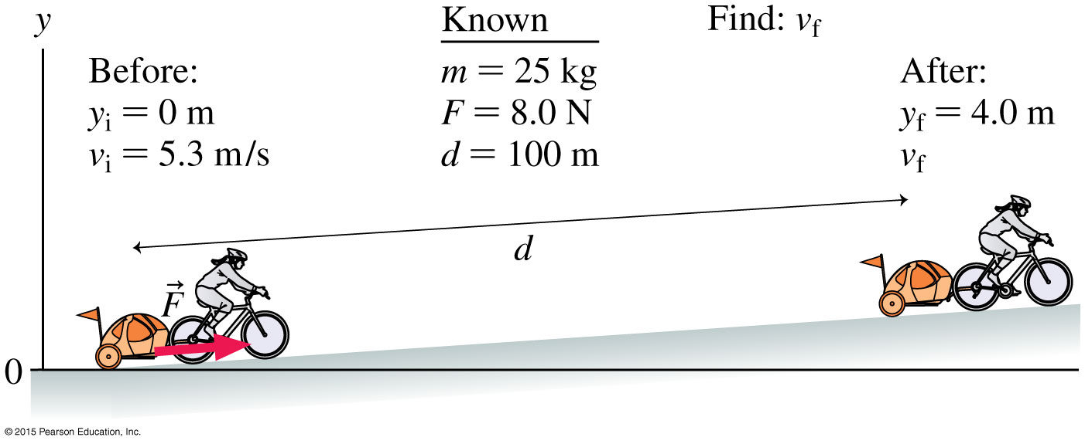
Example 10.13 Pulling a bike trailer
Mounira pulls her daughter Sarah in a bike trailer. The mass of Sarah and the trailer is 25 kg. On the slope, Mounira’s bike pulls on the trailer with a constant force of 8.0 N. Given the information in the figure. What is their speed at the top of the slope?

Slide 59
Example 10.13 (cont.)
prepare Taking Sarah and the trailer as the system, we see that Mounira’s bike is applying a force to the system as it moves through a displacement; that is, Mounira’s bike is doing work on the system. Thus we’ll need to use the full version of Equation 10.18, including the work term W.
solve
∆E = ∆K + ∆U_{g} = W
K_{f} + (U_{g})_{f} = K_{i} + (U_{g})_{i} + W

Slide 60
Example 10.13 (cont.)
Taking y_{i} = 0 m and writing W = Fd, we can solve for the final speed:
from which we find that v_{f} = 3.7 m/s. Note that we took the work to be a positive quantity because the force is in the same direction as the displacement.
assess A speed of 3.7 m/s seems reasonable for a bicycle’s speed. Sarah’s final speed is less than her initial speed, indicating that the uphill force of Mounira’s bike on the trailer is less than the downhill component of gravity.

Slide 61
Energy and Its Conservation

Slide 62
Section 10.7 Energy in Collisions

Slide 63
Energy in Collisions
Collisions are divided into two types: Elastic and inelastic collisions.
momentum is conserved in all types of collisions.
kinetic energy is only conserved in Elastic collisions.
perfectly inelastic collision is a collision where the colliding objects stick together and move with a common velocity.

Slide 64
Elastic Collisions
Elastic collisions obey conservation of momentum and conservation of mechanical energy.
two balls of mass m₁ and m₂ collide head on as shown below:
v_{1i}
v_{2i}
v_{1f}
v_{2f}
Momentum $m_{1}v1i$+m₂v_{2i}= m₁v_{f1} + m₂v_{2f}
Energy $\frac{1}{2}m_{1}v_{1i}^{2}$ + $\frac{1}{2}m_{2}v_{2i}^{2}$= $\frac{1}{2}m_{1}v_{1f}^{2}$ + $\frac{1}{2}m_{2}v_{2f}^{2}$

Slide 65
Elastic Collisions
Using the previous equations, equations for the final velocities of the two objects involved in a head on collision are derived to be:
${ v}_{1f}=\frac{(m_{1}−m_{2})}{(m_{1}+m_{2})}v_{1i}+$ $\frac{(2m_{2})}{(m_{1}+m_{2})}v_{2i}$
${ v}_{2f}=\frac{({2m}_{1})}{(m_{1}+m_{2})}v_{1i}+$ $\frac{(m_{2}−m_{1})}{(m_{1}+m_{2})}v_{2i}$

Slide 66
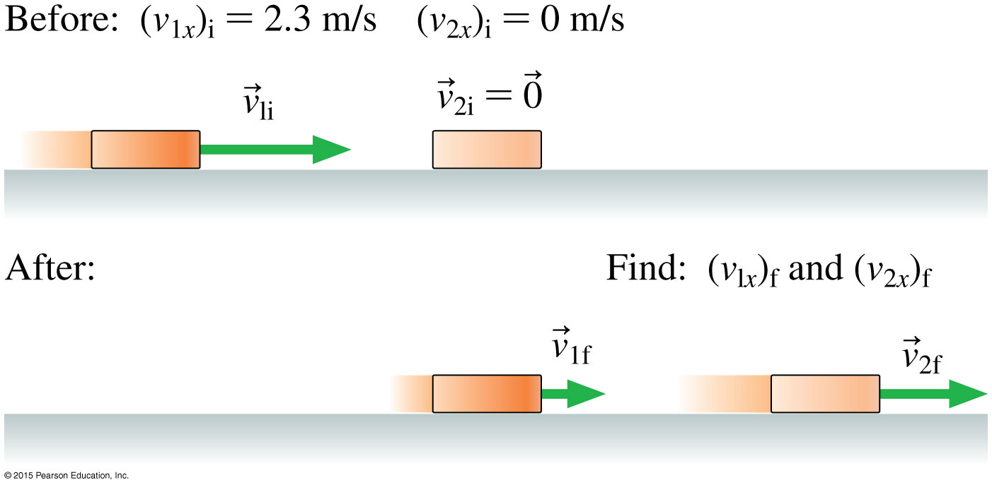
Example 10.16 Velocities in an air hockey collision
On an air hockey table, a moving puck, traveling to the right at 2.3 m/s, makes a head-on collision with an identical puck at rest. What is the final velocity of each puck?

Slide 67
Example 10.16 (cont.)
prepare after the collision, we don’t know which way the pucks will move. Because one puck was initially at rest, we can use the equations to find the final velocities of the pucks.
solve using the derived equations with m₁ = m₂ = m, we get:
$v_{1f}=\frac{(m_{1}−m_{2})}{(m_{1}+m_{2})}v_{1i}+$ $\frac{(2m_{2})}{(m_{1}+m_{2})}v_{2i}$ = 0
$v_{2f}=\frac{({2m}_{1})}{(m_{1}+m_{2})}v_{1i}+$ $\frac{(m_{2}−m_{1})}{(m_{1}+m_{2})}v_{2i}$ = 2.3 m/s
The moving puck stopped and the other puck moved with same velocity as the first puck (they simply exchanged velocities).

Slide 68
Section 10.8 Power

Slide 69
Power
Power is the rate at which energy is transformed or transferred.
The unit of power is the watt:
1 watt = 1 W = 1 J/s

Slide 70
Output Power of a Force
A force doing work transfers energy.
The rate that this force transfers energy is the output power of that force:

Slide 71
QuickCheck 10.20
Four students run up the stairs in the time shown. Which student has the largest power output?
Notes:
71
71
Answer: B

Slide 72
QuickCheck 10.20
Four students run up the stairs in the time shown. Which student has the largest power output?
Notes:
72
72
Answer: B

Slide 73
QuickCheck 10.21
Four toy cars accelerate from rest to their top speed in a certain amount of time. From the information in the table, Which car has the greatest power?
Car | Mass (g) | Speed (m/s) | Time (s)
A | 100 | 3 | 2
B | 200 | 2 | 2
C | 300 | 2 | 3
D | 600 | 1 | 3
E | 400 | 2 | 4
Notes:
73
73
Answer: A

Slide 74
QuickCheck 10.21
Four toy cars accelerate from rest to their top speed in a certain amount of time. From the information in the table, Which car has the greatest power?
Car | Mass (g) | Speed (m/s) | Time (s) | Power (W) | #
A | 100 | 3 | 2 | 0.225 | 1st
B | 200 | 2 | 2 | 0.200 | 2d
C | 300 | 2 | 3 | 0.200 | 2d
D | 600 | 1 | 3 | 0.100 | 5th
E | 400 | 2 | 4 | 0.200 | 2d
Notes:
74
74
Answer: A

Slide 75
Example 10.18 Power to pass a truck
Your 1500 kg car is behind a truck traveling at (27 m/s).
To pass the truck, you speed up to (34 m/s) in 6.0 s.
What engine power is required to do this?
prepare Your engine is transforming the chemical energy of its fuel into the kinetic energy of the car. We can calculate the rate of transformation by finding the change ΔK in the kinetic energy and using the known time interval.

Slide 76
Example 10.18 (cont.)
SOLUTION We have
so that
ΔK = K_{f} − K_{i}
= (8.67 × 10⁵ J) − (5.47 × 10⁵ J) = 3.20 × 10⁵ J
To transform this amount of energy in 6 s, the power required is:

Slide 77
Reading Question 10.1
If a system is isolated, the total energy of the system
Increases constantly.
Decreases constantly.
Is constant.
Depends on the work into the system.
Depends on the work out of the system.

Slide 78
Reading Question 10.1
If a system is isolated, the total energy of the system
Increases constantly.
Decreases constantly.
Is constant.
Depends on the work into the system.
Depends on the work out of the system.

Slide 79
Reading Question 10.2
Which of the following is an energy transfer?
Kinetic energy
Work
Potential energy
Chemical energy
Thermal energy

Slide 80
Reading Question 10.2
Which of the following is an energy transfer?
Kinetic energy
Work
Potential energy
Chemical energy
Thermal energy

Slide 81
Reading Question 10.3
If you raise an object to a greater height, you are increasing
Kinetic energy.
Heat.
Potential energy.
Chemical energy.
Thermal energy.

Slide 82
Reading Question 10.3
If you raise an object to a greater height, you are increasing
Kinetic energy.
Heat.
Potential energy.
Chemical energy.
Thermal energy.

Slide 83
Reading Question 10.4
If you hold a heavy weight over your head, the work you do
Is greater than zero.
Is zero.
Is less than zero.
Is converted into chemical energy.
Is converted into potential energy.

Slide 84
Reading Question 10.4
If you hold a heavy weight over your head, the work you do
Is greater than zero.
Is zero.
Is less than zero.
Is converted into chemical energy.
Is converted into potential energy.

Slide 85
Reading Question 10.5
The unit of work is
The watt.
The poise.
The hertz.
The pascal.
The Joule.

Slide 86
Reading Question 10.5
The unit of work is
The watt.
The poise.
The hertz.
The pascal.
The joule.

Slide 87
Summary: General Principles

Slide 88
Summary: General Principles

Slide 89
Summary: General Principles

Slide 90
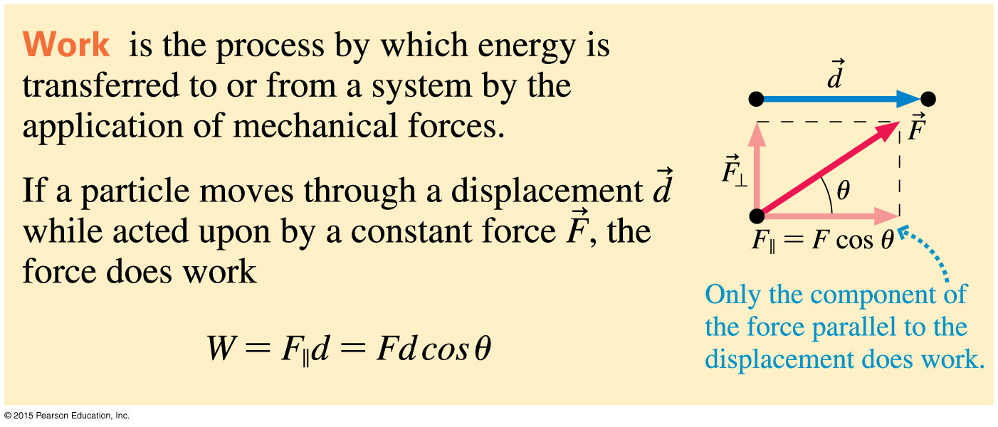
Summary: Important Concepts

Slide 91
Summary: Applications
In the general case where both colliding objects are moving and have a head on collision, we use the equations :
v_{1i}
v_{2i}
v_{1f}
v_{2f}
${ v}_{1f}=\frac{(m_{1}−m_{2})}{(m_{1}+m_{2})}v_{1i}+$ $\frac{(2m_{2})}{(m_{1}+m_{2})}v_{2i}$
${ v}_{2f}=\frac{({2m}_{1})}{(m_{1}+m_{2})}v_{1i}+$ $\frac{(m_{2}−m_{1})}{(m_{1}+m_{2})}v_{2i}$

Slide 92
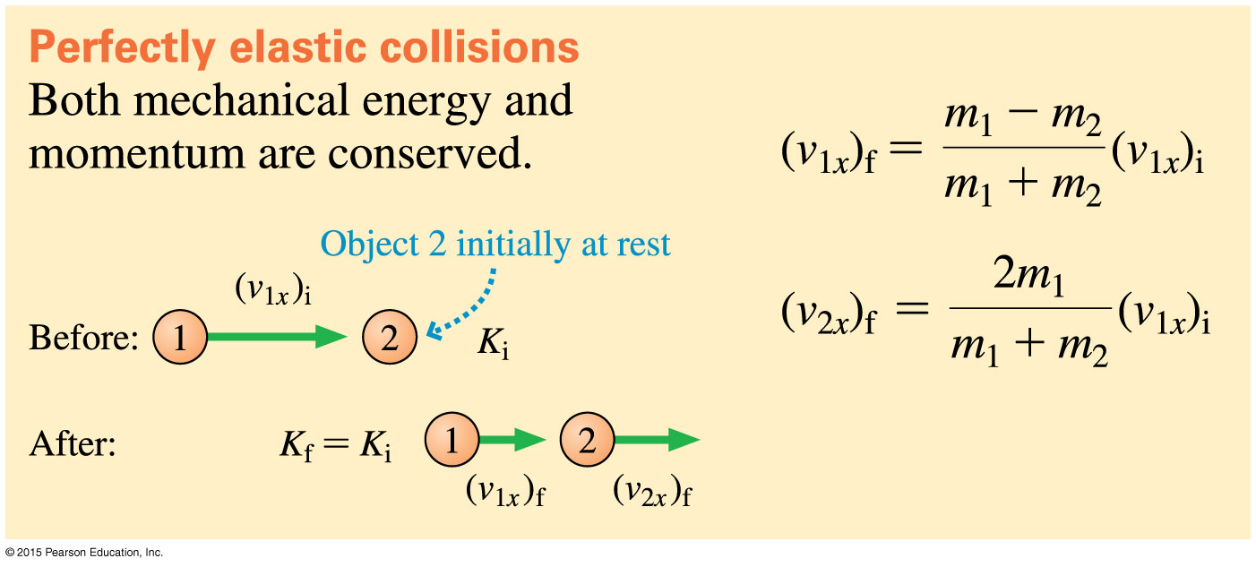
Summary: Applications
The equations for the special case where one of the colliding objects is at rest is given below.

Slide 93
Summary: Applications

Slide 94
Problems on chapter 10

Slide 95
10.2 Work
1) A force is pulling an object in the negative direction. The work must be:
A) positive because the angle between the force and the displacement is zero.
B) negative because the angle between the force and the displacement is 180º.
C) It could be positive or negative, depending on the angle between the force and the displacement.
E) negative because the force is in the negative direction
Answer: C

Slide 96
2) a ball is thrown upward, stops and come back down. The sign of the work by gravity on the ball is:
A) positive both ways.
B) positive going up and negative going down.
C) negative going up and positive going down.
D) negative both ways, force of gravity points downward all the time.
E) Positive both ways
Answer: C

Slide 97
3) A man of mass 20 kg moved from point A to point B to point C in 3 minutes. if point
a is on the ground, point B is 12 m above the ground and point C is 4 m above the ground. The work done by gravity on the man is:
A) 2352.0 J
B) -784.0 J
C) -560.0 J
D) 784.0 J
E) -2352.0 J
Answer: B

Slide 98
4) A mass of 5 kg is given an initial velocity of 20 m/s and left to move in a straight line on a rough surface. If the mass took 10 s to stop then the coefficient of kinetic friction is:
A) 0.2
B) 0.4
C) 0.1
D) 0.15
E) 0.25
Answer: A

Slide 99
10.3 Kinetic Energy
A truck has four times the mass of a car and is moving with twice the speed of the car.
If Kt and Kc refer to the kinetic energies of truck and car respectively,
it is correct to say that
A) Kt = 16Kc.
B) Kt = 4Kc.
C) Kt = 2Kc.
D) Kt = Kc.
E) Kt = Kc/2
Answer: A

Slide 100
2) An engine of a car provides 200 N of force to move the car 100 m. if the mass of the car is 1000 kg, the velocity reached by the car in m/s is:
A) 40
B) 10
C) 2
D) 6.3
E) 20
Answer: D

Slide 101
3) A 1200 kg test car is moving with a kinetic energy of 60 kJ. It is made to crash into a spring and bounced back with 3/4 of its original velocity. The kinetic energy of the car after the crash is:
A) 136 kJ
B) 68 kJ
C) 34 kJ
D) 8 kJ
E) 4.0 J
Answer: C

Slide 102
4) A 5000 kg truck is caught speeding at 100 km/h. If a police car of 1600 kg was gave a chase. The police car kinetic energy on reaching the speed of the truck is:
A) 617 kJ
B) 450 kJ
C) 300 kJ
D) 700 kJ
Answer: A

Slide 103
6.4 Using the Law of Conservation of Energy
1) Two cars of mass M­₁ and M₂ where M_{1 >} M₂ travelling at the same speed and the friction between the road surface and their tiers is the same. Which car would skid longer distance before stopping?
A) Both cars skid the same distance.
B) Car of mass M₁ travel shorter distance.
C) Car of mass M₂ skid longer distance
D) Car of mass M₁ travel longer distance.
E) Car of mass M₂ skid shorter distance
Answer: A

Slide 104
2) Which requires more work, increasing a car's speed from rest to 30 m/s or from 50 m/s to 60 m/s?
A) rest to 30 m/s
B) 50 m/s to 60 m/s
C) It is the same in both cases.
E) it is different in both cases
Answer: B

Slide 105
3) A box is released from rest at the top of 20 m long incline making an angle of 30º with the horizontal. The speed of the box as it reaches the bottom of the ramp, assuming no friction or air resistance, is:
A) 14 m/s
B) 9.9 m/s
C) 196 m/s
D) 98 m/s
Answer: A

Slide 106
4) An adjustable spring toy gun released a ball vertically reaching a maximum height of 6 meters. Neglecting friction, the speed of the ball when released is:
A) 10.9 m/s
B) 117 m/s
C) 19.6 m/s
D) 12 m/s
Answer: A

Slide 107
6.6 Potential Energy
1) Two masses, M and 4M are held at two different heights, 2h and h above the ground respectively. The potential energy of the first mass compared to the second is:
A) one-fourth as much.
B) four times as much.
C) twice as much.
D) one-half as much.
E) the same.
Answer: D

Slide 108
2) two students having the same weight decided to take different path to the top of a building starting from ground. The lazy student took the lift and the athletic student climbed the stairs. The potential energy at the top floor of the building of the lazy student compared to the athletic students is:
A) need the time taken to compare.
B) need the distance travelled by each student.
C) the potential energy of the lazy student is higher because he reached the top floor faster.
D) both students have the same potential energy because potential energy is path independent.
E) the athletic student has higher potential energy because he travelled the longer path.
Answer: D

Slide 109
3) A 2 kg steel ball is dropped from a height of 3 m and hits the ground with a speed of 5 m/s. The average drag force of air on the stone during its journey is:
A) 11.3 N
B) 5.5 N
C) 22.6 kN
D) 33.8 N
E) 16.8 N
Answer: A

Slide 110
4) A 5 kg box started from rest downhill. The hill surface is 10 m long, and the box starting point is 5 m above ground and the energy lost to friction is 155 J. the velocity of the box on reaching the end of the hill is:
A) 12 m/s
B) 3 m/s
C) 6 m/s
D) 9 m/s
Answer: C

Slide 111
6.7 Energy in Collisions
1) Two balls of mass 30 g each collided head on elastically. The first ball’s velocity is 7 m/s and the second is at rest. The net change in the kinetic energy of the two balls before and after the collision is:
A) 1.1 J
B) 7.4 J
C) 14.7 J
D) 0.0 J
Answer: D

Slide 112
2) Two balls of mass 10 g each collided head on elastically. The first ball’s was moving at 5 m/s and the second was moving toward the first at 8 m/s. The net change in the kinetic energy of the two balls before and after the collision is:
A) 0.0 J
B) 2.0 J
C) 3.2 J
D) 1.25 J
Answer: A

Slide 113
3) two cars moving in the same direction, crashed and stuck together after the collision. If the cars have masses of 1000 kg and 1200 kg respectively and were moving at speeds of 20 m/s and 10 m/s with the smaller car behind. The net change in their kinetic energies is:
A) 28 kJ
B) 260.0 kJ
C) -28 kJ
D) -232 kJ
Answer: A

Slide 114
4) A shell of mass 5 kg is fired 50 m/s. The firing tank mass is 3000 kg and its recoiling velocity 50 cm/s. The net change in the kinetic energy of the system is:
A) -6625 J
B) 6250 J
C) 6625 J
D) -375 J
Answer: C

Slide 115
6.8 Power
1) A brick layer does work four times as much as another brick layer but slower who does half of the work of the first brick layer and in twice the time. The power of the first brick layer compared to the second is:
A) the same.
B) one-fourth.
C) one-half.
D) twice.
E) four times.
Answer: E

Slide 116
2) the given unit: kg ∙ m2/s3, is the unit of:
A) kinetic energy
B) potential energy
C) force
D) power
E) work
Answer: D

Slide 117
3) A 1.5 hp motor ran for 30 minutes. If 1 hp = 746 W, then the energy used by the motor is:
A) 4.0 kJ
B) 2.0 MJ
C) 4.5 MJ
D) 2.0 kJ
Answer: B

Slide 118
4) A 750 kg car accelerates from rest to 15 m/s in 12.0 s. The average power given out by the engine is:
A) 6 kJ
B) 112 J
C) 168 kJ
D) 84 kJ
Answer: D

