Slide 1
108 Chem
Chapter 2
Aliphatic Hydrocarbons

Slide 2
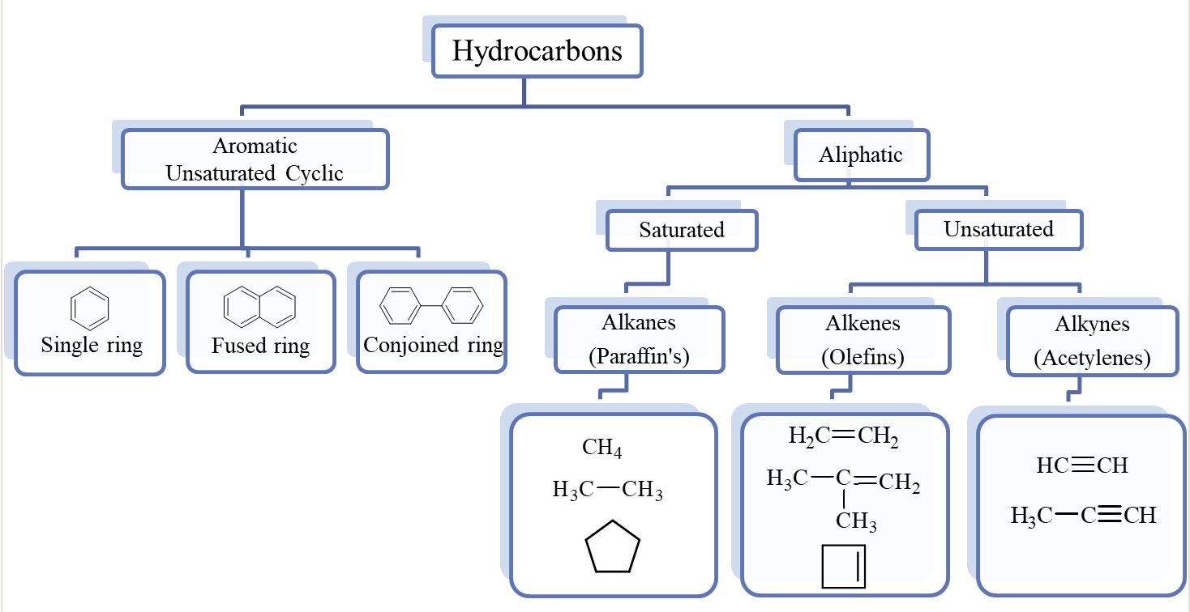
Hydrocarbons
Hydrocarbons are Organic Compounds, which contain only the two elements carbon and hydrogen.
Aliphatic hydrocarbons are subdivided into: Saturated hydrocarbons and Unsaturated hydrocarbons.

Slide 3
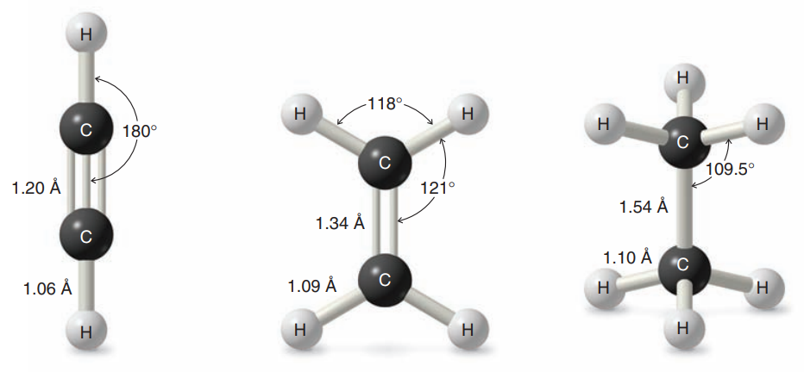
General Molecular Formula of Hydrocarbons
(Homologous Series)
Alkane | C_{n}H_{2n+2} Saturated
Cycloalkane | C_{n}H_{2n} Containing a single ring
Alkene | C_{n}H_{2n} Containing one carbon–carbon double bond
Cycloalkene | C_{n}H_{2n-2} Containing a single ring with one double bond
Alkyne | C_{n}H_{2n-2} Containing one carbon–carbon triple bond
Cycloalkyne | C_{n}H_{2n-4} Containing a single ring with one triple bond

Slide 4
Alkanes
C_{n}H_{2n+2} Saturated
- ane

Slide 5
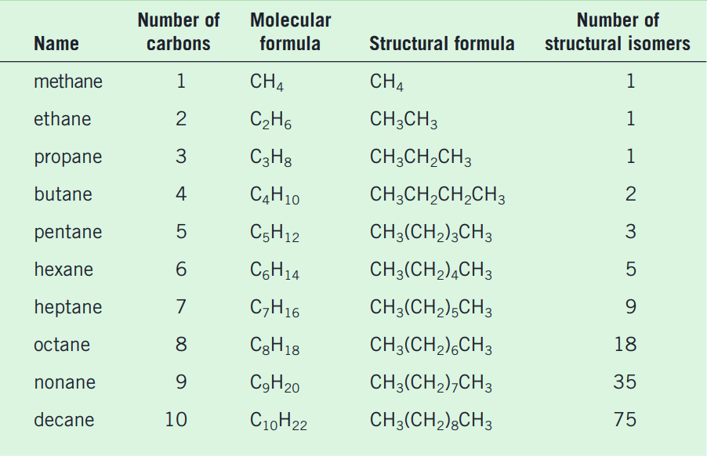
Alkanes
Names and Formulas of the first Ten unbranched Alkanes

Slide 6
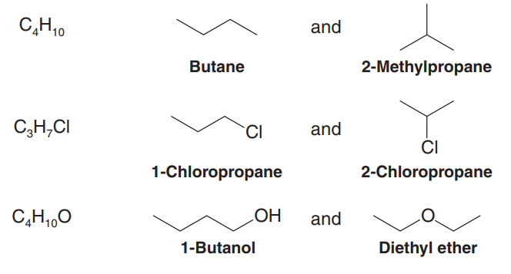
Isomerism
Isomers are molecules with the same number and kinds of atoms but different arrangements of the atoms.
structural ( or constitutional ) isomers have the same molecular formula but different structural formulas.
molecular formula
Structural Isomers

Slide 7
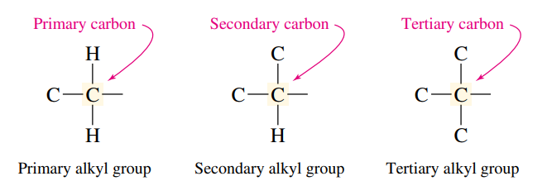
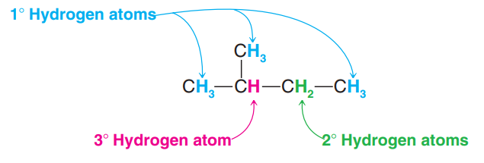
Classification of Carbon and Hydrogen Atoms
The carbon atoms are classified according to their degree of substitution by other carbons.
1º
2º
3º
The hydrogen atoms of an alkane are classified on the basis of the carbon atom to which they are attached. A hydrogen atom attached to a primary carbon atom is a primary (1°) hydrogen atom, and so forth.

Slide 8
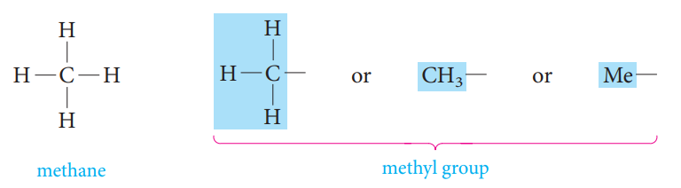
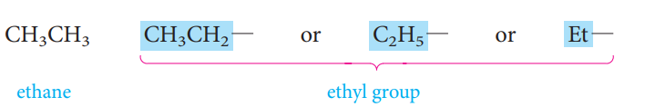
Alkyl Substituents
An alkyl group lacks one of the hydrogen substituents of an alkane.
An alkyl group is named by taking the name of the alkane with the same number of carbon atoms and changing the -ane ending to -yl.
The symbol R is used as a general symbol to represent any alkyl group.

Slide 9
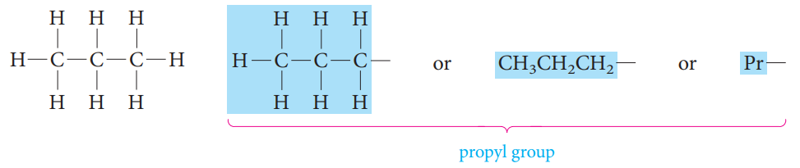
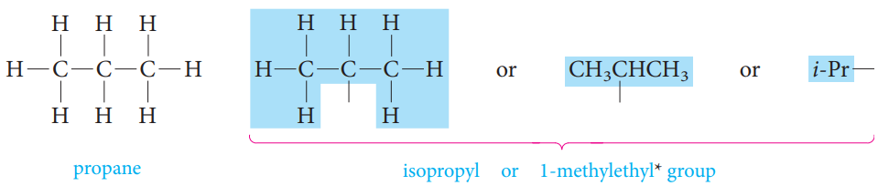
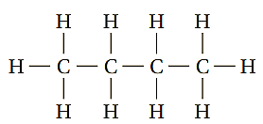
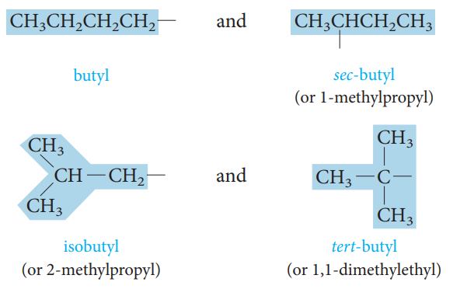
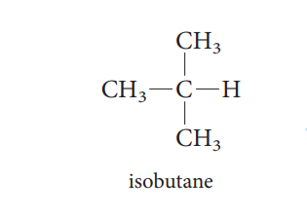

Slide 10


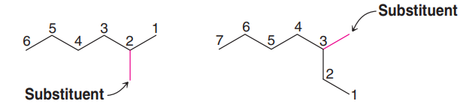
Nomenclature of Organic Compounds
Common or trivial names: The older unsystematic names.
Systematic names: Chemists use a systematic nomenclature developed and updated by the International Union of Pure and Applied Chemistry (IUPAC). Underlying the IUPAC system is a fundamental principle.
IUPAC Rules for Naming Alkanes
1) Locate the longest continuous carbon chain. This gives the name of the parent alkane.
2) Number the longest chain beginning with the end of the chain nearer the substituent.

Slide 11
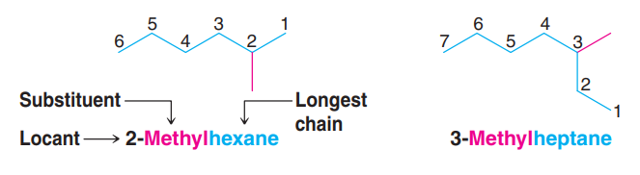
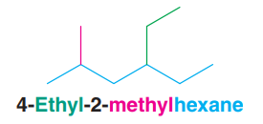
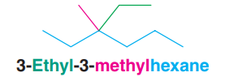
3) Use the numbers obtained by application of rule 2 to designate the location of the substituent group.
4) When two or more substituents are present, give each substituent a number corresponding to its location on the longest chain. The substituent groups should be listed alphabetically (i.e., ethyl before methyl).
5) When two substituents are present on the same carbon atom, use that number twice.

Slide 12
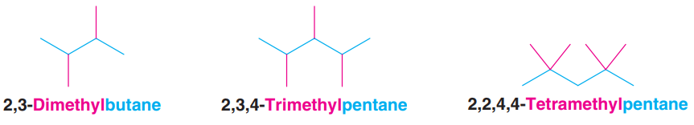
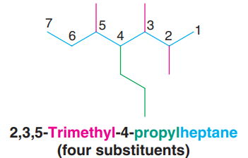
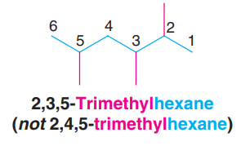
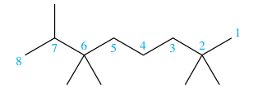
6) When two or more substituents are identical, indicate this by the use the prefixes
di-, tri-, tetra-, and so on.
7) When two chains of equal length compete for selection as the parent chain, choose the chain with the greater number of substituents.
8) When branching first occurs at an equal distance from either end of the longest chain, choose the name that gives the lower number at the first point of difference.
2,2,6,6,7-Pentamethyloctane
(not 2,3,3,7,7-Pentamethyloctane)

Slide 13

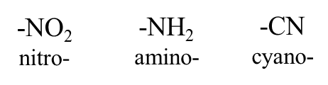

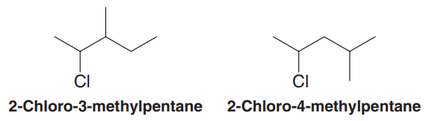
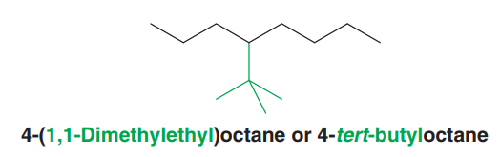
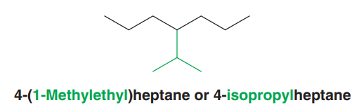
9) If substituents other than alkyl groups are also presents on the parent carbon chain,
all substituents are named alphabetically.

Slide 14
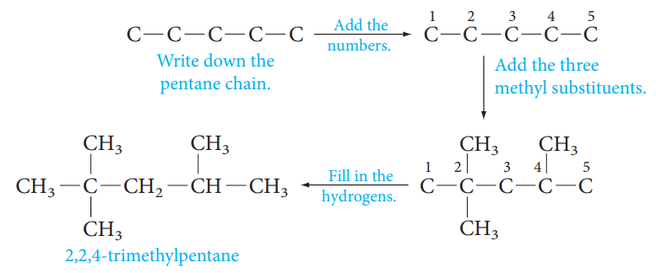
Use of the IUPAC Rules
It is important not only to be able to write a correct IUPAC name for a given structure, but also to do the converse: Write the structure given the IUPAC name.
For example, to write the formula for 2,2,4-trimethylpentane :

Slide 15
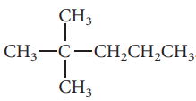
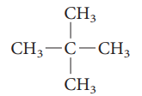








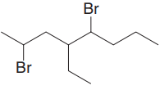

Examples

Slide 16
Physical properties of alkanes
A) Physical States and Solubilities
C₁-C₄
colorless gases
C₅-C₁₇
liquids with characteristic odor
C₂₀ and more
odorless waxy materials
Alkanes are nonpolar compounds. Thus alkanes are soluble in the nonpolar solvents such as carbon tetrachloride (CCl₄) and benzene (C₆H₆), but they are insoluble in polar solvents such as water.

Slide 17
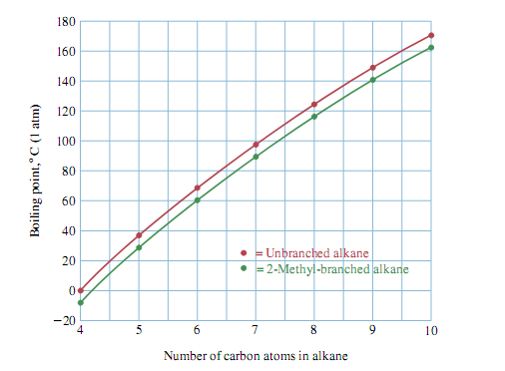
B) Boiling Points
The boiling points of the normal alkanes increase with increasing molecular weight.
Branching of the alkane chain lowers the boiling point.
Example:

Slide 18
Sources of Alkanes and Cycloalkanes
The two most important natural sources of alkanes are petroleum and natural gas.
Petroleum is a complex liquid mixture of organic compounds, many of which are alkanes or cycloalkanes.
Natural gas, often found associated with petroleum deposits, consists mainly of methane (about 80%) and ethane (5% to 10%), with lesser amounts of some higher alkanes. Propane is the major constituent of liquefied petroleum gas (LPG), a domestic fuel used mainly in rural areas and mobile homes. Butane is the gas of choice in some areas. Natural gas is becoming an energy source that can compete with and possibly surpass oil.

Slide 19
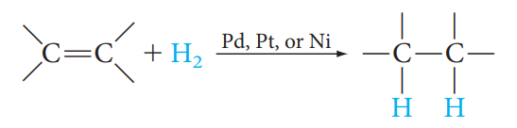
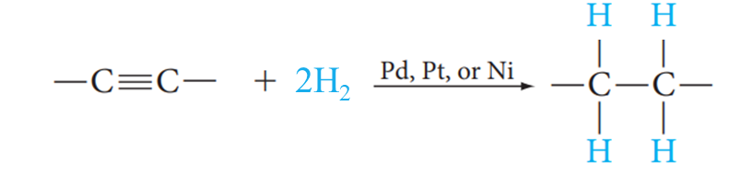
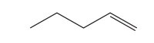

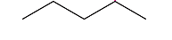

Preparation of alkanes
1) From Alkenes & Alkynes
Catalytic Hydrogenation
Examples
H₂
Pt
1-Pentene
Pentane
2H₂
Pt
1-Pentyne
Pentane

Slide 20
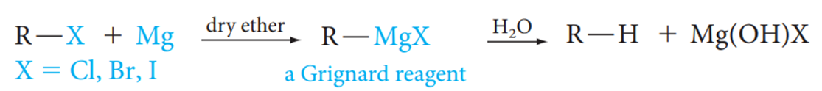
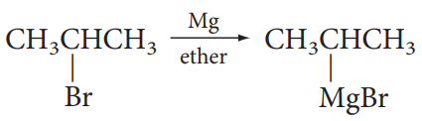


2) Hydrolysis of Grignard Reagent
2-Bromopropane
Propane

Slide 21
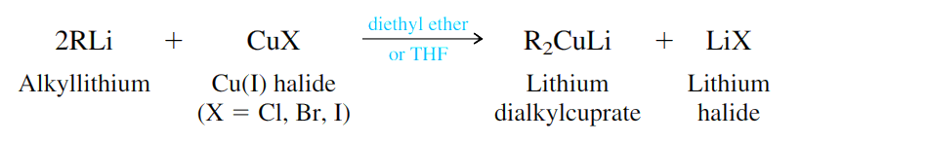
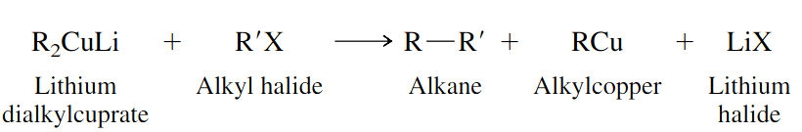
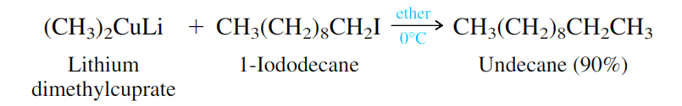
3) The Corey–Posner, Whitesides–House Reaction
Use of Lithium Dialkyl Cuprate (Gilman Reagent) in Coupling Reaction

Slide 22

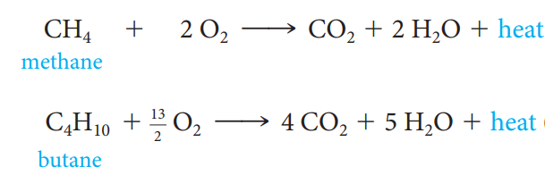
Reactions of alkanes
1) Oxidation and Combustion; Alkanes as Fuels

Slide 23




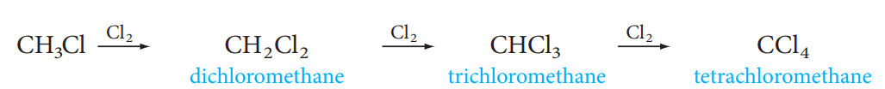
2) Halogenation
Chlorination or Bromination of hydrocarbons is a substitution reaction in which a chlorine or bromine atom is substituted for a hydrogen atom.
Free-radical reaction
If excess halogen is present:

Slide 24

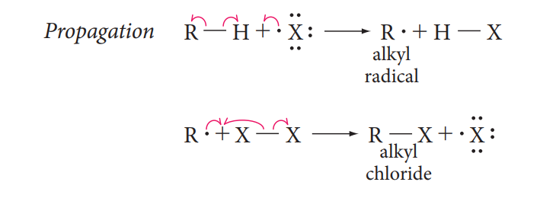
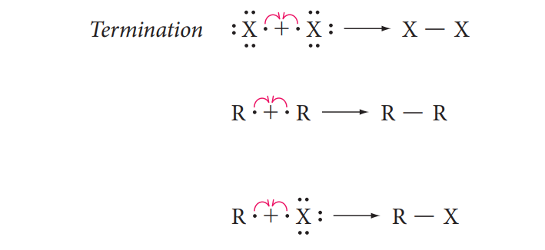
The Free-Radical Chain Mechanism of Halogenation
A reaction mechanism is a step-by-step description of the bond-breaking and bond-making processes that occur when reagents react to form products.
A free-radical chain reaction includes a chain-initiating step, chain-propagating steps, and chain-terminating steps.
(Homolysis of a halogen molecule)

Slide 25
Alkenes
C_{n}H_{2n} Crabon-Carbon double bond
- ene

Slide 26
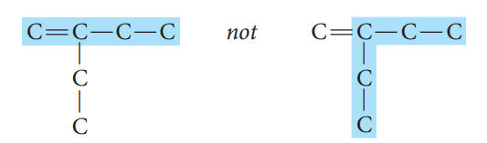
Alkenes
Nomenclature of Alkenes
The IUPAC rules for naming alkenes are similar to those for alkanes, but a few rules must be added for naming and locating the multiple bonds.
  The ending -ene is used to designate a carbon–carbon double bond. When more than one double bond is present, the ending is -diene, -triene, and so on.
  Select the longest chain that includes both carbons of the double.

Slide 27

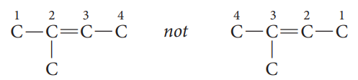


Number the chain from the end nearest the double bond so that the carbon atoms in that bond have the lowest possible numbers.
If the double bond is equidistant from both ends of the chain, number the chain from the end nearest the first branch point.
Indicate the position of the double bond using the lower numbered carbon atom of that bond.
If more than one double bond is present, number the chain from the end nearest the first double bond.

Slide 28




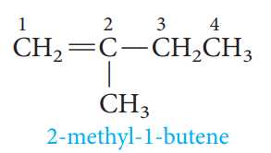
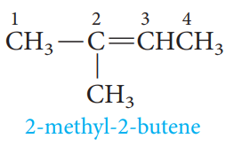
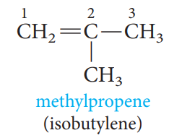
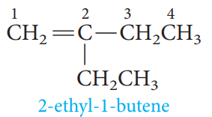
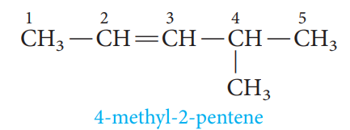
Examples

Slide 29






Common names
The simplest members of the alkene series are frequently referred to by their older common names, ethylene and propylene.
Two important groups also have common names. They are the vinyl and allyl groups, these groups are used in common names.

Slide 30


Cycloalkenes
C_{n}H_{2n-2}
Cycloalkenes are unsaturated hydrocarbons that have at least one ring of carbon atoms.
Nomenclature of Cycloalkenes
In cycloalkenes, the double is always found between carbon 1 and carbon 2. It is therefore not necessary to specify the position of the double bond with a number. If substituents are present, the ring must numbered, starting from the double bond, in the direction that gives the substituents the lowest number(s).

Slide 31
Physical properties of alkenes
Physical States and Solubilities
C₁-C₄
gases
C₅-C₁₈
liquids
More than C₁₈
solids
Alkenes are nonpolar compounds. Thus alkenes are soluble in the nonpolar solvents such as carbon tetrachloride (CCl₄) and benzene (C₆H₆), but they are insoluble in polar solvents such as water.

Slide 32
Geometric Isomerism in Alkene
Because rotation at carbon–carbon double bonds is restricted, geometric isomerism is possible in appropriately substituted alkenes.
The cis-trans system
cis (two similar groups are on the same side)
trans (two similar groups are on the opposite sides)

Slide 33






The E-Z System
Z : Zusammen
(two groups of higher priority are on the same side)
E : Entgegen
(two groups of higher priority are on the opposite sides)
Higher atomic number gets higher priority.
I > Br > Cl > S > P > F > O > N > C > H

Slide 34





Examples

Slide 35




Preparation of alkenes
Alkenes are prepared from alcohols and alkyl halides by Elimination Reactions.
1- Dehydration of Alcohols
Examples:
Primary Alcohol
Secondary Alcohol
Tertiary Alcohol

Slide 36



Regioselectivity in Dehydration of Alcohols: Zaitsev’s Rule
Zaitsev’s Rule:
Hydrogen is preferably removed from the carbon with least no. of hydrogen since the alkene formed is more highly branched and is energetically more stable.
The reaction proceeds via a carbocation intermediate, the stabilities of carbocations and the ease of dehydration of alcohols follows the order 3° > 2° > 1°.
R₂C=CR₂ > R₂C=CHR > R₂C=CH₂, RCH=CHR > RCH=CH₂ > CH₂=CH₂
major

Slide 37



2- Dehydrohaloganation of Alkyl halides
Examples:
Zaitsev’s Rule
major

Slide 38




Reaction of alkenes
Electrophilic Addition reactions on the carbon-carbon double bond.
1- Addition of Hydrogen: Catalytic Hydrogenation

Slide 39



2- Addition of Halogens: Halogenation

Slide 40




3- Addition of Acids:
Acids that add in this way are the hydrogen halides (H-F, H-Cl, H-Br, H-I).

Slide 41




Addition of Unsymmetric Reagents to Unsymmetric Alkenes; Markovnikov’s Rule
When an unsymmetric reagent adds to an unsymmetric alkene, the electropositive part of the reagent adds to the carbon of the double bond that has the greater number of hydrogen substituents .

Slide 42




4- Addition of Water : Hydration
Markovnikov’s Rule

Slide 43




Reaction of alkenes
Oxidation of alkenes to Diols or Carbonyl-Containing Compounds.
1- Oxidation of alkenes with Permanganate
syn hydroxylation
OH⁻
H₂O, cold

Slide 44




2- Ozonolysis:
Oxidation of alkenes by ozone O₃

Slide 45
Alkynes
C_{n}H_{2n-2} Crabon-Carbon Trible bond
- yne

Slide 46



Alkynes
Nomenclature of Alkynes
IUPAC Names:
ane
yne
2,5-dimethyl-3-heptyne
5-Methyl-4-hexen-1-yne
4-Methyl-1-hexen-5-yne

Slide 47


Physical Properties
C₁-C₄ gases
C₅-C₁₈ liquid
More than C₁₈ soilds
Acidity of Terminal Alkynes
A hydrogen atom on a triply bonded carbon is weakly acidic and can be removed by a very strong base. Sodium amide, for example, converts acetylenes to acetylides.

Slide 48




  Preparation of Alkynes
1- Dehydrohalogenation of Alkyl Dihalide
Examples:

Slide 49




2- Alkylation of Acetylene and Terminal Acetylene
By attaching alkyl groups to acetylene, more complex alkynes can be prepared.
By treating the sodium alkynide with a primary alkyl halide.
Examples:

Slide 50



Reactions of Alkynes
1- Addition of Hydrogen: Hydrogenation

Slide 51



Hydrogenation of an alkyne to an alkene can be accomplished through the use of special catalysts or reagents. Moreover, these special methods allow the preparation of either (E)- or (Z)-alkenes from disubstituted alkynes.
Examples:

Slide 52




    2- Addition of Halogen: Halogenation
3- Addition of Hydrogen Halide: Hydrohalogenation
Markovnikov addition

Slide 53


    4- Addition of Water : Hydration
Addition of water to alkynes requires not only an acid catalyst but mercuric ion as well.
Markovnikov addition

