Slide 1
Arrays in Classes And Methods
Ch 7.2

Slide 2
Arrays in Classes and Methods: Outline
Common operations: printing, average, etc
Arrays of Strings
Case Study: Sales Report
Indexed Variables as Method Arguments
Entire Arrays as Arguments to a Method
Arguments for the Method main
Array Assignment and Equality
Methods that Return Arrays

Slide 3
Printing an array
Consider an array list:
int list[ ] = new int[5];
list[0] = 50;
list[3] = 70;
What happens if we print the array name ?
  System.out.print(list + " ");
How do we print the whole array?
  for(int i = 0; i<list.length; i++)
  System.out.println(list[i]);
Notes:
It prints something that looks unreadable, most likely it is the type and an @address, but it is not of much use to you.

Slide 4
Common operations
int sales[]={12, 32, 4, 55, 1, 23, 17, 30};
Sum and average
int sum = 0; double average = 0.0;
for (int index = 0; index < sales.length; index++)
sum = sum + sales[index];
if (sales.length != 0)
average = sum / sales.length;
Finding index of largest number
maxIndex = 0;
for (int index = 1; index < sales.length; index++)
if (sales[maxIndex] < sales[index])
maxIndex = index;
int largestSale = sales[maxIndex];
Notes:
Trace find largest number

Slide 5
Common operations
int sales[]={12, 32, 4, 55, 1, 23, 17, 30};
Searching for a specific value
int searchItem = 10; // what if searchItem = 4 ?
int loc = 0;
boolean found = false;
while (loc < sales.length && !found)
if (sales[loc] == searchItem)
found = true;
else
loc++;
if (found)
System.out.print(loc);
else
System.out.print(“not found”);
Notes:
trace for 10, and trace for 4

Slide 6
ARRAY OF Strings
1
2
3
4
5
6
7
String[] names = new String [5]; //declaration
//Fill in the array
names[0] = “Sarah Fahd”;
names[1] = “Rund Al-Otaibi”;
names[2] = “Asmaa Mubarak”;
names[3] = “Reem Al-Otaibi”;
names[4] = “Hind Al-Tamimi”;
The first statement declares an array names of size 5.
Each element of names is a String.
Remember that a String stores an address rather than a value.
Naturally, all String methods that we previously studied can be applied on EACH element of the String array.

Slide 7
ARRAY OF Strings
Therefore, after the execution of the previous code segment, each array element contains an address that points to (refers to) the corresponding String.
The memory layout will be as follows:
Adrs1
names
names[0] | names[1] | names[2] | names[3] | names[4]
Adrs of Str0 | Adrs of Str1 | Adrs of Str2 | Adrs of Str3 | Adrs of Str4
Sarah Fahd
Rund Al-Otaibi
Asmaa Mubarak
Reem Al-Otaibi
Shahd Al-Sheweiry

Slide 8
ARRAY OF Strings
String methods may be applied on each element of the String array.
The following code segment applies a few methods on each String of the array names:
1
…
7
8
9
10
11
12
13
14
15
16
17
18
String[] names = new String [5]; //declaration
//Fill in the array
names[4] = “Hind Al-Tamimi”;
for (index = 0; index < names.length; index++)
{
System.out.println (names[index]);
System.out.println (names[index].length());
System.out.println (names[index].substring(0, 5));
System.out.println (names[index].toUpperCase());
}

Slide 9
ARRAY OF Strings
String methods may be applied on each element of the String array.
The following code segment applies a few methods on each String of the array names:
1
…
7
8
9
10
11
12
13
14
15
16
17
18
String[] names = new String [5]; //declaration
//Fill in the array
names[4] = “Hind Al-Tamimi”;
for (index = 0; index < names.length; index++)
{
// print the stored names
System.out.println (names[index]);
// print the length of each name
System.out.println (names[index].length());
//extracts the first four letters
System.out.println (names[index].substring(0, 5));
// converts the string into upper case
System.out.println (names[index].toUpperCase());
}

Slide 10
Case Study: Sales Report
Program to generate a sales report
Class will contain
  Name
  Sales figure
View class declaration, listing 7.3
class SalesAssociate

Slide 11
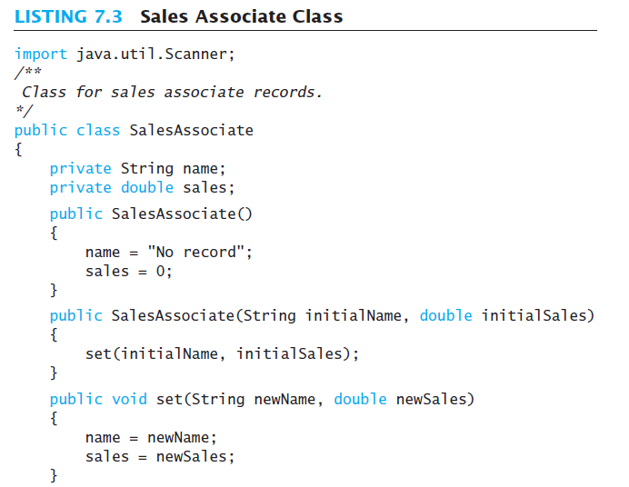

Slide 12
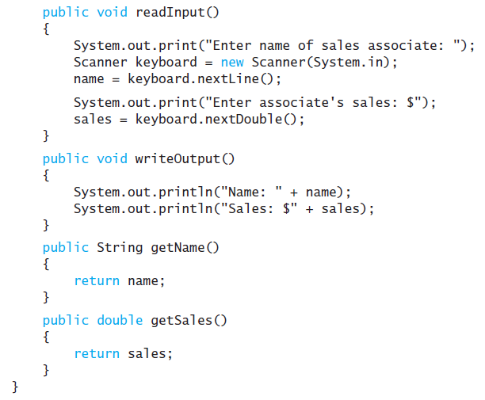

Slide 13
Case Study: Sales Report
Main subtasks for our program
Get ready
Obtain the data
Compute some statistics (update instance variables)
Display the results

Slide 14
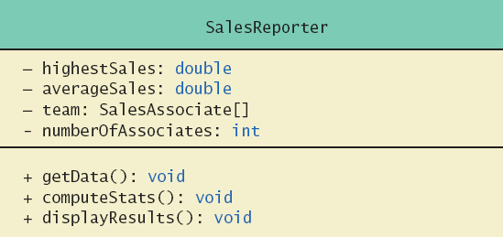
Case Study: Sales Report
Figure 7.3 Class diagram for class SalesReporter

Slide 15
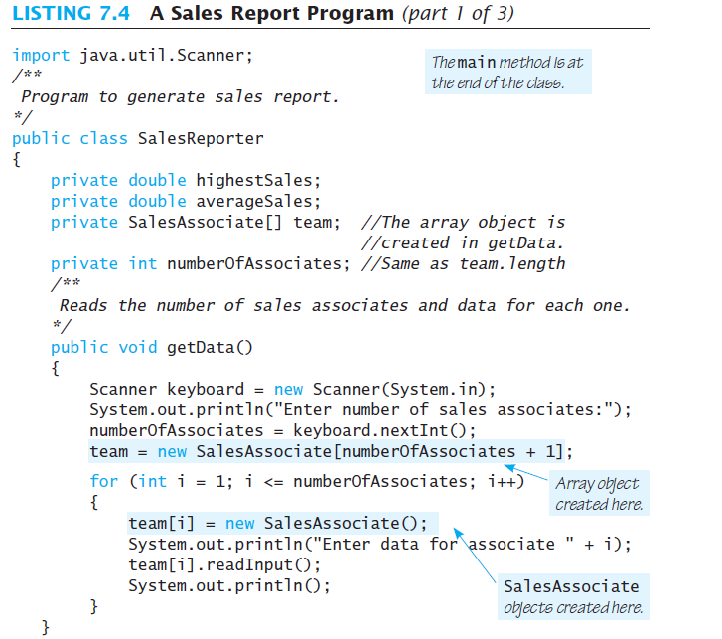

Slide 16
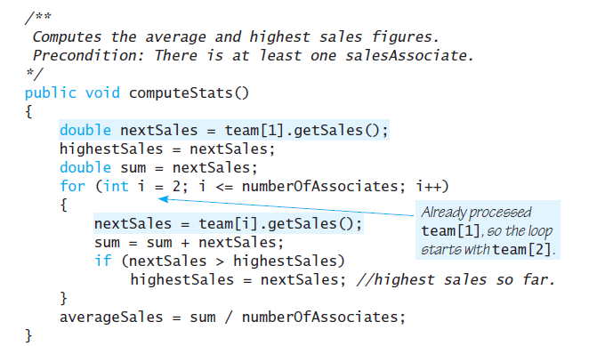

Slide 17
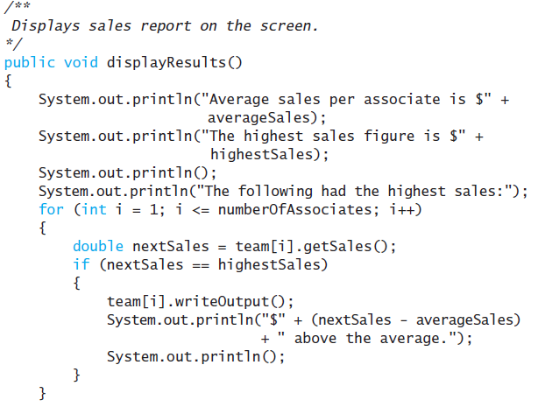

Slide 18
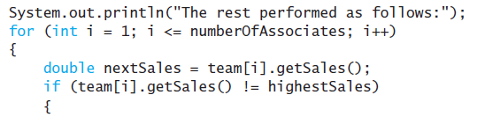
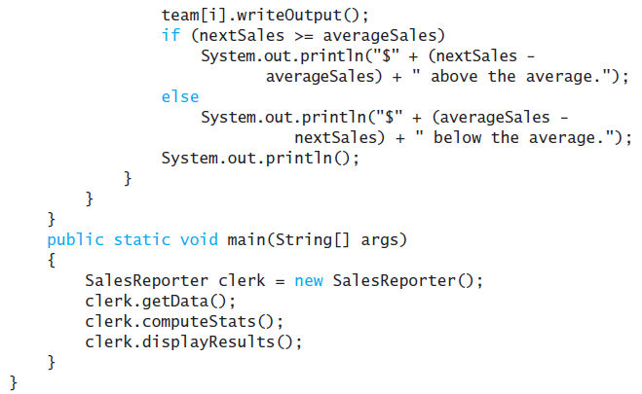

Slide 20
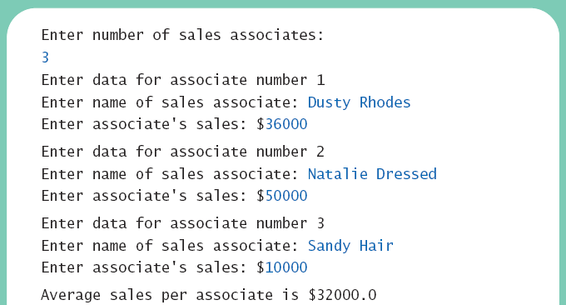
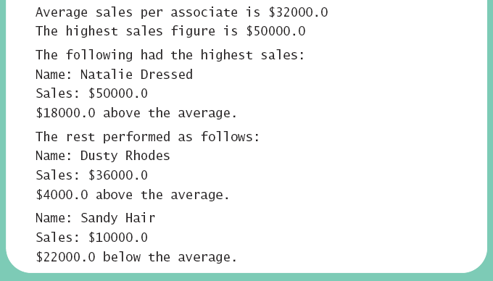
Case Study: Sales Report
View sales report program, listing 7.4
class SalesReporter
Sample
screen output

Slide 21
Indexed Variables as Method Arguments
Indexed variable of an array
  Example … a[i]
  Can be used anywhere a variable of the array base type can be used
View program using indexed variable as an argument, listing 7.5
class ArgumentDemo

Slide 22
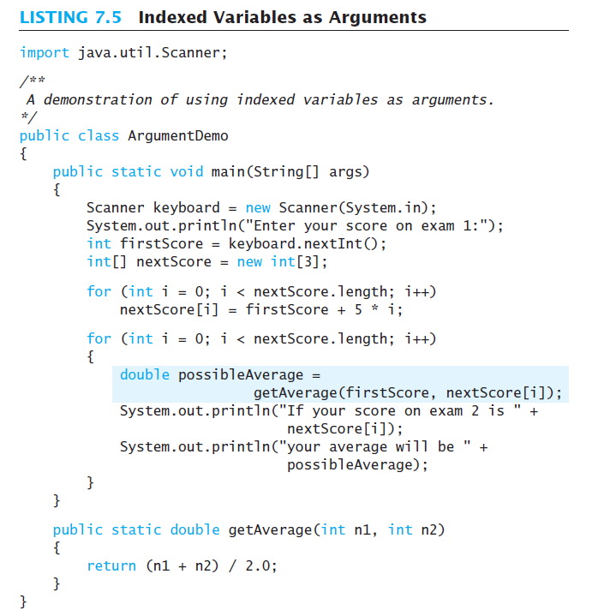

Slide 23
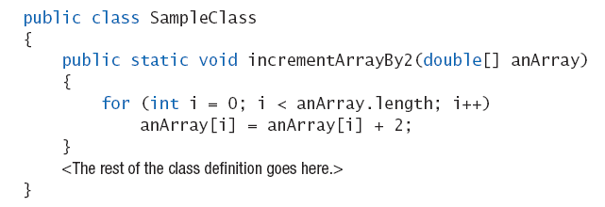
Entire Arrays as Arguments
Declaration of array parameter similar to how an array is declared
Example:

Slide 24
Entire Arrays as Arguments
Note – array parameter in a method heading does not specify the length
  An array of any length can be passed to the method
  Inside the method, elements of the array can be changed
When you pass the entire array, do not use square brackets in the actual parameter
  For example:
  double[] myArray = {1,2,3};
  incrementArrayBy2(myArray);

Slide 25
Array Assignment and Equality
Arrays are objects
  Assignment and equality operators behave (misbehave) as specified in previous chapter
Variable for the array object contains memory address of the object
  Assignment operator = copies this address
  Equality operator == tests whether two arrays are stored in same place in memory

Slide 26
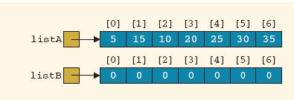
Assinging vs. Copying Arrays of same size
Consider two arrays: listA and listB as shown
Assume we want to make the content of listB a copy of listA
Therefore, we wrote the following:
listB = listA;
Will that work correctly?
No, because it only assigns the address of listA to listB

Slide 27
Copying Arrays of same size
This is the correct way to copy the contents:

Slide 28
EQUALITY OF TWO ARRAYS
Two arrays are considered equal if:
  They have the same size, and
  All corresponding elements in both arrays are equal.
Adrs1
listA
listA[0] | listA[1] | listA[2] | listA[3] | listA[4] | listA[5] | listA[6]
5 | 10 | 15 | 20 | 25 | 30 | 35
Adrs2
listB
listB[0] | listB[1] | listB[2] | listB[3] | listB[4] | listB[5] | listB[6]
5 | 25 | 15 | 20 | 10 | 30 | 35
Adrs3
listC
listC[0] | listC[1] | listC[2] | listC[3] | listC[4] | listC[5] | listC[6]
5 | 10 | 15 | 20 | 0 | 0 | 0
Adrs4
listD
listD[0] | listD[1] | listD[2] | listD[3] | listD[4]
5 | 10 | 15 | 20 | 0
Notes:
In this example none of the arrays are equal ;-)
listA has same length and same elements as listB, BUT the order of them is NOT the same
listC has the same elements in the same order as listD, but list C has more elements. Even though the additional elements are all zeros, we still do NOT consider the two arrays as equal.

Slide 29

Array Assignment and Equality
Two kinds of equality
View example program, listing 7.6
class TestEquals
Sample
screen output

Slide 30
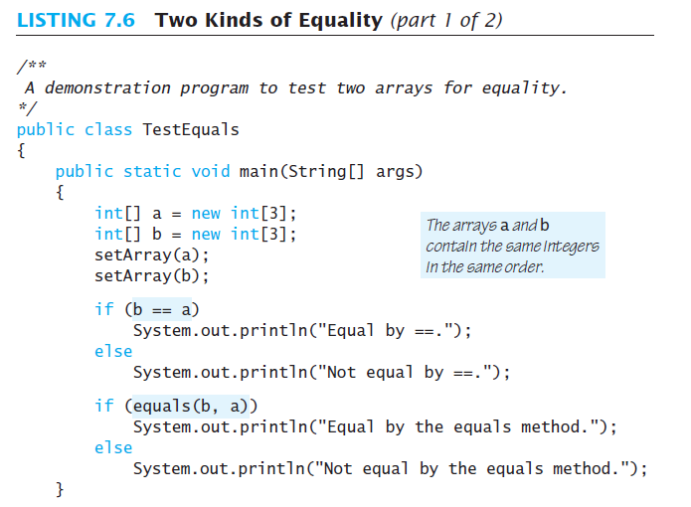
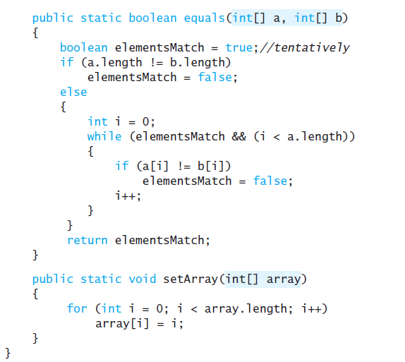


Slide 31
Array Assignment and Equality
Note results of ==
Note definition and use of method equals
  Receives two array parameters
  Checks length and each individual pair of array elements
Remember array types are reference types

Slide 32
Gotcha – Don’t Exceed Array Bounds
The code below fails if the user enters a number like 4. Use input validation.
Scanner kbd = new Scanner(System.in);
int[] count = {0,0,0,0};
System.out.println("Enter ten numbers between 0 and 3.");
for (int i = 0; i < 10; i++)
{
int num = kbd.nextInt();
count[num]++;
}
for (int i = 0; i < count.length; i++)
System.out.println("You entered " + count[i] + " " + i + "'s");

Slide 33
Gotcha – Creating an Array of Objects
When you create an array of objects Java does not create instances of any of the objects!
For example, consider the code:
SalesAssociate[] team = new SalesAssociate[10];
System.out.println(team[0].getName()); // ERROR - why?
  We can NOT access team[0] yet; it is null.
  First we must create references to an object:
team[0] = new SalesAssociate("Jane Doe", 5000);
team[1] = new SalesAssociate("John Doe", 5000);
  we can now access team[0].getName() or team[1].getSalary()
System.out.println(team[0].getName()); // OK - why?
System.out.println(team[1].getSalary()); // OK - why?
System.out.println(team[7].getSalary()); // ERROR - why?

Slide 34
Self-Check Exercises
Write a complete program:
  That searches in an array X for all the elements that are multiples of 7 or multiples of 3
  X is of type integer, and size 100.
  The subscripts of the target elements are to be stored in another array Y of the same size.
  The array X is filled by the user.
  The array Y is initialized to -1.

Slide 35
Methods that Return Arrays
A Java method may return an array
View example program, listing 7.7
class ReturnArrayDemo
Note definition of return type as an array
To return the array value
  Declare a local array
  Use that identifier in the return statement

Slide 36
