Slide 1
Array Basics
Ch7.1

Slide 2
Array Basics: Outline
Creating and Accessing Arrays
Array Details
The Instance Variable length
More About Array Indices
Initializing Arrays

Slide 3

Creating and Accessing Arrays
An array is a special kind of object
Think of as collection of variables of same type that are stored in adjacent memory locations.
Creating an array with 7 variables of type double
To access an element use
  The name of the array
  An index number enclosed in square brackets
Array indices begin at zero

Slide 4
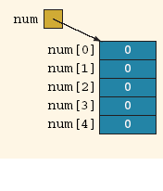
Array declaration - example
Declaring the array num :
int[] num = new int[5];
^{When an array is instantiated,} Java automatically initializes its elements to their default values.
numeric arrays are initialized to 0,
char arrays are initialized to the null character, which is '\u0000',
boolean arrays are initialized to false.
To save space, we also draw an array, as shown in Figures ^{(a) and b).}

Slide 5
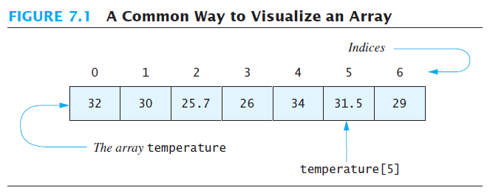
Creating and Accessing Arrays
Note sample program, listing 7.1
class ArrayOfTemperatures

Slide 6
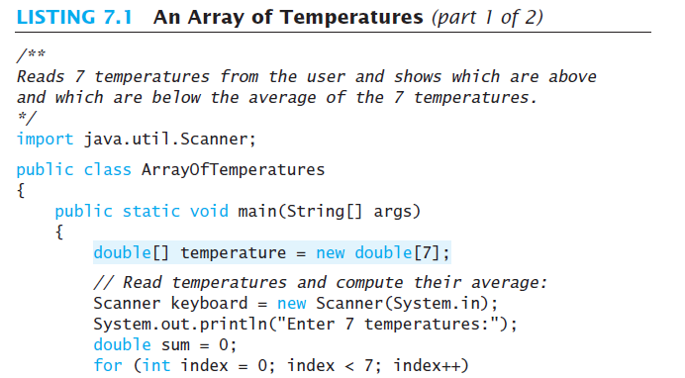
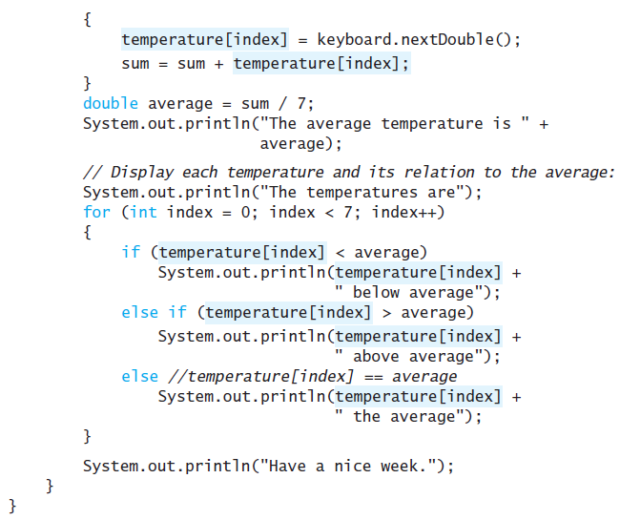

Slide 7
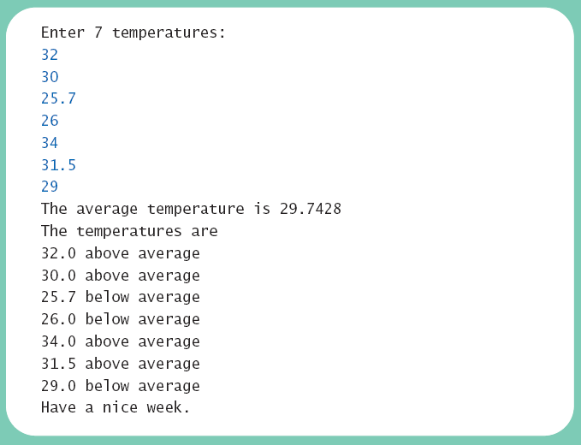
Creating and Accessing Arrays
Sample
screen output

Slide 8

Array Details
Syntax for declaring an array with new
The number of elements in an array is its length
The type of the array elements is the array's base type

Slide 9
Square Brackets [ ] with Arrays
They are used as follows:
  With a data type when declaring an array
  int [ ] pressure;
  To enclose an integer expression to declare the length of the array
  pressure = new int [100];
  To name an indexed value of the array
  pressure[3] = keyboard.nextInt();

Slide 10
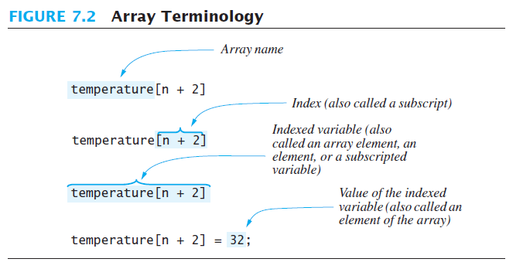
Array Details

Slide 11


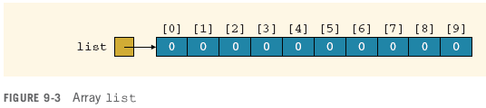

ACCESSING ARRAY ELEMENTS

Slide 12
ACCESSING ARRAY ELEMENTS - Example
Consider the following declarations and their reflection in the memory:
1
double[] list = new double[10];
 | list[0] | list[1] | list[2] | list[3] | list[4] | list[5] | list[6] | list[7] | list[8] | list[9]
list→ | 0.0 | 0.0 | 0.0 | 0.0 | 0.0 | 0.0 | 0.0 | 0.0 | 0.0 | 0.0
2
3
int i = 2;
list[2*i-1] = 46.0; // list[??] = 46.0
 | list[0] | list[1] | list[2] | list[3] | list[4] | list[5] | list[6] | list[7] | list[8] | list[9]
list→ | 0.0 | 0.0 | 0.0 | 46.0 | 0.0 | 0.0 | 0.0 | 0.0 | 0.0 | 0.0
4
list[2*i+1] = 20.0; // list[??] = 20.0
 | list[0] | list[1] | list[2] | list[3] | list[4] | list[5] | list[6] | list[7] | list[8] | list[9]
list→ | 0.0 | 0.0 | 0.0 | 46.0 | 0.0 | 20.0 | 0.0 | 0.0 | 0.0 | 0.0
5
list[7] = list[3] + list[5]; // list[7] = 46.0 + 20.0 = 66.0
 | list[0] | list[1] | list[2] | list[3] | list[4] | list[5] | list[6] | list[7] | list[8] | list[9]
list→ | 0.0 | 0.0 | 0.0 | 46.0 | 0.0 | 20.0 | 0.0 | 66.0 | 0.0 | 0.0

Slide 13
ACCESSING ARRAY ELEMENTS - Example
5
list[7] = list[3] + list[5]; //list[7] = 46.0 + 20.0 = 66.0
 | list[0] | list[1] | list[2] | list[3] | list[4] | list[5] | list[6] | list[7] | list[8] | list[9]
list→ | 0.0 | 0.0 | 0.0 | 46.0 | 0.0 | 20.0 | 0.0 | 66.0 | 0.0 | 0.0
Note the difference to the following statements:
6
list[7] = list[3 + 5]; // list[7] = ??
 | list[0] | list[1] | list[2] | list[3] | list[4] | list[5] | list[6] | list[7] | list[8] | list[9]
list→ | 0.0 | 0.0 | 0.0 | 46.0 | 0.0 | 20.0 | 0.0 | 0.0 | 0.0 | 0.0
7
list[3+5] = list[3] + list[5]; // list[??] = ?? + ??
 | list[0] | list[1] | list[2] | list[3] | list[4] | list[5] | list[6] | list[7] | list[8] | list[9]
list→ | 0.0 | 0.0 | 0.0 | 46.0 | 0.0 | 20.0 | 0.0 | 0.0 | 66.0 | 0.0

Slide 14
Question
consider this array:
int list[ ] = new int[10];
list[ list[2] ] = 77;
list [1] = list[ 7] * list[7];
list [0] = list[ list[8] -1 ];
 | list[0] | list[1] | list[2] | list[3] | list[4] | list[5] | list[6] | list[7] | list[8] | list[9]
list→ | 5 | 7 | 3 | 0 | 9 | 10 | 2 | 3 | 6 | 1

Slide 15
The Instance Variable length
As an object an array has only one public instance variable
  Variable length
  Contains the size of the array: the max number of elements the array can hold
  It is final, value cannot be changed
Note revised code, listing 7.2
class ArrayOfTemperatures2
Notes:
Point out that it is NOT a method. That is why you don’t use ( ) at the end of it.
In Strings we have a METHOD called length()

Slide 16
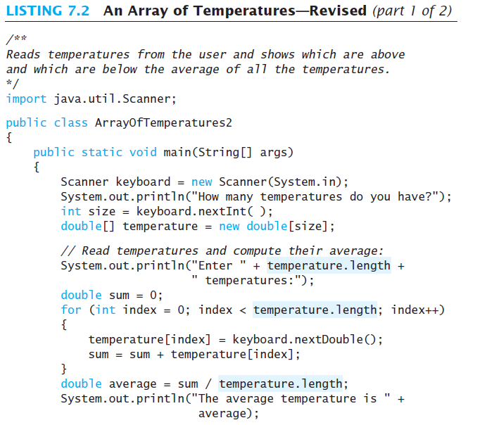
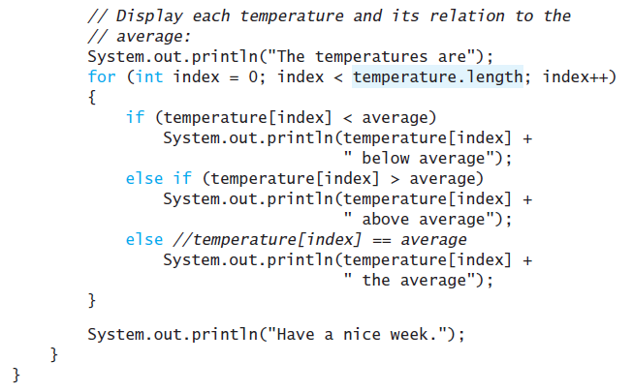

Slide 17
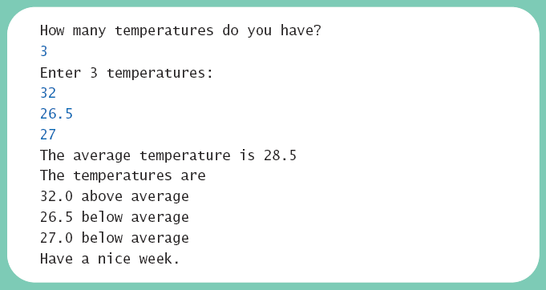
The Instance Variable length
Sample
screen output

Slide 18
More About Array Indices
Index of first array element is 0
Last valid Index is arrayName.length – 1
Array indices must be within bounds to be valid
  When program tries to access outside bounds, run time error occurs
OK to "waste" element 0
  Program easier to manage and understand
  Yet, get used to using index 0

Slide 19
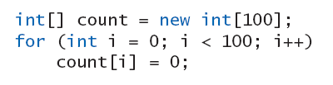
Initializing Arrays
Possible to initialize at declaration time
Also may use normal assignment statements
  One at a time
  In a loop

Slide 20
Initializing Arrays
It is a common practice for a program to keep track of the number of filled elements in an array
Simply store it in a variable, say numOfElements
Then numOfElements will tell you the actual number of elements in the array.
For example:
int numOfElements = 0;
numList[0] = 5;
numList[1] = 10;
numList[2] = 15;
numList[3] = 20;
numOfElements = 4;
System.out.print(numOfElements);
How about this instead?
int numOfElements = 0;
numList[numOfElements++] = 5;
numList[numOfElements++] = 10;
numList[numOfElements++] = 15;
numList[numOfElements++] = 20;
System.out.print(numOfElements);

Slide 21
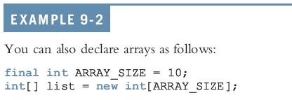
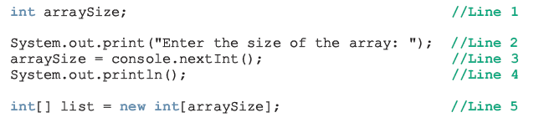
Recap: Specifying array size
Array size can be specified using a constant
Array size can be specified during program execution time

Slide 22
Recap: Specifying array size
Array size can be specified during array declaration with initialization:
The initializer list contains values, called initial values, that are placed between braces and separated by commas
The size of the array will be equal to the number of values.
In this example: sales.length will be equal to 5
sales would be initialized as follows:
sales[0]= 12.25, sales[1]= 32.50, sales[2]= 16.90,
sales[3]= 23.00, and sales[4]= 45.68
Note: If an array is declared and initialized simultaneously, we don’t use the operator new to instantiate the array object

Slide 23
Note on Array Declaration
What is the difference between the following declarations?
int alpha[], beta;
int[ ] gamma, delta;
Notes:
alpha is an array of integers
beta is an integer
gamma and delta are both arrays of integers (like alpha)

Slide 24
Remember
The size of the array specified during instantiation cannot be changed.
Sometimes, the programmer does not know how many elements will be needed.
Therefore, it is common to specify a large size and use only the elements which were actually filled by the user.
Assume that numOfElements is a variable that represents the number of actually filled elements within the array (numOfElements <= length)
The value of numOfElements is used as a counter: it is initialized to zero, and then incremented with each new element filled in the array.

