Slide 1
Public Health Education
Osama A Samarkandi, PhD, RN
EMS 313; Public Health for EMS Professionals

Slide 2
Public Health Education
“A process that informs, motivates & helps people to adopt & maintain healthy practices & lifestyles”
National Conference on Preventive Medicine 1977, USA
Knowledge
Triad
Practice
Attitude

Slide 3
Importance of Health Education
Giving patients handouts about tetanus increased the rate of immunization against tetanus among adults threefold.
(Cates CJ, BMJ, 1990; 300 (6727):789-90)
An educational booklet on back pain for patients reduced the number of consultations made by patients over the following year & 84% said that they found it useful.
(Ronald M, Dixon M, JR Coll GP, 1989; 39(323):244-6)

Slide 4
Aims of Public Health Education
To ensure that health is valued as an asset in the community
To equip the people with skills, knowledge & attitudes to enable them solve their health problems by their own actions & efforts
To promote the development & proper use of health services

Slide 5
Objectives of Health Education (1 of 3)
Impart knowledge, this will:
Clear the barriers of ignorance, prejudice & misconceptions
Lead to assuming more responsibility towards one’s health care
Induce awareness about health needs, minimizing the gap between needs & demands

Slide 6
Objectives of Health Education (2 of 3)
Motivating people:
The emphasis should be on motivating the consumer to choose his own alternatives about the health actions

Slide 7
Objectives of Health Education (3 of 3)
3. Guiding into action:
The suggested technology must be available, culturally acceptable & economically affordable
The stimulus to continue with the change should be persistent
4. Seek help when needed

Slide 8
Models
Cognitive Model – “Telling people”
Health
Illness
Ways to improving & protecting health & efficient use of the delivery system.
Is it enough?
Why?

Slide 9
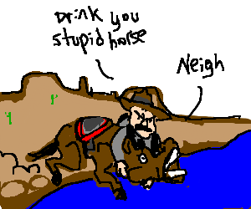
Model
Motivation Model:
Reluctance or inability of people to translate information received into practice.
Shortcomings:
Other elements needed
= social & economic factors

Slide 10
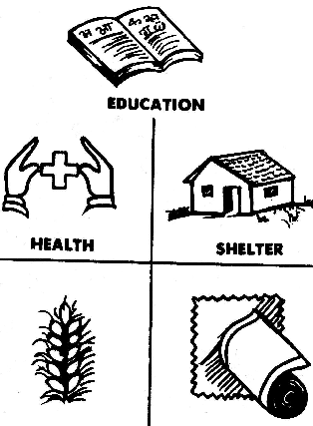
Model
Social Intervention Model:
Pre-requisites for health:
Income
Food
Shelter
Education
Peace
Justice
Equity

Slide 11
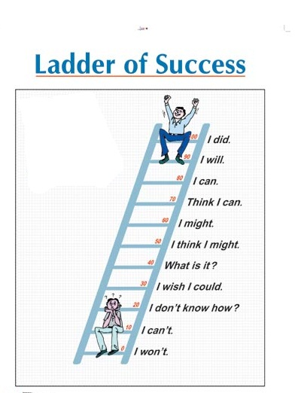
Stages for Health Education
Stage of Sensitization
Stage of Publicity
Stage of Education
Stage of Attitude change
Stage of Motivation and Action
Stage of Community Transformation (social change)

Slide 12
Principles of Health Education
Interest.
Participation.
Proceed from known to unknown.
Comprehension.
Reinforcement by repetition.
6. Motivation
7. Learning by doing
8. People, facts and media.
9. Good human relations
10. Leaders

Slide 13
Principles of Health Education
INTEREST: People are unlikely to listen to those who are not of their interest.
PARTICIPATION: based on active learning - How? Group discussion, workshops, panel discussions.
Start from the KNOWN & lead the people to the UNKNOWN, i.e. knowledge. This will enable the community to develop an in-depth insight into their own health problems.

Slide 14
Principles of Health Education
COMPREHENSION:
Make the learner understand what you are saying now? Adjust your level as a teacher with the educational background of the learner.
“Teaching should be within the mental capacity of the audience”.

Slide 15
Principles of Health Education
REINFORCEMENT:
By repetition of the information in the same session or during subsequent sessions.
Remember: Few people can learn all that is new in a single sitting.

Slide 16
Principles of Health Education
7. MOTIVATION: By creating the desire in a person to learn through incentives like praise, love, rivalry, rewards, etc.
8. LEARNING BY DOING:
Usually leaves a lasting imprint & leads towards positive action

Slide 17
Principles of Health Education
8. SOIL, SEED & SOWER:
The people are soil, the health facts are the seeds & the educator is the sower.
All the components of this triad will influence the outcome.
The 3 factors should be carefully & satisfactorily interrelated.

Slide 18
Principles of Health Education
GOOD HUMAN RELATIONSHIPS:
People must accept you as a friend & well-wisher & have the confidence to confide to you.
The personal qualities of the health educator are more important than his technical qualifications

Slide 19
Principles of Health Education
LEADERS:
People learn best from people who they respect & admire.
Try to make use of Community Head, School Teachers, etc.

Slide 20
Contents of Health Education
Personal hygiene
Proper health habits
Nutrition education
Personal preventive measures
Safety rules
Proper use of health services
Mental health
Sex education
Special education (occupation, mothers …..etc)

Slide 21
Communication
Communicator: the person or the team gives the message (Educator).
Message: the contents (materials) of health education
Channel: method of carrying the message
Audience: the receivers (users or targets) of the message

Slide 22
Good Communication Technique
Source credibility.
Clear message.
Good channel: individual, group & mass education.
Receiver: ready, interested, not occupied.
Feed back.
Observe non-verbal cues.
Active listing.
Establishing good relationship.

Slide 23
Educator
Personnel of Health Services
Social Worker / Community Worker / Multipurpose Worker
Students
School personnel
Community leaders & influential
Requirements:
Personality: popular, influential and interested in work.
Efficiency trained and prepared for the job.
Must show good examples.

Slide 24
Message
What information to be communicated.
Simple, at the level of understanding.
Culturally accepted.
Interested.
Meet a felt need.
Avoid technical jargon.
Use audiovisual aids.

Slide 25
Practice
1. Individual
Face to face
Education through spoken word.
A- Occasions of health appraisal.
B- Home

Slide 26
Practice
2. Group
a. Lessons and lectures in schools.
lectures in work places e.g. factories.
Demonstration and training
3. Mass media.
Broadcasting: Radio & TV
Written word: Newspapers, Posters, Booklets
Others e.g. theaters

Slide 27
Communication Barriers
Social and cultural gap between the sender and the receiver
Limited receptiveness of receiver
Negative attitude of the sender
Limited understanding and memory
Insufficient emphasis by the sender (health professional)
Contradictory messages
Health education without identifying the “needs "of the community

Slide 28
Adoption of new ideas or practice
Five steps
Awareness (know)
Interests (details)
Evaluation (Advantages Vs Disadvantages)
Trial (practices)
Adoption (habit)

Slide 29
Health Education The Process of Change
Awareness:
Influenced by:
The educational approaches adopted
The ability of the person to perceive
The recipient learns some general information about the new idea or practice (its usefulness, limitations & applicability)

Slide 30
Health Education The Process of Change
Interest:
The recipient seeks more detailed information
He is willing to listen or read more about it
Evaluation:
The recipient weighs the pros & cons of the practice, its usefulness to him or his family resulting in a decision to try or reject the proposed practice.

Slide 31
Health Education The Process of Change
Trial:
When the decision is put into practice
The recipient needs additional information so as to overcome the problems in implementing the idea.
Adoption:
The recipient is convinced & decides that the new practice is good & adopts it.

Slide 32
Process of Health Education
Planning
PIE
Evaluation
Implementation

Slide 33
Process of Health Education
Planning & Implementation:
Pre-requisites:
Identification of the community health problems.
Identification of the vulnerable & at-risk groups.

Slide 34
Process of Health Education
Identification of resources & defining the required inputs from:
The health centre
The local governmental sectors
The community
Identification of possible barriers, inadequacies & constraints & alternative methods to overcome them.

Slide 35
Process of Health Education
Set up objectives:
The priority health problems to be tackled
The priority groups to be educated
Choose your methods of communication & material (the message to be passed on in detail)
Schedule your activities on a time basis (weekly, monthly, biannual, annual), e.g. day/date/time, Group/#, Venue, Subject, Media, Educator, comment.

Slide 36
Process of Health Education
Evaluation:
Should not be left to the end, but should be made from time to time to assess the progress.
Evaluate by using indicators for monitoring:
Structure:
Manpower
Materials (media & facilities)

Slide 37
Process of Health Education
Measure its relevancy by:
The number participating
The frequency of sessions
Outcome:
In terms of achievements throughplan objectives, e.g. reduction of disease, incidence measured in terms of numbers, rates & percentages.

Slide 38
Questions
?

