Slide 1
Titration curve cont’ed

Slide 2
Titration curves
It is a curve that monitors the pH of a solution as amounts of alkali or acid is added.
Amino acids are simple weak polyprotic acids.
Neutral amino acids (as alanine, glycine) are treated as diprotic acids.
Acidic amino acids (as aspartic or glutamic acid)
Basic amino acids (as lysine or histidine) are treated as triprotic acids.

Slide 3
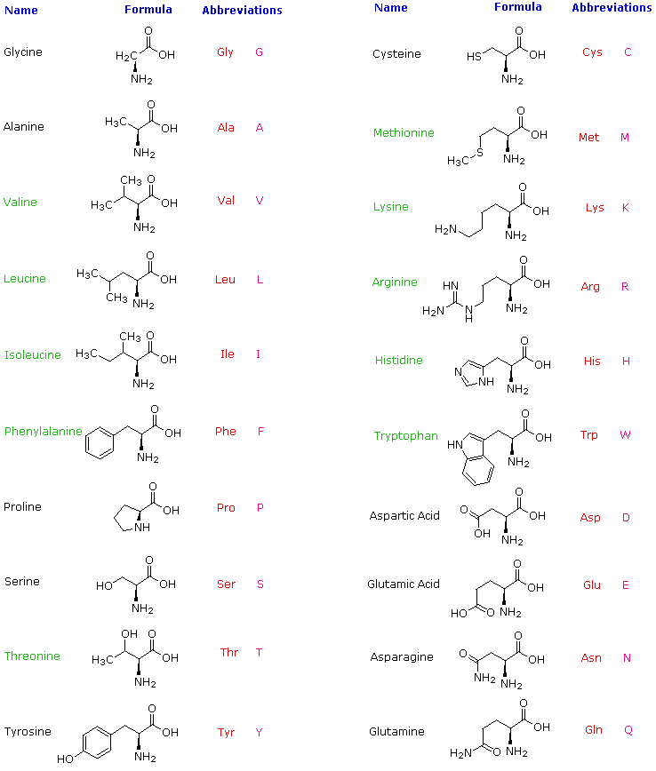
Titration curve of lysine
Lysine is a basic amino acid with an extra amino group in its side chain.
pKa:
  1st α–COOH will be titrated first = 2.18
  2nd α -NH₃⁺ will be titrated next = 8.95
  3rd R-NH₃⁺ will be titrated last = 10.53
We have three flat zones, i.e. three ionized groups.

Slide 4
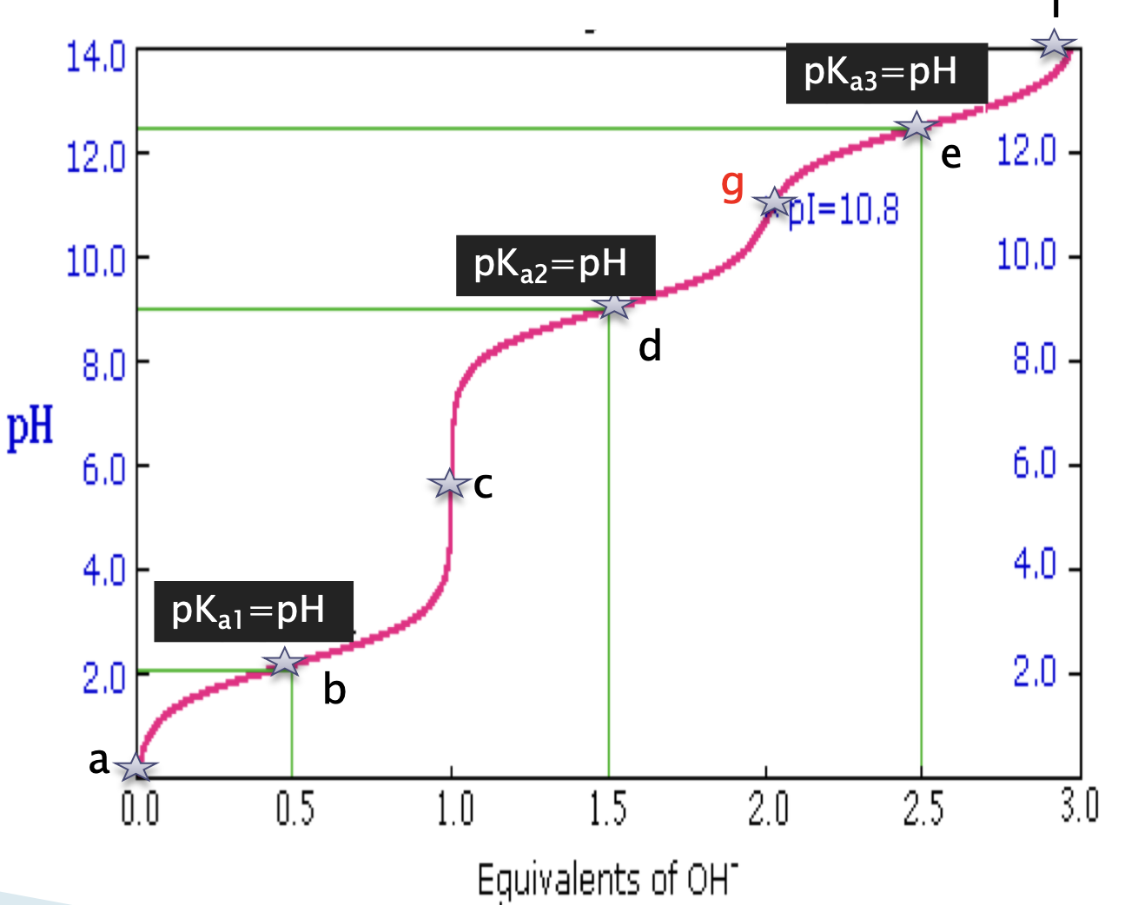
Titration curve of lysine
f

Slide 5
Titration curve of lysine cont’ed
At point a:
  Before titration
  NH⁺₃CH(CH₂)₄NH⁺₃COOH
  The net charge = +2
At point b:
  Pk_{a1} = pH
  Here it has buffering capacity
  NH⁺₃CH(CH₂)₄NH⁺₃COOH = NH⁺₃CH(CH₂)₄NH⁺₃COO⁻
  The net charge = +2 | +1➔ +1.5

Slide 6
Titration curve of lysine cont’ed
At point c:
  NH⁺₃CH(CH₂)₄NH⁺₃COO⁻
  All the α–COOH has been titrated.
  The net charge = +1
At point d:
  Pk_{a2} = pH
  Here it has buffering capacity
  NH⁺₃CH(CH₂)₄NH⁺₃COO⁻ = NH₂CH(CH₂)₄NH⁺₃COO⁻
  The net charge = +1 | 0 ➔ +0.5

Slide 7
Titration curve of lysine cont’ed
At point g:
  It is the pI point
  NH₂CH(CH₂)₄NH⁺₃COO⁻
  The net charge = 0
  pI = pH, pI = (pKa₁+pKa₂)/2
At point e:
  End of titration
  NH₂(CH₂)₄NH⁺₃COO⁻= NH₂(CH₂)₄NH₂COO⁻
  The net charge = 0 | -1 ➔ -0.5
  Pk_{a3} = pH
  Here it has buffering capacity

Slide 8
Titration curve of lysine cont’ed
At point f:
  End of titration
  NH₂(CH₂)₄NH₂COO⁻
  The net charge = -1
  All has been titrated.

Slide 9
Titration Curves of Amino Acids
Information obtained from a titration curve
1- The number of ionizable groups in that amino acid, which can be detected from the number of titration stages in the curve, (or the number of pK_{a}’s or number of flat zones in the curve).
2- Whether the triprotic amino acid is basic or acidic, that can be detected from the pKa₂.
If it’s value is closer to the value of pKa₁ (that of the α- carboxyl group ), then it is an acidic amino acid.
If the value of it’s pKa₂ is closer to the value of pKa₃ (that of the α-amino group ), then it is basic amino acid.
3- The pK_{a} values of the amino acid can be obtained from the curve which is equal to the pH value at the mid-point.

Slide 10
Titration Curves of Amino Acids
4- The isoelectric point , pI for each amino acid can be obtained from the curve by detecting the point where the amino acid is all in the zwitterion form (net charge = 0.0) the pH at that point is the pI.
Or it can be obtained mathematically from:
pI = pKa₁ + pKa₂ (in the case of a neutral amino acid)
2
pI = pKa₁ + pKa₂ ( in the case of acidic amino acids)
2
pI = pKa₂ + pKa₃ ( in the case of basic amino acids)
2

Slide 11
Titration Curves of Amino Acids
5- You can also determine from the curve the pH values at which the amino acid can act as a buffer. (the pH ranges ±1 from the pH value of each midpoint).

Slide 12
How to Obtain a Titration Curves of Amino Acids?
1- Calculate the no. of moles of weak acid or a.a
2- Calculate the first moles of OH⁻ by
A= no. of moles of acid or a.a / pK_{a1}
3- Calculate the second moles of OH⁻ added
B= No of moles of weak acid or a.a + A
4- Calculate the third moles of OH⁻ added
C= No of moles of weak acid or a.a + B

Slide 13
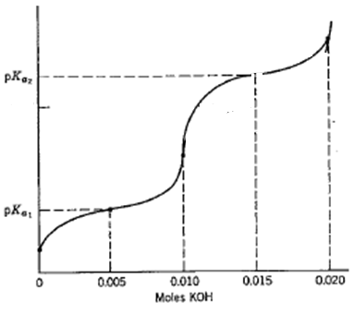
Example 1
Sketch the pH curve for the titration of 100 ml of 0.1M glycine with KOH? pk_{a1} = 1.71, pk_{a2} = 9.6?
No. of moles of a.a = M × V
= 0.1 × 0.1
= 0.01 mole
The first moles of OH⁻:
A = 0.01 / 1.71 = 0.005
The second moles of OH⁻ added:
B = 0.01 + 0.005 = 0.015
PI = (pk_{a1} + pk_{a2}) / 2
= 5.66

Slide 14
Example 2
Plot the titration curve of aspartic acid it has a volume of 100 ml and 0.1M when titrated with 0.1M KOH? pk_{a1}= 2.09, pk_{a2} = 3.86, pk_{a3} = 9.82?
No. of moles of a.a = M X V
= 0.1 X 0.1
= 0.01 mole
The first moles of OH-:
A = 0.01 / 2.09 = 0.005
The second moles of OH- added:
B = 0.01 + 0.005 = 0.015
The third moles of OH- added
C= 0.01+0.015=0.025
PI = (pka1 + pka2) / 2 = 2.975

Slide 15
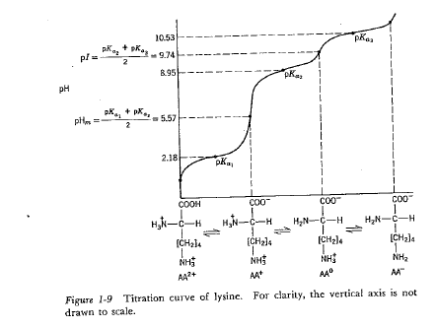
Example 3
Plot the titration curve of lysine which has a volume of 200 ml and 0.3 M when titrated with 0.1M NaOH? pk_{a1}= 2.18, pk_{a2} = 8.95, pk_{a3} =10.35?

Slide 16
Do you have questions?

