Slide 1
Scanning spectrophotometry and spectrophotometric determination of concentration
Lab# 1
BCH 333 [practical]

Slide 2
Objectives:
1. What is absorption spectrum and determination of λmax.
2. Standard curve of known concentration and determine the concentration for a solution “with unknown concentration”.

Slide 3
How a spectrophotometer works.
(spectrophotometer components)

Slide 4
Spectrophotometer: it can be used to measure the amount of light absorbed by a solution. How?
-By using the spectrophotometer, we can quantitatively measure the absorbance, and this information can be used to determine the concentration of the absorbing molecule.
-More concentrated solution will absorb more light and transmits less.[why?]
So, the more concentrated solution → high absorbance value.
And Less concentrated solution → less absorbance value.
Notes:
المذكور كمثال هو احد التطبيقات

Slide 5
Absorption spectrum

Slide 6
Absorption spectrum:
The curve that display the action or behaviour of absorption of molecule [solute] at different weave lengths, Known as Absorption spectrum curve.
-Every molecule has its own Absorption spectrum, So it’s considered as fingerprint for each molecule.
λmax: it is the weave length, at which the molecule has the maximum absorbance at this weave length.[best absorbance]. It can be determined from absorption spectrum curve.
[The wavelength of maximum absorption (λmax)]

Slide 7
Absorption spectrum curve and determination of λmax.

Slide 8
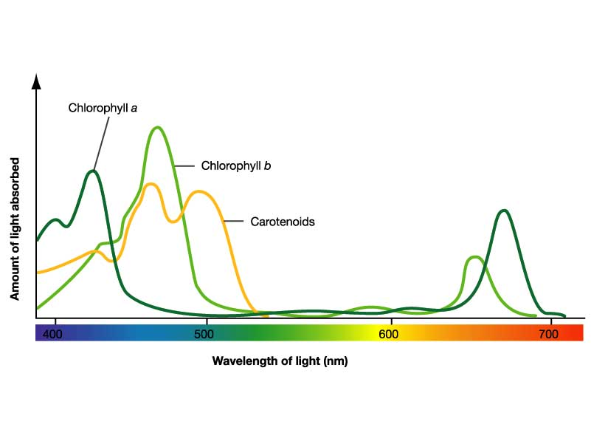
Absorption spectrum curve for different molecules.

Slide 9
What is the benefit of studying the Absorption spectrum :
Determine λmax.
Used to identify substances.
It also can be used to know if there is any contamination with another molecule.

Slide 10
Standard curve of Concentrations

Slide 11
Principle Standard curve of Concentrations:
Beer-Lambert law:
The absorption of light by a solution is described by the Beer-Lambert law as:
There is linear relationship between absorbance and concentration of an absorbing species.
A = εlc
A= is the absorbance.
ε = extinction(absorption) coefficient.
l = length of the light path through the solution.
c = concentration of the absorbing substance.
So, what does standard curve of concentrations mean?

Slide 12
A standard curve for concentrations:
- It is a graph that shows the relationship between different known concentrations of a substance and the absorbance at a specific wave length.
-Standard curve are most commonly used to determine the concentration of a substance, using serial dilution of solutions of known concentrations.
-So, what is the principle of a standard curve concentrations???
Wait….. what is standard solutions???
Standard Solution:
is a solution containing a precisely known concentration of an element or a substance.

Slide 13
How to determine unknown concentration
of a solution with known absorbance value?

Slide 14
If the unknown concentration of a solution has absorbance value =0.45,
the conc. From the curve will be ......??
Absorbance of the
” solution with unknown concentration”
Concentration of the
” solution with unknown concentration”

Slide 15
To determine the concentration of a solution with
“an unknown concentration”:
From standard curve of concentration:
-Measure the absorbance of the “solution with unknown concentration” in order to determine the concentration, from the curve.
Beer-Lambert law:
Using available information of any standard solution to determine the “ε”,
then using these information to get the unknown concentration. Using:A = εlc
Note: “ε” will changed when the weave length changed.

Slide 17
How does a spectrophotometer work?
http://www.youtube.com/watch?v=pxC6F7bK8CU

Slide 18
Spectrophotometry Introduction:
http://www.youtube.com/watch?v=qbCZbP6_j48
Spectrophotometry Example
http://www.youtube.com/watch?v=VqAa_cmZ7OY&feature=relmfu

