Slide 1

Microscopy
&
Cell Structure

Slide 2

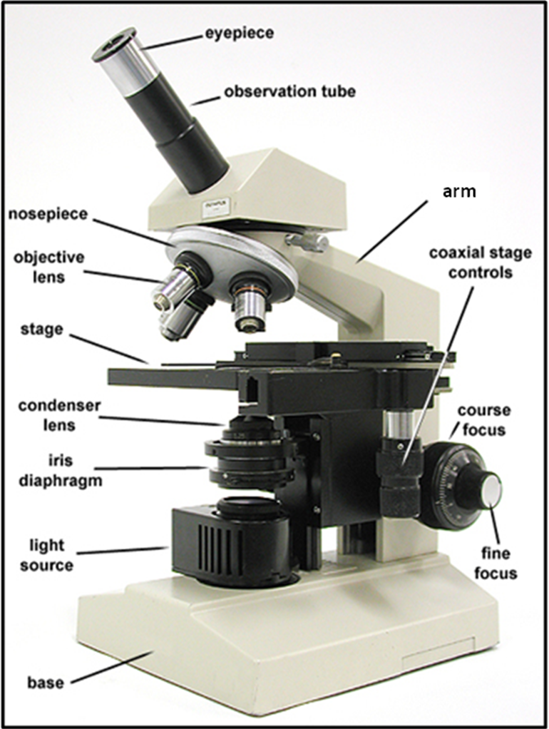
The Compound Microscope:
The compound light microscope is one of the most important instrument used in zoology.
The applications of the microscope :
1- It is used to study cells & cell
parts
2- It is used to study the
organization of tissues & the
structure of developing embryos .

Slide 3

How to maintain the microscope
Always carry your microscope with both hands.
Grasp the arm of the microscope firmly with one hand and support the base with the other hand.
Place it gently on your desk with the arm facing you.
Always remember that this expensive scientific instrument is assigned to you for your use and safe – keeping
Notify your laboratory instructor if you observe any malfunction or if you have any difficulty in the use of your microscope

Slide 4
Parts of the microscope
The mounting and movement system
The illumination system
The magnification system

Slide 5
1.The mounting and movement system
Part | Function
The base | Supporting stand.
The arm | Support the upper part of the microscope.
The stage | The horizontal platform upon which the slide rests.
The coarse focusing knob | To rise and lower the stage from the objective lenses.
The fine focusing knob | Focusing for the sharpest image.
The body tube | Carry the ocular lenses at one end and the objective lenses at the other end.
The revolving nose-piece | Attached to the objective lenses and move the different objective lenses into position over the stage aperture.

Slide 7
2.The magnification system :
The objective lenses
The ocular lenses or the eye-piece
There are three or four lenses, each one gives a different magnification.
5x to 10x and 15x
The scanning objective lens: 3.5x,4x or 5x.
The low power objective lens: 10x or 20x.
The high power objective lens: 40x.
The oil immersion objective lens: 100x.

Slide 8
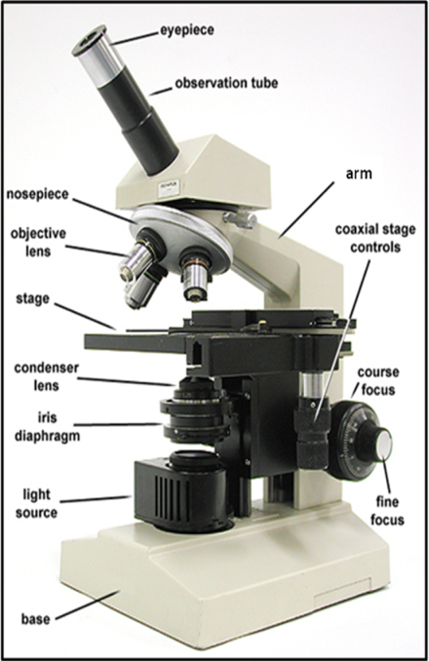
The principle purpose of a microscope is to magnify the image of the objects
The magnification of an object is determined by multiplying the power of the objective lens by the power of the ocular lens.
Example:
10x ocular × 40x objective = 400x total magnification.

Slide 9
3.The illumination system :
The part | The function
The illuminator | Source of light.
The condenser | Collect and concentrate the light towards the slide.
The iris diaphragm | Controlling the amount of light.

Slide 10
Cell Structure
Cells are the basic units of biological structure and function .
The essential features of the cells :
1- The cell membrane
2- The genetic material
3- The cytoplasm

Slide 11
Cell types
Two major types of cells are known according to the arrangement of the genetic material and the contents of the cytoplasm.
Prokaryotes
Eukaryotes
Pro=before, karyon=nucleus
Eu=true, karyon=nucleus
nucleus
Present
Not present
The region where the DNA is found is known as the nucleiod.
DNA is associated with proteins in a complex structure known as the chromatin.

Slide 12
1-Prokaryotes (Bacteria)
Coccus | Bacillus
Round shaped, occur in colonies and strands. | Rod shaped, occur in strands. | Description of the shape
Free living or found in other organism. | Free living or found in other organism. | Location

Slide 13
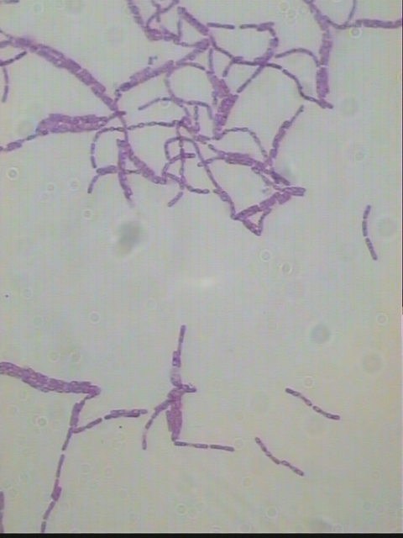
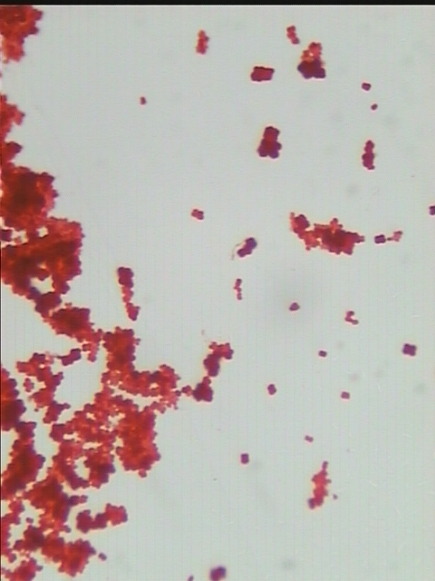
Bacillus
Coccus

Slide 14
2- Eukaryotic cells
Animal cells
Plant cell
which have a cell membrane and no cell wall
which have a cell membrane and cell wall
e.g. onion cells
Rectangular-with eccentric nucleus

Slide 15
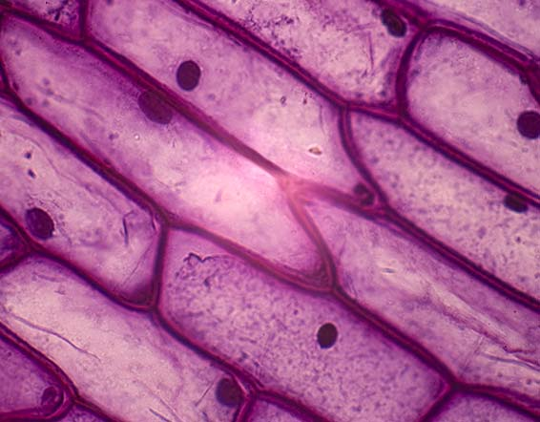
Plant cells

Slide 16
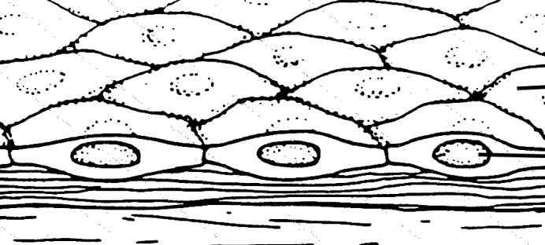
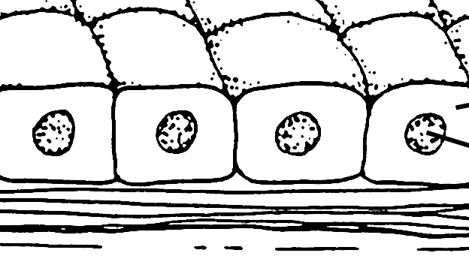
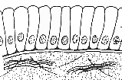
Animal cells
epithelial cells
squamous epithelium
cuboidal epithelium
columnar epithelium
nucleus
cytoplasm
Cell membrane
Basement membrane
Bowman's
Capsules side view
Thyroid gland
squamous epithelium
(lining of the mouth mucosa) top view
Large collecting tubule in the kidney
Intestine
Stomach

Slide 17
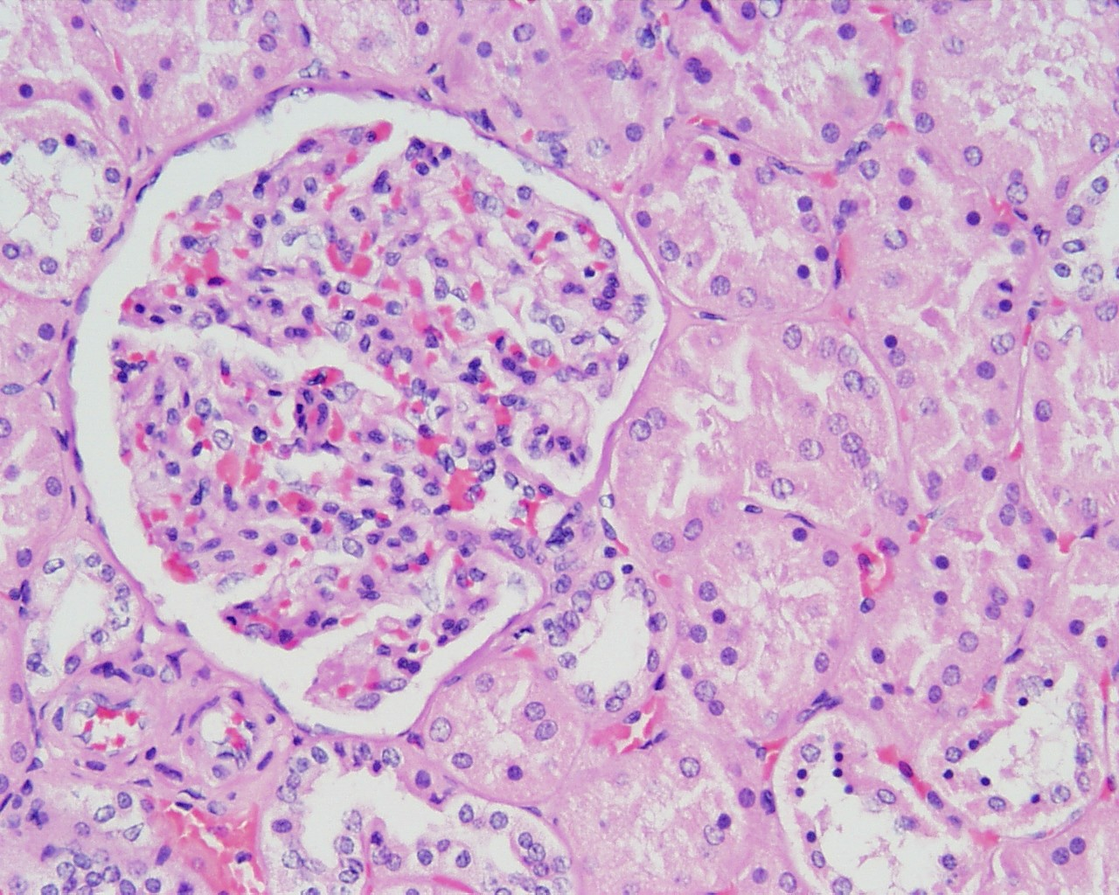
squamous epithelium
Side view
Bowman’s capsule
glomerulus

Slide 18
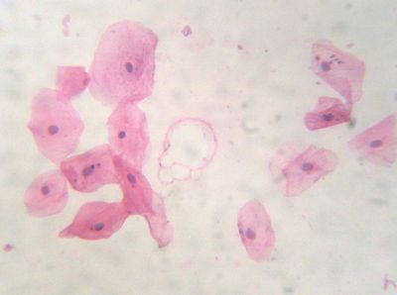
squamous epithelium
top view

Slide 19
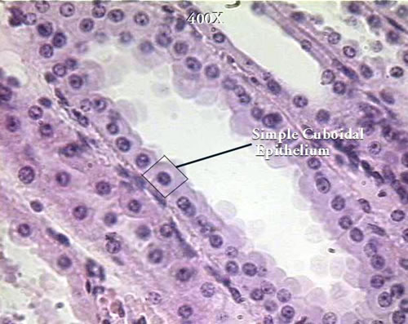
cuboidal epithelium (collecting tubule in the kidney)

Slide 20
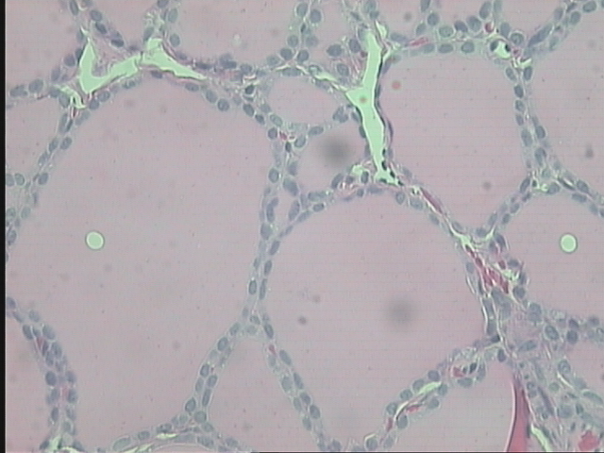
cuboidal epithelium in Thyroid gland

Slide 21
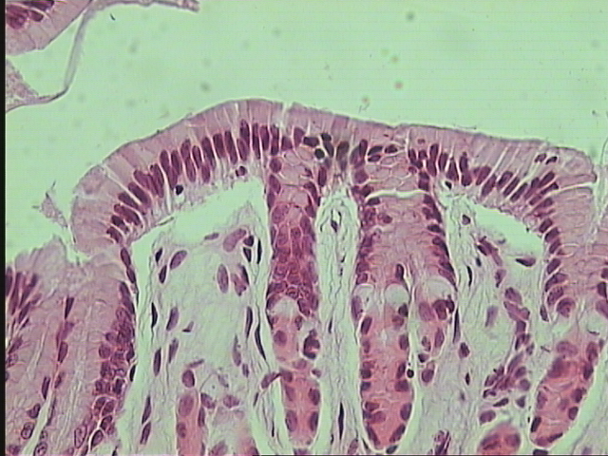
columnar epithelium

