Slide 1
CLS 223
Reem Alkhamis
Email: ralkhamis@ksu.edu.sa
3rd floor/ office # 113

Slide 2
Lecture #1
Introduction to Pathology
Cellular response to stress

Slide 3
Introduction
Pathology: is the study of disease by scientific methods.
Disease: illness or ill health = Disturbed homeostasis.
Pathogenesis: The mechanism of disease that result in presenting the patient with signs and symptoms.
Etiology: The cause of disease. (next slide)
Prognosis: the likely course (outcome) of a medical condition.
Cure, Chronicity, Remission, Relapse, Exacerbation
Mortality: Death from disease.
Morbidity: Being ill
Notes:
Hemeostasis: is the property of a system in which variables are regulated so that internal conditions remain stable and relatively constant. Examples of homeostasis include the regulation of temperature and the balance between acidity and alkalinity (pH). It is a process that maintains the stability of the human body's internal environment in response to changes in external conditions.
The kidneys are used to remove excess water and ions from the blood. These are then expelled as urine. The kidneys perform a vital role in homeostatic regulation in mammals, removing excess water, salt, and urea from the blood.
If the water content of the blood and lymph fluid falls, it is restored in the first instance by extracting water from the cells. The throat and mouth become dry, so that the symptoms of thirst motivate the animal to drink.
If the oxygen content of the blood falls, or the carbon-dioxide concentration increases, blood flow is increased by more vigorous heart action and the speed and depth of breathing increases.
Prognosis: cure, chronicity, exacerbation (increase in the severity of the disease),
Relapse (if a sick or injured person) deteriorate after a period of improvement.
"two of the patients in remission relapsed after 48 months”
Remission (the state of absence of disease activity in patients with a chronic illness, with the possibility of relapse)
Chronic (disease that is persistent or otherwise long-lasting in its effects or a disease that comes with time.[1] The term chronic is usually applied when the course of the disease lasts for more than three months.[1] Common chronic diseases include arthritis, asthma, cancer, COPD, diabetes and HIV/AIDS. (diseases relapse repeatedly, with periods of remission in between)
Exacerbation (increase in the severity of disease or any of it’s symptoms.

Slide 4
Etiology
Idiopathic.
Congenital Causes:
Genetic: Development of abnormal genes. E.g.: ?
Acquired.
3) Acquired:
Hypoxia: oxygen deficiency
Nutritional Imbalances: Obesity, malnutrition, deficiency of proteins and vitamins..
Physical Agents: Radiation, electric shock, trauma, extremes of temperatures..
Chemical Agents: air pollution, insecticides, CO, ethanol, drugs..
Infectious Agents (Biological agents): bacteria, parasites, viruses..
Immunological: Autoimmunity, Hypersensitivity e.g. asthma.
Notes:
Idiopathic (the cause is not understood)
Congenital (a condition existing at birth)
Congenital genetic: Sickle cell anemia, down syndrome.
Congenital environmental: drugs, chemicals, physical agents
Hypoxia : caused by A blocked airway, anemia, heart defect, high altitude..

Slide 5
Cellular response to stress
-The environment around cells is dynamic and constantly changing.
-In this fluid environment, cells are exposed to many stimulations, changes and stress some of which are injurious.
To survive, the cells must have the ability to adapt to these changes.
-If the stress, changes or stimuli are minor or of short duration.
→ cell adaptation.
If More prolonged or intense stimuli → cell injury or death (Non-adaptive)
Notes:
Adaptive cell response: Cells constantly adjust (adapt) their structure and function to accommodate changes and extracellular stress (maintain homeostasis).

Slide 6
Cellular response to stress
Cellular response to stress may be adaptive or non adaptive.
Adaptive | Non-adaptive (cell injury)
hypertrophy | Dysplasia
hyperplasia | neoplasia
Atrophy | Degeneration
Metaplasia | Necrosis, apoptosis & gangrene
Reversible | Reversible* / Irreversible
*to a certain limit

Slide 7
Adaptive changes:
Adaptations are reversible changes of cells in response to changes in their environment.
Hypertrophy: in cell size due to in functional demand
or by specific hormonal stimulation
hypertrophy of skeletal muscles in athletes (physiological).
Myocardium hypertrophy in chronic hyper-tension (pathological).
Hypertrophy of one kidney after the removal of the other (compensatory)
Hypertrophy of uterine muscles during pregnancy
(physiological).
Occurs in cells that can not increase in number

Slide 8
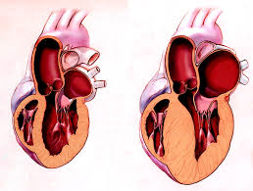
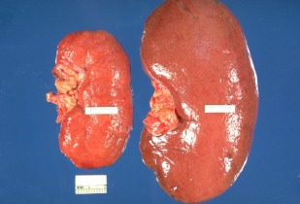
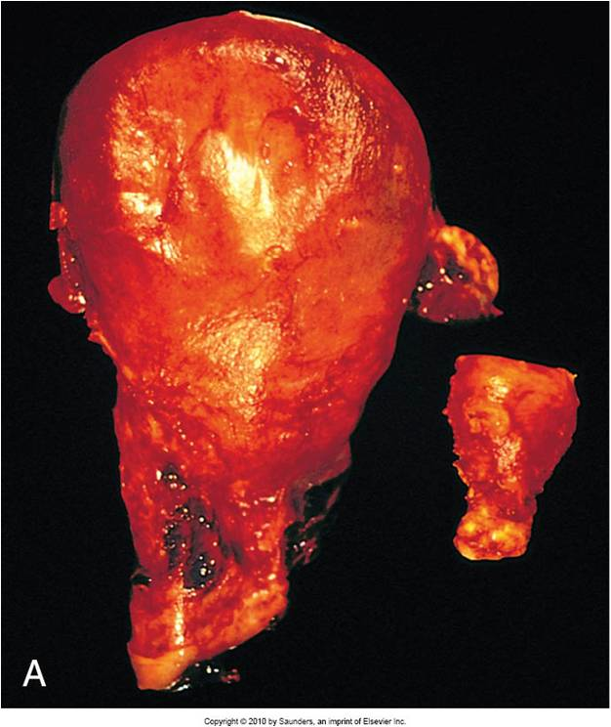
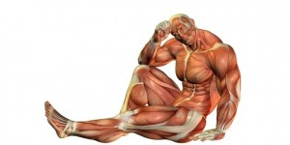

Slide 9
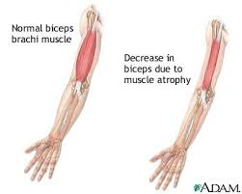
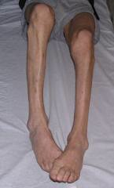
Atrophy: in cell size due to:
(1) work load. E.g.:
immobilization to permit healing of a fracture.
Atrophy is also seen in muscles of paralyzed limbs. Prolonged bed rest.
(2) aging, (3)inadequate nutrition.
Notes:
Aging: physiological
The rest is pathalogical

Slide 10
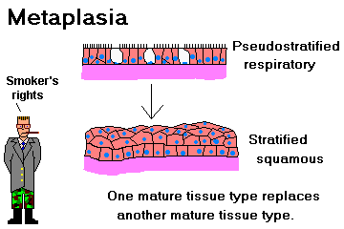
Hyperplasia: in cell number; occurs in cells that are able to divide.
E.g.: liver restored to it’s normal weight 12 hours after partial resection.
Metaplasia: Conversion of one adult cell type to another adult cell type that may have a better chance for survival.
Metaplasia is often a response to chronic irritation making cells able to withstand the stress.

Slide 11
