Slide 1
Hello! CHAPTER#1 Survival model part(2): force of mortality
Salma Alsuwailem

Slide 2
introduction
Actuaries are interested in mortality rates. The mortality rate over one year for a life aged x is given by qx
The mortality rate over an instantaneous period is called the force of mortality. The force of mortality for (x) is denoted as μx.
μx can be viewed as the probability that (x) dies within the next instant (i.e., a small amount of time after age x).
It measures the rate of mortality at age x, given that (0) survives to age x:

Slide 3
Force of mortality

Slide 4
Finding nPx in Terms of Force of Mortality

Slide 5
Adjusted Force of Mortality
Consider two groups of people: smokers and non-smokers. Is the force of mortality for these two groups the same? No, we expect the mortality rates for smokers to be higher than that for non-smokers. Thus, we expect the force of mortality for smokers to be higher than that for non-smokers.
An actuary could develop a force of mortality for non-smokers, and then adjust it to obtain the force of mortality for smokers. Some possible adjustments include :
adding a constant to the force of mortality and
multiplying the force of mortality by a constant.

Slide 6
Adjusted Force of Mortality

Slide 7
Examples
The force of mortality for a substandard life (x) is expressed as
${\text{μ}\text{x}\text{+}\text{t}}^{s}$= μx+t + c,
for some constant c > 0, where μx+t is the force of mortality of a standard life (x). You are given:
• The probability that a standard life (x) survives the next 5 years is 0.75. • The probability that a substandard life (x) survives the next 5 years is 0.40.
Calculate the value of c.
Salma Alsuwailem

Slide 8
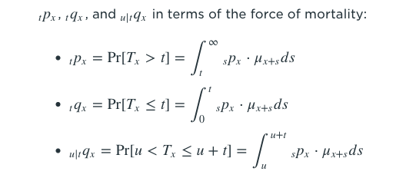
Important relationship

Slide 9
Special Mortality Laws
1-Exponential Distribution (Constant Force)
Key Idea
the key assumption for this mortality law is that the force of mortality is constant for all ages. This means: μx+t=μ ,for all ages

Slide 10
2-Uniform Distribution
Key Idea
The key assumption for this mortality law is that the future lifetime of (0)( is uniformly distributed between 0 and ω, where ω is the limiting age. Thus, the future lifetime of (x) is uniformly distributed between 0 and ω−x. This mortality law is also referred to as DeMoivre's law. With this assumption, the expected number of survivors at age x is given by lx=k(ω−x), where k is a constant. Below is a graph of lx against x.

Slide 11
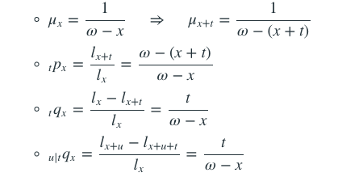
Uniform Distribution

Slide 12
examples
Given:
μx=F+$e^{2x}$, x≥0
0.4P0=0.5
Calculate F.
A –0.2
B -0.09
C 0
D 0.09
E 0.2
Salma Alsuwailem

Slide 13
You are given:
3p70=0.95
2p71=0.96
$$\int_{71}^{75}{\text{μ}\text{xdx}\text{=0.107}}$$
Calculate 5p70.
A 0.85
B 0.86
C 0.87
D 0.88
E 0.89
Salma Alsuwailem

Slide 14
You are given:
Calculate 4|14q50.
A 0.38
B 0.39
C 0.41
D 0.43
E 0.44
Salma Alsuwailem

Slide 15
For a population which contains equal numbers of males and females at birth:
Calculate $q_{60}$ for this population
A 0.076
B 0.081
C 0.086
D 0.091
E 0.096
For females,
For males,
Salma Alsuwailem

Slide 16
In a population initially consisting of 75% females and 25% males, you are given:
For a female, the force of mortality is constant and equals μ .
For a male, the force of mortality is constant and equals 1.5μ .
At the end of 20 years, the population consists of 85% females and 15% males.
Calculate the probability that a female survives one year.
A 0.89
B 0.92
C 0.94
D 0.96
E 0.99
Salma Alsuwailem

Slide 17
A population has 30% who are smokers with a constant force of mortality 0.2 and 70% who are non-smokers with a constant force of mortality 0.1.
Calculate the 75th percentile of the distribution of the future lifetime of an individual selected at random from this population.
A 10.7
B 11.0
C 11.2
D 11.6
E 11.8
Salma Alsuwailem

Slide 18
In a population of newborn consisting of 75% males and 25% females,
you are given:
• Mortality for males follow De Moivre’s law with ω = 90.
• Mortality for females follow De Moivre’s law with ω = 120.
At what age will there be exactly equal proportions of male and female?
Salma Alsuwailem

Slide 19
THANKS!
Any questions?

