Slide 1
A simple Java program
Ch 1.2

Slide 2
A Sip of Java: Outline
History of the Java Language (FYI)
Applications and Applets (FYI)
A First Java Application Program
Writing, Compiling, and Running a Java Program

Slide 3
History of Java
In 1991, James Gosling and Sun Microsystems began designing a language for home appliances (toasters, TVs, etc.).
  Challenging, because home appliances are controlled by many different chips (processors)
  Programs were translated first into an intermediate language common to all appliance processors.
  Then the intermediate language was translated into the machine language for a particular appliance’s processor.
  Appliance manufacturers weren’t impressed.
In 1994, Gosling realized that his language would be ideal for a Web browser that could run programs over the Internet.
  Sun produced the browser known today as HotJava.

Slide 4
Applications and Applets
Two kinds of java programs: applications and applets
Applications
  Regular programs
  Meant to be run on your computer
Applets
  Little applications
  Meant to be sent to another location on the internet and run there
  Deprecated by Oracle and not supported by many web browsers today in favor of HTML5 and JavaScript

Slide 5
Some Terminology
The person who writes a program is called the programmer.
The person who interacts with the program is called the user.
A package is a library of classes that have been defined already.
  import java.util.Scanner;

Slide 6
Some Terminology
The item(s) inside parentheses are called argument(s) and provide the information needed by methods.
A variable is something that can store data.
An instruction to the computer is called a statement; it ends with a semicolon.
The grammar rules for a programming language are called the syntax of the language.

Slide 7
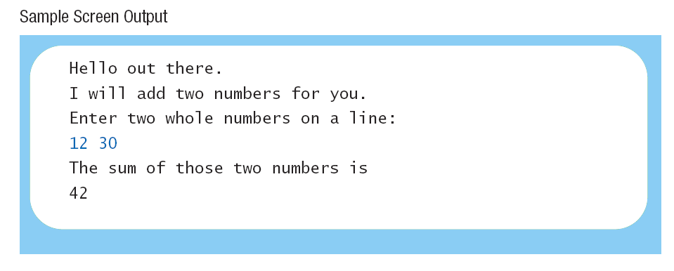
A First Java Application
import java.util.Scanner;
public class FirstProgram
{ public static void main (String [] args)
{ System.out.println ("Hello out there.");
System.out.println ("I will add two numbers for you.");
System.out.println ("Enter two whole numbers on a line:");
int n1, n2;
Scanner keyboard = new Scanner (System.in);
n1 = keyboard.nextInt ();
n2 = keyboard.nextInt ();
System.out.println ("The sum of those two numbers is");
System.out.println (n1 + n2);
}
}
Sample
screen output
Notes:
The Previous terminology could be pointed out here.

Slide 8
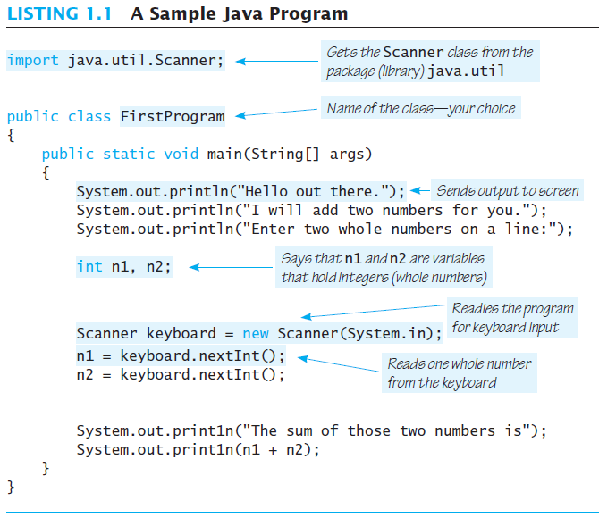

Slide 9
Printing to the Screen
System.out.println (“Whatever you want to print”);
System.out is an object for sending output to the screen.
println is a method to print whatever is in parentheses to the screen.
The object performs an action when you invoke or call one of its methods
objectName.methodName(argumentsTheMethodNeeds);

Slide 10
A First Java Application
import java.util.Scanner;
public class FirstProgram
{ public static void main (String [] args)
{ System.out.println ("Hello out there.");
System.out.println ("I will add two numbers for you.");
System.out.println ("Enter two whole numbers on a line:");
int n1, n2;
Scanner keyboard = new Scanner (System.in);
n1 = keyboard.nextInt ();
n2 = keyboard.nextInt ();
System.out.println ("The sum of those two numbers is");
System.out.println (n1 + n2);
}
}
Sample
screen output
Notes:
This is a repeated slide that you can use to show examples of the print statement.
You can hide it if you don’t find it useful.

Slide 11
Compiling a Java Program or Class
A Java program consists of one or more classes, which must be compiled before running the program.
You need not compile classes that accompany Java (e.g. System and Scanner).
Each class should be in a separate file and ending with.java
The name of the file should be the same as the name of the class.
What would the file for the sample program be named?

Slide 12
Compiling and Running
Use an IDE (integrated development environment) which combines a text editor with commands for compiling and running Java programs.
When a Java program is compiled, the byte-code version of the program has the same name, but the ending is changed from .java to .class.

Slide 13
Compiling and Running
A Java program can involve any number of classes.
The class to run will contain the words
public static void main(String[] args)
somewhere in the file

Slide 14
Programming Basics: Outline
Object-Oriented Programming
(briefly only – will be covered later)
Algorithms
Testing and Debugging
Software Reuse

Slide 15
1. PROGRAMMING APPROACHES
Two programming approaches are known:
The Structured Programming
  Also known as modular programming.
  The problem is divided into smaller sub-problems (modules).
  Each sub-problem is then analyzed and solved.
  The solutions of all sub-problems are then combined to solve the overall problem.
  Examples of such programming model languages include Pascal, Fortran and C.
The Object-Oriented Programming
  Identify the components of the problem. These are called objects.
  For each object, identify the relevant data & operations (methods) to be performed on that data.
  Define the relationship between each object and the other.
  Examples of programming languages that follow such model are C++ and Java.
OBJECTS
DATA
METHODS

Slide 16
Programming
Programming is a creative process.
Programming can be learned by discovering the techniques used by experienced programmers.
These techniques are applicable to almost every programming language, including Java.

Slide 17
Object-Oriented Programming
Our world consists of objects (people, trees, cars, cities, airline reservations, etc.).
Objects can perform actions which affect themselves and other objects in the world.
Object-oriented programming (OOP) treats a program as a collection of objects that interact by means of actions.

Slide 18
OOP Terminology
Objects, appropriately, are called objects.
Actions are called methods.
Objects of the same kind have the same type and belong to the same class.
  Objects within a class have a common set of methods and the same kinds of data
  but each object can have it’s own data values.

Slide 19
OOP Design Principles
OOP adheres to three primary design principles:
  Encapsulation
  Polymorphism
  Inheritance
Notes:
Delayed for later in the course - just mention briefly

Slide 20
Introduction to Encapsulation
The data and methods associated with any particular class are encapsulated (“put together in a capsule”), but only part of the contents is made accessible.
  Encapsulation provides a means of using the class, but it omits the details of how the class works.
  Encapsulation often is called information hiding.

Slide 21
Accessibility Example
An automobile consists of several parts and pieces and is capable of doing many useful things.
  Awareness of the accelerator pedal, the brake pedal, and the steering wheel is important to the driver.
  Awareness of the fuel injectors, the automatic braking control system, and the power steering pump is not important to the driver.

Slide 22
Introduction to Polymorphism
From the Greek meaning “many forms”
The same program instruction adapts to mean different things in different contexts.
  A method name, used as an instruction, produces results that depend on the class of the object that used the method.
  Everyday analogy: “take time to recreate” causes different people to do different activities
More about polymorphism in Chapter 8

Slide 23
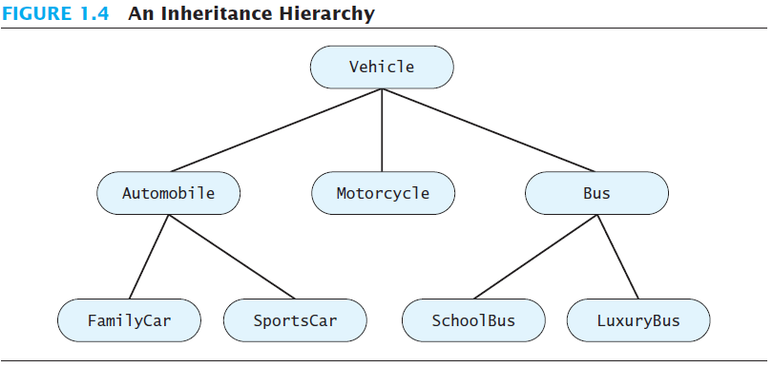

Slide 24
Introduction to Inheritance
Classes can be organized using inheritance.
A class at lower levels inherits all the characteristics of classes above it in the hierarchy.
At each level, classifications become more specialized by adding other characteristics.
Higher classes are more inclusive; lower classes are less inclusive.

Slide 25
Inheritance in Java
Used to organize classes
“Inherited” characteristics do not need to be repeated.
New characteristics are added.
More about inheritance in chapter 8

Slide 26
Algorithms
By designing methods, programmers provide actions for objects to perform.
An algorithm describes a means of performing an action.
Once an algorithm is defined, expressing it in Java (or in another programming language) usually is easy.

Slide 27
Algorithms
An algorithm is a set of instructions for solving a problem.
An algorithm must be expressed completely and precisely.
Algorithms usually are expressed in English or in pseudocode.

Slide 28
Example: Total Cost of All Items
Write the number 0 on the whiteboard.
For each item on the list
  Add the cost of the item to the number on the whiteboard
  Replace the number on the whiteboard with the result of this addition.
Announce that the answer is the number written on the whiteboard.

Slide 29
Testing and Debugging
Eliminate errors by avoiding them in the first place.
  Carefully design classes, algorithms and methods.
  Carefully code everything into Java.
Test your program with appropriate test cases (some where the answer is known), discover and fix any errors, then retest.

Slide 30
Errors
An error in a program is called a bug.
Eliminating errors is called debugging.
Three kinds or errors
  Syntax errors
  Runtime errors
  Logic errors

Slide 31
Syntax Errors
Grammatical mistakes in a program
  The grammatical rules for writing a program are very strict
The compiler catches syntax errors and prints an error message.
Example: using a period where a program expects a comma

Slide 32
Runtime Errors
Errors that are detected when your program is running, but not during compilation
When the computer detects an error, it terminates the program and prints an error message.
Example: attempting to divide by 0

Slide 33
Logic Errors
Errors that are not detected during compilation or while running, but which cause the program to produce incorrect results
Example: an attempt to calculate a Fahrenheit temperature from a Celsius temperature by multiplying by 9/5 and adding 23 instead of 32

Slide 34
Reusable Components
Most programs are created by combining components that exist already. They are not usually created entirely from scratch.
Reusing components saves time and money.
Reused components are likely to be better developed, and more reliable.
New components should designed to be reusable by other applications.

Slide 35
Software Reuse
Reusable classes are used
  Design class objects which are general
  Java provides many classes
  Note documentation on following slide
  https://docs.oracle.com/javase/8/docs/index.html
  https://docs.oracle.com/javase/8/docs/api/java/util/Scanner.html

Slide 36
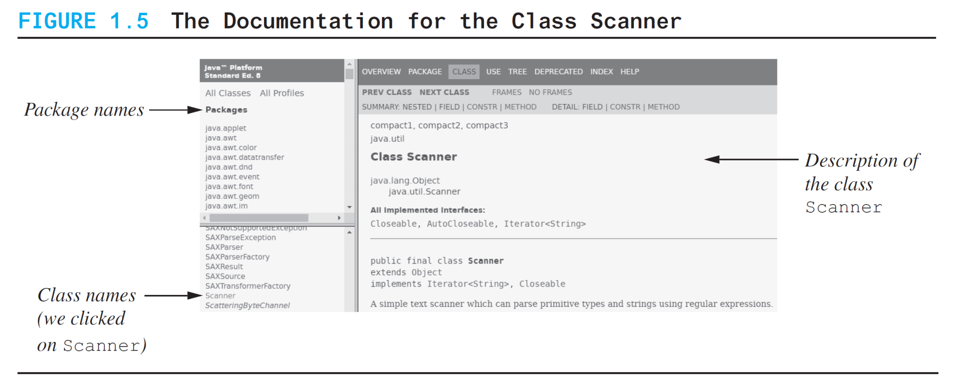
Software Reuse

