Slide 1
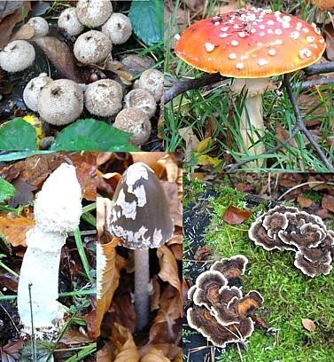
Advanced
Mycology
MBI 531

Slide 2
Introduction
Mykes (Greek word) : Mushroom
Fungi are eukaryotic protista; differ from
bacteria and other prokaryotes.
Cell walls containing chitin (rigidity & support),
mannan & other polysaccharides
Cytoplasmic membrane contains ergosterols
Possess true nuclei with nuclear membrane & paired chromosomes.
Divide asexually, sexually or by both
Unicellular or multicellular

Slide 3
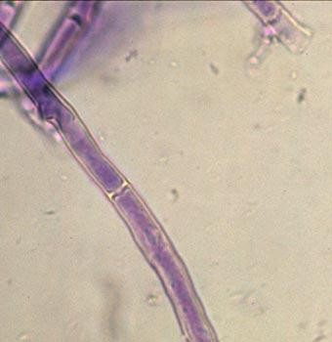
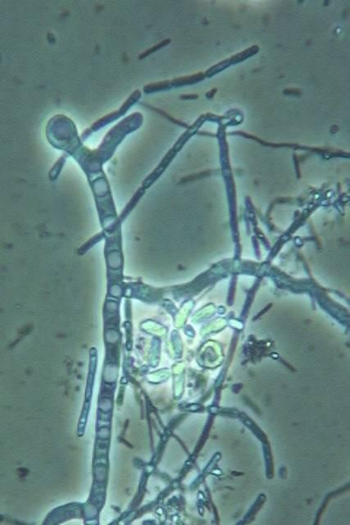
Introduction
Simplest fungus :- Unicellular budding yeast
Hypha :- Elongation of apical cell produces a tubular, thread like structure called hypha
Mycelium :- Tangled mass of hyphae is called mycelium. Fungi producing mycelia are called molds or filamentous fungi.
Hyphae may be septate or non-septate

Slide 4
CLASSIFICATION
Depending on cell morphology
  Yeasts
  Yeast like fungi
  Molds
  Dimorphic fungi

Slide 5
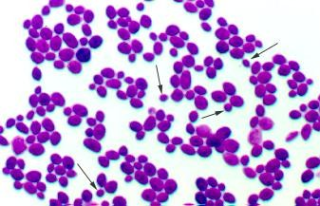
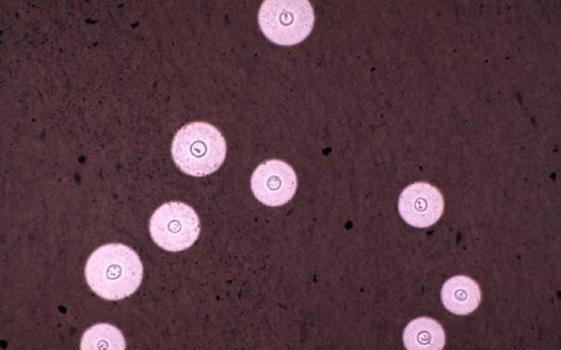
1. Yeasts
Unicellular fungi which reproduce by budding
On culture - produce smooth, creamy colonies
e. g Cryptococcus neoformans (capsulated yeast)

Slide 6
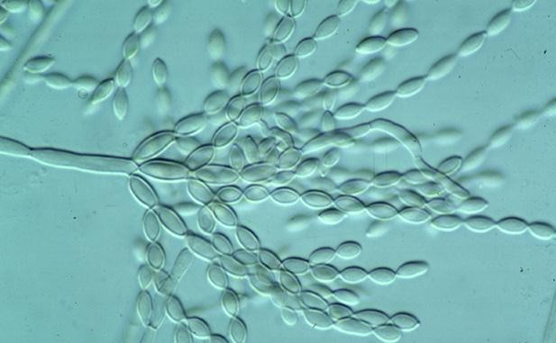
2. Yeast like fungi
Grow partly as yeasts and partly as elongated cells resembling hyphae which are called pseudohyphae.
e.g. Candida albicans

Slide 7
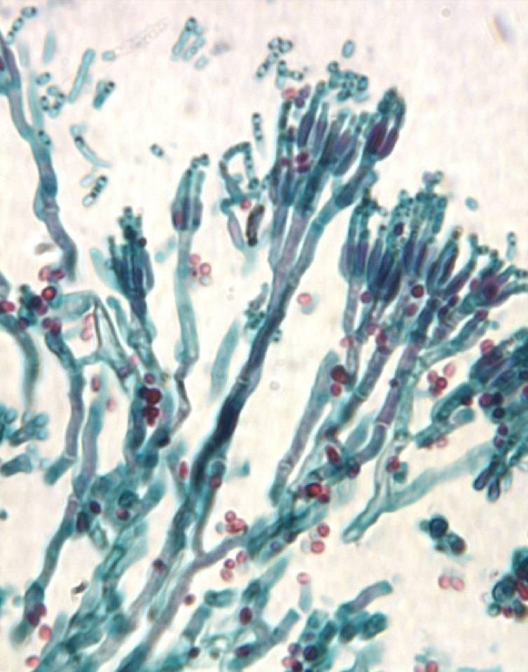
3. Molds/ Filamentous fungi
Form true mycelia & reproduce by formation of different types of spores.
Vegetative/ aerial hyphae
e.g. Rhizopus, mucor

Slide 8
4. Dimorphic fungi
Occur in 2 forms
Molds (Filaments) – 25°C (soil) Yeasts – 37°C (in host tissue)
Most fungi causing systemic infections
are dimorphic:
Histoplasma capsulatum
Blastomyces dermatidis
Paracoccidioides brasiliensis
Coccidioides immitis
Penicillium marneffei
Sporothrix schenkii

Slide 9
Systemic classification
Based on sexual spore formation: 4
classes
Zygomycetes
Ascomycetes
Basidiomycetes
reproduce sexually
4. Deuteromycetes (fungi imperfectii)

Slide 10
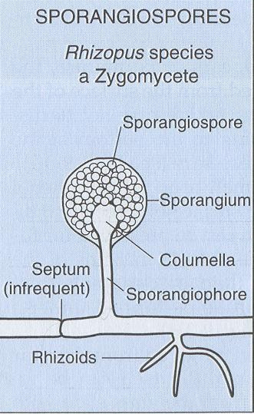
1. Zygomycetes
Lower fungi
Broad, nonseptate hyphae
Asexual spores - Sporangiospores: present within a swollen sac- like structure called Sporangium

Slide 11
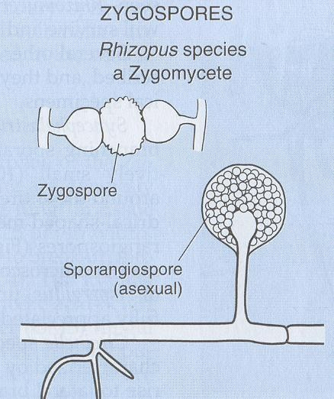
1. Zygomycetes
Sexual spores - Zygospore: a resting, thick walled cell in between hyphae
e.g. Rhizopus,
Mucor, Absidia

Slide 12
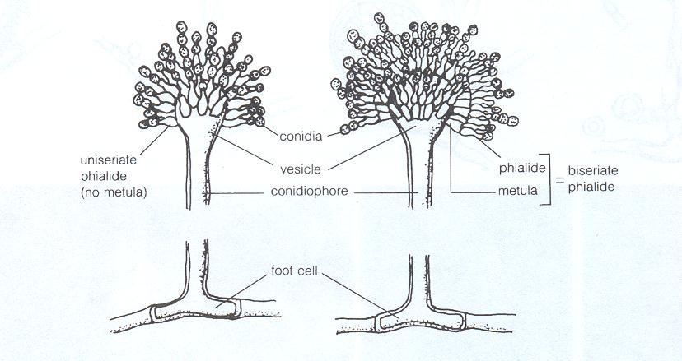
2. Ascomycetes
Includes both yeasts & filamentous fungi
Narrow, septate hyphae
Asexual spores are called conidia borne on conidiophore

Slide 13
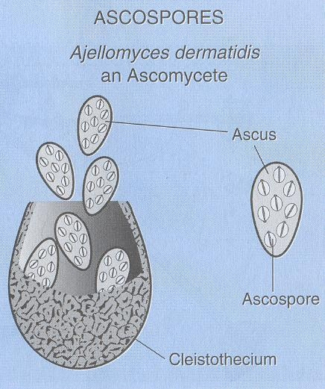
2. Ascomycetes
Sexual spores called ascospores are present within a sac like structure called Ascus.
Several asci may be seen within a fruiting body as seen in Penicillium, Aspergillus
Each ascus has 4 to 8
ascospores.

Slide 14
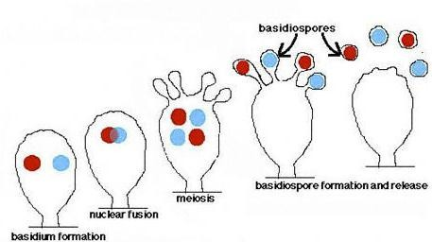
3. Basidiomycetes
Sexual fusion results in the formation of a club shaped organ called base or basidium which bear spores called basidiospores

Slide 15
4. Deuteromycetes
or Fungi imperfectii
Group of fungi whose sexual phases are not identified.
Grow as molds as well as yeasts.
Asexual stage – conidia
e.g. Candida, Cryptococcus

Slide 16
Vegetative Structures of
Fungi
Formed by the vegetative mycelia (modification of single vegetative cells or hyphae)
Have no reproductive value
Important in the differentiation/
identification of clinically significant fungi.

Slide 17
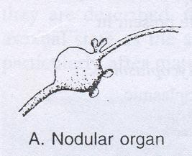
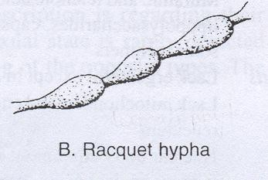
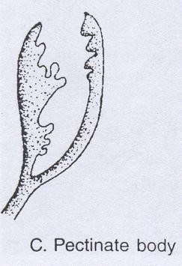
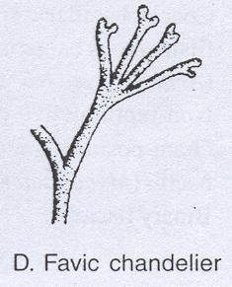
Spiral hyphae in T.Mentagrophytes

Slide 18
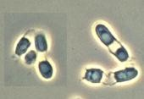
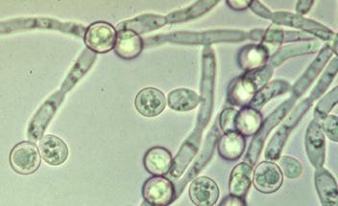
Vegetative Structures of
Fungi
Arthrospores – formed by
segmentation &
condensation of hyphae
Chlamydospores – thick walled resting spores
e.g. C.albicans

Slide 19
Reproduction in fungi
Sexual – by formation of zygospores,
ascospores or basidiospores
Asexual
  By budding or fission
  Spores (conidia) are formed on or in specialized
structures.
  Spores vary in size, shape & colour but these characteristics are constant for a particular species.

Slide 20
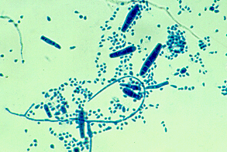
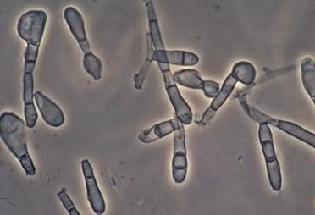
Reproduction in fungi
Micro conidia - Small, single celled
Macro conidia – Large, single or many celled

Slide 21
Fungal Infections/ Mycoses
Superficial mycoses:
  2 types: surface and cutaneous mycoses
  Skin, hair & nails.
  Mild but chronic disease
Deep mycoses:
  2 types: subcutaneous & systemic mycoses
  Caused by soil saprophytes
  Infection is accidental
  Range from a symptomatic infection to fatal disease

Slide 22
Superficial: Surface mycoses
Live exclusively on dead surfaces of skin and its appendages
No contact with living tissue, hence no
inflammatory response
  Tinea versicolor
  Tinea nigra
  Piedra

Slide 23
Superficial: Cutaneous mycoses
Cornified layer of skin & its appendages
Contact with living tissue, hence inflammatory & allergic responses seen
  Dermatophytes – skin, hair & nails
  3 genera - Trichophyton
Microsporum Epidermophyton

Slide 24
Deep mycoses
Subcutaneous mycoses
Mycotic Mycetoma
Chromoblastomycoses
Sporotrichosis
Rhinosporidiosis
Subcutaneous
phycomycoses
Systemic mycoses
Cryptococcoses
Blastomycosis
Paracoccidiomycoses
Coccidioidomycoses
Histoplasmoses

Slide 25
Candidiasis
Caused by candida sps, forms a bridge between superficial & deep mycoses as it can cause cutaneous as well as systemic infections
Can also cause opportunistic infections

Slide 26
Opportunistic infections
Pts with debilitating disease, altered physiological state
Mainly caused by fungi which are common lab contaminant on culture media
  Aspergillus
  Pencillium
  Mucor
  Rhizopus
Produce serious & fatal infections

Slide 27
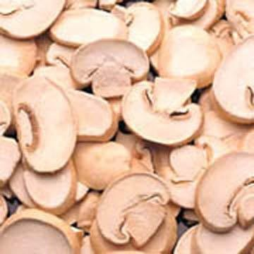
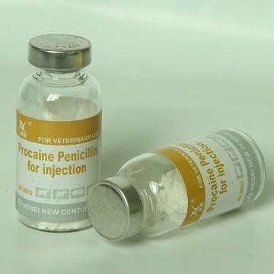

Useful Properties of Fungi
Source of food
e.g. mushrooms
Antibiotic production
e.g. Penicillin from
Penicillium notatum
Fermentation - Production of
alcohol, bread
e.g. Sacchromyces spps

Slide 28

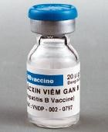
Useful Properties of Fungi
Ergot from Claviceps purpurea, used to induce uterine contractions
Vaccines for Hepatitis B –
Sacchromyces cerevisiae

