Slide 1
Plasmid Isolation and Purification.
Lab# 1
BCH 462 [practical]

Slide 2
DNA cloning techniques:
They are techniques, used to create copies of certain DNA fragments.
Using:
1-PCR[polymerase chain reaction].
2-Cell based. [using a vector carrying the DNA of interest ,which eventually inserted to
A host cell “usually bacteria” and self replicate].
Isolated and amplified specific DNA fragment
“e.g.: gene A”

Slide 3
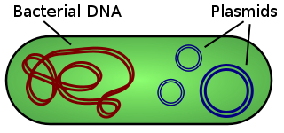
Plasmid:
-Are small, double stranded, closed circular DNA molecules which can replicate independently from a bacterial chromosome. (can be isolated from bacterial cells).
-It is vector.
Features:
1. Found in a wild variety of bacterial species.
2.Extra-chromosomal elements, which replicate independently of the bacterial chromosome.
3. Are not essential for the bacterium but may confer a selective advantage.
4.Using the enzymes and proteins encoded by their host for their replication and transcription.
5. Are inherited.
6. Used in many applications e.g. Drugs production.

Slide 4
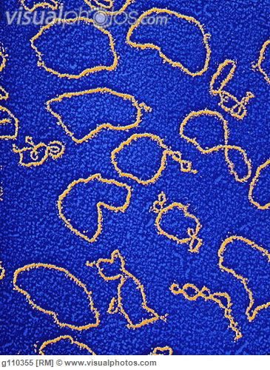
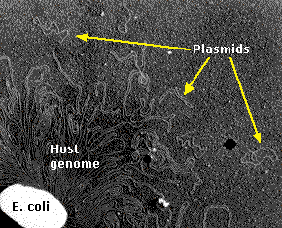

Slide 5
“Cell based” DNA cloning involve:
1.Insertion of DNA fragment in to a cloning vector ”e.g. plasmid”.
2. Introducing a vector with DNA fragment in to bacterial cells ” the host”.
3. Amplifying the (vector DNA), using bacterial DNA replication machinery.
1
DNA fragment
cloning vector
Recombinant DNA
2
Recombinant DNA
the host
Transformed bacteria
3

Slide 6
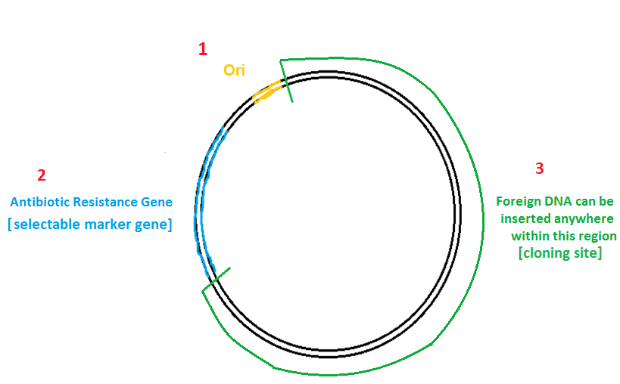
Generally plasmid vectors should contain three important parts.

Slide 7
Vector Element | Description
1- Origin of Replication (Ori) | DNA sequence which allows initiation of replication of the plasmid by cellular enzymes(?).
2- Antibiotic Resistance Gene | Allows for selection of” plasmid-containing “bacteria.
3- Cloning site | A place to insert foreign DNAs(the fragment which we are interested in its replication).

Slide 8
Some of plasmid applications :
Gene therapy.
Molecular cloning.
Make large amounts of proteins.

Slide 9
There are three general classes for plasmids which can be advantageous for host cell:
A- Virulence plasmids encoding toxin genes.
B- Drug-resistance plasmids that confer resistance to antibiotics.
C-Plasmids encode gene required for bacterial conjugation.

Slide 10
Bacterial growth curve
Depending upon nutritional status, bacteria exhibit different growth patterns which include:
Lag phase: in this phase bacteria adapt themselves to growth conditions and synthesis its own DNA,RNA and proteins.
Log phase: it is exponential phase, bacterial cells divide and the production of new cells is proportion to increased time.
Stationary phase: the growth rate slows as nutrients become limited, waste products accumulate and the rate of cell division equals the rate of death.
Death phase: due to continuous accumulation of toxic metabolites and the lack of nutrients, death occurs of the bacteria.

Slide 11
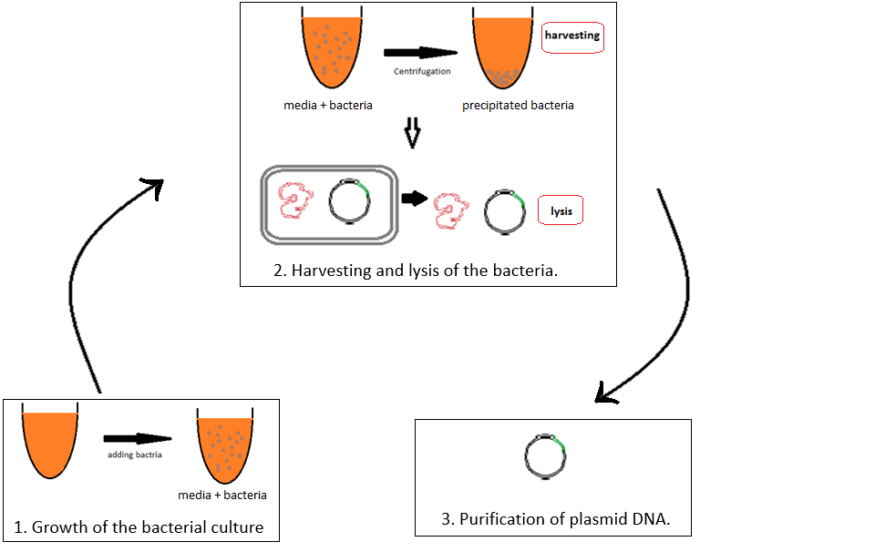
Three general steps involved in plasmid purification:

Slide 12
Harvesting and lysis of the culture:
Bacteria are recovered by centrifugation and lysed by any one of a large number of methods, including treatment with detergents, alkali, organic solvents, and heat. The choice among these methods depends on three factors: the size of plasmid, the bacterial strain and the technique used to subsequently purify the plasmid DNA.

Slide 13
Practical part

Slide 14
Plasmid isolation and purification
Principle of the experiment “Alkaline lysis method “:
Using SDS in the alkaline solution:
-The SDS: will lyse the bacterial cell membrane and denature the proteins too.
-The alkaline pH :denature the genomic DNA and denature the proteins too.
-The degraded cell wall, denatured chromosomal DNA and bacterial proteins form large aggregated complex which will precipitated during the plasmid isolation and removed by centrifugation.
-Native plasmid DNA can be collected from the supernatant.

Slide 15
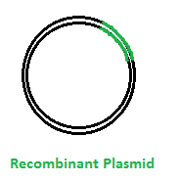
Using same R.E used
For cutting gene A
Using R.E
Animal DNA
“gene A”
“gene A”
DNA cloning using plasmid
1
Ligation
[using ligase enzymes]
2
Bacterial cell
Introducing
3
cloning
Chromosomal
DNA
Culture plate
[media containing appropriate antibiotic ]
Amplified Recombinant plasmid
Transformed bacteria

Slide 16
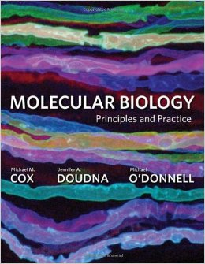
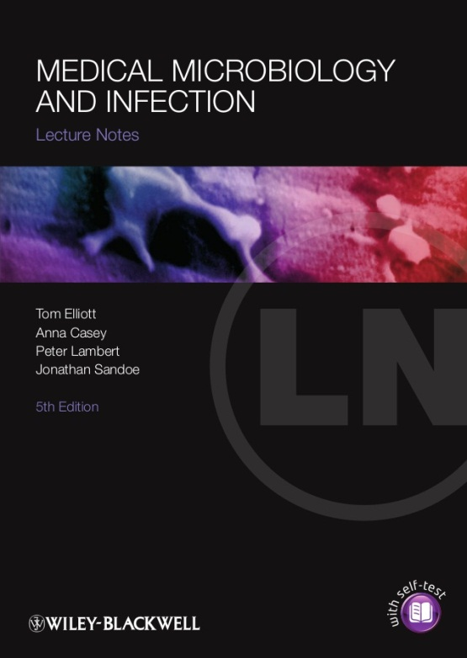
References

