Slide 1
Nursing Leadership & Management

Slide 2
Theories and Styles of Leadership
Objectives:
After 2 Hours of lecture and discussion, students are expected to:
Describe at least four leadership theories or styles that are applicable to nursing
Apply leadership theories in case situations
Differentiate leadership from management
Distinguish roles of leaders and managers

Slide 3
Definition of Terms
Leadership
The process of influencing people to accomplish goals
Management
The coordination and integration of resources through planning, organizing, coordinating, directing, and controlling to accomplish specific institutional goals and objectives
Leadership styles
Different combinations of tasks and relationship behaviors used to influence others to accomplish goals
Huber, D.L. (2010).

Slide 4
Definition of Terms
Followership
An interpersonal process of participation
Empowerment
The act of giving people the authority, responsibility, and freedom to act on what they know
Huber, D.L. (2010).

Slide 5
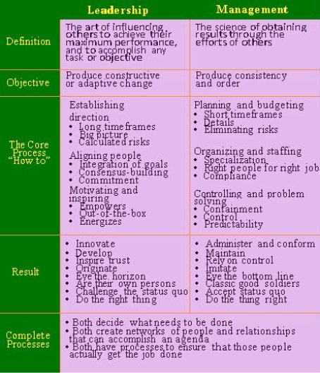

Slide 6
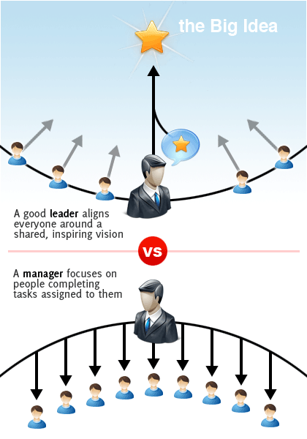

Slide 10
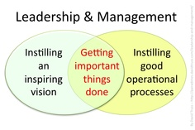

Slide 11
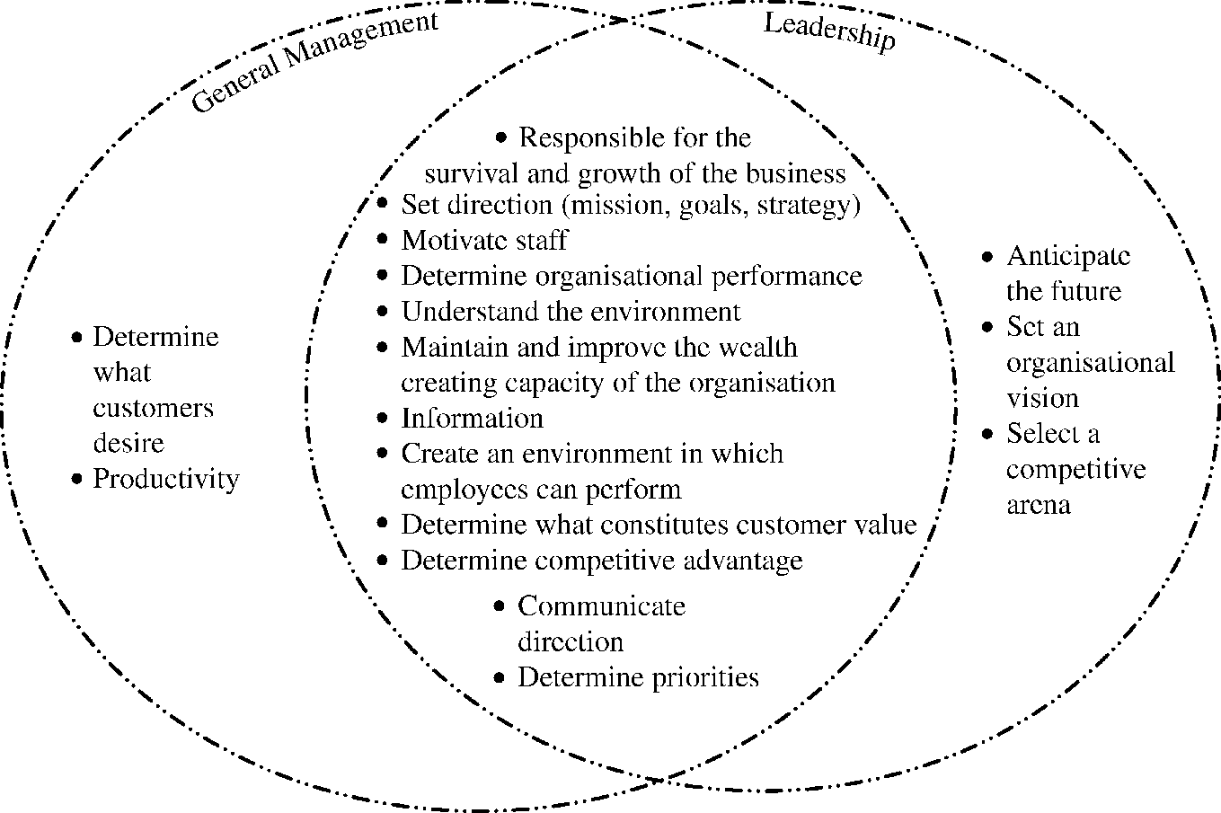

Slide 12
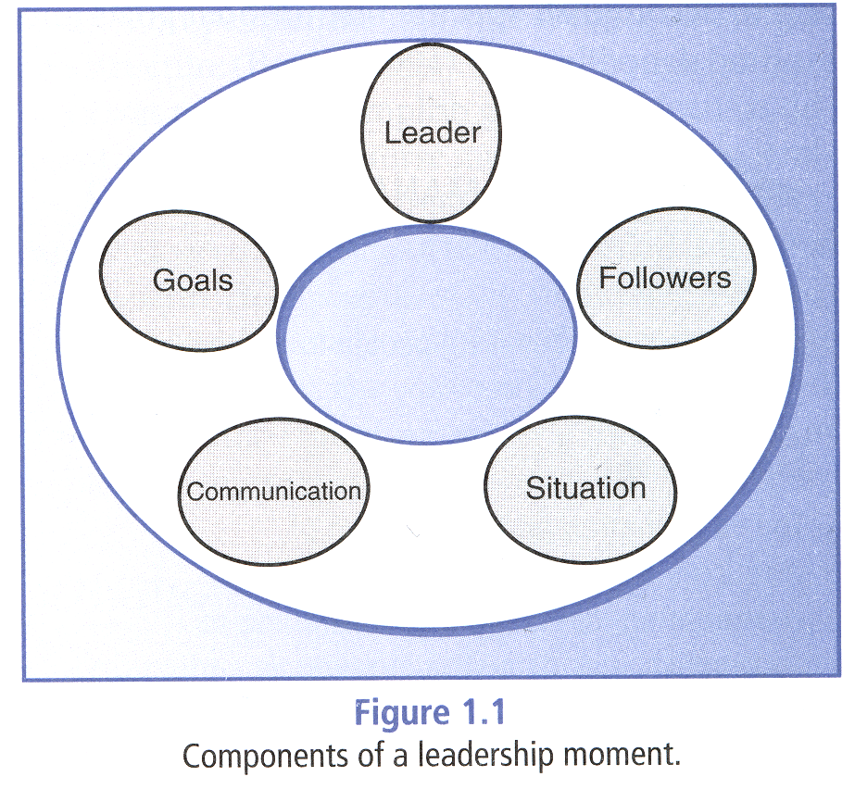
Huber, D.L. (2010).

Slide 13
Leadership Theories & Styles
Great Man Theory
Trait Theory
Behavioral Theory
Role Theory
The Leadership Grid
Lewin’s Leadership Styles
Likert’s Leadership Styles
Hersey & Blanchard’s Situational Leadership Theory
Path-goal Theory of Leadership
Transformational Leadership
Authentic Leadership
Clark, C. C. (2009)

Slide 14
Leadership Theories & Styles
The Great Man Theory
Leaders are born, not made
Leaders were rich and born into leadership
Trait Theory
Leaders are born with inherited traits
Some traits are particularly suited to leadership
Traits that could lead to success or derailment of leaders
Staying calm under pressure
Admitting errors and owning up to mistakes rather than covering them up
Persuading others without resorting to negative or coercive tactics
Being an expert in a broad range of areas rather than having a narrow-minded approach
Clark, C. C. (2009)

Slide 15
Leadership Theories & Styles
Behavioral Theory
Leaders are made not born
Anyone can learn to be a leader
Role Theory
Based on the assumptions that individuals:
Define roles for themselves and others based on social learning and reading
Form expectations about the roles that they and others will play
Subtly encourage others to act within role expectations
Will act within the role they adopt
Clark, C. C. (2009)

Slide 16
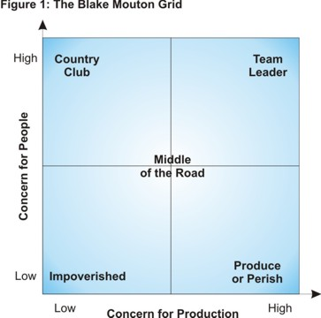
Blake and Mouton’s Leadership Grid
Grid chart leader’s concern about the work to be done compared to their concern for their people
Clark, C. C. (2009)
http://www.mindtools.com/pages/article/newLDR_73.htm

Slide 17
Blake and Mouton’s Leadership Grid
Behavioral Dimensions:
Concern for People
This is the degree to which a leader considers the needs of team members, their interests, and areas of personal development when deciding how best to accomplish a task.
Concern for Production
This is the degree to which a leader emphasizes concrete objectives, organizational efficiency and high productivity when deciding how best to accomplish a task.
Clark, C. C. (2009)
http://www.mindtools.com/pages/article/newLDR_73.htm

Slide 18
Blake and Mouton’s Leadership Grid
Impoverished Leadership – Low Production/Low People
This leader is mostly ineffective.
He/she has neither a high regard for creating systems for getting the job done, nor for creating a work environment that is satisfying and motivating.
The result is disorganization, dissatisfaction and disharmony.
Clark, C. C. (2009)
http://www.mindtools.com/pages/article/newLDR_73.htm

Slide 19
Blake and Mouton’s Leadership Grid
Country Club Leadership – High People/Low Production
This style of leader is most concerned about the needs and feelings of members of his/her team.
These people operate under the assumption that as long as team members are happy and secure then they will work hard.
What tends to result is a work environment that is very relaxed and fun but where production suffers due to lack of direction and control.
Clark, C. C. (2009)
http://www.mindtools.com/pages/article/newLDR_73.htm

Slide 20
Blake and Mouton’s Leadership Grid
Produce or Perish Leadership – High Production/Low People
Also known as Authoritarian or Compliance Leaders, people in this category believe that employees are simply a means to an end.
Employee needs are always secondary to the need for efficient and productive workplaces.
This type of leader is very autocratic, has strict work rules, policies, and procedures, and views punishment as the most effective means to motivate employees.
Clark, C. C. (2009)
http://www.mindtools.com/pages/article/newLDR_73.htm

Slide 21
Blake and Mouton’s Leadership Grid
Middle-of-the-Road Leadership – Medium Production/Medium People
This style seems to be a balance of the two competing concerns, and it may at first appear to be an ideal compromise.
Therein lies the problem, though: When you compromise, you necessarily give away a bit of each concern, so that neither production nor people needs are fully met.
Leaders who use this style settle for average performance and often believe that this is the most anyone can expect.
Clark, C. C. (2009)
http://www.mindtools.com/pages/article/newLDR_73.htm

Slide 22
Team Leadership – High Production/High People
According to the Blake Mouton model, this is the best managerial style.
These leaders stress production needs and the needs of the people equally highly.
The premise here is that employees understand the organizations purpose and are involved in determining production needs.
When employees are committed to, and have a stake in the organization’s success, their needs and production needs coincide.
This creates a team environment based on trust and respect, which leads to high satisfaction and motivation and, as a result, high production.
Blake and Mouton’s Leadership Grid
Clark, C. C. (2009)
http://www.mindtools.com/pages/article/newLDR_73.htm

Slide 23
Leadership Theories & Styles
Lewin’s Leadership Styles
Autocratic Leaders
Makes decisions without consulting others
Happens when administration decides on a change without consulting nursing
Results into low morale, bad feelings, undercover retaliation
Clark, C. C. (2009)

Slide 24
Leadership Theories & Styles
Lewin’s Leadership Styles
Democratic Leaders
Involve people in their decisions even though leaders make the final decision
Followers appreciate participation
Clark, C. C. (2009)

Slide 25
Leadership Theories & Styles
Lewin’s Leadership Styles
Laissez-faire Leaders
Minimally involved in decision making
Works best when people are capable and motivated to decide and not hindered by coordinator
People may not work in a coherent manner or put in the energy they would if they were actively led
Clark, C. C. (2009)

Slide 27
Leadership Theories & Styles
Likert’s Leadership Style for Decision Making
Exploitative authoritative style
Leader uses threats and fear to achieve conformance
People’s concerns are ignored
Communication comes from top down
Benevolent authoritative style
Leader shows concern but sugarcoats information and maintains control of decisions
Forms a benevolent dictatorship
Rewards are dispensed and appropriate performance is praised
Leader listens to people’s concerns although what others hear is often rose colored
Some decisions may be delegated but most are still made by the leader
Clark, C. C. (2009)

Slide 28
Leadership Theories & Styles
Likert’s Leadership Style for Decision Making
Consultative Leadership Style
Makes the major decision and offers rose-colored information
Information flows upward from the staff
Leader listens to people
Participative Leadership Style
Makes maximum use of participative methods
Engages people in making decisions
Helps make sure everyone works well together at all levels
Clark, C. C. (2009)

Slide 29
Leadership Theories & Styles
Hersey and Blanchard’s Situational Leadership Theory
Situational leader takes into account:
Motivation and capability of followers
Situation in which decisions take place
Fact that followers may affect leaders and vice versa
Stress and mood
Available resources and support
Distant events such as family argument
Clark, C. C. (2009)

Slide 30
Hersey and Blanchard’s Situational Leadership Theory
Focuses on the relationship between leaders and followers, as well as potential leaders and potential followers
Maturity = the ability and willingness of people to take responsibility for directing their own behavior in relation to the tasks performed
No perfect leadership style for all situations; style must be adjusted to meet the development level of followers
www.freequality.org/documents/Training/SituationalLeadership.ppt
Notes:
Source for SLM – Nuts & Bolts slides: Chapter 7 of Situational Leadership of Management of Organizational Behavior: Utilizing Human Resources pp. 150-161.

Slide 31
Hersey and Blanchard’s Situational Leadership Theory
High-task, low-relationship focus
follower cannot do the job and is unwilling or afraid to try
Leader steps in and tells the person
What to do
Provide a working structure for the follower
Determine the source of the lack of motivation
High-task, high-relationship focus
Follower can do the job to some extent but overconfident
Leader listens, advises, and coaches
Clark, C. C. (2009)

Slide 32
Hersey and Blanchard’s Situational Leadership Theory
Low-task, high-relationship focus
Follower can do the job but refuses to do it
Leader listens, praises, makes the follower feel good when he/she shows the necessary commitment
Low-task, low-relationship focus
Follower can do the job and is motivated
Leader gets out of the way and doesn’t interfere except to provide occasional recognition and praise
Clark, C. C. (2009)

Slide 33
Leadership Theories & Styles
Path Goal Theory (House & Mitchell, 1974)
Helps leaders clarify the path toward the goal
Remove roadblocks
Increase rewards along the way
Clark, C. C. (2009)

Slide 34
Leadership Theories & Styles
Path-Goal Theory Leadership Styles
1. Supportive leadership
Best choice when work is stressful, boring, and/or hazardous
Making environment more friendly is the goal
Leader strives to increase follower’s self-esteem and make job more interesting
2. Directive leadership
Best choice when the task is unstructured and/or complex and followers are inexperienced
Telling followers what needs to be done and giving appropriate guidance along the way are the goals
Rewards are increased as needed, role ambiguity is decreased by providing clear instructions which strengthens follower’s sense of security and control of the situation
Path Goal Theory
Clark, C. C. (2009)

Slide 35
Leadership Theories & Styles
3. Achievement-oriented leadership
Best choice when the task is complex
Leader knows the right and best way of achieving a goal
Follower is dependent but is believed to be able to succeed
Assumes the leader and follower are completely rational, which may be a big assumption
Path-Goal Theory Leadership Styles
Clark, C. C. (2009)

Slide 36
Leadership Theories & Styles
Transformational Leadership
Assumptions:
People will follow a leader who inspires them
A leader with vision and passion can achieve great things but must maintain personal integrity, be willing to stand up and be counted, and use ceremonies, rituals, and other types of cultural symbolism to maintain motivation
The best way to get things done is to inject enthusiasm and energy into the effort
Appeals to social values and encourages people to collaborate, rather than work as individuals who compete with one another
Gives people an uplifting sense of being connected to a higher purpose, enhancing their sense of meaning and identity
Clark, C. C. (2009)

Slide 37
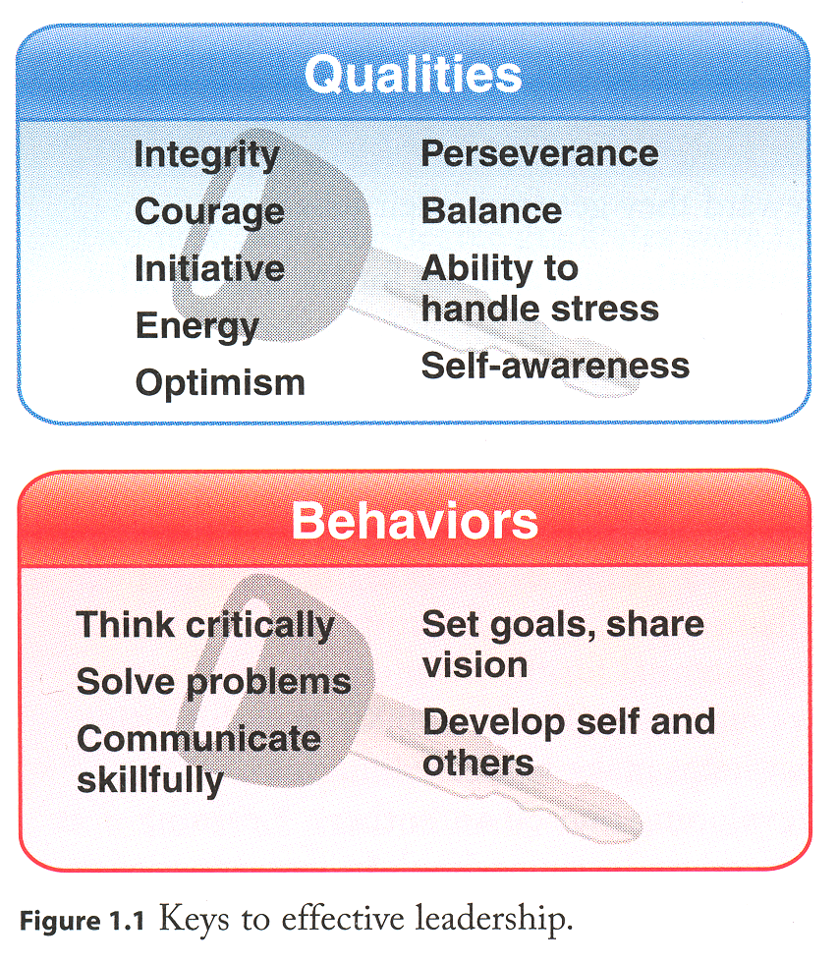

Slide 38
Clark, C. C. (2009). Creative Nursing Leadership & Management. Sudbury, MA: Jones and Bartlett Publishers
Huber, D.L. (2010). Leadership and Nursing Care Management (4th ed.). Missouri: Saunders Elsevier
Mind Tools Ltd. (1996-2014)The Blake Mouton Managerial
Grid: Balancing Task- and People-Oriented Leadership. Retrieved from: http://www.mindtools.com/pages/article/newLDR_73.htm
Situational Leadership Theory. Retrieved from:
www.freequality.org/documents/Training/SituationalLeadership.ppt

