Slide 1
CSC201: Computer Programming
Using C Programming Language

Slide 2
1.1 Computers: Hardware and Software
The programs that run on a computer are referred to as software.
You’ll learn key programming methodology that are enhancing programmer productivity, thereby reducing software-development costs—structured programming (in C).
A computer consists of various devices referred to as hardware
(e.g., the keyboard, screen, mouse, hard disks, memory, DVD drives and processing units).
Computing costs are dropping dramatically, owing to rapid developments in hardware and software technologies.

Slide 3
1.2 Computer organization
Regardless of differences in physical appearance, computers can be envisioned as divided into various logical units or sections (Fig. 1.2).
Dr. Soha S. Zaghloul 3 Copyright © Pearson, Inc. 2013. All Rights Reserved.

Slide 4
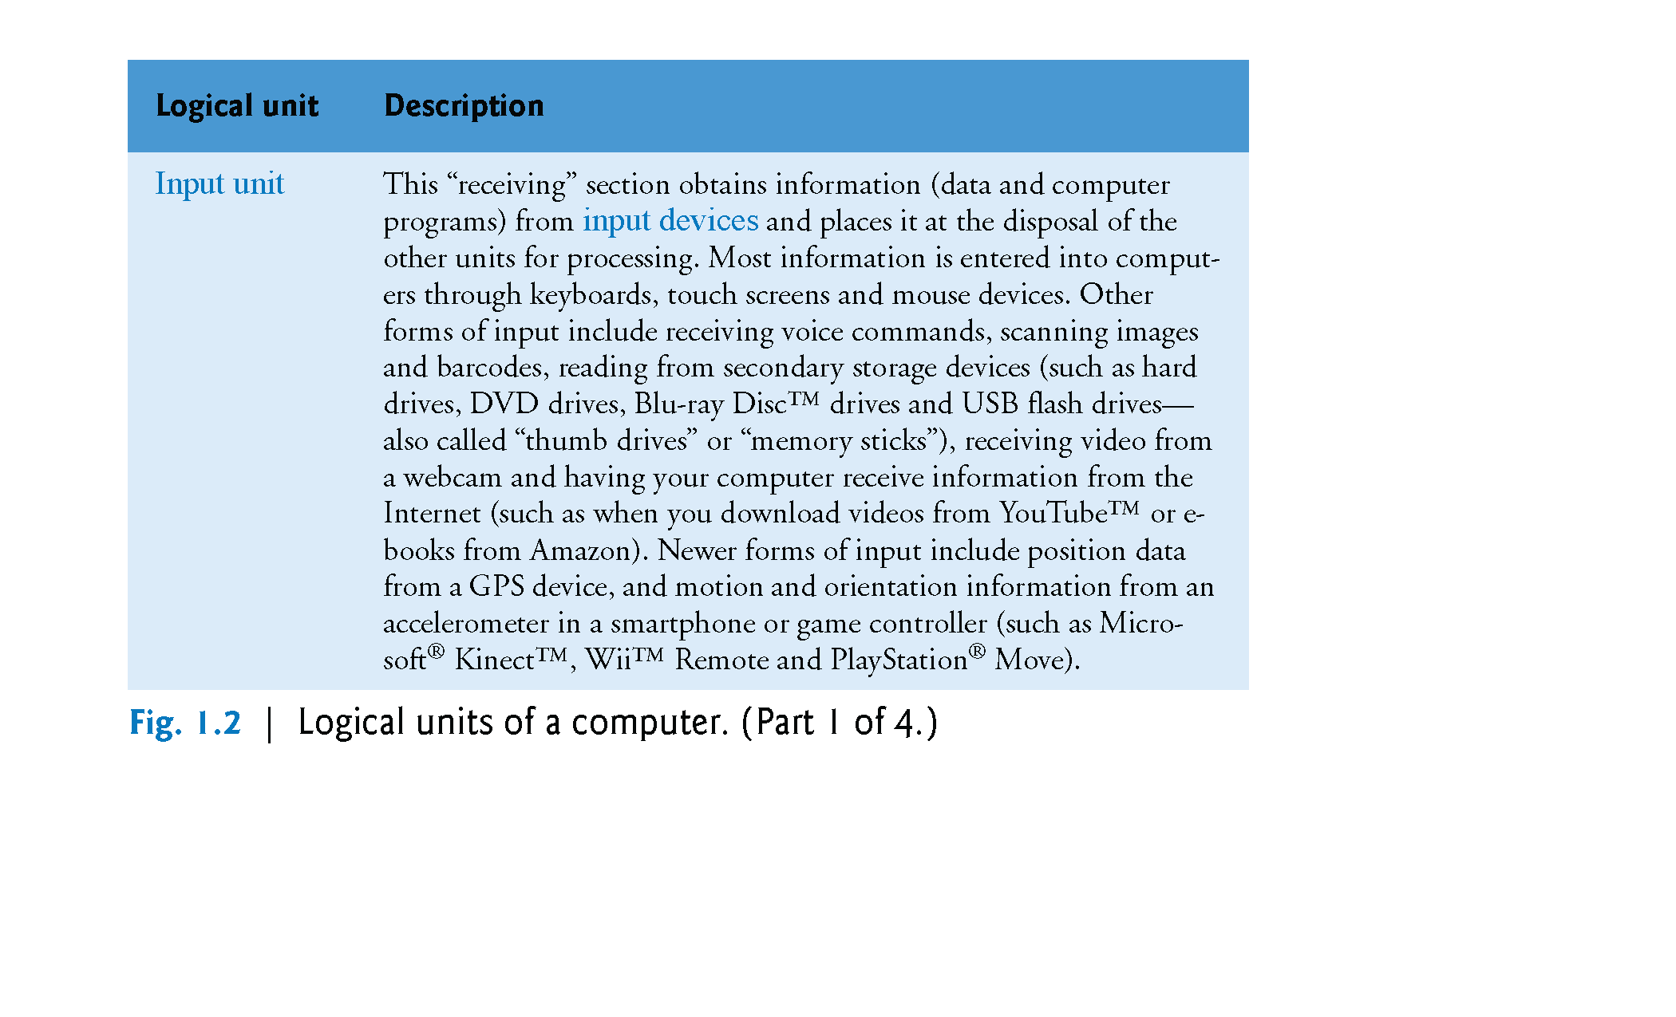
Dr. Soha S. Zaghloul 4 Copyright © Pearson, Inc. 2013. All Rights Reserved.

Slide 5
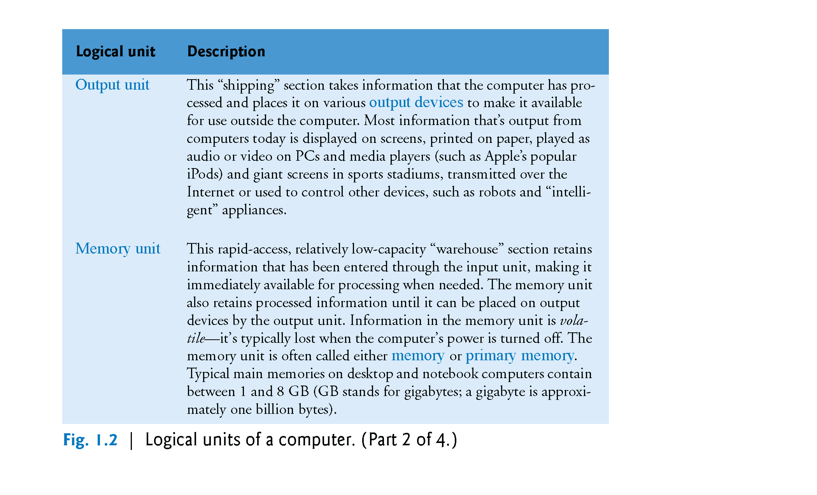
Dr. Soha S. Zaghloul 5 Copyright © Pearson, Inc. 2013. All Rights Reserved.

Slide 6
Dr. Soha S. Zaghloul 6 Copyright © Pearson, Inc. 2013. All Rights Reserved.

Slide 7
Dr. Soha S. Zaghloul 7 Copyright © Pearson, Inc. 2013. All Rights Reserved.

Slide 8
1.3 C Standard Library
As you’ll learn later, C programs consist of pieces called functions.
You can program all the functions you need to form a C program, but most C programmers take advantage of the rich collection of existing functions called the C Standard Library.
When programming in C you’ll typically use the following building blocks:
C Standard Library functions
Functions you create yourself
Functions other people (whom you trust) have created and made available to you
Dr. Soha S. Zaghloul 8 Copyright © Pearson, Inc. 2013. All Rights Reserved.

Slide 9
1.4.1 C program development steps: Editing
The first step consists of editing a file with an editor program.
You type a C program with the editor, make corrections if necessary, then store the program on a secondary storage device such as a hard disk.
C program file names should end with the .c extension.
Dr. Soha S. Zaghloul 9 Copyright © Pearson, Inc. 2013. All Rights Reserved.

Slide 10
1.4.2 C PROGRAM DEVELOPMENT STEPS: Preprocessing
The C preprocessor obeys special commands called preprocessor directives, which indicate that certain manipulations are to be performed on the program before compilation.
These manipulations usually consist of including other files (#include <file2>) in the file to be compiled and performing various text replacements.
Dr. Soha S. Zaghloul 10 Copyright © Pearson, Inc. 2013. All Rights Reserved.

Slide 11
1.4.3 c PROGRAM DEVELOPMENT steps: Compiling
Then, you give the command to compile the program.
The compiler translates the C program into machine language-code.
A syntax error occurs when the compiler cannot recognize a statement because it violates the rules of the language.
Syntax errors are also called compilation.
Dr. Soha S. Zaghloul 11 Copyright © Pearson, Inc. 2013. All Rights Reserved.

Slide 12
1.4.4 c program development steps: Linking
C programs typically contain references to functions defined elsewhere, such as in the standard libraries or in the private libraries of groups of programmers working on a particular project.
The object code produced by the C compiler typically contains “holes” due to these missing parts.
A linker links the object code with the code for the missing functions to produce an executable file (with no missing pieces).
If the program compiles and links correctly, an executable file is produced.
Dr. Soha S. Zaghloul 12 Copyright © Pearson, Inc. 2013. All Rights Reserved.

Slide 13
1.4.5 c PROGRAM DEVELOPMENT STEPS: Loading
Before a program can be executed, the program must first be placed in memory.
This is done by the loader, which takes the executable image from disk and transfers it to memory.
Additional components from shared libraries that support the program are also loaded.
Dr. Soha S. Zaghloul 13 Copyright © Pearson, Inc. 2013. All Rights Reserved.

Slide 14
1.4.6 C program development steps: Execution
Finally, the computer, under the control of its CPU, executes the program one instruction at a time.
Run-time errors may occur while program execution.
For example, a program might attempt to divide by zero (an illegal operation on computers just as in arithmetic).
This causes the program to terminate immediately giving an error message.
Non fatal errors may let the program terminate giving incorrect results.
Dr. Soha S. Zaghloul 14 Copyright © Pearson, Inc. 2013. All Rights Reserved.

Slide 15
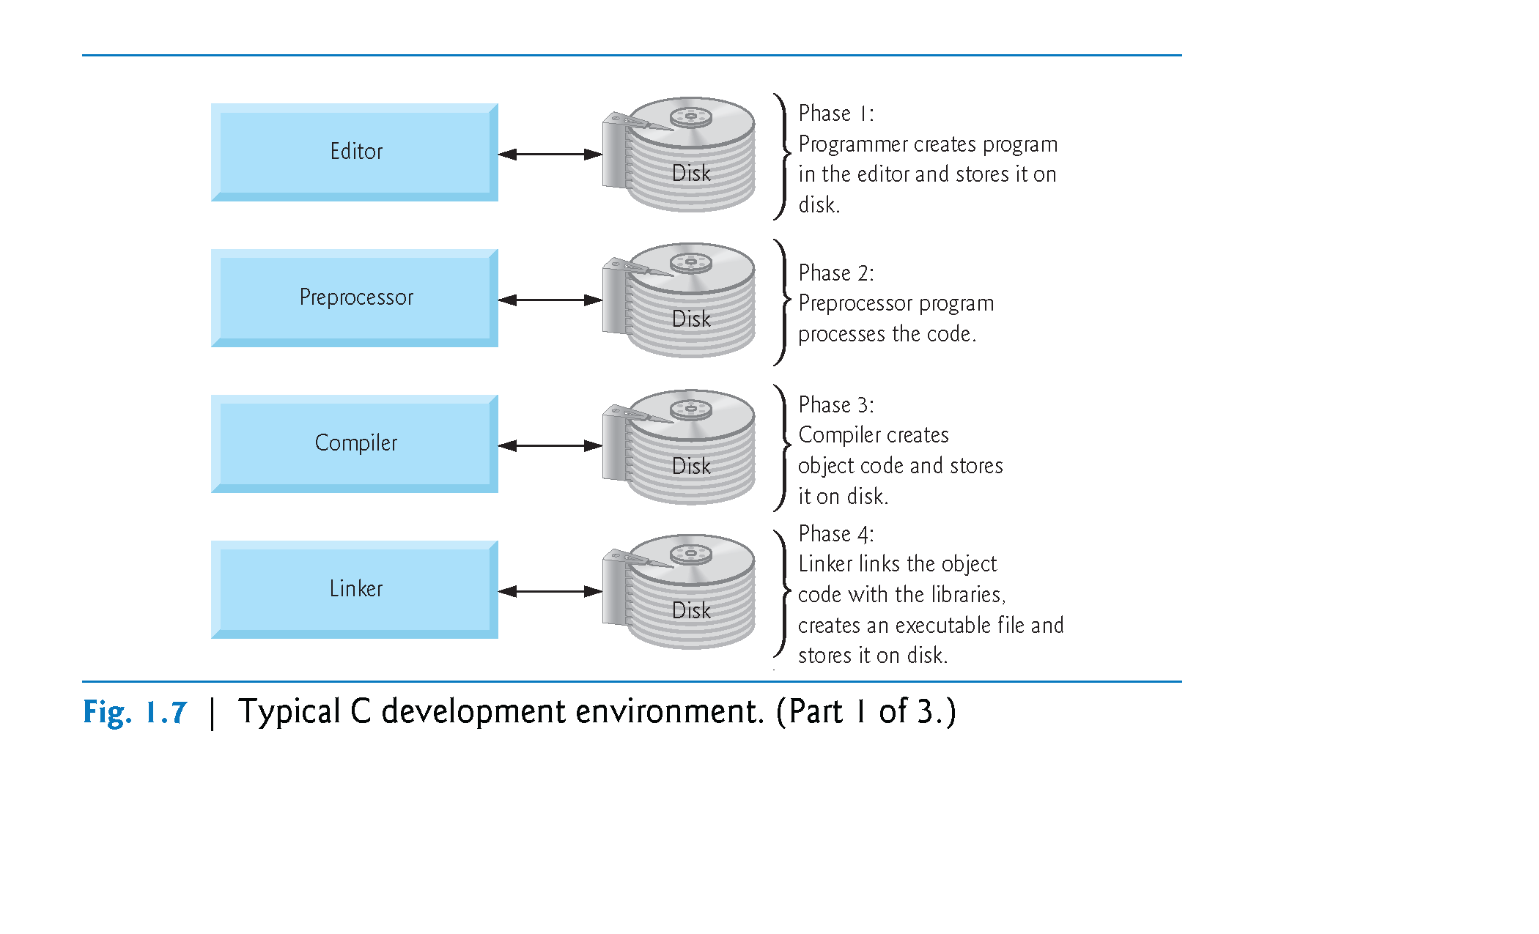
Dr. Soha S. Zaghloul 15 Copyright © Pearson, Inc. 2013. All Rights Reserved.

Slide 16
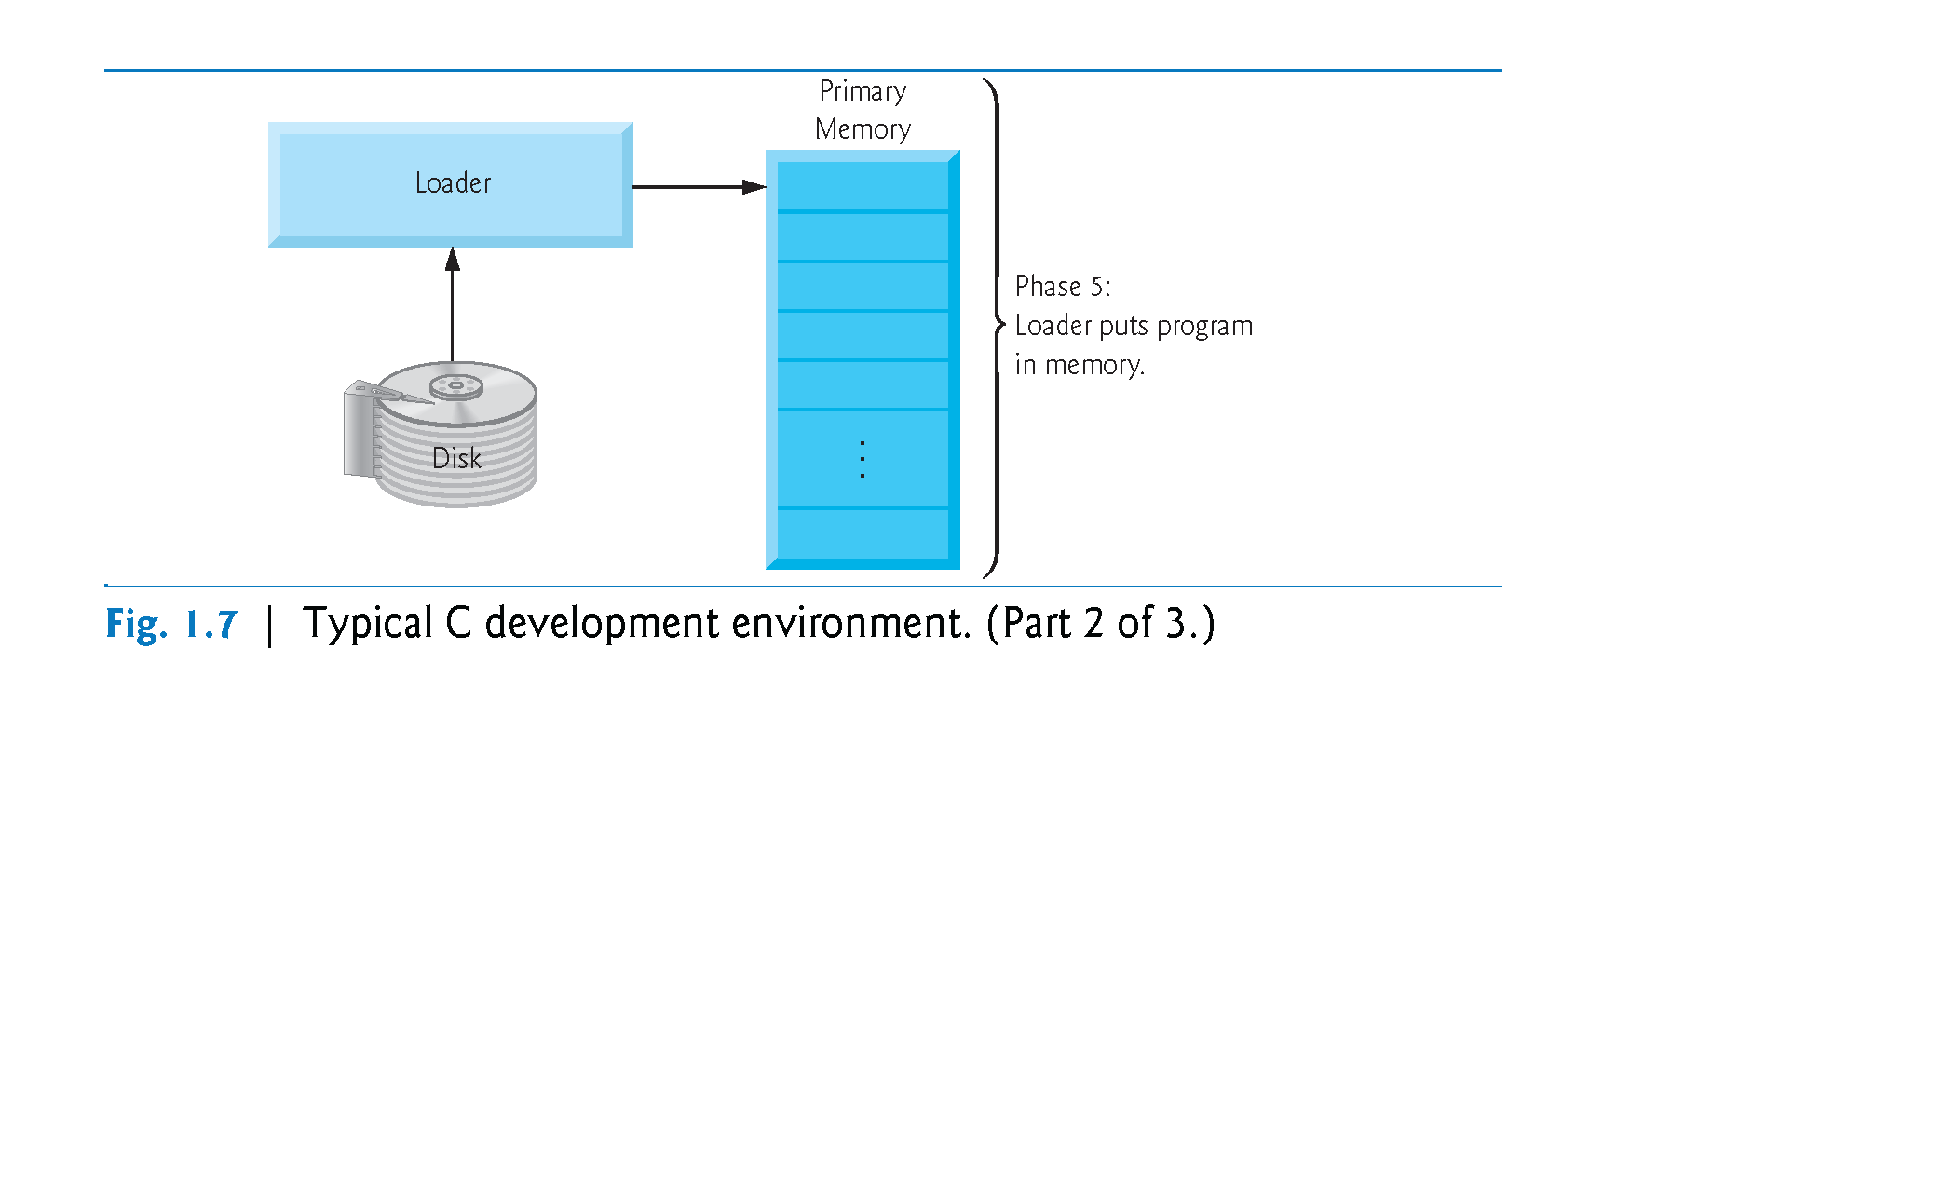
Dr. Soha S. Zaghloul 16 Copyright © Pearson, Inc. 2013. All Rights Reserved.

Slide 17
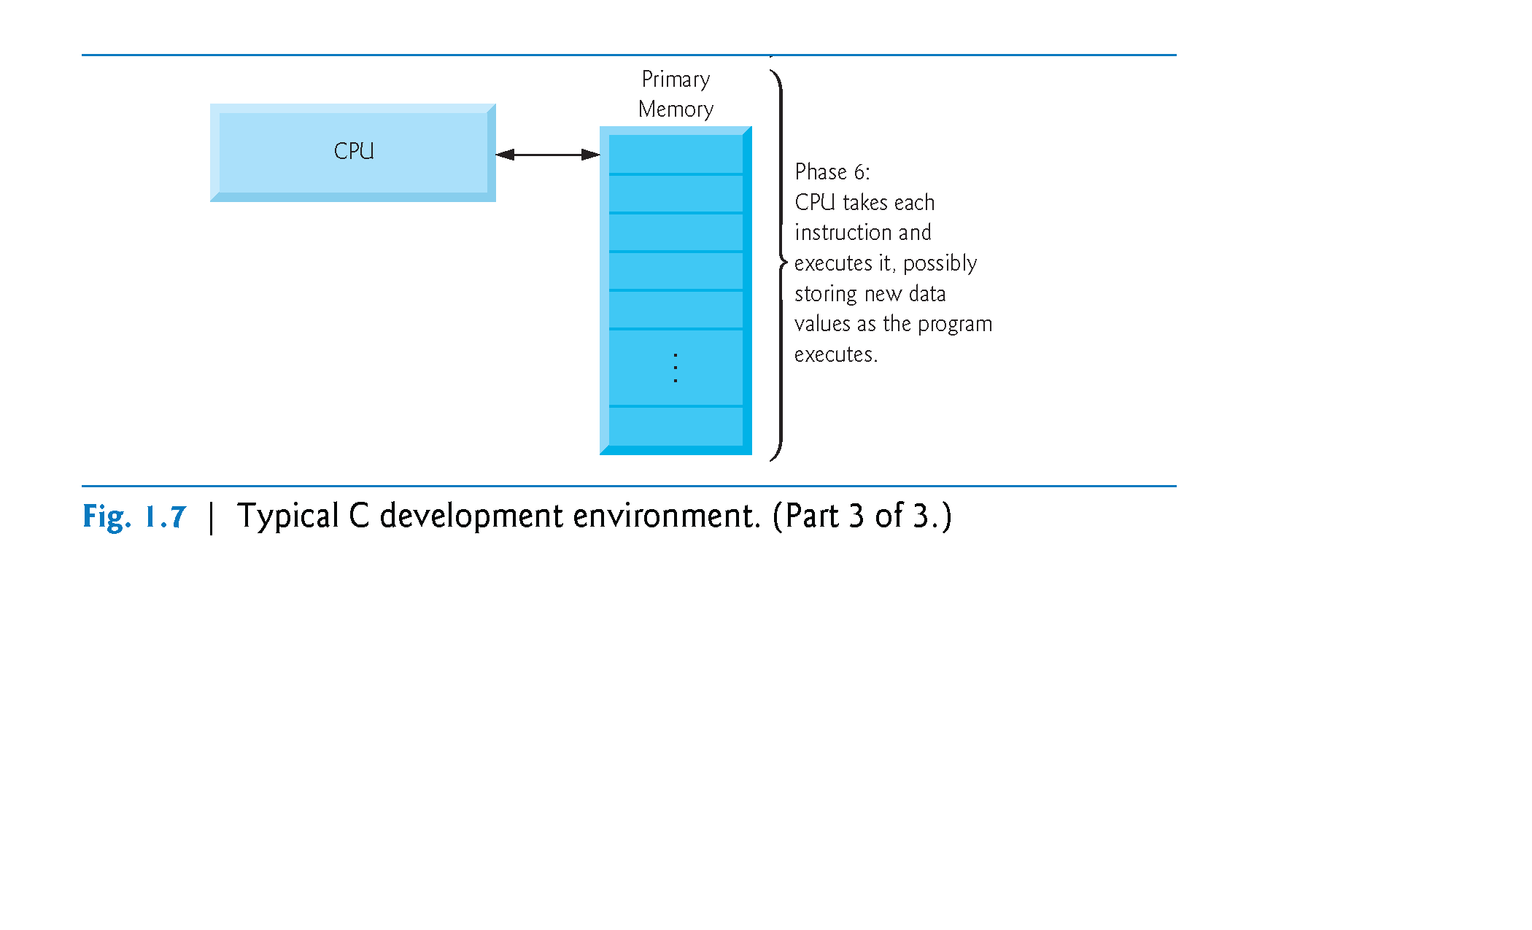
Dr. Soha S. Zaghloul 17 Copyright © Pearson, Inc. 2013. All Rights Reserved.

Slide 18
1.5 A Simple C Program: Printing a Line of Text
We begin by considering a simple C program.
Our first example prints a line of text (Fig. 2.1).

Slide 19
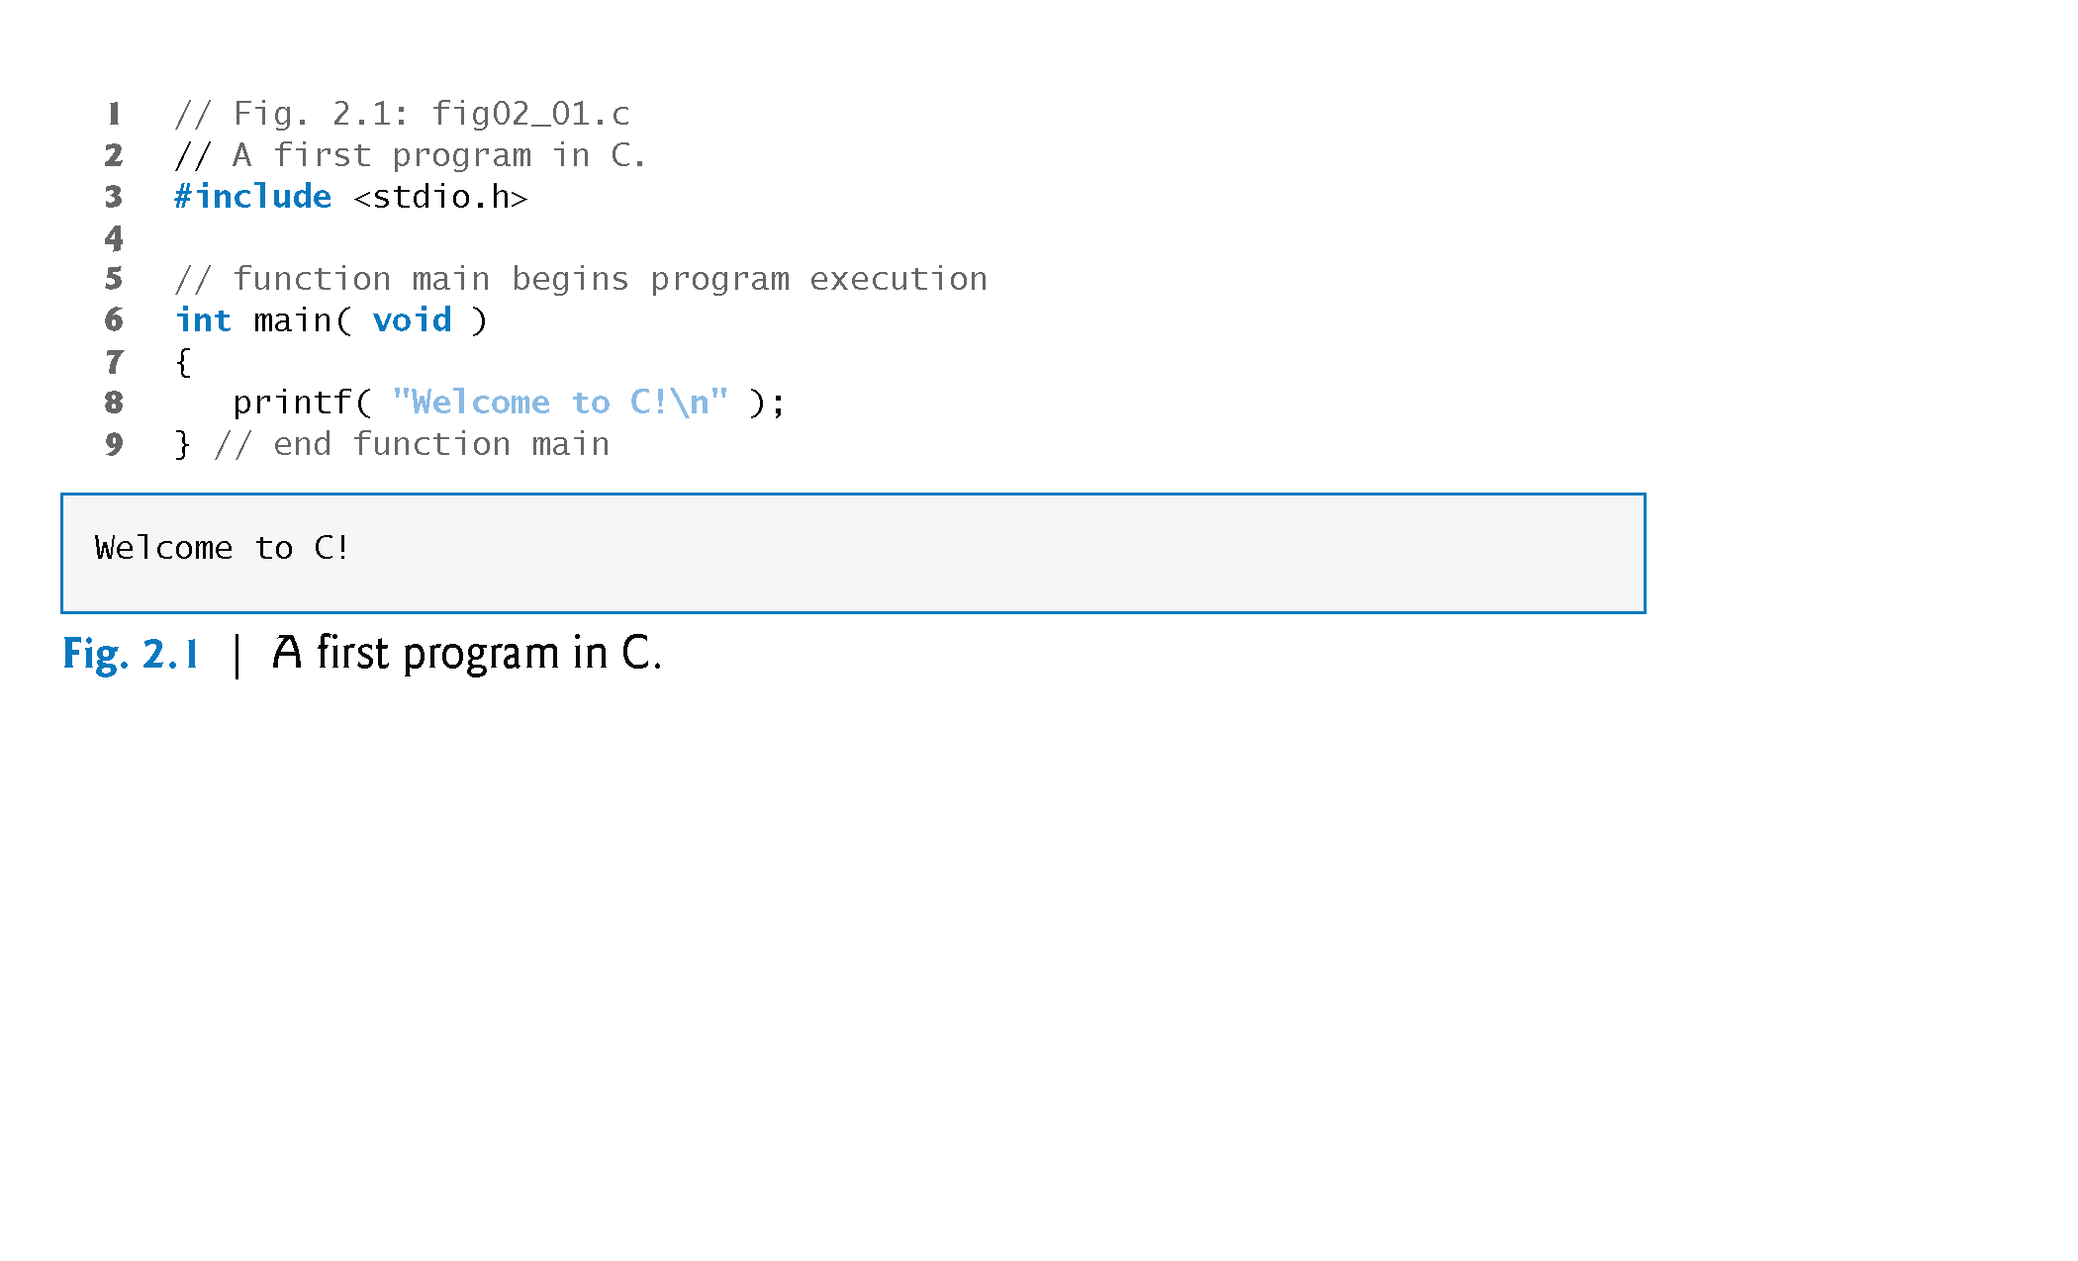

Slide 20
1.5 A Simple C Program: Printing a Line of Text (Cont.)
Comments…
Lines 1 and 2
// Fig. 2.1: fig02_01.c A first program in C
begin with //, indicating that these two lines are comments.
You insert comments to document programs and improve program readability.
Comments do not cause the computer to perform any action when the program is run.
Comments are ignored by the C compiler and do not cause any machine-language object code to be generated.
Comments also help other people read and understand your program.

Slide 21
2.2 A Simple C Program: Printing a Line of Text (Cont.)
Comments…
You can also use /*…*/ multi-line comments in which everything from /* on the first line to */ at the end of the line is a comment.
We prefer // comments because they’re shorter and they eliminate the common programming errors that occur with /*…*/ comments, especially when the closing */ is omitted.

Slide 22
2.2 A Simple C Program: Printing a Line of Text (Cont.)
Preprocessor Directive…
#include Preprocessor Directive
Line 3
#include <stdio.h>
is a directive to the C preprocessor.
Lines beginning with # are processed by the preprocessor before compilation.
Line 3 tells the preprocessor to include the contents of the standard input/output header (<stdio.h>) in the program.
This header contains information used by the compiler when compiling calls to standard input/output library functions such as printf.

Slide 23
2.2 A Simple C Program: Printing a Line of Text (Cont.)
White Space Characters…
Blank Lines and White Space
Line 4 is simply a blank line. You use blank lines, space characters and tab characters (i.e., “tabs”) to make programs easier to read.
Together, these characters are known as white space. White-space characters are normally ignored by the compiler.

Slide 24
2.2 A Simple C Program: Printing a Line of Text (Cont.)
The Main Function…
The main Function
Line 6
int main( void )
is a part of every C program.
The parentheses after main indicate that main is a program building block called a function.

Slide 25
2.2 A Simple C Program: Printing a Line of Text (Cont.)
The Main Function…
C programs contain one or more functions, one of which must be main.
Every program in C begins executing at the function main.
The keyword int to the left of main indicates that main “returns” an integer (whole number) value.
We’ll explain what it means for a function to “return a value” when we demonstrate how to create your own functions.
For now, simply include the keyword int to the left of main in each of your programs.
Functions also can receive information when they’re called upon to execute.
The void in parentheses here means that main does not receive any information.

Slide 26
The Main Function…

Slide 27
2.2 A Simple C Program: Printing a Line of Text (Cont.)
Blocks…
A left brace, {, begins the body of every function (line 7).
A corresponding right brace ends each function (line 11).
This pair of braces and the portion of the program between the braces is called a block.

Slide 28
2.2 A Simple C Program: Printing a Line of Text (Cont.)
Output Statement…
An Output Statement
Line 8
printf( "Welcome to C!\n" );
instructs the computer to perform an action, namely to print on the screen the string of characters marked by the quotation marks.
The entire line, including the printf function (the “f” stands for “formatted”), its argument within the parentheses and the semicolon (;), is called a statement.
Every statement must end with a semicolon (also known as the statement terminator).
When the preceding printf statement is executed, it prints the message Welcome to C! on the screen.
The characters normally print exactly as they appear between the double quotes in the printf statement.

Slide 29
2.2 A Simple C Program: Printing a Line of Text (Cont.)
The Escape Sequence…
Escape Sequences
Notice that the characters \n were not printed on the screen.
The backslash (\) is called an escape character.
It indicates that printf is supposed to do something out of the ordinary.
When encountering a backslash in a string, the compiler looks ahead at the next character and combines it with the backslash to form an escape sequence.
The escape sequence \n means newline.
When a newline appears in the string output by a printf, the newline causes the cursor to position to the beginning of the next line on the screen.
Some common escape sequences are listed in Fig. 2.2.

Slide 30
The Escape Sequence…

Slide 31
2.2 A Simple C Program: Printing a Line of Text (Cont.)
The Escape Sequence…
Because the backslash has special meaning in a string, i.e., the compiler recognizes it as an escape character, we use a double backslash (\\) to place a single backslash in a string.
Printing a double quote also presents a problem because double quotes mark the boundaries of a string—such quotes are not printed.
By using the escape sequence \" in a string to be output by printf, we indicate that printf should display a double quote.
The right brace, }, (line 9) indicates that the end of main has been reached.

Slide 32
2.2 A Simple C Program: Printing a Line of Text (Cont.)
End of Main…
The right brace, }, (line 9) indicates that the end of main has been reached.

Slide 35
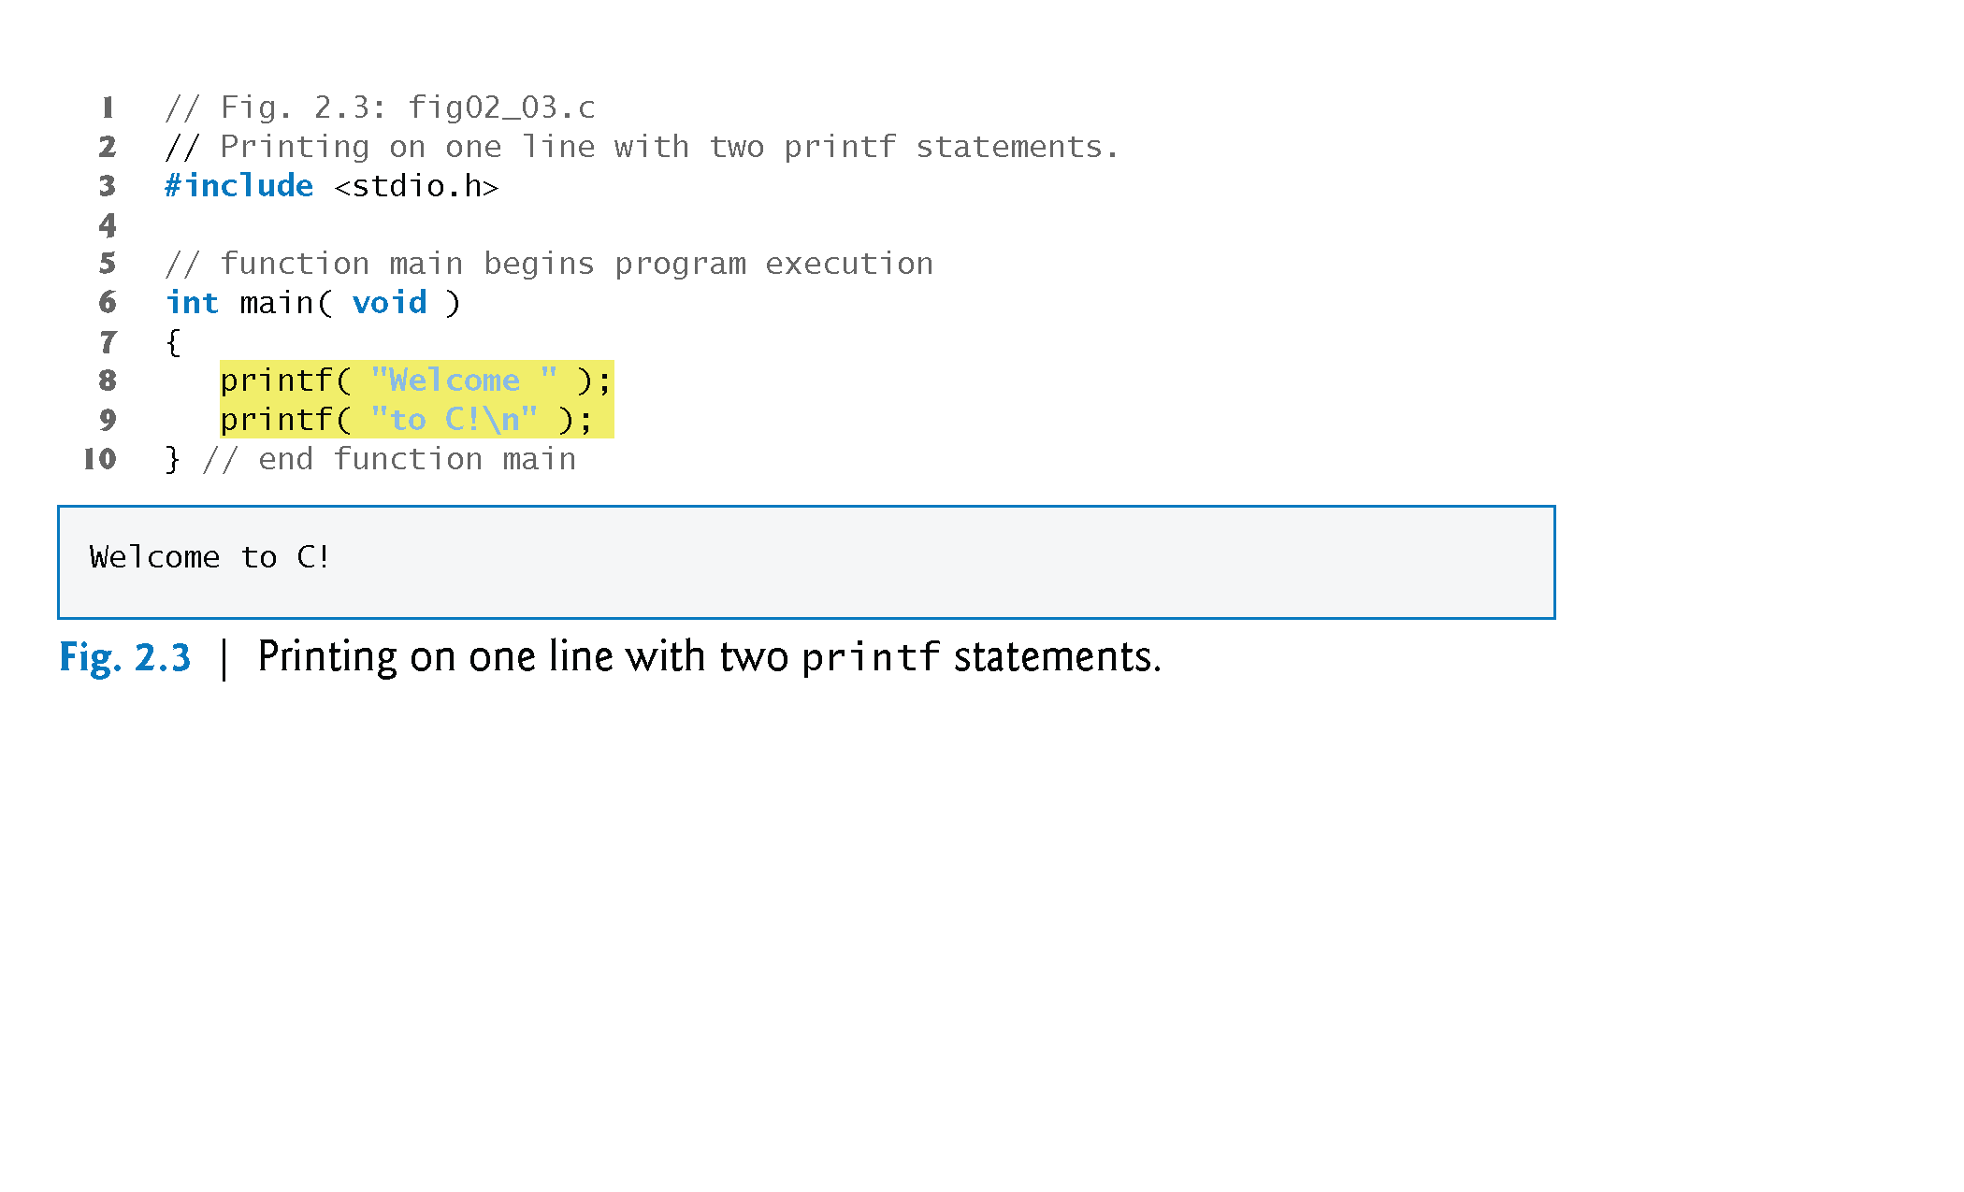

Slide 36
2.2 A Simple C Program: Printing a Line of Text (Cont.)
One printf can print several lines by using additional newline characters as in Fig. 2.4.
Each time the \n (newline) escape sequence is encountered, output continues at the beginning of the next line.

Slide 37
