Slide 1
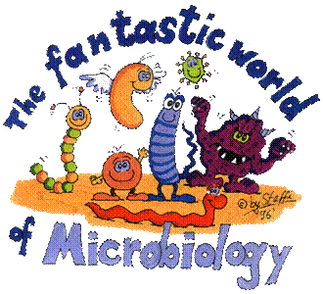
Introduction To Microbiology
CLS 212
Notes:
we will talk about an introduction of microbiology , definition of microbiology ,pathogen and non pathogen microorganism .
Comparison between acellular and cellular microorganism
The important of microorganism
Outline some of the contributions of scientists

Slide 2
What is microbiology?
the branch of biology that studies microorganisms and their effects on humans
Microorganisms
a collection of organisms that share the characteristic of being visible only with a microscope
Microorganisms - Microbes - Germs
Notes:
Micro - too small to be seen with the naked eye
Bio - life
ology - study of
Micro-organisms (or microbes for short) play a very important role in our lives. Some microbes cause disease but the majority are completely harmless. In fact we couldn’t live without them, but they could live without us.

Slide 3
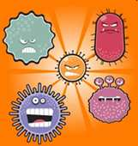
Microbes & You
Normal Flora
Q: Did you always have them?
Q: Are they everywhere on your body?
Q: Are normal flora ever harmful?
Pathogens
Non pathogens
Opportunistic Pathogens
Notes:
Main locations of normal flora:
Skin (epidermis and mucous membranes), especially the moist areas, such as the groin and between the toes.
Respiratory tract, particularly the nose.
Urinary tract.
The digestive tract, i.e. the mouth, the terminal ileum and the colon.
A pathogen (disease causing microorganism ).(full time bad guys) (infectious agents)
Opportunistic Pathogens (part-time bad guys)
An infectious microorganism that is normally does not harm its host but can cause diseases when the host’s resistance is low

Slide 4
Organisms included in the study of Microbiology
1. Bacteria
2. Algae
3. Parasites
4. Yeasts and Molds
Fungi
5. Viruses
Bacteriology
Phycology
Parasitology
Mycology
Virology

Slide 5
Classification of Microorganism
Acellular
Cellular
Prokaryotes
Eukaryotes
They are not cells and have no cell membrane.
They are composed of few genes protected by a protein coat
ex. Viruses.
They can live an reproduce only when inside a living cell.
Pro → Before
Before nucleus , cells without nucleus
Eu→ true or good
Cells that have nucleus .
Have no nucleus,
Have no membrane bond organelles
less complex
Bacteria & Archea
Have true nucleus
Many membrane bond organelles
ex. Algae, protozoa, fungi, plants, animals, and humans.
Notes:
Karyon : nucluse

Slide 6
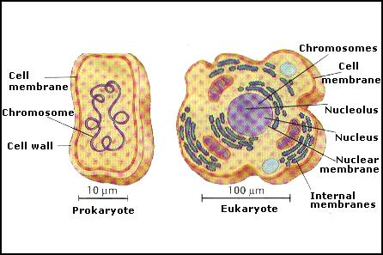
Prokaryotic Cell & Eukaryotic Cell
page 35 (Table 3-1)
Notes:
Students must go back to the reference book to study the table that showing clearly the difference between eukaryotes & prokaryotes
Page 35 (table 3-1)

Slide 7
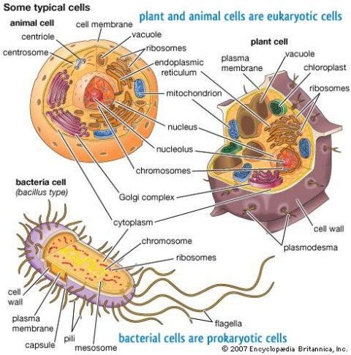

Slide 8
Eukaryotic vs. Prokaryotic
 | Eukaryotic Cell | Prokaryotic Cell
Biological distribution | All animals and protozoa | All bacteria
Nucleus | Present | Absent
Cell Type | Usually multicellular | Usually unicellular (some cyanobacteria may be multicellular)
Nuclear membrane | Present | Absent
Cell wall | Absent | Present
Membranous structures other than cell membrane | Presents | Generally absent
Chromosomes | Composed of DNA and Proteins | Composed of DNA only
Reproduction | Mitosis | Binary fission
Notes:
The organelles include the nucleus, ribosomes, endoplasmic reticulum, Golgi apparatus, vacuoles, lysosomes, mitochondria, and, in plants, chloroplasts.
Binary fission occurs among prokaryotes (cells that do not contain a nucleus). 2.Mitosis occurs among eukaryotes (cells that have a nucleus). 3.Binary fission does not include spindle formation (mitotic apparatus) and sister chromatids in its process making it a faster means of cellular division than mitosis. 4.Binary fission does not have the four distinct cellular phases (from G1 down to the final mitotic phase) that are seen in mitosis.

Slide 9
5 Kingdoms of Living Organisms
1-. Monera ( unicellular prokaryotes)
2- Protista
3-. Fungi
4- Plantae
5- Animalia

Slide 10
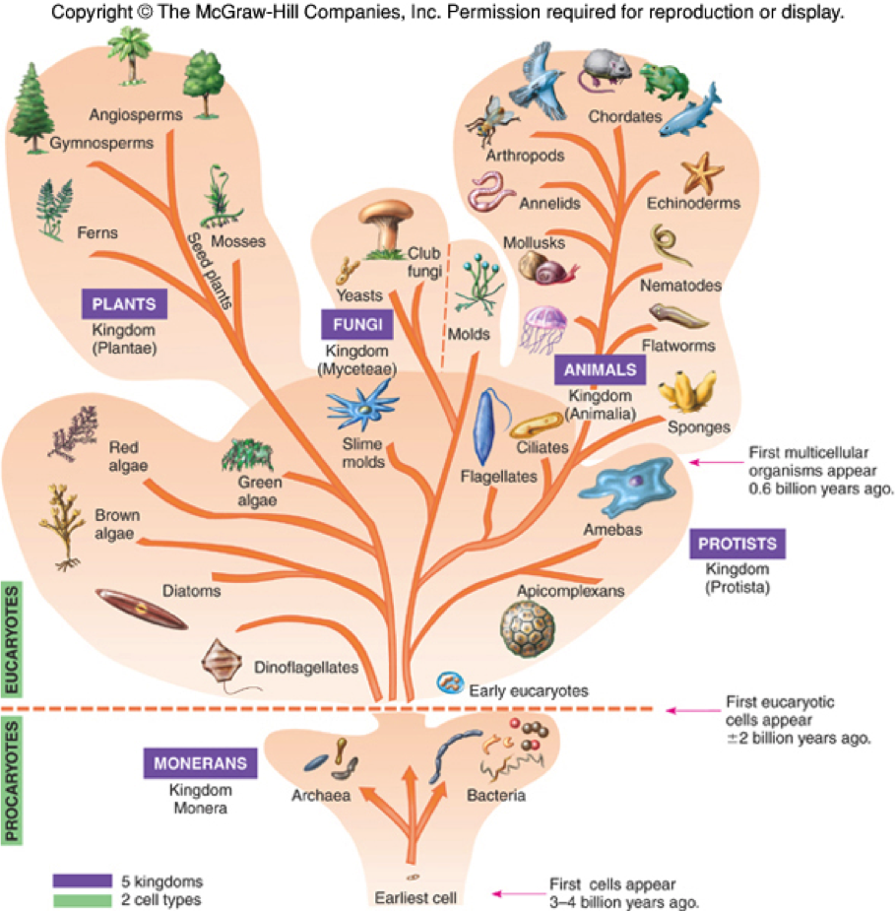
5 Kingdoms of Living Organisms

Slide 11
Taxonomic Classification
Cat
Animalia
Chordate
Mammalia
Carnivora
Felidae
Felis
domestica
Kingdom
Phylum
Class
Order
Family
Genus
species
Notes:
Taxonomy is the science of classifying living organisms
You can ask the students to check out the scientific name of the human

Slide 12
Binomial System of Taxonomic Classification
Use only the Genus and species
Haemophilus influenzae
Toxoplasma gondii
Escherichia coli
Genus and species are either underlined or italicized
Genus is always capitilized
species is never capitilized

Slide 13
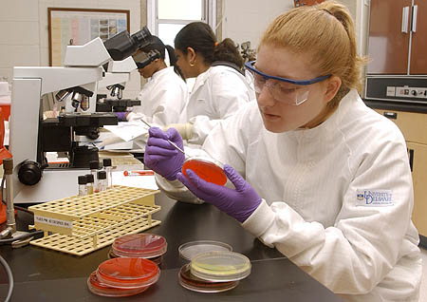
Identification
Microbiologists determine the type of microorganism causing the disease and find a drug, usually an antibiotic, to inhibit the microorganism.
Microbiologists continue to study the microorganisms through research to determine new antibiotics.
Notes:
To identify an organism means to learn the organism’s species name ( i.e. to speciate it )
and this is the job a microbiologist

Slide 14
Microbes Benefit Humans
Bacteria in intestine help in digestion of food and production of some vitamins.
essential in the field of genetic engineering .
Microbes produce various food products
cheese, pickles,, green olives
yogurt, soy sauce, vinegar, bread
Beer, Wine, Alcohol
Notes:
Listed below are few of many reasons to study microbiology
Useful Products from bacteria :-
Chemical poisons to insects
Antibiotics

Slide 15
Microbes Benefit Humans
essential for life on this planet as some produce oxygen e.g. algae and cyanobacteria
are involved in the decomposition of dead organisms and the waste product of living organisms. These are called (Decomposers or Saprophytes)
decompose industrial waste like oil spills
part of the food chain as tiny animals feed on them
Notes:
Useful Products from bacteria :
Chemical poisons to insects
Antibiotics

Slide 16
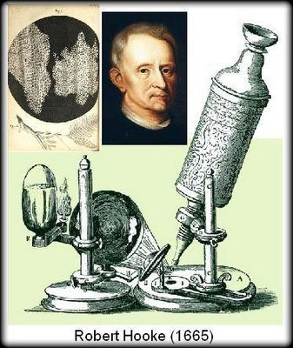
History of the Study of Microorganisms
Robert Hooke, UK (1665)
Proposed the Cell Theory
All living things are composed
of cells

Slide 17
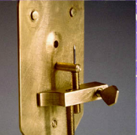
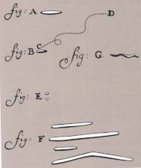
History of the Study of Microorganisms
Anton van Leeuwenhook (1670s)
made a simple one-lens microscope
observed and provided accurate descriptions of protozoa, fungi and bacteria
examine almost anything around him then he called the small living organisms “animalcules”.

Slide 18
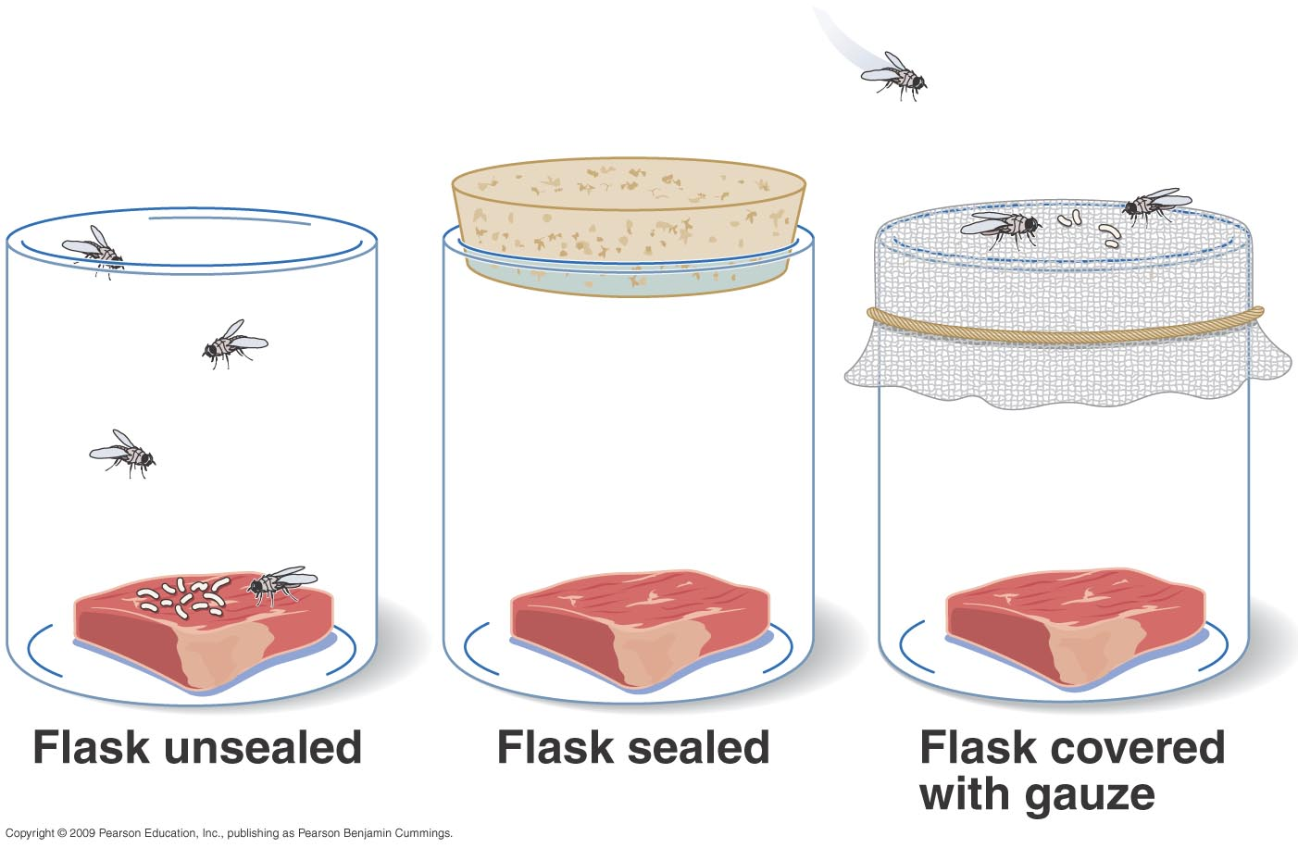
Spontaneous Generation Theory
Spontaneous Generation
Theory that life just “spontaneously” developed from non-living matter
based on observations of rotting food seemingly producing living organisms
Francesco Redi, IT (1626-1678)
Redi’s experiments
first to disprove S.G
Experiment showed that
rotting meat carefully kept from
flies will not spontaneously
produce maggots

Slide 19
Pioneers of Microbiology
Louis Pasteur (1822-1895), Chemist
Fermentation
Pasteurization: heat liquid enough to kill spoilage bacteria
Vaccine development
Proposed the germ theory of disease
Proposed aseptic techniques (prevent contamination by unwanted microbes)
discovered forms of life that can exist in the presence of oxygen called “aerobes” and ones that can exist in the absence of oxygen “anaerobes”.
Notes:
Germ theory: specific microbes cause specific infectious diseases eg (anthrax caused by a specific bacterium (Bacillus anthracis)
fermentation is the conversion of a carbohydrate such as sugar into an acid or an alcohol. More specifically, it can refer to the use of yeast to change sugar into alcohol or the use of bacteria to create lactic acid in certain foods.
Vinegar and cheese are products of bacterial fermentation. Yeast fermentation is used to make leavened bread.

Slide 20
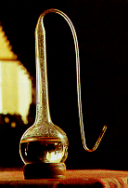
Pasteur’s Experiments
Pasteur designed special “swan-necked flasks” with a boiled meat infusion
Shape of flask allowed air in (vital force) but trapped dust particles which may contain microbes

Slide 21
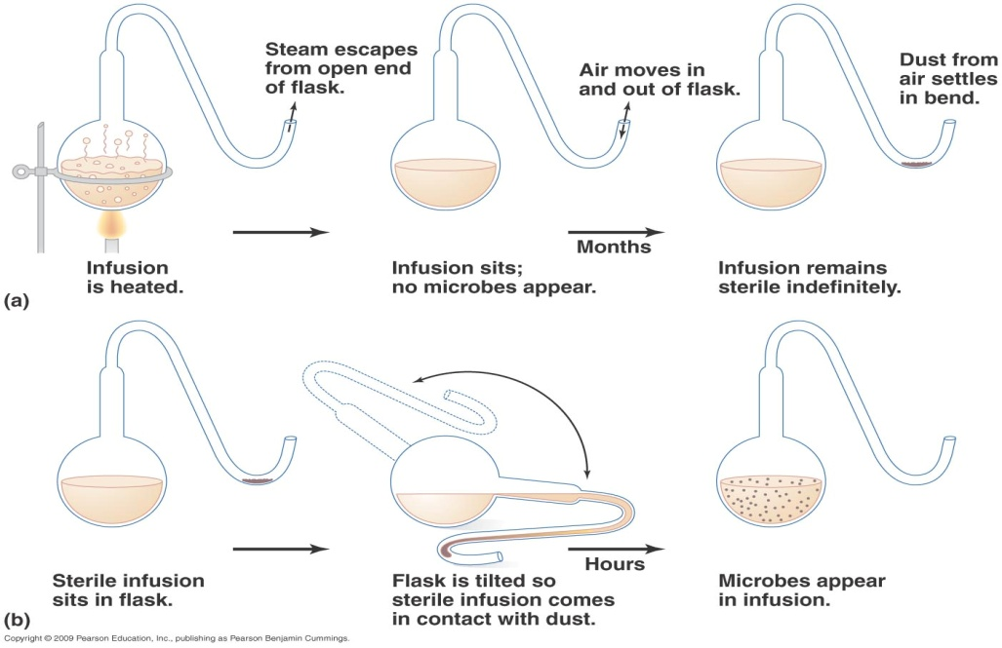
Notes:
When the “swan-necked flasks” remained upright, no microbial growth appeared
When the flask was tilted, dust from the bend in the neck seeped back into the flask and made the infusion cloudy with microbes within a day

Slide 22
Robert Koch (Germany 1843-1910)
He made significant contribution to the
germ theory of disease.
He developed methods of fixing, staining,
and photographing bacteria.
He developed methods for culturing bacteria on solid media.
4. He discovered the bacterium (Mycobacterium tuberculosis) that cause tuberculosis and Invented skin test to diagnose the Tb.
5. He discovered the bacterium (Vibrio cholerae) that causes cholera.
Notes:
Robert koch approve the germ theory
Nobel prize winner as discovered that TB caused caused by a bacterium called Mycobacterium tuberculosis. The bacteria usually attack the lungs, but TB bacteria can attack any part of the body such as the kidney, spine, and brain. If not treated properly, TB disease can be fatal.

Slide 23
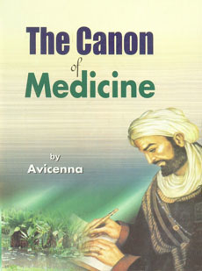
Pioneers of Microbiology
Ibn Sina ( Avicenna )
states that "Body secretions of a host organism are contaminated by tainted foreign organisms that are not visible by naked eye before the infection
He also discovered the contagious nature of tuberculosis
introduced quarantine as a means of limiting the spread of contagious diseases
Notes:
It is quite impressive that this definition is almost the same definition we use today for infections and more importantly that Ibn Sina hypothesized on the existence of microorganisms.
nearly seven centuries after Ibn Sina, the Dutch scientist Anton van Leeuwenhoek observed microorganisms under a microscope

