Slide 1
CLS 212 Medical Microbiology
INSTRUCTOR
Mrs. Hala Al-Dahshan
Email: haldahshan@ksu.edu.sa
Office:
College of Applied Medical Sciences
Department of Clinical Laboratory Sciences
3rd Floor- no. 118
Tel: 011-8050437 ext. 51579

Slide 2
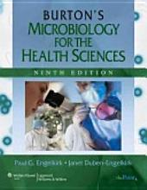

CLS 212 Medical Microbiology
BOOKS:
Burton's Microbiology for the Health Sciences
By Paul G Engelkirk, Janet Duben-Engelkirk –
Lippincott Williams & Wilkins (2010), Ninth
Edition.
Lippincott's Illustrated Reviews:
Microbiology
By Richard A. Harvey, Pamela C. Champe, Bruce D.
Fisher - Lippincott Williams & Wilkins (2006),
Second Edition.

Slide 3
CLS 212 Medical Microbiology
COURSE ASSESMENT Total of 100%
Theory Part: Total of 70%
First Midterm Exam : 15%
Second Midterm Exam : 15%
Final Theoretical Exam : 40%

Slide 4

CLS 212 Medical Microbiology
2. Practical Part: Total of 30%
Lab Quizzes and Attendance: 10%
Final Practical Exam: 20%

Slide 5

Laboratory
Safety 101:
Always wear lab coat
Always wear gloves
Never eat or drink
Closed shoes
Never leave personal items on benches
Always wash your hands before leaving the lab.

Slide 6
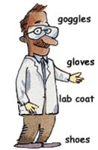
Personal Safety
Clothing
Wear:
Gloves
Long lab coat
Goggles/safety glasses
Closed-toed shoes
Tie back long hair
Do NOT Wear:
Sandals
Jewelry
Loose or
Baggy clothing
Contact lenses

