Slide 1

Fundamentals of Organic Chemistry
CHEM 108
Credit hrs.: (3+1)
King Saud University
College of Science, Chemistry Department
CHEM 108
CHAPTER 1. INTRODUCTION

Slide 2
Learning Outcomes
At the end of this chapter, students will be able to:
Recognize the definition and importance of organic chemistry.
Arrange the electrons in atoms.
Differentiate between ionic and covalent bonds in chemical compounds.
Identify the hybridization of carbon atom.
Know dipole moment & inductive effect in chemical compounds.
Classify the organic compounds according to functional groups.
Define the types of organic reactions.

Slide 3
Importance of Organic Chemistry in every day life
Organic chemistry touches our daily lives. We are made of and surrounded by organic compounds.
Almost all of the reactions in living matter involve organic compounds.
The major constituents of living matter e.g. proteins, carbohydrates, fats, nucleic acid (DNA and RNA), enzymes and hormones are organic.
Other organic materials include the gasoline, oil, tires, clothing we wear, wood for our furniture, the paper for our books, the medicines we take and plastic containers, camera film, perfume, carpeting and fabrics.
In short, organic chemistry is more than just a branch of science for the professional chemist or for student preparing to become a physician, dentist, pharmacist, nurse or agriculturist. It is part of our technological culture.

Slide 4
Organic Chemistry: Definition
The word Organic can be a biological or chemical term, in biology it means anything that is living or has lived. The opposite is Non-Organic.
Organic Chemistry is unique in that it deals with vast numbers of substances, both natural and synthetic.
The clothes, the petroleum products, the paper, rubber, wood, plastics, paint, cosmetics, insecticides, and drugs
But, from the chemical makeup of organic compounds, it was recognized that one constituent common to all was the element carbon.
Organic chemistry is defined as the study of carbon/hydrogen-containing compounds and their derivatives.

Slide 5
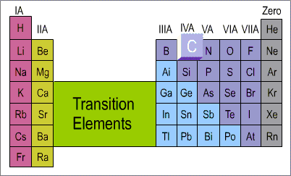
The Uniqueness of Carbon
What is unique about the element carbon?
Why does it form so many compounds?
The answers lie in
The structure of the carbon atom.
The position of carbon in the periodic table.
These factors enable it to form strong bonds with
other carbon atoms
and with other elements (hydrogen, oxygen, nitrogen, halogens,…etc).
Each organic compound has its own characteristic set of physical and chemical properties which depend on the structure of the molecule.

Slide 6
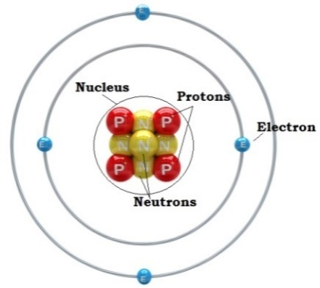
Atomic Structure
Atoms consist of three main particles: neutrons (have no charge), protons (positively charged) and electrons (negatively charged).
Neutrons and protons are found in the nucleus.
Electrons are found outside the nucleus.
Electrons are distributed around the nucleus in successive shells (principal energy levels).
Atom is electrically neutral.
i.e. Number of electrons = Number of protons
Atomic number of an element is the number of protons.
The atomic weight is approximately equal to the sum of the number of protons and the number of neutrons in the nucleus

Slide 7
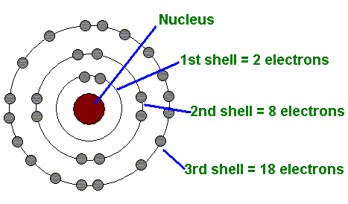
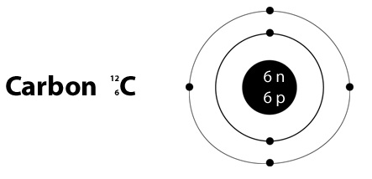
Atomic Structure
The energy levels are designated by capital letters (K, L, M, N, ..) or whole numbers (n).
The maximum capacity of a shell = 2n² electrons.
n = number of the energy level.
For example, the element carbon (atomic number 6)
6 electrons are distributed about the nucleus as
Shell K L M N
Number of electrons 2 4 0 0

Slide 8
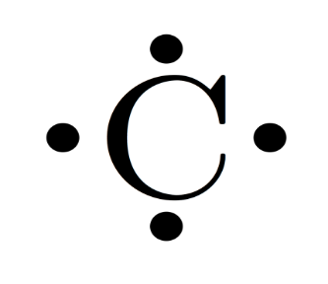
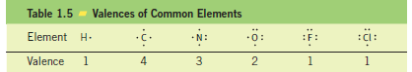
Atomic Structure
Electron-dot structures
Valance Electrons are those electrons located in the outermost energy level (the valance shell).
Electron-dot structures
The symbol of the element represents the core of the atom.
The valance electrons are shown as dots around the symbol.
Valance Electrons are those electrons located in the outermost energy level (the valance shell).
Valences of Common Elments

Slide 9
Chemical Bonding
In 1916 G.N. Lewis pointed out that:
The noble gases were stable elements and he described their lack of reactivity to their having their valence shells filled with electrons.
2 electrons in case of helium.
8 electrons for the other noble gases.
According to Lewis,
in interacting with one another atoms can achieve a greater degree of stability
by rearrangement of the valence electrons
to acquire the outer-shell structure of the closest noble gas in the periodic table.

Slide 10
Chemical Bonding
A) Ionic Bonds
Elements at the left of the periodic table give up their valance electrons and become +ve charged ions (cations).
Elements at the right of the periodic table gain the electrons and become -ve charged ions (anions).
Ionic bond
The electrostatic force of attraction between oppositely charged ions.
The majority of ionic compounds are inorganic substances.

Slide 11
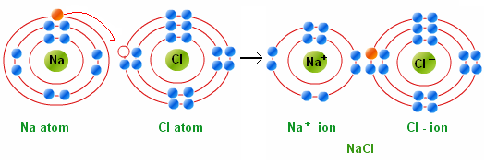

Increasing Electronegativity
Chemical Bonding
A) Ionic Bonds
Electronegativity Measures The Ability of An Atom To Attract Electrons
Example
Increasing Electronegativity
 |  |  |  |  |  |  | H
 |  |  |  |  |  |  | 2.1
F | O | N | C | B |  | Be | Li
4 | 3.5 | 3 | 2.5 | 2 |  | 1.5 | 1
Cl | S | P | Si | Al |  | Mg | Na
3 | 2.5 | 2.1 | 1.8 | 1.5 |  | 1.2 | 0.9
Br |  |  |  |  |  |  | K
2.8 |  |  |  |  |  |  | 0.8

Slide 12
Chemical Bonding
B) Covalent Bonds
Elements that are close to each other in the periodic table attain the stable noble gas configuration by sharing valence electrons between them.
A shared electron pair between two atoms or single covalent bond, will be represented by a dash (-).
A covalent bond involves the mutual sharing of one or more electron pairs between atoms.
When the two atoms are identical or have equal electronegativities, the electron pairs are shared equally

Slide 13
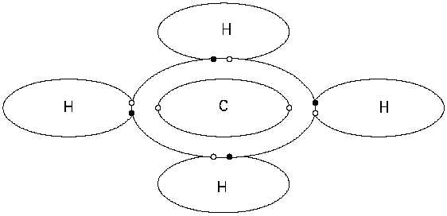
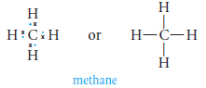
Chemical Bonding
B) Covalent Bonds
When two unlike atoms;
the bonding electrons are no longer shared equally (shared unequally).
1) A Polar Covalent Bond
A bond, in which an electron pair is shared unequally.
The more electronegative atom assumes a partial negative charge and the less electronegative atom assumes a partial positive charge.

Slide 14
Chemical Bonding
2) Coordinate Covalent Bonds
There are molecules in which one atom supplies both electrons to another atom in the formation of a covalent bond.
For example;
Lewis base
The species that furnishes the electron pair to form a coordinate covalent bond.
Lewis acid
The species that accepts the electron pair to complete its valance shell.

Slide 15
Chemical Bonding
How Many Bonds to an Atom? Covalence Number
The number of covalent bonds that an atom can form with other atoms.
i.e. the covalence number is equal to the number of electrons needed to fill its valance shell.
Element Number of Number of electrons Covalence
valence electrons in filled valence shell number
H 1 2 1
C 4 8 4
N 5 8 3
O 6 8 2
F, Cl, Br, I 7 8 1

Slide 16
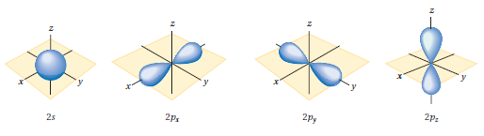
Shapes of Organic Molecules:
Orbital Picture of Covalent Bonds
Atomic Orbitals
An atomic orbital represents a specific region in space in which an electron is most likely to be found.
Atomic orbitals are designated in the order in which they are filled by the letters s, p, d, and f.
Examples:
K shell has only one 1s orbital.
L shell has one 2s and three 2p (2p_{x}, 2p_{y} and 2p_{z}).
An s orbital is spherically shaped electron cloud with the atom’s nucleus and its center.
A p orbital is a dumbbell-shaped electron cloud with the nucleus between the two lobes.

Slide 17
Shapes of Organic Molecules:
Orbital Picture of Covalent Bonds
Atomic Orbitals
An energy level diagram of atomic orbitals.
When filling the atomic orbitals, keep in mind that
(1) An atomic orbital contain no more 2 electrons.
(2) Electrons fill orbitals of lower energy first.
(3) No sub-orbital is filled by 2 electrons until all the sub-orbitals of equal energy have at least one electron.

Slide 18
Shapes of Organic Molecules:
Orbital Picture of Covalent Bonds
Atomic Orbitals
The electronic configuration of carbon (atomic number 6) can be represented as
1s²2s²sp¹_{x}2p¹_{y} or 1s²2s²2p²

Slide 19
Shapes of Organic Molecules:
Orbital Picture of Covalent Bonds
Molecular Orbitals
A covalent bond consists of the overlap between two atomic orbitals to form a molecular orbital.
Example:
Molecular orbital of H₂

Slide 20
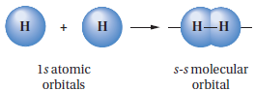


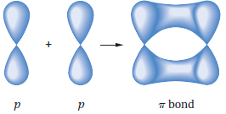
Shapes of Organic Molecules:
Orbital Picture of Covalent Bonds
Molecular Orbitals
Sigma bonds (σ bonds) can be formed from
The overlap of two s atomic orbitals.
The end-on overlap of two p atomic orbitals.
The overlap of two an s atomic orbital with a p atomic orbital.
pi bonds (π bonds) can be formed from the side-side overlap between two p atomic orbitals.

Slide 21
Bond Energy and Bond Length
A molecule is more stable than the isolated constituent atoms.
This stability is apparent in the release of energy during the formation of the molecular bond.
Heat of formation (bond energy)
The amount of energy released when a bond is formed.
Bond dissociation energy
The amount of energy that must be absorbed to break a bond.
Bond length
The distance between nuclei in the molecular structure.

Slide 22
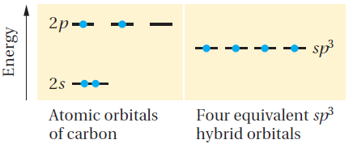

Hybridization (Alkanes sp³)
The electronic configuration of the isolated or ground-state carbon
1s²2s²2p_{x}¹2p_{y}¹
Equivalent to
Mix or combine the four atomic orbitals of the valence shell to form four identical hybrid orbitals, each containing one valence electron.
In this model, the hybrid orbitals are called sp³ hybrid orbitals because each one has one part s character and three parts p character
Each sp³ orbital has the same energy: less than that of the 2p orbitals but greater than that of the 2s orbital.

Slide 23
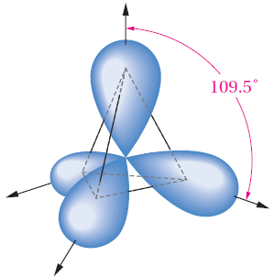
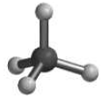
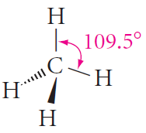
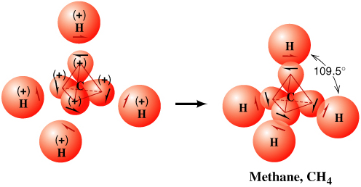
Hybridization (Saturated Hydrocarbons: Alkanes sp³)
Regular tetrahedron with all H-C-H bond angles of 109.5º.

Slide 24
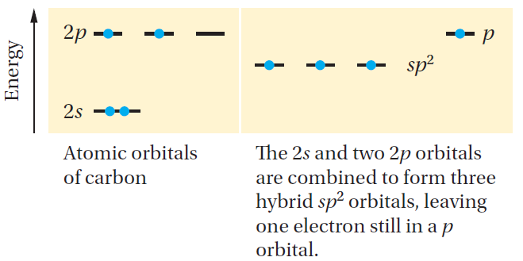
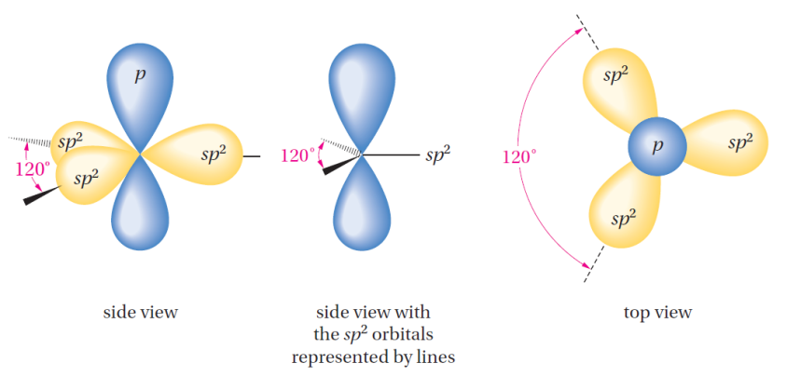
Hybridization (Unsaturated Hydrocarbons: Alkenes sp²)
Combine only three of the orbitals, to make three equivalent sp²-hybridized orbitals (called sp² because they are formed by combining one s and two p orbitals)
Three valence electrons are placed in the three sp² orbitals. The fourth valence electron is placed in the remaining 2p orbital, whose axis is perpendicular to the plane formed by the three sp² hybrid orbitals
A trigonal carbon with bond angles of 120º.

Slide 25
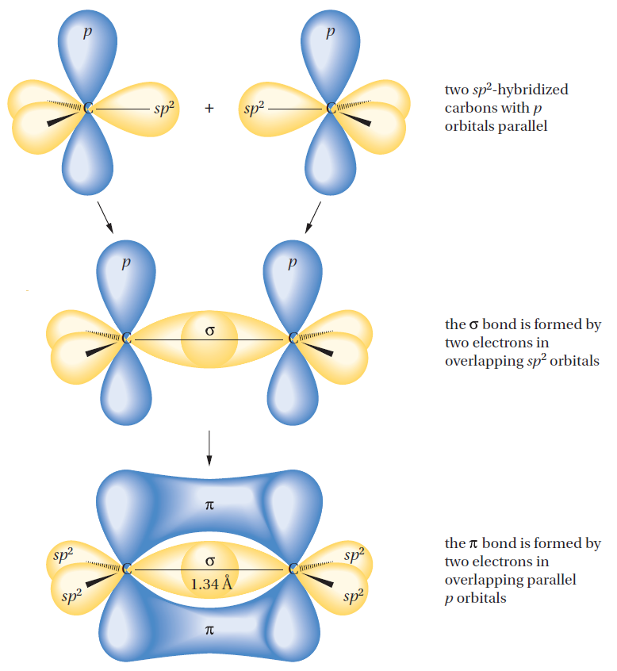
Hybridization (Alkenes sp²)
Schematic formation of a carbon–carbon double bond. Two sp² carbons form a sigma (s) bond (end-on overlap of two sp² orbitals) and a pi (p) bond (lateral overlap of two properly aligned p orbitals).

Slide 26
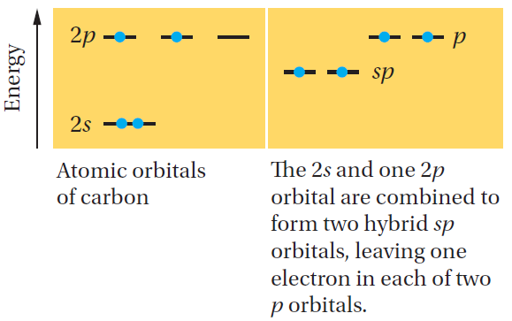
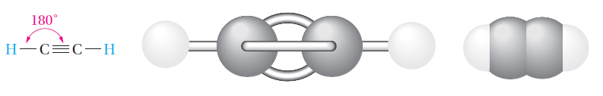
Hybridization (Unsaturated Hydrocarbons: Alkynes sp)
The carbon atom of an acetylene is connected to only two other atoms. Therefore, we combine the 2s orbital with only one 2p orbital to make two sp-hybrid orbitals
The angle between the two hybrid orbitals is 180°
Linear

Slide 27
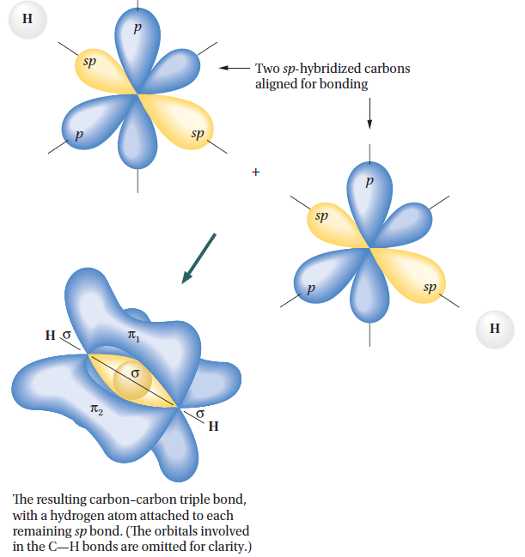
Hybridization (Alkynes sp)
A triple bond consists of the end-on overlap of two sp-hybrid orbitals to form a σ bond and the lateral overlap of two sets of parallel-oriented p orbitals to form two mutually perpendicular π bonds.

Slide 28
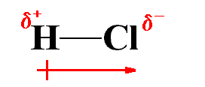

Inductive Effect
Inductive effect can be defined as the permanent displacement of electrons forming a covalent bond (sigma σ bonds ) towards the more electronegative element or group.
The inductive effect is represented by the symbol, the arrow pointing towards the more electronegative element or group of elements.
(+ I) effect if the substituent electron-donating
(- I) effect if the substituent electron-withdrawing
Electron-donating substituents (+I): -CH₃, -C₂H₅,….
Electron-withdrawing substituents (-I): -NO₂, -CN, -SO₃H, COOH, COOR, NH₂, OH, OCH₃

Slide 29
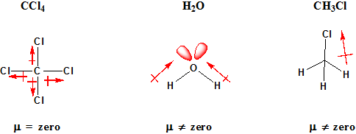
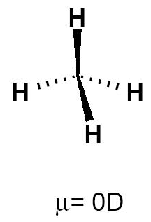
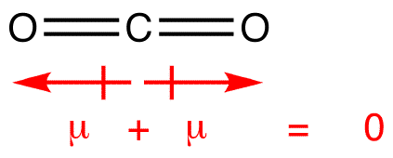
Bond Polarity and Dipole Moment (µ)
Dipole moment (depends on the inductive effect).
A bond with the electrons shared equally between two atoms is called a nonpolar bond like in Cl-Cl and C-C bond in ethane.
A bond with the electrons shared unequally between two different elements is called a polar bond.
The bond polarity is measured by its dipole moment (µ).
Dipole moment (µ) defined to be the amount of charge separation ( +δ and –δ ) multiplied by the bond length.

Slide 30
Functional Groups
Class | General formula | Functional group | Specific
Functional Group is a reactive portion of an organic molecule, an atom, or a group of atoms that confers on the whole molecule its characteristic properties.
Alkane | RH | C – C (single bond) | H₃C – CH₃
Alkene | R – CH = CH₂ | C = C (double bond) | H₂C = CH₂
Alkyne |  | (triple bond)
Alkyl halide | RX | X (X = F, Cl, Br, I) | H₃C - Cl
Alcohol | R – OH | OH | H₃C - OH
Ether | R – O –R’ | - C- O – C - | H₃C – O – CH₃
Aldehyde
Ketone
Carboxylic acid
Ester
Amine | R – NH₂ |  | H₃C – NH₂

Slide 31
Types of Organic Reactions
Substitution reactions
Addition Reaction
Elimination Reaction
Oxidation
Reduction
Rearrangement

Slide 32
Notations for bond breaking and bond making
A covalent bond can be broken in either two ways,
Homolytic cleavage.
Free radicals
Heterolytic cleavage.
Carbocation
Carboanion

