Slide 1
Basic microbiology
4 hour subject
Assessments:
first mid term exam : 15%
Second mid term exam : 15%
Final theoretical exam : 40%
Total theory: 70%
Lab quiz and evaluation 10%
Final practical exam 20%

Slide 2
Over view :
Microorganism: is a small living organism found in every ecosystem and in close association with every type of multi-cellular organism.
It lives within human body and participate in body function as bacteria in intestine, it is called Normal flora

Slide 3
Where as 3% of known microbes are harmful to human body: it is called pathogen.

Slide 4
Taxonomy which is “the science of classification of living organisms”
According to Bergeys manual of systemic bacteriology consisted of separated areas :
classification 2.nomenclature 3.identification

Slide 5
Classification : arrangement of organisms into taxonomic (taxa) on the basis of similarities or relationships.
The taxa include:
Kingdom or domains
Division or phyla
Classes
Order
Families
Genera
Species

Slide 6
There is 5 kingdom:
Procaryotae------------Bacteria and archaeans.
Protista---------------Algae and protozoea.
Fungi------------------fungi
Plantea---------------plantae
Animalia------------- animals and human .

Slide 7
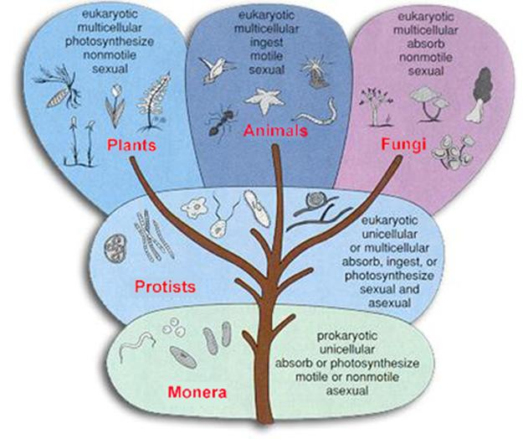

Slide 8
Viruses are not included because they are not living cell. Comparison of human and bacterial classification :
Medically important bacteria
Human being
Kingdom : procaryotae
Phylum : proteobacteria
Class : gamma proteobacteria
Order : Enterbacteriales
Family : Enterbacteriaceae
Genus : Escherichia
Species : Escherichia coli
Animalia
Chordata
Mammalia
Primates
Hominidae
Homo
Homo sapiens

Slide 9
Nomenclature : name the organisms according the international rules.
The first name is genus and the second name is species.
And it is written either underlined or italic.
Quite often bacteria are named for the disease that they cause example:
Bacillus anthrax-------------anthrax
Streptococcus pneumonia------pneumonia
Haemophilus influenzae-------influenzae disease

Slide 10
MICROORGANISM IS CLASSIFIED INTO :
CELLULAR ACELLULAR
viruses
Procaryotic
Bacteria
Eucaryotic
Protozoa
fungi

Slide 11
Cells in our world come in two basic types, prokaryotic and eukaryotic. "Karyose" comes from a Greek word which means "kernel," as in a kernel of grain. In biology, we use this word root to refer to the nucleus of a cell. "Pro" means "before," and "eu" means "true," or "good." So "Prokaryotic" means "before a nucleus," and "eukaryotic" means "possessing a true nucleus." This is a big hint about one of the differences between these two cell types. Prokaryotic cells have no nuclei, while eukaryotic cells do have true nuclei. This is far from the only difference between these two cell types

Slide 12
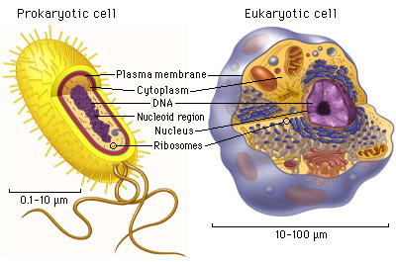

Slide 13
prokaryptic | euokaryotic
All bacteria | All animals and protozoa | Biological distribution
Absent | Presents | Nuclear membrane
Generally absents | presents | Membranous structures other than cell membrane
70s | 80s | Cytoplasmic ribosome's (density)
present of complex chemical , containing peptidoglycan | absent | Cell wall
present | absent | Photosynthesis

Slide 14
BACTERIA
It is prokaryotic organisms that has been divided into two major groups:
The eubacteria : that include all bacteria of medical importance .
And the archae bacteria ; collection of the other bacteria

Slide 15
Historical Background

Slide 16
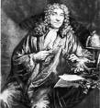
Scientist
Anton van leeuwenhoek(1632-1723)(holland)
Father of microbiology: he is the first one to see the live bacteria and protozoa by single lance microscope.
He called the small living organism “animalcules”

Slide 17
1750-1760 – Carolus Linnaeus classified all known plants and animals and set down rules for classification
1875-1900 – The Golden Age of Microbiology

Slide 18
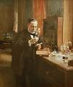
Louis paster:
He is French chemist
He discover forms of life that can exist in the presence of oxygen called “aerobes” and anaerobes can exist with out oxygen.
Develop a process called pasteurization is heat liquid 55⁰c for several minutes pasteurization does not kill all microorganism.
He discover the infectious agent that affect silk industry in France
He made significant contribution to the germ theory of disease -specific microorganism cause specific infectious disease-.
He discover a vaccine for chicken cholera.
Develop vaccine for dog and human rabies.

Slide 19
Robert koch:
Culture bacteria on a solid media.
He invent petridishes
He use the agar as solid media and isolate the organism in a pure culture.
He discover (mycobacterium tuberculosies) that cause tuberculosis and Invent skin test to diagnose the T.B.
He discover vibrio choleae

Slide 20
By the end of this lecture you should know :
Taxonomy of living microorganisms
Difference bet. Eu via pro karyotic cell and the meaning of it.
The achievements of the three scientist.

